Slide 1
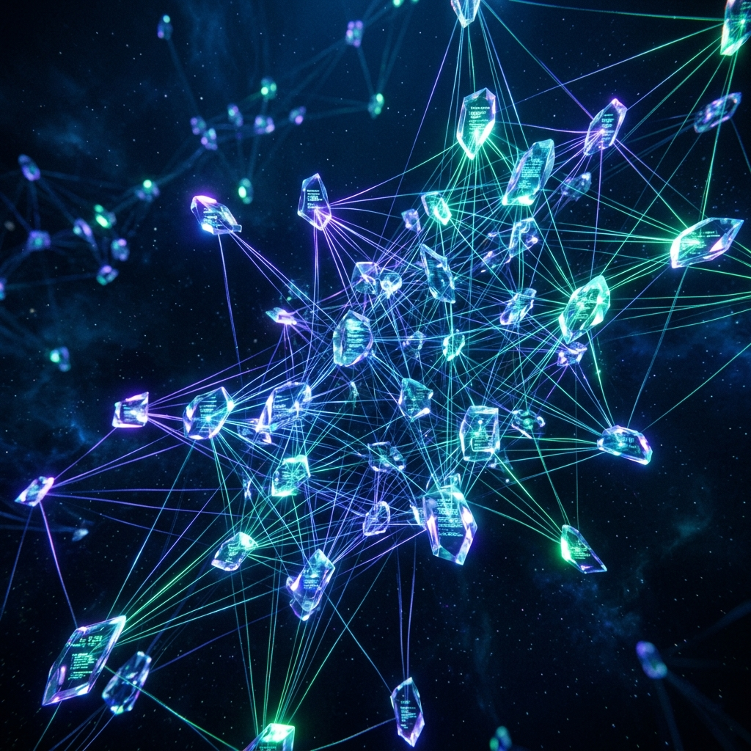
NEURAL MESH
Cognitive Vault & Sharding Infrastructure

Slide 2
The Vulnerability Crisis
Why Traditional Backups Fail
• Centralized Vulnerability (Single Point of Failure)
• Passive Storage (No Intelligence)
• Latency & Bottlenecks in Large Recovery

Slide 3
Neural Mesh Architecture
A Paradigm Shift in Data Integrity
• P2P Sharding: Distributed Intelligence
• Cognitive Parity: AI-Driven Checks
• Mesh Guard: Real-time Protection Core

Slide 4
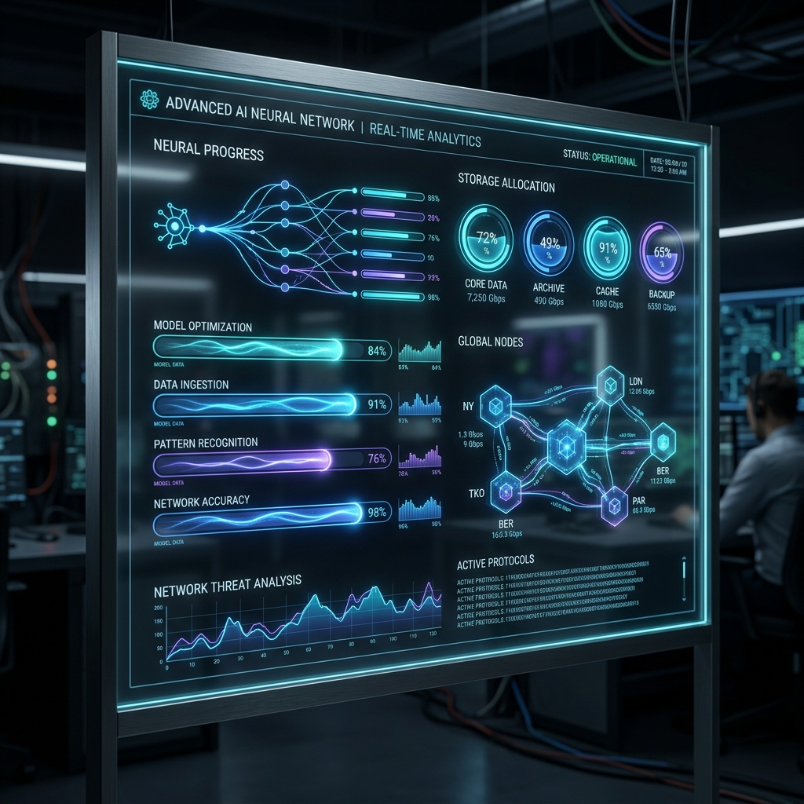
Neural Monitor
• Active Asset Cycle Analysis
• Predictive Storage Insights
• Neural Compression Gauges

Slide 5

Vault Recovery
• Temporal Shard Access
• Cognitive Parity Checksum
• Point-in-Time Recovery

Slide 6
Technological Foundation
• React & Vite: Performance Core
• Firebase: Real-time Mesh Layer
• Capacitor: Mobile Node Integration
• Tailwind CSS: Modern Aesthetic

Slide 7
THE NEW STANDARD IN DATA INTEGRITY

