Slide 1
Akshaya Nanthini V S
TEXT BASED STEGANOGRAPHY
3/21/2024 Annual Review

Slide 2
PROJECT TITLE
TEXT BASED STEGANOGRAPHY
3/21/2024 Annual Review

Slide 3


AGENDA
Introduction
Problem Statement
Project Overview
End Users
Solution and Proposition
The Warp in Our Solution
Modeling
Results
3/21/2024 Annual Review

Slide 4

PROBLEM STATEMENT
In today's digital world, ensuring secure communication is paramount. Traditional encryption methods can be vulnerable to attacks.
Our challenge is to develop a robust text steganography application that can securely encode and decode messages while maintaining a high level of stealth.
3/21/2024 Annual Review

Slide 5

PROJECT OVERVIEW
Our project focuses on implementing text steganography techniques through a user-friendly application.
Users can encode sensitive messages within ordinary text, ensuring that only intended recipients can decipher the hidden information.
3/21/2024 Annual Review

Slide 6

WHO ARE THE END USERS?
Our application targets individuals and organizations that require secure communication channels.
Individuals requiring secure communication channels.
Organizations dealing with sensitive data.
Security-conscious users wanting to learn about steganography.
3/21/2024 Annual Review

Slide 7

YOUR SOLUTION AND ITS VALUE PROPOSITION
Our comprehensive text steganography’s solution and value proposition includes:
Encryption using a user-defined key for secure encoding.
Seamless integration with carrier text to blend encoded messages naturally.
Decryption with the correct key to reveal hidden messages accurately.
3/21/2024 Annual Review

Slide 8

THE WOW IN YOUR SOLUTION
Ease of Use: Our program is user-friendly, making it accessible to both beginners and experienced users.
Customizable Encryption: Users can choose their encryption keys, adding an extra layer of security to their messages.
Cross-platform Compatibility: The program runs on any system supporting Python, ensuring widespread usability.
3/21/2024 Annual Review

Slide 9
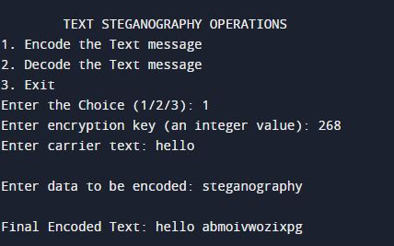
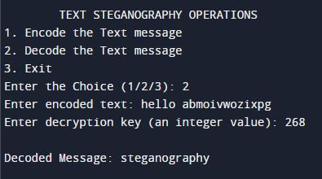
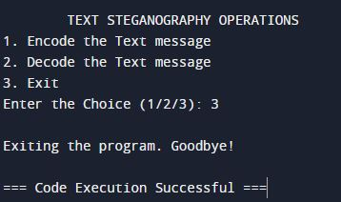
MODELLING
Our application employs a modular design, separating encryption, decryption, and user interface functionalities.
This model ensures scalability and ease of maintenance for future updates and enhancements.
3/21/2024 Annual Review

Slide 10
RESULTS
Through extensive testing and validation, our text steganography application has demonstrated:
Reliable encoding and decoding of messages across different platforms.
Resistance to common attacks such as brute force decryption.
Efficient processing even with large volumes of text data.
Demo Link
3/21/2024 Annual Review

