Slide 1




TRENDING TECHNOLOGIES: STACK OVERFLOW DEVELOPER SURVEY, 2019
Akshith Goud Mothkuri
12 November 2024

Slide 2

OUTLINE
1/19
Executive Summary
Introduction
Methodology
Results
Visualization – Charts
Dashboard
Discussion
Findings & Implications
Conclusion
Appendix

Slide 3

EXECUTIVE SUMMARY
2/19
Top programming languages in demand:
JavaScript, HTML/CSS, SQL, Bash/Shell/PowerShell, Python
Top database skills in demand:
My SQL, Microsoft SQL Server, Postgre SQL, SQLite, MongoDB
Popular platforms:
Windows, Linux, Docker, AWS, Slack
Popular Web Frames:
jQuery, Angular/Angular.js, React.js, ASP.NET, Express
Future Technology Trend:
Python takes the third row, followed by SQL and TypeScript
Redis and Elasticsearch also place in Top 5
Android is in the Top 5 demanded platforms, the rest remains
React.js takes the first row and Vue.js is the latest addition as the last

Slide 4

INTRODUCTION
3/19
In the realm of programming and technology, several key trends have emerged in recent years.
These insights shed light on the evolving landscape of programming languages, web frameworks, and the demographics of professional developers.
Stack Overflow conducts an inclusive survey of individuals engaged in coding globally.
Covering a wide array of topics from preferred technologies to career aspirations, 2019 marks the 9th consecutive year of survey publication.
Nearly 90,000 developers participated in the 20- minute survey in 2019 Survey.
Let's explore some of the notable findings.

Slide 5

METHODOLOGY
4/19
Data is based on the survey conducted by Stack Overflow from January 23 to February 14 and involved 88,883 software developers from 179 countries.
Familiarization with this dataset was achieved through completing IBM labs on Coursera, which encompassed topics such as Web Scraping, Dataset Exploration, Data Wrangling, Exploratory Data Analysis, and Data Visualization.
Data analysis and visualization was conducted via
IBM Cognos Analytics.

Slide 6
RESULTS
5/19
Python overtakes Java, becoming the 5th most preferred language with significant growth. It stands as the fastest- growing major programming language.
JavaScript remains the most used programming language.
jQuery is the most widely used among web frameworks, with React.js surpassing Angular in developer usage this year.
Globally, men represent approximately 90% of respondents, with higher female representation among students than professional developers in regions like the US, India, and the UK.
Around 3/4 of professional developers globally hold at least a bachelor's degree, aligning with past findings.
3/4 of survey respondents in professional developer roles are under 35 years old.

Slide 7
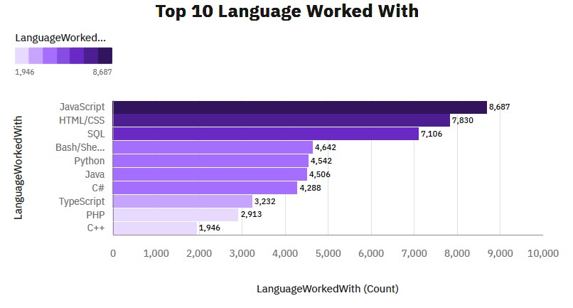
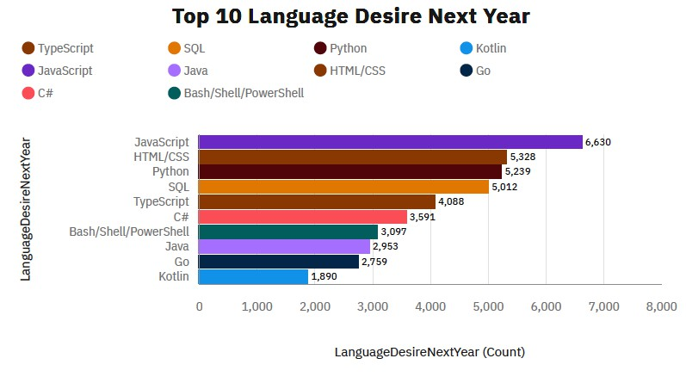
PROGRAMMING LANGUAGE TRENDS
6/19
2019 Following Year

Slide 8
PROGRAMMING LANGUAGE TRENDS
7/19
FINDINGS
JavaScript and HTML/CSS emerge as the most used programming languages among all respondents
SQL also maintains a significant presence.
Python just edged out Java in overall ranking.
IMPLICATIONS
The dominance of JavaScript and HTML/CSS underscores their indispensability in modern web development, highlighting the importance of mastering them for developers.
The high usage of SQL emphasizes the critical role of data management and querying in modern software applications, across both web and non-web environments.
The rise of Python might also reflect its versatility and ease of use, attracting developers across various domains from data science to software development.

Slide 9
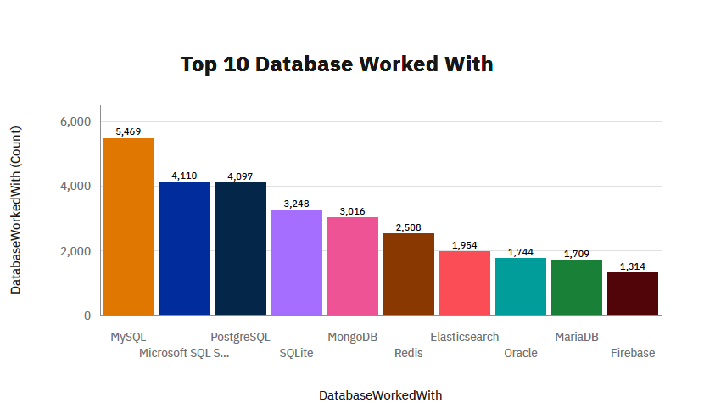
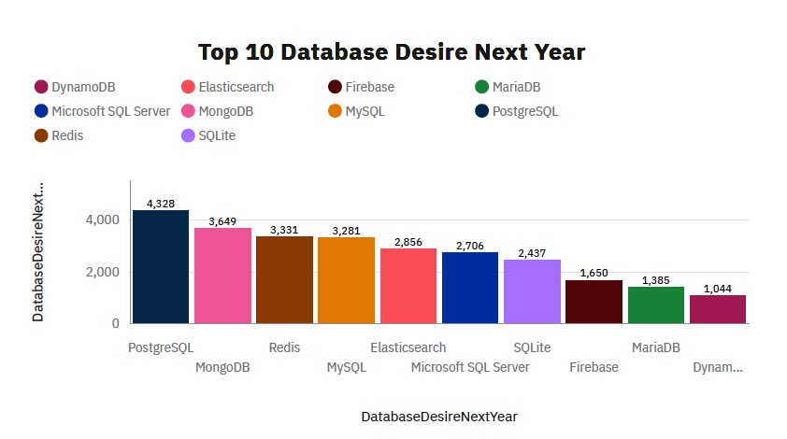
DATABASE TRENDS
8/19
2019
Following Year

Slide 10
DATABASE TRENDS
9/19
FINDINGS
MySQL leads as the most used DBMS among all respondents.
PostgreSQL and Microsoft SQL Server follow closely behind MySQL.
MongoDB ranks as the top NoSQL
database.
IMPLICATIONS
The popularity of MySQL, PostgreSQL, and Microsoft SQL Server underscores the importance of relational databases in various applications.
The high usage of MongoDB reflects the growing trend towards NoSQL databases, driven by the need for flexible data models and scalability, particularly in modern web and mobile applications.
The diverse range of database systems utilized by developers indicates the importance of selecting the right tool for the job, considering factors such as data structure, scalability, and performance requirements.

Slide 11

DASHBOARD
10/19
You can find the dashboard link below:
https://github.com/AKSHITHGOUD9/IBM-Project/tree/b1d21a16aa5ba995537ebfcca7d698fc8f6cd1f6/dashboard

Slide 12
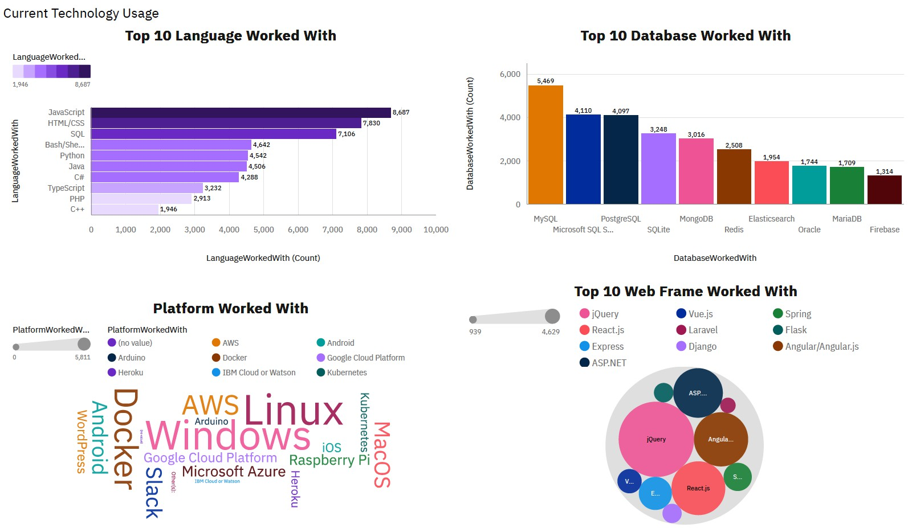
CURRENT TECHNOLOGY USAGE
11/19

Slide 13
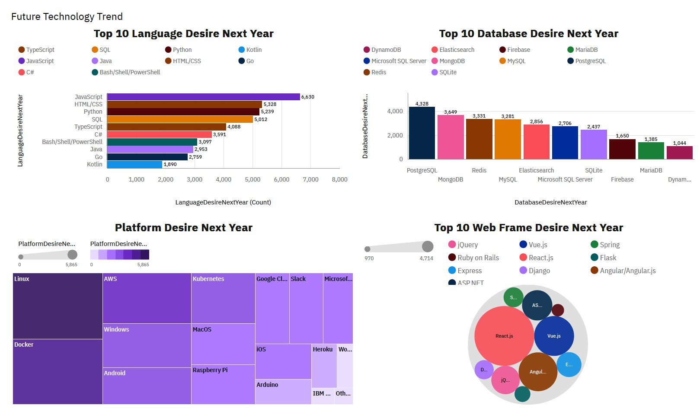
FUTURE TECHNOLOGY TREND
12/19

Slide 14
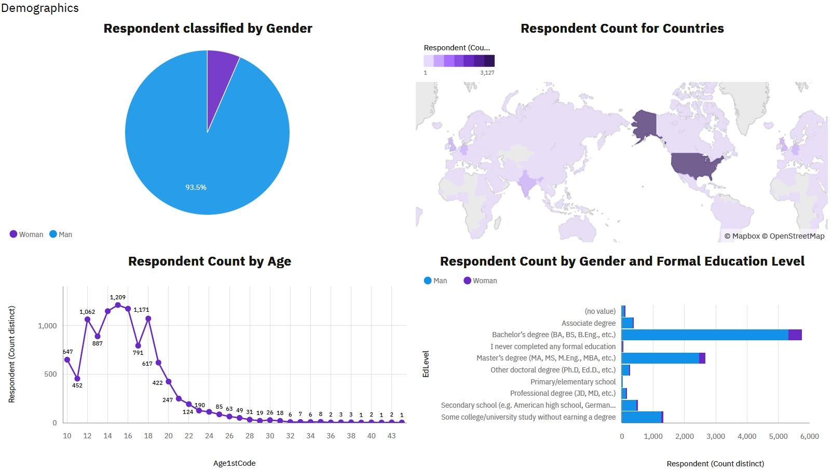
DEMOGRAPHICS
13/19

Slide 15
DISCUSSION
14/19
The dominance of JavaScript and HTML/CSS and the adoption of MySQL as the leading database management system
Highlights the central role of web development in the programming landscape
Opens up discussions on the significance of client-side scripting and styling, trends in web development frameworks, and the evolving nature of web technologies

Slide 16
CONCLUDING REMARKS
15/19
FINDINGS
Technology Trends: The dominance of JavaScript and HTML/CSS underscores the importance of staying updated with technology trends in web development.
Data Management: The prevalence of MySQL, PostgreSQL, and Microsoft SQL Server highlights the critical role of effective data management in software development.
Diversity of Tools: The diverse range of programming languages and database systems utilized by developers underscores the importance of understanding the strengths and weaknesses of different tools.
IMPLICATIONS
Web Dominance: The widespread usage of JavaScript and HTML/CSS indicates the dominance of web development in the programming ecosystem, reflecting the growing importance of online platforms and digital experiences.
Database Diversity: The variety of database management systems used highlights the importance of flexibility and adaptability in data storage solutions. Organizations must consider factors such as data structure, scalability, and performance when selecting a database system.
Industry Standardization: The popularity of certain technologies like JavaScript and MySQL suggests a degree of industry standardization, where certain tools become widely adopted due to their proven reliability and effectiveness. This can simplify collaboration and interoperability within the developer community.

Slide 17

CONCLUSION
16/19
The findings underscore the dynamic
nature of the programming landscape and
the critical role of technology in driving innovation across industries.
As developers navigate this ever-changing terrain,
o a keen understanding of diverse programming languages
o database systems becomes essential to meet the demands of modern applications
o ensure optimal outcomes in software development projects.

Slide 18

APPENDIX
17/19
A- Job Postings Chart
B- Popular Languages Chart

Slide 19
A- JOB POSTINGS CHART
18/19
0
1000
2000
3000
4000
5000
6000
Washington DC
5316
Detroit
3945
Seattle
3375
New York
3226
Los Angeles
640
San Francisco
435
Austin
434

Slide 20
B- POPULAR LANGUAGES CHART
19/19
0 2000 4000 6000 8000 10000 12000
14000
16000
C
Java Python Oracle JavaScript
C# C++
SQL Server MongoDB
Scala PostgreSQL 10
MySQL Server
13498
2609
1173
784
355
333
305
250
174
33
0

