Slide 1

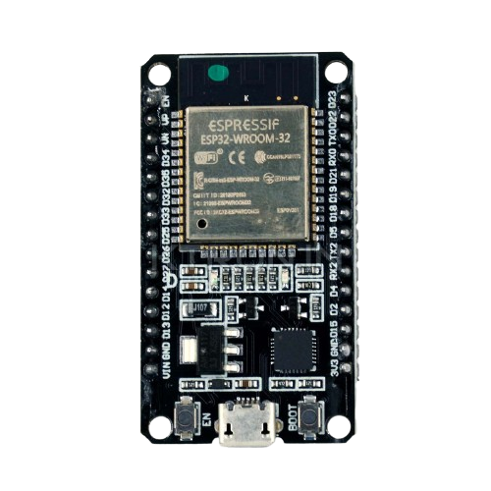
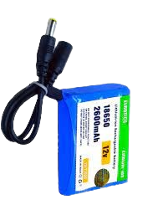
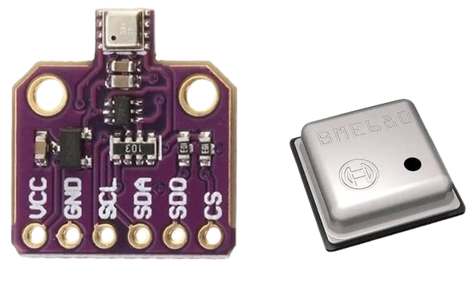
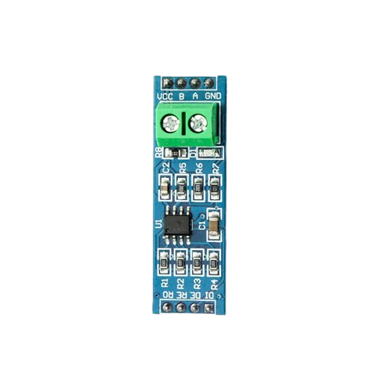


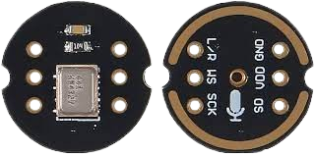
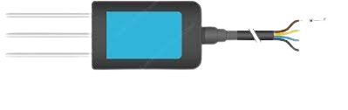
KIBO - (NATURE’S SOUL)
BME680
NPK 7 IN 1(JXCL)
MAX486 TTL TO RS485
RECHARGABLE BATTERY
INMP441 MIC
SPEAKER
CONNECTING WIRE

Slide 2

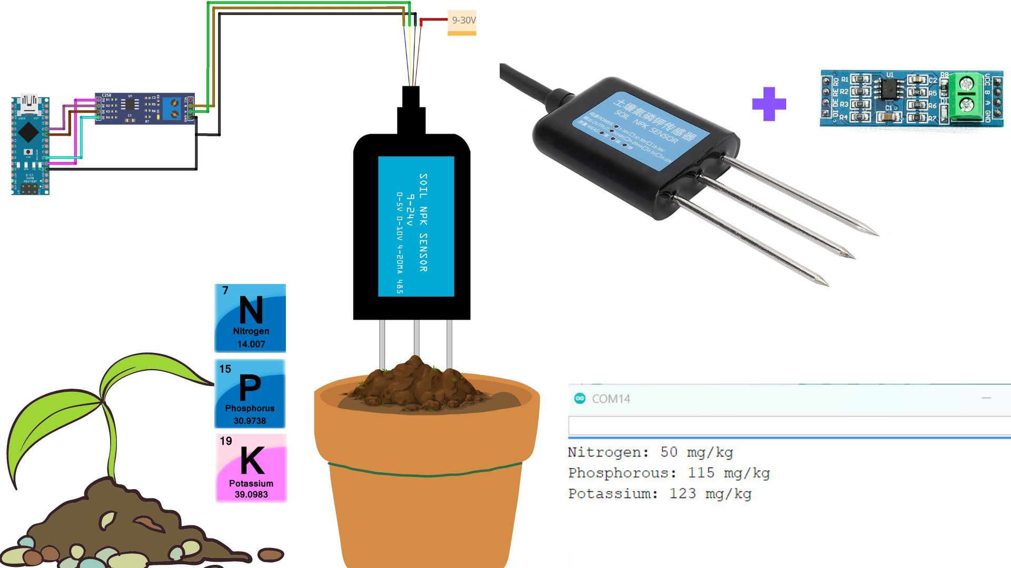

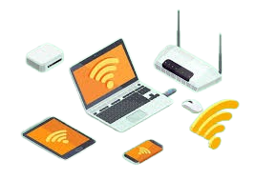
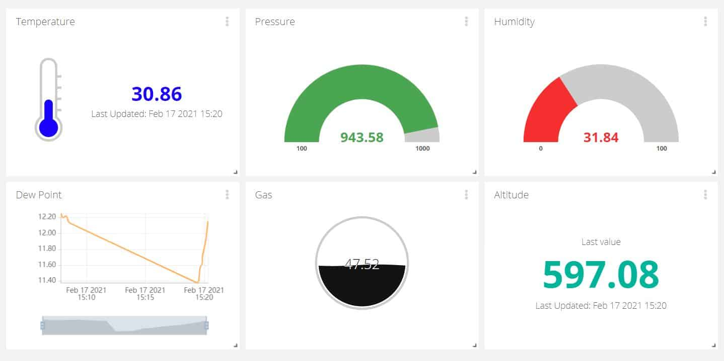


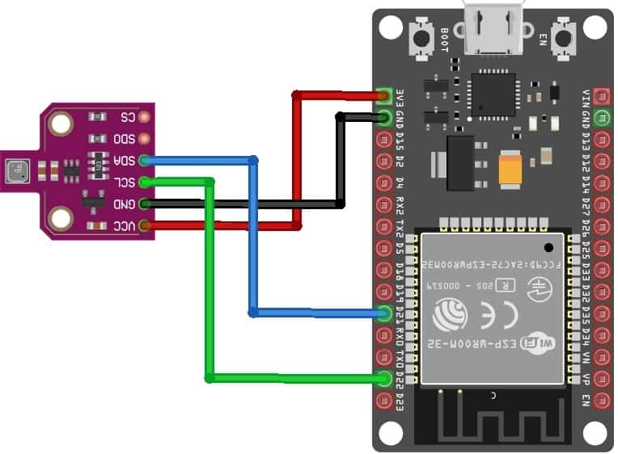
NITROGEN
PHOSPHOROUS
POTTASSIUM
PH
EC
TEMPERATURE
HUMIDITY
PRESSURE
HUMIDITY
TEMPERATURE
GAS

