Slide 1




Welcome to D2R2’24 Third International Workshop on Linked Data-driven Resilience Research 2024
Sebastian Tramp – CTO @ eccenca
2024-05-27
Hersonissos, Greece

Slide 2
Thanks to our Program Committee! 👍
Allard Oelen
Angelie Kraft
Edgard Marx
Enrique Iglesias
Felix Engel
Junbo Huang
Longquan Jiang
Magnus Knuth
Milan Dojchinovski
Nenad Krdavac
Patrick Westphal
Paulo Ricardo Viviurka Do Carmo
Sabine Gründer-Fahrer
Simon Bin
Xi Yan

Slide 3
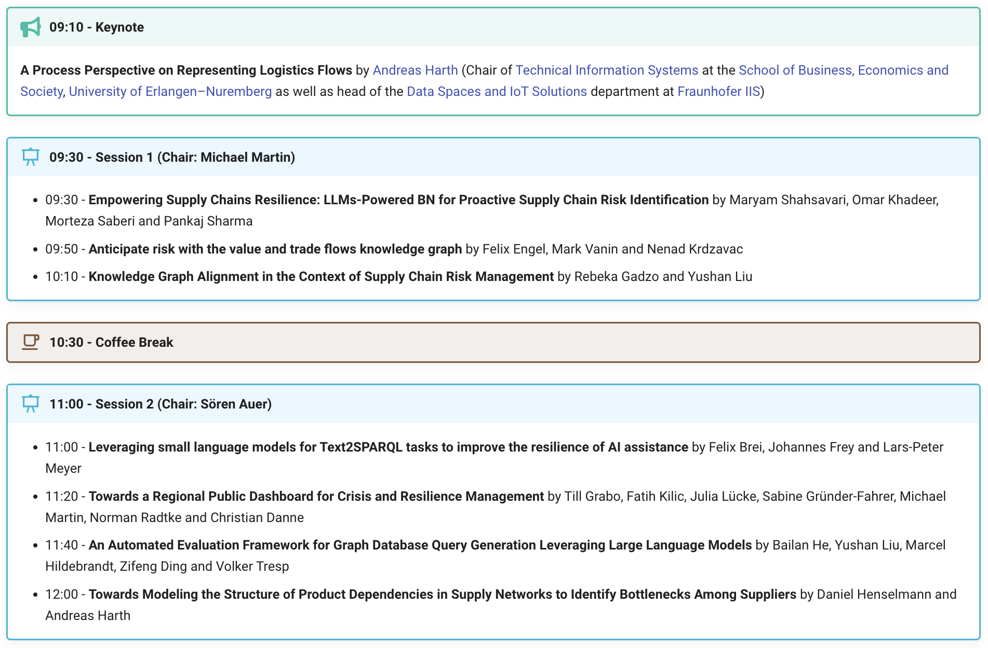

Slide 4
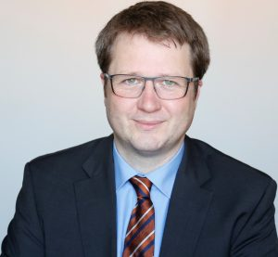
Keynote
A Process Perspective on Representing Logistics Flows
by Andreas Harth
Notes:
Head of the Data Spaces and IoT Solutions department at Fraunhofer IIS
Chair of Technical Information Systems at the School of Business, Economics and Society, University of Erlangen–Nuremberg as well as

