Slide 1


Advanced Developer Conference 2013
Rainer Stropek
software architects gmbh
Web
Mail
Twitter
http://www.timecockpit.com
rainer@timecockpit.com
@rstropek
Silverlight-Style HTML Apps

Slide 2
Read/Download Sourcecode of Samples at http://bit.ly/AngularTypeScript

Slide 3




Agenda
Introduction
What‘s it all about?
Learn
Angular by example
How far?
What didn‘t we cover?
How far can it go?
Stop or go?
Critical evaluation
Image Source: http://flic.kr/p/9bUJEX
Image Source: http://flic.kr/p/3budHy
Image Source: http://flic.kr/p/765iZj
Image Source: http://flic.kr/p/973C1u

Slide 4
TypeScript
This presentation uses AngularJS with TypeScript
JavaScript is generated from TypeScript
However, you still have to understand the concepts of JavaScript
TypeScript advantages
Type-safe AngularJS API (at least most part of it)
Native classes, interfaces, etc. instead of JavaScript patterns and conventions
Possibility to have strongly typed models
Possibility to have strongly typed REST services
TypeScript disadvantages
Only a few AngularJS + TypeScript samples available
Additional compilation step necessary

Slide 5
Introduction
What‘s it all about?
Image Source: http://flic.kr/p/9bUJEX

Slide 6
What‘s AngularJS
Developer‘s Perspective
MVC + data binding framework
Fully based on HTML, JavaScript, and CSS → Plugin-free
Enables automatic unit testing
Dependency injection system
Module concept with dependency management
Handles communication with server
XHR, REST, and JSONP
Promise API for asynchronous programming

Slide 7
What‘s AngularJS
Developer‘s Perspective
Navigation solution for SPAs
Single Page Applications
HTML extensibility mechanism
Custom directives

Slide 8

MVC
View
Model
Architectural Pattern
Layers
View: Visual appearance (declarative languages)
Model: Data model of the app (JavaScript objects)
Controller: Adds behavior (imperative languages)
Workflow
User interacts with the view
Changes the model, calls controller (data binding)
Controller manipulates model, interacts with server
AngularJS detects model changes and updates the view (two-way data binding)
HTML
CSS
Controller
JavaScript
User
Server
API
Data Binding

Slide 9
MVC Notes
MVW = Model View Whatever
MVC is not a precise pattern but an architectural pattern
Clear separation of logic, view, and data model
Data binding connects the layers
Enables automated unit tests
Test business logic and UI behavior (also kind of logic) without automated UI tests

Slide 10
Important Differences
HTML+CSS for view
Plugin-free Extensibility introduced by AngularJS
Data binding introduced by AngularJS
Change detection using model comparison
JavaScript
Many different development environments
Open Source
XAML for view
Silverlight browser plugin
Extensibility built in (e.g. user controls)
Data binding built into XAML and .NET
INotifyPropertyChanged, Dependency Properties
CLR-based languages (e.g. C#)
First-class support in Visual Studio
Provided by Microsoft

Slide 11
Shared Code
JavaScript/TypeScript Everywhere
Client
Server
Shared code between client and server
Server: nodejs
Single source for logic and data model
Mix with other server-side platforms possible
E.g. ASP.NET
Data Model
Data Model
Logic
Logic

Slide 12
SPA
angular.module('helloWorldApp', [])
.config(function ($routeProvider) {
$routeProvider
.when('/', {
templateUrl: 'views/main.html',
controller: 'MainCtrl'
})
.when('/about', {
templateUrl: 'views/about.html',
controller: 'AboutCtrl'
})
.otherwise({
redirectTo: '/'
});
});
Single Page Apps
Define routes with $routeProvider service
Placeholder with „:“ (e.g. /admin/users/:userid)
Access route paramter values with $routeParams service
Define where view should be included in index.html using ng-view
URL Modes
Hashbang and HTML5 mode
See $location service docs for details
angular.module('helloWorldApp')
.controller('MainCtrl', function ($scope) {
…
});
<div class="container"
ng-view="">
</div>
<div class="hero-unit">
<h1>'Allo, 'Allo!</h1>
…
</div>

Slide 13
Tools
Microsoft Visual Studio
Not free
Only Windows
Very good support for TypeScript
Integrated debugging with IE
Build with MSBUILD
Package management with NuGet
JetBrains WebStorm
Not free
Windows, Mac, Linux
Specialized on web apps
Good integration of external tools
Your favorite editor
Some free, some not free
E.g. Sublime, Notepad++, Vim, etc.
Build and test with external tools
Open Source Tools
Project setup
Yoeman
angular-seed
Bower for web package management
Build
Grunt for automated build
Karma test runner
Jasmine for BDD unit tests
JSLint, JSHint for code quality
UI
Bootstrap CSS for prettifying UI
AngularUI for UI utilities and controls
Batarang for analyzing data bindings and scopes
Server-side
nodejs for server-side JavaScript with various npm modules (e.g. express)

Slide 14
Demo
Setup demo project
cd yeoman-demo
yo angular hello-world
Build and test your app (don‘t forget to set CHROME_BIN)
grunt
Add one item to awesomeThings in main.js
Run automated unit tests → will fail
grunt test
Correct unit test to expect 4 instead of 3 items
Run automated unit tests → will work
grunt test
Start development loop
grunt server
Change main.js, save it, and watch the browser refreshing
Add a new view + controller + route, look at changes in app.js
yo angular:route about
Start development loop, launch new route (maybe with Fiddler)
http://localhost:9000/#/about
Yeoman Angular Generator
Setup angular application
Initial setup
Add new artifacts (e.g. route)
Run unit tests
Karma and Jasmine
Code editing with editor
Sublime text

Slide 15
Learn
Angular by example
Image Source: http://flic.kr/p/3budHy

Slide 16
Project Setup
In Visual Studio
Create HTML app with TypeScript
Use NuGet to add angular and bootstrap
Get TypeScript declaration from GitHub
Basic controller with two-way data binding

Slide 17
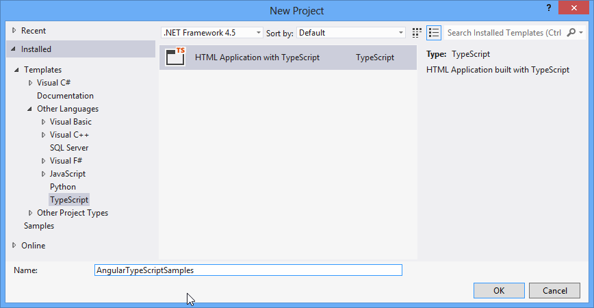
TypeScript
Setup TypeScript Project
Screenshot: Microsoft Visual Studio 2012, Oct. 2013

Slide 18
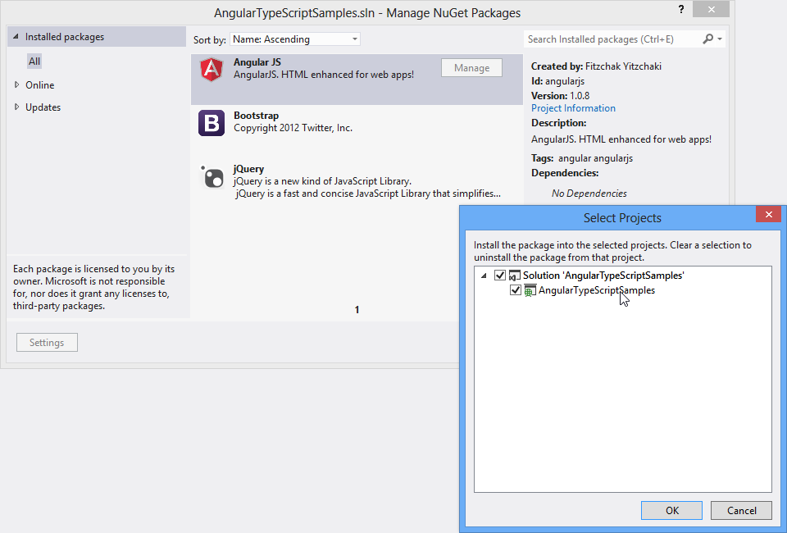
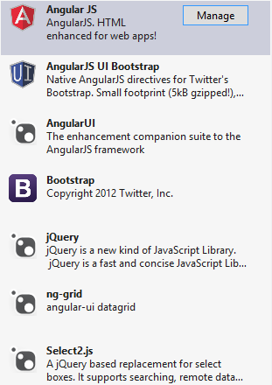
NuGet
Add JavaScript Libraries to VS Projects
Screenshots: Microsoft Visual Studio 2012, Oct. 2013

Slide 19
Controller
<!DOCTYPE html>
<html lang="en">
<head>
<meta charset="utf-8" />
<title>Angular.js Samples Using TypeScript</title>
<link href="../../../Content/bootstrap/bootstrap.css" rel="stylesheet">
<link href="helloWorldWithController.css" rel="stylesheet">
<script src="../../../Scripts/angular.js"></script>
<script src="helloWorldWithController.js"></script>
</head>
<body ng-app>
<div ng-controller="HelloCtrl">
<form>
<h2>Two-Way Binding</h2>
<label for="messageInput">Say 'Hello' to:</label>
<input type="text" id="messageInput" ng-model="name">
<h2>Simple Bindings</h2>
<table class="table table-hover table-condensed">
<tr>
<th>Syntax</th><th>Result</th>
</tr>
<tr>
<td>Interpolation</td><td>Hello, {{name}}!</td>
</tr>
<tr>
<td>ng-bind</td><td>Hello, <span ng-bind="name" />!</td>
</tr>
<tr>
<td>Interpolation with controller function</td>
<td>Hello, {{getName()}}!</td>
</tr>
<tr>
<td>ng-bind with getEnclosedName</td>
<td>Hello, <span ng-bind="getEnclosedName('b')" />!</td>
</tr>
<tr>
<td>ng-bind-html-unsafe with getEnclosedName</td>
<td>Hello, <span ng-bind-html-unsafe="getEnclosedName('b')" />!</td>
</tr>
</table>
</form>
</div>
</body>
</html>
Basic Sample with Controller
See AngularJS docs for ng module

Slide 20
Controller
/// <reference
path="../../../tsDeclarations/angularjs/angular.d.ts"/>
// Create a custom scope based on angular's scope and define
// type-safe members which we will add in the controller function.
interface IHelloWorldScope extends ng.IScope {
name: string;
getName: () => string;
getEnclosedName: (tag: string) => string;
}
var HelloCtrl = function ($scope: IHelloWorldScope) {
$scope.name = "World";
$scope.getName = () => $scope.name;
$scope.getEnclosedName = (tag) => "<" + tag + ">"
+ $scope.name
+ "<" + tag + "/>";
};
Basic Sample with Controller
Get TypeScript definitions for AngularJS, Jasmine, etc. from Definitely Typed project
Referred to from ng-controller

Slide 21
Collections
Binding to Collections
Create collection in controller
Binding the view to collections

Slide 22
Controller
<!DOCTYPE html>
<html lang="en">
<head>
…
</head>
<body ng-app>
<div ng-controller="HelloCtrl">
<form>
…
<h2>Collection Binding</h2>
<table class="table table-hover table-condensed">
<tr>
<th>Pos.</th>
<th>ISO Code</th>
<th>Country Name</th>
</tr>
<tr ng-repeat="country in countries">
<td>{{$index}}</td>
<td>{{country.isoCode}}</td>
<td>{{country.name}}</td>
</tr>
</table>
</form>
</div>
</body>
</html>
Basic Sample with Controller
See AngularJS docs for ngRepeat

Slide 23
Controller
/// <reference
path="../../../tsDeclarations/angularjs/angular.d.ts"/>
// Create a custom scope based on angular's scope and define
// type-safe members which we will add in the controller function.
interface IHelloWorldScope extends ng.IScope {
name: string;
countries: ICountryInfo[];
getName: () => string;
getEnclosedName: (tag: string) => string;
}
interface ICountryInfo {
isoCode: string;
name: string;
}
var HelloCtrl = function ($scope: IHelloWorldScope) {
…
$scope.countries = [
{ isoCode: 'AT', name: 'Austria' },
{ isoCode: 'DE', name: 'Germany' },
{ isoCode: 'CH', name: 'Switzerland' }];
};
Basic Sample with Controller

Slide 24
Scopes
Hierarchy of Scopes
Sample with hierarchy of scopes
Analyze scope hierarchy with Batarang
Sample inspired by Kozlowski, Pawel; Darwin, Peter Bacon: Mastering Web Application Development with AngularJS, Chapter Hierarchy of scopes

Slide 25
Controller
<!DOCTYPE html>
<html lang="en">
<head>
<meta charset="utf-8" />
<title>Angular.js Samples Using TypeScript</title>
<link href="../../../Content/bootstrap/bootstrap.css" rel="stylesheet">
<script src="../../../Scripts/angular.js"></script>
<script src="hierarchyOfScopes.js"></script>
</head>
<body ng-app>
<div ng-controller="WorldCtrl" class="container">
<hr>
<ul>
<li ng-repeat="country in countries">
{{country.name}} has population
of {{country.population | number:1}} millions,
{{worldsPercentage(country.population) | number:1}} %
of the World's population
</li>
</ul>
<hr>
World's population: {{population | number:1}} millions
</div>
</body>
</html>
Basic Sample with Controller
See AngularJS docs about scopes
See AngularJS docs about filters

Slide 26
Controller
/// <reference
path="../../../tsDeclarations/angularjs/angular.d.ts"/>
interface ICountry {
name: string;
population: number;
}
interface IHierarchyScope extends ng.IScope {
population: number;
countries: ICountry[];
worldsPercentage: (countryPopulation: number) => number;
}
var WorldCtrl = function ($scope: IHierarchyScope) {
$scope.population = 7000;
$scope.countries = [
{ name: "France", population: 63.1 },
{ name: "United Kingdom", population: 61.8 }
];
$scope.worldsPercentage = function (countryPopulation) {
return (countryPopulation / $scope.population) * 100;
};
};
Basic Sample with Controller

Slide 27
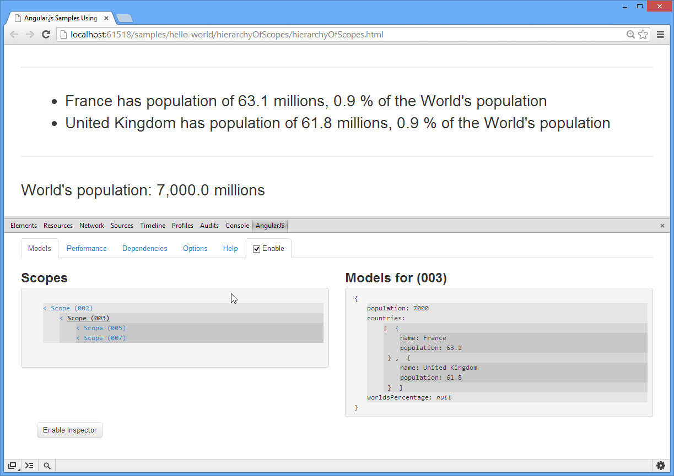
Batarang
Chrome Addin

Slide 28
Modules, Services
…
<body ng-app="notificationsApp" ng-controller="NotificationsCtrl">
…
</body>
module NotificationsModule { …
export class NotificationsCtrl {
constructor(
private $scope: INotificationsCtrlScope, private notificationService: NotificationsService) { … }
…
}
export class NotificationsService {
…
public static Factory(
…,
MAX_LEN: number, greeting: string) { … }
}
}
angular.module("notificationsApp", …)
.constant("MAX_LEN", 10)
.value("greeting", "Hello World!")
.controller("NotificationsCtrl",
NotificationsModule.NotificationsCtrl)
.factory("notificationService",
NotificationsModule.NotificationsService.Factory);
Dependency Injection
AngularJS module system
Typically one module per application or reusable, shared component
Predefined services
E.g. $rootElement, $location, $compile, …
Dependency Injection
Based on parameter names
Tip: Use $inject instead of param names to be minification-safe

Slide 29
Modules, Services
Dependency Injection
TypeScript modules vs. AngularJS modules
AngularJS modules and factories
Sample inspired by Kozlowski, Pawel; Darwin, Peter Bacon: Mastering Web Application Development with AngularJS, Collaborating Objects

Slide 30
Notification Service
module NotificationsModule {
export interface INotificationsArchive {
archive(notification: string);
getArchived(): string[];
}
}
Contract
Contract for notifications archive
Common for all notifications archive implementations

Slide 31
Notification Service
/// <reference path="INotificationsArchive.ts"/>
module NotificationsModule {
export class NotificationsArchive
implements INotificationsArchive {
private archivedNotifications: string[];
constructor() {
this.archivedNotifications = [];
}
archive(notification: string) {
this.archivedNotifications.push(notification);
}
public getArchived(): string[]{
return this.archivedNotifications;
}
}
}
Archive Implementation
Factory function for service creation
Other options
value, service, provider
See Angular docs about angular.Module for details

Slide 32
Notification Service
/// <reference path="INotificationsArchive.ts"/>
module NotificationsModule {
export class NotificationsService {
private notifications: string[];
public maxLen: number = 10;
public static Factory(notificationsArchive: INotificationsArchive,
MAX_LEN: number, greeting: string) {
return new NotificationsService(
notificationsArchive, MAX_LEN, greeting);
}
constructor(private notificationsArchive: INotificationsArchive,
MAX_LEN: number, greeting: string) {
this.notifications = [];
this.maxLen = MAX_LEN;
}
public push(notification: string): void {
var notificationToArchive: string;
var newLen = this.notifications.unshift(notification);
if (newLen > this.maxLen) {
notificationToArchive = this.notifications.pop();
this.notificationsArchive.archive(notificationToArchive);
}
}
public getCurrent(): string[] {
return this.notifications;
}
}
}
Service Implementation

Slide 33
Notification Service
/// <reference path="../../../tsDeclarations/angularjs/angular.d.ts"/>
/// <reference path="NotificationsArchive.ts"/>
module NotificationsModule {
export interface INotificationsCtrlScope extends ng.IScope {
notification: string;
vm: NotificationsCtrl;
}
export class NotificationsCtrl {
constructor(private $scope: INotificationsCtrlScope,
private notificationService: NotificationsService) {
$scope.vm = this;
}
private addNotification(): void {
this.notificationService.push(this.$scope.notification);
this.$scope.notification = "";
}
private getNotifications(): string[] {
return this.notificationService.getCurrent();
}
}
}
Controller

Slide 34
Notification Service
/// <reference
path="../../../tsDeclarations/angularjs/angular.d.ts"/>
/// <reference path="NotificationsArchive.ts"/>
/// <reference path="NotificationsService.ts"/>
/// <reference path="NotificationsCtrl.ts"/>
angular.module("notificationsApp", ["notificationsArchive"])
.value("greeting", "Hello World")
.constant("MAX_LEN", 10)
.controller(
"NotificationsCtrl",
NotificationsModule.NotificationsCtrl)
.factory(
"notificationService",
NotificationsModule.NotificationsService.Factory);
Dependency Injection

Slide 35
Notification Service
<!DOCTYPE html>
<html lang="en">
<head>
<meta charset="utf-8" />
<title>Angular.js Samples Using TypeScript</title>
<link href="../../../Content/bootstrap/bootstrap.css" rel="stylesheet">
<script src="../../../Scripts/angular.js"></script>
<script src="NotificationsArchive.js"></script>
<script src="NotificationsService.js"></script>
<script src="NotificationsCtrl.js"></script>
</head>
<body ng-app="notificationsApp" ng-controller="NotificationsCtrl">
<div style="margin: 10px">
<form role="form">
<textarea ng-model="notification" cols="40"
rows="3" class="span6"></textarea><br>
<button class="btn btn-primary"
ng-click="vm.addNotification()">Add</button>
</form>
</div>
<table class="table table-striped table-bordered">
<tr>
<th>Notifications</th>
</tr>
<tr ng-repeat="notification in vm.getNotifications()">
<td>{{notification}}</td>
</tr>
</table>
</body>
</html>
View

Slide 36
Server Communication
$http service (ng.IHttpService)
Support for XHR and JSONP
$resource service for very simple REST services
Not covered in this talk; see AngularJS docs for details
$q service for lightweight promise API
Note: $http methods return IHttpPromise<T>
$httpBackend service (ng.IHttpBackendService)
Used for unit testing of $http calls

Slide 37
$http
Server Communication
Create Cloud Backend
Azure Mobile Service
Access REST service using $http service
Unit testing with $httpBackend
Build UI with Bootstrap

Slide 38
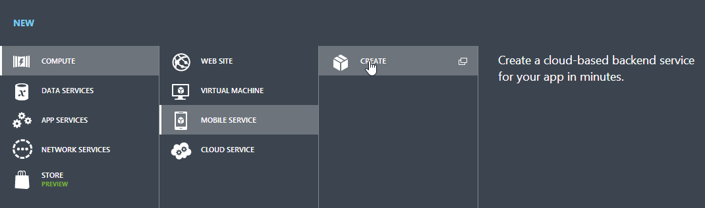
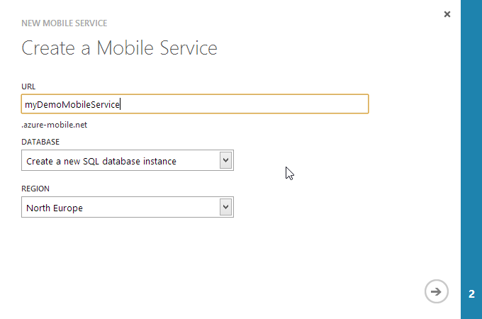
Cloud Backend
Azure Mobile Services
Create a REST services backed by SQL Azure
https://manage.windowsazure.com
Create a table
Step 1: No protection
Step 2: Protection with API key

Slide 39
Access Class
/// <reference
path="../../../tsDeclarations/angularjs/angular.d.ts"/>
module MobileServicesDataAccess {
export interface ITableRow {
id?: number;
}
export interface ITable<T extends ITableRow> {
query: (page?: number) => ng.IHttpPromise<IQueryResult<T>>;
insert: (item: T) => ng.IHttpPromise<any>;
update: (item: T) => ng.IHttpPromise<any>;
deleteItem: (item: T) => ng.IHttpPromise<any>;
deleteItemById: (id: number) => ng.IHttpPromise<any>;
}
export interface IQueryResult<T extends ITableRow> {
results: T[];
count: number;
}
REST Access Layer
Interface representing a single data row
id property needed for Azure Mobile Services
Interface for data access class for Azure Mobile Services
Note usage of TypeScript generics
Note promise API types
Helper interface for query result
Result (eventually filtered) and total server row count

Slide 40
Access Class
export class Table<T extends ITableRow> implements ITable<T> {
constructor(private $http: ng.IHttpService,
private serviceName: string, private tableName: string,
private pageSize: number, private apiKey: string) {
// Set public methods using lambdas for proper "this" handling
this.query = (page?) => this.queryInternal(page);
this.insert = (item) => this.insertInternal(item);
this.update = (item) => this.updateInternal(item);
this.deleteItem = (id) => this.deleteItemInternal(id);
this.deleteItemById = (id) => this.deleteItemByIdInternal(id);
// Build http header with mobile service application key
this.header = {
headers: {
"X-ZUMO-APPLICATION": apiKey
}
};
}
public query: (page?: number) => ng.IHttpPromise<IQueryResult<T>>;
public insert: (item: T) => ng.IHttpPromise<any>;
public update: (item: T) => ng.IHttpPromise<any>;
public deleteItem: (item: T) => ng.IHttpPromise<any>;
public deleteItemById: (id: number) => ng.IHttpPromise<any>;
private header: any;
REST Access Layer
Setting up the access class

Slide 41
Access Class
private queryInternal(page?: number):
ng.IHttpPromise<IQueryResult<T>> {
var uri = this.buildBaseUri()
+ "?$inlinecount=allpages&$orderby=id";
if (page !== undefined) {
// Add "skip" and "top" clause for paging
uri += "&$top=" + this.pageSize.toString();
if (page > 1) {
var skip = (page - 1) * this.pageSize;
uri += "&$skip=" + skip.toString();
}
}
return this.$http.get(uri, this.header);
}
private insertInternal(item: T): ng.IHttpPromise<any> {
return this.$http.post(this.buildBaseUri(), item, this.header);
}
private updateInternal(item: T): ng.IHttpPromise<any> {
var uri = this.buildBaseUri() + "/" + item.id.toString();
return this.$http({ method: "PATCH", url: uri,
headers: this.header, data: item });
}
private deleteItemInternal(item: T): ng.IHttpPromise<any> {
return this.deleteItemByIdInternal(item.id);
}
private deleteItemByIdInternal(id: number): ng.IHttpPromise<any> {
var uri = this.buildBaseUri() + "/" + id.toString();
return this.$http.delete(uri, this.header);
}
private buildBaseUri(): string {
return "https://" + this.serviceName + ".azure-mobile.net/tables/"
+ this.tableName;
}
}
}
REST Access Layer
Accessing Azure Mobile Services

Slide 42
Unit Tests
/// <reference path="../../../tsDeclarations/jasmine/jasmine.d.ts"/>
/// <reference path="../../../tsDeclarations/angularjs/angular.d.ts"/>
/// <reference path="../../../tsDeclarations/angularjs/angular-mocks.d.ts"/>
/// <reference
path="../../../samples/communication/httpService/MobileServicesTable.ts"/>
interface IDummyRow extends MobileServicesDataAccess.ITableRow {
}
describe("Mobile Services Table Test", function () {
var $http: ng.IHttpService;
var $httpBackend: ng.IHttpBackendService;
var table: MobileServicesDataAccess.ITable<IDummyRow>;
beforeEach(inject((_$http_, _$httpBackend_) => {
$http = _$http_;
$httpBackend = _$httpBackend_;
table = new MobileServicesDataAccess.Table<IDummyRow>(
$http, "dummyService", "dummyTable", 10, "dummyKey");
}));
var dummyResult: MobileServicesDataAccess.IQueryResult<IDummyRow> =
{ results: [{ id: 1 }, { id: 2 }], count: 2 };
it(' should query Azure Mobile Service without paging', () => {
$httpBackend.whenGET("https://dummyService.azure-mobile.net
/tables/dummyTable?$inlinecount=allpages&$orderby=id")
.respond(dummyResult);
var result: IDummyRow[];
table.query().success(r => {
result = r.results;
});
$httpBackend.flush();
expect(result.length).toEqual(2);
});
REST Access Layer

Slide 43
Unit Tests
...
it(' should issue a POST to Azure Mobile Service for insert', () => {
$httpBackend.expectPOST("https://dummyService.azure-mobile.net
/tables/dummyTable")
.respond(201 /* Created */);
var data: IDummyRow = {};
table.insert(data);
$httpBackend.flush();
});
...
afterEach(() => {
$httpBackend.verifyNoOutstandingExpectation();
$httpBackend.verifyNoOutstandingRequest();
});
});
REST Access Layer

Slide 44
How Far?
What didn‘t we cover?
How far can it go?
Image Source: http://flic.kr/p/765iZj

Slide 45
Filters
angular.module('MyReverseModule', [])
.filter('reverse', function() {
return function(input, uppercase) {
var out = "";
for (var i = 0; i < input.length; i++) {
out = input.charAt(i) + out;
}
// conditional based on optional argument
if (uppercase) {
out = out.toUpperCase();
}
return out;
}
});
function Ctrl($scope) {
$scope.greeting = 'hello';
}
<body>
<div ng-controller="Ctrl">
<input ng-model="greeting" type="greeting"><br>
No filter: {{greeting}}<br>
Reverse: {{greeting|reverse}}<br>
Reverse + uppercase: {{greeting|reverse:true}}<br>
</div>
</body>
Standard and Custom Filters
Formatting filters
currency
date
json
lowercase
number
uppercase
Array-transforming filters
filter
limitTo
orderBy
Custom filters (see left)
Source of custom filter sample: AngularJS docs

Slide 46
Advanced $http
Interceptors
Used e.g. for retry logic, authentication, etc.
Support for JSONP
For details see AngularJS docs

Slide 47
Directives
myModule.directive('button', function() {
return {
restrict: 'E',
compile: function(element, attributes) {
element.addClass('btn');
if (attributes.type === 'submit') {
element.addClass('btn-primary');
}
if (attributes.size) {
element.addClass('btn-' + attributes.size);
}
}
}
}
Custom Directives and Widgets
Not covered in details here
For details see AngularJS docs

Slide 48
Localization
Internationalization (i18n)
Abstracting strings and other locale-specific bits (such as date or currency formats) out of the application
Localization (L10n)
Providing translations and localized formats
For details see AngularJS docs

Slide 49
Further Readings, Resources
AngularJS Intellisense in Visual Studio 2012
See Mads Kristensen‘s blog
Recommended Book
Kozlowski, Pawel; Darwin, Peter Bacon: Mastering Web Application Development with AngularJS
Sample code from this presentation
http://bit.ly/AngularTypeScript

Slide 50
Stop or Go?
Critical Evaluation
Image Source: http://flic.kr/p/973C1u

Slide 51
Stop or Go?
Many moving parts sometimes lead to problems
You have to combine many projects
Development tools
Services, UI components (directives, widgets), IDE/build components
You still have to test on all target platforms
Operating systems
Browsers
Learning curve for C#/.NET developers
Programming language, framework, runtime, IDE

Slide 52
Stop or Go?
TypeScript for productivity
Type information helps detecting error at development time
Clear separation between view and logic
Testability
Possible code reuse between server and client
One framework covering many aspects
Less puzzle pieces
Relatively large developer team
AngularJS by Google

Slide 53
Q&A
Advanced Developer Conference 2013
Rainer Stropek
software architects gmbh
Mail Web Twitter
rainer@timecockpit.com http://www.timecockpit.com @rstropek
Thank your for coming!

