Slide 1

Azure Functions
Workshop
Rainer Stropek
software architects gmbh
Web
Mail
Twitter
http://www.timecockpit.com
rainer@timecockpit.com
@rstropek
Running small functions in the cloud

Slide 2
Agenda (German)
Microservices schön und gut, aber Kunden wollen funktionierende Gesamtsysteme. Wenn ein Bug in VSTS angelegt wird, muss eine Message in Slack erscheinen und ein Task in der Zeiterfassung eingetragen werden. Wenn das Web-UI eine neue Bestellung meldet, muss jemand im SaaS-ERP den Produktionsauftrag generieren. Bis vor kurzem übernahmen Worker-Prozesse/Container/Jobs diese Aufgabe. Jetzt lernt Azure neue Tricks: Azure Functions erlauben es, kleine Code-Stücke in der Cloud zu hosten, die durch Events wie HTTP-Requests, Queue-Einträge etc. gestartet werden. In Verbindung mit Webhooks und RESTful Web APIs wird die Integration verschiedener SaaS-Lösungen zu einem Gesamtsystem wesentlich erleichtert. In der Session stellt Rainer Stropek, langjähriger Azure MVP und MS Regional Director, Azure Functions vor, zeigt sie anhand einiger Demos und erklärt das Betriebs- und Preismodell

Slide 3

Your Host
Rainer Stropek
Developer, Entrepreneur
Azure MVP, MS Regional Director
IT-Visions
Contact
software architects gmbh rainer@timecockpit.com Twitter: @rstropek

Slide 4
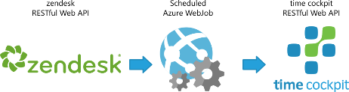
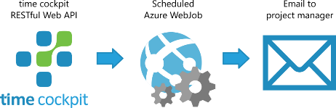
Why?
Use Cases
Background jobs
Integrate SaaS Microservices
Previously: Azure WebJobs
Scripts, command-line programs
Polling (continuously, scheduled) or triggered
WebJobs SDK (important for Functions, too)
Problems
Scaling, pricing
Now: Azure Functions

Slide 5
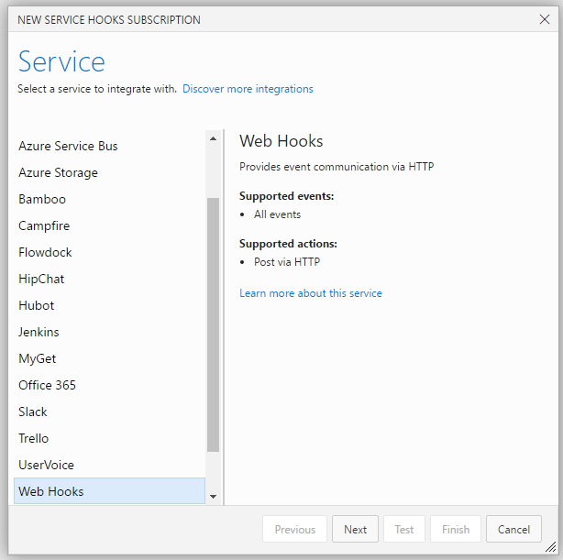
WebHooks
Wikipedia
Examples
Visual Studio Team Services
Microsoft Office 365
GitHub
Docker Hub
Jira
Slack
Zendesk
Dropbox

Slide 6
WebHooks
VSTS
Zendesk
Office365 in live demo later

Slide 7
Getting Started
https://functions.azure.com/signin
SDK on GitHub: https://github.com/azure/azure-webjobs-sdk-script
Functions ≈ WebJobs on steroids
Scripting, Web UI
Functions are implemented using Azure App Services
Good to be familiar with App Services when working with Functions
See also https://rstropek.github.io/DotNetSummitAzureAppServices/

Slide 8
Azure Functions Characteristics
Choice of language
C#, Node.js, Python, F#, PHP, batch, bash, Java, or any executable
Pay-per-use pricing model
Dynamic App Service Plan
Support for NuGet and NPM
Integrated security
Support for OAuth providers like AAD, Facebook, Google, Twitter, and Microsoft Account
Code-less integration
Flexible development
In-portal editor or set up continuous integration (e.g. GitHub, VSTS, local Git repository)

Slide 9
Triggers
Timer
HTTP (Web Host)
REST, Webhook
Azure Storage
Blobs, Queues, Tables
Service Bus
Queues, Topics
DocumentDB
Details

Slide 10
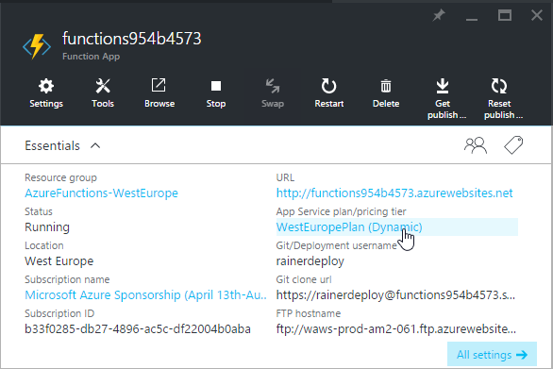
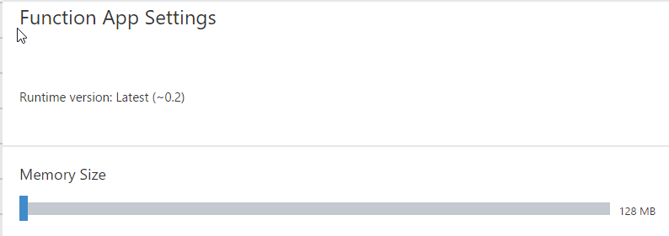
Dynamic App Service Plan
Only pay for the time that your code spends running
Functions pricing (based on “GB-s”, “Gigabyte Seconds”)
„nearest 100ms at Per/GB price based on the time your function runs and the memory size of the function space you choose”

Slide 11
Demo
C# Function with Outlook Notification API

Slide 12
Functions & O365
Create Azure Function (C#) handling Outlook Notifications
Create change subscription for new calendar entries

Slide 13
Sample Function
#r "Newtonsoft.Json"
using System.Net;
using System.Net.Http.Headers;
using Newtonsoft.Json;
public static async Task<HttpResponseMessage> Run(HttpRequestMessage req, TraceWriter log)
{
log.Info($"Received new request at {req.RequestUri}");
// Check if validation token is present
var validationToken = req.GetQueryNameValuePairs()
.FirstOrDefault(q => q.Key == "validationtoken").Value;
if (!string.IsNullOrEmpty(validationToken))
{
log.Info("Received validation request from O365, responsing...");
var res = req.CreateResponse(HttpStatusCode.OK);
res.Content = new StringContent(validationToken);
return res;
}
// Log request details (for demo/debug purposes only)
var data = await req.Content.ReadAsStringAsync();
//log.Info($"body: {data}");
//foreach(var h in req.Headers){ log.Info($"header: {h.Key} {h.Value.FirstOrDefault()}"); }
dynamic body = JsonConvert.DeserializeObject(data);
log.Info($"{body?.value?[0]?.ChangeType} {body?.value?[0]?.Resource}");
return req.CreateResponse(HttpStatusCode.OK);
}
Test data: {"value":[{"@odata.type":"#Microsoft.OutlookServices.Notification","Id":null,"SubscriptionId":"MDU3R...Ng==","SubscriptionExpirationDateTime":"2016-05-14T07:43:26.3413226Z","SequenceNumber":5,"ChangeType":"Created","Resource":"https://outlook.office.com/api/v2.0/Users('01cf6055-43dd-45a9-ad30-a7f2e93ea542@bc8bb254-0741-4e4e-b34f-347f83a7cd93')/Events('AAMkAG...XAAA=')","ResourceData":{}}]}
Reference assembly
Import namespace
Entry point method
C# Script (.csx)
Introduced in VS2015 Update 1
More background…

Slide 14
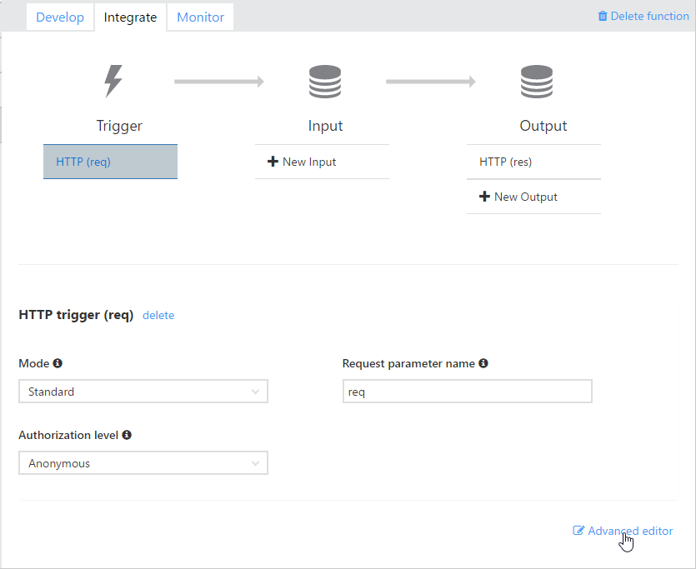
function.json
{
"bindings": [
{
"authLevel": "anonymous",
"name": "req",
"type": "httpTrigger",
"direction": "in"
},
{
"name": "res",
"type": "http",
"direction": "out"
}
],
"disabled": false
}
Demo Visual Studio Online extension
… Run(HttpRequestMessage req, TraceWriter log)
{
…
return req.CreateResponse(HttpStatusCode.OK);
}
More about HTTP and WebHook triggers…

Slide 15
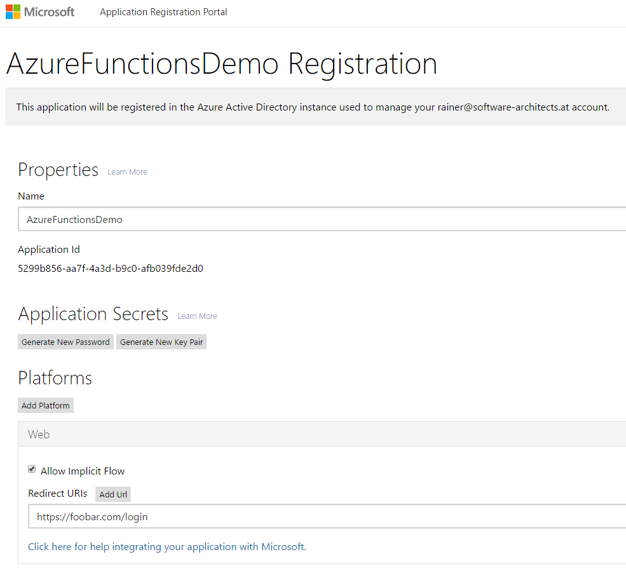
Register Application
Microsoft Application Console
https://apps.dev.microsoft.com/
Use new unified sign-in system
Microsoft Accounts and Azure Active Directory
Alternative for testing: OAuth Sandbox
https://oauthplay.azurewebsites.net/

Slide 16
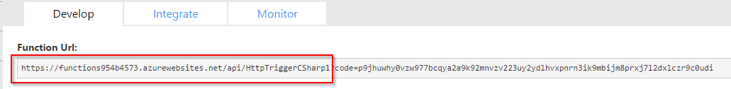
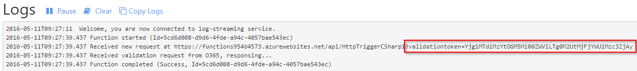
Create Subscription
# Get Token endpoint
GET https://login.microsoftonline.com/common/v2.0/.well-known/openid-configuration
# Get Access Token:
GET https://login.microsoftonline.com/common/oauth2/v2.0/authorize? response_type=id_token%20token& client_id=5299b856-aa7f-4a3d-b9c0-afb039fde2d0& redirect_uri=https:%2f%2ffoobar.com%2flogin& scope=openid+profile+https:%2f%2foutlook.office.com%2fcalendars.read& state=somestatevalue&nonce=somerandomvalue
POST https://outlook.office.com/api/v2.0/me/subscriptions
Content-Type: application/json
Authorization: Bearer <access token retrieved with GET request above>
{
"@odata.type":"#Microsoft.OutlookServices.PushSubscription",
"Resource": "https://outlook.office.com/api/v2.0/me/events",
"NotificationURL": "https://functions954b4573.azurewebsites.net/api/HttpTriggerCSharp1",
"ChangeType": "Created",
"ClientState": "ThisIsSomeState"
}
From app registration
Details about subscribing to changes…

Slide 17
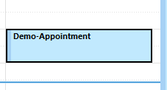
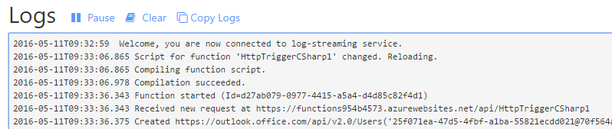
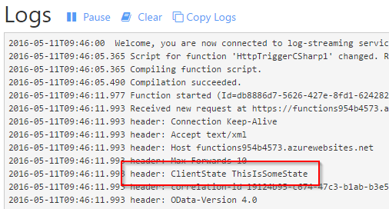
Test HTTP Trigger
# Retrieve event data from O365
GET https://outlook.office.com/api/v2.0/Users('...')/Events('...')
Authorization: Bearer <access token>

Slide 18
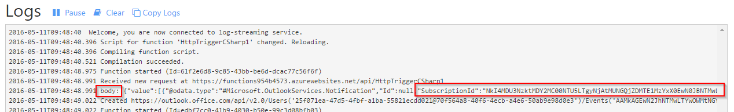
Remove Subscription
# Remove event data from O365
DELETE https://outlook.office.com/api/v2.0/me/subscriptions('...')
Authorization: Bearer <access token>

Slide 19
Demo
Node.js Function with Azure Service Bus

Slide 20
Functions & Queues
Setup Azure ServiceBus
Queues
Create Azure Function (Node.js)
SB Trigger and Output
Deploy using Git

Slide 21
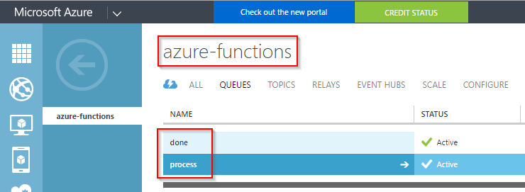
Setup Queues
Two queues
process triggers processing
done receives message when processing has been done

Slide 22
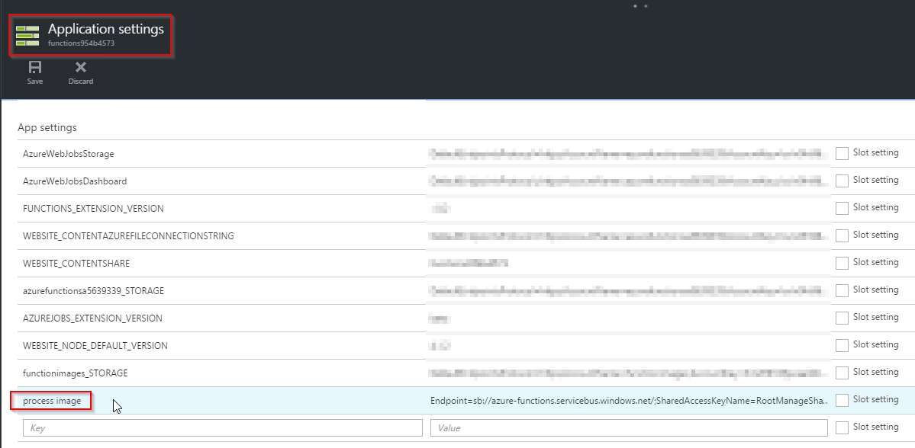
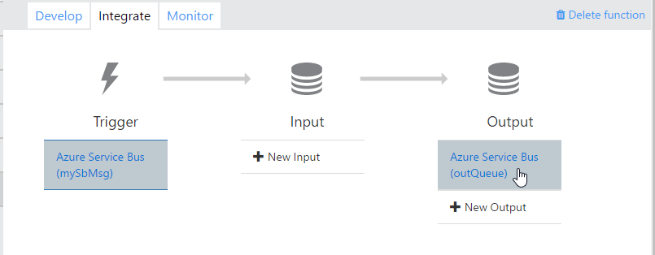
Connect Functions
{
"bindings": [
{
"name": "mySbMsg",
"type": "serviceBusTrigger",
"direction": "in",
"queueName": "process",
"connection": "process image",
"accessRights": "Manage"
},
{
"type": "serviceBus",
"name": "outQueue",
"queueName": "done",
"connection": "process image",
"accessRights": "Manage",
"direction": "out"
}
],
"disabled": false
}

Slide 23
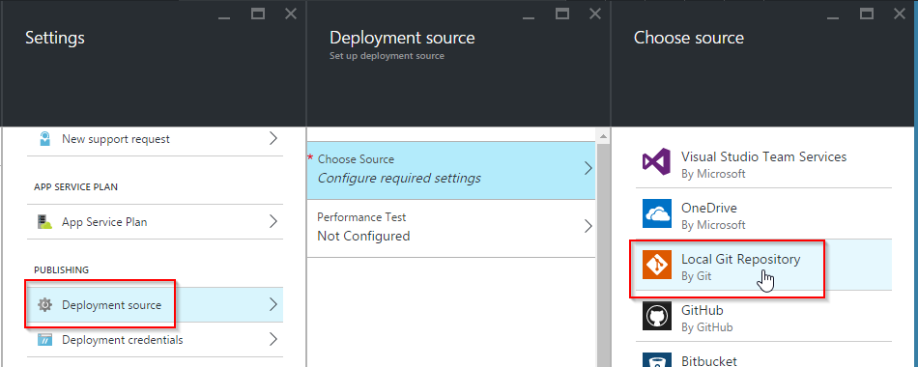
Deploy using Git
git clone https://
rainerdeploy@ <your-app>.scm.azurewebsites.net:443/ <your-app>.git
module.exports = function(context, mySbMsg) {
context.log('Got processing request: ', mySbMsg);
// Do some processing
context.bindings.outQueue = "Hello World, I am done!";
context.done();
};
git add . & git commit –m "." & git push origin master
Trigger name
Output name

Slide 24
Summary
It‘s all about Microservices
Specialized services working together to form a customer solution
Resources on demand
How much does your software cost if it is in standby?
Idempotency
There are no transactions → when in doubt, send again
Prepare for failures
Out-of-sync issues, unreliable networks, servers constantly change, etc.
Importance of logging and telemetry
Learn and implement OpenID Connect
AAD is an easy-to-use option

Slide 25
Q&A
Workshop
Rainer Stropek
software architects gmbh
Web
Mail
Twitter
http://www.timecockpit.com
rainer@timecockpit.com
@rstropek
Thank you for attending!

