Slide 1

DocumentDB
Azure Training Slides
Rainer Stropek
software architects gmbh
Web
Mail
Twitter
http://www.timecockpit.com
rainer@timecockpit.com
@rstropek
NoSQL on Microsoft Azure

Slide 2





Storage in Azure
Azure SQL Database
Different Options for Different Tasks
Relational Databases
Azure SQL Database
Other RDBMS by 3rd parties (e.g. Oracle)
Azure Storage
Table storage = NoSQL Key/Value store
New: DocumentDB
NoSQL document-oriented database
Currently in preview
Blob Storage
Table Storage
Azure Storage
Queues
DocumentDB

Slide 3
What’s a “Document Database”?
Designed to store documents
Designed around documents instead of tuples
Semi-structured data
Schema-free
No need to define and maintain a schema (like table structure in SQL or XSD for XML)
Advantage for further development and complex, heterogeneous data structures
Makes heavy use of denormalization
Optimized for read performance

Slide 4

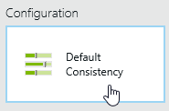
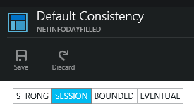
Azure DocumentDB
Built and designed around JSON
Fits very good to JavaScript (server and client SDKs available)
.NET and Python client SDKs provided by Microsoft
Supports transactions
Four consistency levels
Tradeoff between performance and consistency
Fully indexed by default
Optional index configuration (e.g. ExcludePaths, indexType, precisions; see also MSDN)
Fully managed and extremely scalable
Built on Microsoft Azure base infrastructure
Scales in terms of storage capacity and transaction/sec
JSON Logo source: http://en.wikipedia.org/wiki/JSON#mediaviewer/File:JSON_vector_logo.svg

Slide 5




Basic Structure
Account
Databases
Collections
Documents
Attachments
{ }
101
010
Multiple DBs per Account
DB not bound to single machine
Collections ≠ Tables
Server-side programming with JavaScript
Transaction integration
{ }
Users
Stored Procedures
JS
Triggers
Permissions
JS
User Defined Functions
JS

Slide 6
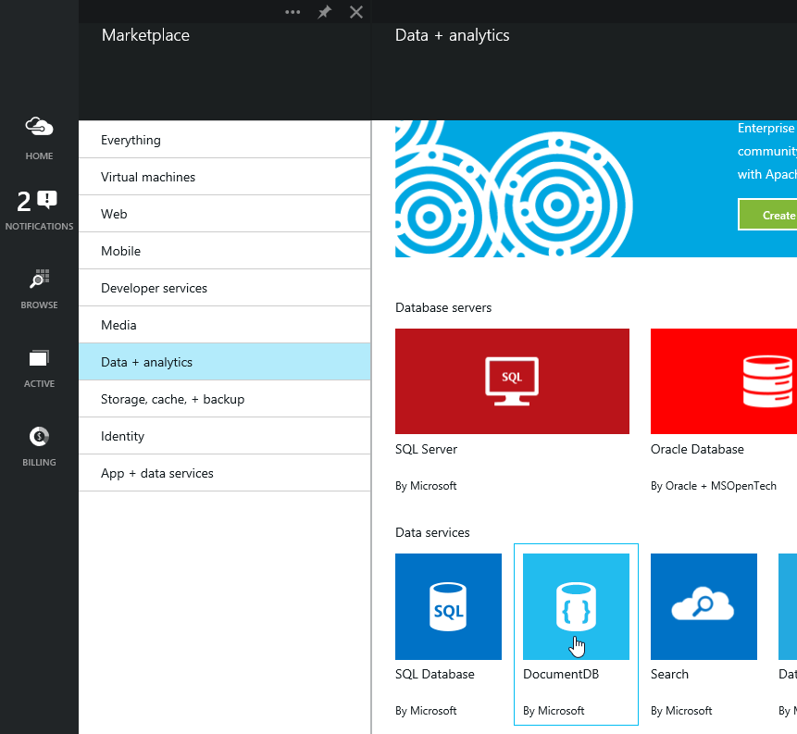
Azure Portal
Managing DocumentDB
Creating accounts, databases, and collections
Scaling
Capacity Units (details see doc)
1 CU = 10GB SSD-backed storage, 2000 request units
Document Explorer

Slide 7
Pricing
1 CU = ~17€/month (preview)
~34€/month later in production
→ 1.7€/month/GB
Alternatives
Table Storage: starts for 1st TB at 0.0522€/month/GB + transaction costs
Blob Storage: start for 1st TB at 0.0179€/month/GB + transaction costs
Managed SQL DB: for Standard between 0.048€ and 0.224€/month/GB

Slide 8
Programming DocumentDB
REST API with HTTP(S)
Option: TCP connectivity for maximum performance (inside Azure DC)
REST API see MSDN
SDKs for .NET, JavaScript, and Python
.NET SDK see MSDN
.NET Code Samples
Stored Procs, UDFs, and Triggers in JavaScript
Introduction and samples

Slide 9
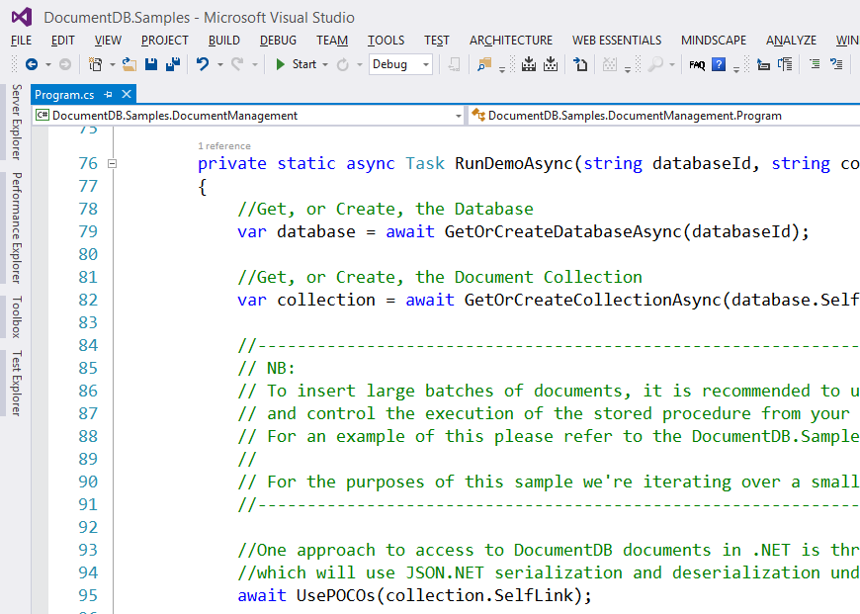
.NET SDK
Programming with DocumentDB
Create Database
Create Collection
Add documents
Query documents

Slide 10
Sample Queries
-- Simple query
SELECT * FROM SampleCollection
-- Simple query with filter
SELECT * FROM SampleCollection s
WHERE s.LastName = 'Andersen‘
-- Filter on property of sub-document
SELECT * FROM SampleCollection s
WHERE s.LastName = 'Andersen' AND s.Address.State = 'WA‘
-- Select sub-document
SELECT s.Children FROM SampleCollection s
-- Joining sub-documents, projection
SELECT s.id, s.LastName, c.FirstName, p.GivenName
FROM SampleCollection s
JOIN c IN s.Children JOIN p IN c.Pets
-- JSON expression in projection
SELECT { "state": f.Address.State, "city": f.Address.City,
"name": f.LastName }
FROM Families f

Slide 11
DocumentDB vs. SQL
When to prefer SQL over DocumentDB
Simple data structures that changes infrequently
Need full power of SQL including grouping, arbitrary joins, aggregations, T-SQL, etc.
Relatively small database (scale-up is sufficient)
You need an option that works on-premise or can be used in production already today
When to consider DocumentDB
Application is document-centric by nature
Potentially huge databases
Complex (semi-structured) data
Note that data modelling is different
Denormalization
Data duplication (e.g. for storing pre-aggregated data)

Slide 12
Q&A
Azure Training Slides
Rainer Stropek
software architects gmbh
Mail Web Twitter
rainer@timecockpit.com http://www.timecockpit.com @rstropek
Thank your for coming!

