Slide 1

Workshop
OAuth2/OpenID Connect Workshop
Rainer Stropek
software architects gmbh
Web
Mail
Twitter
http://www.timecockpit.com
rainer@timecockpit.com
@rstropek
OpenID Connect

Slide 2
Agenda (German)
OpenID Connect ist heute der wichtigste Industriestandard wenn es um Web API Security geht. In diesem Workshop mit Rainer Stropek, Azure MVP der ersten Stunde und Microsoft Regional Director, erarbeiten Sie das notwendige Wissen, um OpenID Connect in Ihre Web APIs einbauen zu können. Rainer fasst am Beginn Grundbegriffe zusammen, damit auch Personen, für die OpenID Connect neu ist, einen guten Einstieg erhalten. Anschließend geht es ins Detail. Anhand von live gezeigten Beispielen analysieren wir das OpenID Connect Protokoll, sehen uns den Fluss von Web Requests beim Authentifizieren an, debuggen die erstellten Token und vieles mehr. Codebeispiele in .NET und Node.js werden im Workshop gezeigt, stehen jedoch nicht im Vordergrund. Bei diesem Workshop konzentrieren wir uns auf OpenID Connect als plattform- und technologieunabhängiges Protokoll.

Slide 3
What You Need to Follow Along
Web Browser
Chrome recommended
Azure Subscription
For Azure Active Directory Sample
Free version is ok
Auth0 Subscription
Free version is ok
Visual Studio and .NET Core
For .NET samples
Node.js
For Angular and Node.js samples
REST Client
E.g. REST Client in VSCode, Postman

Slide 4
Why Change?
Integrated Windows Authentication is great, isn’t it?

Slide 5




Local Auth
Enterprise
Auth inside of the enterprise
Single, integrated domain
All devices belong to the enterprise
Everything is Windows
Problems
External devices
External services
Non-Windows environments
Workstations
Servers
Domain
Devices

Slide 6
WS-Federation
Federated Identity
No single identity management system
Single-sign-on (SSO) across multiple systems/organizations
Microsoft: AD FS (Active Directory Federation System)
HTTP-based
Designed in the times of WCF and SOAP
Quite old
Outdated
Still supported (and it likely will be supported for a long time)
Not recommendable for new systems

Slide 7
OAuth2, OpenID Connect
Today’s de facto standards for delegation and auth on the web

Slide 8
OAuth2
Successor of OAuth1 and OAuth WRAP
Standard for delegating authorization for accessing resources via HTTP(S)
Not a standard for authentication
Not a standard for authorization
Very common in the internet today
Many different flavors as the standard leaves many decisions up to the developer
Example: https://oauth.io/

Slide 9
Important Terms
OAuth Provider
Aka OAuth Server, Authorization Server (AS)
Examples: AD FS, Google, Twitter, Microsoft AAD
Resource Provider
Aka Resource Server (RS)
In our case: A REST Web API
Resource Owner (RO)
In our case: The end user, the organization
Client
Application accessing a protected resource
In our case: Native app, server-based web app, SPA, mobile app

Slide 10
OAuth Endpoints
Authorization Endpoint (aka OAuth-A)
Authenticates the resource owner (e.g. user/password)
Asks for consent
Sends confirmation (access code) to redirect endpoint
Redirect Endpoint
Offered by the client
Called via redirecting the user-agent (HTTP redirect 302)
Receives code (there are other options, too) and fetches token from token endpoint
Token Endpoint (aka OAuth-T)
Creates tokens for access codes, refresh tokens, etc.
Can validate the client using a client secret

Slide 11
OAuth Flows
Authorization Code Flow
Aka 3-legged OAuth
Client must be capable of storing secrets
Implicit Flow
Less secure
No refresh tokens
For clients that cannot store secrets (e.g. SPA written in JavaScript)
Resource Owner Password Flow
For trusted clients
Client Credential Flow
Aka 2-legged OAuth
Client is also the resource owner

Slide 12
Problems with OAuth2
Many different implementations
Not compatible
Limited scope
No specified token formats, crypto algorithms, etc.
No standard for authN, session management, etc.
No specification for token validation
Open ID Connect fills many of the gaps
Standardized way to get the resource owner’s profile data
Introduces an ID-Token
Standardized token format and crypto: JWT (JSON Web Token)

Slide 13
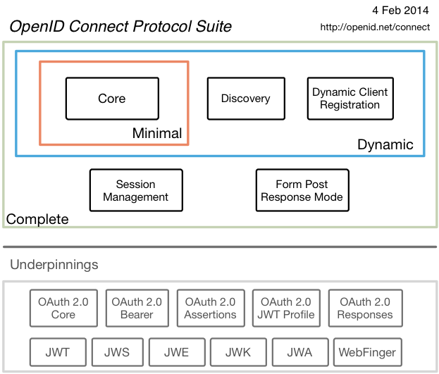
OIC Protocol
OpenID Connect extends OAuth2
Although rather new, OIC is already very popular
Libraries and products: http://openid.net/developers/libraries/
Source: http://openid.net/connect/

Slide 14
AD FS
Active Directory Federation Services

Slide 15
AD FS Server Role
Identity and Federation Provider
Authenticates users and provides tokens
Creates tokens from other tokens issued by other trusted identity providers
Deployment simplified since Windows Server 2012 R2
No dependency on IIS
Installation through Server Manager
Extended in Windows Server 2016
New Features
Supports OpenID Connect

Slide 16
OAuth, OIC and Microsoft

Slide 17
Relevant Microsoft Technologies
AD FS
Active Directory Federation Services
AAD
Azure Active Directory
Authentication Libraries (ADAL, MSAL)
Azure Active Directory Authentication Library Azure Active Directory v2.0 Authentication Library (aka MSAL)
Server-side Middleware
.NET Full Framework .NET Core

Slide 18


Delivering a seamless user authentication experience
Active Directory
Microsoft Azure
Identity Synchronization with password hash sync
User attributes are synchronized using Identity Synchronization services including a password hash, Authentication is completed against Azure Active Directory
Identity Synchronization
Microsoft Azure
User attributes are synchronized using Identity Synchronization tools, Authentication is passed back through federation and completed against Windows Server Active Directory
Source: http://channel9.msdn.com/events/TechEd/Europe/2014/CDP-B210
AD FS

Slide 19
Standards based integrations
Custom LOB applications that integrate with Azure Active Directory
Sign in to Active Directory-integrated applications with cloud identities
Active Directory-integrated applications can access Office 365 and other web APIs
Applications can extend Azure Active Directory schema
Cross-platform support (iOS, Android, and Windows)
Open Standards
(SAML, OAuth 2.0, OpenID Connect, Odata 3.0)
OAuth2 &
OpenID Connect
SAML
WS-Federation
REST based Graph API
Microsoft Azure
Active Directory
SCIM
Source: http://channel9.msdn.com/events/TechEd/Europe/2014/CDP-B210

Slide 20
Basics

Slide 21
Getting a Token
Register App
App Registration Portal
Client App
Web API
Configure Manifest
Get OpenID Metadata
Sample
Sample (Auth0)
OIDC Spec
Further reading: OpenID Connect in Azure Active Directory v2.0

Slide 22
Manifest
{
...,
"oauth2AllowImplicitFlow": true,
...,
"oauth2Permissions": [
{
"adminConsentDescription": "Allow writing...",
"adminConsentDisplayName": "Write data...",
"id": "...",
"isEnabled": true,
"type": "User",
"userConsentDescription": "Allow writing...",
"userConsentDisplayName": "Write data...",
"value": "write_data"
},
{
"adminConsentDescription": "Allow reading...",
"adminConsentDisplayName": "Read data...",
"id": "...",
"isEnabled": true,
"type": "User",
"userConsentDescription": "Allow reading...",
"userConsentDisplayName": "Read data...",
"value": "read_data"
},
{
...
}
],
...
}

Slide 23
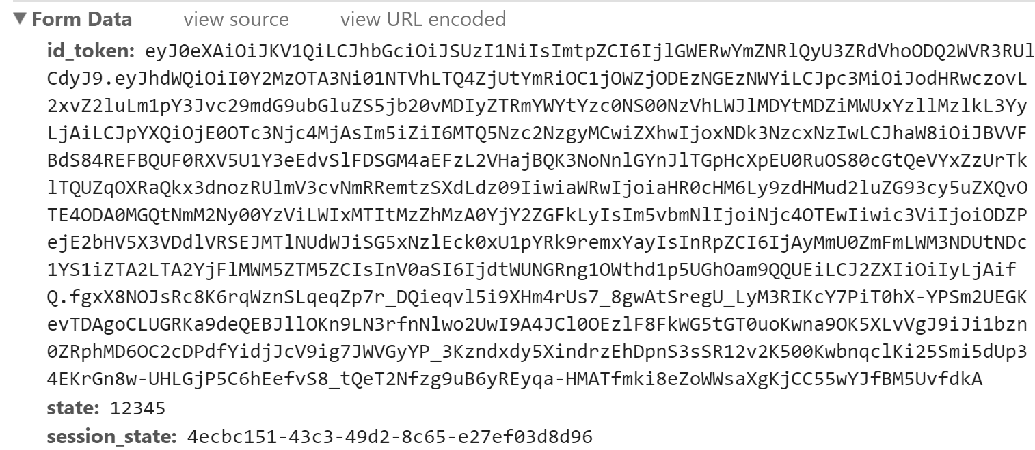
Test App Config
https://login.microsoftonline.com/.../oauth2/v2.0/authorize?
client_id=4cc39076-555a-48f5-bdb8-c9fc8134a35f &response_type=id_token &redirect_uri=https%3A%2F%2Flocalhost:5000%2Flogin &response_mode=form_post &scope=openid &state=12345 &nonce=678910
Try…
Wrong redirect URI
fragment instead of form_post
Analyze JWT with https://jwt.io/
Verify signature with key from OIDC metadata

Slide 24
Digging deeper into OAuth2/OIC
Flows and code walkthroughs

Slide 25
Authorization Code Flow

Slide 26
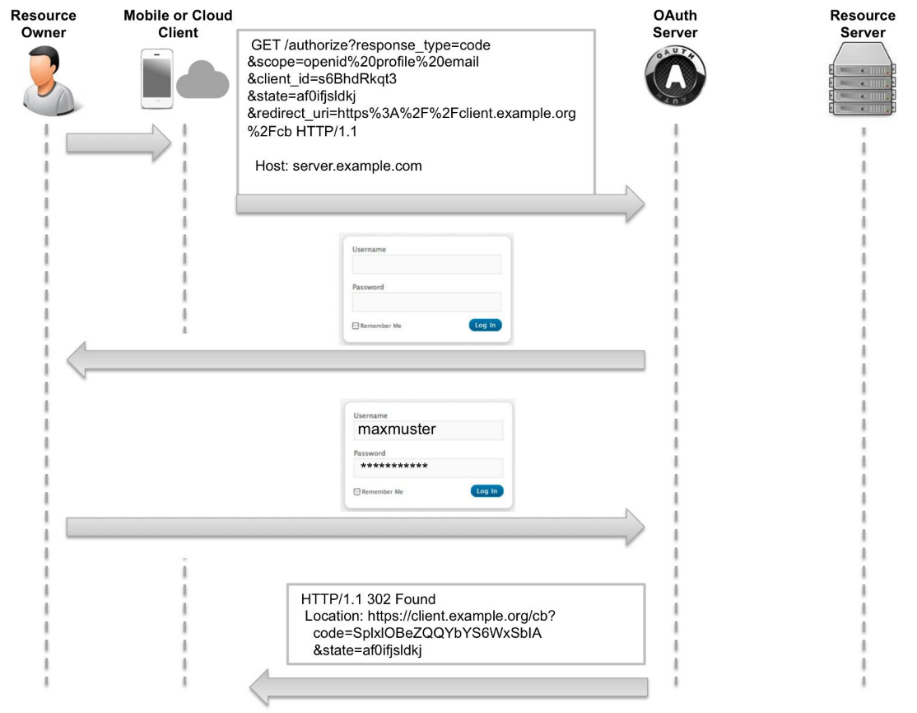
Authorization Code Flow
Getting the auth code
Source: Biehl, Matthias (2014-11-14). OAuth 2.0: Getting Started in API Security (API-University Series Book 1)

Slide 27
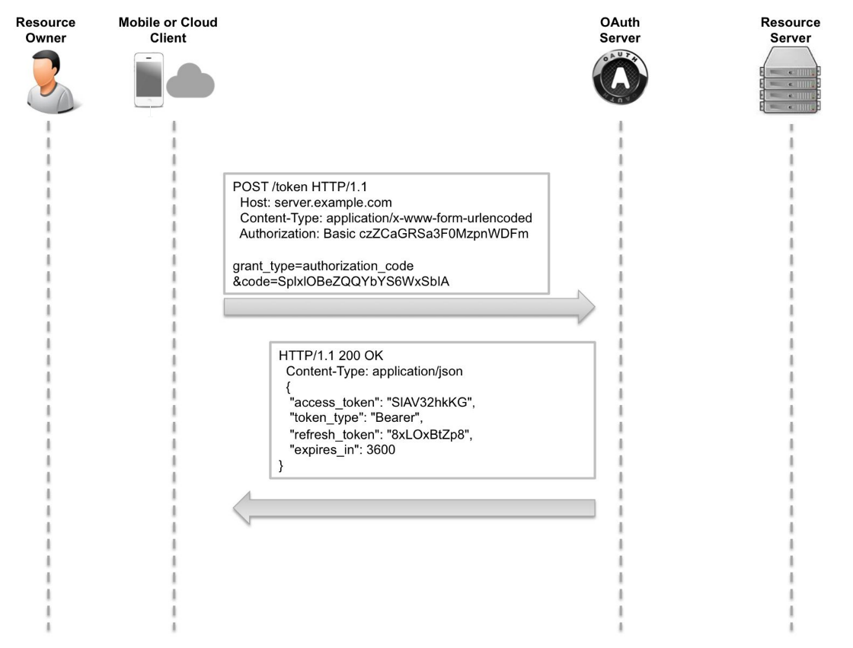
Authorization Code Flow
Getting the token
Source: Biehl, Matthias (2014-11-14). OAuth 2.0: Getting Started in API Security (API-University Series Book 1)

Slide 28
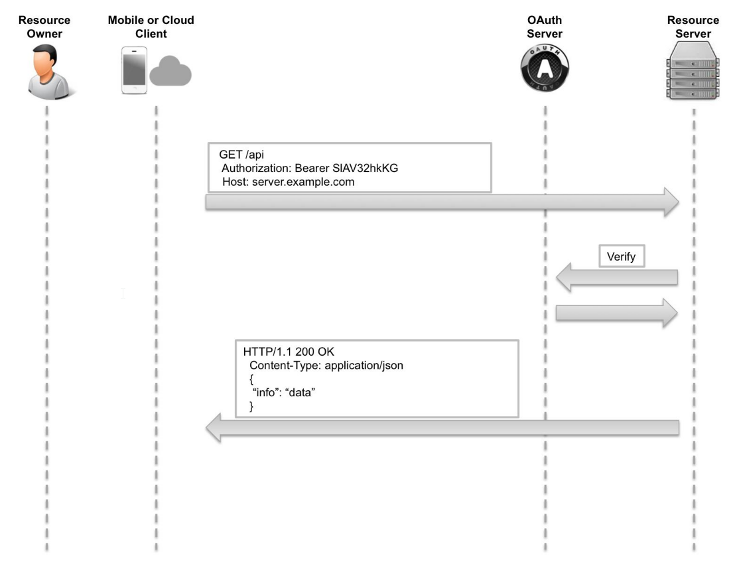
Authorization Code Flow
Accessing the resource
Source: Biehl, Matthias (2014-11-14). OAuth 2.0: Getting Started in API Security (API-University Series Book 1)

Slide 29
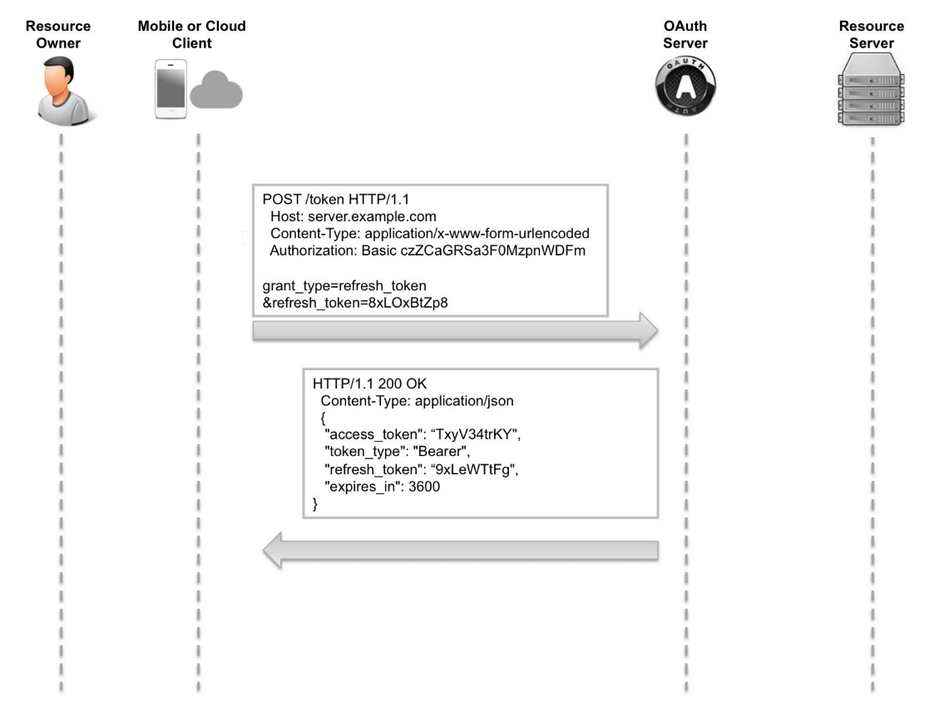
Authorization Code Flow
Refreshing the token
Source: Biehl, Matthias (2014-11-14). OAuth 2.0: Getting Started in API Security (API-University Series Book 1)

Slide 30
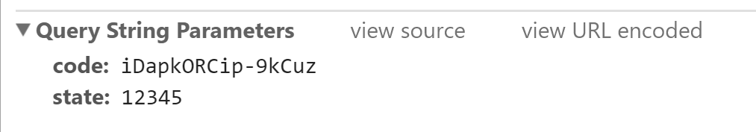
Get Code
https://rainerdemo.eu.auth0.com/authorize? client_id=wDEfs7qeFtBxo7psSmzpeJ7qDutJYI4A &response_type=code &redirect_uri=https%3A%2F%2Flocalhost:5000%2Flogin &response_mode=query &scope=openid%20offline_access &state=12345
Compare with OIDC Spec
https://docs.microsoft.com/en-us/azure/active-directory/develop/active-directory-v2-protocols-oauth-code

Slide 31
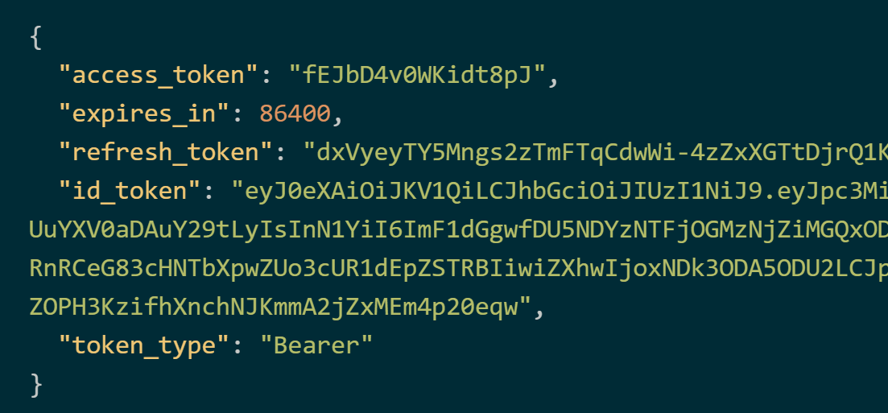
Get Token
POST https://rainerdemo.eu.auth0.com/oauth/token
Content-Type: application/x-www-form-urlencoded
client_id=wDEfs7qeFtBxo7psSmzpeJ7qDutJYI4A &scope=openid%20offline_access &code=DtoirWzOBAxXXqGO &redirect_uri=https%3A%2F%2Flocalhost:5000%2Flogin &grant_type=authorization_code &client_secret=-oAiMEy...

Slide 32
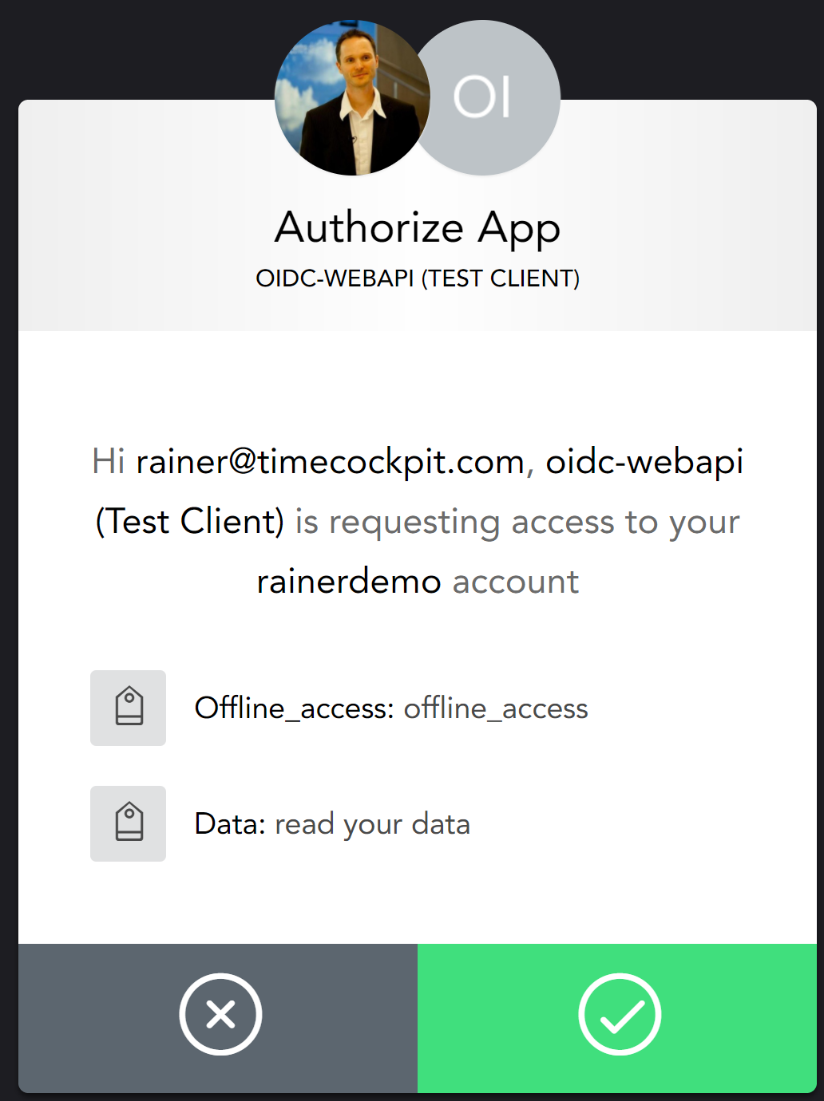
Get Token for API
https://rainerdemo.eu.auth0.com/authorize? client_id=wDEfs7qeFtBxo7psSmzpeJ7qDutJYI4A &response_type=code &redirect_uri=https%3A%2F%2Flocalhost:5000%2Flogin &response_mode=query &audience=http%3A%2F%2Foidc-webapi%2F &scope=openid%20offline_access%20read:data &state=12345
POST https://rainerdemo.eu.auth0.com/oauth/token
Content-Type: application/x-www-form-urlencoded
client_id=wDEfs7qeFtBxo7psSmzpeJ7qDutJYI4A &audience=http%3A%2F%2Foidc-webapi%2F &scope=openid%20offline_access%20read:data &code=gmlFxuze-vf9GLf3 &redirect_uri=https%3A%2F%2Flocalhost:5000%2Flogin &grant_type=authorization_code &client_secret=-oAiMEyVXlmW_jQ...
Compare with OIDC Spec
Try access token in .NET Web API
Sample on GitHub

Slide 33
Further Readings
JWT Validation and Authorization in ASP.NET Core
https://blogs.msdn.microsoft.com/webdev/2017/04/06/jwt-validation-and-authorization-in-asp-net-core/
ASP.NET Core Web API Authorization
https://auth0.com/docs/quickstart/backend/aspnet-core-webapi/01-authorization
ASP.NET Core Web API Using your API
https://auth0.com/docs/quickstart/backend/aspnet-core-webapi/02-using

Slide 34
Implicit Flow

Slide 35
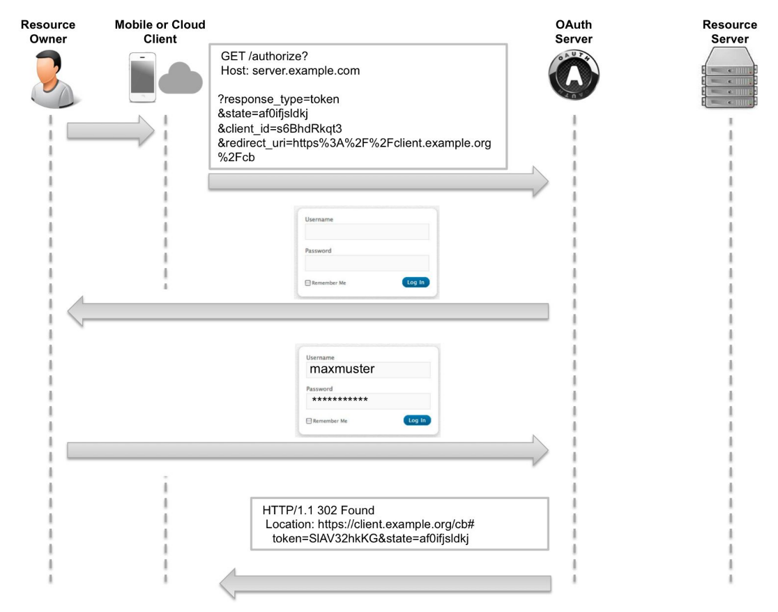
Implicit Flow
Source: Biehl, Matthias (2014-11-14). OAuth 2.0: Getting Started in API Security (API-University Series Book 1)

Slide 36
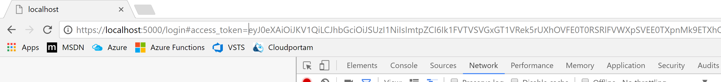
Get Token
GET https://rainerdemo.eu.auth0.com/authorize? client_id=wDEfs7qeFtBxo7psSmzpeJ7qDutJYI4A &response_type=token &redirect_uri=https%3A%2F%2Flocalhost:5000%2Flogin &response_mode=fragment &audience=http%3A%2F%2Foidc-webapi%2F &scope=openid%20offline_access%20read:data &state=12345
Try access token in .NET Web API
Sample on GitHub

Slide 37
JavaScript
Sample on GitHub

Slide 38
Angular
Sample on GitHub

Slide 39
Use Token in API
export class HomeComponent implements OnInit {
…
constructor(public auth: AuthService, private http: Http) {}
getValues() {
let options: RequestOptionsArgs = null;
// If authorized, add header
if (this.auth.isAuthenticated()) {
const headers = new NgHeaders();
headers.append(
'Authorization', 'Bearer ‚ + localStorage.getItem('access_token'));
options = {headers: headers};
}
this.http.get('http://localhost:5001/api/values', options)
.subscribe(res => this.values = res.json(),
err => this.values = [err.statusText]);
}

Slide 40
Password Flows

Slide 41
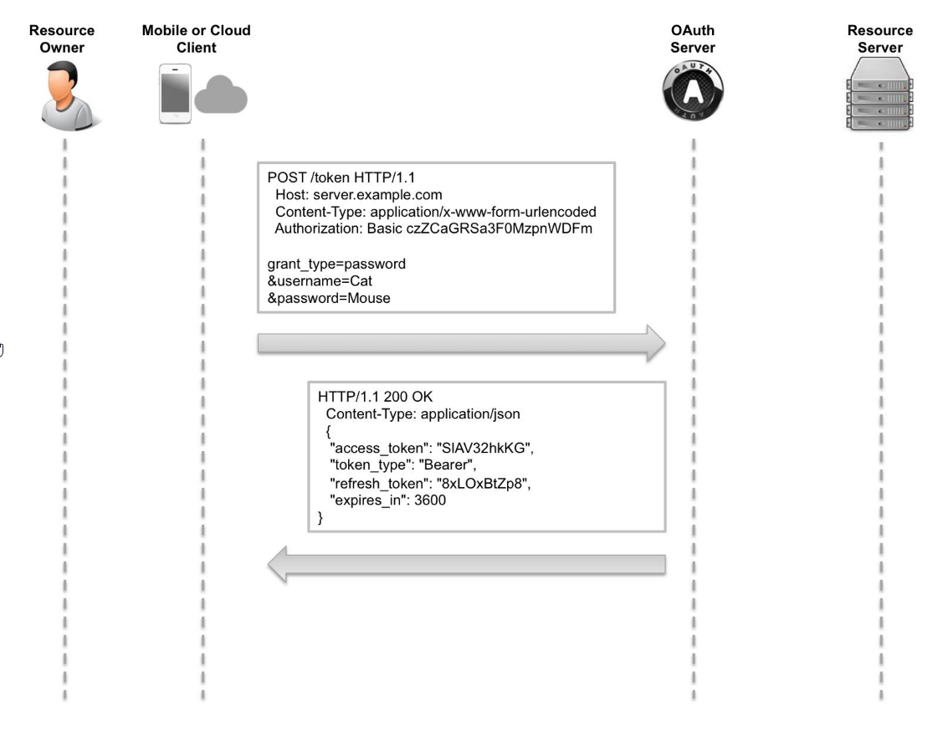
Resource Owner Pwd. Flow
Source: Biehl, Matthias (2014-11-14). OAuth 2.0: Getting Started in API Security (API-University Series Book 1)

Slide 42
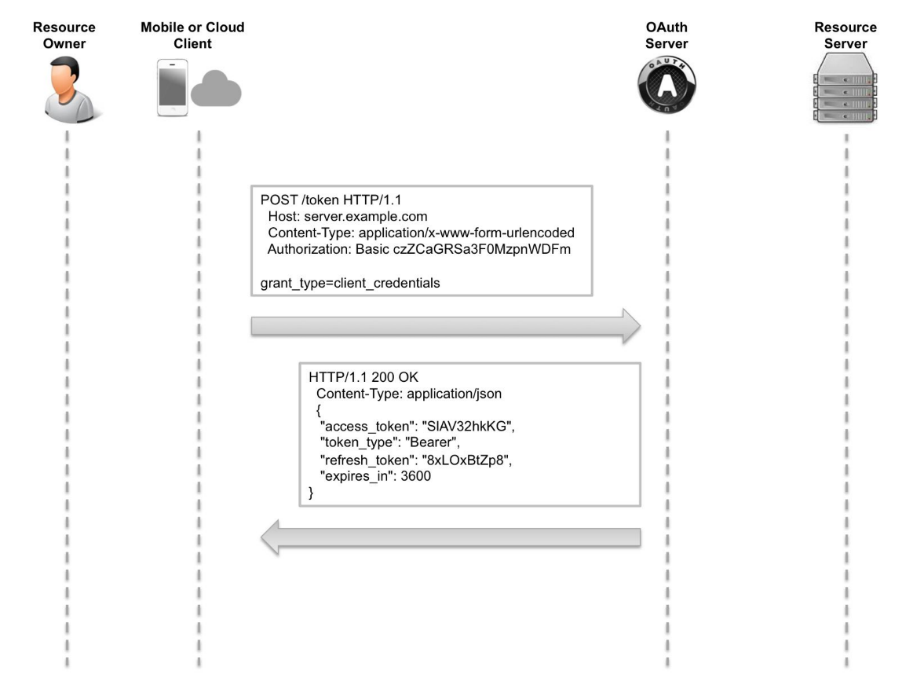
Client Credentials Flow
Source: Biehl, Matthias (2014-11-14). OAuth 2.0: Getting Started in API Security (API-University Series Book 1)

Slide 43
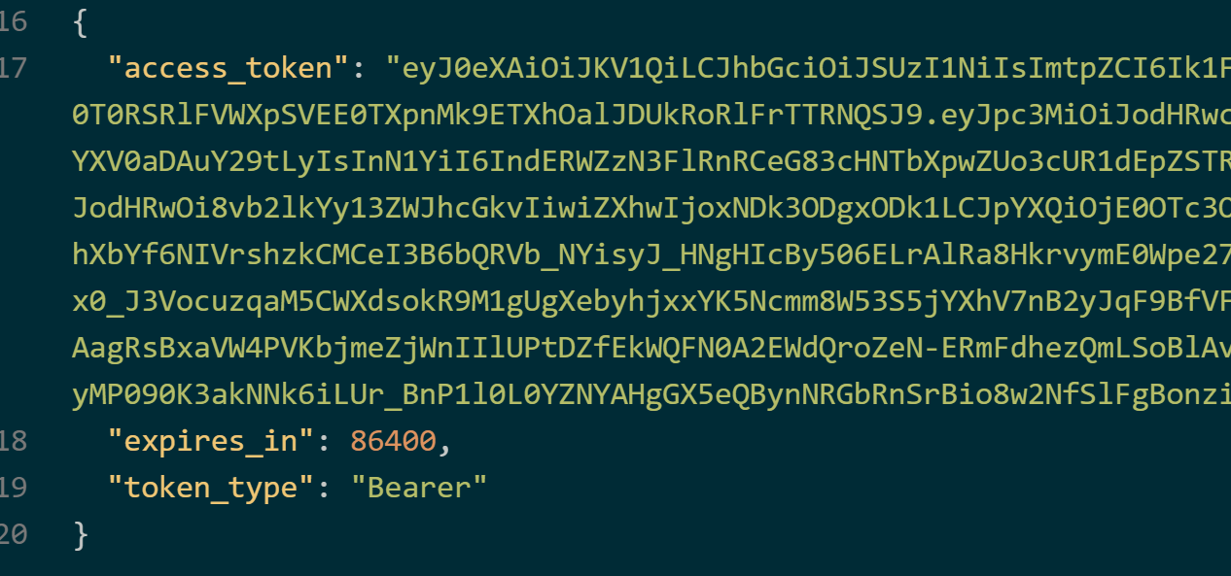
Get Token
POST https://rainerdemo.eu.auth0.com/oauth/token
Content-Type: application/x-www-form-urlencoded
grant_type=client_credentials &audience=http%3A%2F%2Foidc-webapi%2F &client_id=wDEfs7qeFtBxo7psSmzpeJ7qDutJYI4A &client_secret=-oAiMEyVXlmW_jQ9YYLdJwR...

Slide 44
OpenID Connect Flows

Slide 45
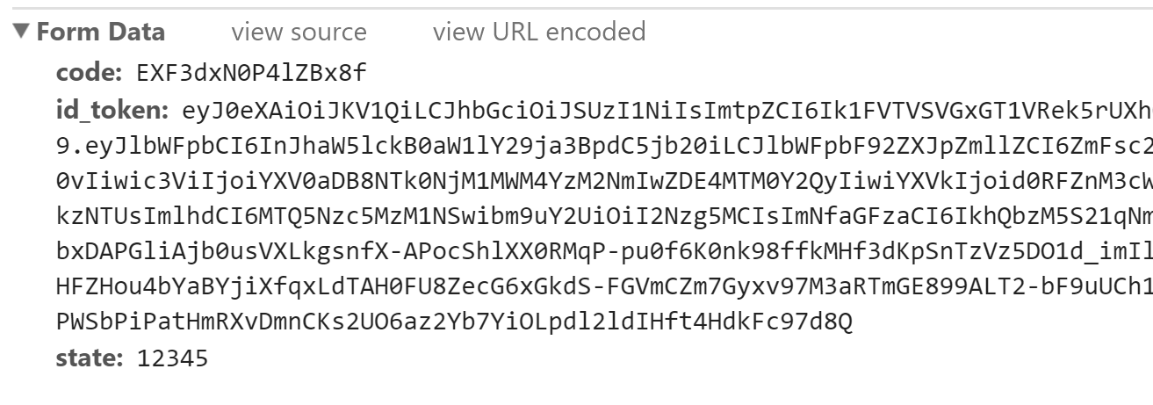
Hybrid Flow
https://rainerdemo.eu.auth0.com/authorize? client_id=wDEfs7qeFtBxo7psSmzpeJ7qDutJYI4A &response_type=code%20id_token &redirect_uri=https%3A%2F%2Flocalhost:5000%2Flogin &response_mode=form_post &audience=http%3A%2F%2Foidc-webapi%2F &scope=openid%20email%20offline_access%20read:data &state=12345&nonce=67890
Discuss advantages of hybrid flow

Slide 46
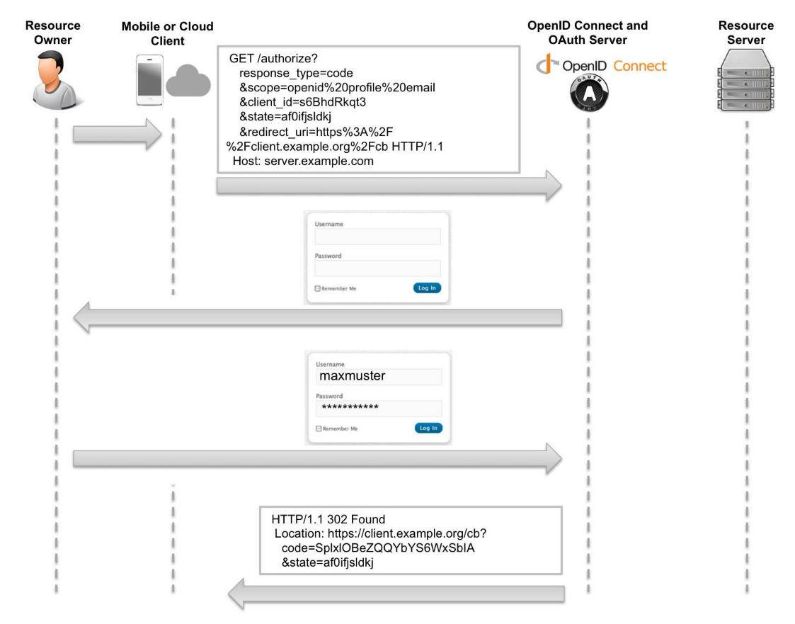
OpenID Connect Flow
Source: Biehl, Matthias (2014-11-14). OAuth 2.0: Getting Started in API Security (API-University Series Book 1)

Slide 47
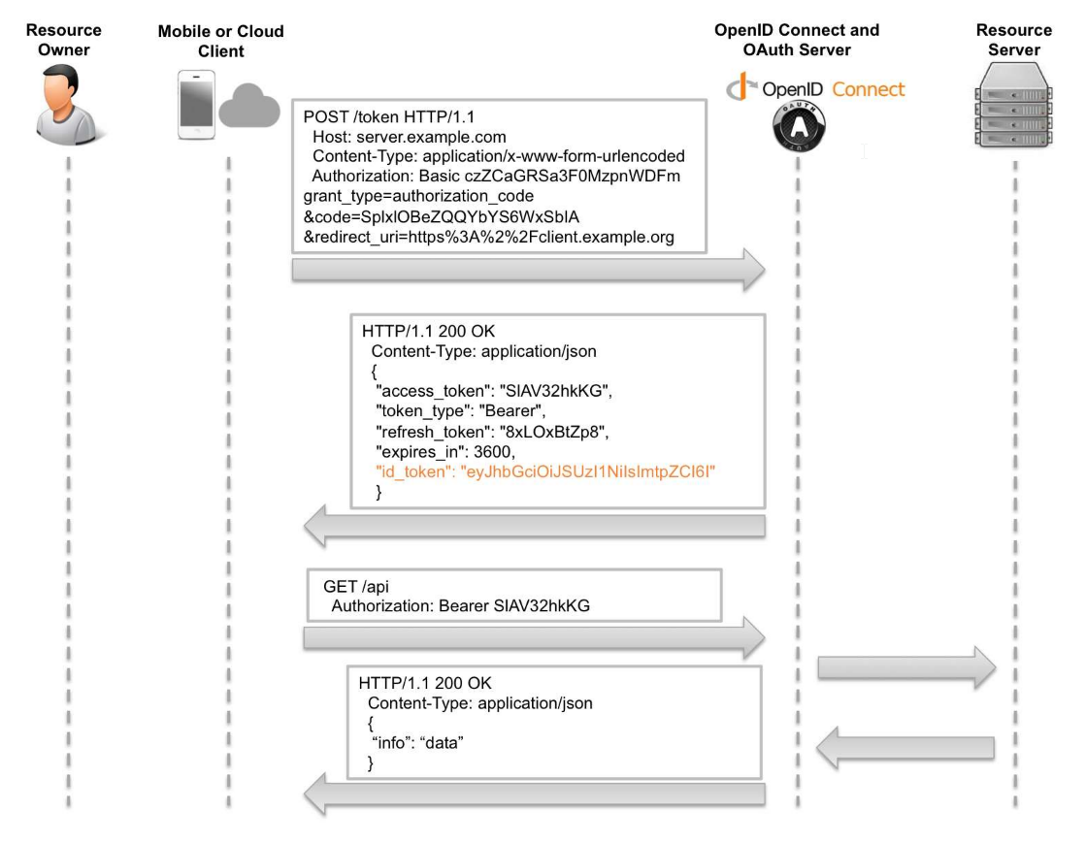
OpenID Connect Flow
Source: Biehl, Matthias (2014-11-14). OAuth 2.0: Getting Started in API Security (API-University Series Book 1)

Slide 48
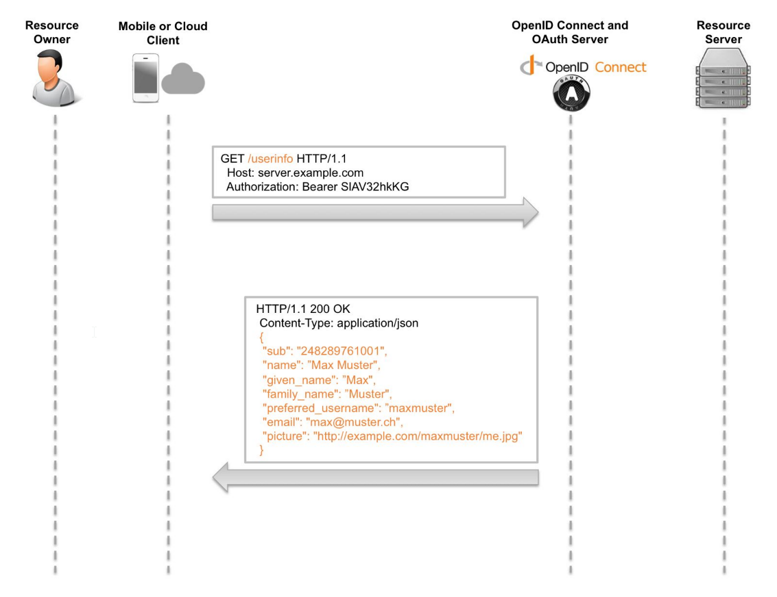
OpenID Connect Flow
Source: Biehl, Matthias (2014-11-14). OAuth 2.0: Getting Started in API Security (API-University Series Book 1)

Slide 49
Summary

Slide 50
Q&A
OAuth2/OpenID Connect Workshop
Rainer Stropek
software architects gmbh
Mail Web Twitter
rainer@timecockpit.com http://www.timecockpit.com @rstropek
Thank your for coming!

