Slide 1
Project: Banking Data and Analysis
All the numeric interpretation has been done.
All the required distribution has been shown.
Each slide contains a single answer.

Slide 2
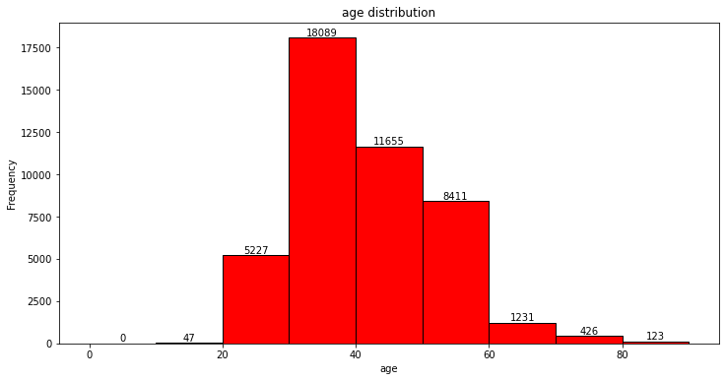
What is the distribution of age among the clients?
0.00 to 10.00, Count: 0
10.00 to 20.00, Count: 47
20.00 to 30.00, Count: 5227
30.00 to 40.00, Count: 18089
40.00 to 50.00, Count: 11655
50.00 to 60.00, Count: 8411
60.00 to 70.00, Count: 1231
70.00 to 80.00, Count: 426
80.00 to 90.00, Count: 123

Slide 3
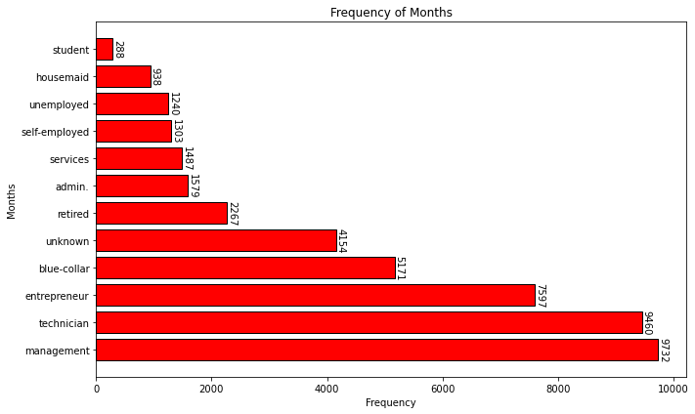
How does the job type vary among the clients?

Slide 4
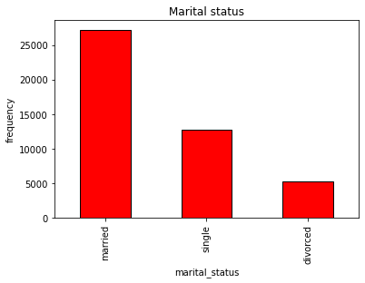
Marital Status distribution
marital_status
married 27216
single 12790
divorced 5207

Slide 5
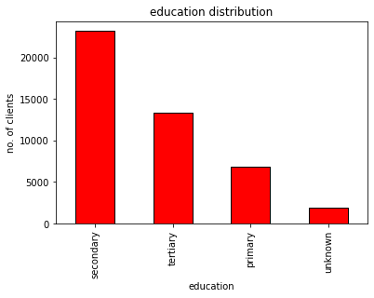
What is the level of education among the clients?
Education Level
secondary 23204
tertiary 13301
primary 6851
unknown 1857

Slide 6
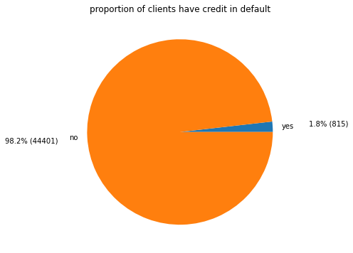
What proportion of clients have credit in default?
no 44401
yes 815

Slide 7
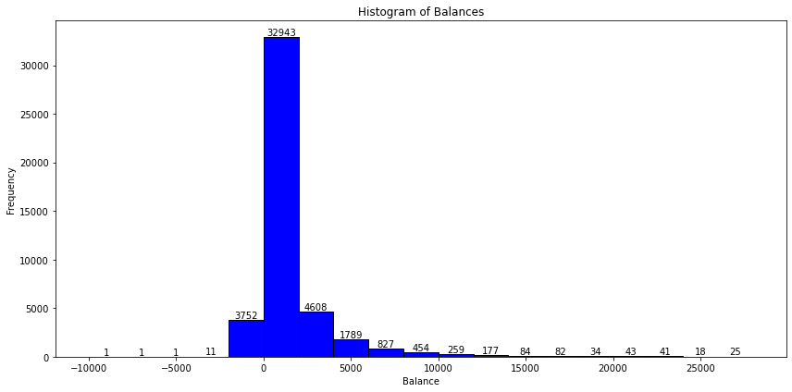
What is the distribution of average yearly balance among the clients?
-10000.00 to -8000.00, Count: 1
-8000.00 to -6000.00, Count: 1
-6000.00 to -4000.00, Count: 1
-4000.00 to -2000.00, Count: 11
-2000.00 to 0.00, Count: 3752
0.00 to 2000.00, Count: 32943
2000.00 to 4000.00, Count: 4608
4000.00 to 6000.00, Count: 1789
6000.00 to 8000.00, Count: 827
8000.00 to 10000.00, Count: 454
10000.00 to 12000.00, Count: 259
12000.00 to 14000.00, Count: 177
14000.00 to 16000.00, Count: 84
16000.00 to 18000.00, Count: 82
18000.00 to 20000.00, Count: 34
20000.00 to 22000.00, Count: 43
22000.00 to 24000.00, Count: 41
24000.00 to 26000.00, Count: 18
26000.00 to 28000.00, Count: 25
Max :102127
Min : -8019

Slide 8
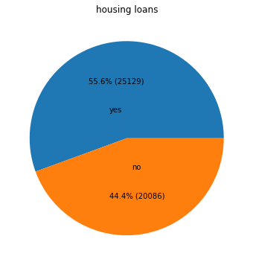
How many clients have housing loans?

Slide 9
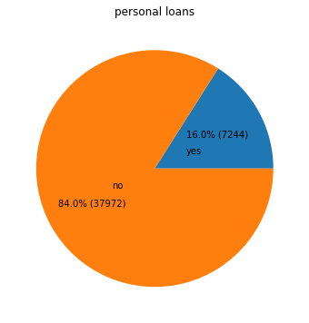
How many clients have personal loans?

Slide 10
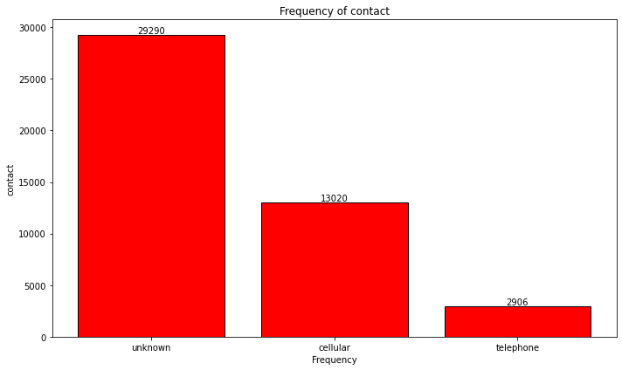
What are the communication types used for contacting clients during the campaign?
cellular 29290
unknown 13020
telephone 2906

Slide 11
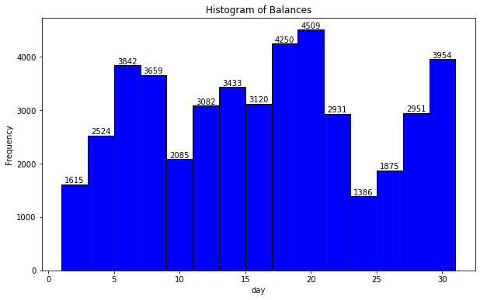
What is the distribution of the last contact day of the month?
1.00 to 3.00, Count: 1615
3.00 to 5.00, Count: 2524
5.00 to 7.00, Count: 3842
7.00 to 9.00, Count: 3659
9.00 to 11.00, Count: 2085
11.00 to 13.00, Count: 3082
13.00 to 15.00, Count: 3433
15.00 to 17.00, Count: 3120
17.00 to 19.00, Count: 4250
19.00 to 21.00, Count: 4509
21.00 to 23.00, Count: 2931
23.00 to 25.00, Count: 1386
25.00 to 27.00, Count: 1875
27.00 to 29.00, Count: 2951
29.00 to 31.00, Count: 3954

Slide 12
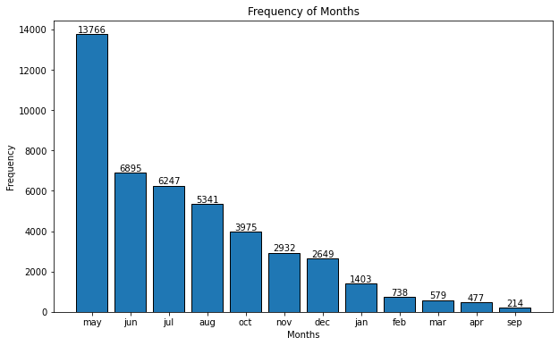
How does the last contact month vary among the clients?

Slide 13
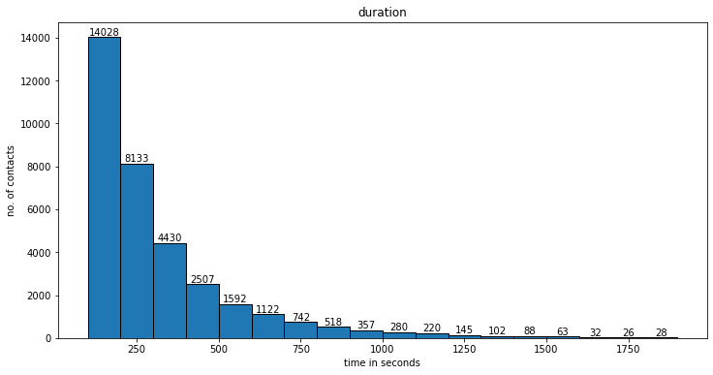
What is the distribution of the number of days passed since the client was last contacted from a previous campaign?
100.00 to 200.00, Count: 14028
200.00 to 300.00, Count: 8133
300.00 to 400.00, Count: 4430
400.00 to 500.00, Count: 2507
500.00 to 600.00, Count: 1592
600.00 to 700.00, Count: 1122
700.00 to 800.00, Count: 742
800.00 to 900.00, Count: 518
900.00 to 1000.00, Count: 357
1000.00 to 1100.00, Count: 280
1100.00 to 1200.00, Count: 220
1200.00 to 1300.00, Count: 145
1300.00 to 1400.00, Count: 102
1400.00 to 1500.00, Count: 88
1500.00 to 1600.00, Count: 63
1600.00 to 1700.00, Count: 32
1700.00 to 1800.00, Count: 26
1800.00 to 1900.00, Count: 28

Slide 14
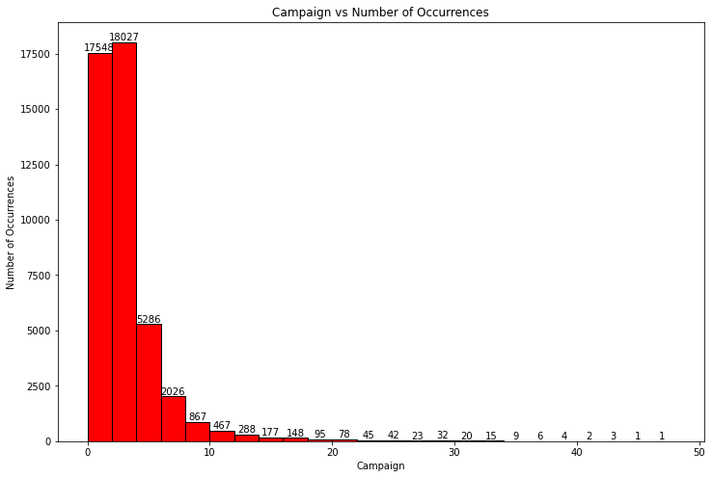
How many contacts were performed during the campaign for each client?
0 to 2, count : 17548
2 to 4, count : 18027
4 to 6, count : 5286
6 to 8, count : 2026
8 to 10, count : 867
10 to 12, count : 467
12 to 14, count : 288
14 to 16, count : 177
16 to 18, count : 148
18 to 20, count : 95
20 to 22, count : 78
22 to 24, count : 45
24 to 26, count : 42
26 to 28, count : 23
28 to 30, count : 32
30 to 32, count : 20
32 to 34, count : 15
34 to 36, count : 9
36 to 38, count : 6
38 to 40, count : 4
40 to 42, count : 2
42 to 44, count : 3
44 to 46, count : 1
46 to 48, count : 1

Slide 15
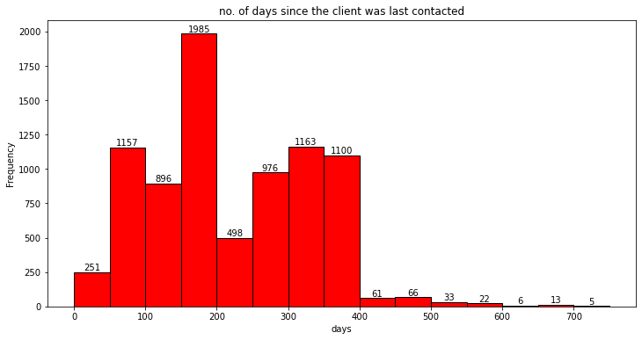
What is the distribution of the number of days passed since the client was last contacted from a previous campaign?
0.00 to 50.00, Count: 251
50.00 to 100.00, Count: 1157
100.00 to 150.00, Count: 896
150.00 to 200.00, Count: 1985
200.00 to 250.00, Count: 498
250.00 to 300.00, Count: 976
300.00 to 350.00, Count: 1163
350.00 to 400.00, Count: 1100
400.00 to 450.00, Count: 61
450.00 to 500.00, Count: 66
500.00 to 550.00, Count: 33
550.00 to 600.00, Count: 22
600.00 to 650.00, Count: 6
650.00 to 700.00, Count: 13
700.00 to 750.00, Count: 5

Slide 16
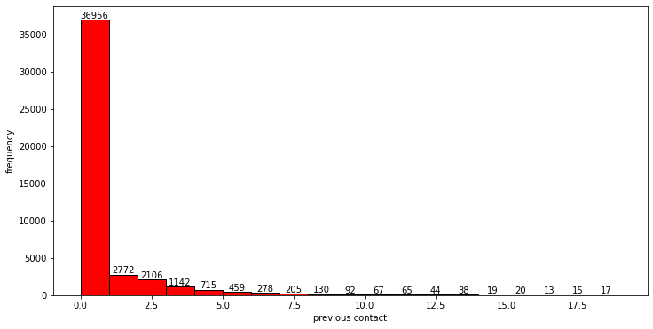
How many contacts were performed before the current campaign for each client?
0.00 to 1.00, Count: 36956
1.00 to 2.00, Count: 2772
2.00 to 3.00, Count: 2106
3.00 to 4.00, Count: 1142
4.00 to 5.00, Count: 715
5.00 to 6.00, Count: 459
6.00 to 7.00, Count: 278
7.00 to 8.00, Count: 205
8.00 to 9.00, Count: 130
9.00 to 10.00, Count: 92
10.00 to 11.00, Count: 67
11.00 to 12.00, Count: 65
12.00 to 13.00, Count: 44
13.00 to 14.00, Count: 38
14.00 to 15.00, Count: 19
15.00 to 16.00, Count: 20
16.00 to 17.00, Count: 13
17.00 to 18.00, Count: 15
18.00 to 19.00, Count: 17

Slide 17
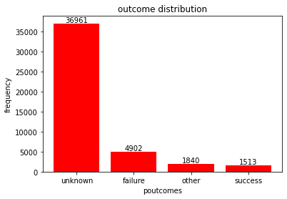
What were the outcomes of the previous marketing campaigns?

Slide 18
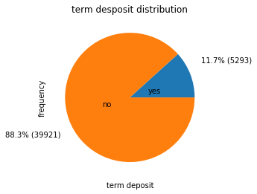
What is the distribution of clients who subscribed to a term deposit vs. those who did not?

Slide 19
Are there any correlations between different attributes and the likelihood of subscribing to a term deposit?
campaign -0.073294
day -0.028307
age 0.025648
balance 0.052821
previous 0.093576
pdays 0.103699
duration 0.394387
y_numeric 1.000000

