Slide 1
Wine quality prediction

Slide 2
Why prediction?
The assessment and prediction of wine quality stand as fundamental pillars within the viticulture industry, influencing consumer preferences and market competitiveness
The evaluation of wine quality often involves complex analyses of multifaceted components, ranging from acidity levels to alcohol content and volatile acidity
the utilization of machine learning algorithms presents an innovative approach. These algorithms, known for their ability to discern patterns and relationships within data, offer a promising avenue for accurately predicting wine quality based on these intrinsic attributes.

Slide 3
Research gaps:
Importance to specific wine quality attributes:
By conducting correlation analyses between individual physicochemical properties and wine quality ratings, this study aims to uncover the relative importance and impact of each attribute on the final quality assessment. High positive or negative correlations can signify strong associations between certain attributes and perceived quality.
Accurate Prediction:
Tuning the hyperparameters and finding the best parameters for each model can increase prediction accuracy.

Slide 4
Dataset overview:
The Wine Quality dataset is a collection of physicochemical measurements of red and white wines from the Vinho Verde region of Portugal.
The data was collected by a team of researchers at the University of Minho in Portugal and is publicly available from the UCI Machine Learning Repository.
The dataset consists of one file: winequality-red.csv
Each file contains a list of wine samples, with each sample represented by a row in the file.

Slide 5
Physicochemical Measurements:
For the experiments conducted in this paper, a subset. consisting of 1599 instances of red wine samples was extracted. from the larger dataset. The dataset encompasses crucial physicochemical attributes that are integral to wine quality assessment. The relevant features included in this study are as follows:
“Fixed Acidity”, “Volatile Acidity”, “Citric Acid”, “Residual Sugar”, “Chlorides”, “Free Sulfur Dioxide”, “Total Sulfur Dioxide”, “Density”, “pH”, “Sulphates”, “Alcohol Content”.

Slide 6
Correlation matrix:
In the pursuit of refining the dataset for predictive modelling of red Vinho Verde wine quality, a critical step involves feature selection through correlation analysis.
The aim is to identify and subsequently remove attributes that exhibit strong correlations, typically above 0.6, with other attributes within the dataset.
To achieve this, a correlation matrix is computed, capturing the pairwise correlations between the physicochemical attributes.
One of the identified attributes having a correlation above 0.6:
“free sulfur dioxide”, “fixed acidity”, “volatile acidity” and “citric acid”

Slide 7
Data preprocessing:
After performing the isnull() operation, we determined that the data does not contain null values.
To categorize the dataset, we need to map it as good or bad. In this case, any data point with a quality score that is less than 6 will be classified as bad, while those with a score of 6 or higher will be considered good.
we can proceed with the label encoder. This data preprocessing technique converts categorical variables into numerical representations.

Slide 8
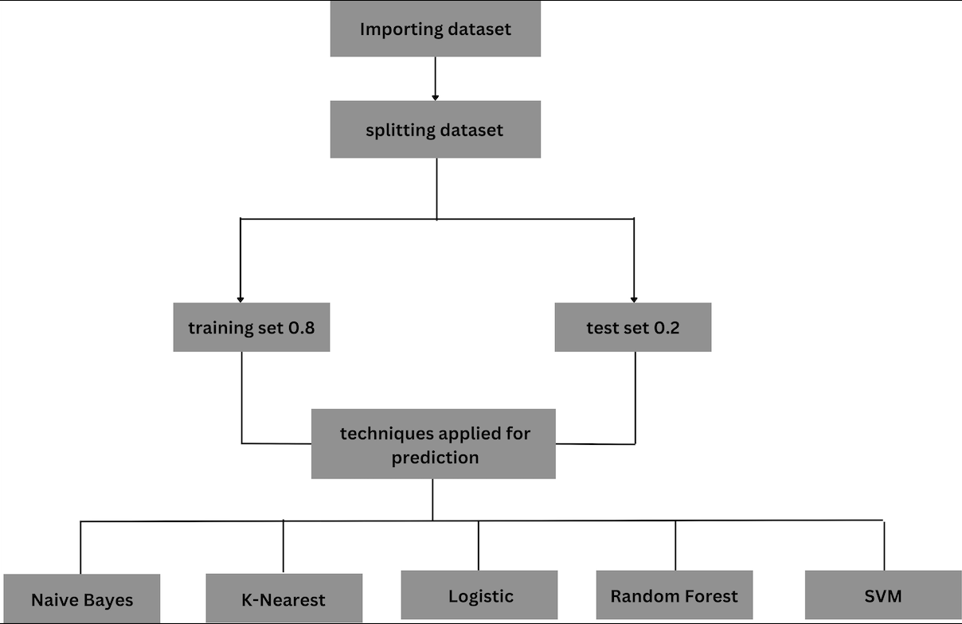
The dataset is split into train and test sets, with 80% for training and 20% for testing.
The models used for the prediction are :
Naive Bayes, K-Nearest, Logistic, Random Forest and Support Vector Machine

Slide 9
K-Nearest Neighbor :
The K-Nearest Neighbors (KNN) algorithm, a non-parametric classifier, was employed to classify new wine instances based on the majority class of their k nearest neighbors in the training dataset
In K-Nearest Neighbors (KNN), To find the optimal value for k, we need to analyze the impact of different 'k' values on accuracy using training and testing data.
The best value of k is 2 for this dataset.
The model has
Test accuracy: 86.094%
Train accuracy: 69.69%

Slide 10
Logistic Regression:
Logistic Regression, a statistical model adept at predicting binary outcomes, was implemented to model the probability of good or bad wine quality.
To optimize the Logistic Regression model, we need to carefully calibrate two hyperparameters 1. iterations and 2. alpha. For this implementation, we chose 1000 iterations and an alpha value of 0.01 for optimal performance.
From the model,
the test accuracy was: 58.750%
the train accuracy was: 63.047%

Slide 11
Naive Bayes:
For classifying numerical values, Gaussian naive Bayes is used instead of Naive Bayes which is for categorical values assuming the data is normally distributed.
Gaussian Naive Bayes is a variant of the Naive Bayes algorithm specifically designed for classification tasks involving continuous or numerical data that follows a Gaussian distribution.
Using the sci-kit-learn library, we trained the training set and made predictions on the test dataset. The resulting accuracy is 73%.
On the training set the accuracy is: 72.734%

Slide 12
SVM:
Support vector machines (SVM), a machine learning algorithm capable of handling both linear and non-linear data, was implemented to identify the optimal hyperplane for separating wine quality classes.
SVM uses important hyperparameters like kernel function, gamma, and C value. GridSearchCV function helps to validate all parameter possibilities and find the best ones.
The best parameters for kernel function, gamma and c values are Linear, 0.1 and 1 respectively.
The model has
Test accuracy: 71.875%
Train accuracy: 72.73%

Slide 13
Random Forest:
Random Forest, an ensemble learning method that combines multiple decision trees, was implemented to harness the collective power of individual trees and improve prediction accuracy.
One of the most critical hyperparameters in random forests is the number of trees (n_estimators). This parameter determines the number of decision trees to be used in the random forest ensemble.
From the observation, the best value for the hyperparameter is 100.
The model has
Test accuracy: 100.000%
Train accuracy: 80.625%

Slide 14
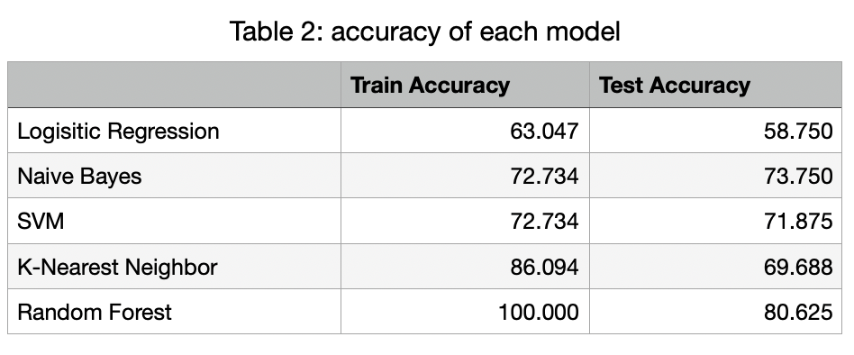
Based on the accuracy scores of the models in the table, it is evident that the Random Forest model outperforms all other models on the dataset.
Apart from the Random Forest, the k-nearest neighbor performs well on training data but not on test data which means the model is overfitting.
The other models also achieve good accuracy, with the Naive Bayes and SVM models achieving the highest accuracy after the random forest model, with 73.750% and 71.875% training and test accuracy, respectively.

Slide 15
Future works:
One direction for future work is to explore the use of different hyperparameters for the random forest model. For example, it would be interesting to see how the maximum tree depth affects the performance of the model.
Another direction for future work would be worth investigating the use of different feature selection methods to identify the most important features for the task. It would be interesting to see how the model performs on datasets with different types of features.

