Slide 1
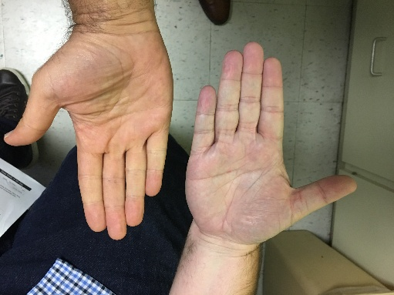
Analyzing Hand Color for Health Status Prediction: A Non-Invasive ML Approach
Capstone 3 Project
Adli Karadsheh
August 02, 2025

Slide 2
Problem Statement & Motivation
Healthcare challenge: Early detection of circulatory/oxygenation issues (e.g., hypoxia) via hand color—bluish (unhealthy) vs. pink (healthy).
Real-world impact: Non-invasive monitoring for at-risk patients (cardiovascular/respiratory conditions); potential mobile app for remote screening.
DSM Alignment: Problem defined, stakeholders (patients/providers), goals (>80% accuracy), risks (imbalance/lighting).

Slide 3
Dataset Overview
Sources: ~70 healthy (stock sites: Pexels/Unsplash/Adobe); ~57 unhealthy (clinic images with bluish tones).
Processing: MediaPipe for landmarks; RGB at midpoints (thumb: 2 segments; others: 3); radii 1/3/5 → ~84 features/CSV.
Stats: Healthy brighter (e.g., Avg_G ~160 vs. ~140, p < 0.001 via t-tests); mild imbalance (~58% unhealthy).
Wrangling: Imputed NaNs (means); no rows lost.
Radius (pixels) | Channel | t-statistic | p-value
1 | Avg_R | 4.22 | 4.72E-05
1 | Avg_G | 5.9 | 3.18E-08
1 | Avg_B | 4.99 | 1.97E-06
3 | Avg_R | 4.15 | 6.10E-05
3 | Avg_G | 5.89 | 3.35E-08
3 | Avg_B | 4.96 | 2.29E-06
5 | Avg_R | 4.11 | 7.13E-05
5 | Avg_G | 5.99 | 2.07E-08
5 | Avg_B | 5.06 | 1.45E-06

Slide 4
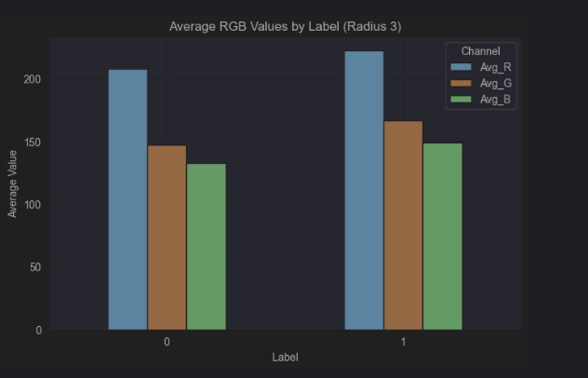
Exploratory Data Analysis (EDA)
Distributions: RGB ~50-255; bimodal histograms reflecting labels.
Correlations: High within channels (~0.9+); Label ~0.4-0.5 with red/green.
Trends: Larger radii smooth noise (std drop ~10%); better separation (green widest gap).
Insights: Outliers minimal; pairplots show R-G clusters.

Slide 5
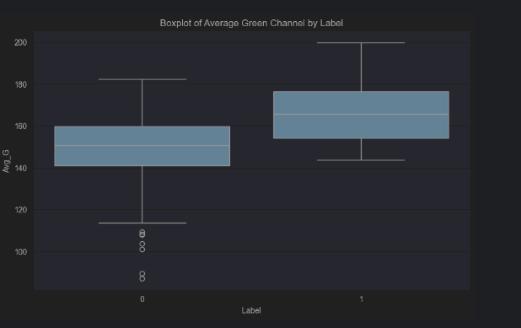
Exploratory Data Analysis (EDA)
Distributions: RGB ~50-255; bimodal histograms reflecting labels.
Correlations: High within channels (~0.9+); Label ~0.4-0.5 with red/green.
Trends: Larger radii smooth noise (std drop ~10%); better separation (green widest gap).
Insights: Outliers minimal; pairplots show R-G clusters.

Slide 6
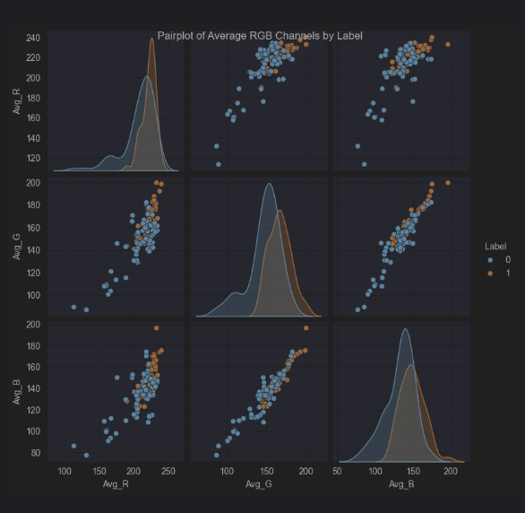
Exploratory Data Analysis (EDA)
Distributions: RGB ~50-255; bimodal histograms reflecting labels.
Correlations: High within channels (~0.9+); Label ~0.4-0.5 with red/green.
Trends: Larger radii smooth noise (std drop ~10%); better separation (green widest gap).
Insights: Outliers minimal; pairplots show R-G clusters.

Slide 7
Methods & Modeling Pipeline
Preprocessing: Standardized; PCA (20 components, ~97% variance); 80/20 train-test split (stratified)
.
Models: Initial LR, Regularized LR, Random Forest (RF), Neural Network (NN)—focus on RF as best.
Evaluation: Test accuracy, 5-fold CV (± std), confusion matrices (low FN priority).
Tools: Python (scikit-learn, TensorFlow, MediaPipe); notebooks for EDA/modeling.

Slide 8
Model Results & Comparison
RF (Best): 92% test across radii; CV up to 83% at R5 (+11% from R1 via smoothing).
Comparison: RF > NN/Reg LR (by +4-11% CV); importances: Comp 1 (global shifts), Comp 16 (green contrasts).
Predictions vs. Actual: RF near-perfect (1 FN at R5); aligns with bright healthy tones.
Limitations: Small data (variability in NN); unaccounted lighting/skin tones.
Model | Radius (pixel) | Test Accuracy | 5-Fold CV Accuracy (std)
Initial LR | 1 | 0.85 | 0.73 (±0.12) | Baseline; balanced CM. Vs. RF: -7% test, linear limits.
Initial LR | 3 | 0.88 | 0.74 (±0.11) | Strong initial; good TN. Vs. RF: Lower CV, no ensemble robustness.
Initial LR | 5 | 0.85 | 0.72 (±0.10) | Stable; minor radius gain. Vs. RF: -7% test, misses non-linearity.
Regularized LR | 1 | 0.85 | 0.73 (±0.12) | No warnings; interpretable coeffs (Comp 10 ~0.80). Vs. RF: -7% test; simpler but less accurate.
Regularized LR | 3 | 0.88 | 0.74 (±0.11) | Best LR; 0 FN at test. Vs. RF: Equivalent test but -4% CV; RF's importances more insightful (Comp 16 ~0.09).
Regularized LR | 5 | 0.85 | 0.72 (±0.10) | Even errors; scalable. Vs. RF: -7% test; RF better on TN (14/15 vs. 13/15).
Random Forest (Current) | 1 | 0.92 | 0.72 (±0.10) | Vs. Reg LR: +7% test; Comp 1/10 key. Vs. NN: Less variance, better TN.
Random Forest (Current) | 3 | 0.92 | 0.76 (±0.11) | Vs. Reg LR: +4% CV; importances shift to Comp 16. Vs. NN: +7% test, consistent CM.
Random Forest (Current) | 5 | 0.92 | 0.83 (±0.12) | Top: +11% CV gain; Comp 16/8-9 dominant. Vs. All: Highest metrics, ideal for deployment—low errors, robust to radius.
Neural Network | 1 | 0.88 | ~0.72 (±~0.10) | Non-linear; stochastic. Vs. RF: -4% test, more variance.
Neural Network | 3 | 0.81 | ~0.70 (±~0.11) | More FN. Vs. RF: -11% test; needs tuning.
Neural Network | 5 | 0.88 | ~0.76 (±~0.12) | Aligns on trend. Vs. RF: -4% test; RF more consistent.

Slide 9
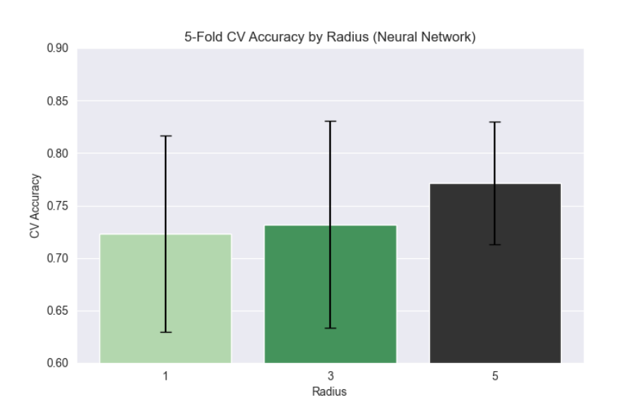
Discussion & Limitations
Success: RGB midpoints effective (green key differentiator); RF robust for screening.
Limitations: Dataset size risks overfit; multicollinearity; no HSV/lighting normalization.
Variability: NN stochastic (±0.06-0.12 CV); errors in borderlines (e.g., shadows).

Slide 10
Next Steps & Recommendations
Processing: Add HSV (for lighting invariance); resize uniformly (512x512); equalize histograms.
Labeling: Include age/chronic conditions (e.g., diabetes) for multi-class; collect oximetry data.
Models: Tune RF (n_estimators=200); ensemble RF+NN; add CNNs for raw images.
App: Prototype in Flutter (TF Lite integration) for real-time predictions/alerts.

Slide 11
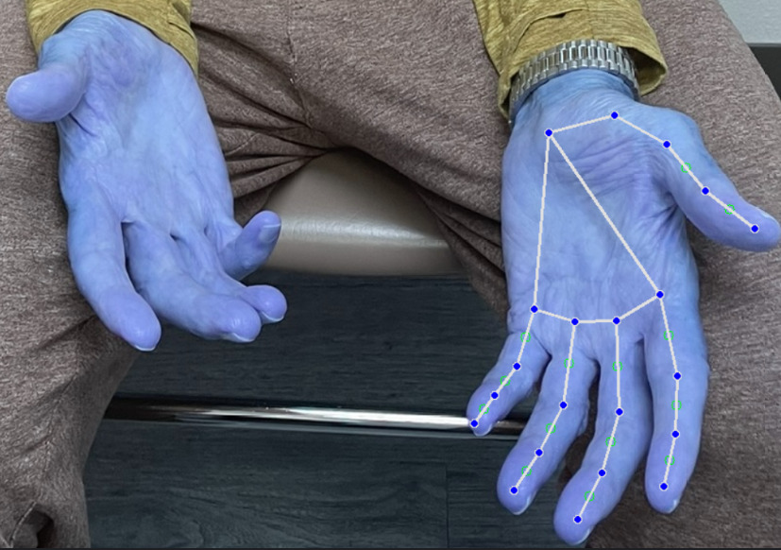
Conclusion
Achieved >80% goal (RF 92%); validates color-based monitoring.
Impact: Bridges DS/healthcare; future app could empower users.
Thanks & Q&A.
The Hands Tell More Than Sign

