Slide 1
NHANES Data Analysis: Exploring CRP
Analyzing Age, Gender, BMI, and Waist-to-Height Ratio
Presented by: A. Karadsheh
Date: June 29, 2025

Slide 2
Data Overview
NHANES dataset (2003-2006) with 18619 participants after combining sets and cleaning.
Features: Age, Gender, BMI, Waist-to-Height Ratio, CRP (C Reactive Protein, an inflammation marker)
Cleaning: Selected columns, dropped rows with missing data; encoded Gender (Male: 1, Female: 0) among other steps.

Slide 3
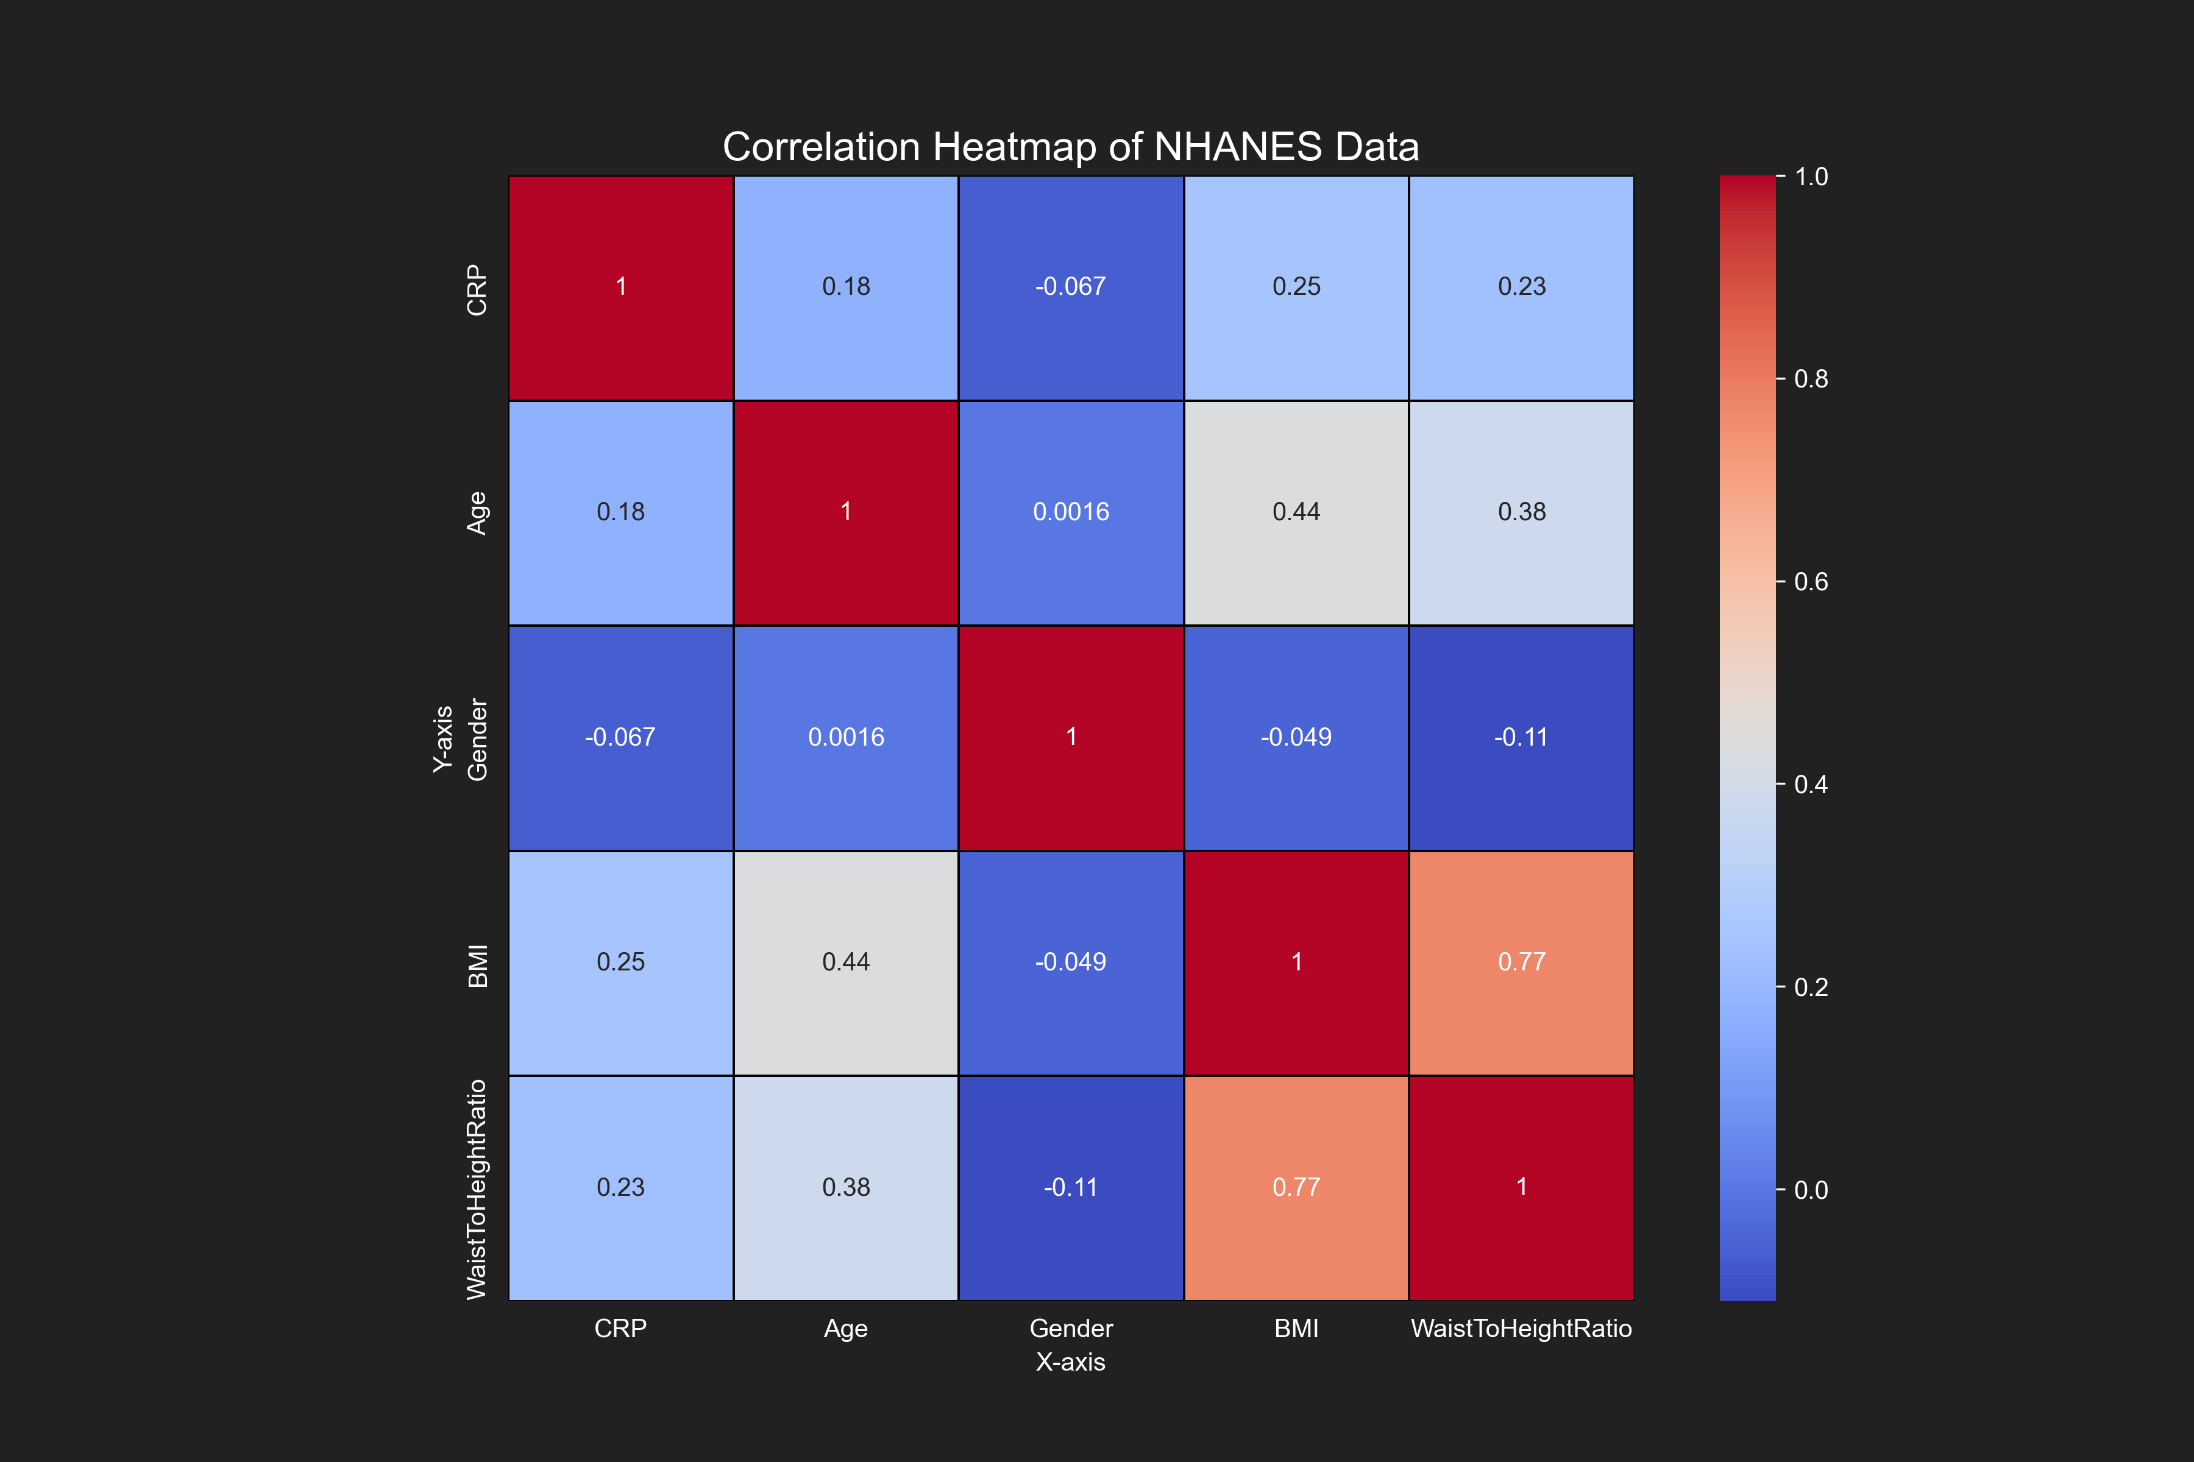
Correlation with CRP
Correlations with CRP:
Age: 0.177
Gender: -0.067
BMI: 0.246
WaistToHeightRatio: 0.230
Insight: BMI and Waist-to-Height Ratio show stronger positive correlations with CRP.

Slide 4
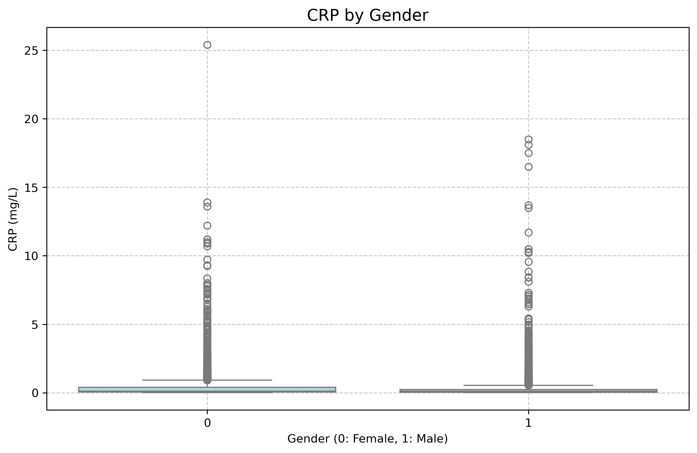
CRP by Gender
Insight: Females (0) tend to have slightly higher median CRP levels than males (1).

Slide 5
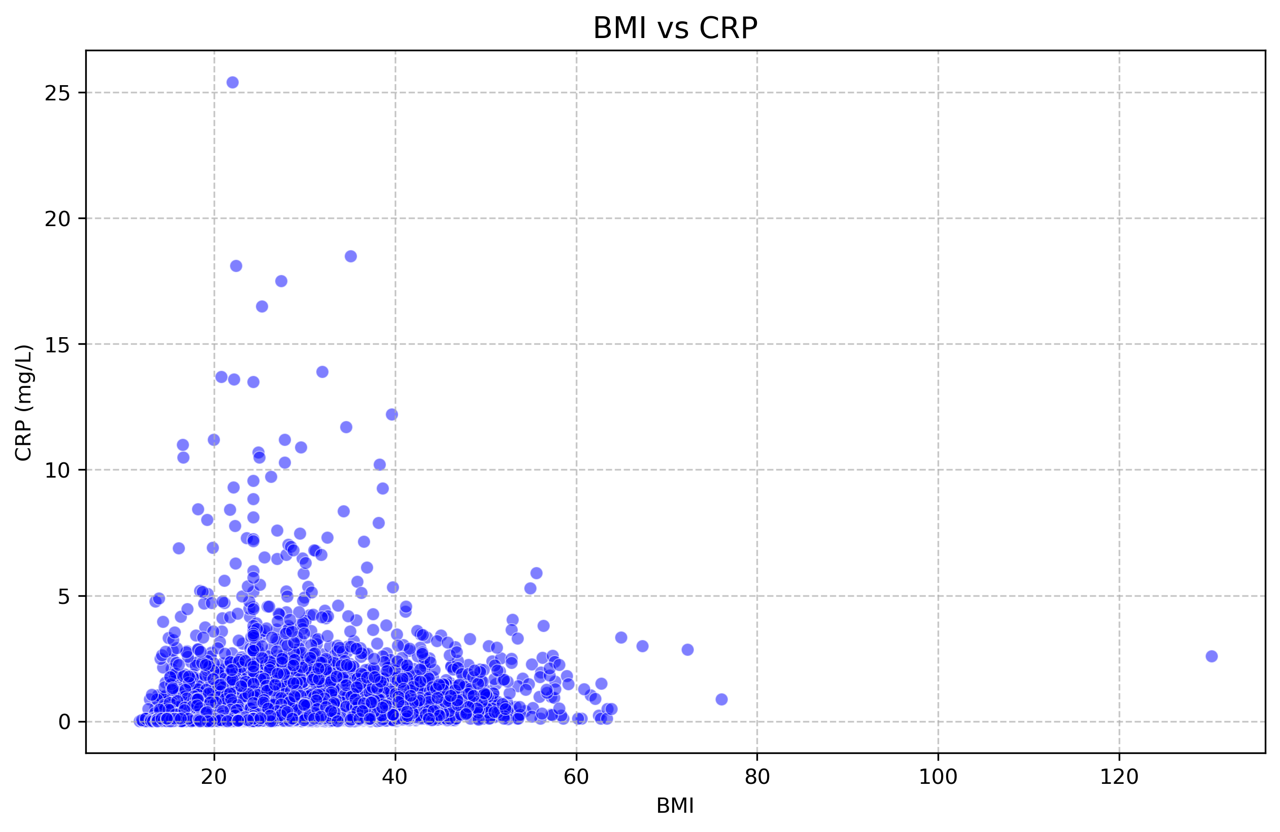
BMI vs CRP
Observation: Higher BMI is associated with elevated CRP levels, indicating inflammation risk.

Slide 6
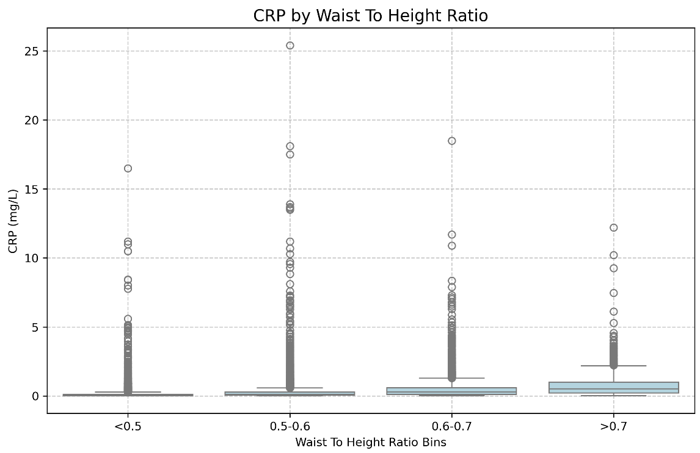
Interesting Fact
Participants with Higher Waist-to-Height Ratio (correlates with BMI) have higher CRP levels, highlighting the link between central obesity and inflammation.

Slide 7
Predictive Modeling
Model Comparison: Random Forest vs. XGBoost
Random Forest (CRP): MSE=0.10, R²=0.21
Ensemble of decision trees, robust to overfitting (winsorized CRP).
Random Forest (LogCRP): MSE=0.08, R²=0.14
Ensemble of decision trees, robust to overfitting (log-transformed CRP).
XGBoost (CRP): MSE=0.09, R²=0.23
Gradient boosting, high performance (winsorized CRP).
XGBoost (LogCRP): MSE=0.08, R²=0.17
Gradient boosting, high performance (log-transformed CRP).
Recommendation: XGBoost slightly outperforms Random Forest.

Slide 8
Conclusion
BMI and Waist-to-Height Ratio are key predictors of CRP, linking obesity to inflammation.
XGBoost is recommended for prediction.
Future Steps: Incorporate diet, activity and other lab data for improved models.

