Slide 1

Dynamic Searchable Encryption with Optimal Search in the Presence of Deletions
Javad Ghareh Chamani
HKUST
Dimitrios Papadopoulos
HKUST
Mohammadamin Karbasforushan
UCSC
Ioannis Demertzis
UCSC
USENIX Security
August 10th – 12th, 2022
Notes:
Hello and thank you for being here! I'm Amin, and I’ll be presenting our work Dynamic Searchable Encryption with Optimal Search in the Presence of Deletions by Javad, Dimitrios, myself, and Ioannis
[transition (end of slide)]

Slide 2




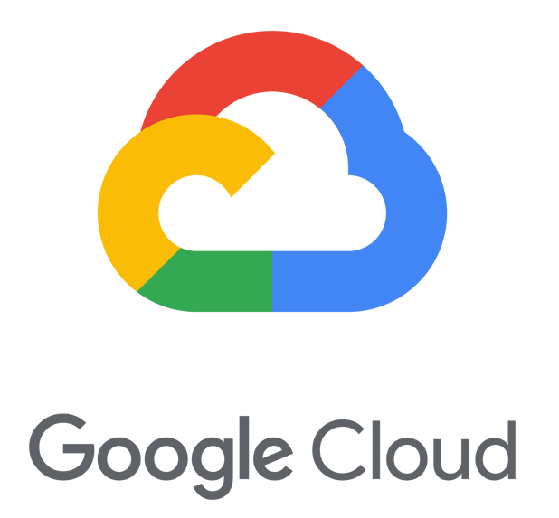

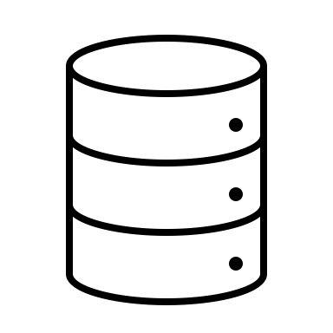

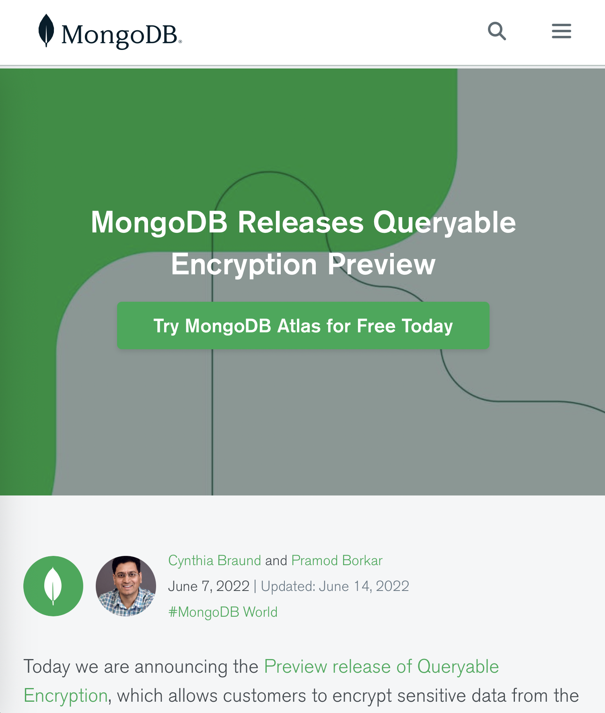


Encrypted Search
Motivation: Private Cloud Computing
Sensitive Data, GDPR, US HIPAA, …
Encryption
Searchable Encryption [SWP00]
Especially, dynamic with efficient search [B16] [KP13] [KKPR12] [GPPR18] [CXWZSJ21] [DGPP20] [EKPE18] [KKLPK17]
Applications:
MongoDB’s Queryable Encryption
Pixek: Annotated Image Search
Gun Registry (US Senate & Brown University)
Encrypted key-value stores and databases
Private end-to-end email communications with search capabilities
Via encrypted inverted index
+ Encryption key at client-side
+ Efficient search and update
[CJJKRM13] [CNR21] [CK10] [DPPDGP18] [DPPDG16] [FJKNRS15]
[KM17] [MKNK15]
[DPPS20] [KM18] [KMO18] [PPYY19]
[ANSS16] [DPP18] [DP17] [DTP18] [MM17] [BBFMR21]
[HSWW18] [RMO15] [RMO18] [WP21] [YLLJC14]
Notes:
Nowadays using clouds has become one of the standard approaches, if not the standard way.
However, given the many potentials for data breaches, be it malice or human error, there is a clear challenge of private cloud computing.
[transition]
The most basic step towards solving this challenge is standard encryption.
Also, the data may be sensitive, or it may fall under certain legislations such as GDPR.
[transition]
However, just encrypting data, for example at rest, is not enough.
The encryption key should not be exposed to anyone but the client, and furthermore, we still need to efficiently process the data.
[transition]
A comprehensive solution to this is Searchable Encryption.
First introduced by Song et al. in 2000, it has received a lot of attention regarding its
[transition]
Security,
Expressiveness,
Efficiency,
Multi-user support, and what we focus on here,
[transition]
Supporting updates while allowing efficient search.
[transition]
It has many applications and has been recently added to MongoDB as their “Queryable Encryption” feature set.
[transition]
It can be used for searching annotated images, and
[transition]
There was an effort to use it as a gun registry.
[transition]
Also, it can be used to create generic encrypted key-value stores and therefore encrypted databases,
and similarly, it can be used to create inverted indexes, for example on emails, so that each person’s email remains private to them and them alone.
[transition (end of slide)]

Slide 3





Dynamic Searchable Encryption (DSE) [LSDHJ10] [SPS14] [BMO17]
?
What does the Cloud learn?
Controlled information called leakage.
K3V3 | Dummy | K1V2 | Dummy
Dummy | K1V4 | K3V2 | K1V1
K3V2 | K3V3 | Dummy | Dummy
{
Key1: [Val1, Val2, Val4],
Key2: [Val2],
Key3: [Val2, Val3]
}
Untrusted
Cloud
Client
Well-Defined and Cryptographically Proven!
Setup Leakage
Encrypted Multi-Map
K3V3 | Dummy | K1V2 | Dummy
Dummy | K1V4 | K3V2 | K1V1
K3V2 | K3V3 | Dummy | Dummy
Setup
Total Size
K2V5
Key1
Search Leakage
Encrypted Search Token
Encrypted Multi-Map
Search Pattern
Query Repetition
K1V4 | K1V1 | K1V2
Encrypted Search Result
Key1
Access Pattern
Records Fetched
Encrypted Search Token
Search
K1V4 | K1V1 | K1V2
K2V5
Encrypted Search Result
Insert {Key2: Val5}
Update Leakage
Encrypted Update Args
Update (Insert/Delete)
Next slide…
K2V5
Encrypted Update Args
Notes:
I will start with a formal description of Dynamic Searchable Encryption.
I will use the most generic use-case, an encrypted key-value store, which can be used to create the other ones.
It is defined by three base protocols, the first being Setup.
[transition]
In Setup, the client has a multi-map, and wants to outsource it to an untrusted cloud.
Of course, a multi-map is a map where each key can have multiple values.
In this example there are three keys, and each of them has its own number of values, some overlapping.
[transition]
First, the client generates an encryption key, and uses it to create the encrypted multi-map that the server would store. Note that, to remain private, the client doesn’t want the cloud to know the contents, and for example by encrypting the values and shuffling them, obscures the cloud’s view.
[transition]
Finally, the client sends the data to the cloud for storage, completing setup.
[transition]
The second protocol is Search, where the client wants to lookup the values for a particular key.
[transition]
The client encrypts the query so that it only give the cloud the information it needs to perform the search.
[transition]
Then, the client sends this encrypted search token to the cloud,
[transition]
and the cloud uses the token to find the values.
Note that the being able to find them doesn’t mean the cloud can see their contents.
Finally, the results are sent back to the client.
[transition]
The third protocol, which is the key in defining dynamic searchable encryption, is Update.
The client can use it to augment their data in the cloud by inserting or deleting key-value pairs.
[transition]
Here too, the client must create an encrypted version of the update arguments that gives the cloud only as much information as necessary.
[transition]
Then the client sends the encrypted arguments to the cloud, and
Using them, the cloud can perform the update.
So far so good.
[transition]
Now, after all of this is done, what would the cloud learn?
The cloud can only learn strictly controlled information called leakage.
The leakage must be well-defined and cryptographically proven, giving the client strict control over their privacy.
[transition]
The leakage of a SE scheme can be broken down to three parts, following the protocols:
Setup leakage, which is what the cloud learns during that protocol, and usually is the total size of the dataset.
[transition]
Then, there’s the search leakage, which for example contains query repetitions or records fetched.
[transition]
Finally, there is update leakage, which is more complicated, and I will explain in the next slide. :)
[transition (end of slide)]
{{{{ 3:26 }}}}

Slide 4
DSE Update Leakage
Formally, the update should leak nothing about the key
?
Search(Key1)
Accessed memory locations
during search
Insert(Key1, Val5)
Untrusted
Cloud
Client
Forward Privacy [SPS14] [ZKP16]: The untrusted cloud should not link updates to previous searches.
… during updates, about searches
K3V3 | Dummy | K1V2 | Dummy
Dummy | K1V4 | K3V2 | K1V1
K3V2 | K3V3 | Dummy | Dummy
Backward Privacy [SPS14] [BMO17]: Controlled information about inserted-then-deleted values should be leaked. (at least not the value)
… during searches, about updates
Encrypted Multi-Map
K3V3 | Dummy | K1V2 | Dummy
Dummy | K1V4 | K3V2 | K1V1
K3V2 | K3V3 | Dummy | Dummy
K3V6
Insert(Key3, Val6)
Delete(Key3, Val6)
K3V6
Search(Key3)
Encrypted Multi-Map
Forward and Backward Privacy have become the de-facto requirements in the literature.
Notes:
I’ll explain the leakage related to the updates using two examples.
First, let’s start with the same encrypted multi-map that we created in the previous slide.
[transition]
The client can perform a search for key 1, and the server must access the memory locations that contain the three results to service the query.
[transition]
The client can then decide to insert a new value for the same key.
We define one aspect of privacy here, called forward privacy,
[transition]
It means the update and the search should not be linkable. More formally,
Forward Privacy requires the updates to leak nothing about the key being updated.
Forward privacy is something that we look out for during updates, but it is often triggered by what the server has previously seen during searches.
[transition]
For the second example, I'll start with the same multi-map:
[transition]
The client can insert a value for some key and delete that value right after.
Note that I’m showing the deletion using a cancellation record here, because as I just stated for forward privacy, I cannot just go and erase the value directly.
[transition]
Finally, the client can perform a search for the same key.
We define our last aspect of privacy here, called backward privacy
[transition]
it requires the searches not to leak “too much” information about the values that have been inserted and deleted, without ever appearing in a search.
The minimum requirement here is that the value itself should not be leaked.
It has a strict and more complicated definition that I will not dive into here.
Forward and backward privacy have become the standard requirements for dynamic searchable encryption in the literature.
A pattern here is that we must sacrifice some efficiency for the sake of privacy. The main outcome is that…
[transition (end of slide)]
{{{{ 4:46 }}}}

Slide 5


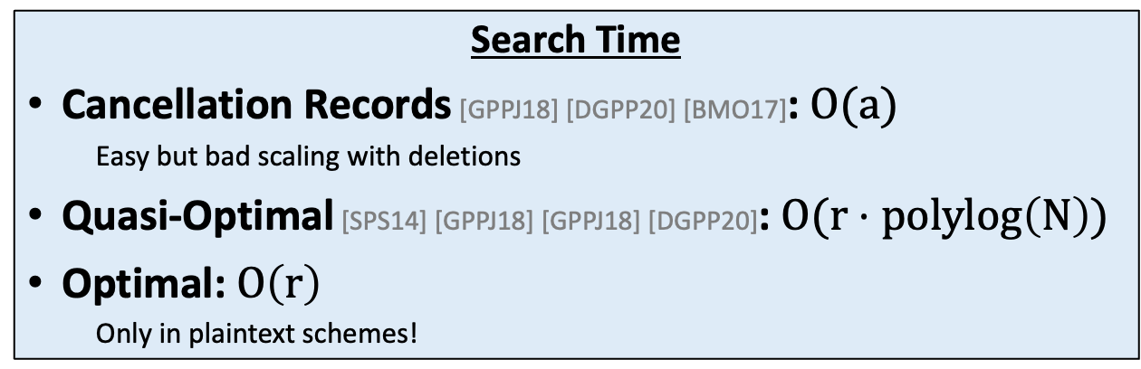




Prior Work: Sub-Optimal Search
?
[GPPJ18] [DGPP20] [BMO17]
Insert(Key1, Val1)
$i$: insertions
Insert(Key1, Val2)
$a=i+d$: all updates
Untrusted
Cloud
Client
.
.
.
Insert(Key1, Vali)
Search Time
Cancellation Records [GPPJ18] [DGPP20] [BMO17]: $O(a)$
Easy but bad scaling with deletions
Quasi-Optimal [SPS14] [GPPJ18] [GPPJ18] [DGPP20]: $O(r⋅polylog\left(N\right))$
Optimal: $O\left(r\right)$
Only in plaintext schemes!
Delete(Key1, Val1)
Delete(Key1, Val2)
.
.
.
Delete(Key1, Vali-1)
$d$: deletions
Dummy | Dummy | Dummy | Dummy
Dummy | Dummy | Dummy | Dummy
Dummy | Dummy | Dummy | Dummy
…
…
K1V2
Search(Key1)
$r=i−d$: result size
K1Vi
K1V2
K1Vi-1
Val1
Val2
…
Vali
Val1
Val2
…
Vali-1
Vali
Cancellation Records
Easy way to stay forward private
K1V1
K1Vi-1
K1V1
$N$: capacity
Notes:
… prior works either did not satisfy forward and backward privacy, or did not have optimal search at all!
[transition]
I’ll start with another example. Let’s assume an empty multi-map with capacity N, and
[transition]
Let’s insert a value for a new key into it.
As a result, some entry in the server’s store should be updated to contain the encrypted value.
The client then inserts more values to reach a total of i elements.
[transition]
Now, the client can start deleting values.
Note that a typical access pattern may be much more complicated and involve multiple keys; and that this is just an example.
[transition]
Many of the prior works used cancellation records to perform deletions, which is an easy way to maintain forward privacy, and that is what I want to showcase.
[transition]
The client keeps deleting values until only one remains.
[transition]
The client can perform a search for the same key now, and the server must read and send all of the insertions and cancellation records.
[transition]
And then the client must go through all of them to find the single remaining value.
I will denote the result size, the number of non-deleted records, with r.
[transition]
Again, many of the prior works used cancellation records to remain forward private. However, as I just showed, that method doesn’t scale with the number of deletions.
A few schemes had quasi-optimal search times, which translates to a poly-logarithmic factor of N on top of the result size.
Optimal search, however, was never achieved in forward and backward private dynamic searchable encryption.
[transition]
We have created the first scheme with optimal search, and during the rest of the talk I will explain how.
[transition (end of slide)]
{{{{ 6:02 }}}}

Slide 6

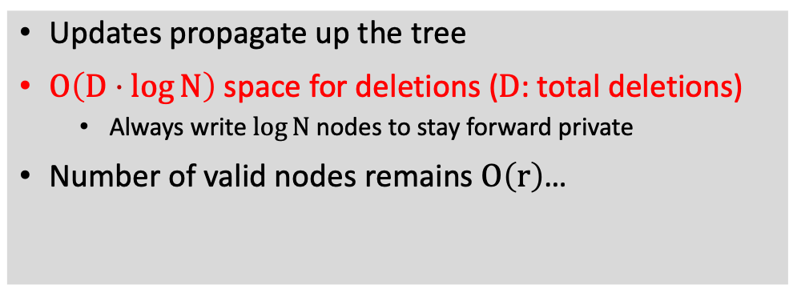


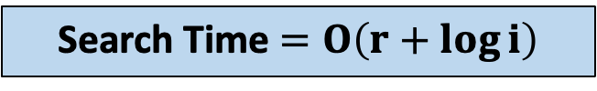
Achieving Optimal Search with Deletions (OSSE)
?
Insert(Key1, Val1)
Updates propagate up the tree
$O\left(D⋅\log{N}\right)$ space for deletions ($D$: total deletions)
Always write $\log{N}$ nodes to stay forward private
Number of valid nodes remains $O\left(r\right)$…
Insert(Key1, Val2)
Untrusted
Cloud
Client
Insert(Key1, Val3)
Insert(Key1, Val4)
Search Time $=O\left(r+\log{i}\right)$
Insert(Key1, Val5)
Delete(Key1, Val1)
v0 nodes have known contents → never written
Delete(Key1, Val4)
1-8 v0
1-8 v1
1-8 v2
Search(Key1)
Pseudorandom addresses
1-4 v0
1-4 v1
Val2
Val2
Val2
1-4 v2
5-8 v0
Dummy | K1V2
… | …
Binary tree on top of entries to avoid deleted regions
vi: node version, increased when pointers change
1-2 v0
3-4 v0
5-6 v0
7-8 v0
Key1:
1
2
3
4
5
6
7
$$\text{8}$$
9
…
$N$: capacity
Notes:
I will present a simplified version of our optimal scheme OSSE using an example, with more details in the next slide.
[transition]
We use an array to store values, but not a regular one.
It’s like what I showed you before, with each element in a pseudorandom location.
We will see more details later; but know that it’s a conceptual array and obscure to the server.
[transition]
Starting with an insertion, we put the entry in the first element of the array.
We also create a parent node for the first and second elements, which creates a very small binary tree on top of them.
[transition]
The client inserts 4 more values, and as we go forward with the insertions, we keep building the tree.
You can see that we are creating a balanced binary tree on top of the inserted elements.
Again, this is a simplified version.
The conceptual array and tree nodes are embedded in the multi-map, and as I will explain later, we leverage the tree to perform efficient deletions and searches.
We show the number of times a node has changed with a version counter, where version zero means default contents.
[transition]
The address of a leaf is the hash of the key and the leaf index. As a result, the non-leaf nodes that I'm showing here have default contents, and don't need to be written.
[transition]
Now I will show an example of a deletion. Let’s say the client wants to delete the first value.
Again, to maintain forward privacy, we cannot touch the array entry that contains it. Instead,
[transition]
We remove the parent of that leaf, which makes the leaf and its sibling unreachable. Then,
[transition]
We point its grandparent to its sibling, which is not deleted.
When I say we delete a node, it means we will never read it.
At this point, we have re-written the grandparent with a new version to a new address; this makes the pointer from its parent, node “1-8” in this figure, invalid. [transition]
To solve this, we re-write the node above it as well.
[transition]
The path from the grand parent all the way to the root must be re-written, and we write $\log{N}$ new nodes during each deletion.
This creates a $\log{N}$ space and time overhead, but also keeps the number of valid nodes in the tree in $O(r)$.
Again, the array and tree are conceptual, and we use them to not touch the deleted regions. And again, when I say a node is deleted, it means we will never read it.
[transition]
Continuing with another example, if the client wants to delete the fourth value,
[transition]
We remove the parent,
[transition]
Point the grandparent to the leaf's sibling that is not deleted; and continue re-writing nodes all the way to the root.
[transition]
Finally, to perform a search for that key, we start a BFS at the root.
[transition]
Following the example, we know that there have been five insertions so far, and that both sides of the root of the example, node 1-8, may contain values.
[transition]
Similarly, both sides of the node 1-4 may contain results, and we follow those edges too.
For node 5-8 however,
[transition]
We only follow the left edge as the right side is empty. Similarly for node 5-6.
The search terminates at the leaves, and the server sends back the reached encrypted values.
[transition]
The search takes time $O(r+\log{i})$, which for large enough result sizes, is optimal.
Up to this point, I have only shown you a binary tree!
Making it work requires more tricks under the hood, and what comes next is the ugly part. :)
[transition(end of slide)]

Slide 7

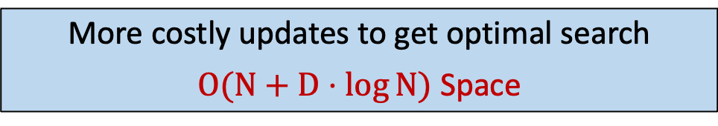
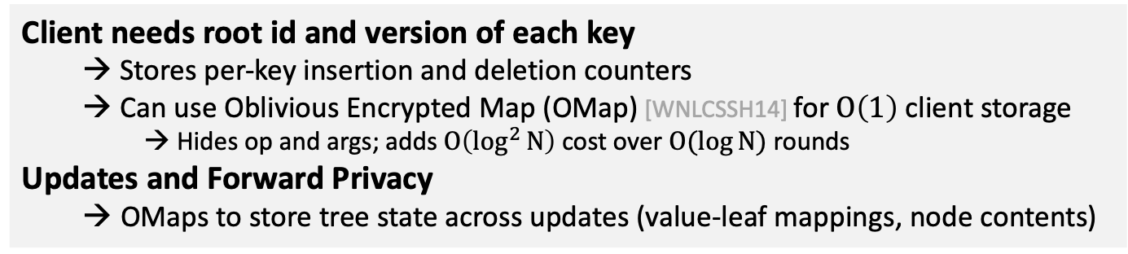
Optimal Search Details
@ H(H( , Key1), id=1-8, ver=2) | v2
Left: id=1-4, ver=2 | Right: id=5-8, ver=0
?
Search(Key1)
Key1
Untrusted
Cloud
Client
Encrypted Search Token
@ H(H( , Key1), id=1-4, ver=2) | v2
Left: id=2, ver=0 | Right: id=3, ver=0
Encrypted Search Token: points to the root
Hash (PRF) of encryption key and search query + root id + root version
→ H( , Key1), id=1-8, ver=2
Client needs root id and version of each key
Stores per-key insertion and deletion counters
Can use Oblivious Encrypted Map (OMap) [WNLCSSH14] for $O\left(1\right)$ client storage
Hides op and args; adds $O\left(\log^{2}{N}\right)$ cost over $O(log{N})$ rounds
Updates and Forward Privacy
OMaps to store tree state across updates (value-leaf mappings, node contents)
1-8 v2
1-4 v2
5-8 v0
5-6 v0
More costly updates to get optimal search
$O(N+D⋅\log{N})$ Space
Key1:
1
2
3
4
5
…
Notes:
Looking at what we had at the end of the previous slide,
[transition]
When the client performs a search, we create an “encrypted search token” to help the server find and traverse the tree.
As we saw in the previous slide, every update goes up to the root, and the root is always fresh.
So, the search token should point to the latest version of the root.
[transition]
The search token contains a hash of the query key to find the specific tree, and the id and version of the root node to find the freshest one.
Also, the encryption key is used in the first part, which is actually a PRF.
[transition]
With this information, the server can find the root of the tree just by calculating another hash.
Now, in order to traverse the tree, the server needs the same information about the root’s children.
[transition]
We embed the id and version of each node in its parent, which is exactly the pointer updates I mentioned before.
[transition]
To create the search token, the client needs the id and version of the root for each key.
The client stores the number of insertions to determine the root, and the number of deletions to know the root’s version.
[transition]
Also, we can use an oblivious encrypted map to store this information on the server and have constant sized client state.
Oblivious maps hide what operations are done and with what arguments but have a cost of log square N over log N rounds.
[transition]
Now, how do we perform our updates while staying forward private?
On a high level, we use an OMap to store what leaf contains what value, and one OMap to store the tree’s topology across deletions.
[transition]
To sum it up, we perform oblivious updates, and in return get optimal search time.
But, as I explained, a part of the cost is requiring super-linear space.
[transition (end of slide)]

Slide 8
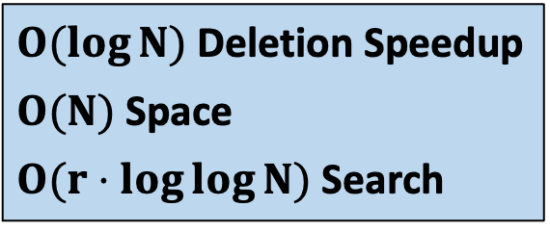
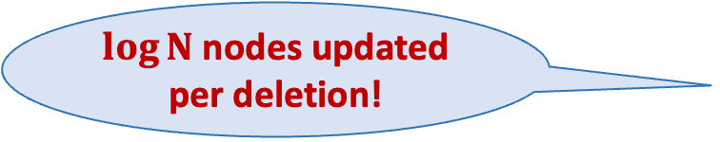

Second Scheme (LLSE)
.
.
.
$\log{N}$ nodes updated per deletion!
OSSE uses $O(N+D⋅log{N})$ space
How to prevent delete propagation?
Idea: Don’t store children’s versions
Binary search for latest node version
Asymptotically and empirically faster than previous State-of-the-Art!
1-8 v2
1-4 v2
5-8 v0
5-6 v0
Key1:
1
2
3
4
5
…
1-8 v0
1-4 v2
5-8 v0
$O(\log{N})$ Deletion Speedup
$O(N)$ Space
$O(r⋅\log{\log{N}})$ Search
5-6 v0
Key1:
1
2
3
4
5
…
Notes:
Now, where did this $D\log{N}$ factor come from?
[transition]
When we delete a value, we must re-write its parents all the way to the root, and we always delete $\log{N}$ nodes to maintain forward privacy.
So how can we prevent this?
[transition]
The idea is simple: by not storing the children’s versions in each node, we only need to re-write the grandparent.
However, this means that we have incomplete pointers.
[transition]
To complete each pointer, we perform a binary search to find the latest version of the node.
[transition]
Our second scheme, called LLSE, is asymptotically and empirically faster than the previous State-of-the-Art, which had a $O(r\log{N})$ search complexity.
Now, let’s finally see some experiments!
[transition (end of slide)]

Slide 9
Experiments
Implemented in C++, using OpenSSL for crypto, AES-NI enabled
Open-source: github.com/jgharehchamani/OS-SSE
compared with the best scheme with cancellation records (SDD) and previous SotA quasi-optimal scheme (QOS) [DGPP20]
Hardware setup: 8-core Intel Xeon E-2174G 3.8Ghz, 128GB RAM, Ubuntu 16.04 LTS
Experiments ran on a single machine
Several optimizations compatible with privacy and leakage profile
Notes:
We implemented our schemes and the competitors in C++, using OpenSSL, with AES-NI enabled, and the code is open-source.
We compared WITH the best cancellation records scheme SDD, and the previous SotA with Quasi-optimal search, QOS.
We ran all experiments on one machine, and finally, we have several optimizations that are compatible with the privacy requirements, and you can read about them in the paper.

Slide 10
Experiment: Search Time
Setup
Search Time vs. Delete Percentage
DB Size = 1M, inserted values = 20K
Deleted uniformly chosen values
SDD: SotA cancellation records scheme
QOS: SotA quasi-optimal search scheme
Notes:
This figure shows search time vs. the percentage of the values that are deleted.
We create a synthetic dataset of 1 million records, with 20 thousand values per key.
The values are then uniformly deleted.
QOS does better search time with more deletions, but SDD, which uses cancellation records, gets slower!
[transition (end of slide)]

Slide 11
Experiment: Search Time
Setup
Search Time vs. Delete Percentage
DB Size = 1M, inserted values = 20K
Deleted uniformly chosen values
SDD: Best cancellation records scheme
QOS: Best quasi-optimal search scheme
Previous SotA
OSSE: Optimal Search Scheme (ours)
OSSE*: OSSE + optimizations
Results
OSSE beats SDD faster than QOS
OSSE beats QOS right off the bat!
Notes:
OSSE beats QOS right off the bat with its optimal search time and becomes faster than SDD at around 55% of deletions.
[transition (end of slide)]

Slide 12
Experiment: Search Time
Setup
Search Time vs. Delete Percentage
DB Size = 1M, inserted values = 20K
Deleted uniformly chosen values
SDD: Best cancellation records scheme
QOS: Best quasi-optimal search scheme
Previous SotA
OSSE: Optimal Search Scheme (ours)
OSSE*: OSSE + optimizations
Results
OSSE beats SDD faster than QOS
OSSE beats QOS right off the bat!
Optimizations bring a very significant boost
Notes:
Finally, the optimized version of OSSE just blows everything away.
Again, I encourage you to read the details of the optimizations in the paper.
[transition (end of slide)]

Slide 13
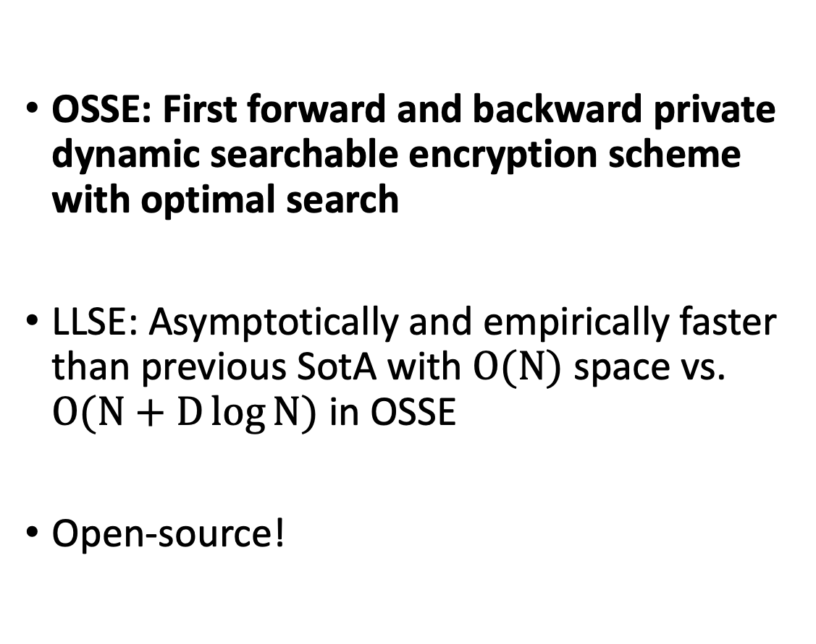
Conclusion
OSSE: First forward and backward private dynamic searchable encryption scheme with optimal search
LLSE: Asymptotically and empirically faster than previous SotA with $O(N)$ space vs. $O(N+D\log{N})$ in OSSE
Open-source!
github.com/jgharehchamani/OS-SSE
Thank You!
akarbas.github.io
Notes:
To conclude,
I presented the first forward and backward private DSE scheme with optimal search, called OSSE.
We also have a second scheme which doesn’t have OSSE’s super-linear storage, and also beats all prior works; the details are in the paper.
Finally, the code is open source.
[transition]
Thank you, and I can take questions now.
[[FAST VERSION]]
I want to mention again that our code is open source.
[transition]
Thank you, and I can take questions now.

Slide 14
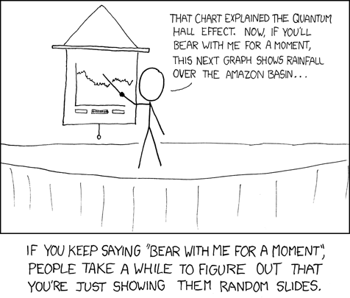
Backup Slides…
https://xkcd.com/365
Notes:
Oops!

Slide 15

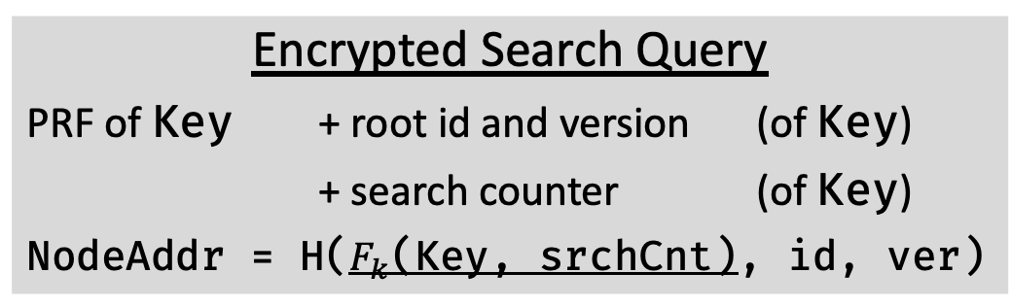


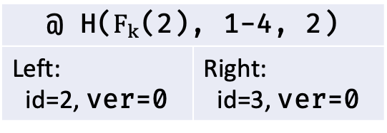

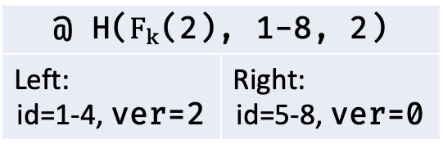

Achieving Optimal Search with Deletions (In Depth)
?
Search(Key1)
Encrypted Search Query
PRF of Key + root id and version (of Key)
+ search counter (of Key)
NodeAddr = H($F_{k}$(Key, srchCnt), id, ver)
Untrusted
Cloud
Client
$$k$$
@ H($F_{k}$(2), 1-8, 2) | v2
Left: id=1-4, ver=2 | Right: id=5-8, ver=0
@ H($F_{k}$(2, 0), 1-8, 2)
Can the cloud read node 6 from
address H(F_k(2), 6, 0)?
1-8 v2
No → Use a ”Search Counter” for each key!
@ H($F_{k}$(2), 1-4, 2) | v2
Left: id=2, ver=0 | Right: id=3, ver=0
@ H($F_{k}$(2, 0), 1-4, 2)
1-4 v2
5-8 v0
5-6 v0
@ H($F_{k}$(2, 0), 2, 0)
@ H($F_{k}$(2, 1), 2, 0)
1
2
3
4
5
6
Search Counter when written:
0 | 0 | 0 | 0 | 0 | 1
Notes:
Search counters!

Slide 16
Experiment: Insert Time
Setup
Insert Time vs. DB Size
OSSE: Optimal Search Scheme
OSSE*: OSSE + optimizations
LLSE: LogLog Search Scheme
SDD: Best cancellation records scheme
QOS: Previous SotA quasi-optimal search scheme
Results
SDD becomes the slowest very quickly
OSSE is always faster than LLSE (1 vs. 2 oblivious encrypted map accesses)

Slide 17
Experiment: Delete Time
Setup
Delete Time vs. DB Size
OSSE: Optimal Search Scheme
OSSE*: OSSE + optimizations
LLSE: LogLog Search Scheme
SDD: Best cancellation records scheme
QOS: Previous SotA quasi-optimal search scheme
Results
LLSE has cancellation record deletion speed and beats previous SotA in search

