Slide 1


Slide 2


Group No. 06
Nihara
Chamodya
Navodi
Gimhani

Slide 3








W hy we need this kind of system ?
W hat do we suggest?
W hat are the objectives ?
H ow we implemented it ?

Slide 4
W hy we need this kind of system ?

Slide 5

Why we need this system?

Slide 6

To identify vaccinated people
We have to identify vaccinated people among a large crowd.
If there is someone who is not vaccinated it is a huge risk for the other people.
ex: consider a shopping mall if a non vaccinated one came it is a huge risk.

Slide 7
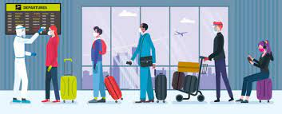
As a solution to a manual system
It is difficult to manage a manual system in this pandemic situation.
In public places it is not easy to continue with manual system as we don’t know who and where be a covid-19 patient.

Slide 8
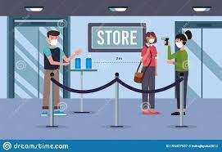
Reduce risk of spreading the virus
In manual checking system the vaccinated cards are exchanging between system.
Indeed that is a high risk of spreading the virus.

Slide 9
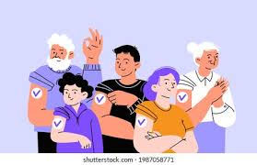
In Sri Lanka it is not still prohibited to go without vaccinating.
But in countries like USA, Italy it is prohibited to go out without vaccinating.
In that case this system will be needed to fight against the covid-19.

Slide 10




W hat do we suggest?
A Sub System
Recommended for which situations

Slide 11


As a Security System …
Only vaccinated people are allowed to let in.

Slide 12






Suitable for Which Situations ?

Slide 13


As a Sub System …

Slide 14


Mathlab Software …
Interactive Graphics
Large library of mathematical functions
Data access and processing
Interactive Environment

Slide 15


Are you excited with this
System ?

Slide 16
W hat are the objectives ?

Slide 18
H ow we implemented it ?

Slide 19
H ow we implemented it ?
GUI
GUI
Codes
Codes
Final Product
Final Product

Slide 20

Let’s run
the program

Slide 21

GUI

Slide 22
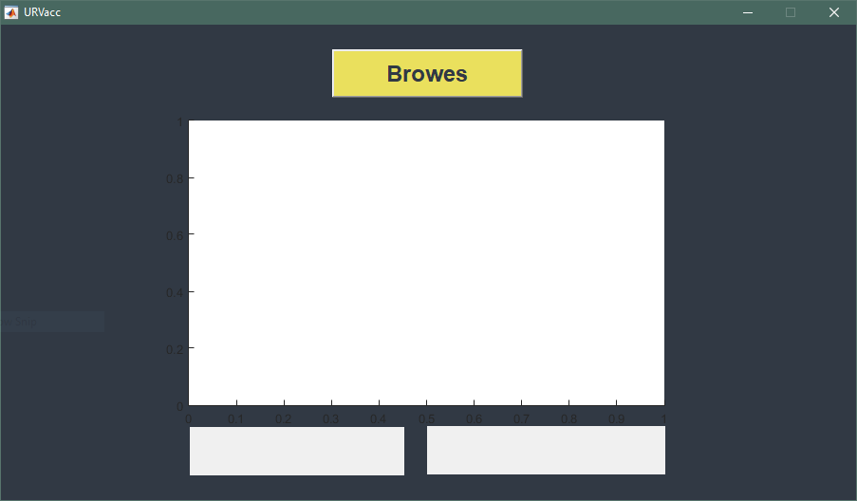
Button
Axes
Text
fields

Slide 23

Codes

Slide 24
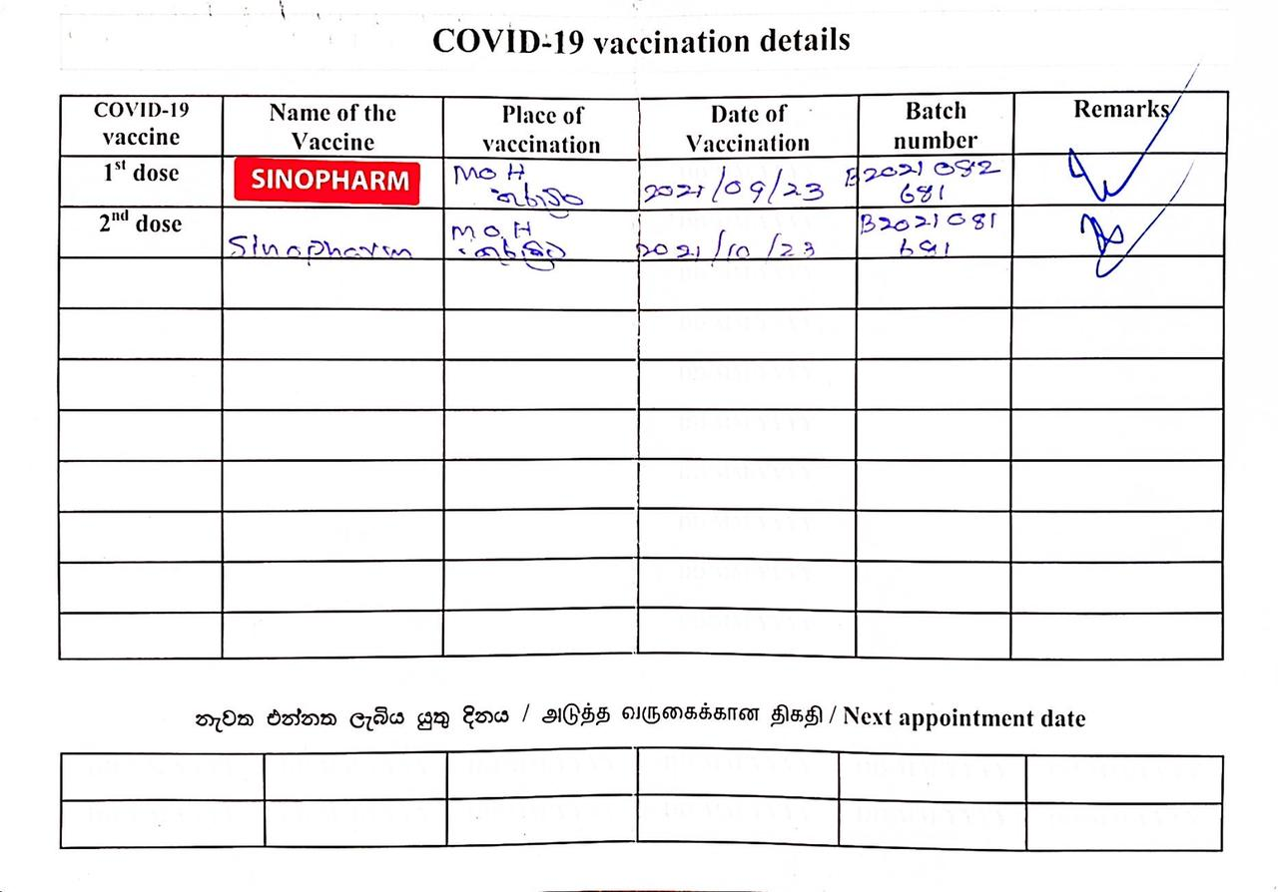
1
Scan the vaccine card

Slide 25
2
Resize the image

Slide 26
3
Crop image

Slide 27
3
Croped image

Slide 28
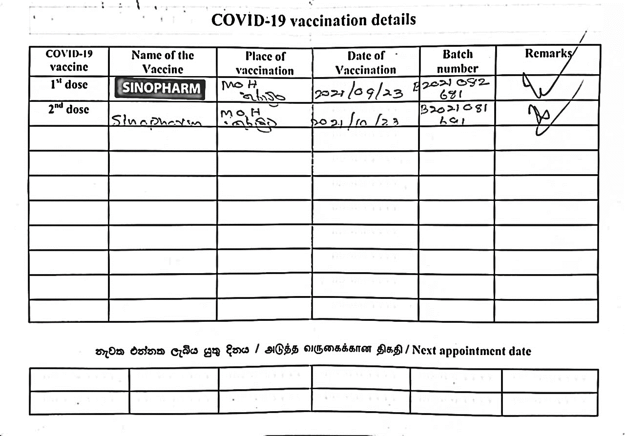
4
Convert to binary image

Slide 29

5
Read each row/column of pixels

Slide 30
5
Read each row/column of pixels

Slide 31
6
Capture table cells which contain with vaccine name

Slide 32
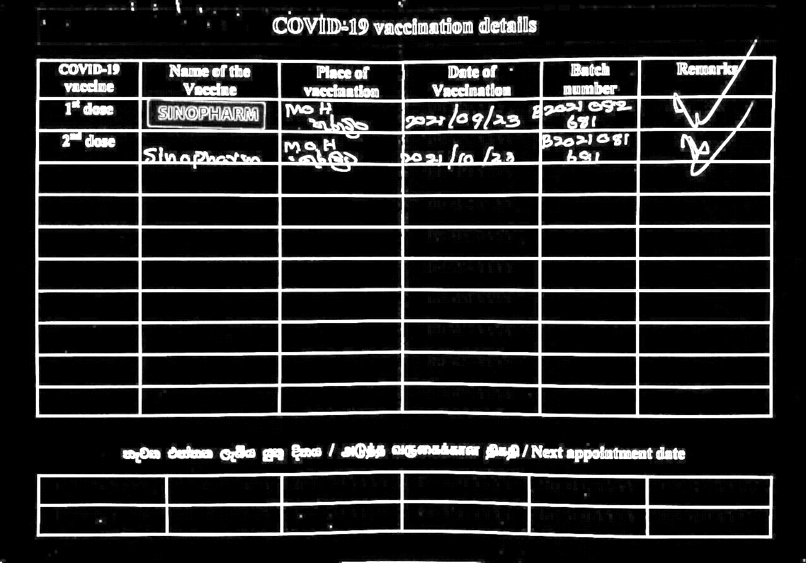
7
Use NOT operator

Slide 33
8
Count objects in each

Slide 34
9
Detect Color

Slide 35

Final Product

Slide 36
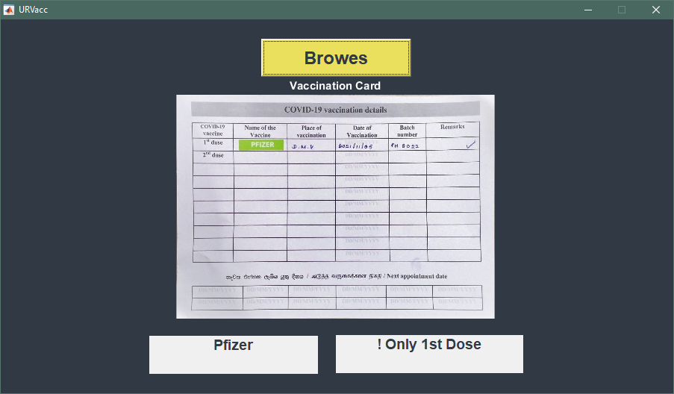

Slide 37


W e are ready to answer your questions ?

