Slide 1


Slide 2


Group No. 06
Nihara
Chamodya
Navodi
Gimhani

Slide 3








W hy we need this kind of system ?
W hat do we suggest?
W hat are the objectives ?
H ow we implemented it ?

Slide 4
W hy we need this kind of system ?

Slide 6
W hat do we suggest?

Slide 8
W hat are the objectives ?

Slide 10
H ow we implemented it ?

Slide 11
H ow we implemented it ?
GUI
GUI
Codes
Codes
Final Product
Final Product

Slide 12

Let’s run
the program

Slide 13

GUI

Slide 14
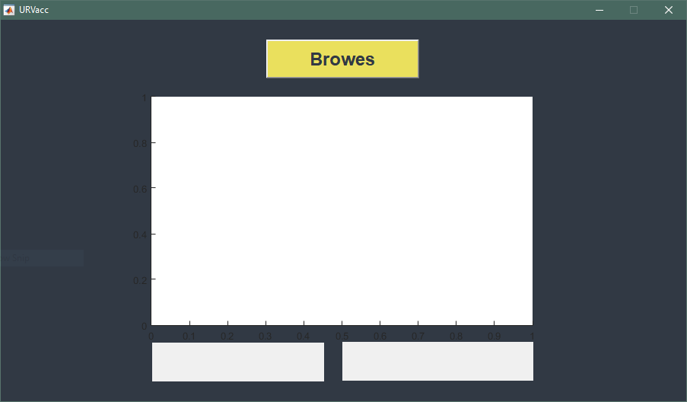
Button
Axes
Text
fields

Slide 15

Codes

Slide 16
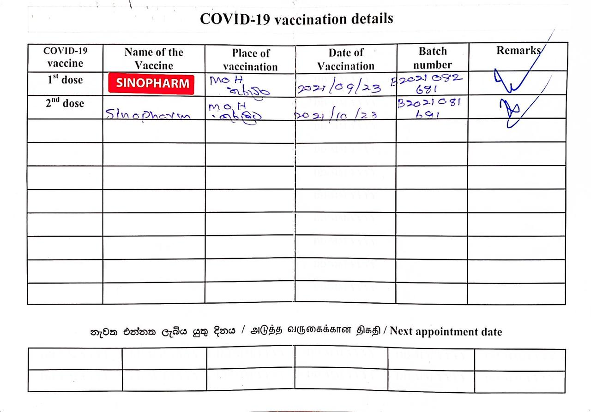
1
Scan the vaccine card

Slide 17
2
Resize the image

Slide 18
3
Crop image

Slide 19
3
Croped image

Slide 20
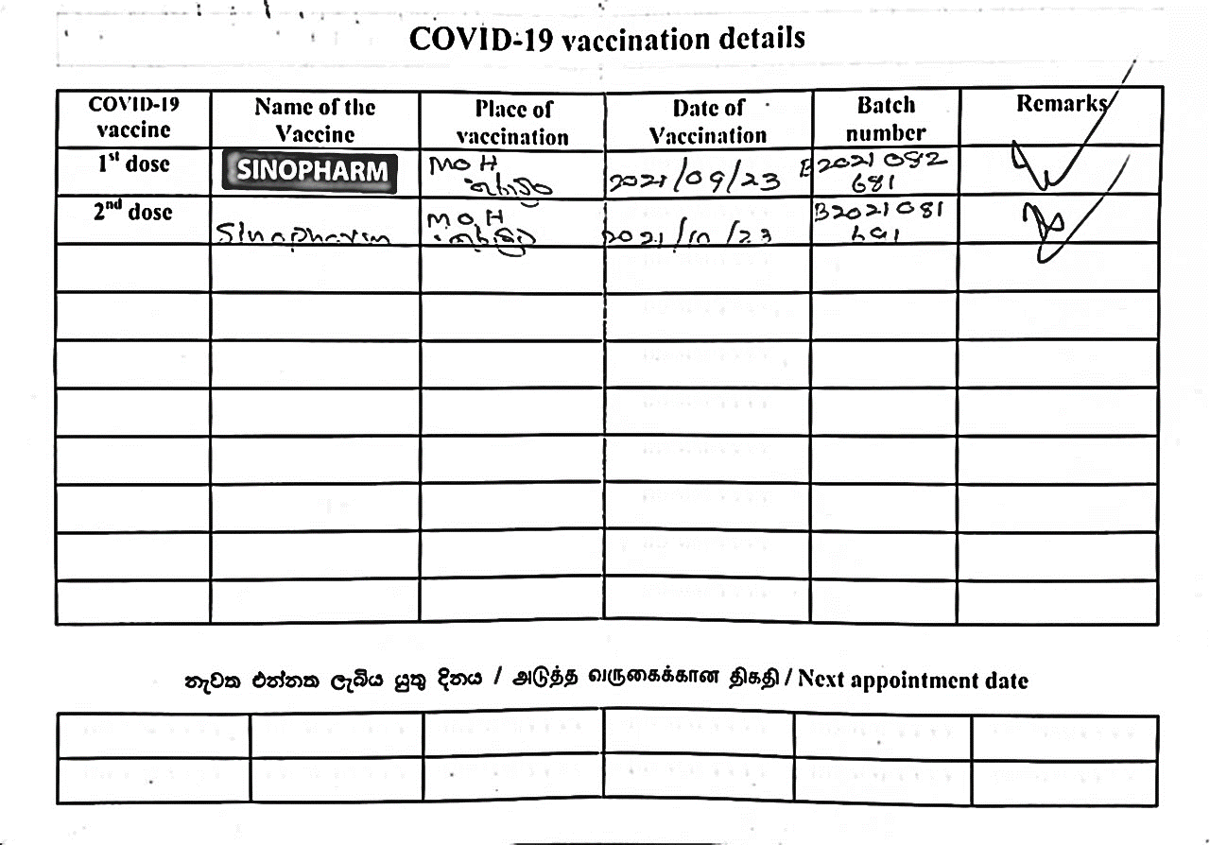
4
Convert to binary image

Slide 21

5
Read each row/column of pixels

Slide 22
5
Read each row/column of pixels

Slide 23
6
Capture table cells which contain with vaccine name

Slide 24
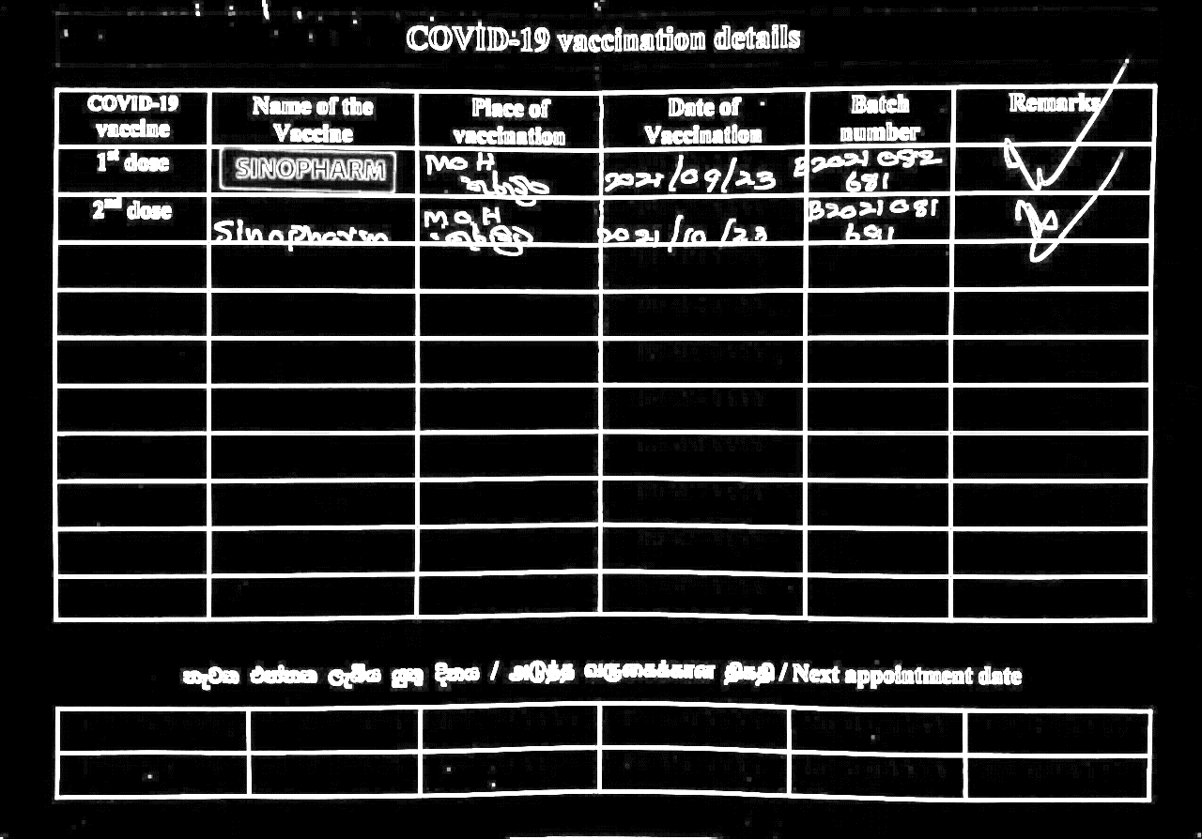
7
Use NOT operator

Slide 25
8
Count objects in each

Slide 26
9
Detect Color

Slide 27

Final Product

Slide 28
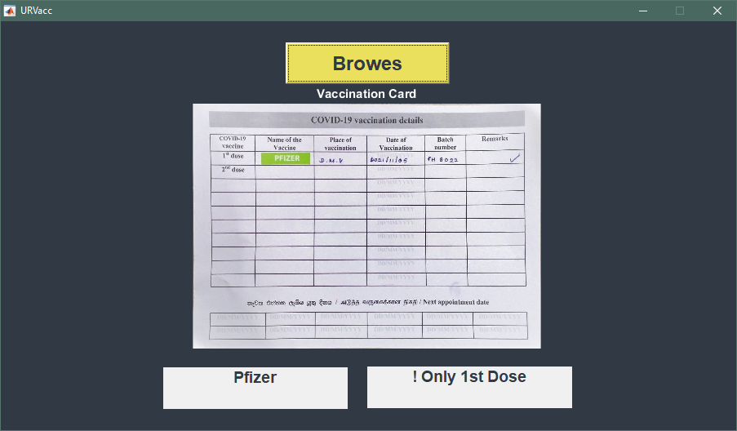

Slide 29


W e are ready to answer your questions ?

