Slide 1
A. Datum Corporation
Azure Cost Optimization Project Results & Next Steps

Slide 2



Agenda
Project Results
Cost Savings
Next Steps

Slide 3
Project Results
Where we started?
Subscription Name | Subscription ID
Azure | db5dc6a8-7519-440a-8c34-34caa0c1027
Azure EU | 515839c7-9de2-46a6-9b92-e5fca2d657c
VBox Cloud Subscription | 06a858d7-ce3e-4192-b149-d3ef1dfeac98
Notes:
Azure Sub (SYNNEX365)
sub-owl-jbi

Slide 4
Project Results
Azure Cost Optimization Project Results
Optimized resources
Backlog of future optimizations
The process of on-going improvements

Slide 5




Project Results
Azure Cost Optimization Project Results
January 2026
February 2026
Change
Average
$164,794.97
$71,772.86
-$93,022.11
↓56.4%
$2,563.32/day
Baseline Period
Comparison Period
Key Performance Indicators (KPI) | Value
# Tasks created | 5
# Tasks completed | 1
# Optimized Resources | 2
Total Savings (Annual) | $354
ROI = 0.5 months

Slide 6
Project Results
Azure Cost Optimization Scope
Recommendation type | # Tasks | # Affected resources
Delete orphaned resources | 1 | 2
Rigthsize Azure AI Search | 1 | 2
Purchase reservations | 1 | 24
Downscale App Service Plans | 1 | 16
Downscale or shutdown Virtual Machines | 1 | 2
Notes:
Azure Sub (SYNNEX365)
sub-owl-jbi

Slide 7
Project Results
Muted Resources (No/Low ROI)
Recommendation type | # Affected resources
Migrate SQL Databases to Azure SQL Databases | 2
Switch to a cost-effective tier for Storage Accounts | 15
Delete unused Public IP addresses | 6
Move resources to cheaper region | 3
Delete orphaned resources | 9
Optimize storage redundancy | 7
Configure pipeline for redeployment of deallocated disks | 4
Notes:
Azure Sub (SYNNEX365)
sub-owl-jbi

Slide 8
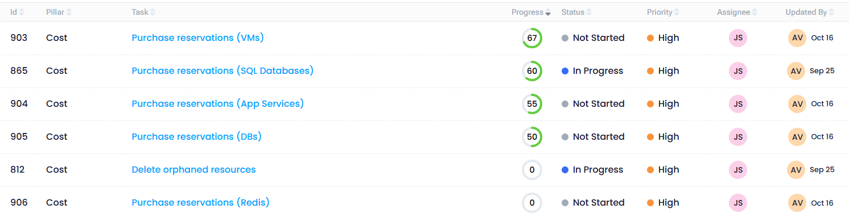
Next Steps
Backlog
Notes:
Azure Sub (SYNNEX365)
sub-owl-jbi

Slide 9
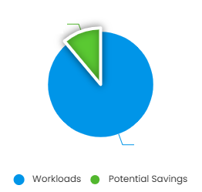
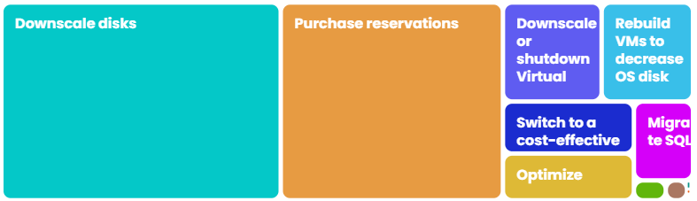
Next Steps
Future Potential Savings
Annual Potential Savings
Current Cost
Optimized Cost
$270,818
14.5%
=
$1,868,452
–
$1,597,633
Estimated annual cost
Cost Recommendations Strategies
10.95%
90.05%
Notes:
Azure Sub (SYNNEX365)
sub-owl-jbi

Slide 10








A Datum Cloud Insights
Cloud Center of Excellence
Cost
Security
Operation
Reduce waste
Improve security depth
Increase observability, reliability & compliance
Potential Savings
Secure Score
Monitoring Coverage
10.95%
47%
64.1%
Tag Coverage
Data Estate Score
Backup Coverage
57.99%
59.8%
62.7%
Budget Utilization
Exposure Score
Policy Compliance
72.3%
81.4%
82.1%

Slide 11
Next Steps
Next Steps:
Consider Litware as CSP
Use vBox for Azure Cloud Mgmt (cost, security, ops)
Discuss Azure Management subscription Service
Questions?

Slide 12
Q&A
Questions?

Slide 13
Visit our site to learn more:
https://www.litware.com

