Slide 1

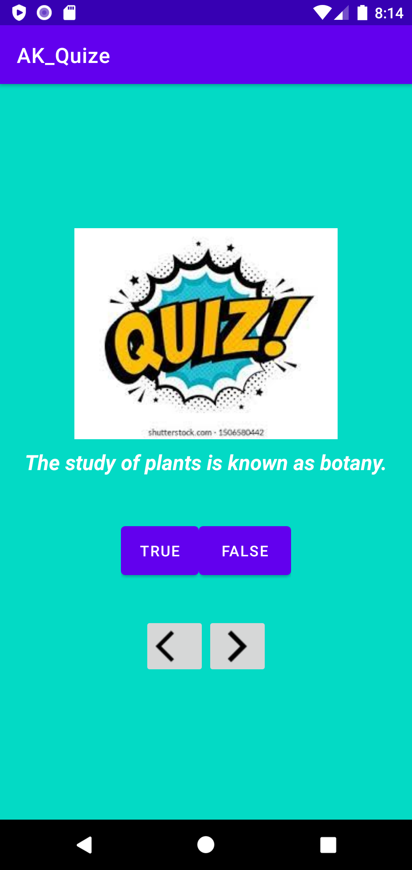

PANIMALAR ENGINEERING COLLEGE
IDEATHON 2022
Team Name: ACFL
Akila Lourdes M.F
III CSE A
akilalourdes@gmail.com
ML‑POWERED ADAPTIVE QUIZ COACH
Personalized practice • Weakness diagnosis • Score prediction
Adaptive exam‑prep app that selects the next question using ML (not fixed order).
Targets weak concepts, keeps difficulty in flow zone, and shows mastery + readiness analytics.

Slide 2
Problem
One-size-fits-all sequencing wastes study time: Most quiz apps use a fixed chapter order or a simple NEXT/PREV flow, so every learner sees the same sequence regardless of background. A student who is weak in fundamentals gets pushed forward too early, while a strong student repeats easy items, both cases lead to unnecessary practice volume with lower learning return.
No true mastery model (only “% correct”): Typical apps track overall accuracy but don’t maintain a reliable topic/skill mastery state. That means the app can’t answer basic questions like: Which concepts are actually weak? Which are improving? Which are uncertain due to few attempts? Without mastery estimates, practice becomes broad and inefficient rather than targeted.
Difficulty mismatch breaks engagement and learning quality: Difficulty labels are often manual and noisy, and fixed difficulty progression doesn’t adapt to the learner. This creates two failure modes:
Too easy: boredom, inflated confidence, low learning gain
Too hard: frustration, repeated failures, higher dropout The app fails to keep users in the productive “challenge zone” where learning is maximized.
No diagnostic + planning layer: Students don’t get topic-wise diagnosis, readiness forecasting, or a personalized study plan. Instead of being told what to do next and why, they must guess: which topics to prioritize, how much practice is enough, and whether they’re on track for the target score, leading to inconsistent preparation and poor retention.

Slide 3
Solution
Adaptive learning loop (closed-loop personalization): Instead of a fixed question order, the app runs a continuous coaching loop after every attempt: the learner answers a question → the system updates the learner’s mastery state (per topic/skill) → it selects the next best question based on weakness and difficulty fit → it delivers instant feedback with the right explanation → and it updates the study plan dynamically. This turns practice into a guided pathway rather than a random or linear quiz list.
Key outputs (what the user actually gets): The system provides practical, decision-making outputs rather than just a score:
- a topic mastery heatmap showing strengths, weaknesses, and progress trends,
- a next-best question chosen to maximize learning gain and maintain the right challenge level,
- an exam readiness score + forecast (predicted score range with confidence and trajectory), and
- a personalized study plan that converts weaknesses into daily practice targets and review schedules (spaced repetition/retention-aware).
Why ML (how it is driven by models, not rules): The adaptivity is powered by three components working together:
- a learner model that estimates mastery/ability over time (e.g., knowledge tracing using BKT/DKT),
- a content model that learns true question difficulty and quality from attempt data (e.g., IRT calibration), and
- a decision policy that recommends the next question by optimizing expected learning gain while enforcing constraints like syllabus coverage, diversity, and avoiding repeats. Together, these enable real personalization that improves as more attempt logs are collected.

Slide 4
Adaptive Learning Flow (Inference‑time)
Instead of a static NEXT/PREV question order, the app runs an adaptive inference loop after every attempt to personalize what comes next.
• Capture rich attempt signals: When the user answers, we log correctness plus time-to-answer, hints used, retry count, and optional confidence. These signals help distinguish “lucky guesses” from true understanding and detect topics where the learner is struggling.
• Update mastery immediately (Knowledge Tracing): The system updates the learner’s topic/skill mastery state using BKT/DKT after each question. This produces an updated mastery probability (and uncertainty) per topic, which becomes the learner’s current knowledge profile.
• Select the next-best question (Decision policy): Using the updated mastery and calibrated difficulty (IRT), the recommender chooses the next question to maximize expected learning gain while keeping difficulty in a productive range (not too easy, not too hard). It also enforces constraints like topic coverage, diversity, and avoiding repeated/near-duplicate items.
• Provide instant feedback + grounded explanations: The app returns immediate feedback and retrieves the most relevant explanations/solutions (and similar examples) based on the skill tag and the learner’s error pattern, so the user learns from mistakes in-context.
• Predict readiness trajectory + adjust the plan: The system estimates exam readiness (score range with confidence) and updates the study plan dynamically, allocating more practice to weak topics, scheduling review for retention, and adapting the daily target based on recent performance trends.
Result: each practice session becomes a personalized coaching loop—attempt → mastery update → next question → feedback → updated plan, improving learning efficiency compared to fixed navigation.
User answers a question (+ time, confidence, hints)
Model updates mastery state (KT: DKT/BKT)
Recommender picks next question (difficulty + topic targeting)
Feedback: explanation + analytics (readiness score & study plan)

Slide 5
ML Architecture & Pipeline
- Question bank + metadata: The system maintains a structured repository of questions where each item is stored with metadata such as topic/skill tags, difficulty level, question type, and solution/explanation. This metadata is essential for filtering questions (avoid repeats), ensuring syllabus coverage, and supporting cold-start personalization before enough user data is collected.
- Telemetry (logs & signals): Every user interaction is logged as anonymized learning signals—correct/incorrect, time-to-answer, hints used, retry count, and optional self-reported confidence. These signals capture not only accuracy, but also effort and uncertainty, which are crucial for estimating mastery and calibrating question difficulty.
- Feature store: Raw telemetry is converted into reusable ML features such as user-topic mastery vectors, rolling performance trends (recent accuracy, speed, streaks), recency/forgetting features, and optionally user/topic embeddings. A feature store enables fast lookups for real-time inference and consistent feature definitions for training.
- Models (core intelligence): The pipeline trains multiple models that work together:
a difficulty estimator / IRT calibration model to learn true question difficulty from real attempts,
a knowledge tracing model (BKT/DKT) to estimate a learner’s mastery per topic over time, and
a recommender (next-best-question policy) to select questions that maximize learning gain while keeping difficulty appropriate and maintaining topic coverage.
- Serving (low-latency inference): Models are deployed behind an inference API that returns the next question, updated mastery summary, and optional reason codes (why this question was chosen). The Android app keeps an on-device cacheof candidate questions and recent user state to reduce latency and support limited offline practice, syncing logs when connectivity is available.
- Continuous improvement loop (Offline training → Online inference): User logs flow into the feature store and are used in offline retraining to improve difficulty calibration, mastery estimation, and recommendation quality. Updated models are pushed to the inference service so the system improves continuously as more learners interact with it.
Offline training → Online inference (continuous improvement loop)
Logs & Signals
Feature Store
Model Training
Model Registry
Inference Service
Android App

Slide 6
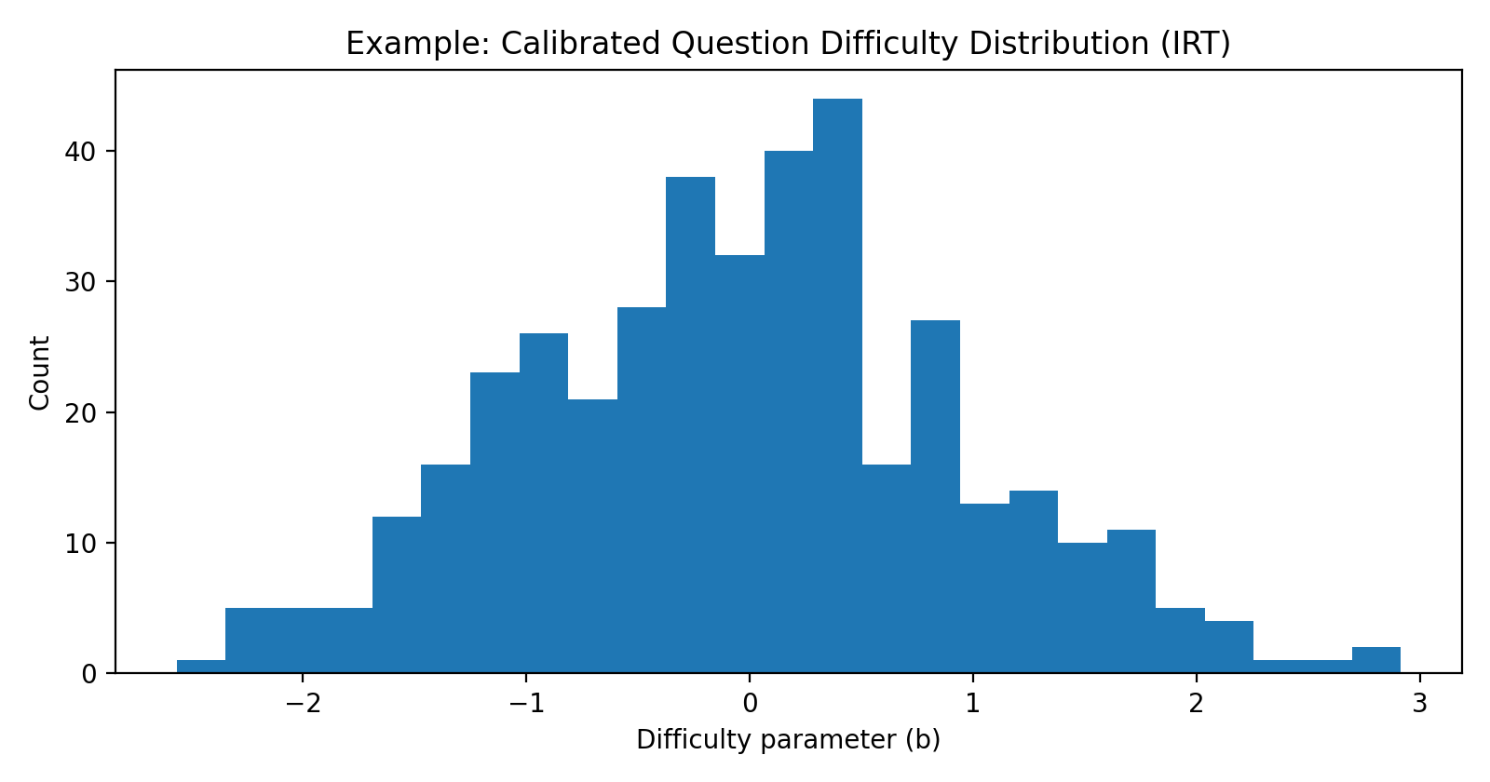
Core ML Models
IRT difficulty calibration:
learner ability θ and item difficulty b → pick flow‑zone items
Knowledge tracing (BKT/DKT):
update mastery per topic after every attempt
Recommendation policy:
bandit/heuristics chooses next‑best question for learning gain
Plot: Difficulty distribution histogram (shows calibrated item difficulty rather than manual guessing)

Slide 7
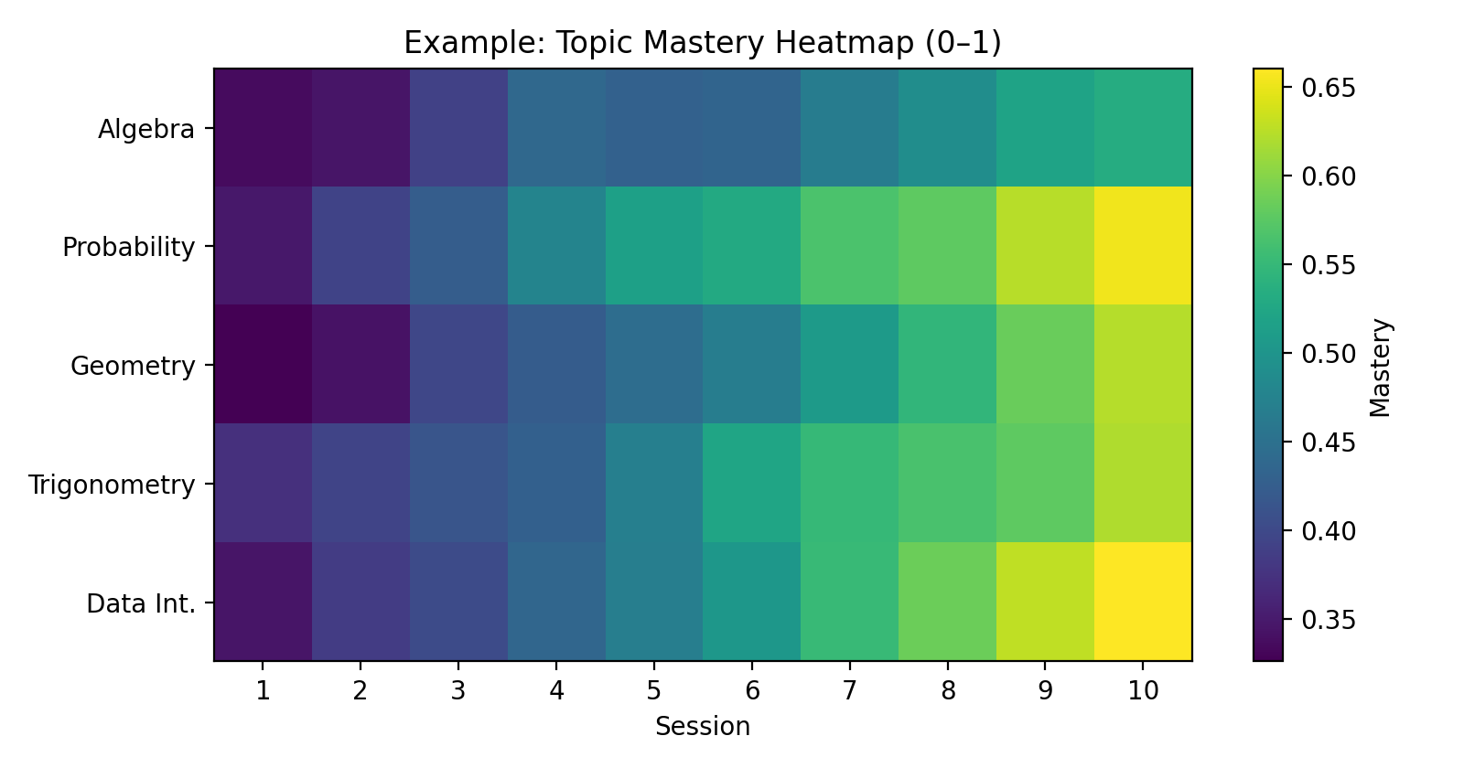
User Experience and Analytics
Topic mastery heatmap: shows strengths/weaknesses clearly.
Readiness score: predicted exam performance + confidence.
Study plan: daily practice targets + spaced review for retention.
Instant feedback: explanation retrieval + similar examples.
Plot: Topic mastery heatmap

Slide 8

Benefits & Impact
Higher efficiency: fewer questions to reach mastery via adaptive selection
Personalized paths: every learner gets a different sequence based on strengths/weaknesses
Better retention: spaced-repetition schedule learned from performance signals
Transparent analytics: topic heatmaps, readiness score, and improvement forecast
Fairness & quality: detect ambiguous items, drift, and cheating patterns from logs
Teacher/coach dashboard: identify class-wide gaps and content that needs re-teaching
Higher engagement: flow-state difficulty reduces frustration/boredom and improves session completion
Stronger explanations: targeted remediation (similar examples + concept notes) based on error patterns
Scalable content growth: auto-tagging and difficulty calibration let new questions be added quickly with consistent quality

Slide 9
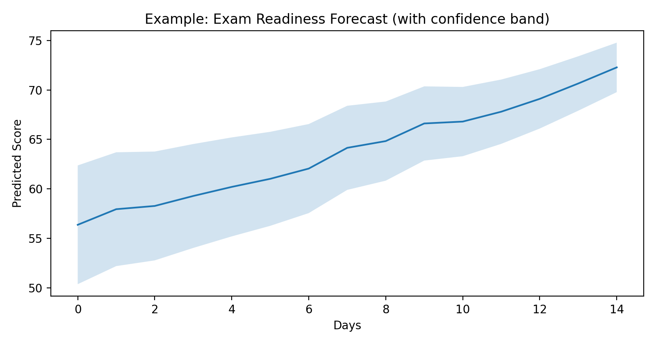
Evaluation and Validation
Offline ML metrics: AUC/log loss, calibration error (ECE), ranking metrics (NDCG@k)
Learning outcomes (most important): A/B test adaptive vs fixed order, pre‑test → post‑test gain, time‑to‑mastery, 7‑day retention
Product metrics: session completion, weekly active practice, drop‑off after wrong answers
Plot: Readiness forecast trajectory with confidence band

Slide 10
Roadmap (Realistic MVP -> V1 -> V2
MVP:
manual tags + difficulty tiers, BKT mastery update, heuristic ranking, basic analytics + study plan
V1:
IRT calibration from logs, bandit policy for next‑best question, question quality scoring
V2:
DKT/Transformer KT (if data supports), NLP auto‑tagging + grounded assistant, controlled question generation (review gated)

