Slide 1

Average Lifespan in A Game of Thrones

Slide 2

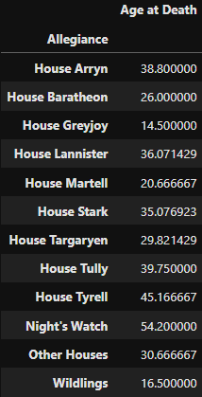
Average Lifespan
The average lifespan of a person in the world of Game of Thrones is about 34 years.
The faction with the longest average lifespan amongst its members is the Night’s Watch.
The faction with the shortest average lifespan is House Greyjoy.

Slide 3
