Slide 1

Likely cause of death
STYLE

Slide 2
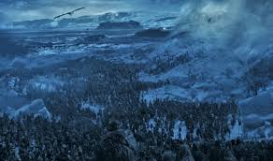
#1. Battle (of Winterfell specifically) 2278 + 1191 = A Lot
3,469

Slide 3
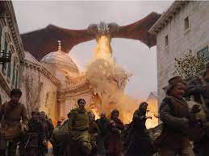

#2 daenarys Targaryen attack on kings landing: 1010 Killed when daenarys Targaryen lost her cool

Slide 4
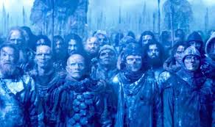
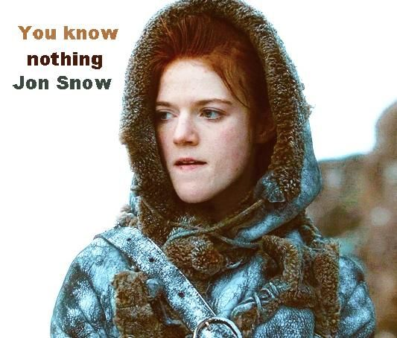
#3 wight walker escapade led by jon snow. 830 killed because dead people were more prepared than jon snow

Slide 5
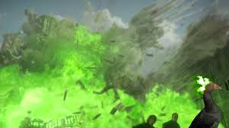
# 4 Cersei’s coup on the great sept of bailor: 198 killed when cersei attacked her son’s wedding guests

Slide 6
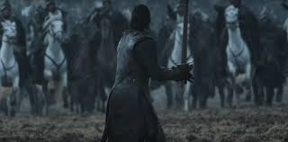
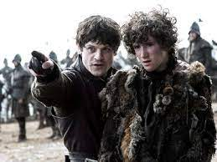

#5 battle of the bastards 168 killed during the battle to take back winterfell. it may have been 167 if someone would have taught rickon stark how to do a proper zigzag

Slide 7


