Slide 1

Data Throne
Kayli Aguilera, Autumn Klepal, Uma Ranganathan, Roland Salazar, Randie Sinclair

Slide 2

About our Data
For this project we had chosen to look at data that contains information on the death of all characters in the series Game of Thrones.
We looked at dangerous areas, types of battles, types of deaths, who had the most kills, and average life spans.
We also look into if allegiances contributed to deaths, and if it is affected by location

Slide 3
Why this topic
We wanted to do this project because it had appealed to us.
It was a chance to put what we learned into a solid project.
We ended up becoming curious about who had so many kills, how did most people die. What was the life span, and so on.
In short this project tickled our brain in the best way possible.

Slide 4
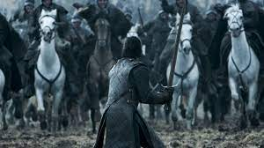
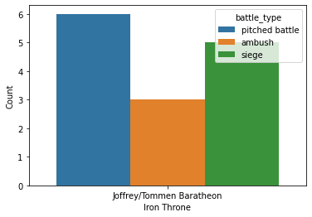
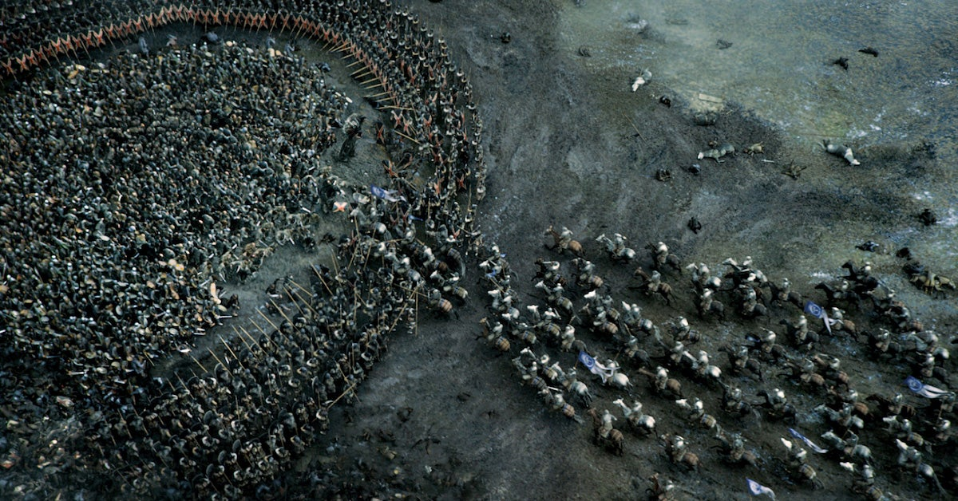
Types of battles
There are three types of battles that were used the most found in the data and those were the pitched, ambushed, and siege tactics.
A pitched battle is a battle that takes place on agreed space.
Ambush is a lie in wait tactic.
A siege is basically a cut off and starve tactic.

Slide 5
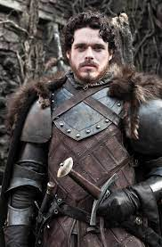
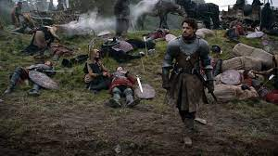
Kings who fight
As a history buff I love seeing how some kings will fight along their men, to support and rally the men for the cause. When looking at the data I had round that Robb Stark had fought along his men the most out of all the other leaders in the series.

Slide 6
My struggles
One of the struggles I had with this project was finding all the information I had wanted and being able to organize it even better. It falls into the user error as I noticed after working I found more information but was not at a spot to jump ship and follow that route.
Organization and with some unforeseen situations that happened, my time was very limited and strained.
Also while searching some data would be inconsistent but it was just taken from the show or the book and not both.

