Slide 1

TOP three Most Dangerous Areas of Westeros
Dataset Source:
Tan, Shelly (2018) data-game-of-thrones-deaths [Data set].
Washington Post/Github.
https://github.com/washingtonpost/data-game-of-thrones-deaths/blob/master/game-of-thrones-deaths-data.csv
Notes:
With this database I researched the top 3 deadliest areas of this world, the top 5 killers in each of those areas, and also the top 5 deaths by allegiance in each of the 3 areas. To clarify, I wanted to know what allegiance it was most dangerous for in each of those areas. If you’ve never seen this show and plan to, turn your volume all the way down right now. Many spoilers ahead!
You may be wondering as I did, who in their right mind took the time to count every single one of the alleged 6,887 deaths over the course of 8 seasons of this show… This insane and wonderful individual is Shelly Tan, a graphics reporter specializing in data visualization, illustrations and pop culture. I wanted to be sure to thank and properly credit her for her efforts.
With a dataset like this, there are so many variables, that a methodology must be established to be able to research and get the results that we seek. Some of the decisions that were made to create this dataset include:
A death is only counted if the character is killed on-screen. UNLESS, the character dies off-screen but the death is confirmed or assumed due to imminent death while on screen. The exception would be prominent off-screen deaths, and prominence is determined mostly by importance to the plot.
Another decision that was made for this dataset was that if a character orders the death of another, the character who does the direct killing receives credit; not the one who orders the kill. But for cases where the direct killer is unidentifiable, like when Cersei Lannister uses the caches of wildfire to blow up the Great Sept of Baelor, the order giver receives the credit.
It is also noted that for big battles such as the Battle of the Bastards, it is often unclear which side a soldier being killed belongs to. Educated guesses were made based on the details like the shape of a helmet a soldier is wearing, along with other things like sigils that can be seen on armor.

Slide 2
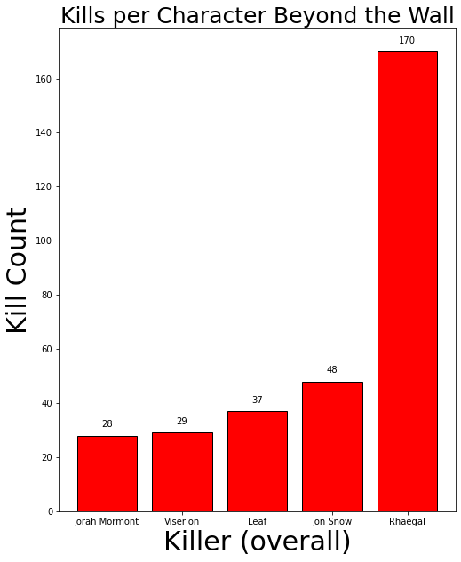
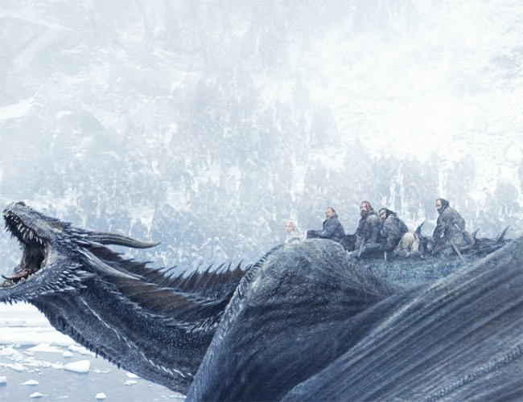
Most dangerous areas Number three
Top five Killers Beyond the wall Overall | Amount of Kills Percentage of Death responsible for overall
5. Jorah Mormont | 28 (%2.82)
4. Viserion (Dragon) | 29 (%2.92)
3. Leaf (Children of the Forest – non-human) | 37 (%3.73)
2. Jon Snow | 48 (%4.83)
1. Rhaegal (Dragon) *pictured* | 170 (%17.12)
beyond the wall
The Wall was a northern boundary erected to protect Westeros from the White Walkers. Beyond that boundary, was the third most dangerous place in the era of Fire and Ice with 993 deaths.
Top five Killers Beyond the wall Individual Humans | Amount of Kills Percentage of Death responsible for overall
5. Beric Dondarrion | 21 (%2.11)
4. Tormund | 22 (%2.22)
3. Benjen Stark | 23 (%2.32)
2. Jorah Mormont | 28 (%2.82)
1. Jon Snow | 48 (%4.83)
Notes:
In my breakdown I made the decision to create two top 5s to separate beings such dragons, and groups such as armies who get kills in masses from individual humans. There was also just curiosity to see who the most dangerous individuals were by breaking it up.
*proceed to data*
Rhaegel was the second deadliest dragon in the shows run, and 170 of his 273 total kills took place Beyond the Wall
Jon Snow is one debatably the main protagonist of the show, and runs up an impressive kill count through a variety of locations all over Westeros. 48 of his 112 total kills were Beyond the Wall

Slide 3
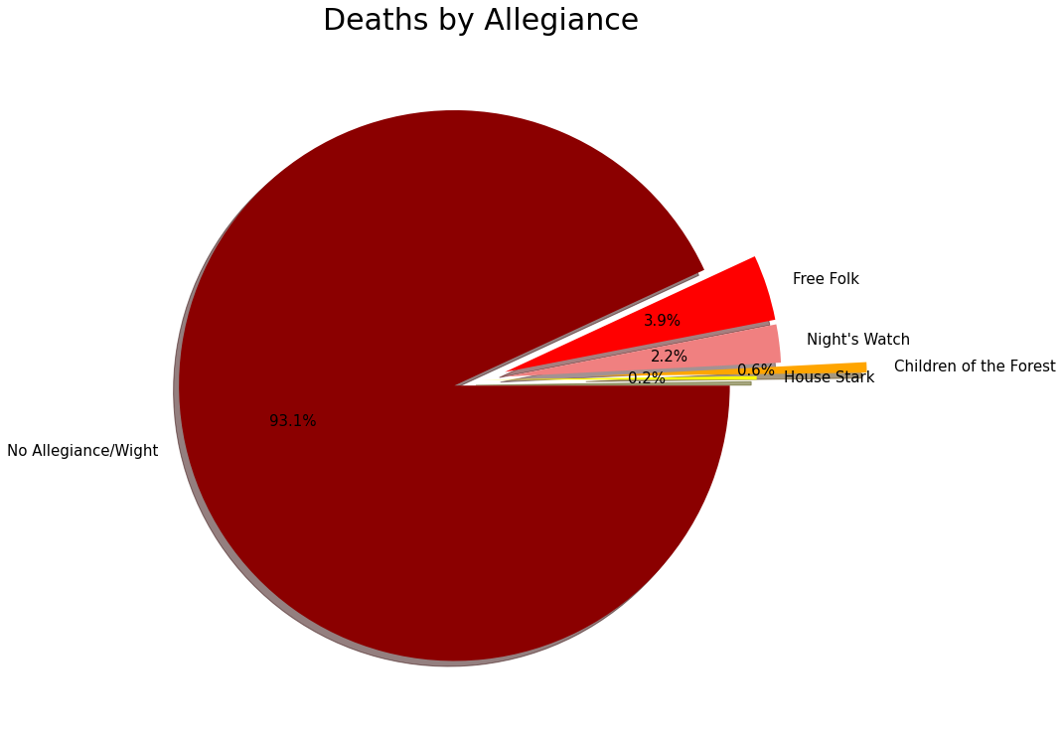
Most dangerous areas per allegiance beyond the wall
Though categorized as having no allegiance, the group that saw the most casualties Beyond the Wall were the Wights. The Wights are groups of undead hordes of reanimated corpses resurrected by the White Walkers. For most of the show, this group was confined beyond the border of The Wall.
Over 800 of these casualties came from a Wight hunt led by Jon Snow, who wanted to capture a Wight to prove the existence of White Walkers and unite the kingdoms against them.
Top five allegiances with most casualties in beyond the wall Overall | Amount of casualties Percentage based off of top 5
5. House Stark | 2 (%0.2)
4. Children of the Forest | 6 (%0.6)
3. Night's Watch | 19 (%2.2)
2. Free Folk | 35 (%3.9)
1. No Allegiance/Wight | 917 (%93.1)
Notes:
Fun facts:
The very first death in Game of Thrones was Beyond the Wall, in the very first episode. Waymar Royce, a Ranger with The Night’s Watch, was killed by a White Walker.
Most death Beyond the Wall was not at the hands of anyone. For example, of the 917 Wights that died Beyond the Wall 421 of them drowned.

Slide 4
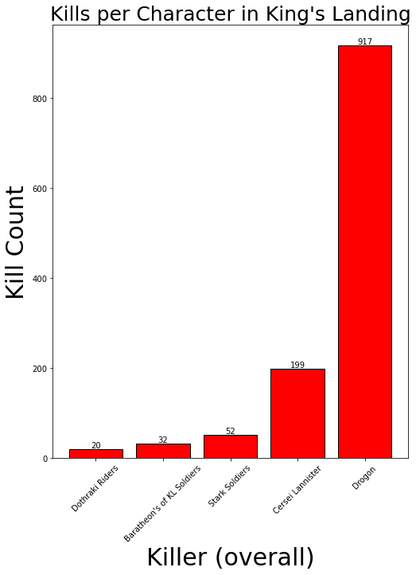
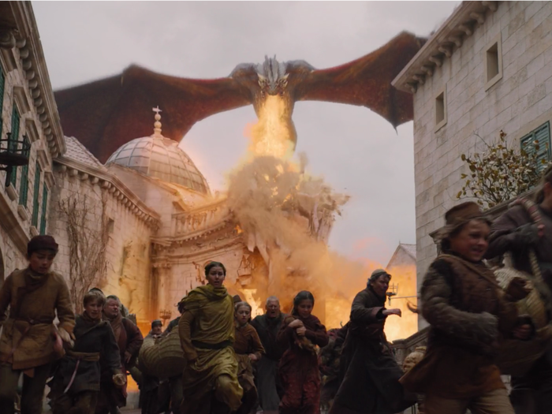
Most dangerous areas Number TWO
Top five Killers Of kings landing Overall | Amount of Kills Percentage of Death responsible for overall
5. Dothraki riders | 20 (%1.47)
4. Baratheon of King’s Landing soldiers | 32 (%2.36)
3. Stark Soldiers (group) | 52 (%3.83)
2. Cersei Lannister | 199 (%14.66)
1. Drogon (Dragon) *pictured* | 917 (%67.58)
KINGS LANDING
King’s Landing was the second most dangerous location during the era of Fire and Ice, as 1,357 people where killed their in that time
Top five Killers Of kings landing Individual Humans | Amount of Kills Percentage of Death responsible for overall
5. Jon Snow | 10 (%0.74)
4. Grey Worm | 14 (%1.03)
3. Sandor “the Hound” Clegane | 14 (%1.03)
2. Bronn | 15 (%1.11)
1. Cersei Lannister | 199 (%14.66)
Notes:
Drogon is the largest and deadliest dragon in the shows run. 917 of his 1,426 total kills took place in King’s Landing
Cersei Lannister was a ruthless but very effective leader who oversaw The Seven Kingdoms. She assumed the throne after tragically losing each of her children, and was the last monarch to sit on the Iron Throne before it was destroyed.

Slide 5
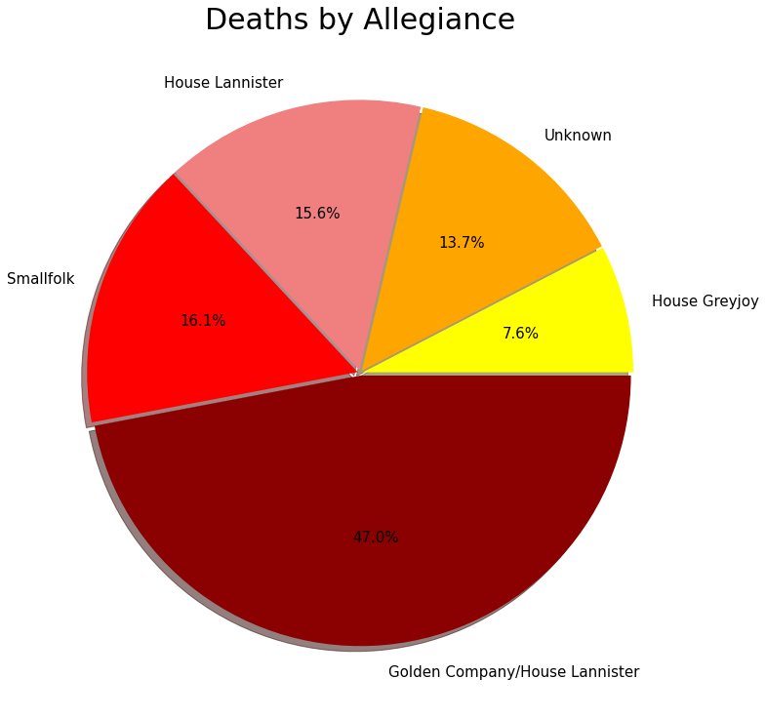
Most dangerous areas per allegiance kings landing
King’s Landing was most dangerous if you were aligned with the Golden Company during the era of Fire and Ice.
The area saw most of it’s casualties when Daenerys unleashed Drogon on the city after she lost everything. The Golden Company, a massive army for hire acquired by Cersei Lannister, was the group most devasted by this attack.
The majority of deaths noted as “Unknown Allegiance” stem from an attack from Cersei Lannister, where she destroyed the Great Sept of Baelor with Wildfire in order to evade her trial and get revenge on her recent enemies.
The
Top five allegiances with most casualties in kings landing Overall | Amount of casualties Percentage based off of top 5
5. House Greyjoy | 92 (%7.6)
4. Unknown Allegiance | 166 (%13.7)
3. House Lannister | 188 (%15.6)
2. Smallfolk | 194 (%16.1)
1. Golden Company/House Lannister | 568 (%47.0)
Notes:
Fun Facts:
King’s Landing is the home of the most amount of deaths of characters who were categorized as most important to the series (16):
Robert Baratheon, Ned Stark, Joffrey Baratheon, Oberyn Martell, Shae, Tywin Lannister, High Sparrow, Loras Tyrell, Margaery Tyrell, Tommen Baratheon, Missandei, Euron Greyjoy, Sandor “The Hound” Clegane, Jaime Lannister, Cersei Lannister, and Daenerys Targaryen
- King’s Landing is the location of the very last death in the series

Slide 6
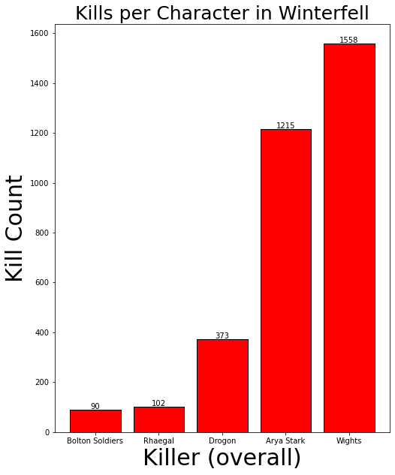
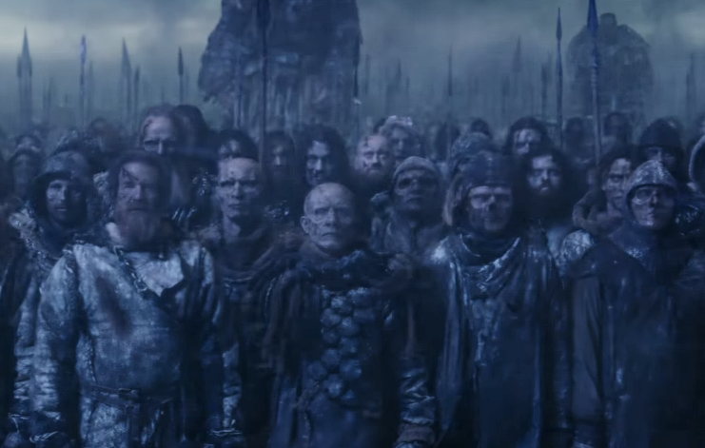
Most dangerous areas Number one
Top five Killers Overall | Amount of Kills Percentage of Death responsible for overall
5.Bolton Soldiers (group) | 90 (%2.43)
4.Rhaegal (Dragon) | 102 (%2.75)
3.Drogon (Dragon) | 373 (%10.06)
2. Arya Stark | 1215 (%33.76)
1. Wight (group) *pictured* | 1558 (%42.01)
Winterfell
Winterfell was far and away the deadliest location in Westeros during the era of Fire and Ice. It was the place of death for 3,709 people
Top five Killers Individual Humans | Amount of Kills Percentage of Death responsible for overall
5. Tormund | 21 (%0.57)
3/4. Then Greyjoy | 26 (%0.7)
3/4. Jorah Mormont | 26 (%0.7)
2. Jon Snow | 35 (%0.94)
1. Arya Stark | *1215 (%33.76)
*When Arya slayed the Night King, every being that the Night King resurrected died as a result and credit for each death was given to Arya which skews the data.
Notes:
- If we remove all death connected to the Night King’s slaying, Arya drops to #4 with only 24 kills
- The Wights led by the Night King and White Walkers descended on Winterfell in search of Bran Stark to kill him. They were met by several forces to stand against them starting one of the largest battles of the show, hence the most kills in Winterfell

Slide 7
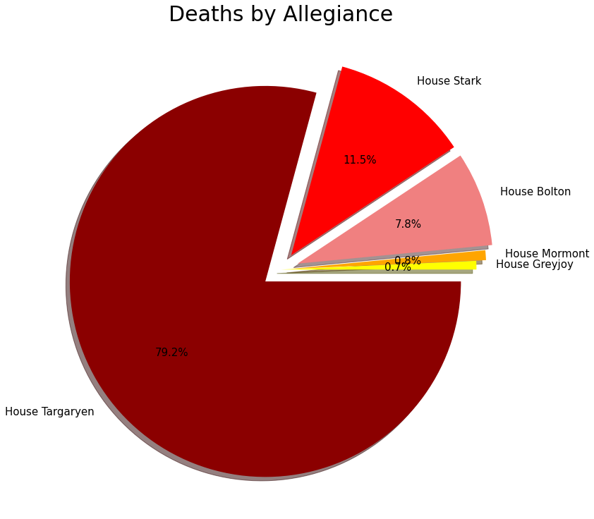
Most dangerous areas per allegiance Winterfell
Winterfell was most dangerous if you were aligned with House Targaryen during the era of Fire and Ice.
Almost all deaths aligned with House Targaryen came from the final battle of Winterfell. The casualties where primarily comprised of Dothraki riders, and the Unsullied.
It is unfortunate that Winterfell was second most Deadly for House Stark, as Winterfell is their home.
Top five allegiances with most casualties in winterfell Overall | Amount of casualties Percentage based off of top 5
5. House Greyjoy | 7 (%0.7)
4. House Mormont | 8 (%0.8)
3. House Bolton | 77 (%7.8)
2. House Stark | 113 (%11.5)
1. House Targaryen | 781 (%79.2)
Notes:
Winterfell is the home of the second most amount of deaths of characters who were categorized as most important to the series (10):
Stannis Baratheon, Roose Bolton, Rickon Stark, Ramsay Bolton, Petyr Baelish, Theon Greyjoy, Night King, Viserion (Wight), Jorah Mormont, Melisandre “Red Woman” of Asshai
Arya Stark is responsible for 3 of those 10 kills

Slide 8
Additional Analysis
Some of the kill count numbers may seem low, please remember only on-screen deaths are counted
Jon Snow on each of the 3 most dangerous places, top 5 individual killers list
The most dangerous group was the Wights amassing 1,602 kills
The most dangerous non-human was Drogon, credited with 1426 kills
The most dangerous individual was Arya Stark if we count everyone that perished with the death of the Night King. If we decide not to count those kills, Cersei Lannister is the most dangerous individual human in Game of Thrones

Slide 9

questions?

