Slide 1
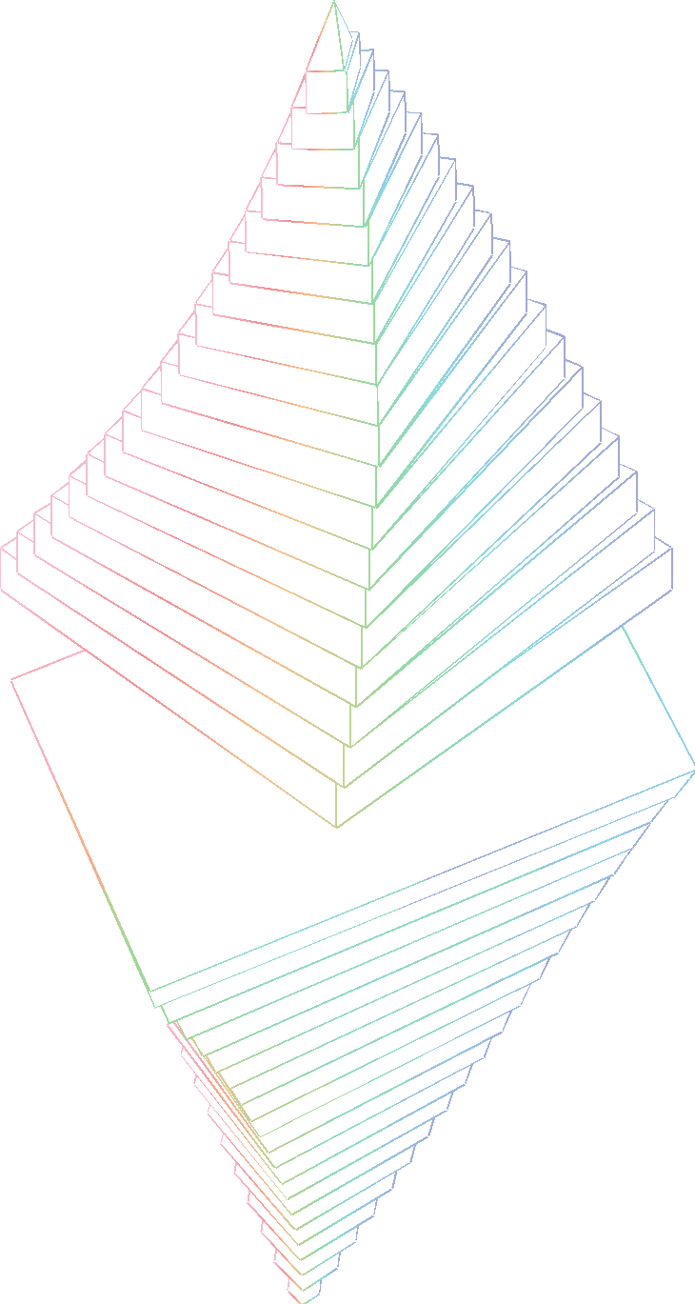


SWARM Distributed storage platform
Marcin Rabenda

Slide 2



Blockchain and State data on Swarm
Incentivised bandwidth sharing
Hosting
Anonymous browsing
Feeds
Encryption
Real-time dark messaging
Trustless service networks
Spam protection
Access control
Database services
Sharing
Data transfer
Dropbox services
Incentivised and Insured storage

Slide 3

Swarm
Swarm is a distributed storage platform and content distribution network, a native base layer service of the Ethereum web3 stack.

Slide 4
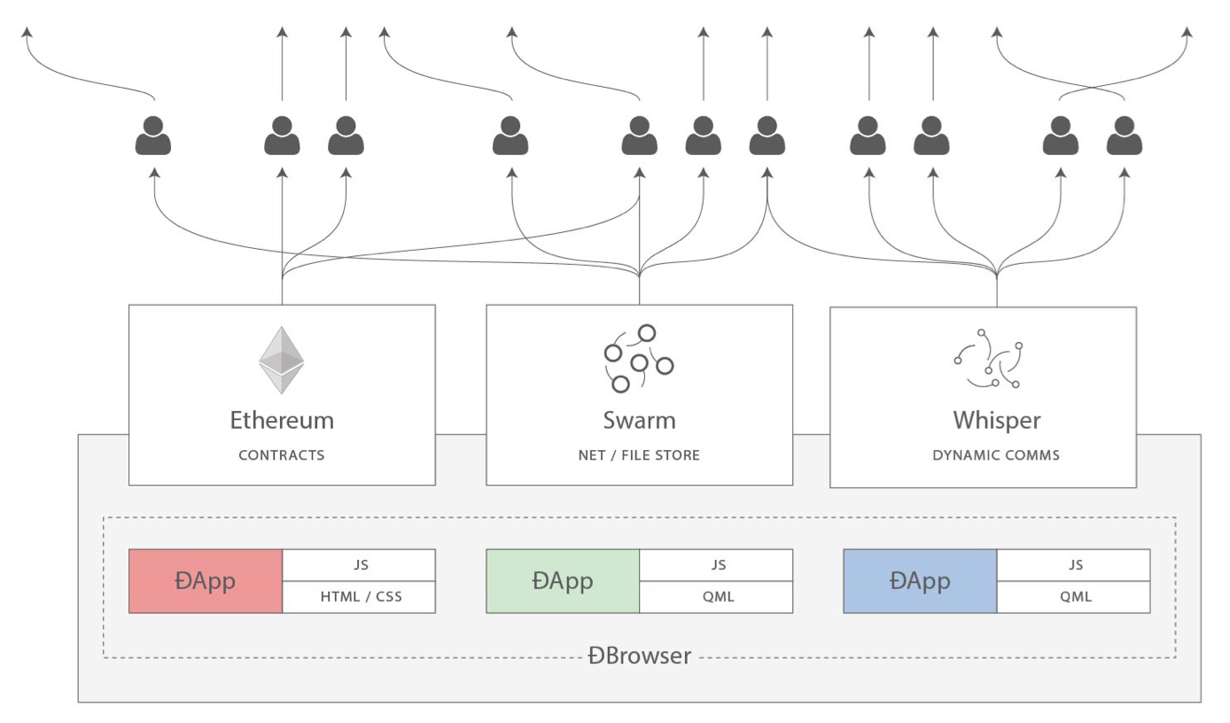
Holy trinity

Slide 5
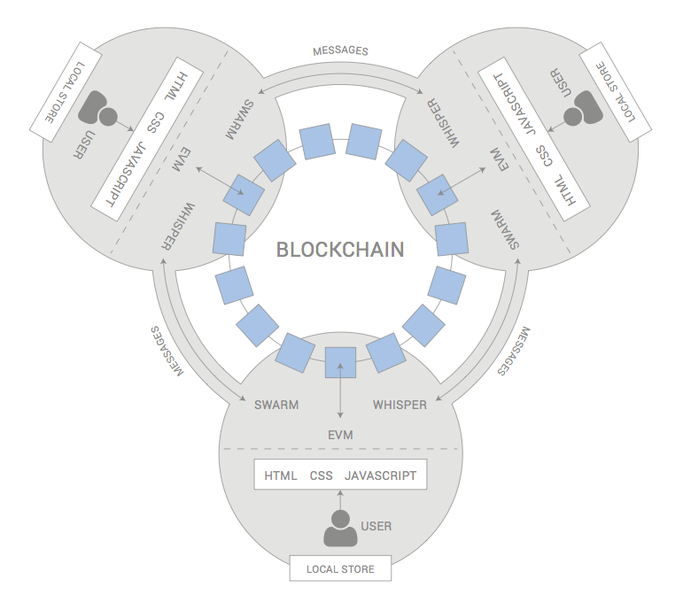
Holy trinity

Slide 6
Swarm home
devcon iv

Slide 7
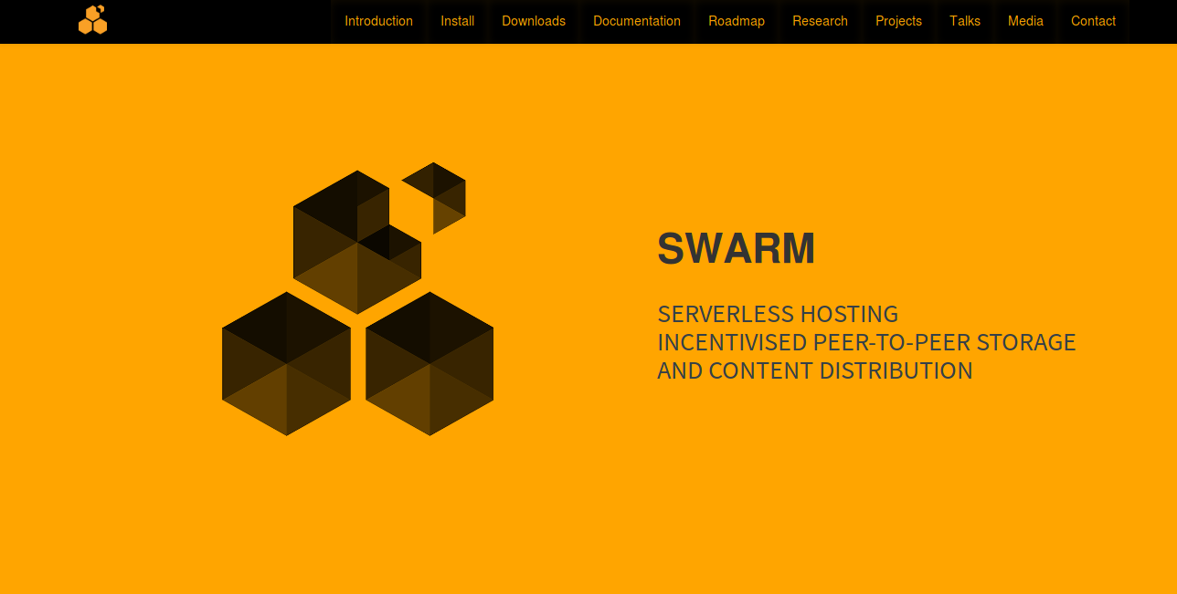
swarm.ethereum.org
Notes:
Announce easy-to-remember URL

Slide 8
bzz://theswarm.eth
devcon iv

Slide 9
Team Updates
devcon iv

Slide 10
Swarm Team Updates
Feeds - Updating content & Social DApps building blocks
Encryption - Storing private data in Swarm Access Control - Managing permissions for Swarm hosted content
PSS - Using the Swarm network for communication
Light Node - Supporting mobile clients
Roadmap - More goodies on the way

Slide 11
Swarm Feeds
devcon iv

Slide 12
Swarm feeds
Pub/sub system:
post updates about a topic
read other people's updates about a topic
retrieve older posts
devcon iv

Slide 13
Swarm feeds
A key-value store, where:
Each user can only write to their own key space
read yours and other users' key space
retrieve older versions of the value for a key.
devcon iv

Slide 14
Swarm Feeds - applications
alter content in Swarm without ENS
enable DApps to persist content easily
Use in communication protocols
IoT data feeds
devcon iv

Slide 15
Swarm Feeds - Posting to / reading a Feed
To post to a Swarm Feed, you need two things:
A private key/address pair to sign your update.
The topic of your post
To read a Swarm Feed you need to know:
The user's ethereum address
The topic under which the user is posting
(Optional) if interested in older posts, the timestamp to look up
devcon iv

Slide 16


Swarm Feeds - Example
TODAY:
Topic | User 0xAAAA… | User 0xBBBB… | User 0xCCCC…
avatar
local-weather | “sunny” | “cloudy”
website |  | 0xbacde124… | 0x9876533…
Thus, QueryFeed(0xAAAA, “avatar”) ->
QueryFeed(0xBBBB, “local-weather”) -> “cloudy”
devcon iv

Slide 17
Swarm Feeds - Example
THE NEXT DAY...:
Topic | User 0xAAAA… | User 0xBBBB… | User 0xCCCC…
avatar
local-weather | “sunny” | “rainy”
website |  | 0x12345678… | 0x9876533…
QueryFeed(0xAAAA, “avatar”) ->
QueryFeed(0xAAAA, “avatar”, YESTERDAY) ->
QueryFeed(0xBBBB, “local-weather”, YESTERDAY) -> “cloudy”
devcon iv

Slide 18
Swarm Feeds - ENS and Swarm-hosted websites
before:
Register hash of content manifest (output of swarm up) on ENS
Update ENS with hash of a new content manifest (requires another transaction)
mysite.eth
ENS
Content-manifest (JSON)
Content
mysite.eth
ENS
Content-manifest (JSON)
Content
New Content-manifest (JSON)
New content
devcon iv

Slide 19
Swarm Feeds - ENS and Swarm-hosted websites
With Swarm feeds:
Register hash of feed manifest (output of swarm feed create) on ENS
To update: simply post to the feed the hash of the new content manifest
mysite.eth
ENS
Feed manifest (JSON)
Content-manifest (JSON)
Content
mysite.eth
ENS
Feed manifest (JSON)
Content-manifest (JSON)
Content
New Content-manifest (JSON)
New content
devcon iv

Slide 20
More info & API documentation:
https://swarm-guide.readthedocs.io/en/latest/usage/feed.html
devcon iv

Slide 21
Encryption in Swarm
devcon iv

Slide 22
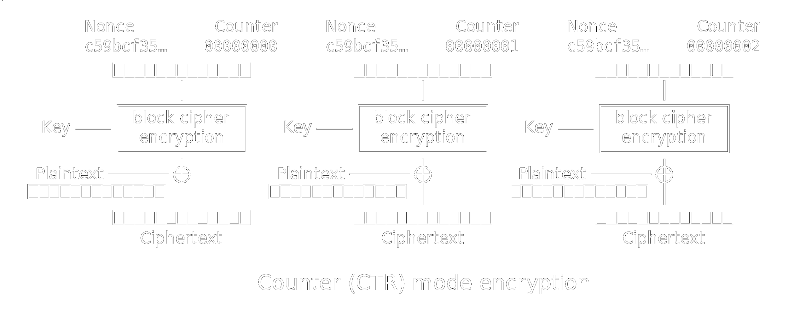
CTR Encryption in Principle (from Wikipedia)
devcon iv

Slide 23
Swarm Content Encryption as Implemented
key
counter
SHA3
SHA3
plaintext
+
ciphertext
devcon iv

Slide 24
Swarm Content Encryption in Practice
References: Ciphertext Hash + Decryption Key (64 bytes in total)
API unchanged except for reference size
Cryptographic assumption: security of SHA3
Smart contract friendly
devcon iv

Slide 25
Access Control in Swarm
devcon iv
Notes:
Over the last year we introduce a lot of observability and monitoring tools within Swarm.

Slide 26
Access control in Swarm
Swarm now supports restricting access to content through several access control strategies
Ultimately,
read access corresponds to the ability to decrypt,
write access corresponds to the ability to register.
devcon iv

Slide 27
Access control strategies in Swarm
pass Any user that knows the passphrase can access the content
pk For an undisclosed party - only one grantee can access the content using private key
act For a number of undisclosed parties (with passphrases or key-pairs) - every grantee can access the content.
devcon iv

Slide 28
ACT properties
No information leaked beyond upper bound on # of grantees
Parties with revoked access cannot read updates
Changing ACT does not require re-encryption of content
Changing the content does not require modifying ACT
Granting access is an O(log n) operation
Revoking access is an O(n) operation
Possibly different ACT for each file and/or directory
devcon iv

Slide 29
Accessing content which is access controlled is enabled only when using a local Swarm node.
devcon iv

Slide 30
NEVER (!!!) use an external gateway to upload or download access controlled content as you will be putting your privacy at risk!
devcon iv

Slide 31
PSS
devcon iv

Slide 32

Postal Services over Swarm
Reuse routing for messaging
Efficiency over secrecy
All nodes take part
devcon iv

Slide 33

Postal Services over Swarm
Reuse routing for messaging
Efficiency over secrecy
All nodes take part
devcon iv

Slide 34

Postal Services over Swarm
Reuse routing for messaging
Efficiency over secrecy
All nodes take part
devcon iv

Slide 35
Light Node
devcon iv

Slide 36
Light node - mobile support
Low-bandwidth
Short on disk storage
Volatile uptime (high churn for network)
Restricted access / interprocess comms
Platform requirements
Permission issues
devcon iv

Slide 37
Light node - solutions
Gateways - Metamask, Infura
Private gateways - DappNode
Light mode of operation - Status
Light requests - Native
Swarm in the browser?
devcon iv

Slide 38
Light nodes are same but different
Not dialled, not saved
Not syncing storing chunks
Not serving retrieve requests
Not counted in local neighbourhood
Forwarding pss messages?
devcon iv

Slide 39
Light mode requests
Outsourcing domain name resolution
Manifest path resolution
Range queries, partial access
Erasure coding and insurance
Encryption / decryption (private remote node)
devcon iv

Slide 40
Roadmap
devcon iv

Slide 41
Coming up next...
Incentivised bandwidth (SWAP) - at least testnet
Spam protection (proof of burn)
Erasure Coded content
devcon iv

Slide 42
Also on the roadmap
Storage Guarantees and Insurance
Swap, Swear, Swindle - contract suite developed by Ralph Pilcher (RIAT); Go API to be built
Databases on Swarm
better JavaScript support
other language bindings
devcon iv

Slide 43
New release process
devcon iv

Slide 44

Swarm and Geth are on the same release cycle
Swarm lives in the same Github repository as Geth
devcon iv

Slide 45
Swarm and Geth are on the same release cycle
Swarm lives in the same Github repository as Geth
Whenever there is a Geth release, there is a Swarm release
devcon iv

Slide 46
Swarm and Geth are on the same release cycle
Swarm lives in the same Github repository as Geth
Whenever there is a Geth release, there is a Swarm release
Whenever there is a Swarm release, the nodes at swarm-gateways.net are updated to the newest version
devcon iv

Slide 47
Swarm and Geth are on the same release cycle
Swarm lives in the same Github repository as Geth
Whenever there is a Geth release, there is a Swarm release
Whenever there is a Swarm release, the nodes at swarm-gateways.net are updated to the newest version
Swarm is under heavy development, and breaking changes can and do happen.
Always stay up to date. Install latest release.
devcon iv

Slide 48
Swarm and Geth are on the same release cycle
Always stay up to date. Install latest release.
devcon iv

Slide 49
Installation
devcon iv

Slide 50
Installing Swarm is easier than ever
devcon iv

Slide 51
Installing Swarm is easier than ever
From Source
Swarm is now in the same repository as Geth. github.com/ethereum/go-ethereum
devcon iv

Slide 52
Installing Swarm is easier than ever
From Source
Download binaries
Swarm is now in the same repository as Geth. github.com/ethereum/go-ethereum
Available on the new Downloads page (via swarm.ethereum.org)
bzz://theswarm.eth/downloads/
devcon iv

Slide 53
Installing Swarm is easier than ever
From Source
Download binaries
Swarm is now in the same repository as Geth. github.com/ethereum/go-ethereum
Available on the new Downloads page (via swarm.ethereum.org)
bzz://theswarm.eth/downloads/
Ubuntu Repositories
Ubuntu users can simply use the PPA (ppa:ethereum/ethereum) to install sudo apt install ethereum-swarm
devcon iv

Slide 54
Installing Swarm is easier than ever
From Source
Download binaries
Swarm is now in the same repository as Geth. github.com/ethereum/go-ethereum
Available on the new Downloads page (via swarm.ethereum.org)
bzz://theswarm.eth/downloads/
Ubuntu Repositories
Docker
Ubuntu users can simply use the PPA (ppa:ethereum/ethereum) to install sudo apt install ethereum-swarm
Official Swarm docker images are available at ethdevops/swarm docker pull ethdevops/swarm:latest
devcon iv

Slide 55
Summary
devcon iv

Slide 56
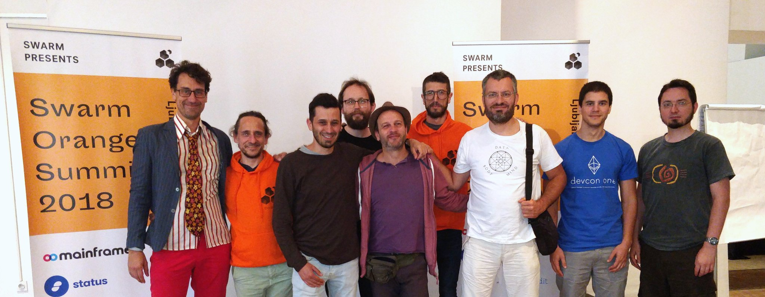
The Team at Swarm Orange Summit 2018
devcon iv

Slide 57
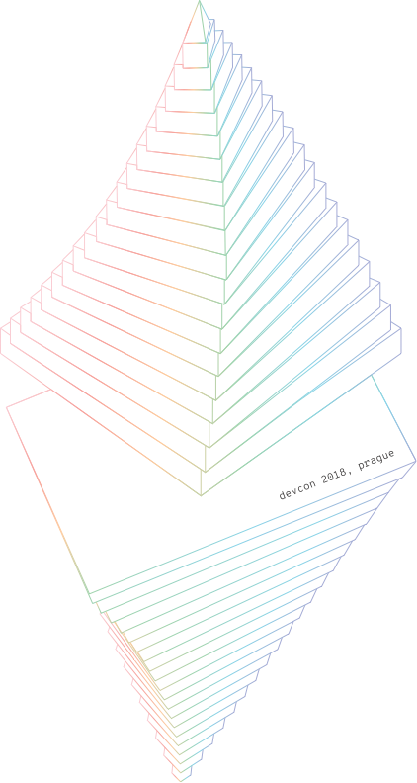
Contact Us
swarm.ethereum.org
twitter.com/ethswarm
reddit.com/r/ethswarm
gitter.im/ethereum/swarm
swarm@ethereum.org

