Slide 1

Detecting Handwritten Numbers using Multilayer Perceptron

Slide 2


Project Overview
Data | 60,000 training images and labels 10,000 testing images and labels
Data Source | https://www.kaggle.com/datasets/warisali2/mnist-database-of-handwritten-digits
Aim | Predict the correct number from handwritten image
Method | Artificial neural network, multilayer perceptron
Model | Keras Sequential model
Python libraries | Keras, Tensorflow

Slide 3
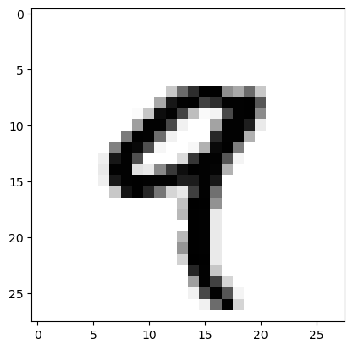
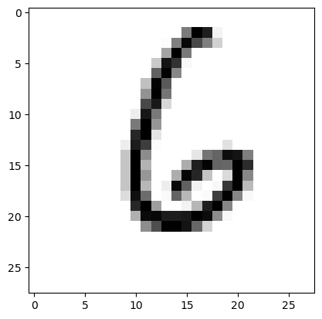
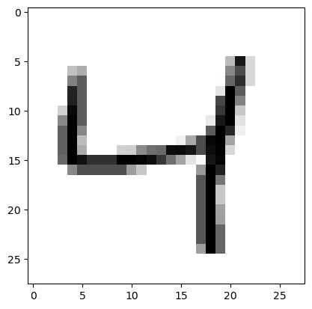
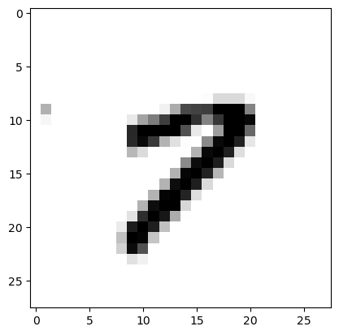
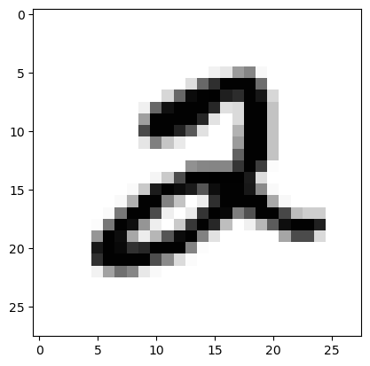
Data Overview
Training
Validation
Testing
12,000
60,000
10,000
[ 9, 6, 4, 1, 2 ]

Slide 4

Data Preprocessing - Images
(28, 28, 1)

Slide 5
Data Preprocessing - Labels
array([5, 0, 4, 1, 9, 2, 1, 3, 1, 4])
One Hot Encoding

Slide 6
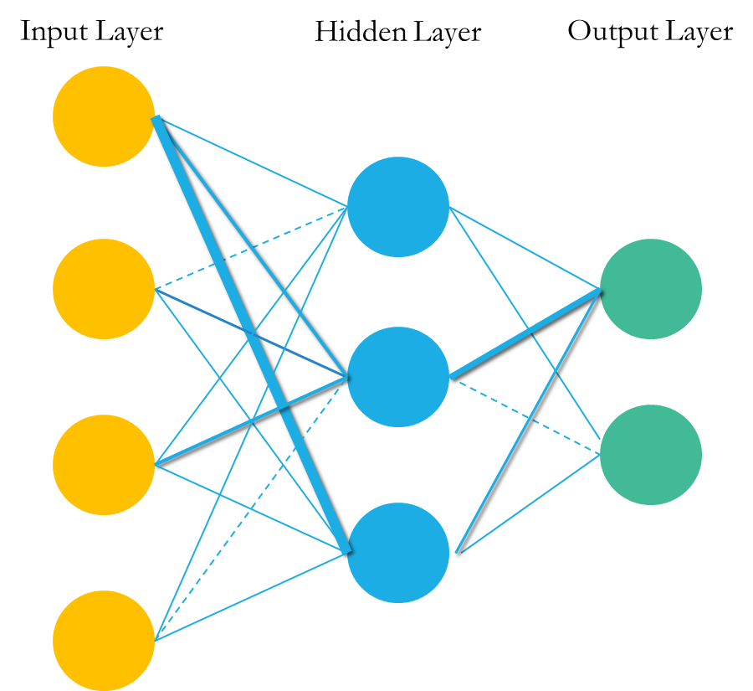
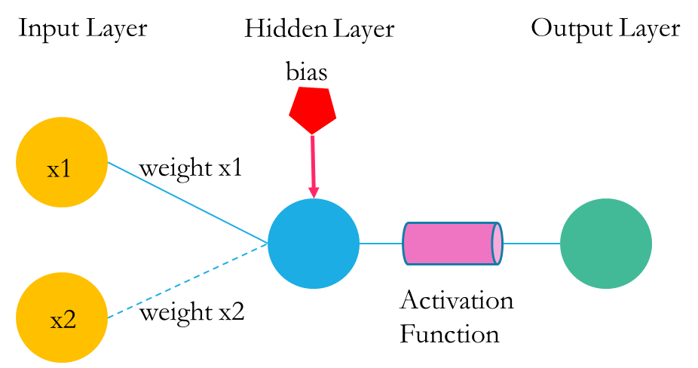
Components of Neural Network Weight, Bias and Activation Function
Multilayer Perceptron with 3 Layers
Perceptron

Slide 7
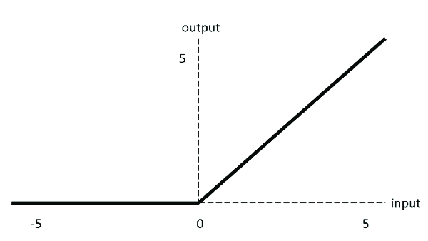
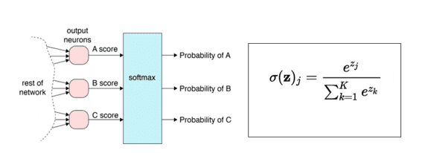
Activation Functions
RELU – Hidden layers
Softmax – output layer
https://www.researchgate.net/figure/ReLU-activation-function_fig7_333411007
https://360digitmg.com/activation-functions-neural-networks#softmax

Slide 8
Model Fitting
1. Number of hidden layers
Adding more layers did not always improve accuracy
2. Number of neurons in each hidden layer
More neurons in hidden layers generally improves accuracy
3. Number of epochs
Higher number of epochs improves accuracy but cause overfitting after a certain point
4. Dropout
Reduces overfitting
5. Early Stopping
Stops training the model when validation loss stops decreasing to eliminate overfitting

Slide 9
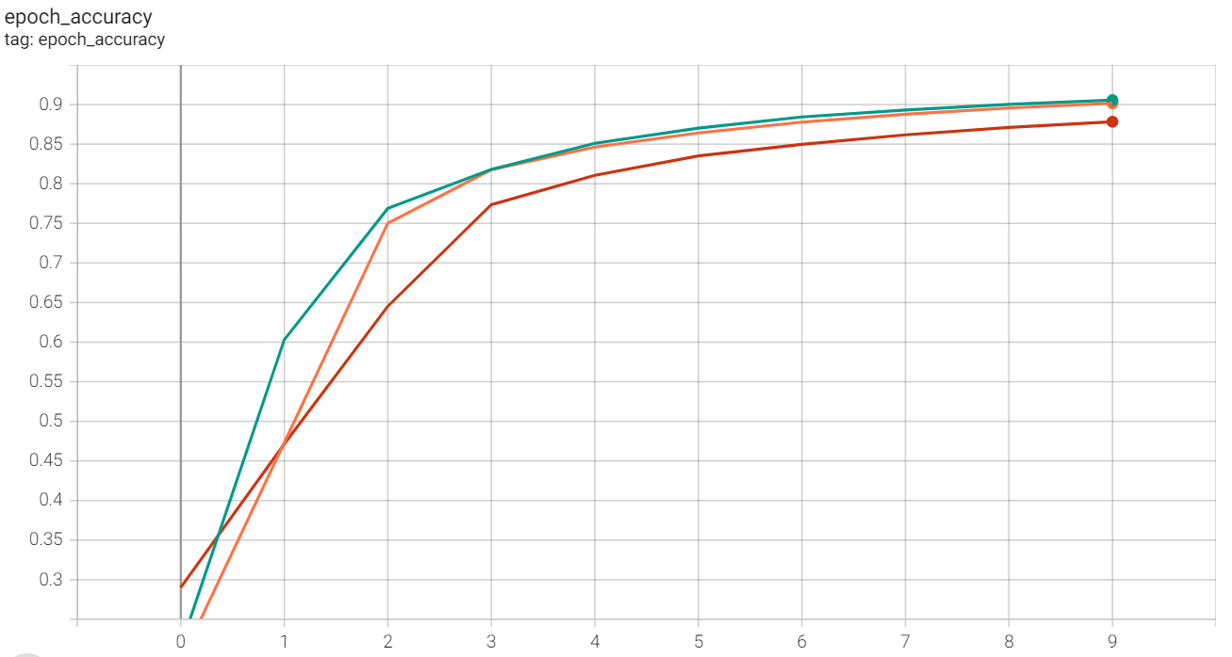
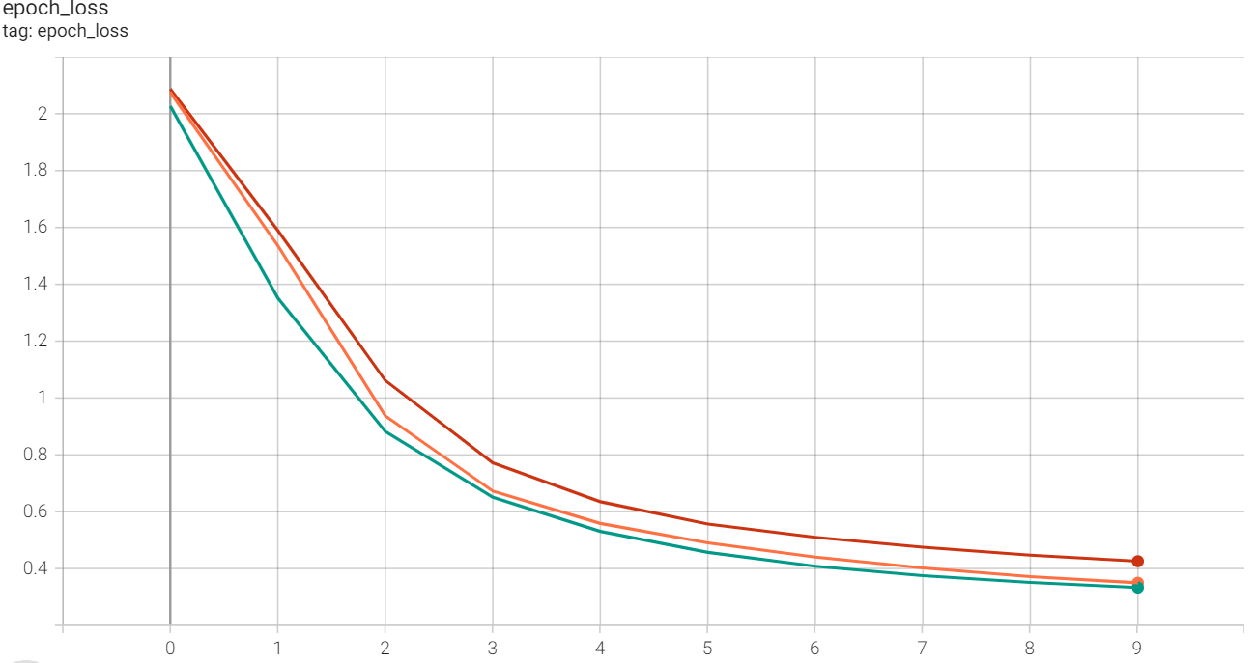
1. Impact of Increasing the number of Hidden Layers – More Layers Does Not Always Improve the Model
2 hidden layers
5 hidden layers
3 hidden layers
3 hidden layers
2 hidden layers
5 hidden layers

Slide 10
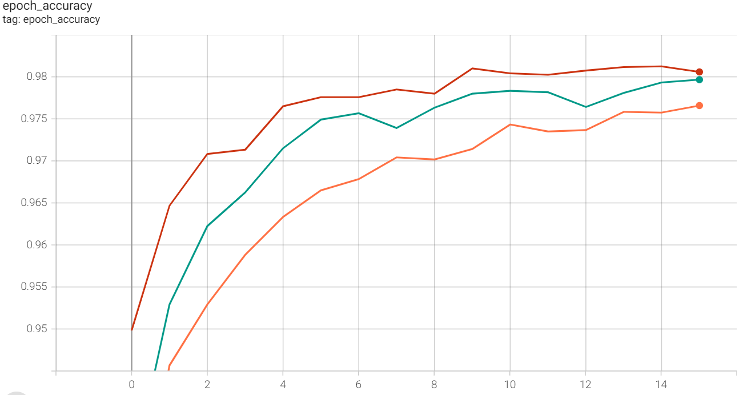
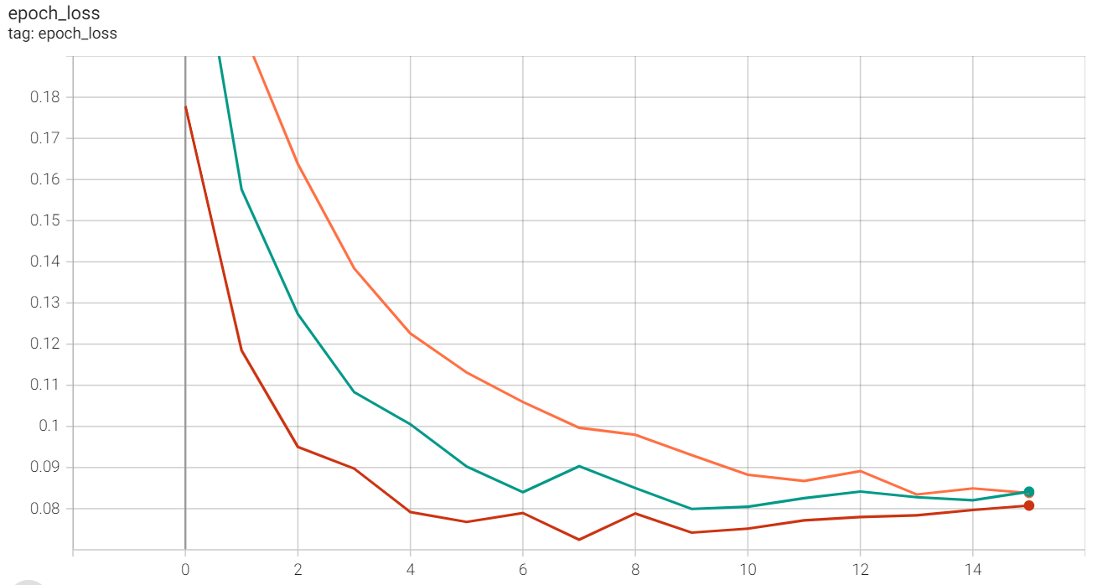
2. Increasing the number of Neurons in Hidden Layers – More Neurons Tend to Improve the Model
Model 3 – 1176/784
Model 1 – 523/348
Model 2 – 261/87
Model 2 – 261/87
Model 1 – 523/348
Model 3 – 1176/784

Slide 11
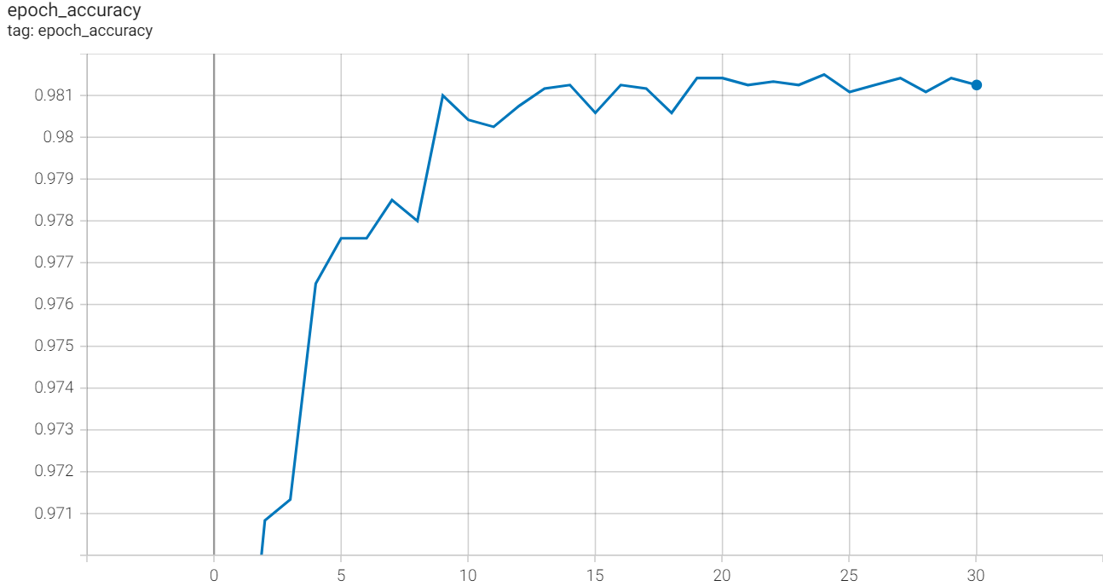
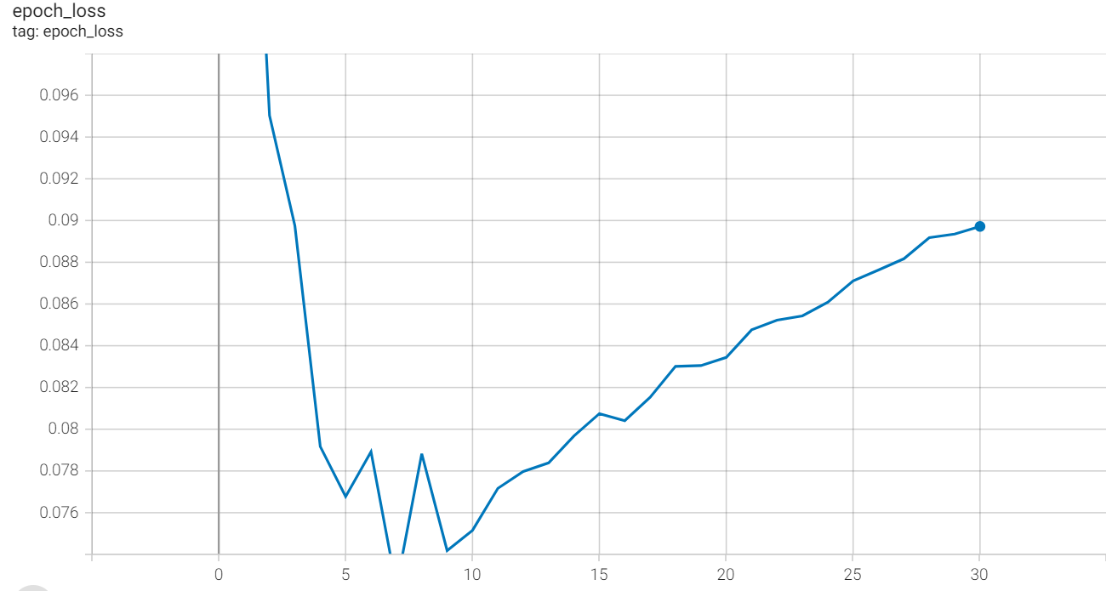
3. Increasing the number of Epochs – More Epochs Improves the Model only up to a certain point
Model 3 with 30 epochs – Indication of overfitting after around 10 epochs

Slide 12
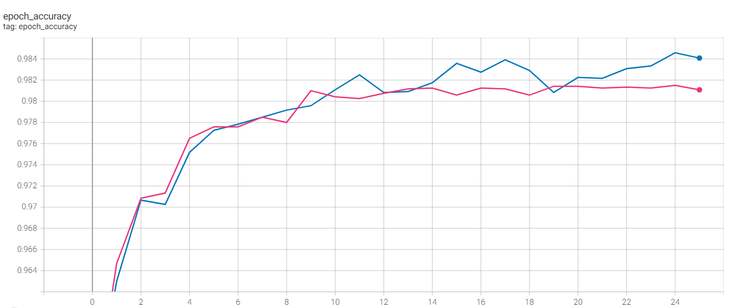
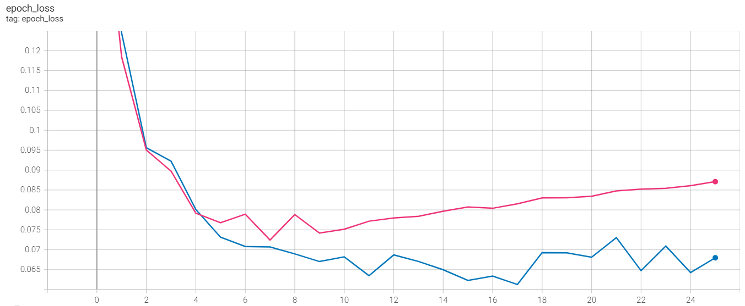
4. Dropout reduces Overfitting
Model 3 with Dropout
Model 3 no Dropout
Model 3 no Dropout
Model 3 with Dropout

Slide 13
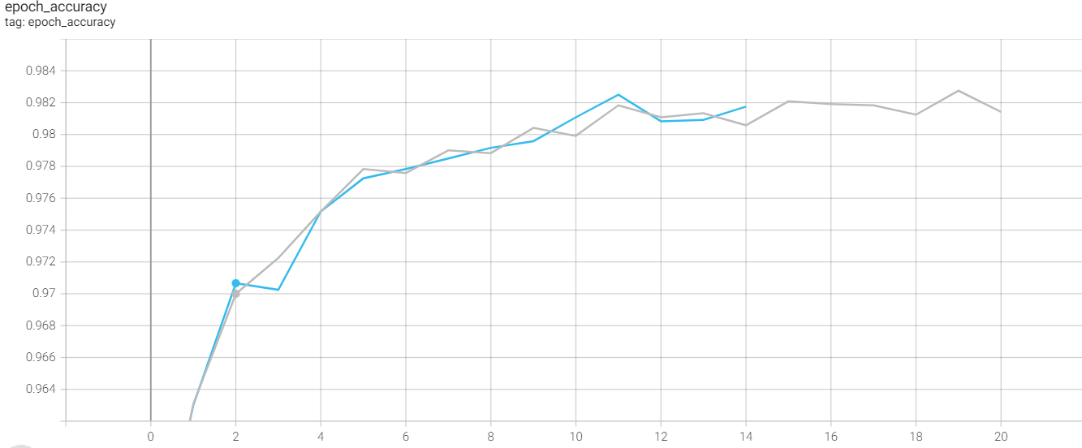
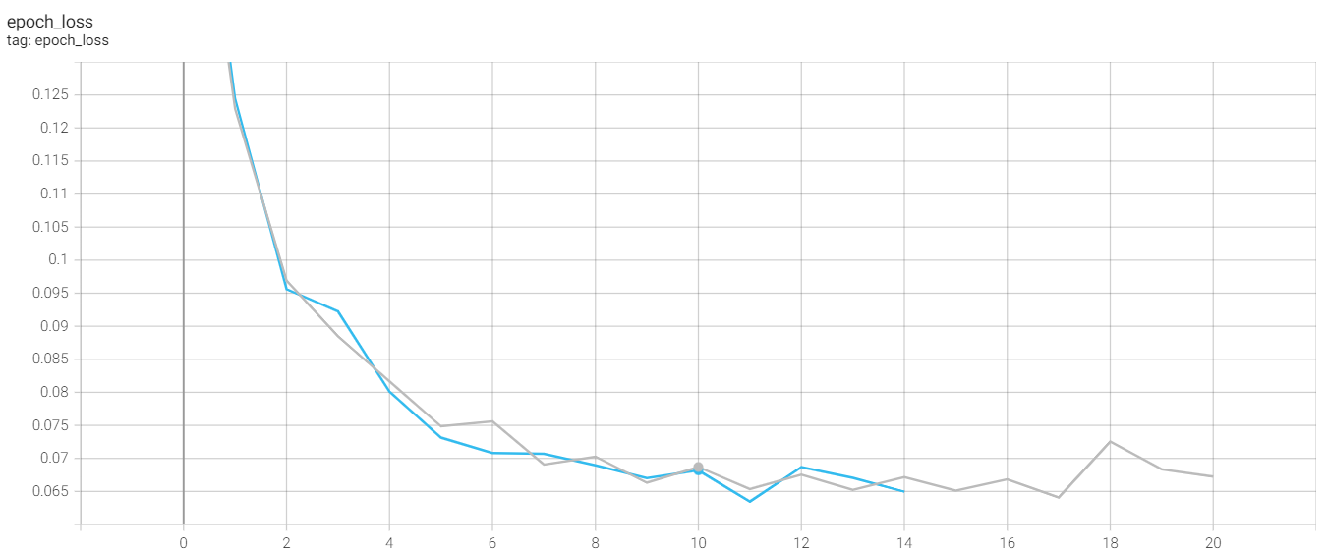
5. Early Stopping
Model 3 with Dropout only
Model 3 with Dropout only
Model 3 with Dropout and Early Stopping
Model 3 with Dropout and Early Stopping

Slide 14
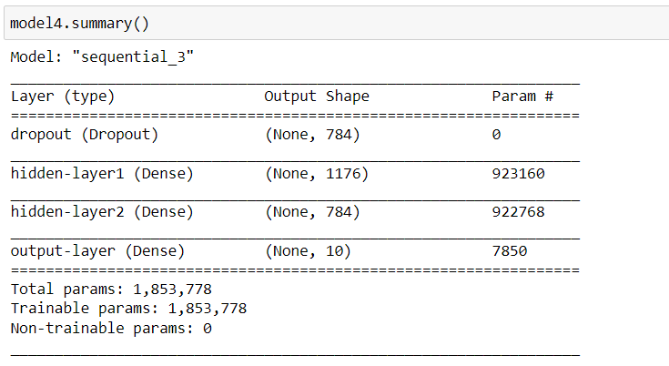
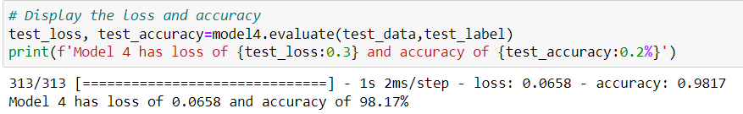
Model Summary
Model accuracy of 98.2%

Slide 15
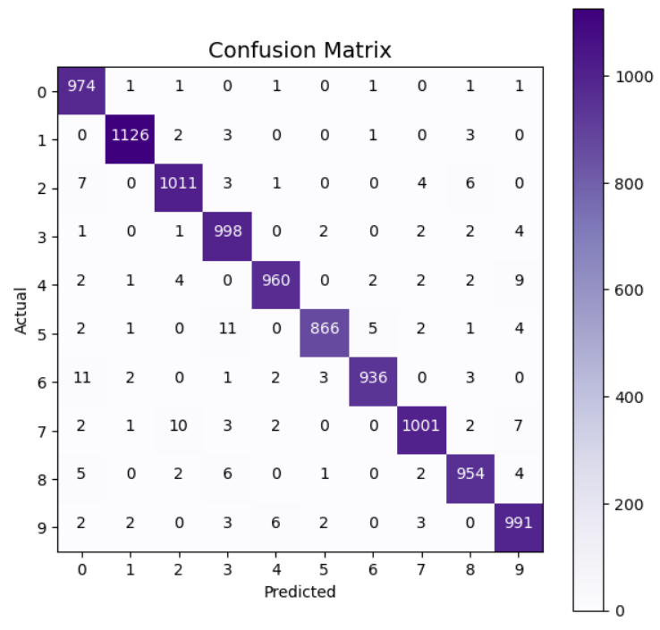
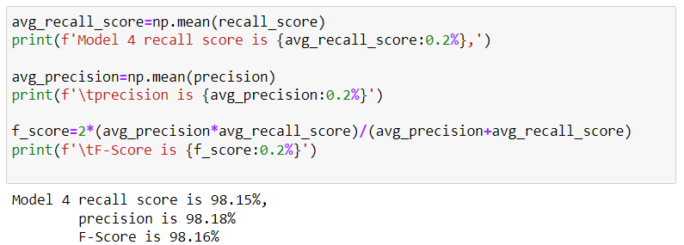
Model Evaluation

Slide 16
Appendix
Fall 2022
Data Source:
https://www.kaggle.com/datasets/warisali2/mnist-database-of-handwritten-digits
(Which originally came from http://yann.lecun.com/exdb/mnist/ )

