Slide 1
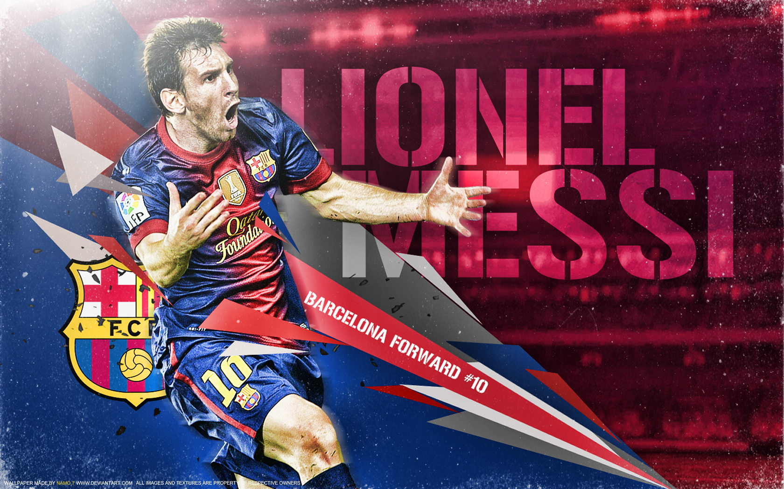
672
GOALS
RATIO
0.86
49 HAT TRICKS
269
ASSISTS
RATIO
0.35
MATCHES
778
35
TITLES

