Slide 1
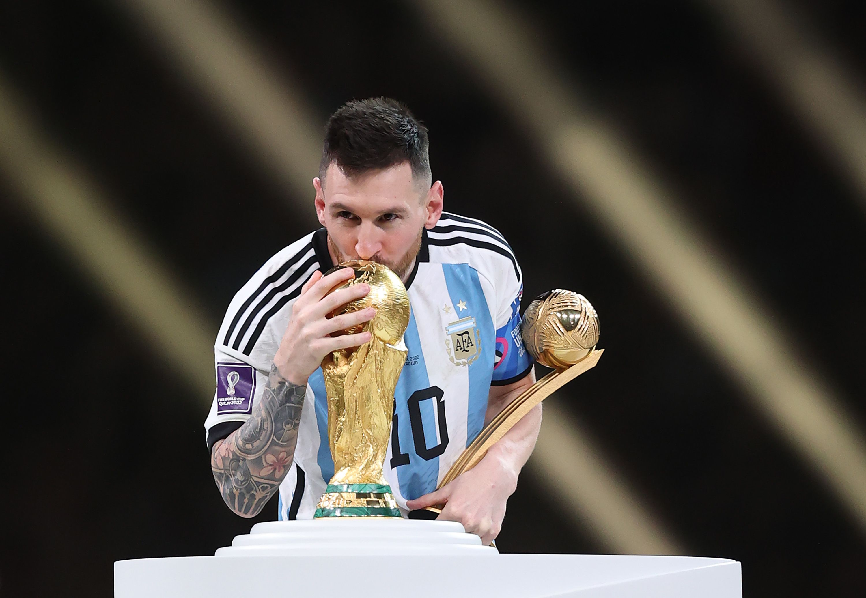
102
GOALS
RATIO
0.59
49 HAT TRICKS
54
ASSISTS
RATIO
0.31
MATCHES
174
5
TITLES

