Slide 1
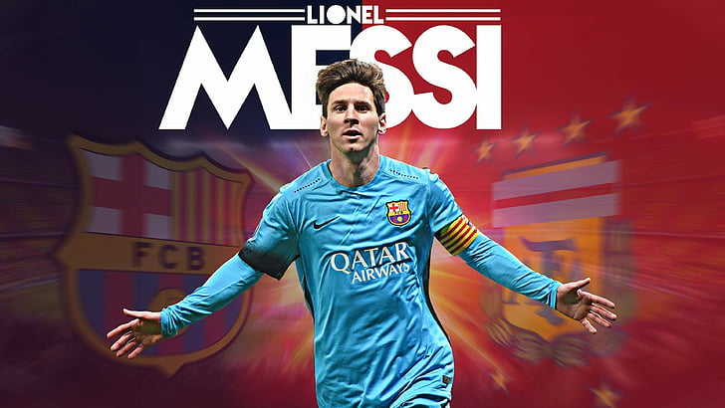
There are ALL ABOUT LIONEL MESSI

