Slide 1

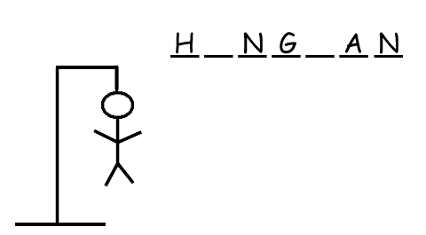

Slide 2

How the game works:
The word to guess is represented by a row of dashes, representing each letter of the word. In most variants, proper nouns, such as names, places, and brands, are not allowed .Only formal words are allowed, If the guessing player suggests a letter which occurs in the word, the other player writes it in all its correct positions. If the suggested letter does not occur in the word, the other player draws one element of a hanged stick figure as a tally mark.

Slide 3




Stages of the game :-
Stage 1 Stage 2 Stage 3 Stage 4

Slide 4



Stage 5 Stage 6 Stage 7
After Stage 7 you lose . The word is displayed along with an option to play again

Slide 5
CONCEPTS USED
LOOPS
FILE SYSTEMS
TKINTER
RANDOM MODULE
exec() function
matplotlib
Excel Sheet to store scores
Numpy
Pandas

Slide 6
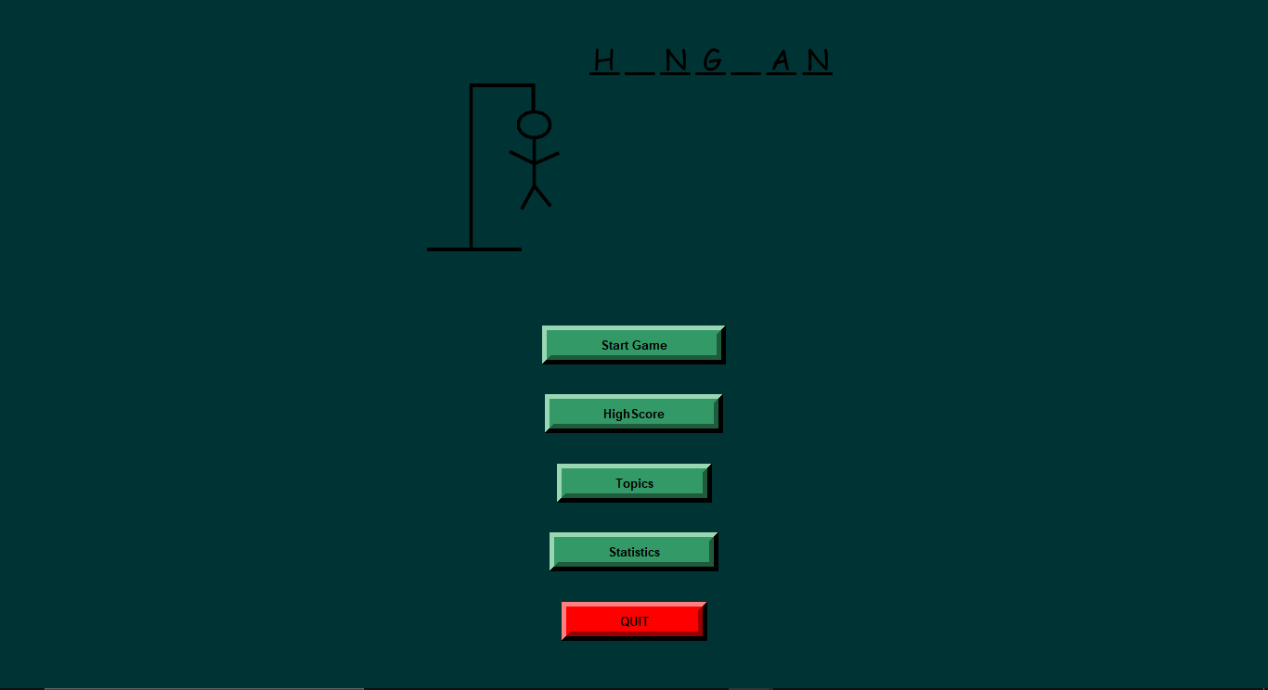
Start Screen :-

Slide 7
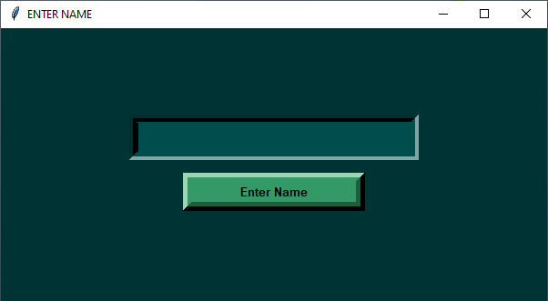
Enter miscellaneous details:-

Slide 8

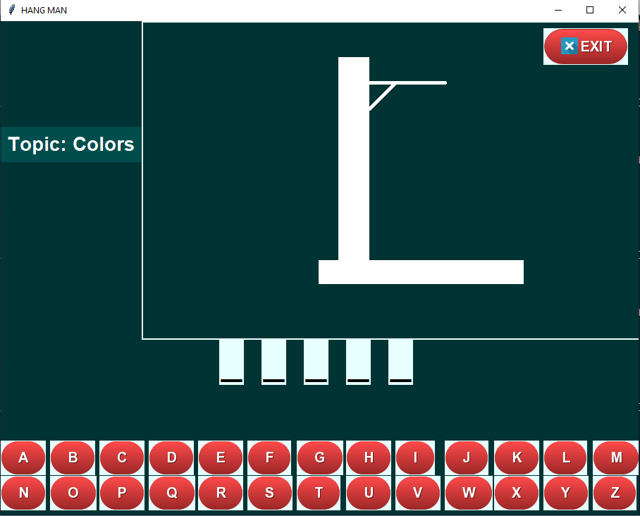
Game Screen :-

Slide 9
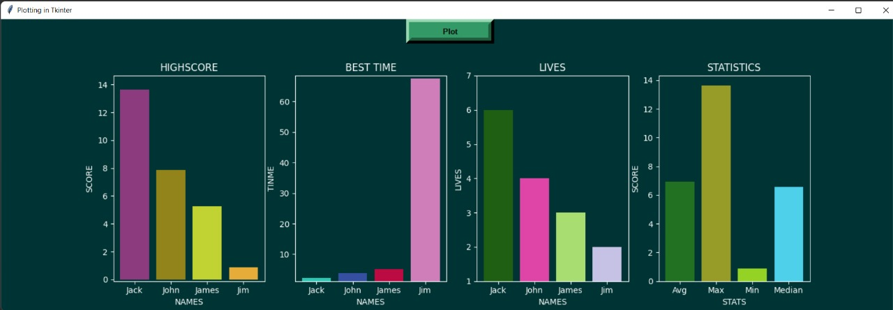
MatplotLib : -

Slide 10
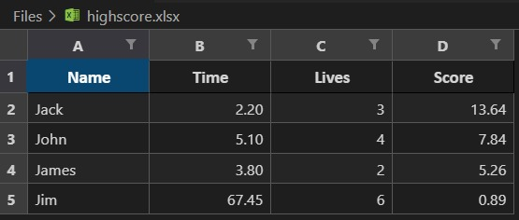
Excel Sheet Storage :-

Slide 11
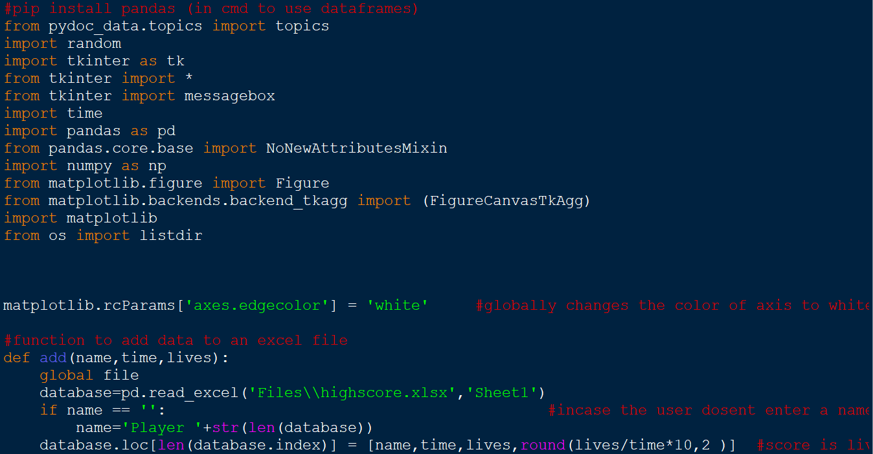
Code

Slide 12
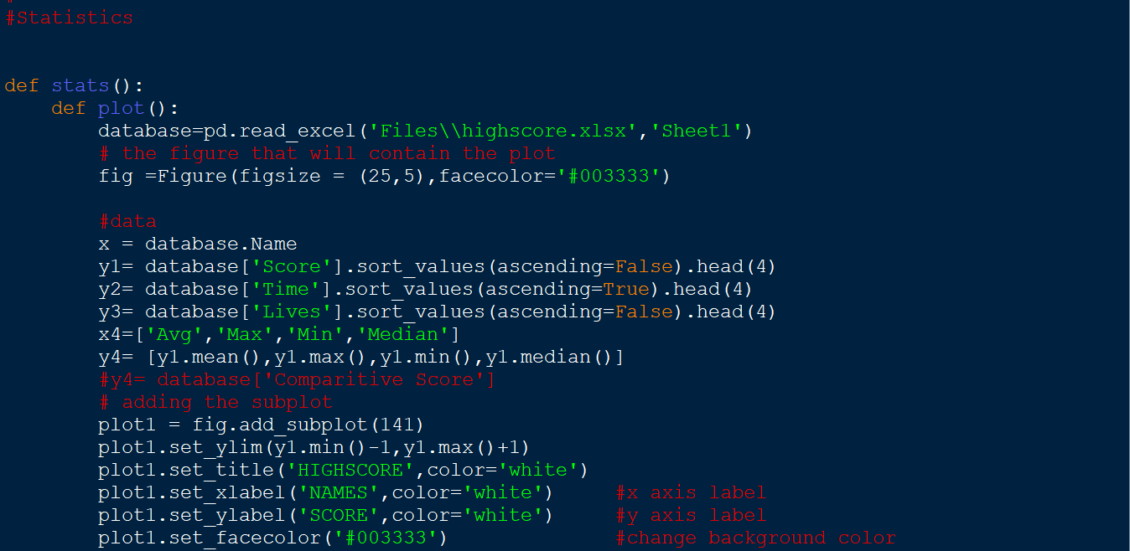
.

Slide 13
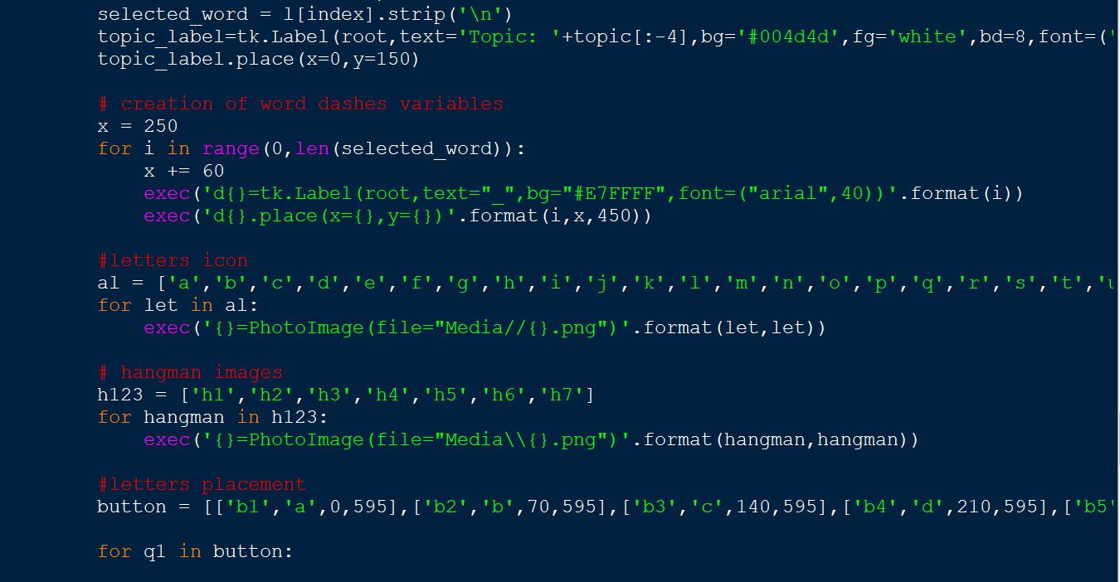

Slide 14
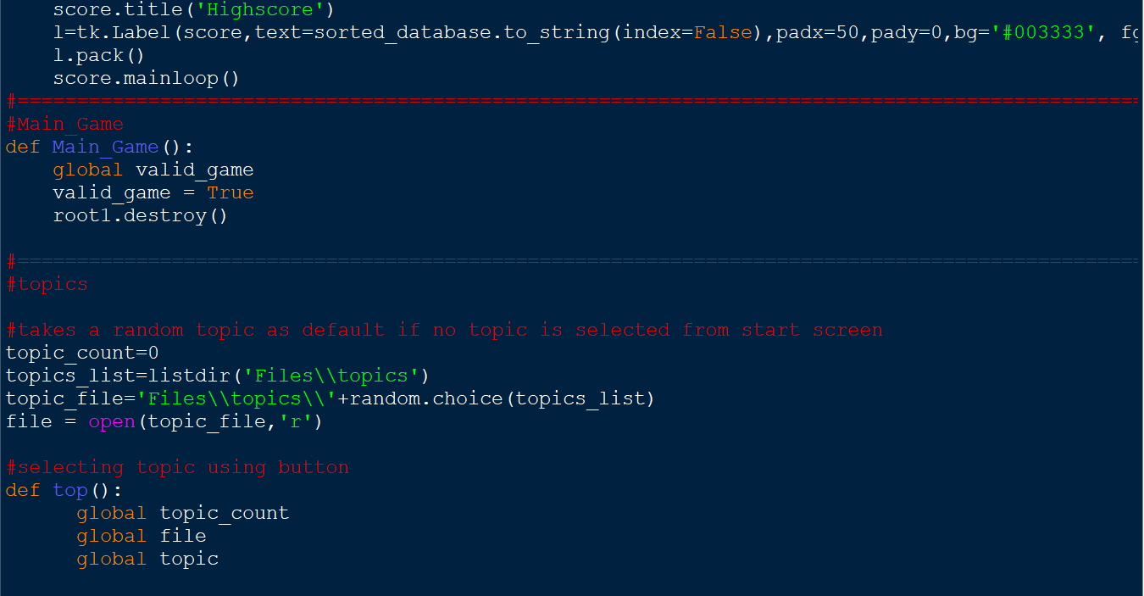

Slide 15
THANK YOU
Credits –
Aayush K
Arish K
Vaibhav A
Aditya K S

