Slide 1
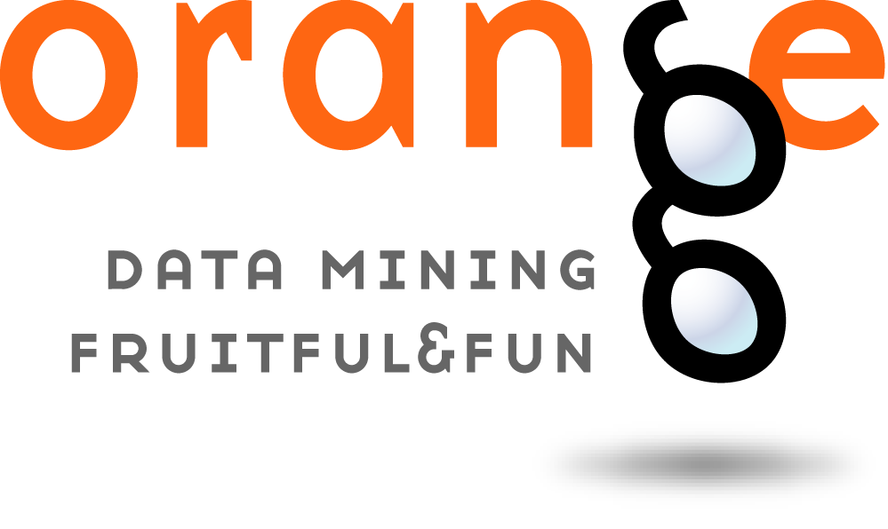
Anastasija Zujeva

Slide 2
Do you mean fruit?
Orange is an open-source data visualization, machine learning and data mining toolkit

Slide 3
Description
Component-based visual programming software package
Components are widgets
Advanced users can use orange as a Python library
Regular users can use visual programming with user-designed widgets

Slide 4
Purpose
Is used in:
Biomedicine
Bioinformatics
Genomic research
Teaching

Slide 5
Scientific Purpose
Is used in:
Testing new machine learning algorithms
Implementing new techniques in genetics and bioinformatics

Slide 6
Educational Purpose
Is used in:
Teaching machine learning and data mining methods to students of:
Biology
Biomedicine
Informatics

Slide 7
Features
Data
Visualize
Classify
Regression
Evaluate
Unsupervised

Slide 8
Features: adds-on
Associate
Bioinformatics
Data fusion
Educational
Geo
Image analytics
Network
Text mining
Time series
Spectroscopy

Slide 9
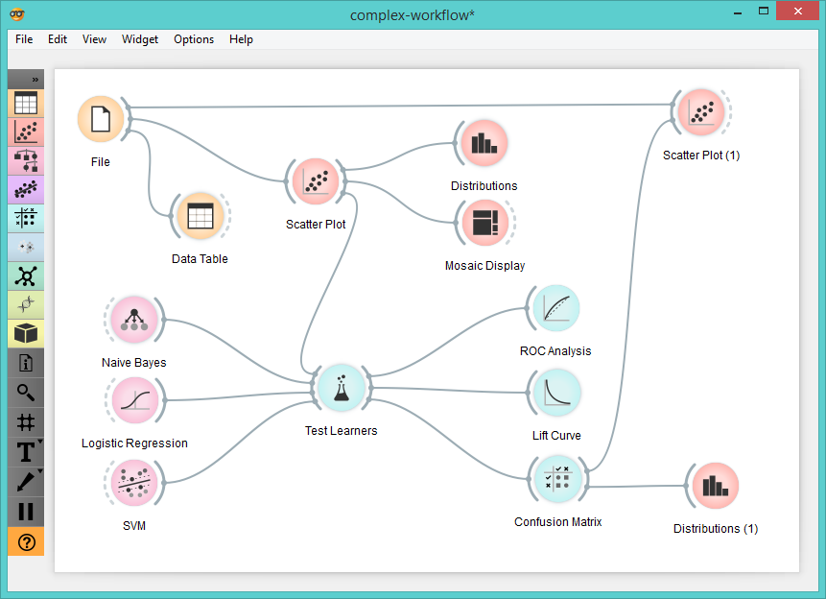
Example: Typical workflow

Slide 10
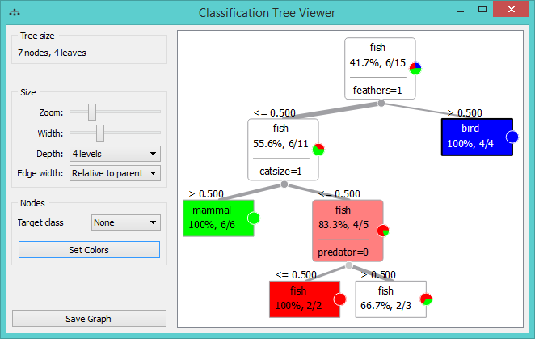
Example: Classification tree widget

Slide 11
Example: Classification tree widget

Slide 12
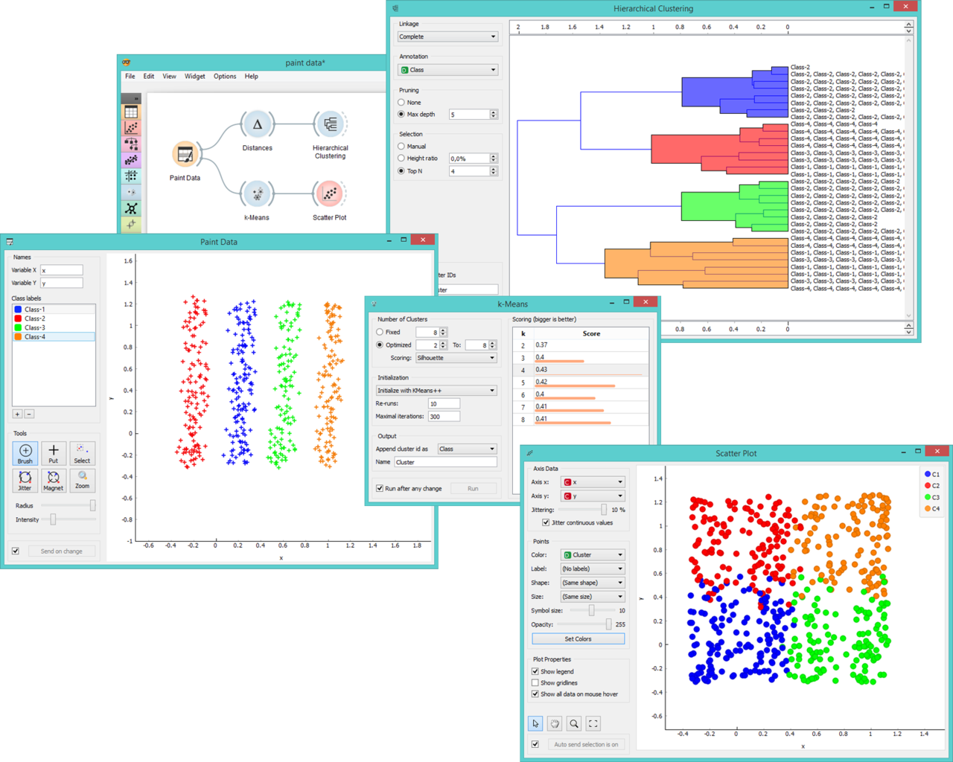
Example: Paint Data widget

Slide 13
Code Example
https://orange-data-mining-library.readthedocs.io/en/latest/tutorial/data.html#data-input

Slide 14
Thank you for
your attention

