Slide 1


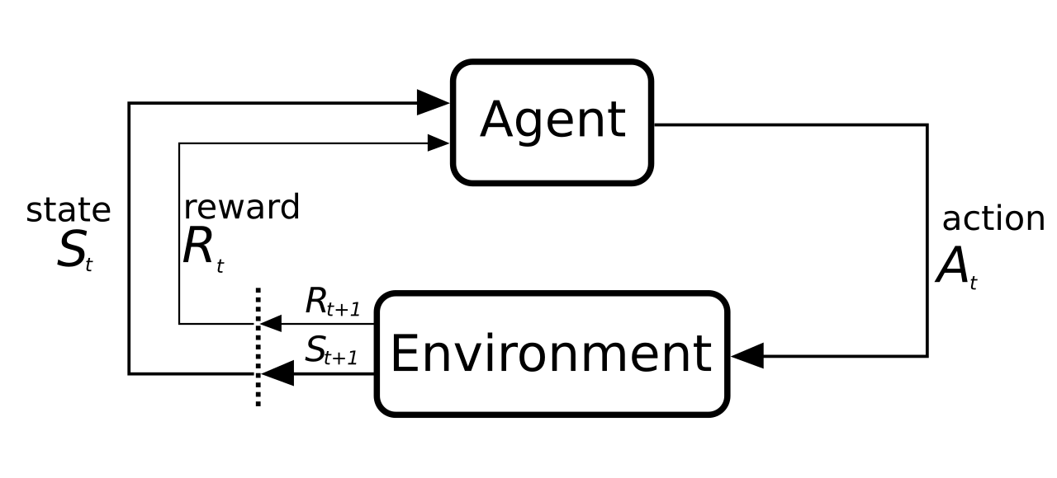
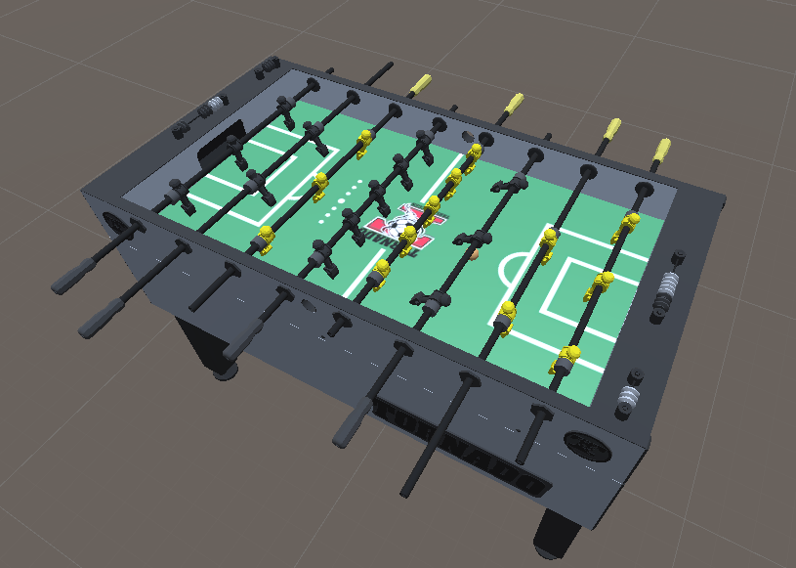
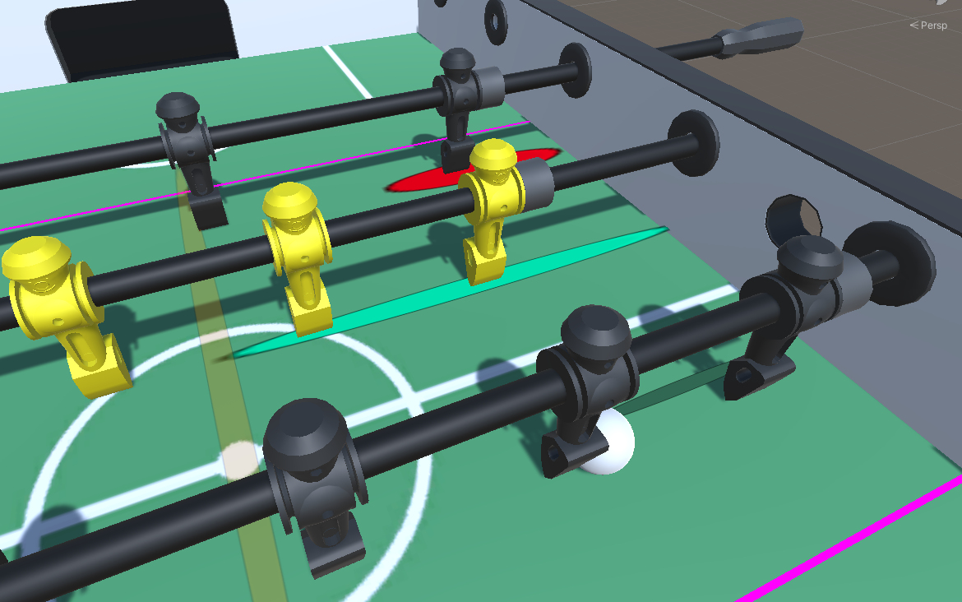
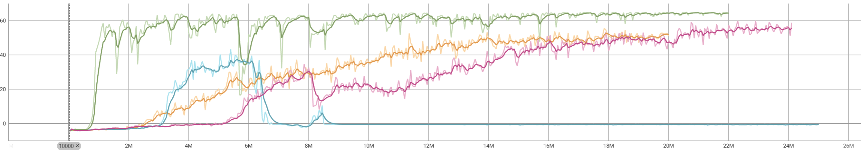
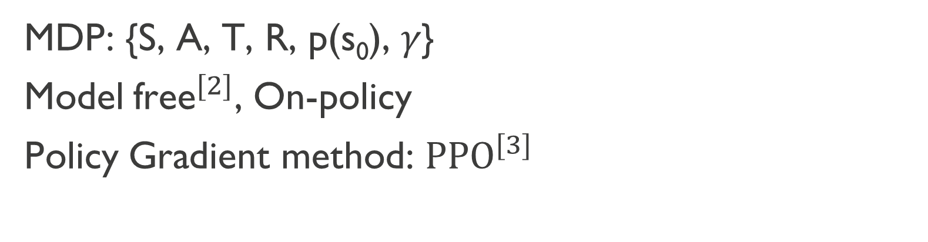
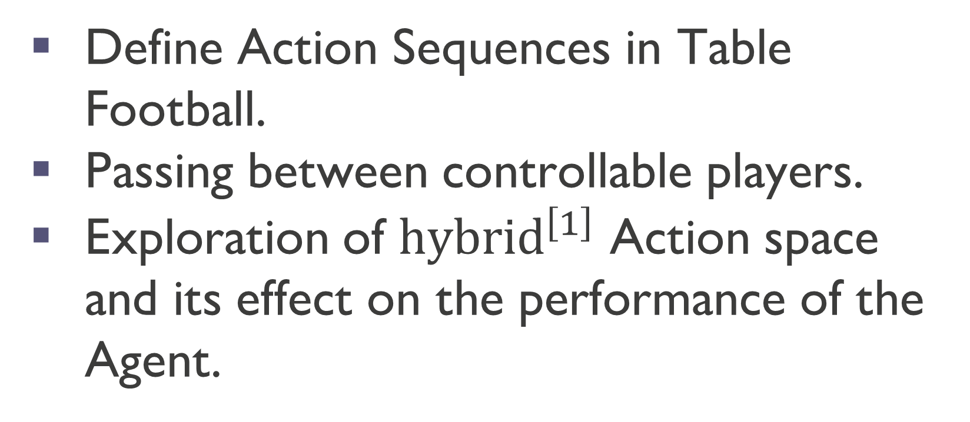
Reinforcement Learning of Action Sequences in Table Football
Author: Alexandros Kyrloglou. Promotor: Wannes Meert. Guidance: Jens Bürger, Wen-Chi Yang.
Introduction:
Methodology:
Define Action Sequences in Table Football.
Passing between controllable players.
Exploration of ${hybrid}^{\left[1\right]}$ Action space and its effect on the performance of the Agent.
MDP: {S, A, T, R, p(s₀), 𝛾}
Model${\text{free}}^{[2]}$, On-policy
Policy Gradient method: ${PPO}^{[3]}$
Reinforcement Learning Setup:
Observations (Normalized)
Only Necessary Rods: (x, θ)
Ball: (x, y)
Actions
Translation: Action × Δt × Speed.
Rotation: Action × Δt × Speed.
Rewards:
Ball position or collisions.
Problem Statement:
Action Type | Rota-tion | Trans-lation | Rot. Speed | Tran. Speed | On/Off Move
Discrete all | D | D | constant | constant | -
DCCS | D | D | C | C | -
DCCM | C | C | - | - | D
Continuous all | C | C | - | - | -
max
target
trigger
lane
start
min
D = Discrete, C = Continuous
Results:
Types of passes:
Ball control (tick-tacking)
Forward Pass 5 to 3 player:
vs Static opponent: Non-factor, single position
vs Dynamic opponent: rhythmic, random static, random movement
vs Enemy agent
Adding Noise
Transfer: Mirror, Another rod.
Reward vs Training steps
Tick-Tacking:
Discrete all: Easy to train, Jumpy moves not human-like.
DCCS: Slower at start, Learns robust moves.
DCCM: Discrete choice is not helpful for tick-tacking.
Continuous all: Slower to train, Human-like moves.
Metrics: speed of ball, time to completion, success rate (opponent type).
[1] Z. Fan, R. Su, W. Zhang, and Y. Yu. Hybrid actor-critic reinforcement learning in parameterized action space, 2019.
[2] A. Morris and F. Cushman. Model-free rl or action sequences? Frontiers in Psychology, 10, 2019.
[3] J. Schulman, F. Wolski, P. Dhariwal, A. Radford, and O. Klimov. Proximal policy optimization algorithms, 2017.

