Slide 1

Note: The data and information in this document is reflective of a hypothetical situation and client. This document is to be used for KPMG Virtual Internship purposes only.
Sprocket Central Pty Ltd
Data analytics approach
Ansar Lala

Slide 2
Note: The data and information in this document is reflective of a hypothetical situation and client. This document is to be used for KPMG Virtual Internship purposes only.
Agenda
Introduction
Data Exploration
Model Development
Interpretation

Slide 3
Note: The data and information in this document is reflective of a hypothetical situation and client. This document is to be used for KPMG Virtual Internship purposes only.
Introduction
Identify which of the 1000 new customers should be targeted from the existing customer datasets
Approach to this problem:
The general approach involves the following:
Cleaning the data given to us from Sprocket Central ensuring data entries are valid and of the correct type.
Exploring the makeup of the existing customer set looking at:
- Age demographic of customers (new and old)
- Distribution of industries
- Bike related purchases in the last 3 years
- Wealth distribution by age groups
- Cars owned by state
Use RFM model to interpret which customers
drive the business.
Outline of the problem:
Sprocket Central is a company specializing in bikes and bike related accessories.
They need to boost business by determining current customer trends and behaviors by analyzing their customer dataset.

Slide 4
Note: The data and information in this document is reflective of a hypothetical situation and client. This document is to be used for KPMG Virtual Internship purposes only.
Data Exploration
Data Quality assessment (more info in email)
 | Accuracy | Completeness | Consistency | Currency | Relevancy | Validity | Uniqueness
Customer Demographic | DOB: One record contained the year 1843. | DOB : Some values were missing Job title: missing values | Gender: different entries for same gender: ’male’ and ‘M’. | Deceased indicator: Records with ‘Y’ were removed | Default: Useless info; deleted
Transactions | No profit column from list price and standard cost. | Customer id: missing values Brand, list-price: missing values |  |  | Filter out cancelled orders. | Format list price, standard cost to currency and first sold date to date format.
Customer Address |  |  | States: different entries for same state: Victoria’ and ‘VIC’.

Slide 5
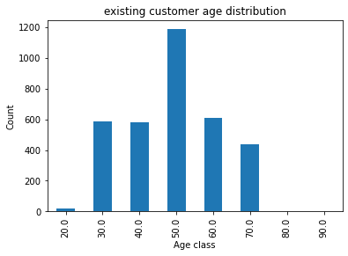
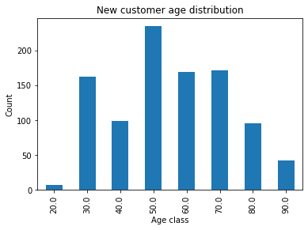
Note: The data and information in this document is reflective of a hypothetical situation and client. This document is to be used for KPMG Virtual Internship purposes only.
Data Exploration
Existing and new customer age distributions
The age group 40-50 is the most numerous in both customer sets.
<20’s and +80’s have the lowest proportion in both customer sets.
Seems to be a high proportion of middle aged people 40-60 in the existing customer set.
High proportion of 20-30 year olds in the new customer set as well as 40-69 year olds.
Both customer sets are predominantly middle aged (40-69).

Slide 6
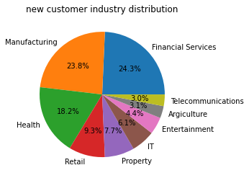
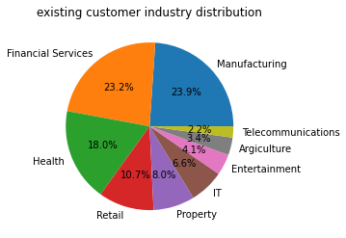
Note: The data and information in this document is reflective of a hypothetical situation and client. This document is to be used for KPMG Virtual Internship purposes only.
Data Exploration
Old and New customer industry distributions
The most populous industry in the new customer set is financial services, manufacturing in the new customer set.
Both customer sets have financial services, manufacturing and health contributing around 2/3 of the total industry distribution.
Telecommunications is the least popular of the job industries for both customer sets.

Slide 7
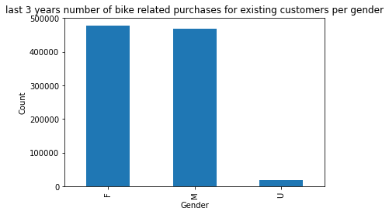
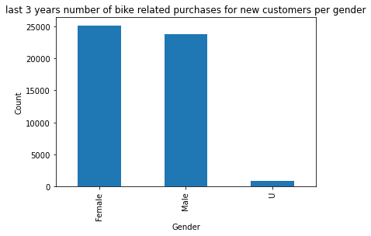
Note: The data and information in this document is reflective of a hypothetical situation and client. This document is to be used for KPMG Virtual Internship purposes only.
Data Exploration
Bike related purchases in the last 3 years
Females in both data sets make more bike related purchases in the 3 years than males which constitutes to half of all purchases although the data is pretty even between males and females with U contributing to a very small percentage.
Gender has little to do with bike related purchases.

Slide 8
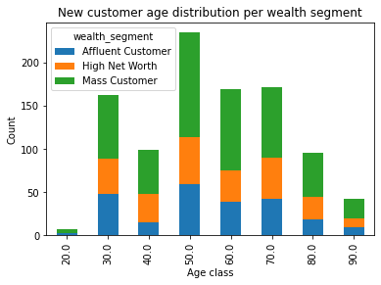
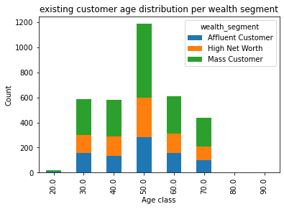
Note: The data and information in this document is reflective of a hypothetical situation and client. This document is to be used for KPMG Virtual Internship purposes only.
Data Exploration
Age Distribution per wealth segment
In all age groups for both customer sets, ’mass customer’ is the most popular segment making up ~50% of each age group. Followed by ‘high net worth’ group.
In the 40-49 age group for the old customers, there are more affluent customers than high net worth customers.

Slide 9
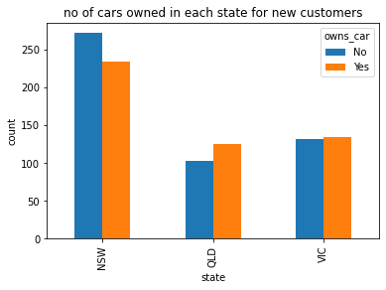
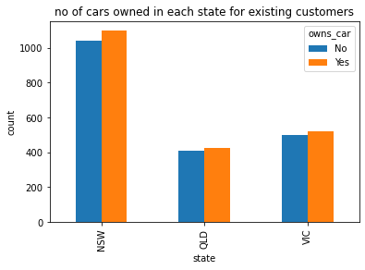
Note: The data and information in this document is reflective of a hypothetical situation and client. This document is to be used for KPMG Virtual Internship purposes only.
Data Exploration
Number of owned cars per state
For both sets, NSW seems to be the most populated state, inferring that a lot of data collection was in this state. However, for new customers, there’s a notable difference that more people do not own cars whilst for the existing customers, more people own cars despite the split being more even.
For the other 2 states in both sets, more people own cars than not despite the splits being relatively even with the exception of QLD for new customers.

Slide 10
Customer Title | RFM Score | Customer Loyalty | Description
most loyal customer | 444 | Excellent | Bought most recent, buys frequently, spends the most
very loyal customer | 433-443 | Excellent | Bought, most recent, buys frequently, spends a lot
Becoming loyal | 421-432 | Excellent | Bought very recent, buys often, spends little money
Recent customer | 344-420 | Excellent/Good | Bought recent, buys sometimes, spends average
Potential customer | 323-343 | Good | Bought recently, not buy often, spends average
first time buyer | 311-322 | Good | Bought quite recently, not come often, but sends a little.
losing customer | 224-310 | Average | Bough quite a while back, not come often, spends some money
Could be lost | 212-223 | Average | Bought long time ago, not come often, spends some money
On the brink of losing customer | 124-211 | Poor | Bought long time ago, hardly comes, spends little money
Evasive customer | 112-123 | Poor | Bought very long time ago, not come, Spends very little
Lost customer | 111 | Poor | Bought very long time ago, not come, Spends nothing
Model Development

Slide 11
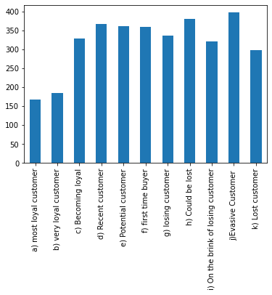
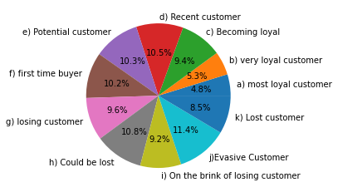
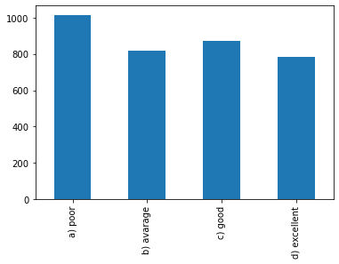
Note: The data and information in this document is reflective of a hypothetical situation and client. This document is to be used for KPMG Virtual Internship purposes only.
Model Development
Proportions and number of the customer title and loyalty
Most popular evasive customer are 11.4%.
Least is most loyal customer at 4.8%
Poor represents ~30% of existing customer list.
Excellent and good represents 50.8% of the list.
Most popular loyalty group is poor at over a 1000. 1000 customers are at least on the brink of being lost.
Followed by good at over 800.
Loyalty levels are split quite evenly amongst the 3 less numerous levels.
But 50% are average or poor.
Predominantly from c to k are the customer titles which are split quite evenly.

Slide 12
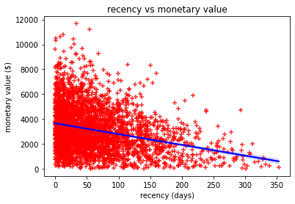
Note: The data and information in this document is reflective of a hypothetical situation and client. This document is to be used for KPMG Virtual Internship purposes only.
Model Development
Relationship between recency and monetary value
Overall a negative correlation between recency and monetary value.
Most profitable customers are the ones that came most recently.
Specifically, from 0-50 days a great number of revenue is generated (at least $3000 per customer according to the trend line).
From 250 + days, very little revenue is generated except from one customer.

Slide 13
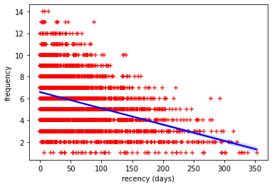
Note: The data and information in this document is reflective of a hypothetical situation and client. This document is to be used for KPMG Virtual Internship purposes only.
Model Development
Place headline insight or information here. This should be the most important point for this slide.
Negative correlation between frequency and recency. The most frequent customers are the one that bought the most recent.
Generally, according to the trendline, customers need to visit a minimum of 7 times to become very recent customers.
Customers that bought 10 times would not buy from the store for a maximum of 100 days (barring a couple of outliers).

Slide 14
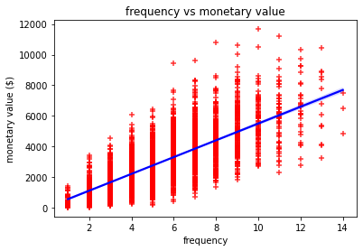
Note: The data and information in this document is reflective of a hypothetical situation and client. This document is to be used for KPMG Virtual Internship purposes only.
Model Development
Place headline insight or information here. This should be the most important point for this slide.
A strong positive correlation between monetary value and frequency. The most frequent a customer comes, the more revenue that can be generated.
Linking to the previous slide, a customer with a frequency of 7 means that an average of $4000 is generated per customer.
The most revenue generated were from customers that bought from the store 10-13 times as expected.

Slide 15
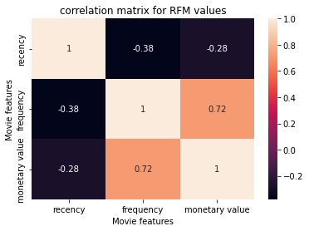
Note: The data and information in this document is reflective of a hypothetical situation and client. This document is to be used for KPMG Virtual Internship purposes only.
Interpretation
Place headline insight or information here. This should be the most important point for this slide.
According to the correlation matrix, the 2 strongest relationships involve frequency as one of the variables.
particularly in relationship with the monetary value at 0.72.
This is the greatest contributor to the revenue generated than the recency of the customers buying from the store.
Therefore, focusing our efforts on the most frequently visited customers and the demographics that make up this should be the way forward as they would be the ones that like to spend the most and bought most recently.

Slide 16
Note: The data and information in this document is reflective of a hypothetical situation and client. This document is to be used for KPMG Virtual Internship purposes only.
Appendix

Slide 17
Note: The data and information in this document is reflective of a hypothetical situation and client. This document is to be used for KPMG Virtual Internship purposes only.
Appendix
This is an optional slide where you may place any supporting items.

