Slide 1
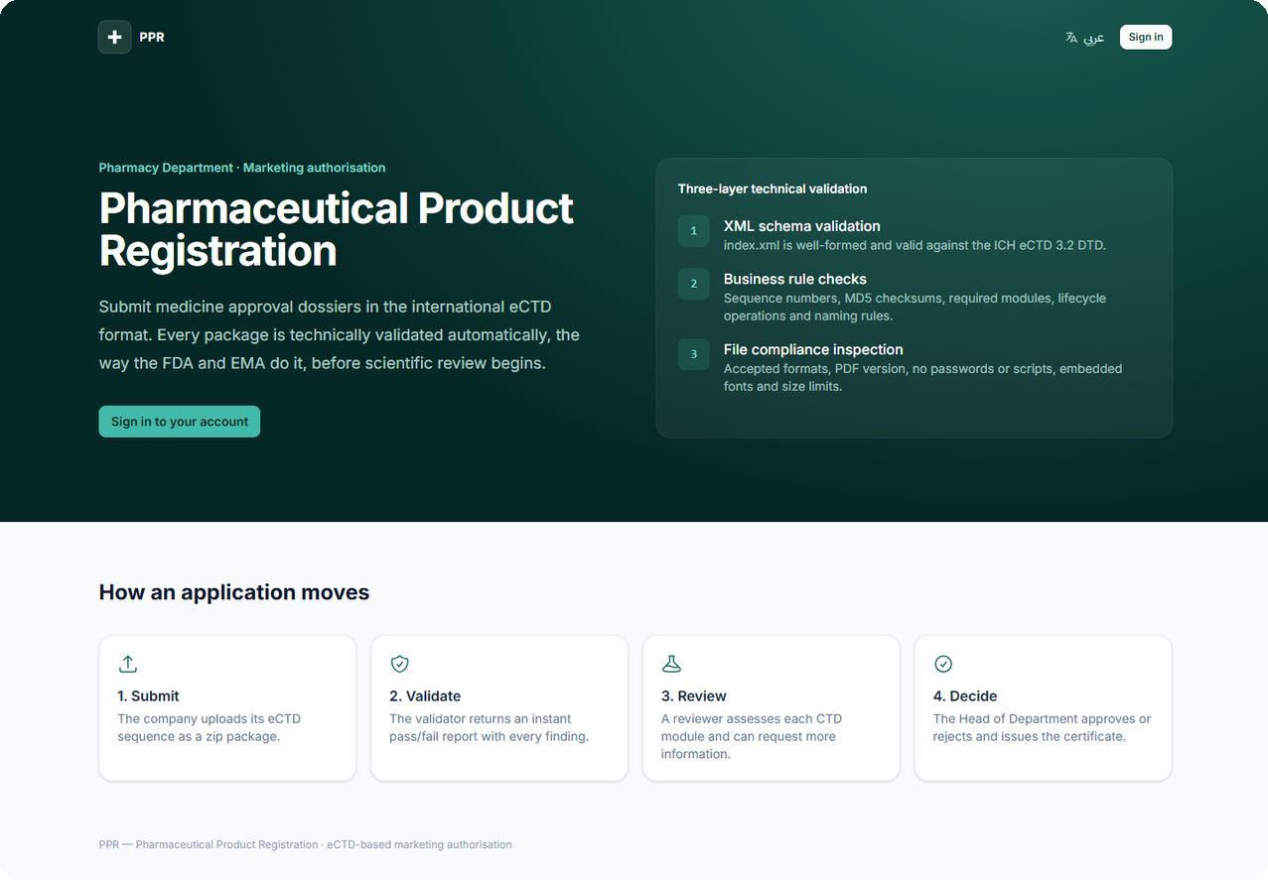
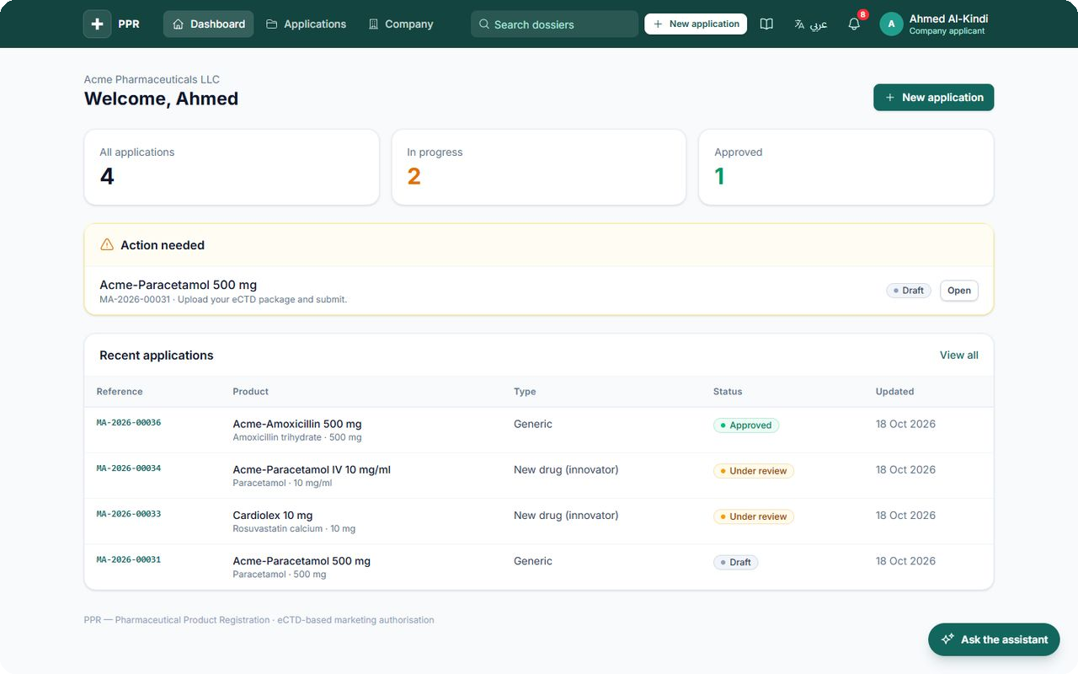
From dossier to certificate
PHARMACY DEPARTMENT · PRODUCT REGISTRATION
One system for submission, automatic eCTD validation, specialist review and decision. In English and Arabic.
نظام إلكتروني للموافقة على الأدوية
Notes:
Opening: PPR takes a medicine application from eCTD upload to approval certificate in one bilingual system. Screens are real captures from the running prototype with demonstration data (PPR-POC-001 v0.2).

Slide 2
Problems surface after review has already started
THE PROBLEM
01
02
03
Errors found late
Work split across tools
No single record
Broken checksums, missing files and locked PDFs show up during review, not at submission.
Validation, assessment, questions and decisions end up in email, files and spreadsheets.
Showing who decided what, and when, means rebuilding the story by hand.
The FDA and EMA validate every eCTD package technically before scientific review. PPR brings the same discipline in-house.
Notes:
Frame the problem without inventing numbers: late discovery of technical errors, fragmented tools, no single audit trail.

Slide 3




Four steps, one system
HOW IT WORKS
Submit
Validate
Review
Decide
The company creates the application and uploads its eCTD sequence as a zip.
A three-layer technical check runs automatically and reports every finding.
A specialist assesses each CTD module. The lead reviewer can request more information.
The Head of Department approves or rejects. A bilingual certificate is issued.
Every status change goes through one state machine: role checked, change logged, people notified.
Notes:
Ten application states, one state machine. A package cannot reach a reviewer until it passes validation.

Slide 4
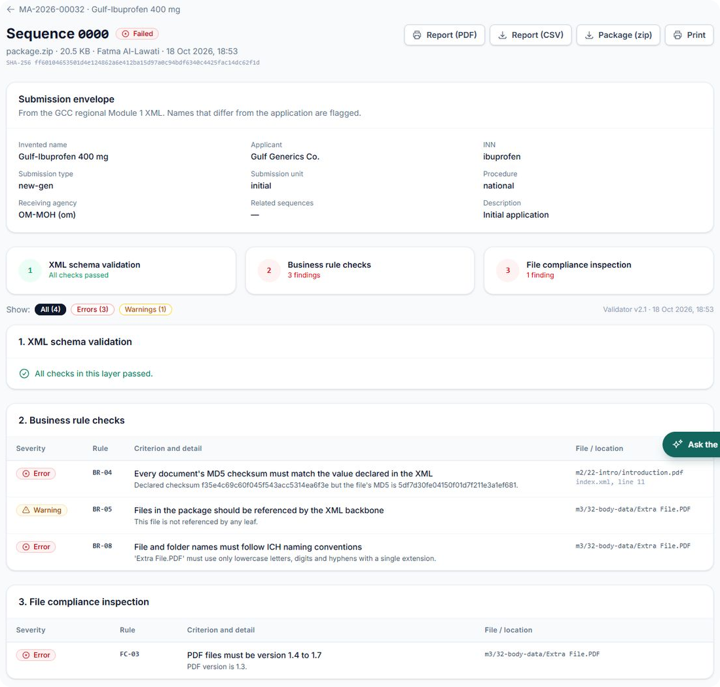
Errors are caught before a reviewer sees the file
TECHNICAL VALIDATION
1
XML schema
index.xml and the regional Module 1 are valid against the DTDs.
2
Business rules
Checksums, references, required modules, lifecycle, GCC envelope.
3
File compliance
Safe zip, unlocked PDFs, no scripts, embedded fonts, size limits.
Notes:
Validation runs against the official ICH eCTD 3.2 DTD and the GCC Module 1 v1.5 criteria, with the envelope addressed to Oman. Reports export as CSV and printable PDF. In production validation runs in a background worker.

Slide 5
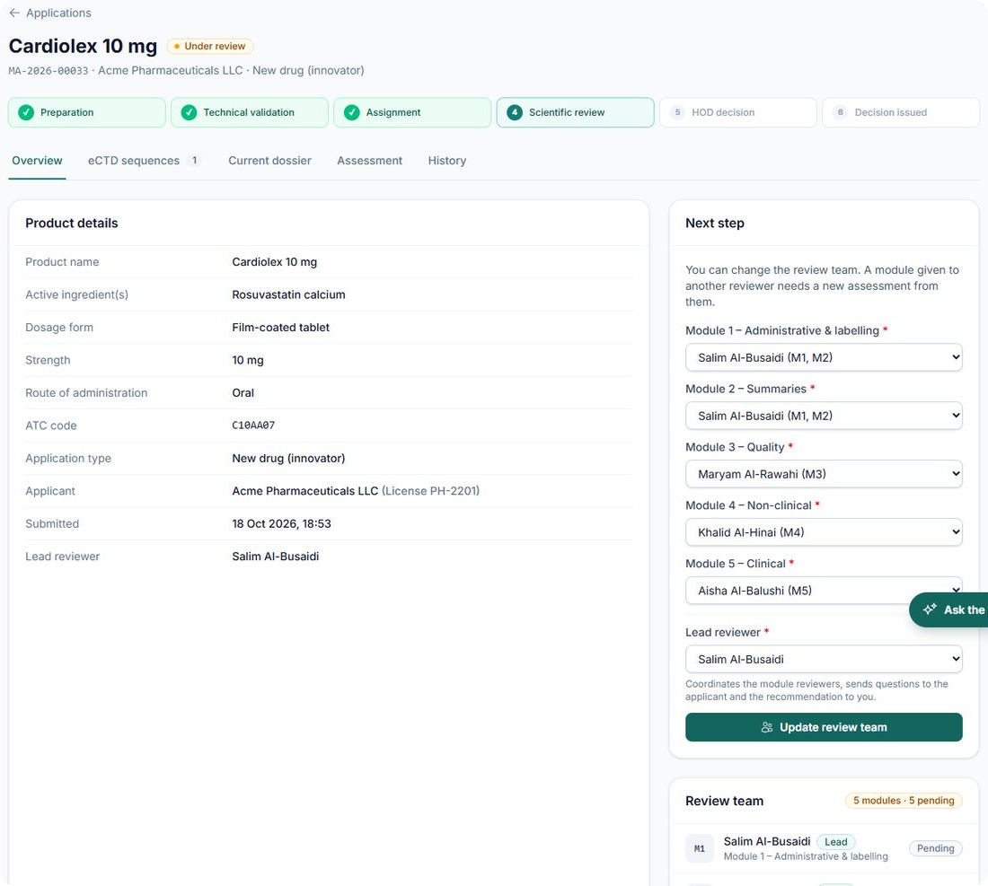
The right specialist on every module
SPECIALIST REVIEW
Assigned automatically
Each module goes to the qualified reviewer with the fewest active modules.
Led by one reviewer
The lead sends questions to the applicant and the team's recommendation.
Decided by the Head
Approve, reject, or return to the lead reviewer.
Notes:
The Head of Department sets reviewer specialties (M1 to M5). Teams are assembled automatically; manual assignment only when a module has no qualified reviewer.

Slide 6
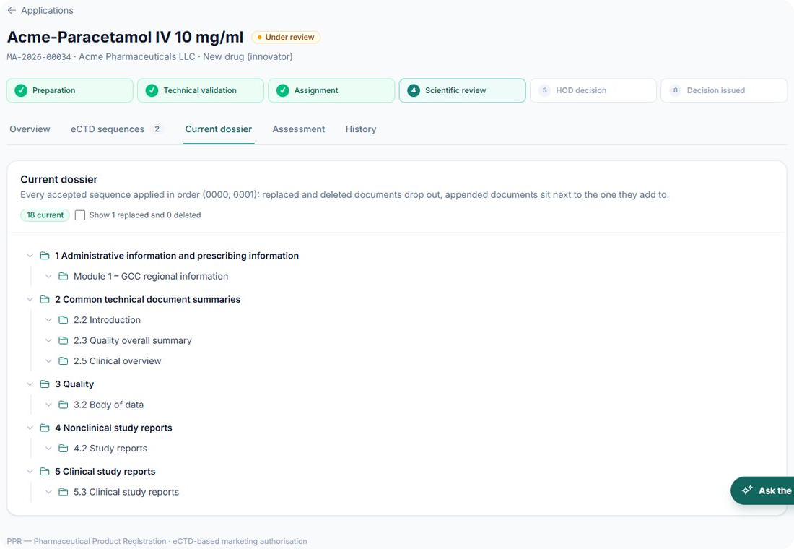
Reviewers always see what is current
REVIEWER TOOLS
Current dossier
Replaced and deleted documents drop out.
Page-linked notes
Internal, never shown to applicants.
Full-text search
Across every dossier a reader may open.
Dossier assistant
Current dossier: every accepted sequence applied in order.
Answers with document and page citations.
Notes:
Be candid: notes are linked to a page, not drawn on the PDF. The assistant's model hosting decision is still open.

Slide 7
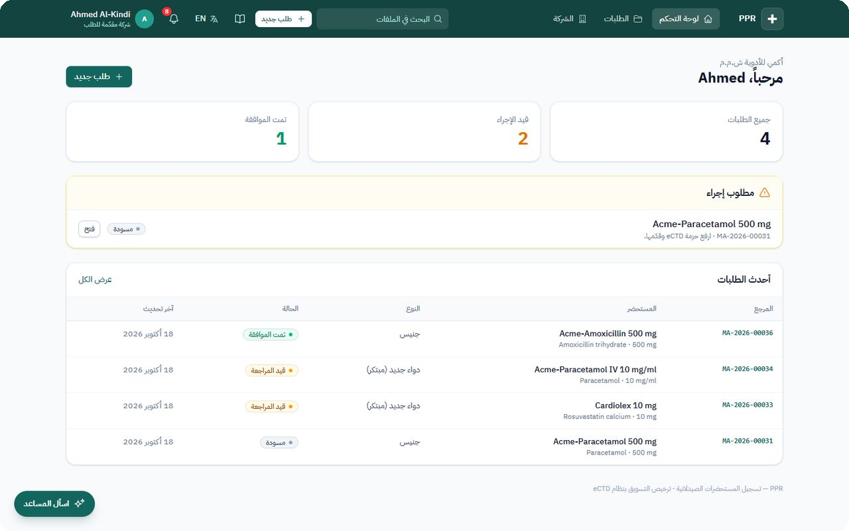
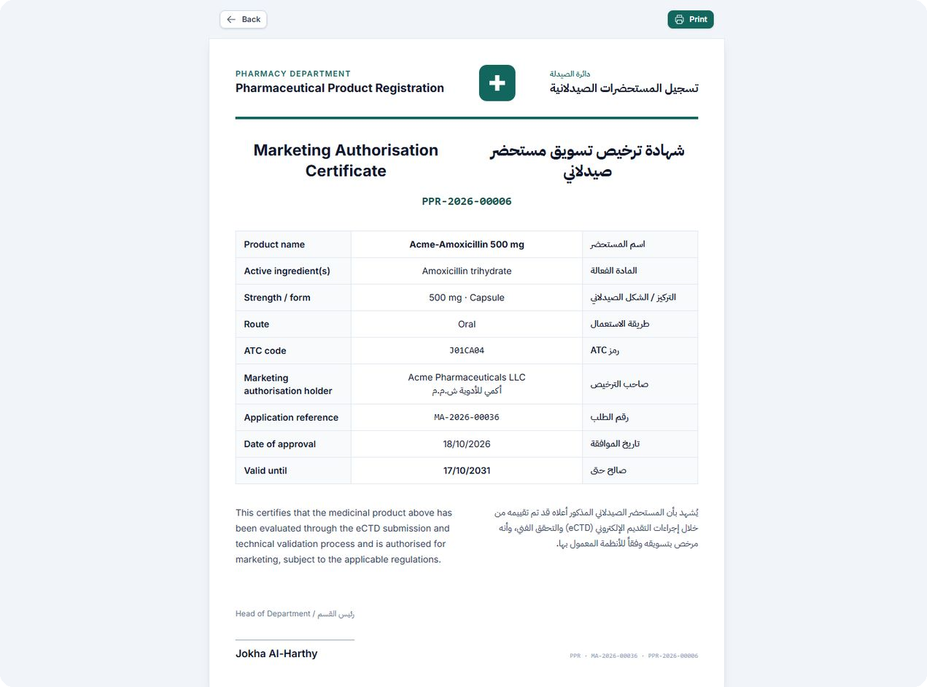
Arabic and English, end to end
BUILT FOR THE REGION
Every screen mirrors into a full right-to-left layout. Approval issues a bilingual certificate with a validity period.
Demonstration data
Notes:
Certificate and dashboard use seeded demonstration data, not a real applicant. GCC Module 1 v1.5 rules with envelope addressed to Oman (OM-MOH).

Slide 8
Control, clarity and ownership
WHAT THE DEPARTMENT GETS
01
Less wasted review effort
02
Clear for applicants
Packages with technical errors never reach a reviewer.
Every finding named, with rule, file and line, and exportable.
03
One audit trail
04
Owned by the department
Who decided what, and when, in a single record.
No licence fees. Changes are made in-house, quickly.

Slide 9
Built to be trusted
149
10
12
2
automated tests passed
application states in one state machine
guided workflows in the training guide
languages, with full right-to-left
Every status change is recorded with user, time and note.
Notes:
149 tests and the 12 workflows are from the PoC report. 10 application states are from the executive summary. Qualification (IQ/OQ/PQ) is drafted but not yet executed.

Slide 10






Secure and auditable by design
SECURITY
Role-based access
Safe package intake
Companies see only their own files; reviewers only their teams.
Blocks path traversal, symlinks, encrypted and oversized zips.
Hardened sign-in
Full audit trail
Lockout, 12+ character passwords, optional staff SSO.
Every status change, with user, time and note.
Protected documents
Internal review notes
Access-checked downloads; HTTPS and CSP enforced.
Never visible to applicants.

Slide 11
Complementary to the market leader
ALONGSIDE EXTEDO
CAPABILITY | PPR | EXTEDO EURS
Applicant portal and submission | ✓ | not part of EURS
Technical eCTD validation | ✓ | ✓
Specialist review per CTD module | ✓ | not stated
Decision and certificate | ✓ | not part of EURS
Arabic interface | ✓ | not mentioned
Years of production use, EMA reference | proof of concept | ✓
If a benchmark shows gaps, PPR keeps the workflow and calls an EXTEDO validator.
Source: PPR-CMP-001 v0.2. EXTEDO points are vendor claims from public material; the software was not tested.
Notes:
Position PPR as complementary: EXTEDO validates and reviews inside an authority; PPR runs the registration case. EXTEDO customer counts are its own claims.

Slide 12
What is done, and what comes next
ROADMAP
Done
Before real submissions
Pilot and phase 2
Official ICH DTD and GCC M1 v1.5 rules
Background validation queue
Dossier view, search, API, staff SSO
Benchmark against a reference validator
Execute qualification and sign-off
Adopt SFDA's distributed GCC DTD files
Decide where the assistant model runs
Self-registration and two-factor login
Review timelines, QR-verified certificates
Fees, variations and renewals
Notes:
Being open about what remains builds trust: the benchmark and qualification sign-off stand between PPR and a defensible go-live decision.

Slide 13
Let's run a pilot
1
2
3
See it live
Prove it
Pilot it
Walk through every role with the demonstration accounts.
Run the validation benchmark and the qualification protocol.
Train staff with the built-in guide and start with selected applicants.
Pharmacy Department · PPR project team
دائرة الصيدلة · تسجيل المستحضرات الصيدلانية
Notes:
Close with the ask: agree to a demo, the benchmark and a pilot.

