Slide 1




Software Engineering
Home
About us
Startegy
Contact
Lab1_HW
Doaa AL-Maghriby
GA 2025

Slide 2
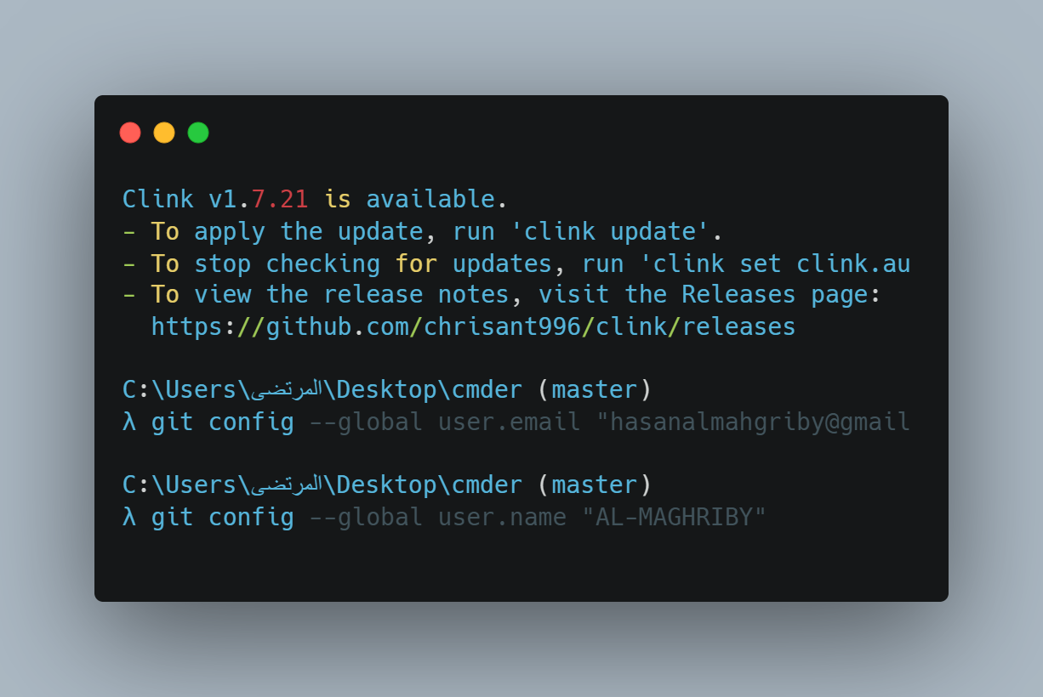
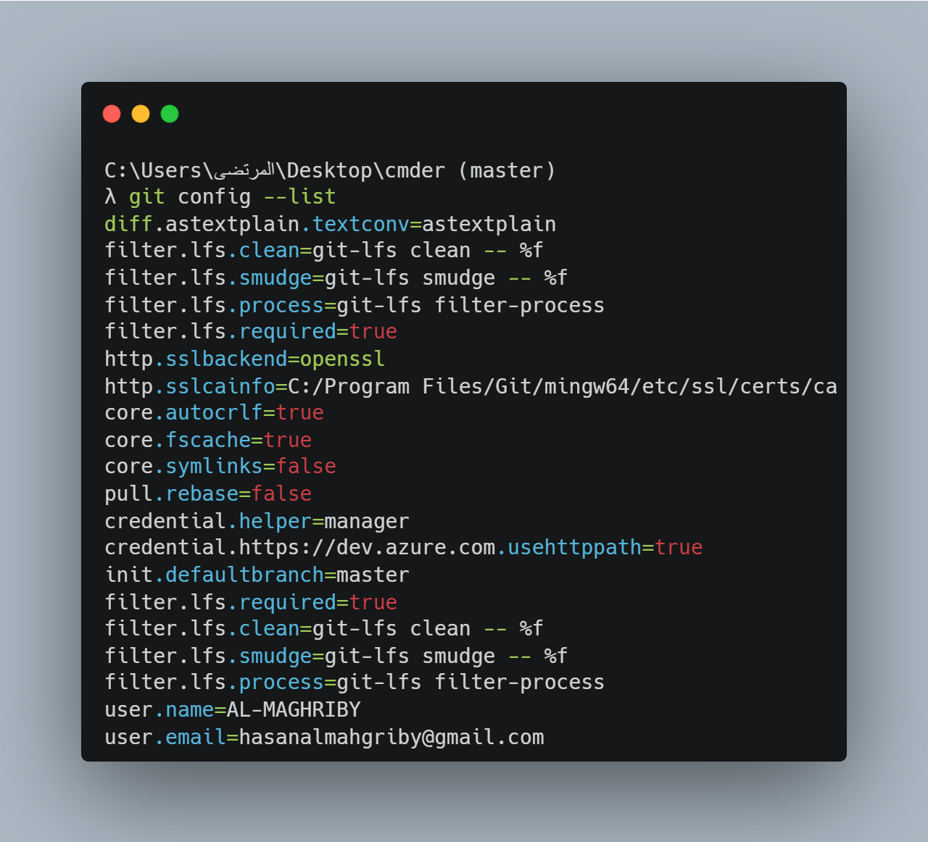
Software Engineering
Home
About us
Startegy
Contact
Page 01

Slide 3
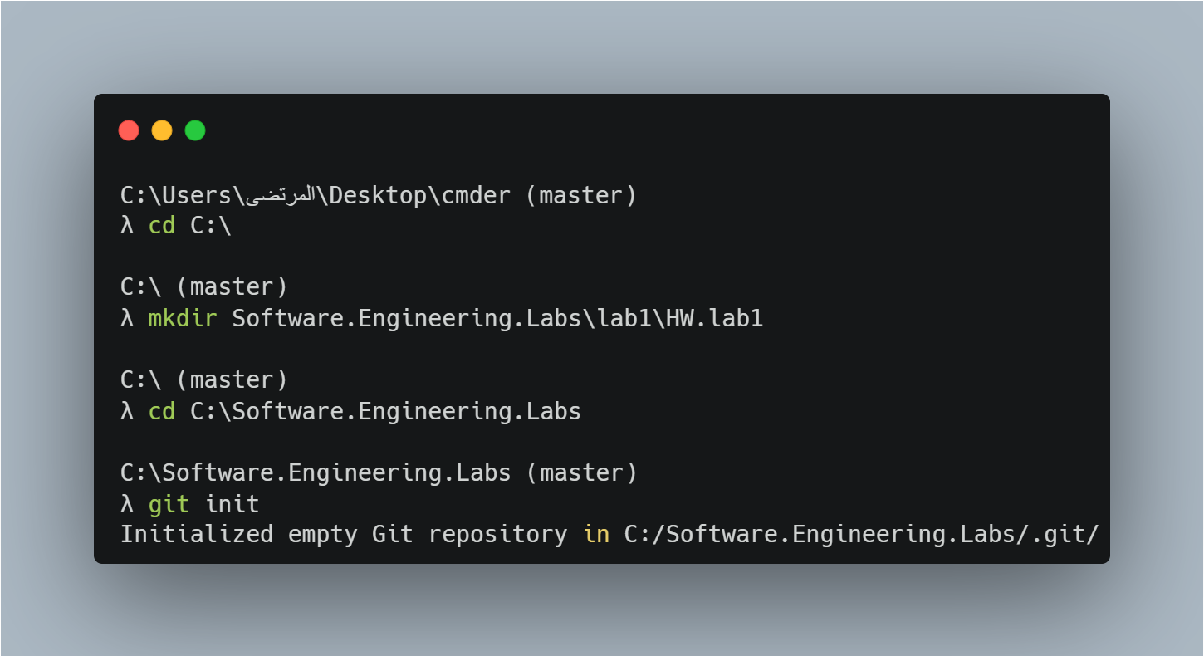
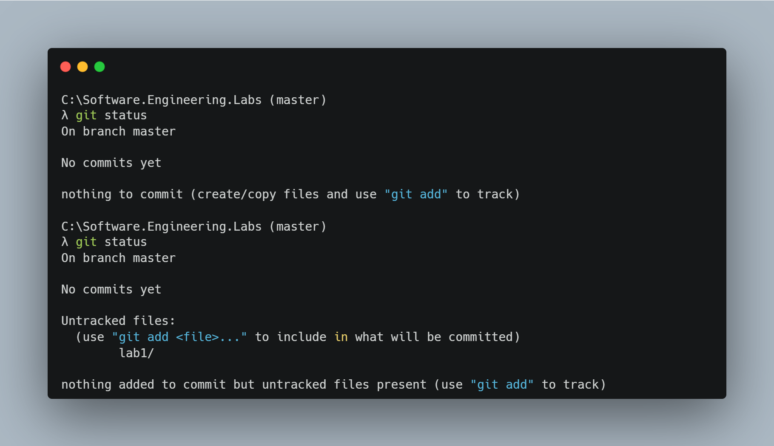
Software Engineering
Home
About us
Startegy
Contact
Page 02

Slide 4

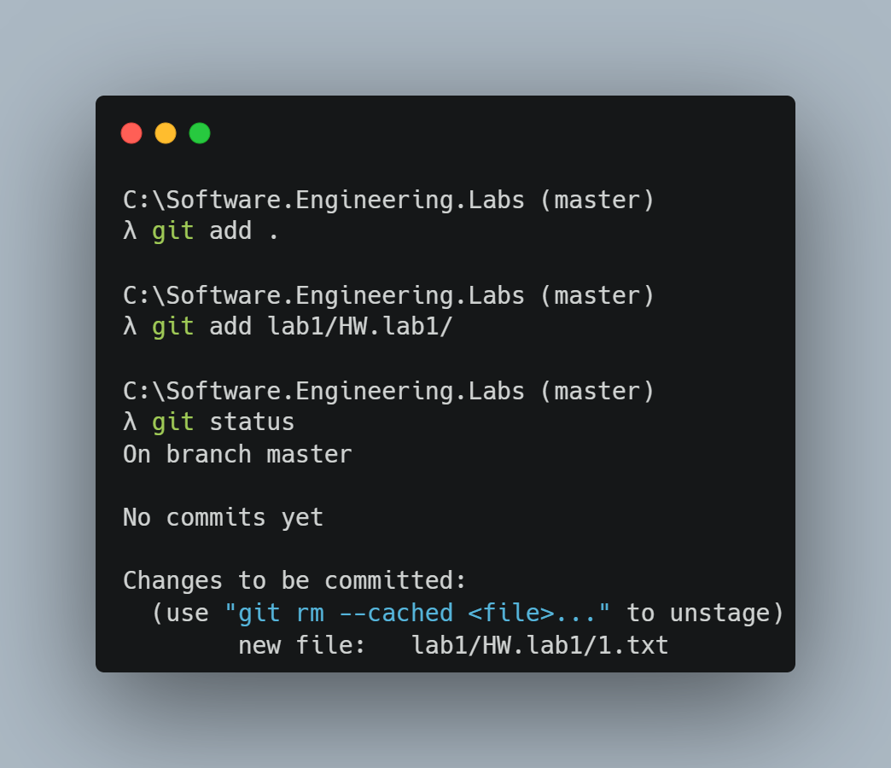
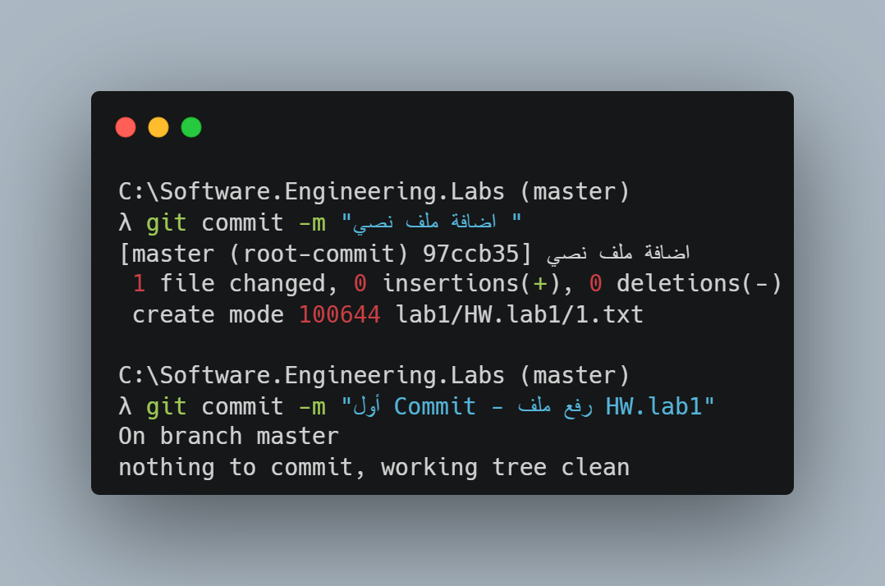
Software Engineering
Home
About us
Startegy
Contact
Page 03

Slide 5
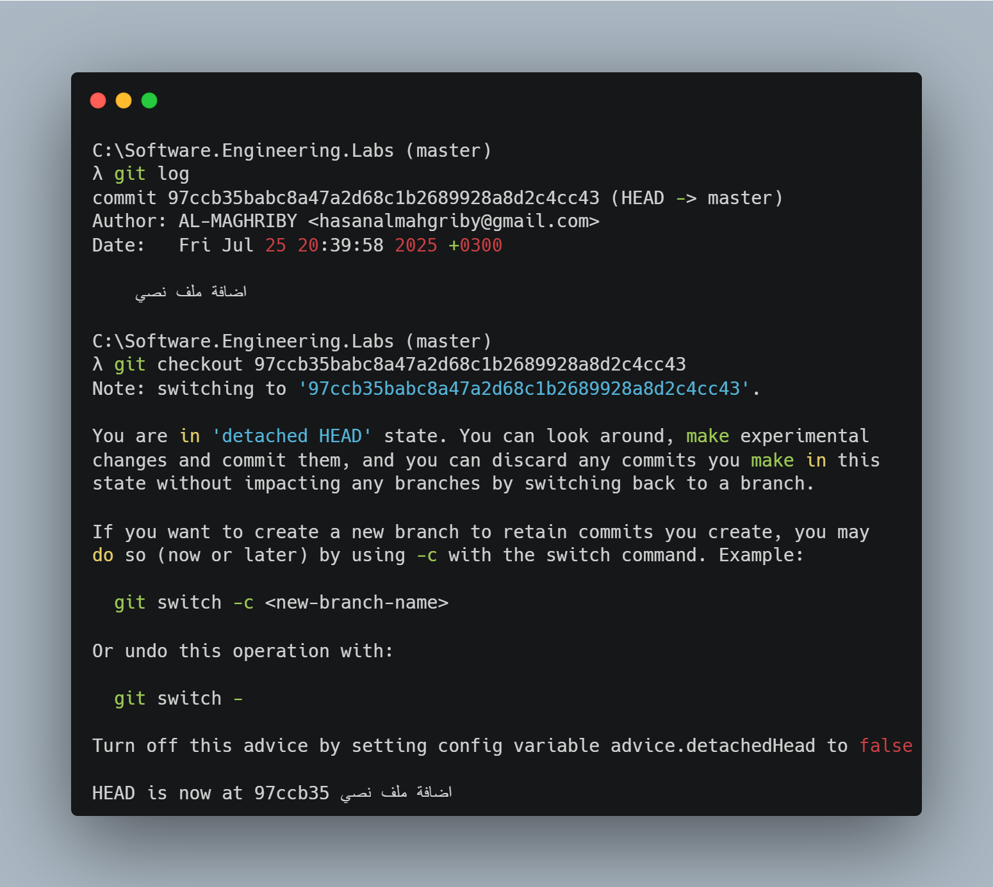
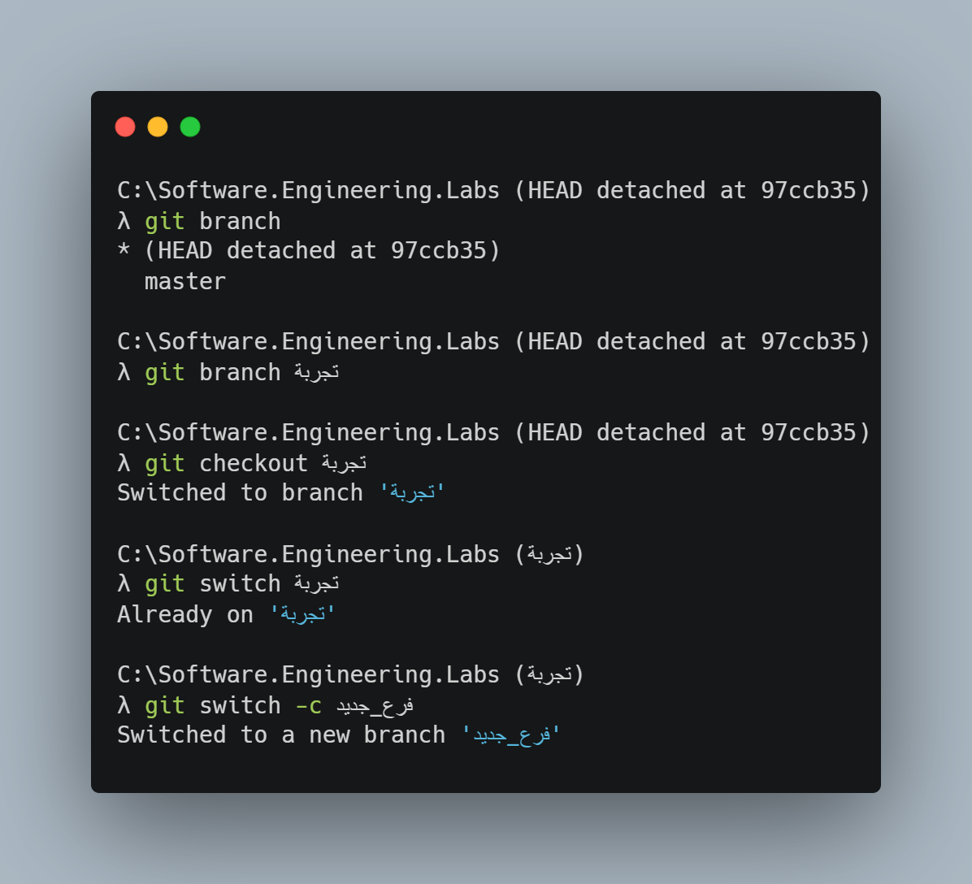
Software Engineering
Home
About us
Startegy
Contact
Page 04

Slide 6
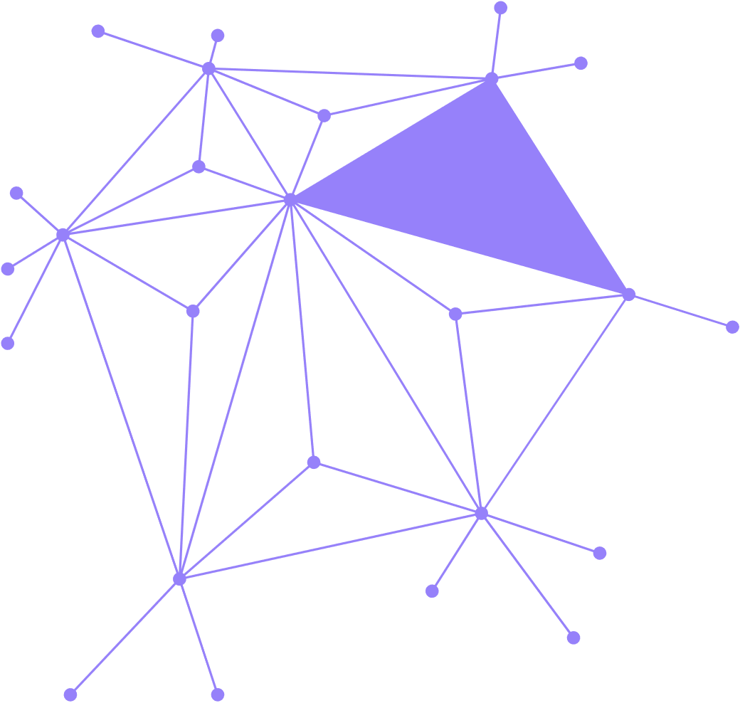
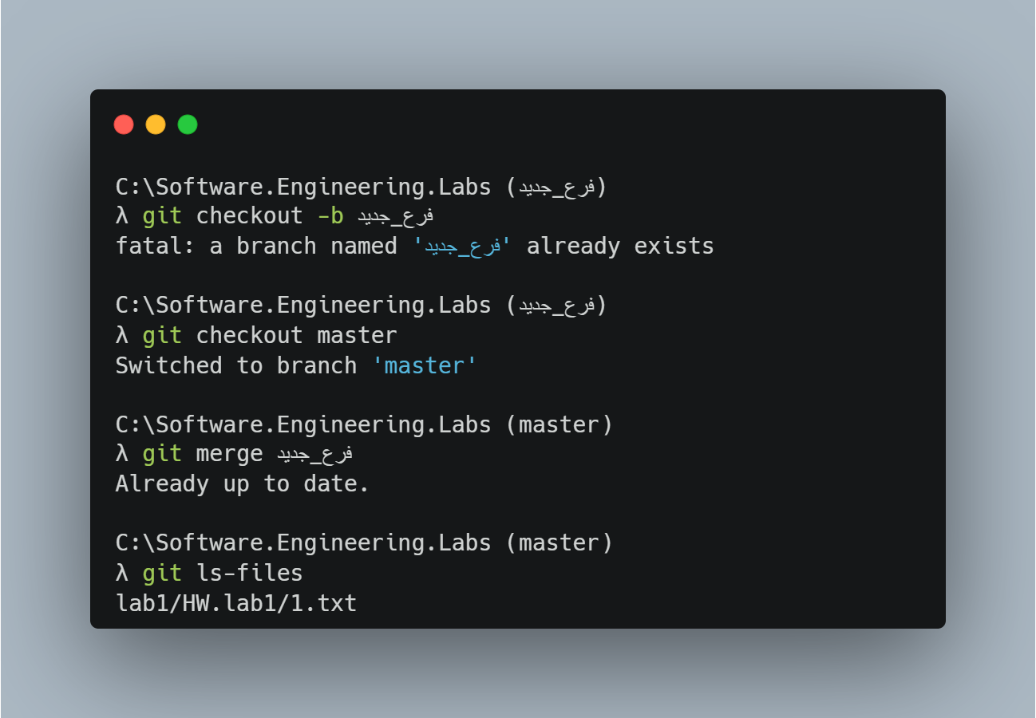
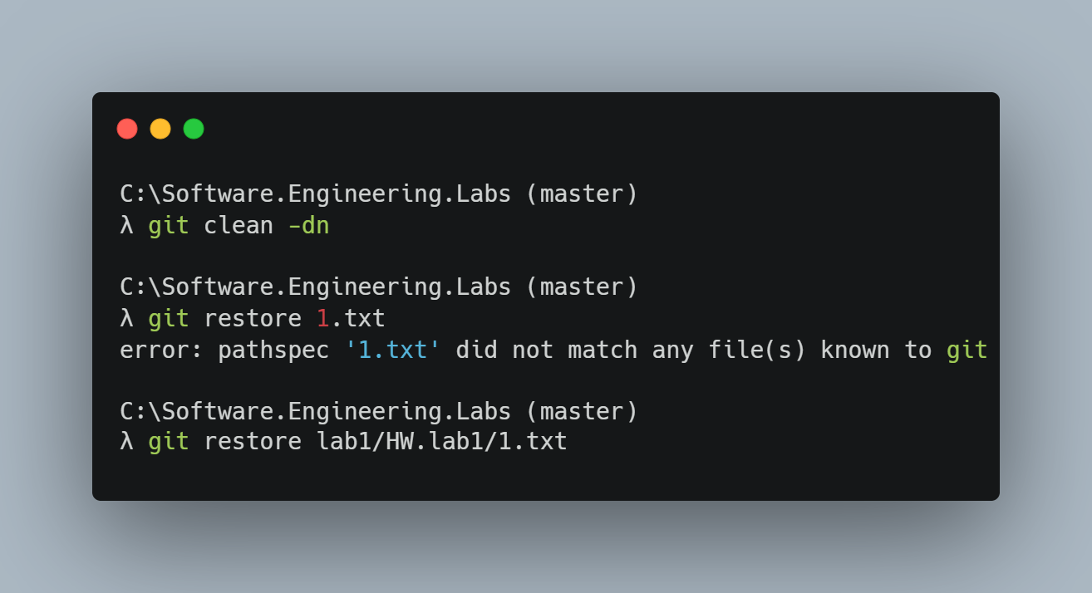
Software Engineering
Home
About us
Startegy
Contact
Page 05

Slide 7
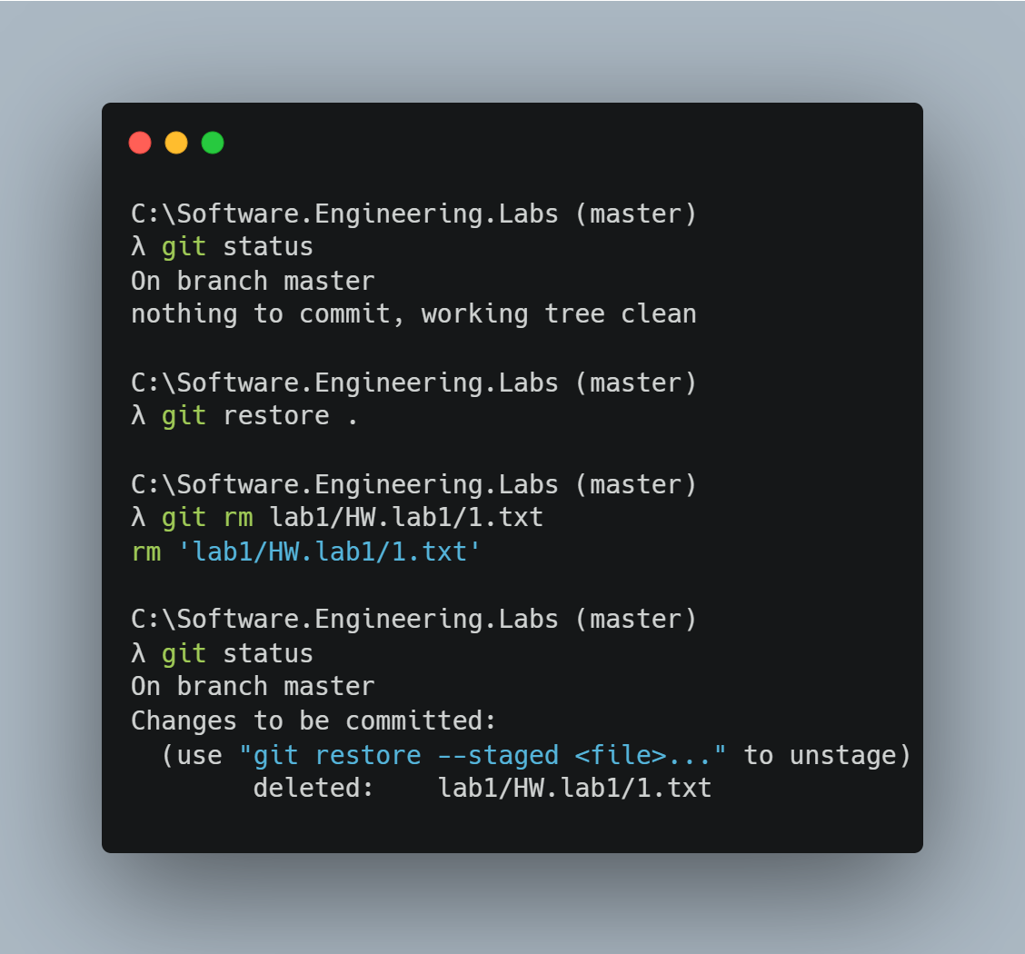
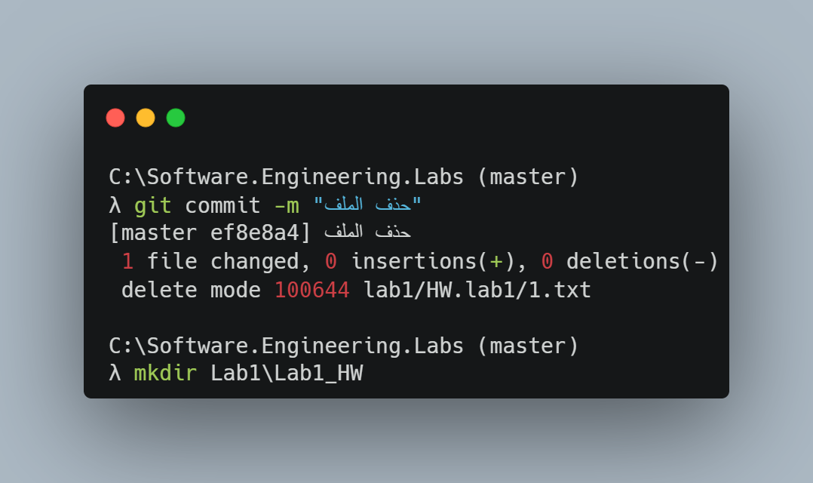
Operating System
Home
About us
Startegy
Contact
Page 06

Slide 8
Operating System
Home
About us
Startegy
Contact
Thank you very much!
Page 07

