Slide 1

ML Project: Option 4
News Categorization Model
Elnur A. – 7329516
Jan S. - 6446136
Notes:
Some words about the task.
TASK: Learn a model to classify 4 classes of news

Slide 2
Network:
def __init__(self, input_size, hidden_size, num_classes):
super(Network, self).__init__()
self.layer_1 = nn.Linear(input_size,hidden_size, bias=True)
self.relu = nn.ReLU()
self.layer_2 = nn.Linear(hidden_size, hidden_size, bias=True)
self.output_layer = nn.Linear(hidden_size, num_classes, bias=True)
def forward(self, x):
out = self.layer_1(x)
out = self.relu(out)
out = self.layer_2(out)
out = self.relu(out)
out = self.output_layer(out)
return out
Notes:
Network, Algorithm
We used the Network from the last practice class
What the Network does: Takes articles and their type as input and learns to predict type of article.

Slide 3
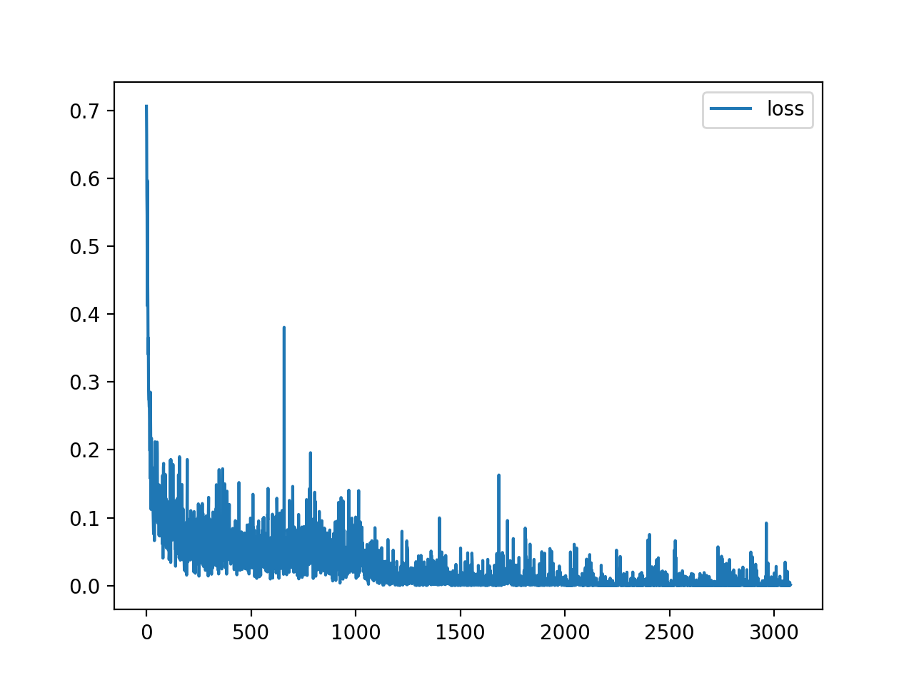
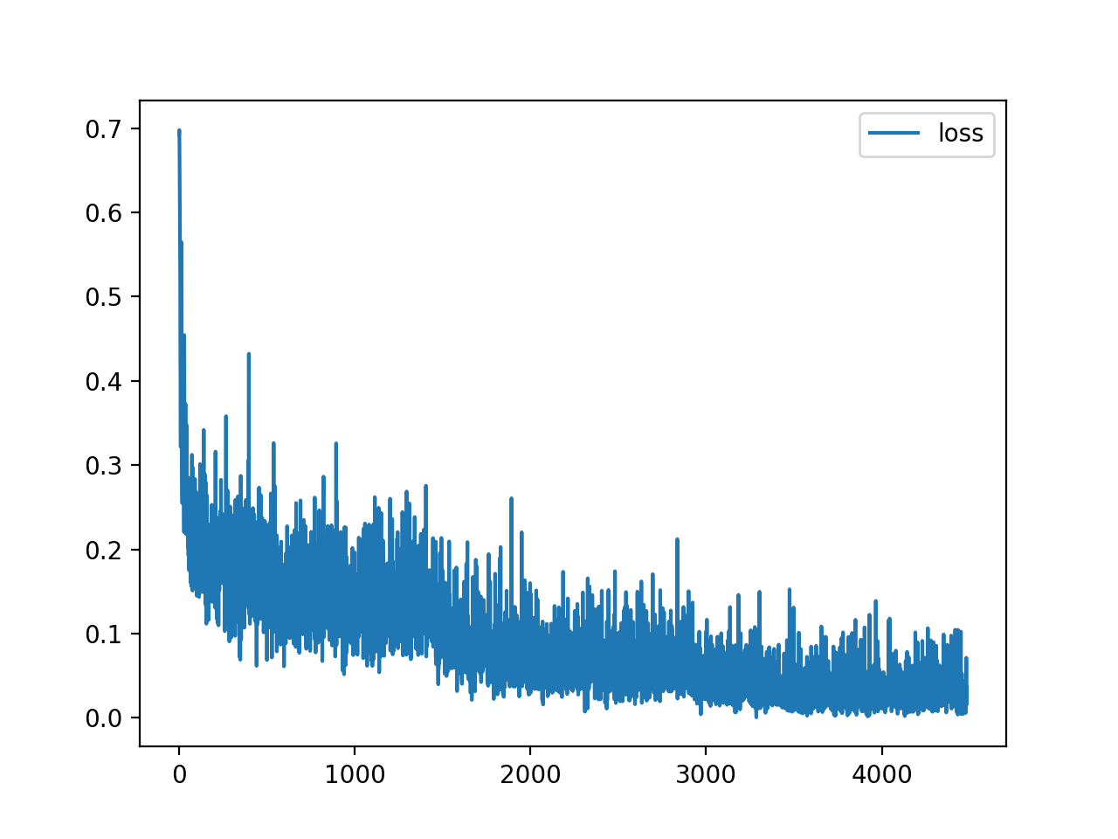
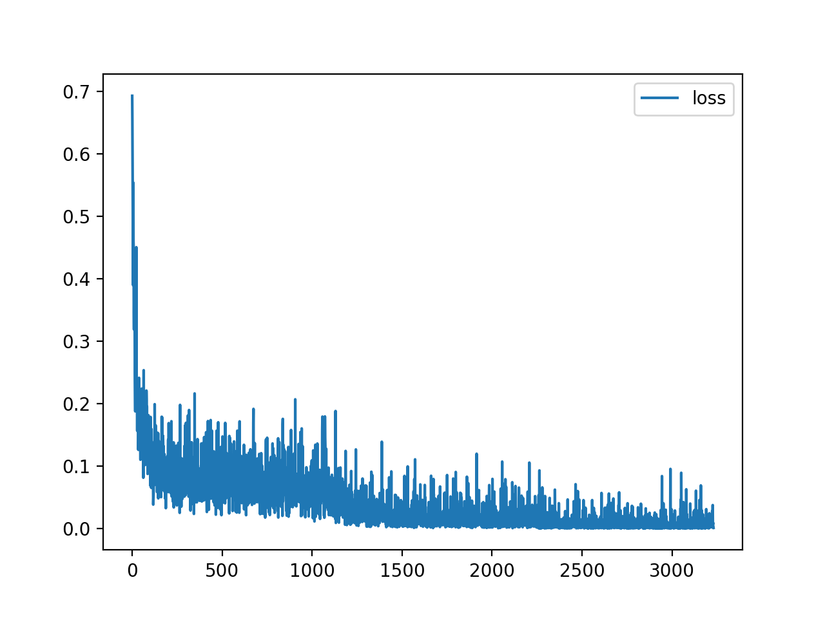
technology and health
business and technology
business and health
Binary classification
Technology and Health model learns easy
Business and Technology model learns hard
Notes:
Loss function behavior (whole dataset)
There was no worse model than “business and technology”

Slide 4
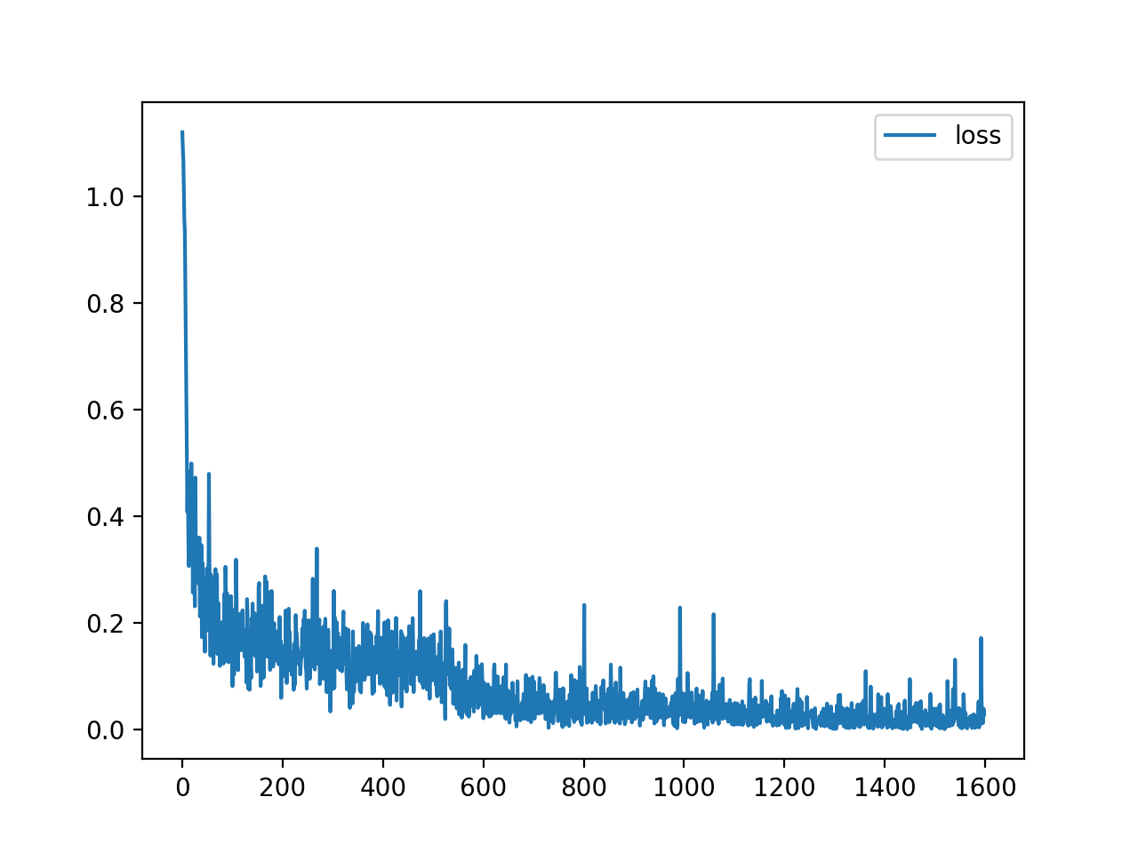
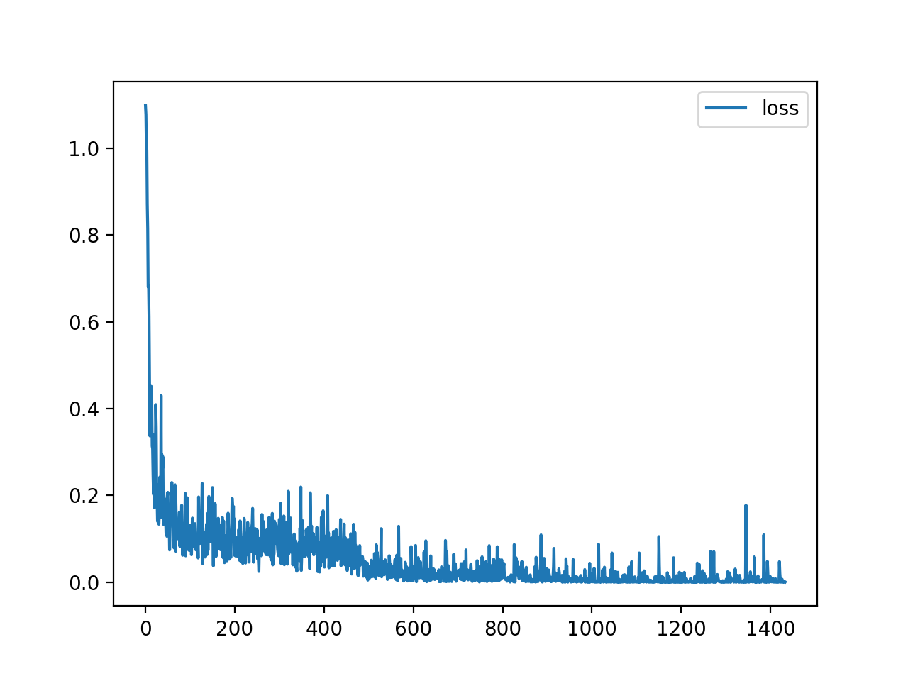
dataset: 100k
accuracy: 97%
dataset: 100k
accuracy: 99%
business, health and technology
health, entertainment and technology
dataset: 150k
accuracy: 94%
Multiclass classification:
Multiclass models learn fast too
all 4 classes
Notes:
Model of multiclass categorization learns pretty fast (strange: it learns better than binary classification for “business and technology model”)

Slide 5
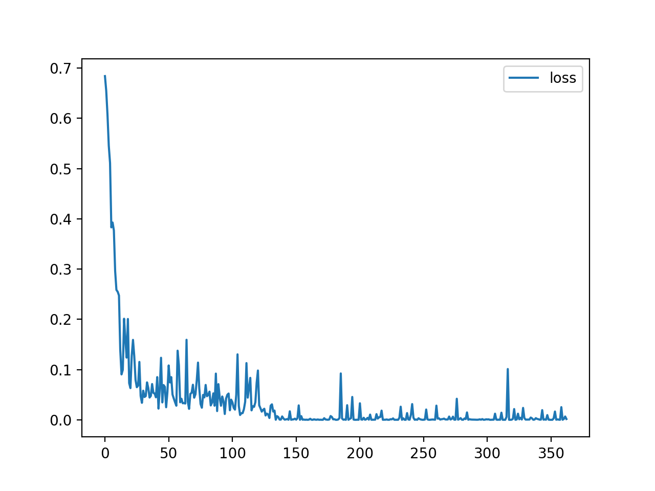
Some metrics - binary classification
accuracy: 99%
technology
Precision: 0.9991452991452991
Recall 1.0
F1-Score: 0.9995724668661822
health
Precision: 1.0
Recall 0.9979906229068989
F1-Score: 0.9989943010392223
technology and health: dataset - 100k

Slide 6
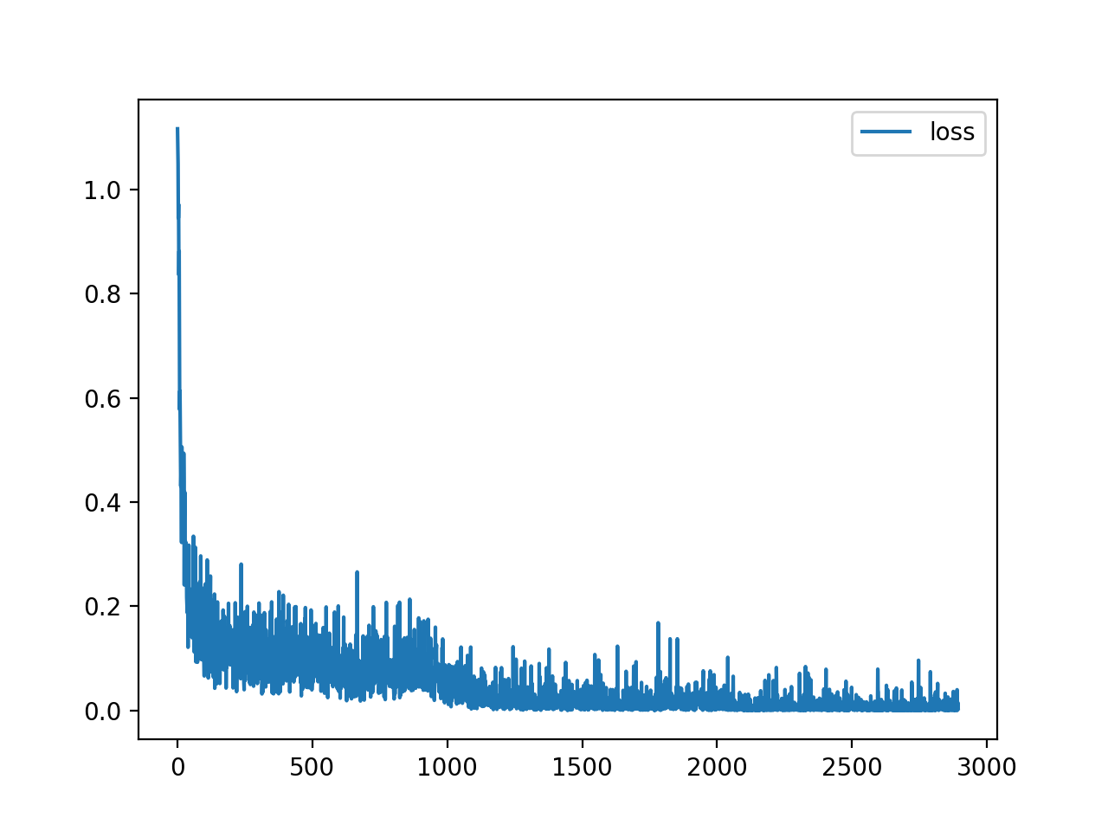
Some metrics - multiclass
Accuracy: 99 %
Category: technology
Precision: 0.9995058242146135
Recall 0.998378111557718
F1-Score: 0.998941649615466
Category: health
Precision: 0.999113160695282
Recall 0.998227892964735
F1-Score: 0.9986703306444464
Category: entertainment
Precision: 0.9986631677971975
Recall 0.9997026169706582
F1-Score: 0.9991826220493893
technology, health and entertainment: dataset – 200k

Slide 7
Reduce learning rate to 0.001 (dataset = 100k)
Accuracy: 94 %
Category: b
Precision: 0.9344031035090813
Recall 0.9298122477627654
F1-Score: 0.9321020228671943
Category: m
Precision: 0.9318385650224216
Recall 0.938572719060524
F1-Score: 0.9351935193519353
Category: t
Precision: 0.9363288333669152
Recall 0.9342581423401689
F1-Score: 0.9352923417530442
Category: e
Precision: 0.9737948430493274
Recall 0.9769436243497821
F1-Score: 0.9753666923994666

Slide 8
Evaluation:
Used NN: 2 hidden layers, ReLU activation function
Both binary and multiclass categorization models learn fast
Worst model – business and technology (binary classification)
Best model – technology and health (binary classification)
Due to the high test-accuracy of learned model other metrics are also relatively high.

Slide 9

Thanks for your attention! GitHub?

