Slide 1

Cognitive Considerations
Accessibility Beyond Compliance (ABC)
Trevor Pierce Designer + Accessibility Specialist, VSP trevor@adhocteam.us
Jennifer Strickland Designer + Accessibility Specialist, VSA
jennifer.strickland@adhocteam.us
January 24, 2020

Slide 2
“For most people, technology makes things easier. But for people with disabilities, technology makes things possible.”
– Mary Pat Radabaugh

Slide 3
Schedule and upcoming sessions
ABC » Cognitive Considerations
5-minutes — Chat, wait for stragglers
5-minutes — Introduction
20-minutes — Content
20-minutes — Q&A
10-minutes — Wiggle room, or free for a bio break before your next meeting
Upcoming Learning Sessions
February 21 Web Performance Impact on UX & Accessibility
Then, we’ll evaluate how these learning sessions are going, to ensure this is a useful format.
Previous ABC Learning Sessions are available in our repo.

Slide 4
Subject Matter
We are going to touch on PTSD, mental injuries/illness, and other cognitive considerations. I aim for this to be a safe space where we may speak about these tough subjects, but acknowledge this may be hard.
It’s okay to take a break if you need to.
Notes:
• If you find yourself triggered, please seek professional support.
• One option is to call the PRS Crisis Text Connect line at 1-800-273-8255, or text ‘connect’ to 85511.

Slide 5
Agenda and intro
ABC » Cognitive Considerations
What are Cognitive Considerations?
Design Considerations
Technology Solutions
“Just ask for help.”
Accessibility Compliance

Slide 6
According to the World Health Organization (WHO), mental health is “a state of well-being in which the individual
realizes [their] own abilities,
can cope with the normal stresses of life,
can work productively and fruitfully,
and is able to make a contribution to [their] community”

Slide 7
In the United States
1 in 5 adults experience a mental illness in a given year.
1 in 25 adults live with a serious mental illness.
6.9 percent of adults live with major depression.
18.1 percent of adults live with an anxiety disorder.
African Americans and Hispanic Americans use mental health services at ½ the rate of whites.
Asian Americans at ⅓ the rate of whites.
LGBTQ individuals are 2 or more times more likely as straight individuals to have a mental health condition.
Depression and anxiety have a significant economic impact; the estimated cost to the global economy is US$ 1 trillion per year in lost productivity.
Sources: https://www.nami.org/NAMI/media/NAMI-Media/Infographics/GeneralMHFacts.pdf
https://www.nami.org/NAMI/media/NAMI-Media/Infographics/MulticulturalMHFacts10-23-15.pdf
https://www.who.int/mental_health/in_the_workplace/en/
Notes:
In the United States
1 in 5 adults experience a mental illness in a given year.
1 in 25 adults live with a serious mental illness.
6.9% of adults live with major depression.
18.1% of adults live with an anxiety disorder.
African Americans and Hispanic Americans used mental health services at ½ the rate of whites. Asian Americans at ⅓ the rate of whites.
LGBTQ individuals are 2 or more times more likely as straight individuals to have a mental health condition.
Depression and anxiety have a significant economic impact; the estimated cost to the global economy is US$ 1 trillion per year in lost productivity.
https://www.nami.org/NAMI/media/NAMI-Media/Infographics/GeneralMHFacts.pdf
https://www.nami.org/NAMI/media/NAMI-Media/Infographics/MulticulturalMHFacts10-23-15.pdf
https://www.who.int/mental_health/in_the_workplace/en/

Slide 8
Nearly half (47.7 percent) of all Gulf War II veterans with a disability reported a cognitive difficulty.
Source: https://www.census.gov/content/dam/Census/library/working-papers/2016/demo/Holder-2016-01.pdf

Slide 9
Since October 2001, approximately 1.64 million U.S. troops have deployed to support operations in Afghanistan and Iraq.
A study conducted by the RAND corporation estimates approximately 300,000 veterans who have returned from Afghanistan and Iraq are currently suffering from PTSD or major depression, and about 320,000 may have experienced a traumatic brain injury (TBI) during deployment.
Approximately 18.5 percent of U.S. service members who have returned from Afghanistan and Iraq currently have post-traumatic stress disorder or depression; and 19.5 percent report experiencing a traumatic brain injury during deployment.
Sources: https://www.rand.org/pubs/monographs/MG720.html and https://www.rand.org/news/press/2008/04/17.html

Slide 10
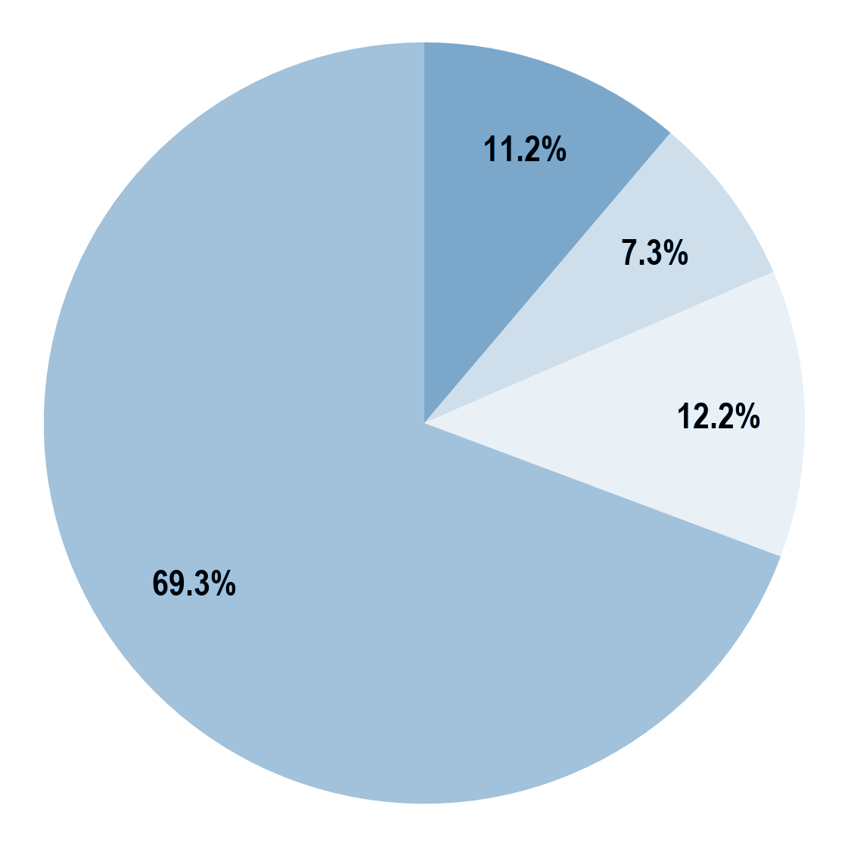
An estimated 31 percent of troops returning from Iraq and Afghanistan have a mental health condition or reported experiencing a TBI.
PTSD or depression, no TBI
PTSD or depression and TBI
TBI only
No PTSD, depression, or TBI
Source: https://www.rand.org/pubs/research_briefs/RB9336.html

Slide 11
What do you think of these stats?

Slide 12
What are Cognitive Considerations?
ABC » Cognitive Considerations

Slide 13
A disability is a condition that limits a major life activity.

Slide 14
Accessibility helps more than just the blind
ABC » Cognitive Considerations
There are five disability types that are commonly considered in digital accessibility:
seeing
hearing
speaking
moving
thinking
“Thinking” includes disabilities that impact emotions, problem-solving, memory, and other ways we use our brain.
Notes:
https://www.deque.com/blog/an-introductory-guide-to-understanding-cognitive-disabilities/

Slide 15
“Thinking” disabilities
ABC » Cognitive Considerations
Cognitive disabilities are by far the most common type of disability and may arise as a result of:
congenital conditions from birth
developmental conditions from a young age
traumatic injury, infections, chemical imbalances, or other conditions later in life
They may also be situational considerations attributed to fatigue, environmental stimulus, or being new to a situation.

Slide 16
Some types of cognitive disabilities
ABC » Cognitive Considerations
aphasia | Speaking (finding words), writing or understanding language
autism | May have difficulty understanding some communications or social interactions
attention deficit/ hyperactivity disorder | Focusing and keeping attention
dyslexia | Recognizing letters and words
dyscalculia | Recognizing numbers and symbols
intellectual | “Intellectual functioning (such as learning, problem-solving, judgment) and/or adaptive functioning (activities of daily life such as communication and independent living)”
memory loss | Difficult time remembering past events, new events, or both
These types of cognitive disabilities are just the beginning, there are many more.
Notes:
Intellectual definition from the American Psychiatric Association Below are simple to understand descriptions of the problems people with cognitive disabilities encounter. Let’s talk about words and phrases you can use to describe problems or barriers you may find:
Attention – ability to focus and keep focused on the current task
Processing Speed – the rate at which the brain handles information
Short-Term Memory – the ability to retain information for short periods of time
Long-Term Memory – the ability to store and recall information for later use
Logic & Reasoning – the ability to reason, prioritize and plan
Language Processing – the ability to recognize letters and words and the ability to understand written or spoken language
Math Processing – the ability to recognize numbers and symbols and the ability to understand and calculate simple math
The first three skills (attention, processing speed, and short-term memory) are part of automatic processing. The last four skills (long-term memory, logic and reasoning, language processing and math processing) are part of higher thinking.

Slide 17
Cognitive disability spectrum
ABC » Cognitive Considerations
There are so many different kinds, and so many variations.
An individual may experience a deficit in only one area, rather than all of them.
Some trends or categories are worth listing, not because they apply to everyone, but because they are part of the cognitive disability spectrum.

Slide 18
Functional disabilities
ABC » Cognitive Considerations
We consider cognitive disabilities by functional disability. Functional disabilities ignore the medical or behavioral causes of the disability and instead focus on the resulting abilities and challenges. Cognitive disabilities impact the capacity of an individual to:
think
concentrate
react to emotions
formulate ideas
problem solve
reason
remember
Notes:
Cognitive is a tough area because the differences are so diverse. I try to pair it with thinking about distracted users. What happens when a person gets pulled off task? How can we keep them on task? How can we get them back into "flow" when they return to the task?
Find a way to relate to the team. If they don't have or know a disabled person in their life, then focus on things like, what if you broke your glasses? What if you are holding a baby in one arm? Need to run into the other room for 10 minutes to handle a child who fell and hurt themselves?
Most people can understand situational disabilities that are temporary, and when related to how by helping those people we are helping the disabled too, they start to get it.

Slide 19
Design Considerations
How to incorporate this info into your day-to-day
ABC » Cognitive Considerations

Slide 20
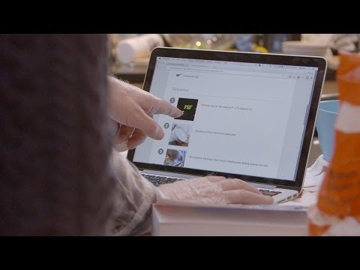

Slide 21
Limited Comprehension
ABC » Cognitive Considerations
Most people with cognitive disabilities experience limited comprehension of one kind or another.
They may not be able to understand complex ideas.
They may have difficulty with metaphors or abstract language.
They may not understand some kinds of slang or idiomatic expressions.
Some people with cognitive disabilities have exceptionally high cognitive functions in one area — the ability to remember numbers or conversations — but low cognitive functions in other areas, such as social skills or emotional awareness.

Slide 22
Considerations for lower comprehension
ABC » Cognitive Considerations
Users who have lower comprehension will have a better experience if the interface and content are easy to use and understand. Too many options and complex information may be difficult for them to process.
Simplify the interface as much as possible (reduce content, provide structure).
Simplify the content as much as possible (i.e., PlainLanguage.gov).
Keep content to short sentences, bullets, good summarizing headings.
Keep videos and audio as short as possible.
Limit the number of choices on the screen.
Provide help features, especially contextual help.
Design for ease of use, anticipate possible errors.
Test the usability of the interface with actual users, preferably including users with cognitive disabilities.

Slide 23


Slide 24
Short-Term Memory Loss
ABC » Cognitive Considerations
Some people with cognitive disabilities have a hard time remembering things from one moment to the next. Their brains don’t allow them to focus on new information, so they don’t retain it in the short term.
Long web processes — such as online purchasing procedures, account sign-up procedures, or setting preferences — can cause users to forget what they were doing, or to lose track of information that they may need to remember from one step to the next.
Notes:
Consider calling out (speaking to) what specific improvements could be made about this interaction you show in the video. Maybe something like, "We could rewrite our loading messages to be more specific about what page we're waiting on"

Slide 25
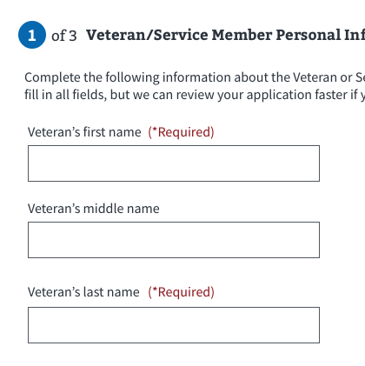
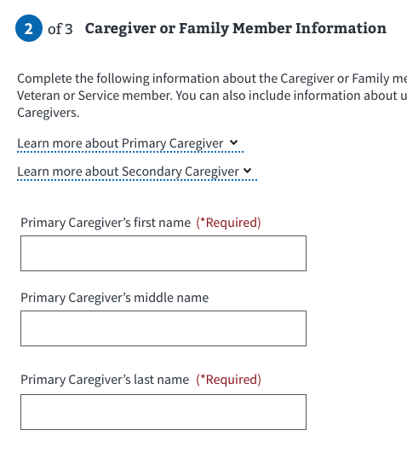
People with memory loss
ABC » Cognitive Considerations
A website that has predictability across all its pages (same navigation, same structure, etc.) will greatly benefit users with memory loss. Sites that are too complicated may fatigue users with memory loss. If users have difficulty interacting with the web page, help features can assist them with navigating the web page.
Retain information across screens, and within a path.
Provide help features, particularly contextual help.

Slide 26
Attention Deficit
ABC » Cognitive Considerations
Some users experience attention deficits, making it hard for them to focus on the task at hand. They may
get lost in their own thoughts…
find online ads or long loading indicators distracting…
causing them to forget why they went to the website in the first place.

Slide 27
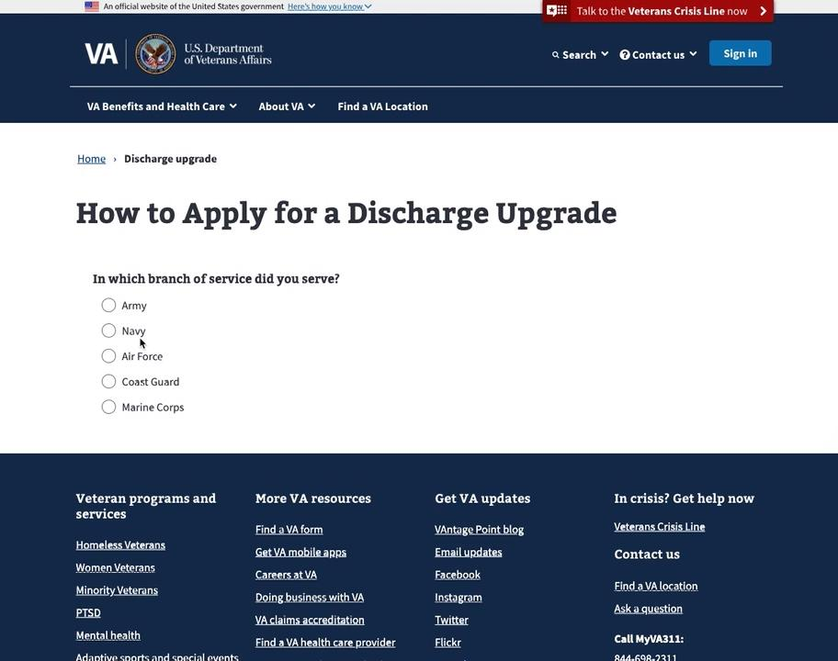
People with distractibility
ABC » Cognitive Considerations
Too many distractions on a web page may cause people with cognitive disabilities to miss important information being conveyed on a web page. Distractions may cause them to lose focus or overwhelm them, and users may navigate from the web page.
Reduce or eliminate distractions
Be careful with motion, ads, carousels, intrusive audio, intrusive video, etc.
Allow user to stop / control

Slide 28
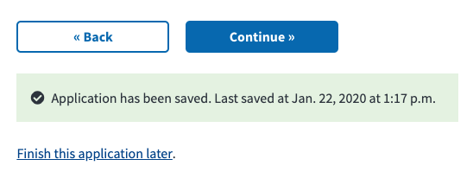
Low Tolerance for Cognitive Overload
ABC » Cognitive Considerations
Some people with cognitive disabilities easily become frustrated or upset when they sense difficult situations, or when there are too many things in their environment happening at the same time. They cannot handle the complexity of the moment, may need to take a break. They need things to be simple and straightforward. Too many choices can cause them to freeze, and they may be emotionally unable to change their state of mind for a period of time.
Notes:
The Veteran at DAV

Slide 29
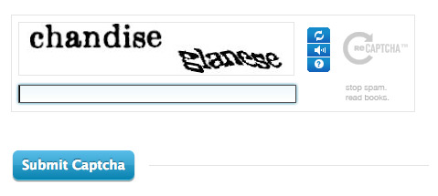
Limited Problem-Solving Skills
ABC » Cognitive Considerations
When presented with a problem to solve, some people with cognitive disabilities may simply be unable to solve it, so they may not even attempt to solve it. If a website requires users to type text in a CAPTCHA, for instance, they may not be able to process what kind of action is required.
If they type an incorrect response and get an error message, they may not be able to figure out why they got the error message, or how to solve the problem.
Notes:
https://www.fastcompany.com/90369697/googles-new-recaptcha-has-a-dark-side

Slide 30
Difficulty Reading
ABC » Cognitive Considerations
Many people with cognitive disabilities experience difficulty reading.
Some read at a lower level than their peers of the same age, and some can't read at all. It can help to provide illustrations or audio to supplement text.
Some people with dyslexia have high levels of cognitive function at a conceptual level, but visual encoding of text can be difficult, so they have a hard time spelling or reading words.
Some with dyslexia read the ‘shapes’ rather than letters.
Dyslexia Bookmarklet https://data.qz.com/2016/dyslexia/
Show on https://www.va.gov/

Slide 31
Designing for dyslexia
ABC » Cognitive Considerations
Although the number of people with dyslexia is far greater than the number of blind users, few building experiences know how to design for them.
Typography
try to use a sans-serif font
‘hooks’ on serif letters may distort shapes
if you must use a serif, reduce letter-spacing slightly
explore typefaces developed for dyslexic users
avoid using italics and underlines which can visually distort text
bold is recommended for emphasis

Slide 32
Designing for dyslexia
ABC » Cognitive Considerations
Although the number of people with dyslexia is far greater than the number of blind users, few building experiences know how to design for them.
Layout
aim for columns of no more than 80 characters per line
narrower columns make reading easier
use percentage widths for text areas
set margins to “0 auto” via CSS so margins adjust proportionately
white space is your friend, but must be consistent

Slide 33
Designing for dyslexia
ABC » Cognitive Considerations
Although the number of people with dyslexia is far greater than the number of blind users, few building experiences know how to design for them.
Tools
offer readability tools, such as text-to-audio option via an automated tool
ensure your markup activates functionality like iOS Reader Mode
Navigation
keep navigation as logical as possible
ensure Home page is accessible throughout your website or app, offering reassurance if people start feeling confused

Slide 34
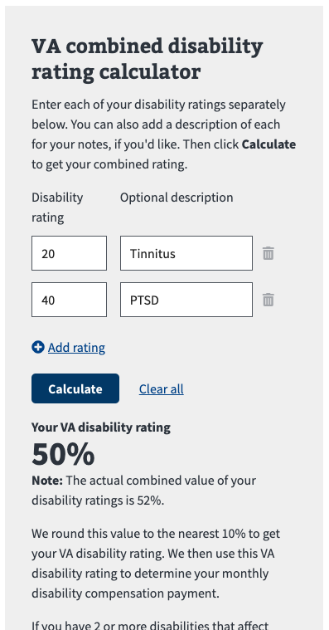
Difficulty Understanding or Using Math
ABC » Cognitive Considerations
Some people experience math anxiety, which is an emotional or psychological fear that grips some people when confronted with math problems. This is less of an intellectual deficit than a psychological deficit. Other people truly cannot solve mathematical problems because their brains are not capable of that kind of thinking.

Slide 35
Examples of user needs
ABC » Cognitive Considerations
For reference in documenting acceptance criteria and scenarios, here are three examples of types of user needs for people with cognitive disabilities:
Easy to use and secure authentication
i.e. “I need a secure way to log in that is easy enough for me to use.”
No distractions
i.e. “I need to be able to read content or complete a task without distractions.”
Prevent errors
i.e. “I need help avoiding mistakes, and minimizing mistakes I might make.”

Slide 36
What are some examples of digital design that support cognitive considerations?

Slide 37
Technology Solutions
ABC » Cognitive Considerations

Slide 38
Assistive Technology (Software/Hardware)
ABC » Cognitive Considerations
There are many solutions to help people with disabilities access content online. Assistive technologies can help people with disabilities:
Type or speak to their computer to help them write emails
Search the internet
Post to Facebook
Keep records
Make documents
For cognitive disabilities, there are also assistive technologies that can:
Remember passwords
Help a person organize their thoughts before writing a letter
Keep track of where they are in a project

Slide 39
What are some tools that support cognitive considerations?

Slide 40
“Just ask for help.”
ABC » Cognitive Considerations

Slide 41
Often, if you cannot do something on your own, or encounter inaccessible experiences, the common response is “just ask for help.”
However, this is not an appropriate response to a person with a cognitive disability, as they should be able to access the web with the same independence as a person without a disability.

Slide 42
Keeping information private
ABC » Cognitive Considerations
Being able to access your information independently is a civil right. This is very important when the information about you is personal and something you want to keep private.
Asking for help means having to sacrifice not only independence, but may become vulnerable to sharing personal information, such as medical information in the following example. Potential accessibility blockers:
The website does not work with your assistive technology.
You can’t remember your login and password, then have trouble resetting it because the steps are not easy to follow.
Once you open the results, they are in a PDF that doesn’t work with your assistive technology.
It may happen with password information on VA.gov, if the person encounters issues with login.

Slide 43
Deliver for the range of possibilities
ABC » Cognitive Considerations
Sometimes people just need information presented in a different way in order to retain their independence. How might that apply for someone who learns best from videos? Here are a few examples of accessibility blockers in a video that may exist for a person with a cognitive disability.
Difficult words — The words and examples in the video script might be too difficult.
Complicated directions — The video may not break things down so the steps are easy to follow. Do you ever get lost when the directions are too complicated?
No captions — Many people use captions, including some people with cognitive disabilities. If the captions are not there, some people may not be able to follow along. They may not remember the information as well. Or they may not learn the new vocabulary.
Not able to turn captions off — For other people the captions can be distracting. If unable to turn off the captions, they may have difficulty focusing on your content.
Can’t play video — What if you can’t control the video player using your way of interacting with a computer (such as your voice)? You may not be able to use the video at all.

Slide 44
“Our job isn’t to tell them how to interact with what we create; our job is to create something that they can interact with in whatever way they choose to interact.”
– John Porter

Slide 45
How do you react when you have to ask for help with something, and have to reveal your SSN, for example?

Slide 46
Accessibility Compliance
ABC » Cognitive Considerations

Slide 47
Is There Existing Web Accessibility Legislation?
ABC » Cognitive Considerations
A group of people at the W3C created a rule called the Web Content Accessibility Guidelines (WCAG).
This rule explains how to make the web work better for people with disabilities.
Some countries have made this rule required for governments to follow. Examples are the United States, Canada, and Europe.

Slide 48
Do these rules apply for supporting people with cognitive disabilities?
ABC » Cognitive Considerations
The Cognitive Accessibility Task Force at the W3C is working on making the web more accessible for people with cognitive disabilities. They identify where user needs are not being met and are writing a guide for “Making Content Usable for People with Cognitive and Learning Disabilities.”
Their efforts informed WCAG 2.1, which builds on and extends WCAG 2.0, but does not supersede or replace 2.0.
WCAG 2.0 doesn’t explicitly list criteria for cognitive considerations. The WCAG 2.0 spec has sections for Perceivable (1) and Understandable (3) that hint at cognitive, but each release builds on the previous one and fills in gaps, adding more clarity and expectation to those seeking to follow that standard. WCAG 2.1 is the next release.
The same criteria that ensure an accessible experience — semantic structure, sight and sound, interactivity and dynamic content, understandability — apply for cognitive considerations.

Slide 49
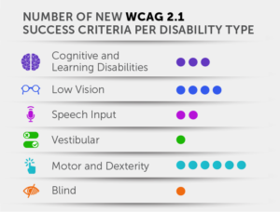
What’s in WCAG 2.1?
ABC » Cognitive Considerations
WCAG 2.1 success criteria primarily address items related to mobile (small screens and touch screens) that accommodate users with motor and dexterity disabilities, users with low vision, and users with cognitive disabilities. In addition, there are success criteria that benefit users of voice input, users with vestibular disabilities, and users of screen readers.
Sources: https://dev-level-access.pantheonsite.io/wcag-2-1-exploring-new-success-criteria/

Slide 50
Accessibility Beyond Compliance (ABC)
Still editing
ABC » Cognitive Considerations
When thinking about web accessibility, a lot of focus is on ‘checking the boxes’ to meet Section 508 compliance. As Trevor Pierce says, this is a fear mindset: doing accessibility as a way of running away from pain for the company.
Accessibility beyond compliance acknowledges needing to meet those standards. But that’s not enough. It’s possible to meet the standards, and a screen reader user still not be able to navigate your site because your headings don’t make sense, your links are styled as buttons (or vice-versa), or you otherwise break expected patterns for how real people use real websites.
Accessibility beyond compliance isn’t about fear, it’s running TO an equitable, inclusive future, where end users are co-creators, where people building websites think about HOW an actual human being will interact with them. It’s about not resting on the laurels of a clean compliance scan, but embracing the work of welcoming your users in, learning how you can do better, and then doing it.

Slide 51
Planning towards the future…
Still editing
ABC » Cognitive Considerations
Currently, 508 Compliance is based on the Web Content Accessibility Guidelines (WCAG) 2.0 standard. The new standard, WCAG 2.1, was released last year and includes new standards for mobile and cognitive considerations. So, we want to be sure we’re prepared for when Section 508 is based on WCAG 2.1.
This isn’t a burden. It's not a negative. It's a craftsmanship. For example, the curb cuts on a sidewalk, is now better for everyone — whether you have a stroller, wheelchair, or joint pain; the bumps are inclusive.
Notes:
One example for a stressful interaction and the ability for someone to take breaks, like in form design if someone can save their progress, walk away, pause, and come back — tell the story of the Veteran at the DAV and John French kids & blueberries)

Slide 52
As you look at these user needs, you may be thinking, everyone will benefit from these improvements. Correct!
But for a person with a cognitive disability, these user needs are crucial for them to equally access content online.

Slide 53
Thank you! Any questions?
Contact your accessibility specialists in #vetsgov-accessibility channel in the DSVA Slack, or message Trevor Pierce (VSP) or Jennifer Strickland (VSA).

Slide 54
Takeaways
ABC » Cognitive Considerations
Simplify the interface as much as possible
Simplify and shorten the content as much as possible
Keep videos and audio as short as possible
Limit the number of choices on the screen
Design for ease of use
Test the usability of the interface with actual users, preferably including users with cognitive disabilities
Retain information across screens, and within a path
Provide help features, particularly contextual help
Reduce or eliminate distractions (be careful with motion, ads, carousels, intrusive audio, intrusive video, etc.)
Provide easy to use and secure authentication
Prevent errors, and provide clear support for messages

Slide 55
Resources
ABC » Cognitive Considerations
Deque University’s curriculum on cognitive disabilities (requires subscription)
Assistive Technology for Individuals with Cognitive Impairments, 3.5MB PDF
An Introductory Guide to Understanding Cognitive Disabilities Deque
Cognitive Accessibility Mozilla Developer Network
WCAG 2.1, exploring the new success criteria Level Access
Web Accessibility Perspectives Videos W3C
How to Design for Dyslexia Usabilla/UX Booth
Dyslexia Bookmarklet https://data.qz.com/2016/dyslexia/
Funkify, Disability Simulator https://www.funkify.org
How to enable Reader Mode on your site

