Slide 1
VAMC Facilities

Slide 2
Overview
Research on VA Healthcare related facilities for four Potential Site Visits
Pittsburgh (VISN 4) Chosen due to established relationships with DSVA (early January 2019)
New England (VISN 1) Recommending due to mix of urban, suburban and rural populations, location of Rural Health Resource (1 of 3 in VA), proximities to existing team members (Dates TBD)
Los Angeles & Phoenix (VISN 22) Recommending due to highest population densities of Veterans over the age of 65 and a high number of OCs, CBOCS, Vet Centers and Rural Health Care Coordination Centers (Dates TBD)
Oklahoma (VISN 19) Recommending due to Oklahoma having the highest rate of Veteran suicide, particularly among Veterans age 18-34, we believe that there is an opportunity to contribute to VA’s number one clinical priority of reducing Veteran suicide by improving content (Dates TBD)

Slide 3
Definitions
Veterans Integrated Service Network (VISN): The U.S. is divided into 23 VISNs, regional systems of care working together to better meet local health care needs and provides greater access to care.
VA Healthcare System (HCS): In many areas of the country, several medical centers and clinics may work together to offer services to area Veterans as a Healthcare System (HCS) in an effort to provide more efficient care. By sharing services between medical centers, Healthcare Systems allow VHA to provide Veterans easier access to advanced medical care closer to their homes. A VISN will contain one or more VA Healthcare Systems within it’s network.
VA Medical Center (VAMC): VAMCs are full service hospitals that provide both inpatient and outpatient services. There is approximately 170 VAMCs cross the country. VAMCs fall within HCS’
Outpatient Clinics (OC) / Community Based Outpatient Clinics (CBOC): VHA utilizes Outpatient Clinics and Community-Based Outpatient Clinics (CBOC) across the country. These clinics provide the most common outpatient services, including health and wellness visits, without the hassle of visiting a larger medical center. VHA continues to expand the network of CBOCs to include more rural locations, putting access to care closer to home. There are approximately 1100 of these clinics across the country. OCs and CBOCs fall within HCSs
Vet Centers (VCs): Vet Centers across the country provide a broad range of counseling, outreach, and referral services to combat Veterans and their families. Vet Centers guide Veterans and their families through many of the major adjustments in lifestyle that often occur after a Veteran returns from combat. Services for a Veteran may include individual and group counseling in areas such as Post-Traumatic Stress Disorder (PTSD), alcohol and drug assessment, and suicide prevention referrals. All services are free of cost and are strictly confidential. There are also Mobile Vet Centers (MVCs). There are more than 300 VCs and MVCs across the country.
By the numbers:
23 VISNs
170 VAMCs (approx.)
1100 OC/CBOCs (approx.)
300 Vet Centers

Slide 4
Site Visit 1: VISN 4 – Pittsburgh, PA
Unique setting as the the VISN, HCS and VAMCs are all located in one city, as well as a Vet Center
Additionally there are 2 Outpatient Clinics with 30 miles
Within the VISN there is a single HCS so the downtrace is more straightforward
Facilities for January Site Visit
VISN 4 Headquarters – Pittsburgh PA
VA Healthcare System – VA Pittsburgh Healthcare System
VA Medical Centers (VAMC)
VA Pittsburgh Healthcare System H. J. Heinz Campus
VA Pittsburgh Healthcare System University Drive Campus
Outpatient Clinics
Cranberry Township VA Clinic
Westmoreland County VA Clinic
Vet Center – Pittsburgh Vet Center
Notes:
Benefit Facility Office Partner
CMS

Slide 5
Healthcare System(s)
VA Medical Center(s)
VA Pittsburgh Healthcare System H. J. Heinz Campus
VA Pittsburgh Healthcare System University Drive Campus
VA Pittsburgh Healthcare System
Pittsburgh (VISN 4)
Pittsburgh Vet Center
Cranberry Township VA Clinic
Westmoreland County VA Clinic
Outpatient Clinics / Community Based Outpatient Clinics
Vet Centers

Slide 6
Current Website Tree – VISN 4 downtrace
VISN 4 (Pittsburgh)
https://www.visn4.va.gov/
VISN - Administrative
VA Pittsburgh Healthcare System
https://www.pittsburgh.va.gov/index.asp
HCS – Administrative / Full Service Clinical (inpatient/outpatient)
Pittsburgh VAMC University Drive Campus
https://www.pittsburgh.va.gov/locations/university-drive.asp
Pittsburgh VAMC HJ Heinz Campus
https://www.pittsburgh.va.gov/locations/HJ-heinz.asp
VAMC – Full Service Clinical (inpatient/outpatient)
Corporal Michael J. Crescenz VAMC
(Philadeplphia, PA)
https://www.philadelphia.va.gov/
Wilmington VAMC
(Wilmington, DE)
https://www.wilmington.va.gov/
Cranberry Township VA Outpatient Clinic
https://www.butler.va.gov/locations/Cranberry_Township_VA_Outpatient_Clinic.asp
OC/CBOC – Clinical (outpatient)
Westmoreland VA Outpatient Clinic
https://www.pittsburgh.va.gov/locations/westmoreland.asp
Vet Center– Counseling Services (outpatient)
Pittsburgh Vet Center
https://www.va.gov/directory/guide/facility.asp?ID=592

Slide 7
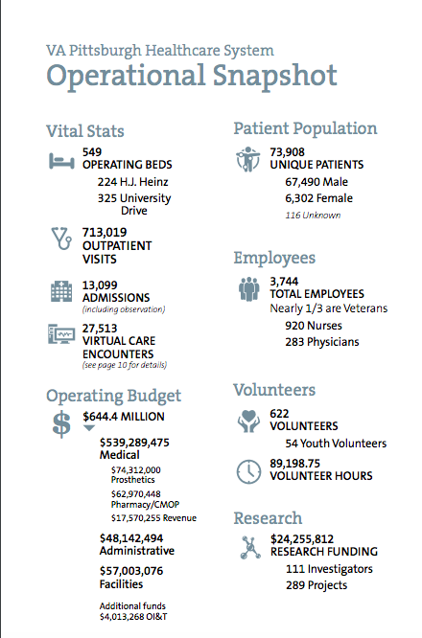
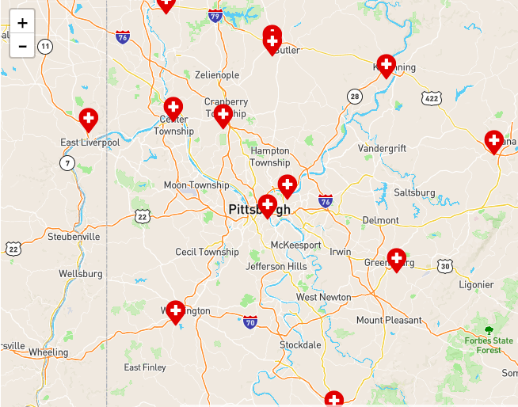
Veterans Data for the State of Pennsylvania
VA Medical Facilities in and around Pittsburgh, PA

Slide 8
Site Visit 2: VISN 1 – New England Healthcare System
2 Healthcare Systems
A wide range of facilities that include VAMCs in urban/metropolitan areas as well as rural areas
White River Junction (VT) VAMC is one of the Rural Health Resource Centers
Jane Newman works out of Boston VAMC / Josh Q. lives near the West Haven VAMC / Jeff Brauer is 1 ½ hours from White River Junction
Opportunities to cross pollinate with Regional Benefits Office(s)
Facilities for Site Visit
VA Healthcare System – VA Boston Healthcare System
VA Medical Centers (VAMC)
West Haven VA Medical Center (West Haven, CT)
Jamaica Plain VA Medical Center (Boston, MA)
White River Junction VA Medical Center (White River Junction, VT)
Outpatient Clinics -
Vet Center – White River Junction Vet Center

Slide 9
Healthcare System(s)
VA Medical Center(s)
Jamaica Plain VA Medical Center (Boston, MA)
VA Boston Healthcare System
West Haven VA Medical Center (West Haven, CT)
White River Junction VA Medical Center
(White River Junction, VT)
Office of Rural Health Hub
New England VISN 1
White River Junction Vet Center
Outpatient Clinics / Community Based Outpatient Clinics
Vet Centers

Slide 10
Current Website Tree – VISN 1 downtrace
VISN - Administrative
VA Boston Healthcare System
https://www.boston.va.gov/
HCS – Administrative / Full Service Clinical (inpatient/outpatient)
VAMC – Full Service Clinical / Co-Located with HCS (inpatient/outpatient)
Jamaica Plain VA Medical Center
https://www.boston.va.gov/locations/Jamaica_Plain_.asp
VA Connecticut Healthcare System West Haven Campus
https://www.connecticut.va.gov/locations/directions.asp
VAMC – Full Service Clinical / Standalone / Rural Health Resource Center (inpatient/outpatient)
White River Junction VA Medical Center
https://www.whiteriver.va.gov/
Vet Center– Counseling Services (outpatient)
White River Junction Vet Center
https://www.va.gov/directory/guide/facility.asp?ID=478

Slide 11
Site Visit 3: VISN 22 – Desert Pacific Healthcare Network
Covers New Mexico, Arizona, and Southern California
According to the VAs Veterans Population Data from 2016, Los Angeles, CA and Maricopa, AZ host the largest population of Veterans age 65 and older.
Los Angeles: 133,000
Maricopa: 124,000
It has been well documented that when addressing technology, there are specific needs related to seniors that need to be considered
http://www.pewinternet.org/2017/05/17/technology-use-among-seniors/
https://www.aarp.org/content/dam/aarp/research/surveys_statistics/technology/info-2018/atom-nov-2017-tech-module.doi.10.26419%252Fres.00210.001.pdf
The Healthcare Systems and VAMCs in this network are supported by a high number of Outpatient Clinics, Community Based Outpatient Clinics, Vet Centers and two Rural Health Care Coordination Centers
Facilities for Site Visit
VA Healthcare System and VA Medical Centers (VAMC)
Phoenix VA Healthcare System
VA Greater Los Angeles Healthcare System
VA West Los Angeles Medical Center
Outpatient Clinics –
VA Los Angeles Ambulatory Care Center
Thunderbird VA Health Care Clinic (Phoenix, AZ)
Vet Center –
West Los Angeles Vet Center
Phoenix Vet Center
Rural Health
Casa Grande Rural Health Care coordination Center

Slide 12
VISN 22 Desert Pacific Healthcare Network
Los Angeles
Phoenix
VA Greater Los Angeles Healthcare System
VA West Los Angeles Medical Center
Healthcare System(s)
Phoenix VA Healthcare System
VA Medical Center(s)
VA Los Angeles Ambulatory Care Center
Outpatient Clinics / Community Based Outpatient Clinics
Thunderbird VA Health Care Clinic (Phoenix, AZ)
West Los Angeles Vet Center
Vet Centers
Phoenix Vet Center
Rural Health
Casa Grande Rural Health Care coordination Center

Slide 13
Current Website Tree – VISN 22 downtrace
VISN - Administrative
HCS – Administrative / Full Service Clinical (inpatient/outpatient)
Phoenix VA Healthcare System
https://www.phoenix.va.gov/
VA Greater Los Angeles Healthcare System
https://www.losangeles.va.gov/
VAMC – Full Service Clinical / Co-Located with HCS (inpatient/outpatient)
VA West Los Angeles Medical Center
https://www.losangeles.va.gov/locations/directions.asp
VA Los Angeles Ambulatory Care Center
https://www.losangeles.va.gov/locations/directions-LAACC.asp/
OC/CBOC – Clinical (outpatient)
Thunderbird VA Health Care Clinic
https://www.phoenix.va.gov/locations/thunderbird.asp
Vet Center– Counseling Services (outpatient)
West Los Angeles Vet Center
https://www.va.gov/directory/guide/facility.asp?ID=516&map=1&dnum=1&stateid=CA
Phoenix Vet Center
https://www.va.gov/directory/guide/facility.asp?ID=380&map=1&dnum=1&stateid=AZ
Rural Health Coordination Center
Casa Grande Rural Health Care Care Coordination Center
https://www.va.gov/directory/guide/facility.asp?ID=6279&map=1&dnum=1&stateid=AZ

Slide 14
Site Visit 4: VISN 19 – Rocky Mountain Network
Utah, Montana, Wyoming, Colorado, Oklahoma and portions of Idaho, Kansas, Nebraska, Nevada and North Dakota
This site visit would focus specifically on Oklahoma
The suicide rate among Veterans in Oklahoma is far higher than the national average, specifically in the 18-34 age bracket
https://www.mentalhealth.va.gov/docs/data-sheets/2016/Oklahoma_2016.pdf
https://newsok.com/article/5594881/suicide-rates-among-these-oklahoma-vets-is-the-highest-in-the-nation
https://www.tulsaworld.com/news/state/panel-studies-ways-to-reduce-suicide-among-oklahoma-veterans/article_5c3aa9e9-e053-5819-81fa-d006bf978f1c.html
Veteran Suicide is the VA’s number one clinical priority, if there is a way to help reduce Veteran suicide by improving the content on facilities web sites to make it easier for Veterans to get the help they need before it reaches the crisis point that needs to be explored
This specific effort should be done in partnership with a number of offices and stakeholders including; VA Office of Mental Health and Suicide Prevention (OMHSP), VSOs in Oklahoma, OPIA for the purpose of working with Oklahoma State Officials and others TBD
Facilities for Site Visit
VA Healthcare System and VA Medical Centers (VAMC)
Eastern Oklahoma VA Healthcare System (Jack C. Montgomery VAMC)
Oklahoma City VA Healthcare System
Outpatient Clinics –
Tulsa Behavioral Medicine Clinic
Ada CBOC
Altus VA Clinic
Vet Center –
Lawton Vet Center
Tulsa Vet Center

Slide 15
VISN 19 Rocky Mountain Network
Healthcare System(s)
VA Medical Center(s)
Eastern Oklahoma VA Healthcare System (Muskogee, OK)
Oklahoma City VA
Healthcare System
Tulsa Behavioral Medicine Clinic
Tulsa Vet Center
Lawton Vet Center
Altus VA Clinic
Ada CBOC
Outpatient Clinics / Community Based Outpatient Clinics
Vet Centers

Slide 16
Current Website Tree – VISN 19 downtrace
VISN - Administrative
HCS – Administrative / Full Service Clinical (inpatient/outpatient)
Eastern Oklahoma VA Healthcare System
https://www.muskogee.va.gov /
VAMC – Full Service Clinical / Co-Located with HCS (inpatient/outpatient)
Oklahoma City VA Healthcare System
https://www.oklahoma.va.gov/
Tulsa Behavioral Medicine Clinic
https://www.va.gov/directory/guide/facility.asp?ID=6275
OC/CBOC – Clinical (outpatient)
Ada CBOC
https://www.oklahoma.va.gov/locations/Ada_OK.asp
Altus VA Clinic
https://www.oklahoma.va.gov/locations/Altus_OK.asp
Tulsa Vet Center
https://www.va.gov/directory/guide/facility.asp?ID=5458
Vet Center– Counseling Services (outpatient)
Lawton Vet Center
https://www.va.gov/directory/guide/facility.asp?ID=5892

