Slide 1


Volcano plots & ggplot2
Erika Duan
R-Ladies Canberra
https://github.com/erikaduan/R-tips

Slide 2

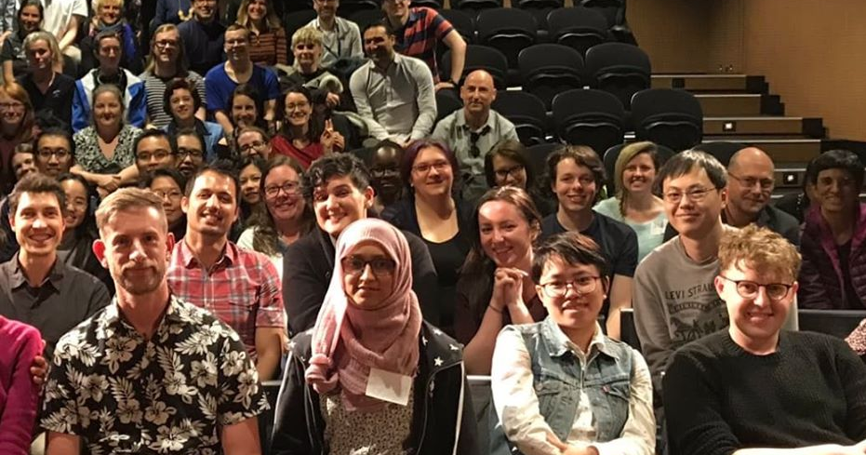

About this talk
Something I wrote up for R-Ladies Melbourne in 2018.
All credit goes to soon-to-be Dr Chuanxin Liu.
Fun fact: R-Ladies and Responsible AI meetups → I became a data scientist!

Slide 3


It’s a volcano plot if…
You are comparing between 2 different groups of samples.
You are interested in visualising how much group B differs with respect to group A.
Group A: healthy cells
Group B: ‘diseased’ cells

Slide 4



It’s a volcano plot if…
You also have lots of data points collected for both samples.
Equivalence (in unit) between these data points.
Group A: healthy cells
Group B: ‘diseased’ cells
Gene A
4 | 3 | 9 | 7 | 2 | 3 | 3 | 5 | 6 | 2
3 | 6 | 7 | 3 | 4 | 25 | 34 | 21 | 40 | 38
11 | 13 | 7 | 8 | 17 | 0 | 2 | 5 | 1 | 0
Gene B
Gene C

Slide 5
It’s a volcano plot if…
versus
Is this a gene that only appears during disease?
-log10(adjusted P value)
log2(Fold change)

Slide 6
Volcano plot: just another way to communicate complex information
Liu et al, 2019, Journal of Immunology 203 (4)

Slide 7

Let’s use this as an excuse to play around with ggplot2 !

