Slide 1

An AI Tool for STM32Cube
Technical Support
From raw GitHub data to precise technical answers:
Understanding how it works , step by step.
Presented by: Abir GHARBI
Supervised by: Ali LABBENE & Omar SAKET
PFE - 2026 | STMicroelectronics Tunis | Support & Maintenance Team

Slide 2
Today’s Program
8 steps to understand the project
01
Meet the STM32Cube persona
05
Results & evaluation
What our project is building
50Q benchmark , concrete numbers
02
What this project does ?
06
Challenges encountered
The daily problem it solves
Concrete technical challenges
03
Where AI stands in here !
07
Next steps
Persona, Knowledge Base, Data Sources
What remains and how to get there
04
The preprocessing pipeline
08
Q&A
Ingest → Clean → Enrich → Deliver
Open discussion

Slide 3
01
Why this project?
The daily problem it solves
02
C'est quoi l'IA ici do?
Persona · Knowledge Base · Data Sources
03
Meet the STM32Cube persona
What this project builds

Slide 4
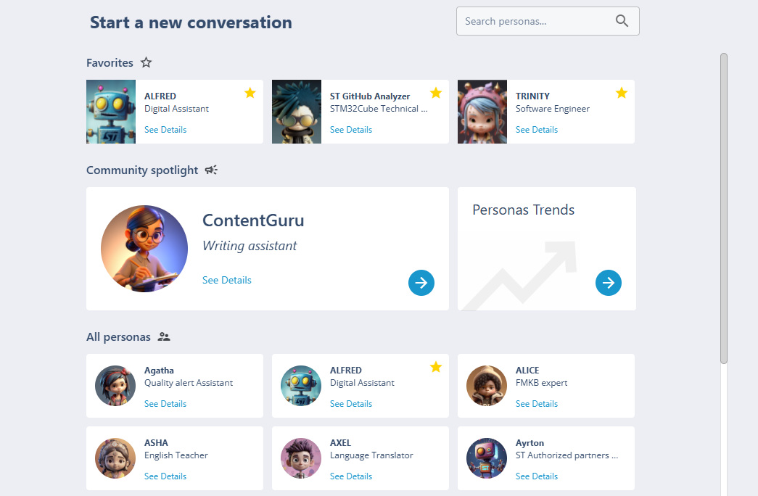
The ST ChatGPT Platform, Creating a Persona
Not just a chatbot: a configurable AI assistant built on Knowledge Bases
What is ST ChatGPT?
The ST ChatGPT platform allows teams to create specialized AI personas tailored to a specific domain or use case.
Key concept: the Persona
A persona is a configured AI assistant , it has a name, a system prompt, one or more Knowledge Bases, and associated data sources.
Personas already live at ST:
● Alfred does: general ST assistant
● Others does: domain-specific across ST teams
→ This project creates a NEW persona specialized in STM32Cube technical support.
Each persona = Knowledge Base + Data Sources + System prompt

Slide 5
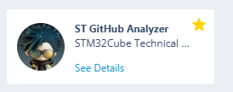
Meet the STM32Cube AI Persona
The Daily Problem in Technical Support
Before this project, finding technical information was time-consuming
The idea behind this project
ST already has personas: Alfred, Trinity, and others, each specialized for a domain.
.
A persona that knows STM32Cube.
A persona that has read 300+ issues, 5,000+ technical files, and every resolved PR. That can answer in seconds what took minutes to find manually.

Slide 6

ST ChatGPT
Request and Access Process — Persona & API ST ChatGPT
From business request to persona / API access
Business Need
ServiceNow
Validation
Access / Configuration
Usage
Yes
Is the request for New Persona / API?
No
For existing persona updates, admin rights, system prompt updates.
Technical issues
Change requests
Click on this link
Click on this link
https://st.service-now.com/hub?id=sc_cat_item&sys_id=b7e4acc9fb1d66103949f4bbaeefdc7b
https://st.service-now.com/hub?id=support_details&topic=d0a6002b1b53d2d0aaf48553604bcb1b

Slide 7
ST ChatGPT
Request and Access Process — Persona & API ST ChatGPT
From business request to persona / API access
Business Need
ServiceNow ServiceNow
Validation
Access / Configuration
Usage
For each new persona / API:
  1st level review and approval by Business Enterprise Architect ( BEA) as per above slide
  2nd level approval by Global co-Ordinator (Loic ECHENE / Salvo CICIA)
For support of existing persona review/approval is not applicable

Slide 8
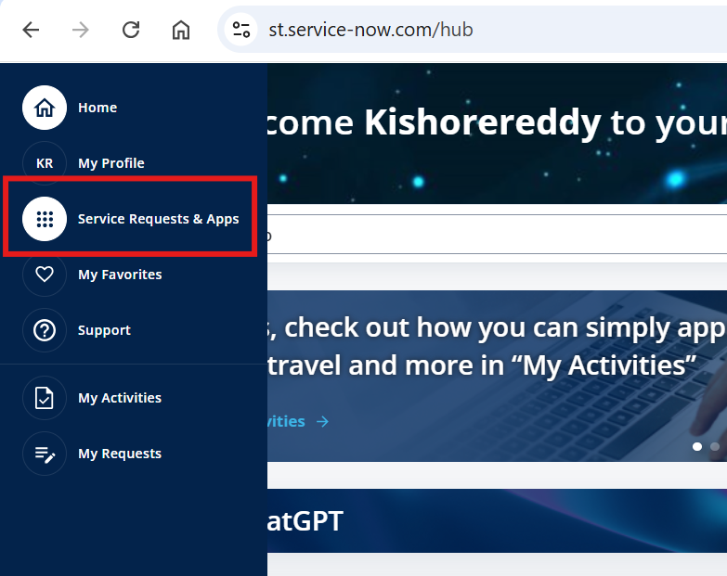
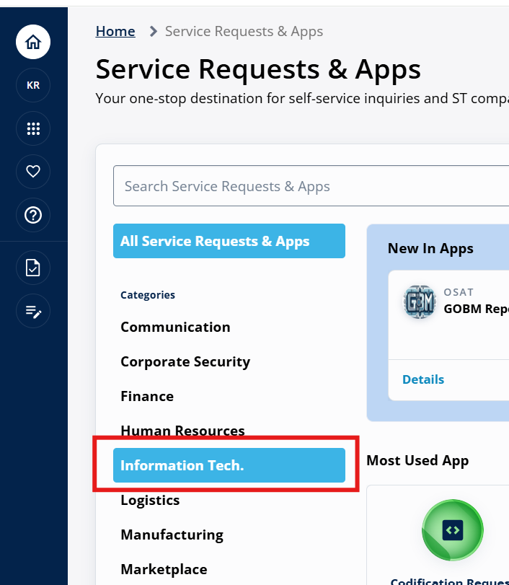
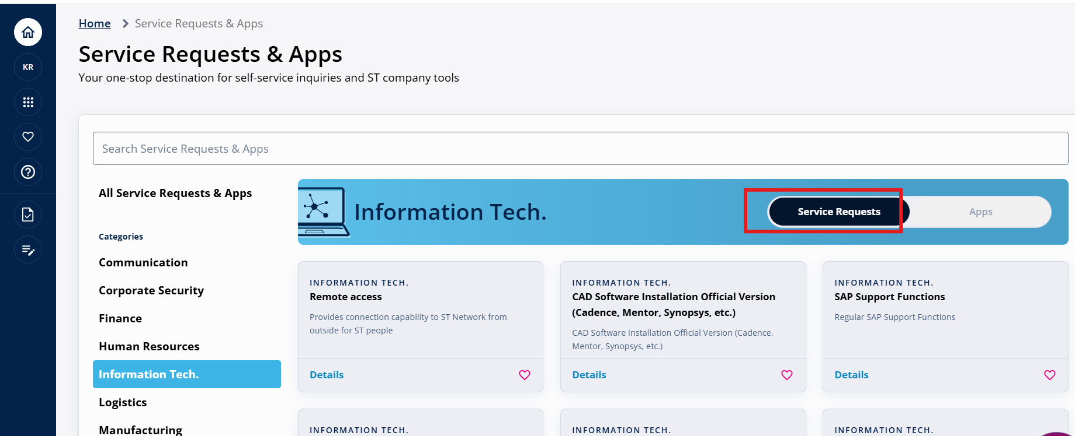
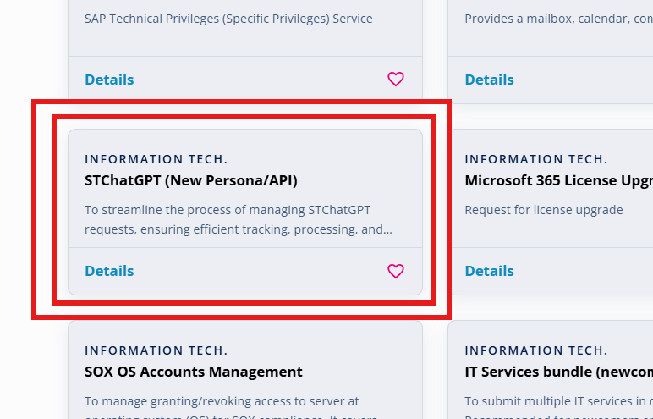
ST ChatGPT
Request and Access Process — Persona & API ST ChatGPT
From business request to persona / API access
Go to https://st.service-now.com/hub
Click Service Requests & Apps from in the left side menu
Click Information Tech. under categories
Click Service Requests tab
Find and click the card STChatGP (New Persona/API)

Slide 9

Why this project?
The Daily Support Problem
Technical info exists , but it's scattered
Before this project
This project's objective
Support engineers already had reference sources and search habits
Centralize : all STM32Cube knowledge in one placet
For standard issues, the information was often available
Structure : data normalized, enriched, ready for retrieval
For new or less obvious bugs, useful clues could be spread across multiple sources
Answer : technical questions in seconds with sources
Investigation often required manual cross-checking between issues, documentation, and other technical references
Trace : every answer back to issue, PR, commit, or doc
The issue was not missing information, but the time needed to connect the right pieces
Learn: from every resolved bug for the next ones
Notes:
Centralize: all STM32Cube knowledge in one place Structure: data normalized, enriched, ready for retrieval Answer: technical questions in seconds with sources Trace: every answer back to issue, PR, commit, or doc Learn: from every resolved bug for the next ones

Slide 10




Where AI stands in here !
No magic — organized retrieval from structured knowledge
Understanding what the STM32Cube persona actually does
Analogy
Imagine a senior engineer with 10 years of STM32 experience. They have read every issue, every file, every PRs. When you ask a question, they search their memory and give you the answer with sources. The tool does exactly that — automatically.
The AI (LLM)
The KB (Knowledge Base)
RAG
Large Language Model
Knowledge Base
Retrieval-Augmented Generation
A program trained on billions of texts. It understands natural language and generates coherent responses.
This is the engine behind ST ChatGPT.
This is the tool's library. All STM32 information is stored as small indexed text chunks.
The tool searches here before answering.
This technique combines KB + LLM. When a question arrives:
Search the KB for relevant passages
Feed them to the LLM to formulate the answer.
Like a brain that understands questions
Like an ultra-organized, searchable library
Retrieve first — answer second

Slide 11
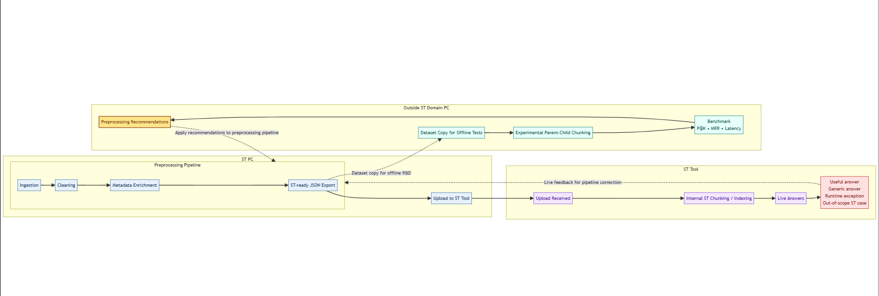
Project Overview !
Notes:
Flèche pleine
= flux principal opérationnel
Flèche pointillée
= feedback / recommandation / boucle de correction / lien secondaire
Ce que tu peux dire si on te pose la question
Les flèches pleines représentent le flux principal du projet, depuis la préparation des données jusqu’au live dans l’outil ST.
Les flèches pointillées représentent les retours d’amélioration : recommandations du benchmark offline et feedback observé en production, qui servent à corriger le pipeline.

Slide 12

The ST ChatGPT Platform
How does the platform work?
Full chain: from question to sourced, traceable answer
Status: Knowledge Base currently under construction
User Prompt
Search
Knowledge Base
LLM (AI)
Answer
Asks a technical question
Searches KB for closest passages
Returns the chunks (relevant segments)
Formulates the response from the chunks retrieved
Answer + sources
My role in this project:
My role = prepare the data that feeds the Knowledge Base.
If the data is bad → the answers are bad , If the data is good → the answers are good.

Slide 13
The ST ChatGPT Platform
How does the platform work?
Full chain: from question to sourced, traceable answer
Status: Knowledge Base currently under construction
RAG Workflow
User Prompt
Search
Knowledge Base
LLM (AI)
Answer
Asks a technical question
Searches KB for closest passages
Returns the chunks (relevant segments)
Formulates the response from the chunks retrieved
Answer + sources

Slide 14
The ST ChatGPT Platform
How does the platform work?
Full chain: from question to sourced, traceable answer
Status: Knowledge Base currently under construction
Retrieval
Generation
User Prompt
Search
Knowledge Base
LLM (AI)
Answer
Asks a technical question
Searches KB for closest passages
Returns the chunks (relevant segments)
Formulates the response from the chunks retrieved
Answer + sources
RAG = retrieval of relevant chunks from the knowledge base + answer generation by the LLM using those retrieved chunks
generate the answer using that augmented context
Find the most relevant passages in the knowledge base
Augmented
Inject those retrieved passages into the model input

Slide 15
The ST ChatGPT Platform
How does the platform work?
Full chain: from question to sourced answer
User Prompt
Search
LLM (AI)
Answer
Asks a technical question
Searches KB for closest passages
Knowledge Base
Formulates the response from the chunks retrieved
Answer + sources
Data Source
Data Source
Data Source
Notes:
Data Sources

Slide 16
The ST ChatGPT Platform
How does the platform work?
Full chain: from question to sourced answer
User Prompt
Search
LLM (AI)
Answer
Asks a technical question
Searches KB for closest passages
Knowledge Base
Formulates the response from the chunks retrieved
Answer + sources
Data Source
Data Source
Data Source
(CSV, JSON, PDF)
(CSV, JSON, PDF)
(CSV, JSON, PDF)
Files
Issues, fichiers, PRs, Commits, PDFs, resolver cases
Notes:
Data Sources

Slide 17
The ST ChatGPT Platform
How does the platform work?
Full chain: from question to sourced answer
User Prompt
Search
LLM (AI)
Answer
Asks a technical question
Searches KB for closest passages
Knowledge Base
Formulates the response from the chunks retrieved
Answer + sources
Data Source
Data Source
Data Source
(CSV, JSON, PDF)
(CSV, JSON, PDF)
(CSV, JSON, PDF)
Files
Docs
Issues, files, PRs, Commits, PDFs, resolver cases, Diagnostic cards
,
Notes:
Data Sources

Slide 18



Data Sources Used
Where does the information come from?
Everything extracted from GitHub STM32Cube public repos — nothing fabricated
GitHub Issues
300+ issues
Technical Files
5,000+ files
User-reported bugs: title, body, comments, labels, state (open/resolved), github_url, timestamps
Des sources techniques: drivers, middlewares, utilities, components, src/inc, include/source, BSP board files.
Des docs techniques: release notes, readme project, PDF documentation.
Des fichiers of configuration/metadata useful for context: package.xml, sbom, security, etc.
Source: STM32CubeH7, H5, and extensible to other series
Source: STM32CubeH7, H5, and extensible to other series
PRs & Commits
Resolver Cases
Intelligent synthesis layer
Diagnostic cards
When a bug is resolved, we trace the PR and commit that provide the confirmed fix
Structured cards: Problem → Evidence → Solution. Built automatically from resolved issues
Source: STM32CubeH7, H5, and extensible to other series
Source: Generated by pipeline
Pour chaque série STM32Cube : we unify issues, PRs and commits afin of produire des diagnostic cards traçables and actionnables.

Slide 19
Getting Better Answers — How to Query the Persona
Context-rich questions produce context-rich answers
What to specify when asking
For best results, always specify:
● The STM32 series (H7, H5, L4, G0…)
● The exact MCU or board if known
● The peripheral involved (DMA, UART, I2C, USB…)
● The HAL API or function name if applicable
● The observed symptom or error
● The context: bug, config issue, regression, compilation error…
Vague vs Precise — Example
Vague question:
"DMA does not work"
Result: generic answer, low relevance, no specific source
Precise question:
"On STM32H743, ADC DMA circular mode gives inconsistent values after enabling
D-Cache. What should I check?"
Result: specific issue retrieved, with relevant HAL context, PR/commit link if available, and concrete debug steps
The more context you give, the more the persona can retrieve and the better the answer.

Slide 20
Demo

Slide 21
04
The preprocessing pipeline
Ingest → Clean → Enrich → Deliver
05
Results & evaluation
50Q benchmark — concrete numbers
06
Challenges & Next Steps
What works, what needs fixing

Slide 22



The Preprocessing Pipeline
7 steps to transform raw data into KB-ready knowledge
Each step is deliberate — nothing is done at random
1
2
3
4
5
6
7
Ingestion
Cleaning
Similarity
Chunking
Evaluation
(Benchmark)
Enrichment
(Feature
Engineering)
Delivery
(resolver cases, diagnostic cards, exports ST-ready)
Download raw data
from GitHub
Clean:
remove HTML,
normalize
Link related issues
describing the same bug
Split into chunks
for the KB
Add board, component, layer, severity, issue_kind, is_valid
Test with 50
questions of reference
Deliver JSON
format ST-ready

Slide 23
The Preprocessing Pipeline
7 steps to transform raw data into KB-ready knowledge
Each step is deliberate — nothing is done at random
1
2
3
4
5
6
7
Ingestion
Cleaning
Enrichment
(Feature
Engineering)
Similarity
Chunking
Evaluation
(Benchmark)
Link related issues
describing the same bug
Delivery
(resolver cases, diagnostic cards, exports ST-ready)
Download raw data
from GitHub
Clean:
remove HTML,
normalize
Split into chunks
for the KB
Test with 50
reference questions
Deliver JSON
format ST-ready
Add board, component, layer, severity, issue_kind, is_valid
❓ What does Cleaning do?
Raw data contains broken HTML, unreadable illisibles, des blocs of code non structurés. Le cleaning transforms them into clean, usable te and exploitable.

Slide 24

Pipeline: cleaning
Cleaning — Why clean the data?
Raw data = imprecise answers => Clean data = useful answers.
❌ Raw data (before)
✅ Cleaned data (after)
<p class="issue">The <b>HAL_DMA_Init</b> crashes when...<img src="/assets/diag.png"/><br/>&nbsp;&nbsp;See <a href="...">PR#142</a> and commit <code>3f2a1b</code></p>
[IMAGE: configuration diagram]
<!-- auto-generated comment -->
HAL_DMA_Init crashes when circular mode is active. Image: [IMAGE: configuration diagram showing DMA channels]. See PR#142 and commit 3f2a1b for fix.
Issues:
Improvements:
HTML tags unreadable by AI
HTML stripped, pure text
Image content lost (no text)
Images replaced by [IMAGE] tag + description
Noise from auto-generated comments
Body + useful comments concatenated

Slide 25
The Preprocessing Pipeline
7 steps to transform raw data into KB-ready knowledge
Each step is deliberate — nothing is done at random
1
2
3
4
5
6
7
Ingestion
Cleaning
Enrichment
(Feature
Engineering)
Similarity
Chunking
Evaluation
(Benchmark)
Link related issues
describing the same bug
Delivery
(resolver cases, diagnostic cards, exports ST-ready)
Download raw data
from GitHub
Clean:
remove HTML,
normalize
Split into chunks
for the KB
Test with 50
reference questions
Deliver JSON
format ST-ready
Add board, component, layer, severity, issue_kind, is_valid
❓ What l’Enrichment
Adds technical metadata: layer, severity, issue_kind, board, component, file_type, is_valid.
Converts clean content into structured V2 documents (issues and files).
Creates features of filtrage and ranking pour la récupération d’information.

Slide 26
Pipeline: Enrichment (Feature Engineering)
Enrichment — Why enrich the data?
Plain text = generic answers => Enriched data = targeted, actionable answers
User question: Why does USART fail to compile when UART is not enabled?
Sans enrichment
Avec enrichment
The engine finds documents where 'UART' appears, but cannot distinguish bug type, component, or MCU series.
The document is enriched with:
component=UART, issue_kind=bug_report, layer=HAL/Driver, severity=high, repo=STM32CubeH7, is_valid=true
Typical answer:
Typical answer:
Check your UART settings and HAL configuration.
Problem:
The failure comes from USART dependency on UART module guards in HAL config.
Enable the required UART macro or patch the conditional compilation section in the USART driver for your STM32CubeH7 version.
Vague answer, no root cause, no prioritization.
Impact:
Technical, root-cause-oriented, actionable answer.
Notes:
Le Cleaning rend les données lisibles. L’Enrichment les rend intelligentes pour la décision technique.

Slide 27
The Preprocessing Pipeline
7 steps to transform raw data into KB-ready knowledge
Each step is deliberate — nothing is done at random
1
2
3
4
5
6
7
Ingestion
Cleaning
Enrichment
(Feature
Engineering)
Similarity
Chunking
Evaluation
(Benchmark)
Link related issues
describing the same bug
Delivery
(resolver cases, diagnostic cards, exports ST-ready)
Download raw data
from GitHub
Clean:
remove HTML,
normalize
Split into chunks
for the KB
Test with 50
reference questions
Deliver JSON
format ST-ready
Add board, component, layer, severity, issue_kind, is_valid
❓ Objective: Similarity
Identify issues describing the same symptom/technical problem.
What Similarity does:
compare les textes d’issues
calculates semantic proximue
adds related_issue_ids for each issue

Slide 28
Pipeline: Similarity
Why link issues together?
Sans Similarity
Why this step?
User asks:
Two different issues can describe the same bug with different words. Computing similarity enriches each issue with useful cross-references.
"USART compile error when UART disabled"
System finds one issue → partial answer, no cross-validation.
How?
TF-IDF applied to the clean_text des issues
Example
Score cosine entre chaque paire d'issues
Avec Similarity
Add the related_issue_ids dans chaque issue
Configurable similarity threshold
Le système retrouve 3 issues proches:
même composant (UART/USART)
same symptom type (compile-time guard/dependency)
corrections déjà discutées dans des threads liés
Résultat does: chaque issue sait quelles autres issues lui ressemblent → related_issue_ids.
Result: réponse plus fiable, avec alternatives of fix and validation croisée.
Notes:
Modifier HOW

Slide 29
Pipeline: Similarity
Recherche TF-IDF Interactive — Validation Offline
Pourquoi ? Comment ça fonctionne ?
Objective: Before uploading the data to the ST platform, we want to validate offline that the system retrieval retrieves relevant documents on real queries. Enter a natural language question → the system returns the 5 closest issues or files with a cosine. Un score > 0.40 est considéré pertinent. C'est un test of qualité du pipeline d'indexation.
Même TF-IDF pipeline but in interactive query mode
Recherche Issues (max_features=8 000)
Recherche Fichiers (max_features=8 000)
Output Exemple :
Output Exemple :
[score=0.623] #487 — DMA SPI issue
layer=HAL_Driver, severity=high
component=SPI, board=NUCLEO-H743
url=github.com/STM32CubeH7/issues/487
[score=0.541] release_notes
Drivers/STM32H7xx_HAL_Driver/
Release_Notes.html
excerpt: STM32H7 HAL v1.11...

Slide 30
The Preprocessing Pipeline
7 steps to transform raw data into KB-ready knowledge
Each step is deliberate — nothing is done at random
1
2
3
4
5
6
7
Ingestion
Cleaning
Similarity
Chunking
Evaluation
(Benchmark)
Enrichment
(Feature
Engineering)
Link related issues
describing the same bug
Delivery
(resolver cases, diagnostic cards, exports ST-ready)
Download raw data
from GitHub
Clean:
remove HTML,
normalize
Split into chunks
for the KB
Test with 50
reference questions
Deliver JSON
format ST-ready
Add board, component, layer, severity, issue_kind, is_valid
❓ Why chunk?
The AI cannot read 5,000 files at once. We split them into small chunks (chunks). Chaque chunk = un passage précis. La KB indexe ces chunks.

Slide 31

Pipeline: chunking
Chunking PARENT_CHILD — Splitting intelligently
Why not give the full document to the LLM at once?
Book analogy: If you look for info erchez une information dans un livre, vous n'envoyez pas tout le livre à quelqu'un.
You first find the right chapitre (CHILD = 1 000 caractères), puis vous lisez le chapitre complet pour comprendre le contexte
(PARENT = 3 000 caractères).
PARENT CHUNK (~3,000 chars)
CHILD CHUNK (~1,000 chars)
Contains full document context
Precise sub-segment of the parent
Used by LLM to formulate the answer
subdivided into ▶
Used for SEARCH in the KB
Preserves global meaning of the section
Finds the right passage for the query
Sent whole to AI for generation
Linked to parent to retrieve context

Slide 32
Pipeline : STM32Cube RAG Chunking Benchmark

Slide 33
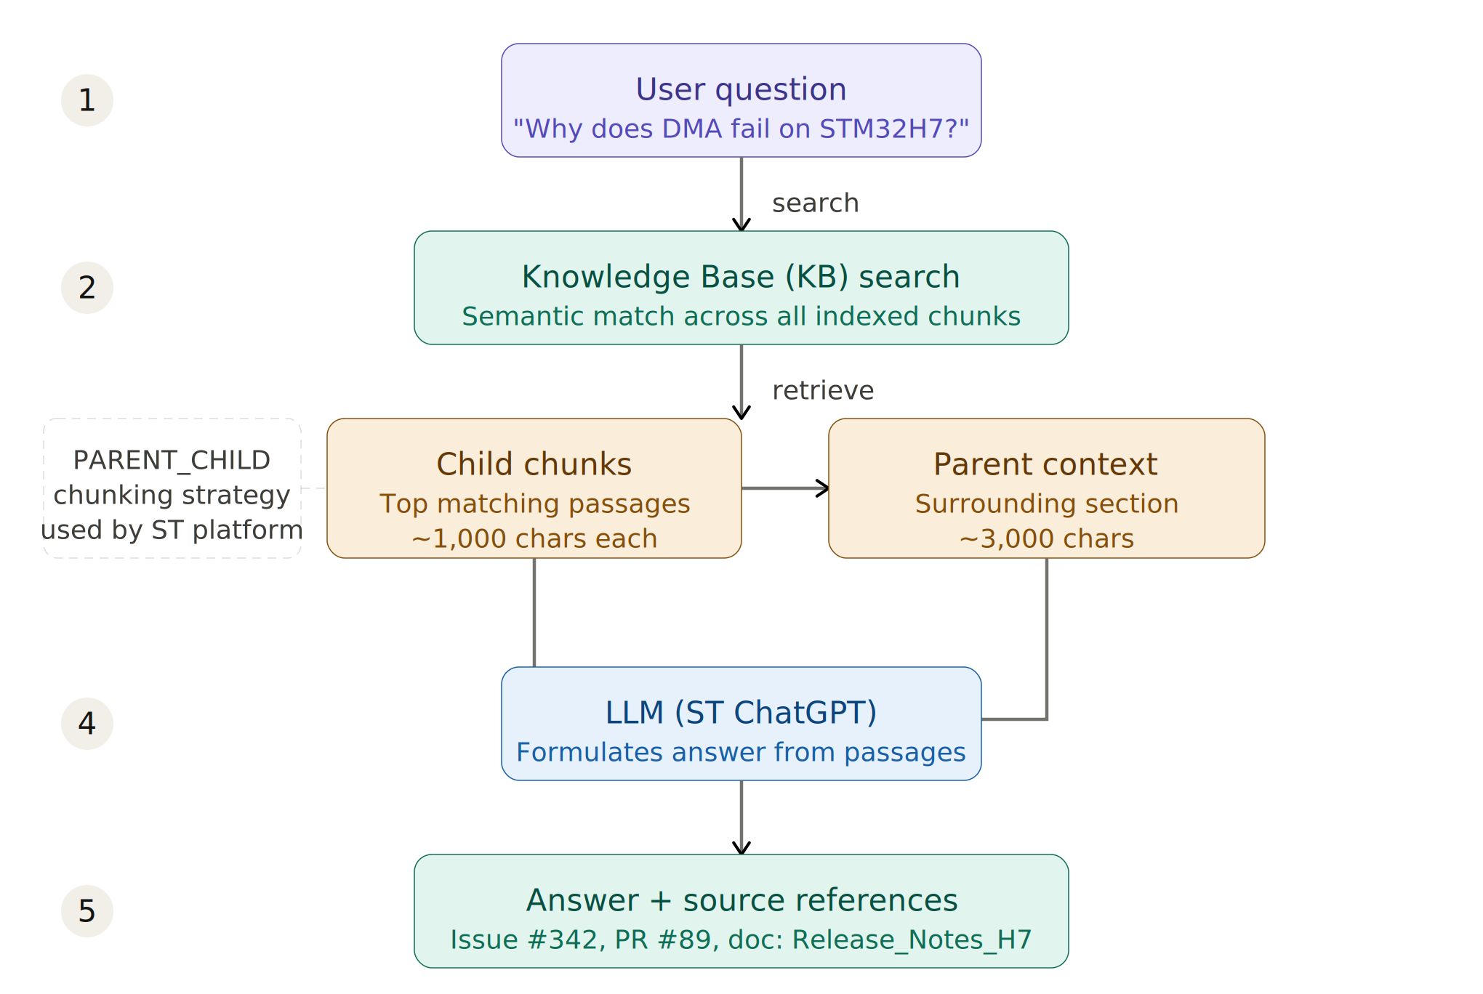
How the Persona Works , RAG Behind the Scenes
The persona does not answer from memory , it retrieves from its Knowledge Base

Slide 34
How the Persona Works , RAG Behind the Scenes
The persona does not answer from memory , it retrieves from its Knowledge Base
The RAG Behind is a black box

Slide 35
How the Persona Works , RAG Behind the Scenes
The persona does not answer from memory , it retrieves from its Knowledge Base
The RAG Behind is a black box
The ONLY lever we have is data quality:
● Clean text → better semantic matching
● Rich metadata (component, layer, severity) → better filtering
● Structured st_ready_text → better lexical anchors
● Resolver cases + diagnostic cards → actionable answers
Bad data in → vague answers out.
Good data in → precise, traceable answers out.

Slide 36
The Preprocessing Pipeline
7 steps to transform raw data into KB-ready knowledge
Each step is deliberate — nothing is done at random
1
2
3
4
5
6
7
Ingestion
Cleaning
Similarity
Chunking
Evaluation
(Benchmark)
Enrichment
(Feature
Engineering)
Link related issues
describing the same bug
Delivery
(resolver cases, diagnostic cards, exports ST-ready)
Download raw data
from GitHub
Clean:
remove HTML,
normalize
Split into chunks
for the KB
Test with 50
reference questions
Deliver JSON
format ST-ready
Add board, component, layer, severity, issue_kind, is_valid
❓ Delivery objective
Delivery transforms raw technical data into knowledge directly usable in a support KB.
The goal:
Provide actionable answers for troubleshooting.
Maintain complete traceability to GitHub.
Fournir un format stable pour l’ingestion côté ST.

Slide 37

Pipeline: Delivery(resolver cases, diagnostic cards, exports ST-ready)
ST-ready exports = actionable, traceable, platform-ready knowledge
Why a Delivery Layer?
We observed a gap between raw available data and actual support usability:
● Raw issues explain a problem but lack a clear diagnostic path
● Users ask symptom-oriented questions, not issue-number queries
● Results could be correct at source but weak on actionable steps
● Without delivery standards, labels and links become inconsistent
The content existed, the operational layer was missing.
The solution:
Build a structured export layer that transforms raw pipeline output into KB-ready, support-oriented knowledge artifacts.

Slide 38
Pipeline: Delivery(resolver cases, diagnostic cards, exports ST-ready)
Delivery — Why structure the final output?
Des exports ST-ready = actionable cases, ready to integrate
A = (docs_..._v2) — source of vérité riche en metadata
B = Format ST-ready (st_ready_... ) — adapté au moteur RAG ST
Structure: st_ready_text (issues) — fields exposed to the moteur RAG
Problem
Context
Constraints
Keywords
Root cause
Fix
Technical details
Key comments

Slide 39
Pipeline: Delivery(resolver cases, diagnostic cards, exports ST-ready)
Delivery — Why structure the final output?
Des exports ST-ready = actionable cases, ready to integrate
Resolver Cases: what we built and how
Real need: ST engineers receive technical questions about STM32 bugs. To answer, they need to know if a GitHub bug is already resolved : was a PR mergede ? Does a fix commit exist ? Existe-t-il un chemin of correction crédible and vérifiable pour ce bug?
These cards are injected into the ST Knowledge Base (KB) so the RAG engine can cite fixes during a query.
GitHub Issue (problem)
PR (proposition of correction)
Ticket décrivant un bug ou comportement anormal sur STM32Cube (repo GitHub ST).
Contient: title, technical descriptione, labels, état (open/closed).
Code change proposal on code soumise sur GitHub. Si elle est mergée, elle constitue un fix officiel.
Contains: title, changed filesngés, commits associated (preuve technique of changement).
Resolver Case
Fiche structurée ST-ready linking an issue to its PRs/commits fix PRs/commits.
Contient: resolution status, levu of confiance, fichiers impactés, texte prêt for the KB.
Notes:
→ Un Resolver Case est la réponse structurée à cette question : pour chaque issue GitHub, on crée une fiche qui indique le statut de résolution, les PRs et commits liés, et les fichiers modifiés par le fix.

Slide 40
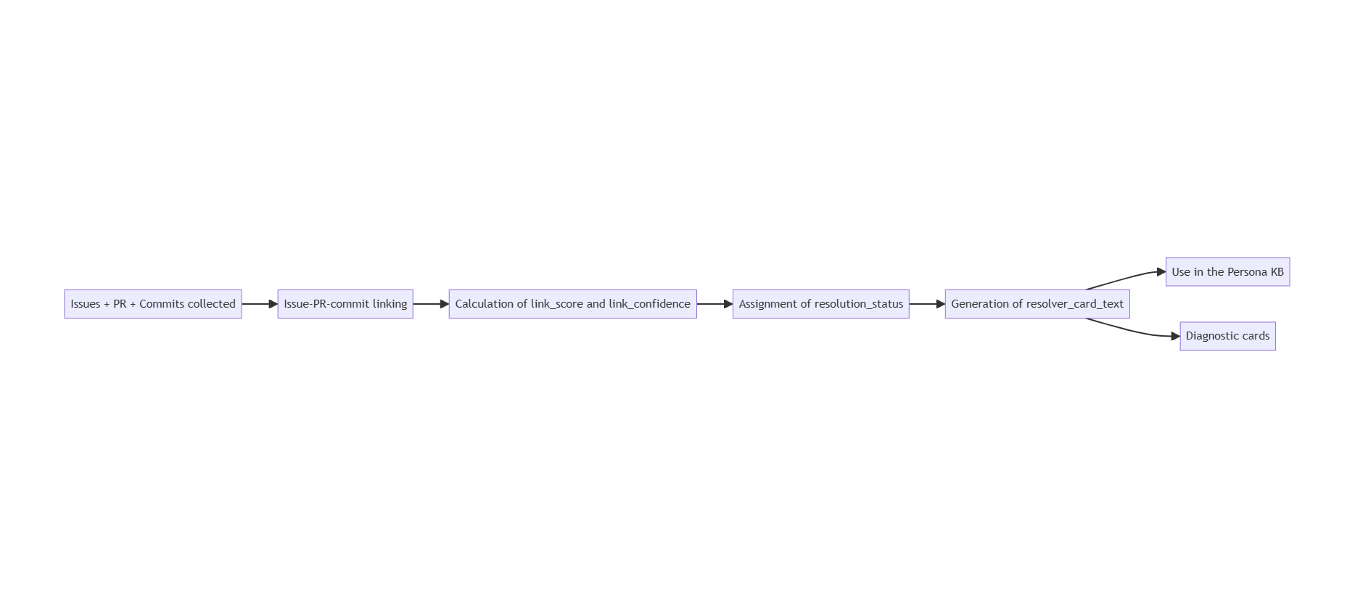
Resolver Cases — Tracing Bugs to Their Fix
Going beyond issue similarity: linking confirmed resolutions
Construction process:
Notes:
1. Start from a resolved GitHub issue
2. Fetch all related PRs (pull requests) for that repo
3. Match PRs to the issue via text similarity + label linking
4. Fetch commits from each candidate PR
5. Compute link_score (0.0–1.0) and link_confidence
6. Assign resolution_status:
• merged_fix — PR merged, commit confirmed
• candidate_fix — strong candidate, not 100% confirmed
• reference_only — mentioned but not a direct fix
• unlinked — no credible fix path found
7. Generate resolver_card_text (structured fix summary)

Slide 41
Resolver Cases — Tracing Bugs to Their Fix
Going beyond issue similarity: linking confirmed resolutions
Construction process:
Notes:
1. Start from a resolved GitHub issue
2. Fetch all related PRs (pull requests) for that repo
3. Match PRs to the issue via text similarity + label linking
4. Fetch commits from each candidate PR
5. Compute link_score (0.0–1.0) and link_confidence
6. Assign resolution_status:
• merged_fix — PR merged, commit confirmed
• candidate_fix — strong candidate, not 100% confirmed
• reference_only — mentioned but not a direct fix
• unlinked — no credible fix path found
7. Generate resolver_card_text (structured fix summary)

Slide 42
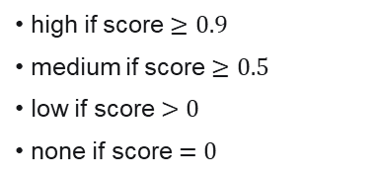
Resolver Cases — Tracing Bugs to Their Fix
Going beyond issue similarity: linking confirmed resolutions
Construction process:
Calcul calculation:
Confidence:
link_score=min(1,PR+MergeBonus+Commit)
high if score $≥0.9$
medium if score $≥0.5$
low if score $>0$
none if score $=0$
Avec: $PR∈\left\{0 , 0.5\right\}, MergeBonus∈\left\{0 , 0.1 , 0.3\right\} , Commit∈\left\{0 , 0.2\right\}$
Explicit PR found: +0.5
Merged PR: +0.3
If PR found but not merged: +0.1 (au lieu of +0.3)
Commit "meaningful trouvé" does: +0.2
Final score capped at 1.0
Notes:
Dans ton pipeline, un commit est considéré non meaningful si son message commence par:
merge branch
merge pull request
Commit meaningful = vrai changement de code (patch, correction, refactor utile au bug).
Commit non meaningful = commit de merge “administratif” sans preuve technique directe.
e min dans le calcul de score veut dire: on plafonne le score à 1.0.
Formellement:
$$score=min⁡\left(1.0 , score_{brut}\right)$$
Interprétation simple:
Si score brut = 0.8, alors score final = 0.8
Si score brut = 1.2, alors score final = 1.0
Pourquoi on met min:
C’est une sécurité pour ne jamais dépasser 1.0
Même si plus tard on ajoute d’autres bonus, le score reste borné
Avec tes règles actuelles, le maximum est déjà 1.0, mais min reste une bonne protection.
Exemple rapide:
PR liée + PR mergée + commit meaningful: $0.5+0.3+0.2=1.0$
PR liée + pas mergée + commit meaningful: $0.5+0.1+0.2=0.8$
Seulement commit meaningful, sans PR liée: $0.2$ (signal faible)

Slide 43
Resolver Cases — Tracing Bugs to Their Fix
Going beyond issue similarity: linking confirmed resolutions
Construction process:
Calcul calculation:
Statut status:
Confidence:
link_score=min(1,PR+MergeBonus+Commit)
high if score $≥0.9$
medium if score $≥0.5$
low if score $>0$
none if score $=0$
merged_fix: PR mergée + commit meaningful
candidate_fix: PR trouvée + commit meaningful (merge non confirmé)
reference_only: PR trouvée mais pas of commit meaningful
unlinked: pas of chemin of fix crédible
Avec: $PR∈\left\{0 , 0.5\right\}, MergeBonus∈\left\{0 , 0.1 , 0.3\right\} , Commit∈\left\{0 , 0.2\right\}$
Explicit PR found: +0.5
Merged PR: +0.3
If PR found but not merged: +0.1 (au lieu of +0.3)
Commit "meaningful trouvé" does: +0.2
Final score capped at 1.0
Notes:
merged_fix
Meaning:
On a une preuve forte qu’un correctif est intégré.
Condition:
PR mergée + commit meaningful.
Message à dire:
“Le fix est très probablement dans la branche principale.”
candidate_fix
Meaning:
On a un candidat sérieux de correction, mais pas encore confirmé à 100%.
Condition:
PR trouvée + commit meaningful, mais merge non confirmé.
Message à dire:
“Le correctif est plausible, à valider avant de conclure.”
reference_only
Meaning:
Il existe une PR liée au sujet, mais sans preuve technique suffisante du fix.
Condition:
PR trouvée, mais pas de commit meaningful.
Message à dire:
“C’est une référence utile, pas une preuve de correction.”
unlinked
Meaning:
Aucun chemin crédible issue → PR → commit n’a été trouvé.
Condition:
Pas de liaison fiable vers un fix.
Message à dire:
“Pas de preuve de correction disponible, on passe en diagnostic par similarité.”
Résumé ultra-court (ligne slide):
merged_fix = confirmé, candidate_fix = probable, reference_only = indicatif, unlinked = non prouvé.
Le Resolver Case ne devine pas un fix, il mesure une chaîne de preuves; notre amélioration consiste à enrichir cette preuve pour passer d’un score heuristique à une décision plus fiable et plus explicable.

Slide 44
Pipeline: Delivery(resolver cases, diagnostic cards, exports ST-ready)
Delivery — Why structure the final output?
Des exports ST-ready = actionable cases, ready to integrate
Diagnostic Cards: what we built and how
Real need: An ST engineer receives a customer question: “My HAL_SPI_Transmit_DMA blocks on 2 bytes, why?”. They need a fiche diagnostique structurée ready-to-use structured diagnostic card, not just a GitHub ticket n lien vers un ticket GitHub.
A Diagnostic Card contains
Construction = Issue + Resolver
Issue GitHub
Resolver Case
symptom_summary does: Summary of the observed symptom
issue_title
layer, severity
component, board
st_ready_text
github_url
resolution_status
link_confidence
linked_pr_urls
linked_commits
files_evidence
likely_causes does: Probable causes (root cause)
+
confirmed_facts does: Faits vérifiés (evidence_strength, commit sha)
plausible_diagnosis does: Hypotheses based on layer+component+pattern
debug_checks does: Debug debug actions
→ build_diagnostic_card()
possible_workarounds does: Contournements possibles
constraints_or_limits does: Validated scope: MCU series, firmware version
Diagnostic Card JSON
→ injected into the ST KB
→ optimized for retrieval RAG
evidence_refs does: Liens does: issue, PR, commit
query_aliases does: NL aliases for retrieval RAG
keywords + api_tags does: Labels, HAL_* tags (max 24)
Notes:
Une Diagnostic Card fusionne l'issue GitHub + le resolver case pour produire : le symptôme, les causes probables, les actions de debug, les contournements, les faits confirmés et les liens de preuve ,

Slide 45
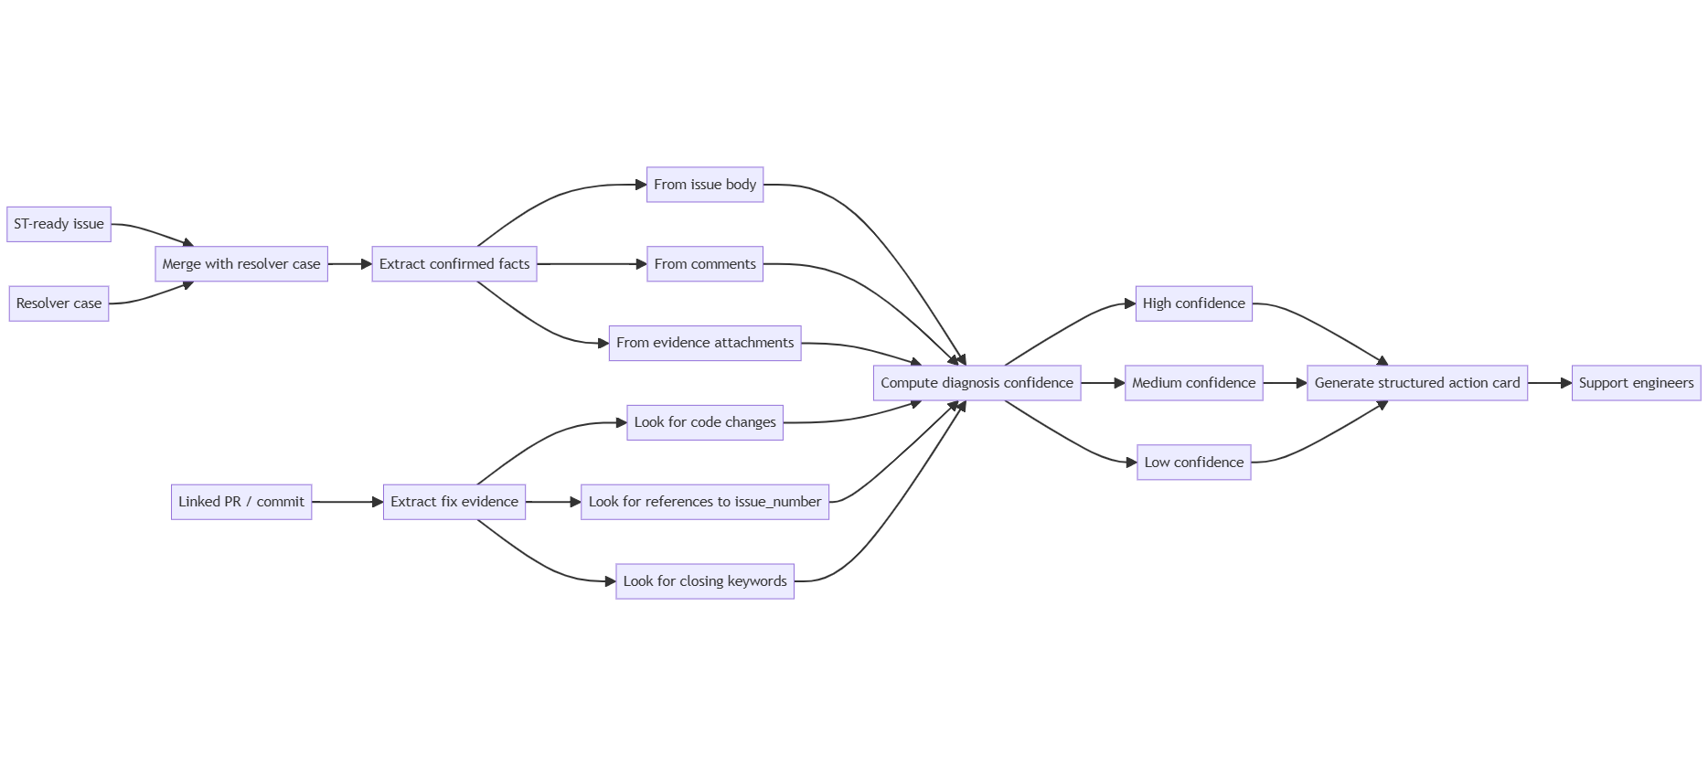
Diagnostic Cards — Structured Troubleshooting Knowledge
18 cards delivered: 13 diagnostic · 3 behavior · 2 resolution guidance
Notes:
Diagnostic Cards convert raw GitHub history into
Card Statistics & Scores
18 diagnostic cards delivered — distribution:
● 13 technical diagnostic cards
● 3 assistant behavior cards (guardrails, uncertainty handling)
● 2 resolution guidance cards (structured fix workflows)
Confidence score distribution:
● High confidence (score >= 0.75): 8 cards
● Medium confidence (0.50–0.74): 7 cards
● Low confidence (score lt 0.50): 3 cards
Schema validation pass rate: gt 95%
All card fields verified: problem, context, facts,
hypotheses, actions, fix_reference, confidence_level
Key value: cards answer support questions directly
without requiring the user to browse raw issues.
Traceable to real GitHub issue + PR + commit.
immediate troubleshooting guidance: what is confirmed, what is still hypothesis, what to test now, and where the fix evidence is. They make support faster, more consistent, and fully traceable.

Slide 46
Pipeline: AI Agents — Two Specialized Assistants in the Project
C'est quoi un Agent IA do?
Not just one AI: two agents used for engineering acceleration
An AI agent = an LLM given a specific mission with a defined context. It automatically analyzes, documents, or compares. In this project, 2 agents are used to accelerate Pipeline.
benchmark outputs
Agent 1 — Preprocessing Agent
Agent 2 — PDF Vision Agent
STM32Cube Preprocessing Agent
STM32Cube PDF Vision Agent
Role
Assistant dédié à l'analyse and documentation du pipeline
Role
Analyzes figures & diagrams extracted from technical PDFs
Analyze
The data flow, JSON outputs and benchmark outputs
Read
pdf_image_tasks_<repo>.jsonl
Document
Data schemas, test results
Analyze
Figures / diagrams from PDFs
Compare
Structuring / chunking strategies
Describe
Injectable technical text descriptions
Value
Documentation acceleration + pipeline readability
Faster iteration on data quality improvements
Value
Preserve information in PDF diagrams
Multimodal PDF workflow:
Text extraction →
Page image rendering →
Figure detection →
Crop figures →
JSONL tasks →
JSON descriptions →
Enriched re-injection

Slide 47
Evaluation Protocol & Benchmark Results
Concrete numbers
G1 → G2 → G3 → G4 → Upload KB
G1
Stats Quality
test_stats_issues_v2
test_stats_files_v2
Distribution + couverture metadata
G2
TF-IDF Retrieval
test_tfidf_search_issues_v2
test_tfidf_search_files_v2
Top-3 pertinence verifie offline
G3
Schema Validation
validate_schemas.py
Taux cible : >95%
Contrat doc/chunk verifie
G4
30Q + 50Q Live
run_h7_50q_ab_test.ps1
DMA,UART,I2C,USB,ADC,FDCAN
Benchmark manuel, zero biais

Slide 48

Evaluation Protocol & Benchmark Results
50Q Live Run — ST Platform results
Evaluation incrementale: chaque ajout de source evalue separement pour ne pas introduire d'hallucination ni de reponses hors-contexte
↑

Slide 49
Challenges encountered
Technical obstacles encountered during the project
Technical Challenges
Operational & Validation Challenges
Black-box RAG engine
Retrieval/chunking internals inaccessible. All improvements must be data-centric only.
→ Solution: Structured lexical anchors + stable card templates
4. Upload payload limits
STM32CubeH7: 4,707 docs / ~57.6 MB — exceeds single-batch limits.
→ Solution : Manual split workflow: 50 parts, deterministic upload order
2. Defining high data quality
No existing quality definition. What is "good enough" for RAG retrieval?
→ Solution : Schema validation >95% + TF-IDF smoke tests before every upload
5. Validation without ground truth
No labeled STM32Cube Q&A dataset existed anywhere.
→ Solution : Built 30Q+50Q benchmark manually — zero synthetic bias
3. Heterogeneous source formats
Issues, PRs, commits, files, PDFs: all have different structures.
→ Solution : Unified docs_v2 schema normalizing all sources
6. New bugs with no linked PR
Truly new bugs (e.g. HAL_CRYP >65535 bytes) return "I DON'T KNOW".
→ Next: Technical pattern tags for class-based retrieval (overflow, uint16_limit...)

Slide 51

For further support in creating a PowerPoint presentation, including graphic assets, formatting tools and additional information on the ST brand
you can visit the ST Brand Portal
https://brandportal.st.com

