Slide 1

End of studies project presentation​
by​
Abir GHARBI
From Raw Data to Actionable Knowledge:
Designing, Automating, and Industrializing an Intelligent Data Preprocessing Pipeline for STM32Cube
Supervised by: Ali LABBENE & Omar SAKET
PFE - 2026 | STMicroelectronics Tunis
STM32 MCU Embedded Software Support & Maintenance Team

Slide 2
Plan
01
05
Project Context
Configuration & Evaluation
02
06
Architecture Overview
Ongoing work & perspectives
03
07
The Data preprocessing pipeline and ALFRED Vision Integration
Live Demo & Hands-On
04
08
Value Proposition & Impact
Q&A

Slide 3
Plan
01
05
Project Context
Configuration & Evaluation
02
06
Architecture Overview
Ongoing work & perspectives
03
07
The Data preprocessing pipeline and ALFRED Vision Integration
Live Demo & Hands-On
04
08
Value Proposition & Impact
Q&A

Slide 4
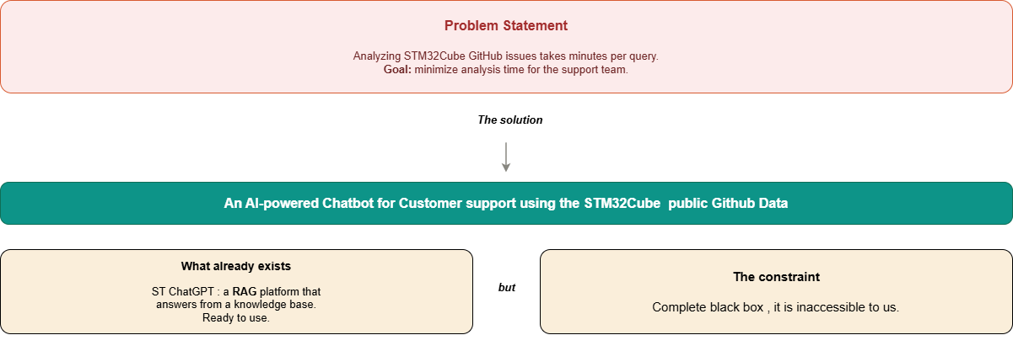
Project context ( Problem Statement , Solution )

Slide 5
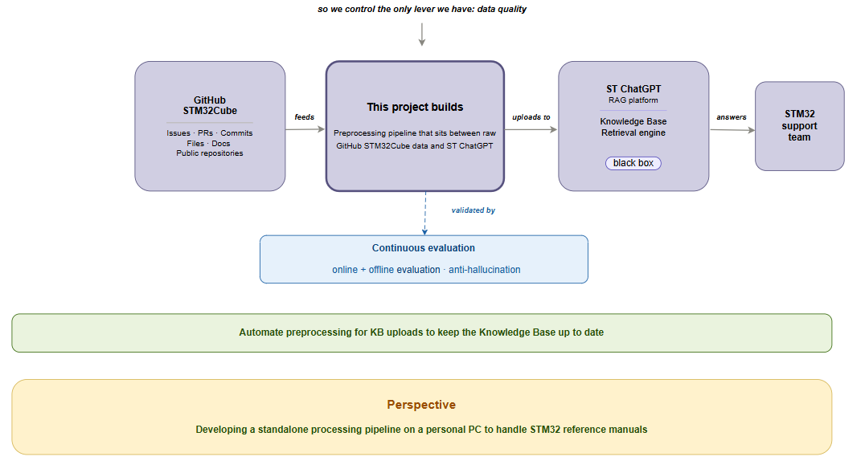

Project context (Ongoing Work)

Slide 6
Plan
01
05
Project Context
Configuration & Evaluation
02
06
Architecture Overview
Ongoing work & perspectives
03
07
The Data preprocessing pipeline and ALFRED Vision Integration
Live Demo & Hands-On
04
08
Value Proposition & Impact
Q&A

Slide 7
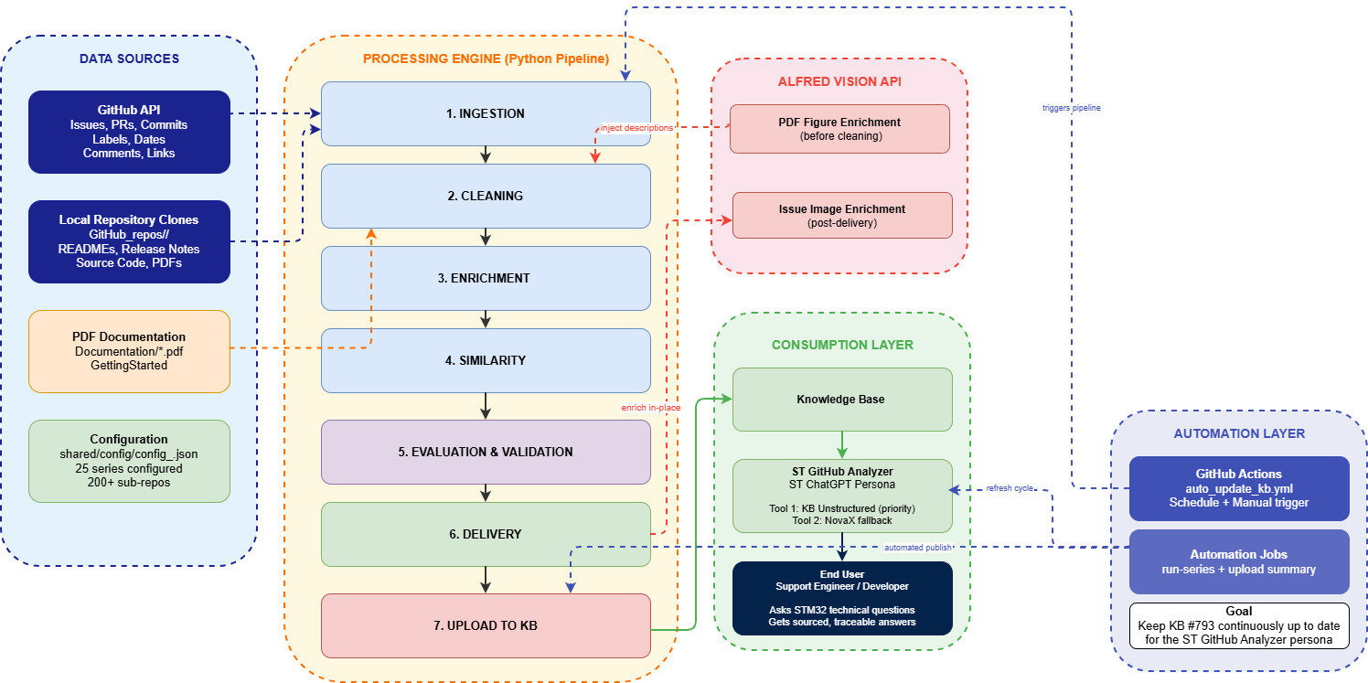
Architecture

Slide 8



Data Sources Used
GitHub
25 series
200+ repos
Pipeline
7 stages
23 steps
ST-ready JSON
4 artifact types
KB
90 data sources
ST ChatGPT
GPT-5.1
Sourced
answer
Issues
Technical Files
User-reported bugs: title, body, comments, labels, state (open/resolved), github_url, timestamps
Source code files: drivers (HAL, LL) , middleware, utilities, components, BSP board files.
Technical documentation: release notes, project README, PDF documentation.
Configuration/metadata files useful for context: package.xml, security-related files, etc.
Source: STM32CubeH7 and extensible to other series
Source: STM32CubeH7 and extensible to other series
PRs & Commits
Resolver Cases
Diagnostic cards
Intelligent synthesis layer
When a bug is resolved, we trace the PR and commit messages that provide the confirmed fix
Structured cards: Problem → Evidence → Solution. Built automatically from resolved issues
Source: Generated by pipeline
Source: Generated by pipeline
For Each STM32Cube series : we unify issues, PRs and commits (Resolver Cases) to produce diagnostic cards.

Slide 9






The ST ChatGPT Platform
How does the platform work?
Full chain: from question to sourced, traceable answer
User Prompt
Search
Knowledge Base
LLM (AI)
Answer
KB preparation (once): documents are chunked → turned into embeddings (numeric meaning) → indexed so retrieval works on meaning, not just keywords.

Slide 10
The ST ChatGPT Platform
How does the platform work?
Full chain: from question to sourced, traceable answer
User Prompt
Search
Knowledge Base
LLM (AI)
Answer
R
A
etrieval
ugmented
G
eneration

Slide 11
Why RAG , not just standard ChatGPT
Without RAG the model invents. With RAG, every answer is grounded in real STM32 documents.
1
You ask
2
RAG searches
3
RAG injects
4
AI answers
"Why does my STM32H7 DMA give wrong values after cache is enabled?"
Finds the 3 most relevant passages in STM32 documents
Passes those passages to the AI as augmented context
Precise answer with source: Issue #1234, PR #456
Standard ChatGPT
ST ChatGPT with RAG
Trained on generic internet data
No knowledge of your STM32 project
Invents plausible-sounding answers
Cannot cite the source of its answer
Dangerous for technical support
Trained on real STM32 data (issues, docs, fixes)
Knows your exact project context
Answers are built from retrieved passages
Always cites the source (issue / PR / doc)
Reliable for technical support teams
VS
RAG = Retrieval-Augmented Generation. The engine retrieves before the LLM generates.

Slide 12
Plan
01
05
Project Context
Configuration & Evaluation
02
06
Architecture Overview
Ongoing work & perspectives
03
07
The Data preprocessing pipeline and ALFRED Vision Integration
Live Demo & Hands-On
04
08
Value Proposition & Impact
Q&A

Slide 13



The Data Preprocessing Pipeline
ALFRED · Path A — PDF figure pipeline (injects Figure Descriptions)
PDF Documents › Render Pages › Figure Detection › ALFRED Vision API › Figure Descriptions
Raw GitHub Data
raw_issues/files/prs/commits.json
Clean Documents
clean_issues · clean_files.json
Enriched Documents
docs_issues_v2 · docs_files_v2.json
Linked Issues
related_issue_ids
Support Artifacts
Resolver + Diagnostic Cards
1
2
3
4
5
6
Ingestion
Cleaning and structuring
Enrichment
Similarity
Data Generation
Delivery
Download raw GitHub data
Remove HTML and noise, then structure the documents.
Add metadata & features
Link duplicate issues
Build support artifacts
Export ST-ready JSON
IN GitHub repositories
OUT Raw JSON datasets
IN Raw JSON
OUT Clean documents
IN Clean documents
OUT Structured docs + metadata
IN Enriched issues
OUT Linked issues
IN Issues·PRs·commits·files
OUT Resolver & Diagnostic cards
IN All generated artifacts
OUT ST-ready JSON
ST-ready JSON
ALFRED · Path B — issue screenshot pipeline
ST-ready Issues JSON › Download screenshots › ALFRED Vision API › Image descriptions › Replace [IMAGE ATTACHED] › Updated ST-ready JSON
Indexed Knowledge Base
1536-d embeddings
Ada V2
Chunks
Continuous improvement
↺ Cleaning · Enrichment · Similarity · Data Generation
10
9
8
7
Quality Index
Indexing
Embeddings
Chunking
Test · 50 ref. questions
Store in knowledge base
Vectorize chunks
Split into chunks
IN Indexed KB + 50 Q
OUT Quality score
IN Embeddings
OUT Knowledge Base
IN Chunks
OUT Embedding vectors
IN ST-ready JSON
OUT Chunks
Each step is evaluated to ensure it produces valid results
My data preprocessing pipeline
ST ChatGPT platform (RAG)
ALFRED Vision (image AI)

Slide 14
Quality Index Evolution
My data preprocessing pipeline
+33 points
The Diagnostic Cards jump
Symptom → Hypotheses → Root cause → Fix, plus query aliases. Structure beat model tuning.
−40 points
Multi-series dilution
KB grew from ~2k to ~14k docs. Same-name APIs across F4/H7 blur retrieval. Scaling ≠ adding data.
The biggest quality gain came from restructuring the knowledge , not from a bigger model, not from a bigger prompt.

Slide 15
Existing Platform Constraints
ST ChatGPT platform (RAG)
We adapt to the platform, we don't redesign it
ST ChatGPT's retrieval engine is a given. Its settings dictate what a 'good' document looks like.
chunkStrategy
childChunkSize
parentChunkSize
PARENT_CHILD
1 000
3 000
Small-to-big retrieval
characters · indexed
characters · restored context
embedding model
jobBatchSize
embeddingsBatchSize
AdaV2
60
20
1536-dim vectors
docs per indexing job
texts per API call
Design consequence
Every exported document must be: clean, compact, semantically dense, traceable, and stable under platform-side PARENT_CHILD chunking. These values are the project's input, not its output.

Slide 16
How the Pipeline Adapts to the Existing RAG
ST ChatGPT platform (RAG)
Each platform constraint on the left maps to a concrete pipeline design decision on the right
Platform constraint (fixed) | Pipeline design decision (our lever)
PARENT_CHILD chunking · 1 000-char children | Discriminating terms (HAL_UART, NUCLEO-H743ZI, error codes) placed at the top of every card, guaranteed to fall inside the first child.
Hybrid search (semantic + full-text) | Cards carry both natural-language summaries (semantic) and exact API/board names (full-text) , feeding both retrieval branches.
jobBatchSize 60 · ~57 MB per upload batch | The delivery step splits the data into N smaller JSON files, and “Upload_All_Drivers.ps1” uploads them one by one in a fixed order, waiting 5 seconds between batches.
No control over ranker or re-ranker | Restrictive NovaX tool description forces KB-first routing. The tool description is a configuration parameter as critical as the threshold.
KB is a black box , retrieval internals inaccessible | All quality is measured OUTSIDE the platform: TF-IDF smoke tests + schema validation before every upload; QI campaigns after.
The pipeline is not a workaround for the platform. It is a data-shaping layer built on top of measured platform behavior.

Slide 17
Alfred Vision · Two integration paths
ALFRED Vision (image AI)
PATH A
PDF figures · BEFORE cleaning (Step 7)
PATH B
Issue images · AFTER delivery (Step 23)
1
PDF docs in cloned repos
1
st_ready_issues_with_images_*.json
2
PyMuPDF · render pages @ 150 DPI
2
For each issue: download screenshot
3
OpenCV · detect + crop figures
3
ALFRED API · describe screenshot
4
ALFRED API · describe each figure
4
[IMAGE ATTACHED] → [IMAGE DESCRIPTION]
5
Inject into files_to_docs_v2
5
In-place modification (no new file)
6
st_ready_files_v3.json with descriptions
6
This is what gets uploaded to KB

Slide 18
Plan
01
05
Project Context
Configuration & Evaluation
02
06
Architecture Overview
Ongoing work & perspectives
03
07
The Data preprocessing pipeline and ALFRED Vision Integration
Live Demo & Hands-On
04
08
Value Proposition & Impact
Q&A

Slide 19
Alfred Path A · PDF Figure Pipeline
PDF docs
PyMuPDF
OpenCV
ALFRED API
Inject
GitHub_repos/<repo>/*.pdf
render pages @ 150 DPI
detect + crop figures
describe figure
into files_to_docs
pdf_figure_service.py · functions called
Storage layout
extract_pdf_multimodal()
entry point for a repository
On-disk artifacts produced by the pipeline:
1
data/pdf_pages/<repo>/*.png
2
render_pdf_pages()
PyMuPDF converts each page → 150 DPI PNG
(rendered pages)
3
detect_candidate_figure_regions()
OpenCV contour + area filter
data/pdf_figures/<repo>/*.png
crop_figures_from_page()
isolate individual figures as PNG
(cropped figures)
4
data/pdf_image_tasks_<repo>.jsonl
5
build_pdf_figure_tasks()
generate JSONL task file for ALFRED
(ALFRED task queue)
inject_figure_descriptions_into_pages()
merge descriptions back into docs
data/pdf_image_descriptions.json
6
(242 descriptions · 19 series)
Why BEFORE cleaning? Descriptions must exist before Enrichment can inject them into files_to_docs_v2.

Slide 20
Alfred Path B · Issue Screenshot Pipeline
Delivered JSON
Download
ALFRED API
Replace tag
In-place save
st_ready_issues_with_images_*.json
screenshot URLs from image_urls
describe each screenshot
[IMAGE ATTACHED] → [IMAGE DESCRIPTION]
same file overwritten
Concrete example · STM32CubeH7 Issue #335
Topic: Warning observed with -Wcast-align flag during compilation
Before Alfred
After Alfred
st_ready_text extract:
same file · in-place replacement:
"Reproduce steps: see screenshot below.
[IMAGE ATTACHED]
Expected: no warning.
Actual: warning at line ..."
"Reproduce steps: see screenshot below.
[IMAGE DESCRIPTION] Eclipse Tool Settings panel showing GCC assembler flags including -Wcast-align enabled for arm-none-eabi-gcc.
Expected: no warning..."
Why AFTER delivery? Path B needs the final structured metadata; the enrichment for the LLM happens on the file the KB will actually see.

Slide 21
KB-First Agent · Persona, KB Tool, and the NovaX Fallback
Engineer
ST GitHub Analyzer
Sourced answer
technical question
Persona · GPT-5.1
with github_url citations
routes queries
ALWAYS FIRST
Second knowledge source ONLY IF KB EMPTY
Third and LAST knowledge source
KB Tool . KB as a Tool
NovaX Tool . Persona as a Tool
Alfred Tool . Persona as a Tool
Hybrid search over 90 datasources — issues, files, resolver cases, diagnostic cards.
Bugzilla tickets + ST Community forum — coverage for topics the KB does not have yet.
USE THIS TOOL ONLY WHEN ALL of the following hold :
- The Knowledge Base was searched first and returned no relevant result, AND
- NovaX was tried and did not provide a relevant answer
Current KB configuration
Search type
Hybrid
Semantic threshold
0.55
Semantic top-K docs
25
Full-text top-K docs
12
Datasources
90 (per series × artifact type)

Slide 22
Plan
01
05
Project Context
Configuration & Evaluation
02
06
Architecture Overview
Ongoing work & perspectives
03
07
The Data preprocessing pipeline and ALFRED Vision Integration
Live Demo & Hands-On
04
08
Value Proposition & Impact
Q&A

Slide 23
Per-Stage Quality Scores
Evaluation is not only the final chatbot score, but each stage is also measured, separating pipeline defects from source-data limits
Every stage of the pipeline has its own metric , the global score is a weighted average
Ingestion
Cleaning V3
Enrichment
Alfred issues
Alfred PDF
Similarity
Delivery
99.7%
100%
72.2%
98.5%
41.7%
22%
100%
weight 1
weight 1.5
weight 1.4
weight 0.4
weight 0.2
weight 0.5
weight 2
EXCELLENT
EXCELLENT
ACCEPTABLE
EXCELLENT
INSUFFICIENT
INSUFFICIENT
EXCELLENT
Global weighted score
Note :
87.1 / 100
Alfred PDF (41.7%) — page context too weak. Similarity (22%) — real bug diversity, not a heuristic failure. Impact on QI: negligible

Slide 24
Retrieval Strategy Benchmark
Cfg | Search | Thr. | Sem | FT | QI
S0 | Hybrid | 0.55 | 25 | 12 | 65
S1 | Hybrid | 0.45 | 35 | 15 | 66
S2 | Hybrid | 0.65 | 18 | 8 | 63
S3 | Hybrid | 0.55 | 35 | 6 | 51
S4 | Hybrid | 0.55 | 15 | 20 | 47
S5 | Semantic | 0.55 | 25 | 0 | 41
Reading the numbers
Removing the full-text branch (S5) would make the system 24 points worse. STM32 questions need exact matches for APIs and boards.
Removing semantic recall (S3) would make the system 14 points worse. People often ask the same thing in different words, so simple keyword matching is not enough.
S1 wins by 1 point. This is a small but real improvement. It means the system is already very close to its best possible performance with the current data.
The pipeline adapts to the platform's fixed retrieval, it does not redesign it. Hybrid search is not preference, it's a measured requirement.

Slide 25
Alfred Vision — Contextual Trust, not just API success
Measuring whether generated image descriptions are actually anchored in the source context
Issue screenshots
PDF figures
98.5%
41.7%
contextual trust (200 evaluated · 3 low coherence)
contextual trust (242 evaluated · 141 low coherence)
OCR fallback L_OCR reinforces token overlap with the surrounding text
Rich context: body + comments provide the anchor Alfred needs
No structured OCR — validator has less overlap material to work with
Next: enrich the prompt with section title and figure caption before validation

Slide 26
Comparative Study · Generic LLM vs Persona KB
KPI | Generic LLM | Persona KB
Score / answer | 5.8 / 10 | 8.1 / 10
Answer rate | 100% | 80%
Perfect answers (10/10) | 0 | 4
Verifiable citations | 0% | 87%
Actionable fix | 25% | 75%
+39%
quality gain vs generic LLM
5.8 / 10 → 8.1 / 10 (average score per answer)
Where the gain comes from
Issue-specific
Migration / Version
General knowledge
Documentation
LLM 5.9 KB 9.2
LLM 3.7 KB 9.7
LLM 7.0 KB 7.0
LLM 5.0 KB 4.0
Optimal architecture: KB-first + restrictive NovaX fallback — traceability protected, coverage extended.

Slide 27
Plan
01
05
Project Context
Configuration & Evaluation
02
06
Architecture Overview
Ongoing work & perspectives
03
07
The Data preprocessing pipeline and ALFRED Vision Integration
Live Demo & Hands-On
04
08
Value Proposition & Impact
Q&A

Slide 28
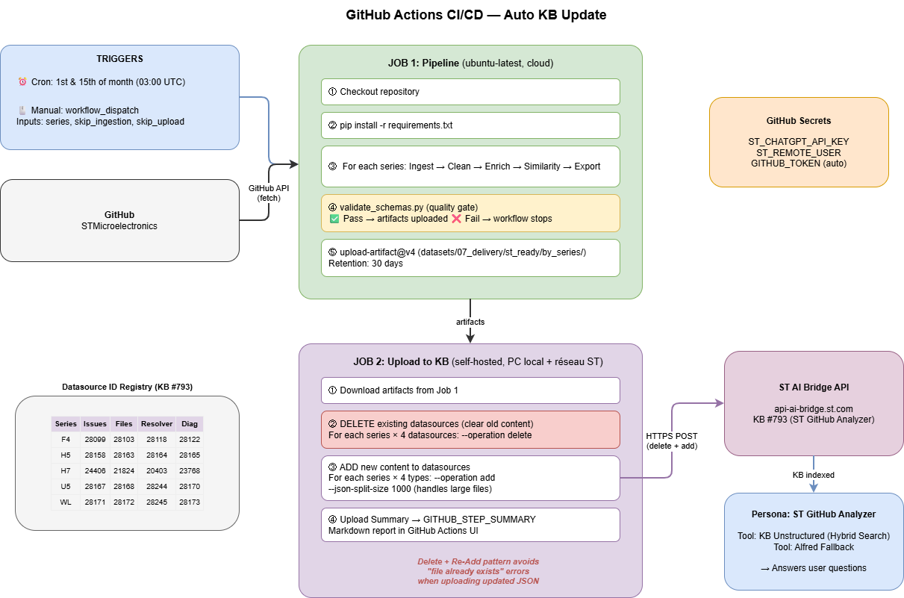

Slide 29
Why a Second Pipeline?
A Second Pipeline for the Big PDFs (Reference Manuals)
Why the workshop pipeline cannot do this — four measured obstacles
1
Dense PDFs
2
Memory crashes
3
Slow figure AI
4
LLM context limit
Register tables, bus diagrams, clock trees — no GitHub source, only massive PDF files.
Standard PDF libraries hit std::bad_alloc ("out of memory") on 3 000+ page documents in one pass.
Vision AI takes ~100 seconds per figure → 33 hours estimated for a single PDF, unusable in production.
The extractor AI can only read ~8 000 characters at a time — but one PDF produces 7 600 000 characters.
1
2
3
4
5
Ingest
VLM
Recombine
Extract
Output
Docling · pypdfium2
LLaVA via Ollama
in-place merge
Mistral 7B
JSON renderer
Read the PDF. Extract every page's text and every figure as an image.
AI "looks" at each figure and writes a text description of what's in it.
Insert every figure's description into the text at the exact place where the figure was.
AI reads the combined text and outputs structured data: registers, peripherals, tables.
Save the structured result to disk, ready for indexing in a Knowledge Base.

Slide 30
Plan
01
05
Project Context
Configuration & Evaluation
02
06
Architecture Overview
Ongoing work & perspectives
03
07
The Data preprocessing pipeline and ALFRED Vision Integration
Live Demo & Hands-On
04
08
Value Proposition & Impact
Q&A

Slide 31
Plan
01
05
Project Context
Configuration & Evaluation
02
06
Architecture Overview
Ongoing work & perspectives
03
07
The Data preprocessing pipeline and ALFRED Vision Integration
Live Demo & Hands-On
04
08
Value Proposition & Impact
Q&A

Slide 32

Thank you for your attention !

Slide 33
Value Dimensions
Dimension | Description | Evidence
Efficiency | One-command processing for entire series | 23 steps automated, batch multi-series
Traceability | Every answer links to a source | github_url, evidence_refs in cards
Robustness | Quality gates prevent bad data reaching KB | Schema validation + placeholder gate
Scalability | Config-driven, no code changes | 25 series configured, 200+ sub-repos
Maintainability | Modular stages, clear interfaces | Each stage independently testable
Explainability | Diagnostic cards explain cause+resolution | QI = 94/100 on H7

Slide 34
Annexe
10. Value Proposition & Impact

Slide 35
The Data Preprocessing Pipeline
My data preprocessing pipeline
1
2
3
4
5
6
7
Ingestion
Cleaning and structuring
Enrichment
(Feature
Engineering)
Similarity
Data Generation
Delivery
Evaluation
(Benchmark)
Download raw data
from GitHub
Remove HTML and noise, then structure the documents.
Link related issues
describing the same bug
Deliver JSON
format ST-ready
Add board, component, layer, severity, issue_kind, is_valid
A post-processing stage that turns prepared data into actionable support artifacts
Test with 50
questions of reference
❓ What Gets Collected ?
GitHub API (token required, 5000 req/h)
Local clone (repo_sync_service)
File collection (file_collect_service)

Slide 36



The Data Preprocessing Pipeline
My data preprocessing pipeline
1
2
3
4
5
6
7
Ingestion
Cleaning and structuring
Enrichment
(Feature
Engineering)
Similarity
Data Generation
Delivery
Evaluation
(Benchmark)
Download raw data
from GitHub
Remove HTML and noise, then structure the documents.
Link related issues
describing the same bug
Deliver JSON
format ST-ready
Add board, component, layer, severity, issue_kind, is_valid
A post-processing stage that turns prepared data into actionable support artifacts
Test with 50
questions of reference
Nothing is fabricated , everything comes from public STM32Cube GitHub repos
Issues
Technical files
PRs & commits
extracted
extracted
extracted
User-reported bugs: title, body, comments, labels, state, URL, timestamps
HAL/LL drivers, middleware, BSP, README, release notes, PDF docs
The code changes that confirm how a bug was fixed

Slide 37
The Data Preprocessing Pipeline
My data preprocessing pipeline
1
2
3
4
5
6
7
Ingestion
Cleaning and structuring
Enrichment
(Feature
Engineering)
Similarity
Data Generation
Delivery
Evaluation
(Benchmark)
Download raw data
from GitHub
Remove HTML and noise, then structure the documents.
Link related issues
describing the same bug
Deliver JSON
format ST-ready
Add board, component, layer, severity, issue_kind, is_valid
A post-processing stage that turns prepared data into actionable support artifacts
Test with 50
questions of reference
❓ What does Cleaning do?
• Normalizes text (line breaks, backticks, whitespace).
• Detects embedded images → marks them as [IMAGE ATTACHED].
• Collects image URLs into image_urls array.
• Structures content: Title + Body + Comments → clean_text field.
• Preserves raw metadata (labels, dates, state).

Slide 38

Pipeline: cleaning V1
My data preprocessing pipeline
❌ Raw data (before)
✅ Cleaned data (after)
Title: STM32CubeIDE throws error when compile line option -mstrict-align is enabled
Body:Hi,When enabling -mstrict-align below error is observed:
arm-none-eabi-gcc: error: unrecognized command-line option '-mstrict-align'; did you mean '-Wstrict-aliasing’?
[IMAGE ATTACHED]
Please suggest a fix.
Thanks,
Rajeev
Comments:
[rxa1031 - 2026-02-11T13:13:48Z]
[IMAGE ATTACHED]
Title: STM32CubeIDE throws error when compile line option -mstrict-align is enabled
Body:
Hi,
When enabling -mstrict-align below error is observed:
arm-none-eabi-gcc: error: unrecognized command-line option '-mstrict-align'; did you mean '-Wstrict-aliasing'?
<img width="1475" height="1702" alt="Image" src="https://github.com/user-attachments/assets/ef04062d-f370-4a59-b26d-e05fc91a3020" />
Please suggest a fix.
Thanks,
Rajeev
Comment:
<img width="663" height="50" alt="Image" src="https://github.com/user-attachments/assets/57b08795-01df-4541-ad2f-33fe6b6811c1" />
Issues:
Improvements:
HTML tags unreadable by RAG
HTML stripped, pure text
Image content lost (no text)
Images replaced by [IMAGE ATTACHED] tag + description

Slide 39
Pipeline: cleaning V2
My data preprocessing pipeline
Type-Aware Cleaning : One noise-reduction strategy per file type , not one strategy for all
raw_files_*.json
detect_file_type()
Release Notes (HTML)
strip_html()
−33%
README (Markdown)
clean_markdown()
−15%
Source code (.c / .h)
strip_license()
−10%
Other
passthrough
0%
Notes:
Ce que veut dire Before et After dans V3
Before = longueur du texte d’entrée juste avant le nettoyage V3, calculée par len(original_text) dans clean_files_v3.py:399.
After = longueur du texte après règles V3, calculée par len(cleaned_text) dans clean_files_v3.py:400.
Ces deux valeurs sont sauvegardées dans chaque record JSON.
Preuve sur un vrai fichier .h
Exemple réel: Include/stm32f301x8.h dans clean_files_cmsis_device_f3_v3.json:100.
Valeurs stockées: original_length = 698576 et cleaned_length = 27567 dans clean_files_cmsis_device_f3_v3.json:113.
Formule exacte de réduction
Réduction (%) = $\frac{Before−After}{Before}×100$
Pour cet exemple: $\frac{698576−27567}{698576}×100=96.05\%$
Sur slide, on l’affiche souvent en arrondi: -96%.
Ton exemple 1,458,301 -> 52,140
Même formule: $\frac{1458301−52140}{1458301}×100=96.4\%$
Donc le -96.4% vient directement de ce calcul.

Slide 40
The Data Preprocessing Pipeline
My data preprocessing pipeline
1
2
3
4
5
6
7
Ingestion
Cleaning and structuring
Enrichment
(Feature
Engineering)
Similarity
Data Generation
Delivery
Evaluation
(Benchmark)
Download raw data
from GitHub
Remove HTML and noise, then structure the documents.
Link related issues
describing the same bug
Deliver JSON
format ST-ready
Add board, component, layer, severity, issue_kind, is_valid
A post-processing stage that turns prepared data into actionable support artifacts
Test with 50
questions of reference
❓ What is Enrichment
Adds technical metadata: layer, severity, issue_kind, board, component, file_type, is_valid.
Converts clean content into structured V2 documents
Creates features of filtering and ranking for information retrieval.

Slide 41
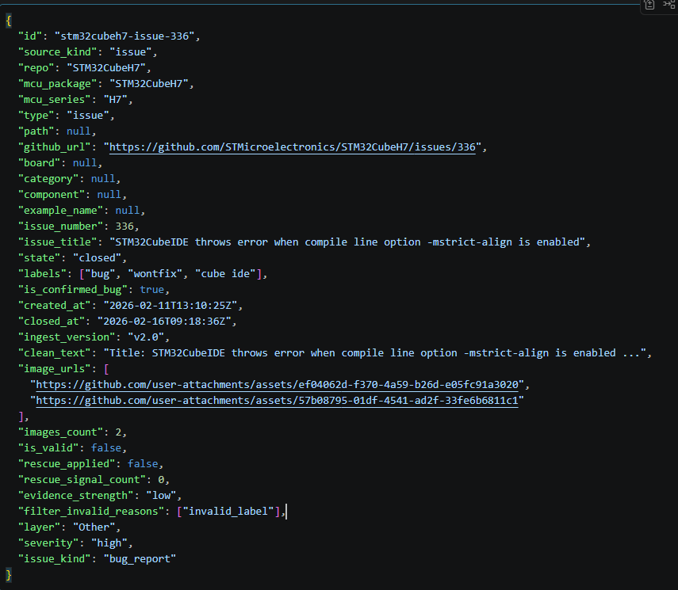
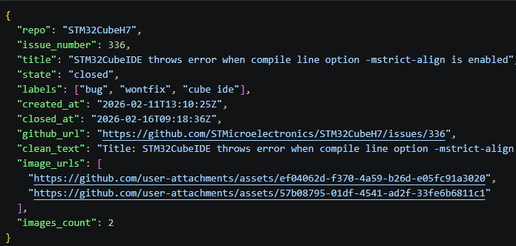
Pipeline: Enrichment (Feature Engineering)
My data preprocessing pipeline
Before (clean_issues.json)
After (docs_issues_v2.json)
→ Cleaning step output

Slide 42
Pipeline: Enrichment (Feature Engineering)
My data preprocessing pipeline
Adds the metadata that makes documents filterable, rankable, and searchable
Layer
88.2%
Component
72.6%
Board
45.3%
HAL, BSP, CMSIS, Middleware, Application
SPI, I2C, UART, DMA, USB, FDCAN, …
NUCLEO-H743ZI, STM32H750B-DK, …
API prefixes (HAL_, LL_, MX_) + keywords
Labels + regex on title/body
Regex on board patterns + fallback
Severity
100%
issue_kind
is_valid
86.4%
High · Medium · Low
bug_report · question · doc_issue · config
true / false
HardFault, freeze → High; typos → Low
Labels + heuristic patterns
Length + bot/spam/duplicate filters
Note · Board coverage (45.3%) is lower because most issues do not mention a board. Source-data limitation, not a heuristic failure.

Slide 43
The Data Preprocessing Pipeline
My data preprocessing pipeline
1
2
3
4
5
6
7
Ingestion
Cleaning and structuring
Similarity
Data Generation
Delivery
Evaluation
(Benchmark)
Enrichment
(Feature
Engineering)
Download raw data
from GitHub
Remove HTML and noise, then structure the documents.
Link related issues
describing the same bug
Deliver JSON
format ST-ready
Add board, component, layer, severity, issue_kind, is_valid
A post-processing stage that turns prepared data into actionable support artifacts
Test with 50
questions of reference
❓ Objective: Similarity
Two different GitHub issues may describe the same technical bug but using different words.
By computing similarity, we enrich each issue with cross-references to other related issues.
→ This improves retrieval and helps the assistant give more complete and reliable support answers.

Slide 44
Pipeline: Similarity
Why link issues together?
How?
We compute similarity using the issue text (clean_text):
sim(dᵢ,dⱼ) = (vᵢ · vⱼ) / (‖vᵢ‖ ‖vⱼ‖)
Convert each issue into a TF-IDF vector
related(dᵢ) = { dⱼ | sim ≥ 0.3 }
Compute cosine similarity between issue vectors
Threshold 0.3 keeps only strong links. H7 coverage 22% = issue diversity, not a failure.
Store related issue IDs inside each issue (related_issue_ids)
Apply a configurable similarity threshold (only keep strong matches)
Example
What is the result ?
A: “HAL_UART compile error when UART disabled”
B: “USART build fails, missing UART macro”
Each issue becomes connected to other similar issues:
Same peripheral/component (UART, USB, DMA…)
Same type of symptom (compile error, crash, timeout…)
Access to fixes already discussed in other threads
cosine ≈ 0.72 → same topic, linked.
My data preprocessing pipeline

Slide 45




Pipeline: Similarity
Why link issues together?
Without Similarity
User asks:
Issue text
"USART compile error when UART disabled"
The system retrieves only one issue → partial answer, limited context.
A: “HAL_UART compile error when UART
disabled”
B: “USART build fails, missing UART macro”
TF-IDF
Example
With Similarity
cosine ≈ 0.72 → same topic, linked.
Cosine
The system retrieves multiple related issues:
Same component (UART / USART)
Similar symptom type (compile-time guard / dependency issue)
Previous fixes already documented in linked threads
Related IDs
My data preprocessing pipeline

Slide 46
The Data Preprocessing Pipeline
My data preprocessing pipeline
1
2
3
4
5
6
7
Ingestion
Cleaning and structuring
Enrichment
(Feature
Engineering)
Similarity
Data Generation
Delivery
Evaluation
(Benchmark)
Download raw data
from GitHub
Remove HTML and noise, then structure the documents.
Link related issues
describing the same bug
A post-processing stage that turns prepared data into actionable support artifacts
Deliver JSON
format ST-ready
Add board, component, layer, severity, issue_kind, is_valid
Test with 50
questions of reference
❓ Data Generation Objective
Data Generation is the key step that turns processed data into useful knowledge, so the assistant can find the right answer.
Resolver Cases : they connect issues to likely fixes (PRs/commits), so the assistant can suggest concrete solutions.
Diagnostic Cards :they provide clear checks and questions, so the assistant can guide troubleshooting quickly.

Slide 47
Pipeline: Data Generation
My data preprocessing pipeline
Goal: generate support reasoning content from prepared evidence.
Data Generation
Build Diagnostic Cards
Diagnostic Cards
Turn issue context and resolver knowledge into guidance
generated output
_{Problem → checks → guidance}
Technical Files
Resolver knowledge
_{Technical reference}
Build Resolver Cases
_{Link issues to fix evidence}
Resolver Cases
generated output
PRs & Commit Links
Problem → fix evidence
_{Fix evidence}
Issues
_{Problem context}
These two artifact types are the single biggest source of Quality Index gain in the entire project.

Slide 48
Pipeline: Data Generation(Resolver cases)
My data preprocessing pipeline
Resolver Cases: what we built and how
Real need: ST engineers receive technical questions about STM32 bugs. To answer them, they need to know whether a GitHub bug has already been resolved: Was a PR merged? Does a fix commit exist? Is there a credible and verifiable path to a correction for this bug?
These cards are injected into the ST Knowledge Base (KB) so the RAG engine can cite fixes during a query.
GitHub Issue (problem)
PR (proposition of correction)
A ticket describing a bug or abnormal behavior in STM32Cube (ST GitHub repo).
Contains: title, technical description, labels, status (open/closed).
A code change proposal submitted on GitHub. If it is merged, it becomes an official fix.
Contains: title, changed files, associated commits (technical evidence of the change).
Resolver Case
A structured, ST-ready sheet linking an issue to its fix PRs/commits.
Contains: resolution status, confidence level, impacted files, text ready for the knowledge base.

Slide 49

Resolver Cases : Why they matter
My data preprocessing pipeline
Is there a confirmed fix for this STM32H7 DMA issue?
Before resolver cases — persona says:
"There is a known DMA issue on STM32H7."
No fix status. No PR link. No changed files. No confidence.
The engineer still has to search GitHub manually.
Impact on persona quality :
Eliminated "I don't know" on fix-status questions
Persona now provides: fix status, PR link, changed files, confidence level
Prevents unsupported "it was fixed" claims , confidence-gated
Direct QI boost:
The persona acts like a support engineer, not a search engine.
After resolver cases — persona says:
"This DMA issue was fixed in PR #247 (merged).
Files changed: stm32h7xx_hal_dma.c. Confidence: high."
The engineer gets the answer immediately , no manual search.
Without resolver cases, the persona reports bugs. With them, it resolves them.
49

Slide 50
Pipeline: Data Generation(Diagnostic cards)
My data preprocessing pipeline
Diagnostic Cards: what we built and how
Real need: An ST engineer receives a customer question: “My HAL_SPI_Transmit_DMA blocks on 2 bytes, why?”, They need a structured, ready-to-use diagnostic card, not just a GitHub ticket or a link to a GitHub ticket.
Construction = Issue + Resolver
Issue GitHub
Resolver Case
issue_title
layer, severity
component, board
st_ready_text
github_url
+
resolution_status
link_confidence
linked_pr_urls
linked_commits
files_evidence
→ build_diagnostic_card()
Diagnostic Card JSON
→ injected into the ST KB
→ optimized for retrieval RAG
Notes:
query_aliases = pour mieux retrouver,
possible_workarounds = pour agir tout de suite,
plausible_diagnosis = pour raisonner,
debug_checks = pour vérifier méthodiquement.

Slide 51
Diagnostic Cards — Why they matter
My data preprocessing pipeline
UART callback is not reached on STM32H7, what are the likely causes and what should I check ?
Impact on persona quality
Highest-value artifacts in the entire pipeline
Each card provides: symptoms, likely causes, debug checks, workarounds, evidence refs
Benchmark showed clear QI jump on mixed questions , from generic abstention to actionable answers
Confidence-gated: if evidence is weak, caution is added automatically
Direct QI boost:
persona guides diagnosis like a senior engineer.
Before diagnostic cards — persona says:
"UART callback is not reached on STM32H7."
Describes the problem. No guidance. No debug steps
The engineer has to figure out the diagnosis alone.
After diagnostic cards — persona says:
"Symptom: UART callback not reached. Likely causes: NVIC
priority, DMA config. Debug: check IRQ enable, verify HAL init
sequence. Confidence: medium.“
The engineer gets a full troubleshooting guide instantly.
Resolver cases + diagnostic cards = the persona answers like a senior engineer, not a search engine.
51

Slide 52
The Data Preprocessing Pipeline
My data preprocessing pipeline
1
2
3
4
5
6
7
Ingestion
Cleaning and structuring
Enrichment
(Feature
Engineering)
Similarity
Data Generation
Delivery
Evaluation
(Benchmark)
Download raw data
from GitHub
Remove HTML and noise, then structure the documents.
Link related issues
describing the same bug
Deliver JSON
format ST-ready
Add board, component, layer, severity, issue_kind, is_valid
A post-processing stage that turns prepared data into actionable support artifacts
Test with 50
questions of reference
❓ Delivery objective
Delivery transforms raw technical data into knowledge directly usable in a support KB.
The goal:
Provide actionable answers for troubleshooting.
Maintain complete traceability to GitHub.
Provide a stable format for ingestion within ST.

Slide 53
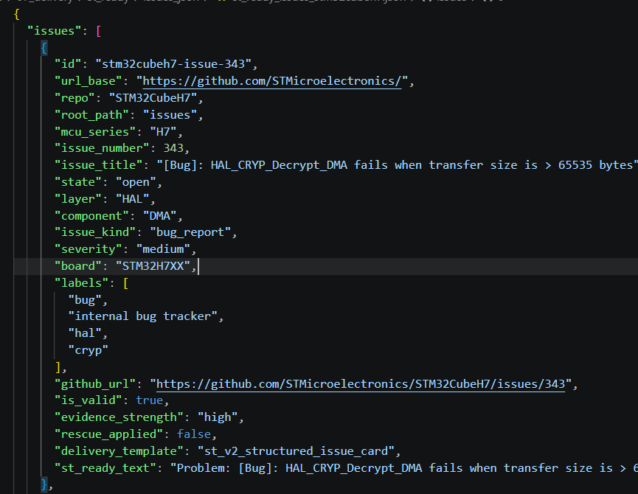
Pipeline: Delivery
My data preprocessing pipeline
Even if only a child chunk is retrieved, it still contains context + fix signal.

Slide 54
The Data Preprocessing Pipeline
My data preprocessing pipeline
1
2
3
4
5
7
6
Ingestion
Cleaning and structuring
Enrichment
(Feature
Engineering)
Similarity
Data Generation
Delivery
Evaluation
(Benchmark)
Download raw data
from GitHub
Remove HTML and noise, then structure the documents.
Link related issues
describing the same bug
Deliver JSON
format ST-ready
Add board, component, layer, severity, issue_kind, is_valid
A post-processing stage that turns prepared data into actionable support artifacts
Test with 50
questions of reference
❓ Evaluation Objective ?
Test whether our preprocessing decisions produce the right answers , before anything reaches ST ChatGPT.
50 real questions, measured offline and online, to catch hallucinations and missing context before deployment.

Slide 55

Evaluation Protocol & Benchmark Results
My data preprocessing pipeline
Concrete numbers
Incremental evaluation: each added source is evaluated separately to avoid introducing hallucinations or out-of-context responses.
Offline Evaluation :
Evaluation 1
Stats Quality
test_stats_issues_v2
test_stats_files_v2
Distribution + metadata cover
Evaluation 2
TF-IDF Retrieval
test_tfidf_search_issues_v2
test_tfidf_search_files_v2
Top-3 pertinence verified offline
Evaluation 3
Schema Validation
validate_schemas.py
Contract doc verified
Online Evaluation ( 50Q Live Run , ST Platform results ) :
Quality Index
↑

Slide 56
The ST ChatGPT Platform
How does the platform work?
RAG workflow
Retrieval
Generation
User Prompt
Search
Knowledge Base
LLM (AI)
Answer
Asks a technical question
Answer + sources
Search the knowledge base using embeddings to retrieve the most relevant passages (chunks)
The AI generates a precise, sourced answer from that augmented context
Augmented
Inject those passages directly into the AI model's input

Slide 57
RAG Configuration Parameters — What Each One Means
The knobs of the ST retrieval platform, and how the pipeline honors them
Search type
Combines semantic vectors (meaning) + full-text (exact terms). Ablating either branch costs 14–24 QI points — measured on the S3 / S5 configurations.
chunkStrategy
Small-to-big retrieval. Match on small 1 000-char child chunks, return the 3 000-char parent as LLM context. Precision + context in one strategy.
Hybrid
PARENT_CHILD
childChunkSize
The unit the vector index actually sees. Every artifact must survive this cut and still carry the discriminating terms — API names, boards, error codes go first.
parentChunkSize
The context returned to the LLM after a match. Large enough to reconstruct the full symptom → root cause → fix reasoning around each hit.
1 000 chars
3 000 chars
embedding model
1 536-dimensional vectors. Fixed by the platform — no fine-tuning available. Pipeline compensates via structured cards and TF-IDF-friendly vocabulary.
Semantic threshold
Minimum cosine similarity to consider a semantic hit. Lowered to 0.45 in S1 → recall+ configuration, gaining +1 QI point without noise.
AdaV2
0.55
Semantic top-K
Number of semantic candidates. S1 raises to 35, gaining recall for reformulated questions users actually ask.
Full-text top-K
Number of exact-match candidates. Critical for STM32-specific terms (HAL_UART_Init, NUCLEO-H743ZI). Removing it (S5) costs −24 QI.
25 docs (S0)
12 docs (S0)
jobBatchSize
Indexing job size. Drives the ~57 MB per-batch limit — the reason large series (H7: 4 707 docs) require a 50-part manual split.
embeddingsBatchSize
Embedding-API call size. Fixed platform parameter that the pipeline respects by design (no per-doc oversized fields).
60 docs
20 texts
Every value above was measured, not assumed. The S0–S5 ablation study on slide 26 shows the impact of moving each knob.
STM32Cube Workshop · Abir GHARBI · PFE 2026 · STMicroelectronics Tunis
36 / 47

Slide 58
Pipeline overview
1-6. INGESTION
GitHub API calls + local repo sync + file collection (incl. PDFs)
7. ALFRED PDF
Extract PDF figures, render pages, crop regions, generate descriptions
8-9. CLEANING and STRUCTURING
Normalize text, detect [IMAGE ATTACHED], structure content
10-12. ENRICHMENT
Classify: layer, board, component, severity, is_valid + similarity
13-17. EVALUATION
Chunking + stats + TF-IDF search tests + schema validation
18-22. DELIVERY
Export 4 artifact types + issues_with_images variant
23. ALFRED IMAGES
ALFRED Vision on issue screenshots → [IMAGE DESCRIPTION]

Slide 59
Pipeline overview . run_full_workflow.py — Internal Steps (Real Code)
STEPS list (executed in order):
        ("Ingestion issues", fetch_issues_main) # 1
        ("Ingestion PRs", fetch_prs_main) # 2
        ("Ingestion commits", fetch_commits_main) # 3
        ("Ingestion links", fetch_links_main) # 4
        ("Ingestion sync repos", sync_local_repos_main) # 5
        ("Ingestion files", fetch_files_main) # 6
        ("Alfred PDF figures", _enrich_pdf_main) # 7
        ("Cleaning issues", clean_issues_main) # 8
        ("Cleaning files", clean_files_main) # 9
        ("Enrichment issues V2", issues_to_docs_v2_main) # 10
        ("Enrichment files V2", files_to_docs_v2_main) # 11
        ("Similarity issues V2", similarity_main) # 12
        ("Chunking issues V2", chunks_issues_main) # 13
        ("Chunking files V2", chunks_files_main) # 14
        ("Stats issues V2", stats_issues_main) # 15
        ("Stats files V2", stats_files_main) # 16
        ("Schema validation", validate_schemas_main) # 17

Slide 60
Pipeline overview . run_full_workflow.py — Internal Steps (Real Code)
STEPS list (executed in order):
--export-st-ready adds 6 additional steps:
("Delivery ST-ready issues", export_issues_all) # 18
("Delivery ST-ready files", export_files_all) # 19
("Delivery ST-ready resolver", export_resolver_all) # 20
("Delivery ST-ready diag cards", export_diag_all) # 21
("Delivery ST-ready issues with imgs", export_with_images_all) # 22
("Alfred image descriptions", _enrich_alfred_images) # 23
How flags filter steps:
• --skip-ingestion → removes steps where label starts with “Ingestion”
• --skip-chunking → removes steps with label “Chunking”
• --no-enrich-pdf → removes “Alfred PDF figures” step
Error handling:
• Without --continue-on-error → exception = STOP immediately
• With --continue-on-error → print [WARN] + continue to next step

Slide 61

Pipeline: Delivery
Delivery , Why structure the final output?
From processed data → ST-ready Knowledge Base payload
Goal: convert enriched STM32Cube data into a format directly ingestible by ST ChatGPT Knowledge Base.
4 ST-ready JSON payloads generated automatically:
Why Delivery matters (RAG constraints)
Issues JSON
Files JSON
Resolver Cases JSON
Diagnostic Cards JSON
Upload logs confirm Parent/Child chunking strategy.
→ Therefore, each document must be self-contained and chunk-friendly.
ST-ready text template (retrieval-optimized) : All key technical signals are injected into one structured field: st_ready_text
Structure: st_ready_text (issues) — fields exposed to the moteur RAG
Problem
Context
Constraints
Keywords
Root cause
Fix
Technical details
Key comments
Notes:
Issues JSON
Structured bug cards (Problem → Root cause → Fix)
Files JSON
Source code + documentation cards (HAL/LL/BSP, release notes, README, etc.)
Resolver Cases JSON
Issue ↔ PR ↔ Commit linking (fix evidence + confidence)
Diagnostic Cards JSON
Troubleshooting guidance (checks, causes, workarounds, constraints)

Slide 62
Pipeline: Similarity
TF-IDF ? Cosine Similarity ?
TF-IDF (Text → Vector)
TF-IDF converts each issue text into a vector of important keywords.
Words that appear often in one issue → higher weight
Words that are common in all issues (STM32, driver, error) → lower weight
Technical terms (HAL_CRYP, DMA, HardFault) → higher weight
Example:
Issue text contains many times: “HAL_CRYP_Decrypt_DMA”, “Size overflow”, “uint16_t”
→ TF-IDF gives these terms high weight, because they strongly describe the bug.
Result:
Each issue becomes a numeric representation of its main technical topic.
Cosine Similarity (Vector → Similarity Score)
Cosine similarity compares two issue vectors and returns a score:
1.0 = very similar issues (same bug/topic)
0.0 = unrelated issues
We keep only links above a tuned threshold (example : 0.55) to avoid noise.
Example:
Issue A: “HAL_UART compile error when UART disabled”
Issue B: “USART build fails due to missing UART macro definition”
Result:
Cosine similarity might be 0.72 → they are likely the same topic.

Slide 63
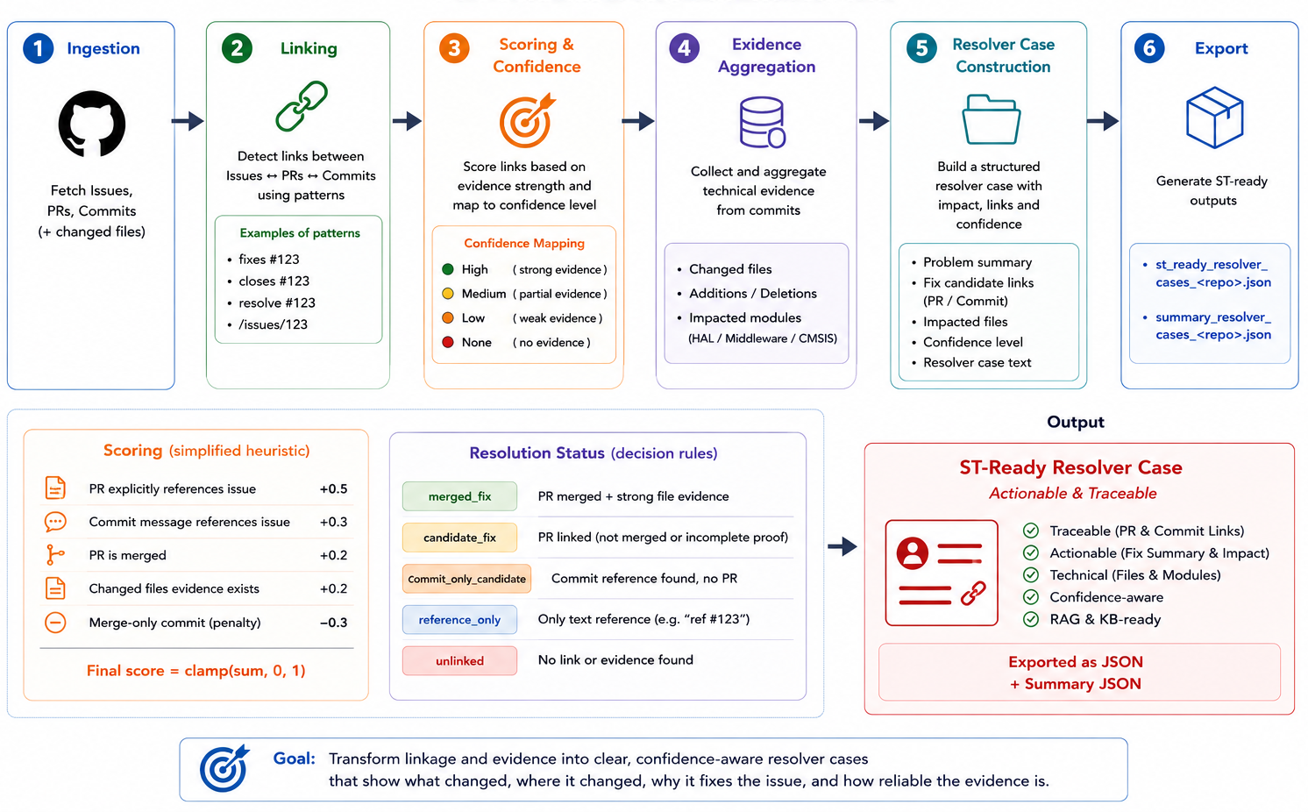
Resolver Cases — Tracing Bugs to Their Fix
Going beyond issue similarity: linking confirmed resolutions

Slide 64
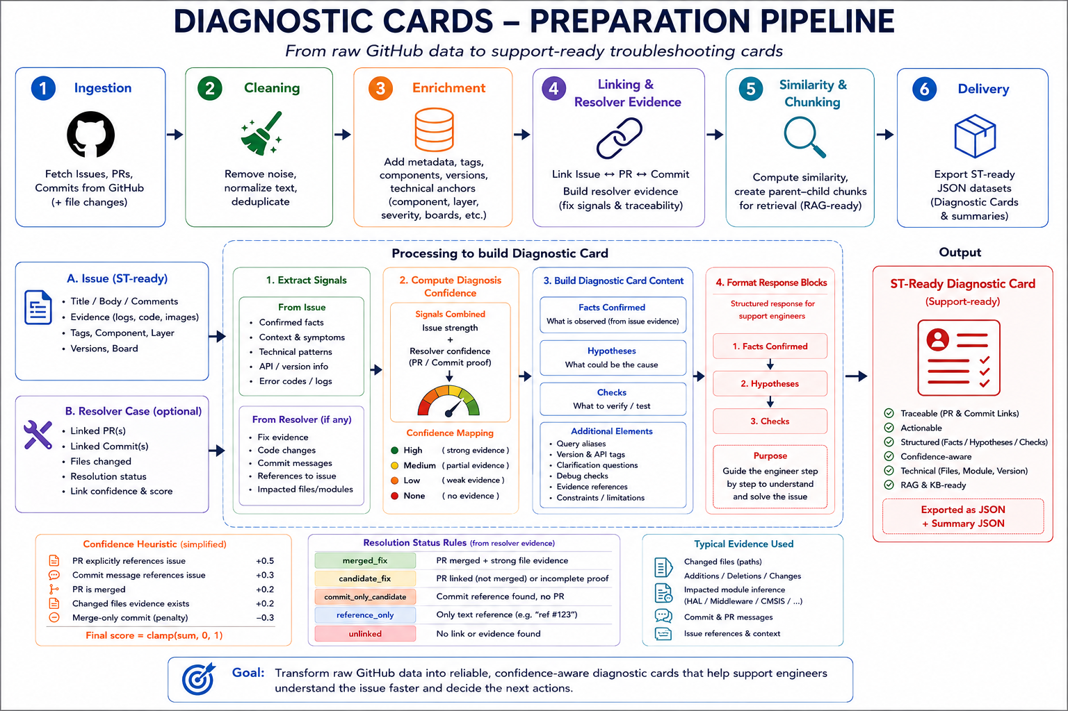
Diagnostic Cards — Structured Troubleshooting Knowledge

Slide 65
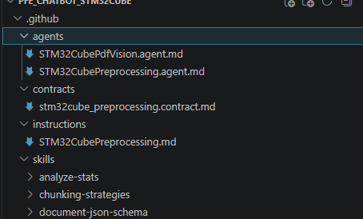
Pipeline: AI Agents — Two Specialized Assistants in the Project
Not just one AI: two agents used for engineering acceleration
Real need: avoid bad or noisy data before upload and keep the pipeline easy to improve.
Real need: capture technical information that exists only in PDF images.
benchmark outputs
Agent 1 — Preprocessing Agent
Agent 2 — PDF Vision Agent
STM32Cube Preprocessing Agent
STM32Cube PDF Vision Agent
Role
Assistant dedicated to pipeline analysis and documentation
Role
Analyzes figures and diagrams extracted from technical PDFs
Analyze
The data flow, JSON outputs, and benchmark outputs
Read
pdf_image_tasks_<repo>.jsonl
Document
Data schemas, test results
Analyze
Figures / diagrams from PDFs
Compare
Structuring strategies
Describe
Injectable technical text descriptions
Value
Documentation acceleration + pipeline readability
Faster iteration on data quality improvements
Value
Preserve information in PDF diagrams
Multimodal PDF workflow:
Text extraction →
Page image rendering →
Figure detection →
Crop figures →
JSONL tasks →
JSON descriptions →
Enriched re-injection

Slide 66
Alfred Coverage Across the STM32Cube Family
Series | Issues w/ Images | Total Images | Alfred Success | PDF Figures
H7 | 53 | 98 | 97 / 98 | 10
F4 | 34 | 62 | 61 / 62 | 11
WL | 23 | 48 | 48 / 48 | 11
F7 | 20 | 26 | 26 / 26 | 11
C0 | 3 | 5 | 5 / 5 | 12
U5 | 6 | — | OK | 14
H5 | 3 | — | OK | 13
G0 | yes | — | OK | 13
N6 | — | — | — | 15
H7RS | — | — | — | 25
F0 / F1 / F2 / F3 | few | — | OK | varies
TOTAL (19 series) | >99% | — | — | 242 figures
The API works
242 figures described across the whole family. ~1% failure rate is timeout / very small figure filtered out — negligible for retrieval.
The API is not the metric
99% API success ≠ 99% useful descriptions. That's why we measure contextual trust separately (next slide).
Deployment is done. The remaining work is on quality of descriptions in weak-context cases — not on making the pipeline reach more series.

Slide 67
Stage 1 : Ingest — Reading a 3 000-page PDF Without Crashing
The trick: never load the whole PDF at once
DEFINITIONS
Chunking strategy · 50 pages at a time
Docling = open-source library that reads a PDF and extracts its text, images, and structure.
pypdfium2 = a faster PDF-reading engine (~10× faster than the default).
Chunking = splitting a big file into small blocks and processing them one at a time.
Timeout = a safety limit; if a step takes longer than the timeout, we stop it and move on.
A 3 550-page manual becomes 71 chunks — each processed independently.
skip
51
101
151
201
251
301
351
401
451
… 71
1-50
100
150
200
250
300
350
400
450
500
Chunk 1 skipped — cover + Table of Contents can block Docling
Timeout 180s per chunk — a stuck chunk is killed, not the whole run
Engineering choices that made this work
✓
SKIP_FIRST_N_PAGES = 6
✓
50 pages per chunk
✓
multiprocessing.Process.kill()
Skip cover, TOC, revision history — pages that block the parser
Small enough to fit in memory · large enough to be efficient
If a chunk hangs, we can force-stop just that chunk
✓
gc.collect() between chunks
✓
pypdfium2 backend
Free memory before the next chunk starts
About 10× faster than the default Docling backend

Slide 68
Stage 2 : VLM — Making Every Figure Readable to Text Search
Diagrams and tables carry critical information — but text-search engines cannot see pixels
DEFINITIONS
VLM (Vision Language Model) = an AI that looks at an image and writes a text description of what's in it. LLaVA = a specific open-source VLM (free, runs on your own GPU).
Ollama = a tool that lets you run AI models on your own computer instead of calling a paid cloud API.
1
Figure extracted
2
Contextual prompt
3
Ollama runs LLaVA
4
vlm_description
image + caption + page number
we tell LLaVA: "here is a figure from page N, caption is X, describe what you see"
100% on the local GPU · timeout 120 seconds · never sends data to the cloud
a rich text description that replaces the figure in the document
Measured on the first STM32H7 Reference Manual
1 173
76.7 s
3
~25 h
figures found in one PDF
average time per figure
timeouts (kept moving on)
total processing time

Slide 69
Stages 3 & 4 : Recombine + Extract
Putting figure descriptions back where they belong, then turning it all into structured data
STAGE 3
Recombine
STAGE 4
Extract
Merge text + figure descriptions
Text → structured JSON
Placeholder = a marker we put in the text where a figure was, so we can put its description back later. Format: [[FIGURE_N]]
Mistral 7B = a free open-source LLM, runs locally on your PC.
Before:
Extracts:
...The AHB bus [[FIGURE_47]] connects...
• peripherals[] list of every peripheral (UART, SPI, etc.)
After:
• registers[] list of every register with its address
• tables[] bit-field tables from the manual
...The AHB bus [AHB bus diagram — 4 masters, 8 slaves, ...] connects...
The chunking-again problem · and how we solved it
Context window = the maximum amount of text an AI can read at once. Mistral's context window ≈ 8 000 characters.
Problem: one PDF produces 7 629 693 characters of combined text. That's 950× the context window.
Solution: cut the combined text into 1 100 chunks of 8 000 characters each, extract JSON from each independently, then merge the results (concat + de-duplicate).

Slide 70
Results & Metrics
Five STM32H7 Reference Manuals — processed end-to-end, no crashes
15 000+
5 000+
5 500+
pages processed
figures described
chunks extracted
5 PDFs · STM32H7 family
LLaVA running on GPU · 100%
Mistral 7B running locally
0
~25 h
100%
pipeline crashes
per PDF (VLM stage)
recovery on error
all timeouts handled gracefully
76 seconds average per figure
progress.json — resumes after crash
Incremental saving · the pipeline writes intermediate results to disk after every PDF. If the PC shuts down mid-run, we resume from the next PDF — no work lost.

Slide 71
what makes this project useful for STMicroelectronics next
What is delivered
✓
Complete, robust pipeline
5 PDFs × ~3 000 pages processed end-to-end — no crashes, no lost work
✓
Structured extraction
peripherals, registers, bit-fields, and tables extracted as machine-readable JSON
✓
Modular, reusable architecture
each stage is a swappable Python file — same design works for other document types
What comes next · three concrete directions
Integration
Optimization
Evaluation
Integrate into ST ChatGPT
Faster figure AI
Quality benchmark
Index the extracted JSON as RAG data
Benchmark moondream (~7 seconds/figure) vs LLaVA (~76 seconds/figure) — potential 10× speedup on the same GPU.
Run the extractions against real support questions to measure whether structured RM data actually improves answer quality.
From the workshop pipeline (GitHub data) to the doc_pipeline (Reference Manuals) — two complementary halves of the same STM32 knowledge story.

Slide 72
Technical Challenges & Solutions
Five real problems encountered while building this — and how each was solved
1
✗
Out of memory (std::bad_alloc) on 3 000+ page PDFs
ingest.py
✓
Chunking 50 pages/chunk + multiprocessing.Process.kill() + gc.collect() between chunks
2
✗
Docling hung > 900 seconds on some pages (cover, TOC)
ingest.py
✓
SKIP_FIRST_N_PAGES=6 + faster pypdfium2 backend
3
✗
LLaVA at ~100 s/figure → 33 h ETA for one PDF
vlm.py
✓
asyncio.wait_for(timeout=120s) + live progress logs + real-time ETA display
4
✗
Mistral returned empty JSON on 7.6 M characters (context window too small)
extract.py
✓
Split into 8 000-char chunks + robust JSON parser with regex fallback + merge
5
✗
All work lost if the PC shut down mid-run
stm32_refman.py
✓
Incremental JSON save after each PDF + progress.json → automatic resume on the next PDF

