Slide 1

An AI Tool for STM32Cube
Technical Support
From raw GitHub data to precise technical answers:
Understanding how it works , step by step.
Presented by: Abir GHARBI
Supervised by: Ali LABBENE & Omar SAKET
PFE - 2026 | STMicroelectronics Tunis
STM32 MCU Embedded Software Support & Maintenance Team

Slide 2
Today’s Program
8 steps to understand the project
01
Project context
05
Tests , Results & evaluation
The daily problem it solves
benchmark , concrete numbers
02
ST ChatGPT : platform overview & access request
06
Challenges encountered
What our project is building
Concrete technical challenges
03
How ST ChatGPT answers : RAG workflow, data sources & demo
07
Next Steps & Perspectives
Persona, Knowledge Base, Data Sources
What remains and how to get there
04
The Data preprocessing pipeline
08
Q&A
Ingest → Clean → Enrich → Deliver
Open discussion

Slide 3
Today’s Program
8 steps to understand the project
01
Project context
05
Tests , Results & evaluation
The daily problem it solves
benchmark , concrete numbers
02
ST ChatGPT : platform overview & access request
06
Challenges encountered
What our project is building
Concrete technical challenges
03
How ST ChatGPT answers : RAG workflow, data sources & demo
07
Next Steps & Perspectives
Persona, Knowledge Base, Data Sources
What remains and how to get there
04
The Data preprocessing pipeline
08
Q&A
Ingest → Clean → Enrich → Deliver
Open discussion

Slide 4
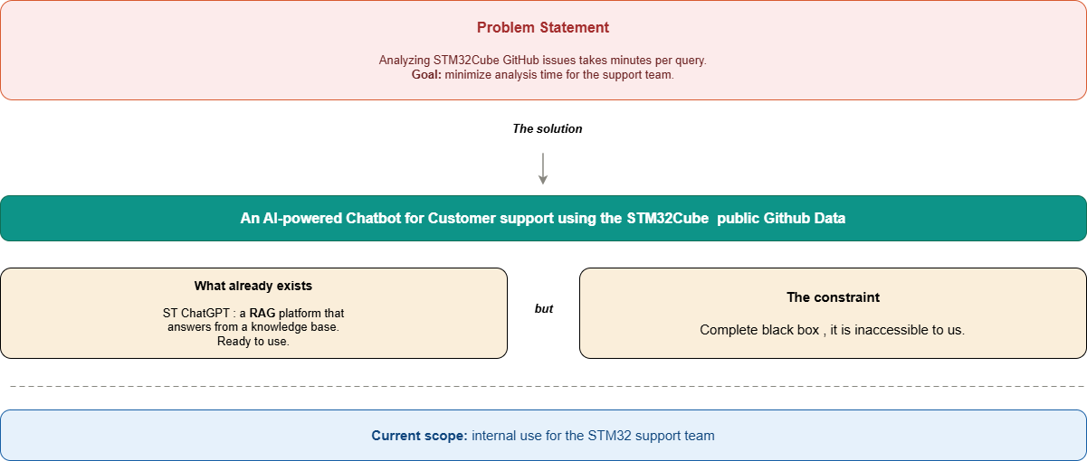
Project context ( Problem Statement , Solution )

Slide 5
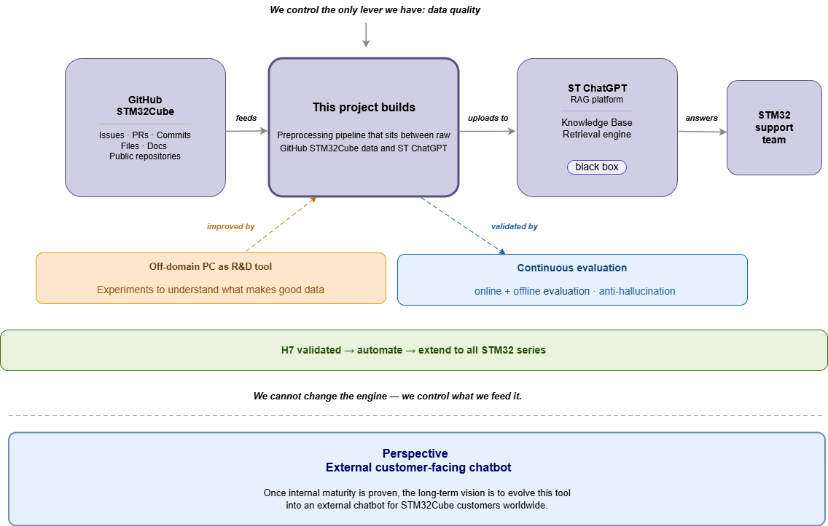

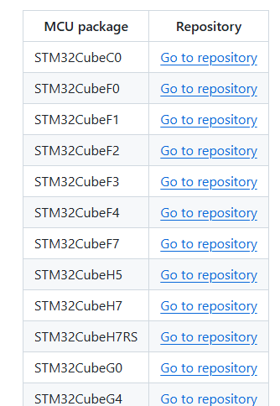
Project context (Ongoing Work)

Slide 6
Today’s Program
8 steps to understand the project
01
Project context
05
Tests , Results & evaluation
The daily problem it solves
benchmark , concrete numbers
02
ST ChatGPT : platform overview & access request
06
Challenges encountered
What our project is building
Concrete technical challenges
03
How ST ChatGPT answers : RAG workflow, data sources & demo
07
Next Steps & Perspectives
Persona, Knowledge Base, Data Sources
What remains and how to get there
04
The Data preprocessing pipeline
08
Q&A
Ingest → Clean → Enrich → Deliver
Open discussion

Slide 7
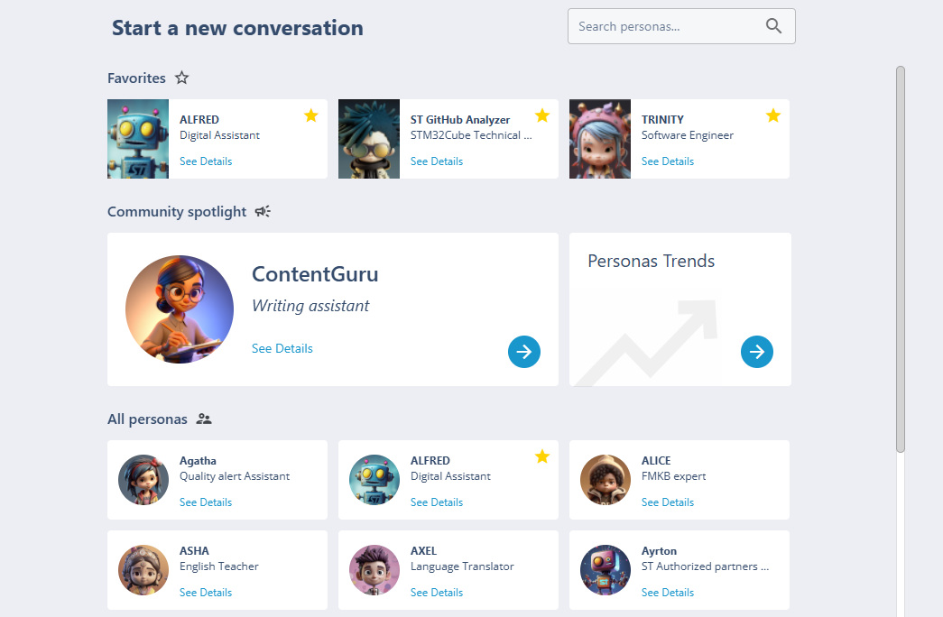
The ST ChatGPT Platform, Creating a Persona
Not just a chatbot: a configurable AI assistant built on Knowledge Bases
What is ST ChatGPT?
The ST ChatGPT platform allows teams to create specialized AI personas tailored to a specific domain or use case.
Key concept: the Persona
A persona is a configured AI assistant , it has a name, a system prompt, one or more Knowledge Bases, and associated data sources.
Personas already live at ST:
● Alfred does: general ST assistant
● Others does: domain-specific across ST teams
→ This project creates a NEW persona specialized in STM32Cube technical support.

Slide 8
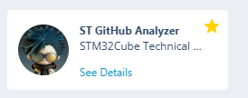
Meet the STM32Cube AI Persona
The Daily Problem in Technical Support
Before this project, finding technical information was time-consuming
The idea behind this project
ST already has personas: Alfred, Trinity, and others, each specialized for a domain.
.
A persona that knows STM32Cube.
A persona that has read 300+ issues, 5,000+ technical files, and every resolved PR. That can answer in seconds what took minutes to find manually.

Slide 9

ST ChatGPT
Request and Access Process — Persona & API ST ChatGPT
From business request to persona / API access
Business Need
ServiceNow
Validation
Access / Configuration
Usage
Yes
Is the request for New Persona / API?
No
For existing persona updates, admin rights, system prompt updates.
Technical issues
Change requests
Click on this link
Click on this link
https://st.service-now.com/hub?id=sc_cat_item&sys_id=b7e4acc9fb1d66103949f4bbaeefdc7b
https://st.service-now.com/hub?id=support_details&topic=d0a6002b1b53d2d0aaf48553604bcb1b

Slide 10
ST ChatGPT
Request and Access Process — Persona & API ST ChatGPT
From business request to persona / API access
Business Need
ServiceNow
Validation
Access / Configuration
Usage
For each new persona / API:
  1st level review and approval by Business Enterprise Architect ( BEA) as per above slide
  2nd level approval by Global co-Ordinator (Loic ECHENE / Salvo CICIA)
For support of existing persona review/approval is not applicable

Slide 11
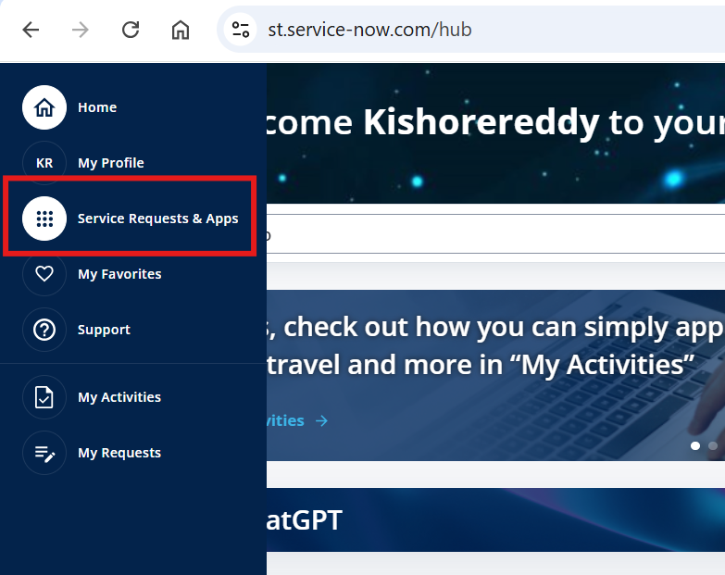
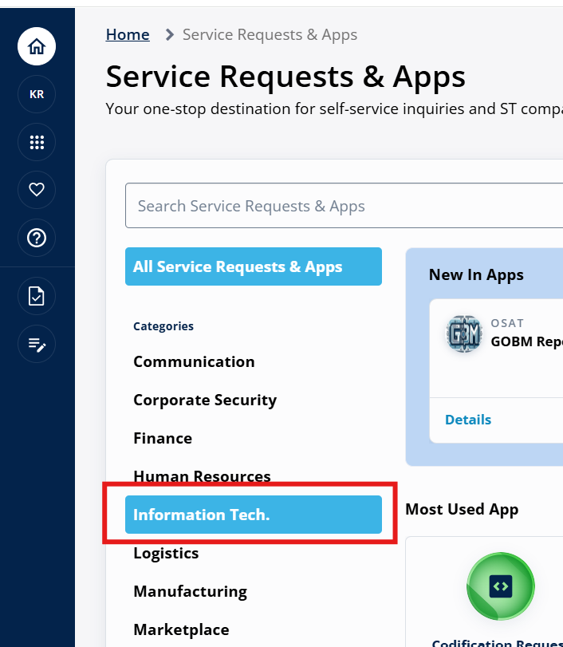
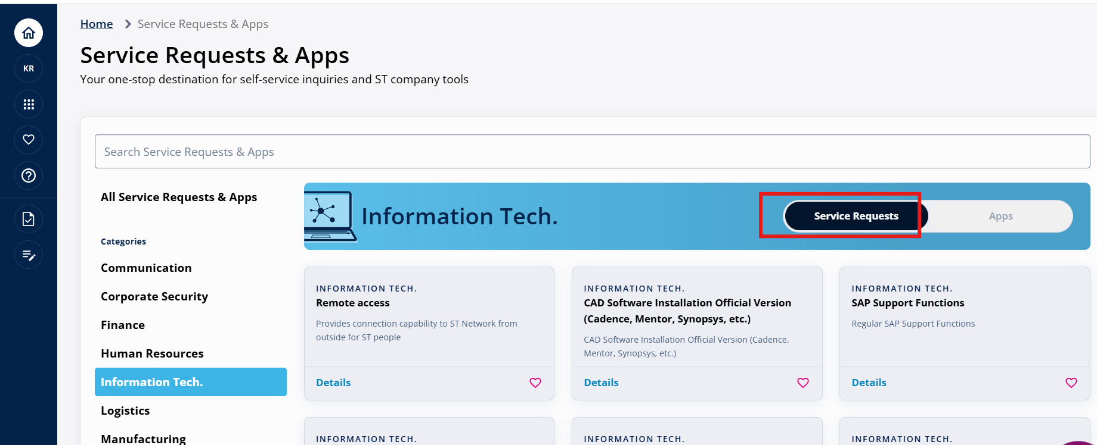
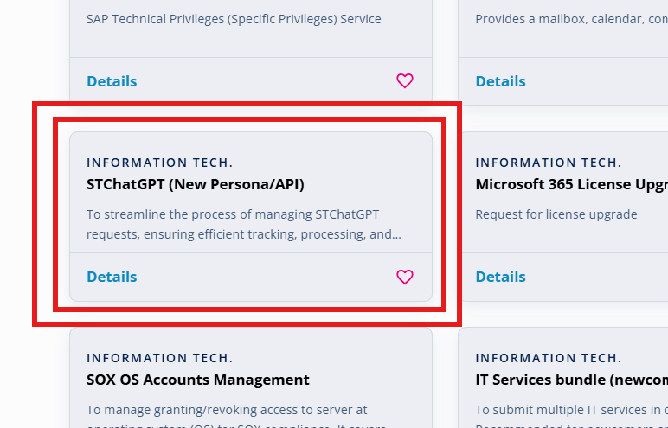
ST ChatGPT
Request and Access Process — Persona & API ST ChatGPT
From business request to persona / API access
Go to https://st.service-now.com/hub
Click Service Requests & Apps from in the left side menu
Click Information Tech. under categories
Click Service Requests tab
Find and click the card STChatGP (New Persona/API)

Slide 12
Today’s Program
8 steps to understand the project
01
Project context
05
Tests , Results & evaluation
The daily problem it solves
benchmark , concrete numbers
02
ST ChatGPT : platform overview & access request
06
Challenges encountered
What our project is building
Concrete technical challenges
03
How ST ChatGPT answers : RAG workflow, data sources & demo
07
Next Steps & Perspectives
Persona, Knowledge Base, Data Sources
What remains and how to get there
04
The Data preprocessing pipeline
08
Q&A
Ingest → Clean → Enrich → Deliver
Open discussion

Slide 13



Data Sources Used
Where does the information come from?
Everything extracted from GitHub STM32Cube public repos — nothing fabricated
Issues
Technical Files
Source code files: drivers (HAL, LL) , middleware, utilities, components, BSP board files.
Technical documentation: release notes, project README, PDF documentation.
Configuration/metadata files useful for context: package.xml, security-related files, etc.
User-reported bugs: title, body, comments, labels, state (open/resolved), github_url, timestamps
Source: STM32CubeH7 and extensible to other series
Source: STM32CubeH7 and extensible to other series
PRs & Commits
Resolver Cases
Diagnostic cards
Intelligent synthesis layer
When a bug is resolved, we trace the PR and commit messages that provide the confirmed fix
Structured cards: Problem → Evidence → Solution. Built automatically from resolved issues
Source: Generated by pipeline
Source: Generated by pipeline
For Each STM32Cube series : we unify issues, PRs and commits (Resolver Cases) to produce diagnostic cards.

Slide 14





The ST ChatGPT Platform
How does the platform work?
Full chain: from question to sourced, traceable answer
Status: Knowledge Base currently under construction
User Prompt
Search
Knowledge Base
LLM (AI)
Answer

Slide 15
The ST ChatGPT Platform
How does the platform work?
Full chain: from question to sourced, traceable answer
Status: Knowledge Base currently under construction
User Prompt
Search
Knowledge Base
LLM (AI)
Answer
These 3 steps you just saw on this diagram...
...have a name.

Slide 16
The ST ChatGPT Platform
How does the platform work?
Full chain: from question to sourced, traceable answer
Status: Knowledge Base currently under construction
User Prompt
Search
Knowledge Base
LLM (AI)
Answer
These 3 steps you just saw on this diagram...
...have a name.
This is called RAG.

Slide 17
The ST ChatGPT Platform
How does the platform work?
Full chain: from question to sourced, traceable answer
Status: Knowledge Base currently under construction
User Prompt
Search
Knowledge Base
LLM (AI)
Answer
R
A
etrieval
ugmented
G
eneration

Slide 18
The ST ChatGPT Platform
How does the platform work?
Full chain: from question to sourced answer
Status: Knowledge Base currently under construction
Knowledge Base
Note : The knowledge base and the data sources can be either heterogeneous (same file types) or homogeneous (different file types)
Data Source
Data Source
Data Source
(CSV, JSON, PDF)
(CSV, JSON, PDF)
(CSV, JSON, PDF)
The knowledge base is composed of several data sources

Slide 19
The ST ChatGPT Platform
How does the platform work?
Full chain: from question to sourced answer
Status: Knowledge Base currently under construction
Knowledge Base
Data Source
Data Source
Data Source
(CSV, JSON, PDF)
(CSV, JSON, PDF)
(CSV, JSON, PDF)
Each Data Source is composed of files
Files
Issues, Technical Files, resolver cases, Diagnostic cards

Slide 20
The ST ChatGPT Platform
How does the platform work?
Full chain: from question to sourced answer
Status: Knowledge Base currently under construction
Knowledge Base
Data Source
Data Source
Data Source
(CSV, JSON, PDF)
(CSV, JSON, PDF)
(CSV, JSON, PDF)
Files
Docs
Each line of the file is a DOC
Issues, Technical Files, resolver cases, Diagnostic cards

Slide 21
The ST ChatGPT Platform
How does the platform work?
RAG workflow
Knowledge Base
Knowledge Base preparation:
Each chunk is:
a focused passage from a larger document
small enough to be searched efficiently
large enough to preserve useful technical meaning
→
→
chunking embeddings Indexing
An embedding is a numerical representation of a text.
It allows the system to compare:
the meaning of the user query
with the meaning of stored chunks
→ This helps retrieval work beyond exact keyword matching.
Indexing is the step where the chunks, their embeddings, and their metadata are stored and organized inside the knowledge base.
→ This makes the knowledge base searchable.
A document is often too long to be used efficiently as a single block.
→ So it is split into smaller pieces called chunks.

Slide 22
The ST ChatGPT Platform
How does the platform work?
RAG workflow
Retrieval
Generation
User Prompt
Search
Knowledge Base
LLM (AI)
Answer
Asks a technical question
Answer + sources
Search the knowledge base using embeddings to retrieve the most relevant passages (chunks)
The AI generates a precise, sourced answer from that augmented context
Augmented
Inject those passages directly into the AI model's input

Slide 23
The ST ChatGPT Platform
How does the platform work?
RAG workflow
Retrieval
Generation
User Prompt
Search
Knowledge Base
LLM (AI)
Answer
Asks a technical question
Answer + sources
Search the knowledge base using embeddings to retrieve the most relevant passages (chunks)
The AI generates a precise, sourced answer from that augmented context
Augmented
Inject those passages directly into the AI model's input
Each chunk = one precise passage the KB can index and retrieve.

Slide 24
Demo

Slide 25
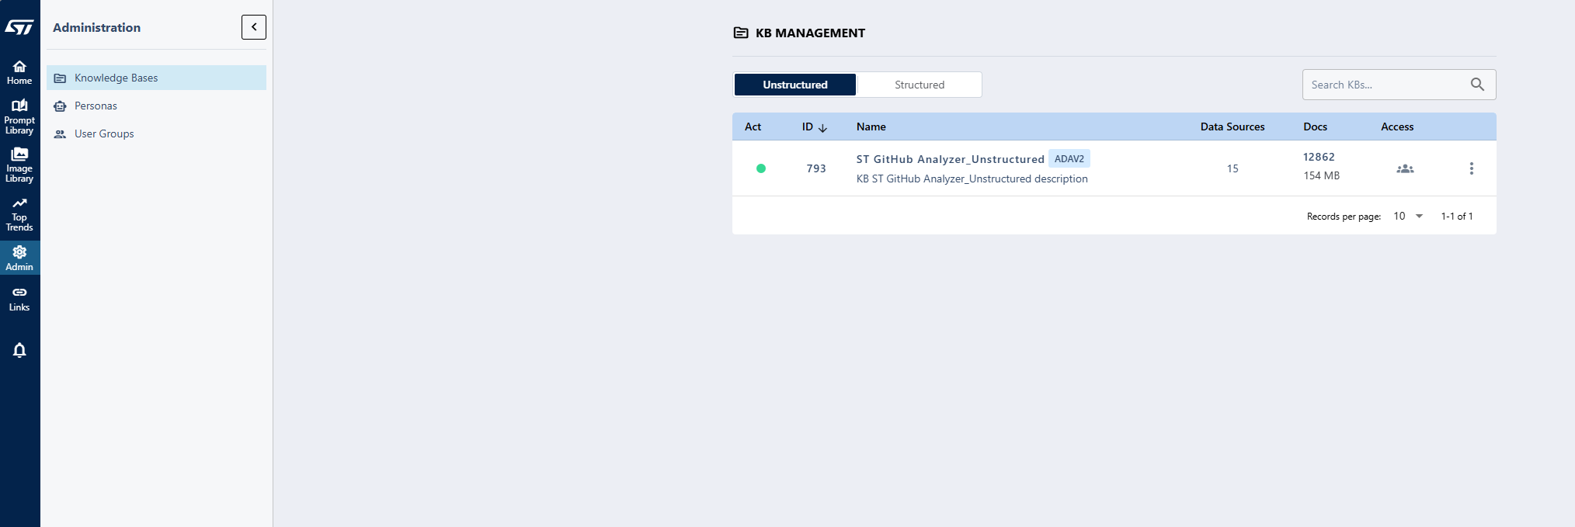
c
The knowledge base ID is required to access it via the Persona API with scripts.
The knowledge base provided by the DTIT team
Admin Access : il apparaît uniquement pour les créateurs de Persona et les propriétaires de l’API Persona.

Slide 26
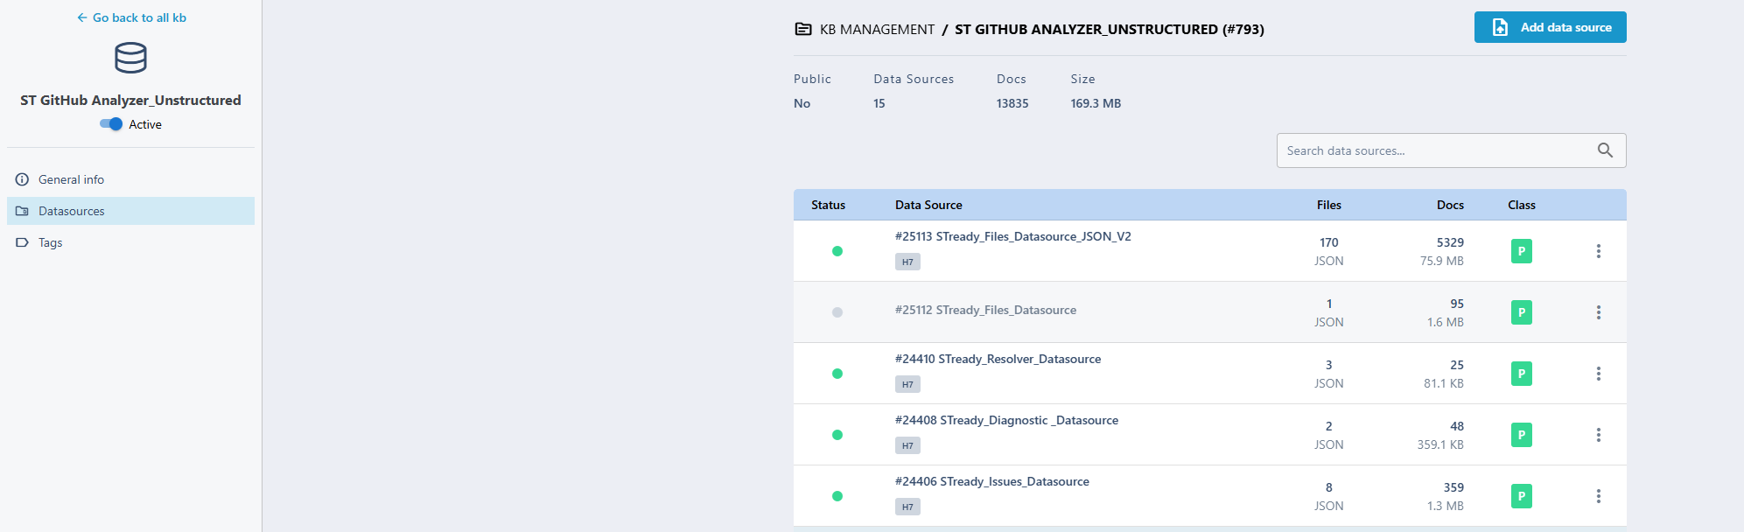
When you click on the knowledge base, a page listing the data sources is displayed :
You can click this button to add data sources.
The Data source’s ID is required to access it via the Persona API with scripts.
A deactivated data source: The KB manager can activate or deactivate a data source as needed.
Data source’s TAG : each data source has a TAG so the Knowledge Base managers can use them to categorize and organize documents in an unstructured KB. It helps in managing the importance and relevance of various documents within the KB.
KB’s Data sources

Slide 27
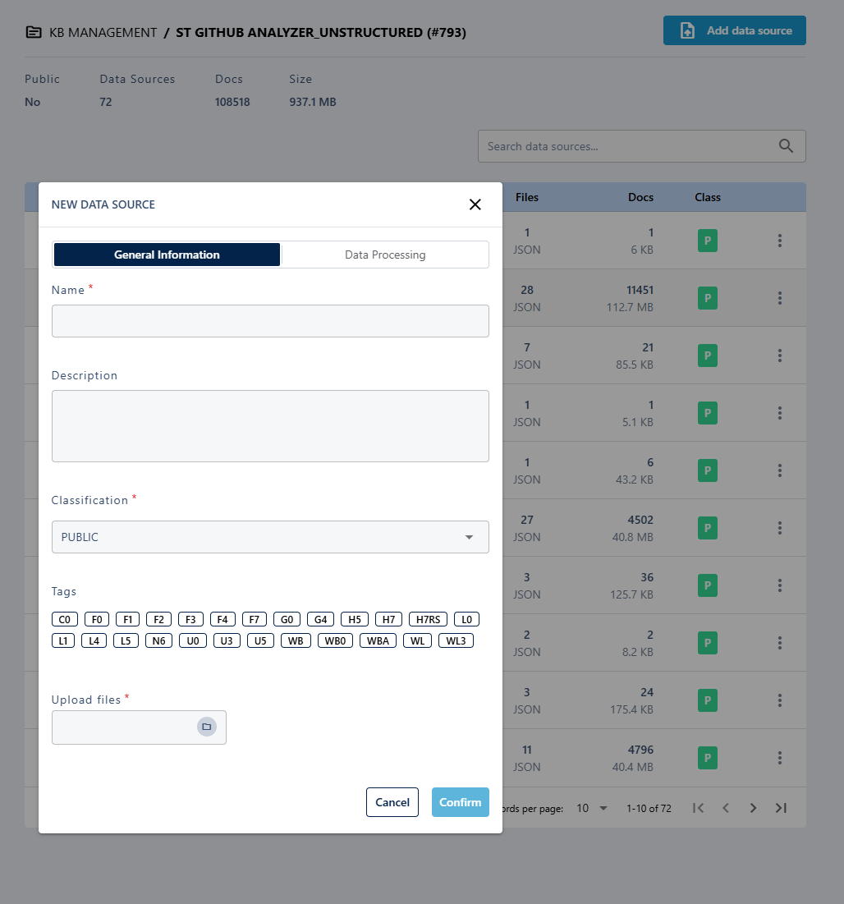
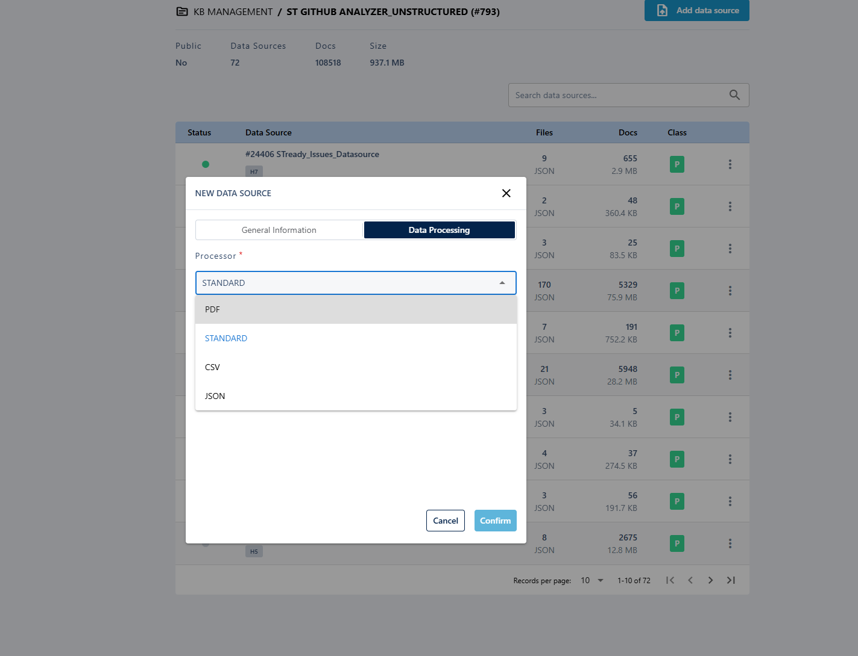
When you click on the Add data source button , a pop-up is displayed :
1
You must enter the data source’s name
2
For each data source you must upload at least one file
You can select the data source Tags
Once you uploaded the files , you must specify the files type

Slide 28
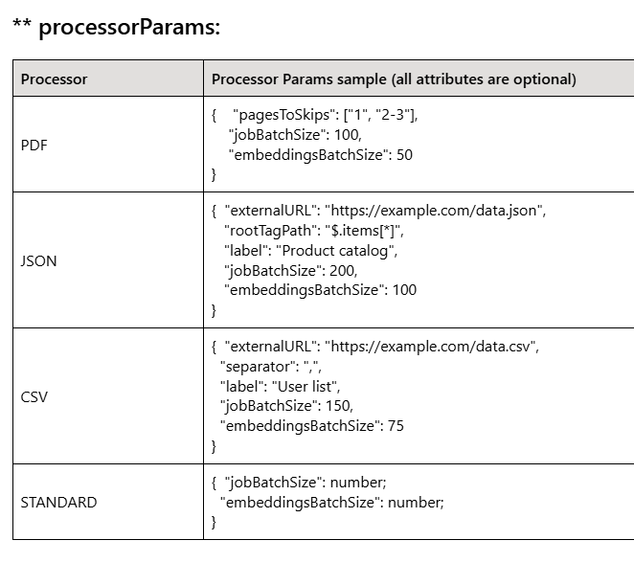
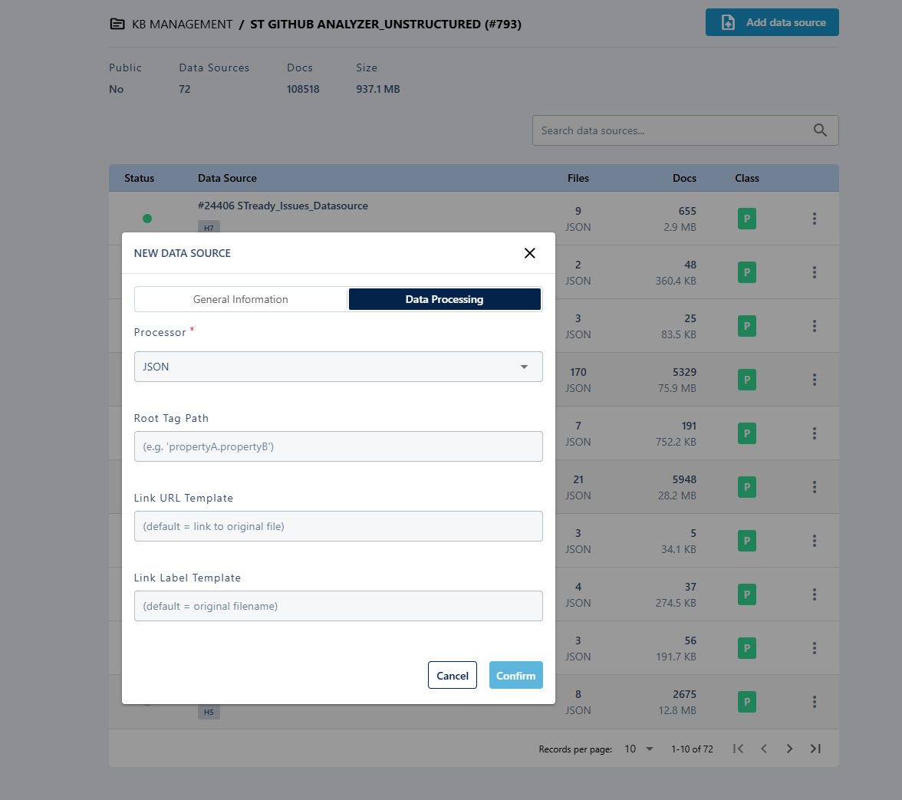

Slide 29
When you click on the Add data source button , a pop-up is displayed :

Slide 30
Getting Better Answers — How to Query the Persona
Context-rich questions produce context-rich answers
What to specify when asking
For best results, always specify:
● The STM32 series (H7, H5, L4, G0…)
● The exact MCU or board if known
● The peripheral involved (DMA, UART, I2C, USB…)
● The HAL API or function name if applicable
● The observed symptom or error
● The context: bug, config issue, regression, compilation error…
Vague vs Precise — Example
Vague question:
DMA does not work !
Result: generic answer, low relevance, no specific source
Precise question:
On STM32H743, ADC DMA circular mode gives inconsistent values after enabling
D-Cache. What should I check ?
Result: specific issue retrieved, with relevant HAL context, PR/commit link if available, and concrete debug steps
The more context you give, the more the persona can retrieve and the better the answer.

Slide 31
Today’s Program
8 steps to understand the project
01
Project context
05
Tests , Results & evaluation
The daily problem it solves
benchmark , concrete numbers
02
ST ChatGPT : platform overview & access request
06
Challenges encountered
What our project is building
Concrete technical challenges
03
How ST ChatGPT answers : RAG workflow, data sources & demo
07
Next Steps & Perspectives
Persona, Knowledge Base, Data Sources
What remains and how to get there
04
The Data preprocessing pipeline
08
Q&A
Ingest → Clean → Enrich → Deliver
Open discussion

Slide 32



The Data Preprocessing Pipeline
8 steps to transform raw data into KB-ready knowledge
Each step is deliberate — nothing is done at random
1
2
3
4
5
Ingestion
Cleaning
Similarity
Data Generation
Enrichment
(Feature
Engineering)
Download raw data
from GitHub
Clean:
remove HTML,
noisy text
Link related issues
describing the same bug
Add board, component, layer, severity, issue_kind, is_valid
A post-processing stage that turns prepared data into actionable support artifacts
6
7
8
Chunking
Evaluation
(Benchmark)
Delivery
Split into chunks
for the evaluation
Deliver JSON
format ST-ready
Test with 50
questions of reference

Slide 33
The Data Preprocessing Pipeline
8 steps to transform raw data into KB-ready knowledge
Each step is deliberate — nothing is done at random
1
2
3
4
5
6
7
8
Ingestion
Cleaning
Similarity
Data Generation
Chunking
Evaluation
(Benchmark)
Enrichment
(Feature
Engineering)
Delivery
Download raw data
from GitHub
Clean:
remove HTML,
Noisy text
Link related issues
describing the same bug
Split into chunks
for the evaluation
Deliver JSON
format ST-ready
Add board, component, layer, severity, issue_kind, is_valid
A post-processing stage that turns prepared data into actionable support artifacts
Test with 50
questions of reference
❓ What does Cleaning do?
Raw data contains broken HTML, unreadable text, and unstructured code blocks. Cleaning transforms them into clean, usable, and exploitable content.

Slide 34

Pipeline: cleaning
Cleaning — Why clean the data?
Raw data = imprecise answers => Clean data = useful answers.
❌ Raw data (before)
✅ Cleaned data (after)
Title: STM32CubeIDE throws error when compile line option -mstrict-align is enabled
Body:Hi,When enabling -mstrict-align below error is observed:
arm-none-eabi-gcc: error: unrecognized command-line option '-mstrict-align'; did you mean '-Wstrict-aliasing’?
[IMAGE ATTACHED]
Please suggest a fix.
Thanks,
Rajeev
Comments:
[rxa1031 - 2026-02-11T13:13:48Z]
[IMAGE ATTACHED]
Title: STM32CubeIDE throws error when compile line option -mstrict-align is enabled
Body:
Hi,
When enabling -mstrict-align below error is observed:
arm-none-eabi-gcc: error: unrecognized command-line option '-mstrict-align'; did you mean '-Wstrict-aliasing'?
<img width="1475" height="1702" alt="Image" src="https://github.com/user-attachments/assets/ef04062d-f370-4a59-b26d-e05fc91a3020" />
Please suggest a fix.
Thanks,
Rajeev
Comment:
<img width="663" height="50" alt="Image" src="https://github.com/user-attachments/assets/57b08795-01df-4541-ad2f-33fe6b6811c1" />
Issues:
Improvements:
HTML tags unreadable by RAG
HTML stripped, pure text
Image content lost (no text)
Images replaced by [IMAGE ATTACHED] tag + description
Noise from auto-generated comments
Body + useful comments concatenated

Slide 35
The Data Preprocessing Pipeline
8 steps to transform raw data into KB-ready knowledge
Each step is deliberate — nothing is done at random
1
2
3
4
5
6
7
8
Ingestion
Cleaning
Similarity
Data Generation
Chunking
Evaluation
(Benchmark)
Enrichment
(Feature
Engineering)
Delivery
Download raw data
from GitHub
Clean:
remove HTML,
Noisy text
Link related issues
describing the same bug
Split into chunks
for the evaluation
Deliver JSON
format ST-ready
Add board, component, layer, severity, issue_kind, is_valid
A post-processing stage that turns prepared data into actionable support artifacts
Test with 50
questions of reference
❓ What is Enrichment
Adds technical metadata: layer, severity, issue_kind, board, component, file_type, is_valid.
Converts clean content into structured V2 documents
Creates features of filtering and ranking for information retrieval.

Slide 36
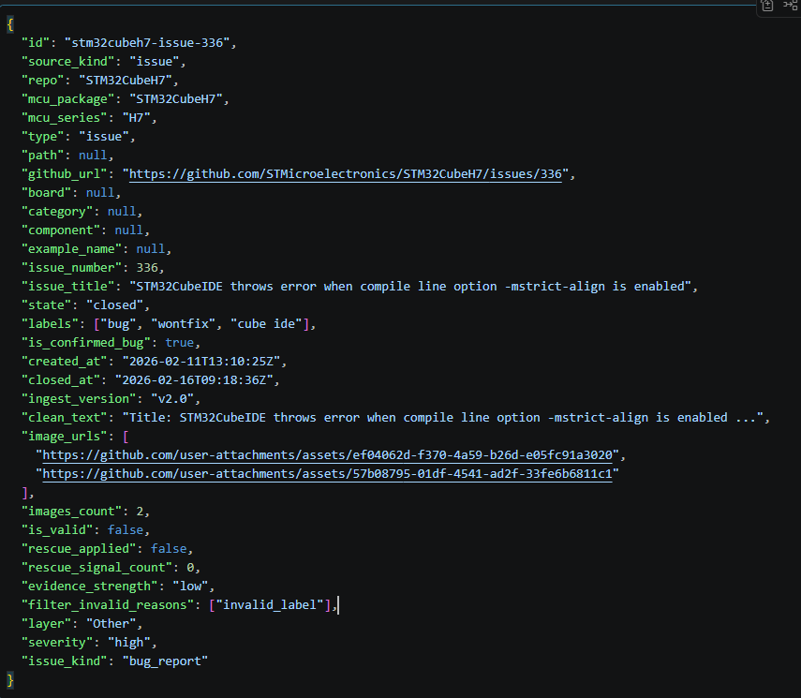
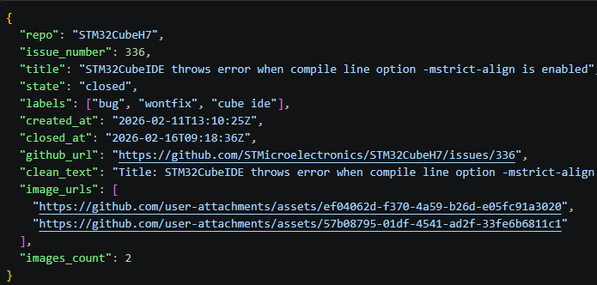
Pipeline: Enrichment (Feature Engineering)
Enrichment Layer — Before vs After (Issues)
Before (clean_issues.json)
After (docs_issues_v2.json)
→ Cleaning step output

Slide 37
Pipeline: Enrichment (Feature Engineering)
Enriched fields
Layer
Severity
Component
Detect API anchors: HAL_, LL_, MX_
Middleware keywords: FreeRTOS, LwIP, FatFs…
High if crash keywords (HardFault, freeze, deadlock…)
Low if doc keywords (typo, documentation…)
Else medium
From labels (usb, dma, usart…)
Fallback from API patterns (HAL_UART_, USBD_)
Issue_kind
Board
Bug if labels contain bug / internal bug tracker
Doc issue if typo/documentation patterns
Config issue if CubeMX configuration patterns
Regex extraction (STM32H723VGTx, NUCLEO, DISCO…)
Fallback: STM32H7XX

Slide 38
Pipeline: Enrichment (Feature Engineering)
Enrichment — Why enrich the data?
Plain text = generic answers => Enriched data = targeted, actionable answers
User question: Why does USART fail to compile when UART is not enabled?
Without enrichment
With enrichment
The engine finds documents where 'UART' appears, but cannot distinguish bug type, component, or MCU series.
The document is enriched with:
component=UART, issue_kind=bug_report, layer=HAL/Driver, severity=high, repo=STM32CubeH7, is_valid=true
Typical answer:
Typical answer:
Check your UART settings and HAL configuration.
Problem:
The failure comes from USART dependency on UART module guards in HAL config.
Enable the required UART macro or patch the conditional compilation section in the USART driver for your STM32CubeH7 version.
Vague answer, no root cause, no prioritization.
Impact:
Technical, root-cause-oriented, actionable answer.

Slide 39
The Data Preprocessing Pipeline
8 steps to transform raw data into KB-ready knowledge
Each step is deliberate — nothing is done at random
1
2
3
4
5
6
7
8
Ingestion
Cleaning
Similarity
Data Generation
Chunking
Evaluation
(Benchmark)
Enrichment
(Feature
Engineering)
Delivery
Download raw data
from GitHub
Clean:
remove HTML,
Noisy text
Link related issues
describing the same bug
Split into chunks
for the evaluation
Deliver JSON
format ST-ready
Add board, component, layer, severity, issue_kind, is_valid
A post-processing stage that turns prepared data into actionable support artifacts
Test with 50
questions of reference
❓ Objective: Similarity
Two different GitHub issues may describe the same technical bug but using different words.
By computing similarity, we enrich each issue with cross-references to other related issues.
→ This improves retrieval and helps the assistant give more complete and reliable support answers.

Slide 40
Pipeline: Similarity
Why link issues together?
How?
Without Similarity
We compute similarity using the issue text (clean_text):
User asks:
Convert each issue into a TF-IDF vector
"USART compile error when UART disabled"
Compute cosine similarity between issue vectors
The system retrieves only one issue → partial answer, limited context.
Store related issue IDs inside each issue (related_issue_ids)
Apply a configurable similarity threshold (only keep strong matches)
Example
With Similarity
What is the result ?
Each issue becomes connected to other similar issues:
Same peripheral/component (UART, USB, DMA…)
Same type of symptom (compile error, crash, timeout…)
Access to fixes already discussed in other threads
The system retrieves multiple related issues:
Same component (UART / USART)
Similar symptom type (compile-time guard / dependency issue)
Previous fixes already documented in linked threads

Slide 41
Pipeline: Similarity
TF-IDF ? Cosine Similarity ?
TF-IDF (Text → Vector)
TF-IDF converts each issue text into a vector of important keywords.
Words that appear often in one issue → higher weight
Words that are common in all issues (STM32, driver, error) → lower weight
Technical terms (HAL_CRYP, DMA, HardFault) → higher weight
Example:
Issue text contains many times: “HAL_CRYP_Decrypt_DMA”, “Size overflow”, “uint16_t”
→ TF-IDF gives these terms high weight, because they strongly describe the bug.
Result:
Each issue becomes a numeric representation of its main technical topic.
Cosine Similarity (Vector → Similarity Score)
Cosine similarity compares two issue vectors and returns a score:
1.0 = very similar issues (same bug/topic)
0.0 = unrelated issues
We keep only links above a tuned threshold (example : 0.55) to avoid noise.
Example:
Issue A: “HAL_UART compile error when UART disabled”
Issue B: “USART build fails due to missing UART macro definition”
Result:
Cosine similarity might be 0.72 → they are likely the same topic.

Slide 42
The Data Preprocessing Pipeline
8 steps to transform raw data into KB-ready knowledge
Each step is deliberate — nothing is done at random
1
2
3
4
5
6
7
8
Ingestion
Cleaning
Similarity
Data Generation
Chunking
Evaluation
(Benchmark)
Enrichment
(Feature
Engineering)
Delivery
Download raw data
from GitHub
Clean:
remove HTML,
Noisy text
Link related issues
describing the same bug
Split into chunks
for the evaluation
Deliver JSON
format ST-ready
Add board, component, layer, severity, issue_kind, is_valid
A post-processing stage that turns prepared data into actionable support artifacts
Test with 50
questions of reference
❓ Data Generation Objective
Data Generation is the key step that turns processed data into useful knowledge, so the assistant can find the right answer.
Resolver Cases : they connect issues to likely fixes (PRs/commits), so the assistant can suggest concrete solutions.
Diagnostic Cards :they provide clear checks and questions, so the assistant can guide troubleshooting quickly.

Slide 43
Pipeline: Data Generation
Goal: generate support reasoning content from prepared evidence.
Data Generation
Build Diagnostic Cards
Diagnostic Cards
Turn issue context and resolver knowledge into guidance
generated output
_{Problem → checks → guidance}
Technical Files
Resolver knowledge
_{Technical reference}
Build Resolver Cases
_{Link issues to fix evidence}
Resolver Cases
generated output
PRs & Commit Links
Problem → fix evidence
_{Fix evidence}
Issues
_{Problem context}

Slide 44
Pipeline: Data Generation(Resolver cases)
Delivery — Why structure the final output?
Des exports ST-ready = actionable cases, ready to integrate
Resolver Cases: what we built and how
Real need: ST engineers receive technical questions about STM32 bugs. To answer them, they need to know whether a GitHub bug has already been resolved: Was a PR merged? Does a fix commit exist? Is there a credible and verifiable path to a correction for this bug?
These cards are injected into the ST Knowledge Base (KB) so the RAG engine can cite fixes during a query.
GitHub Issue (problem)
PR (proposition of correction)
A ticket describing a bug or abnormal behavior in STM32Cube (ST GitHub repo).
Contains: title, technical description, labels, status (open/closed).
A code change proposal submitted on GitHub. If it is merged, it becomes an official fix.
Contains: title, changed files, associated commits (technical evidence of the change).
Resolver Case
A structured, ST-ready sheet linking an issue to its fix PRs/commits.
Contains: resolution status, confidence level, impacted files, text ready for the knowledge base.

Slide 45

Resolver Cases : Why they matter
From "this bug exists" to "this bug was fixed , here is the proof"
Is there a confirmed fix for this STM32H7 DMA issue?
Before resolver cases — persona says:
"There is a known DMA issue on STM32H7."
No fix status. No PR link. No changed files. No confidence.
The engineer still has to search GitHub manually.
Impact on persona quality :
Eliminated "I don't know" on fix-status questions
Persona now provides: fix status, PR link, changed files, confidence level
Prevents unsupported "it was fixed" claims , confidence-gated
Direct QI boost:
The persona acts like a support engineer, not a search engine.
After resolver cases — persona says:
"This DMA issue was fixed in PR #247 (merged).
Files changed: stm32h7xx_hal_dma.c. Confidence: high."
The engineer gets the answer immediately , no manual search.
Without resolver cases, the persona reports bugs. With them, it resolves them.
45

Slide 46
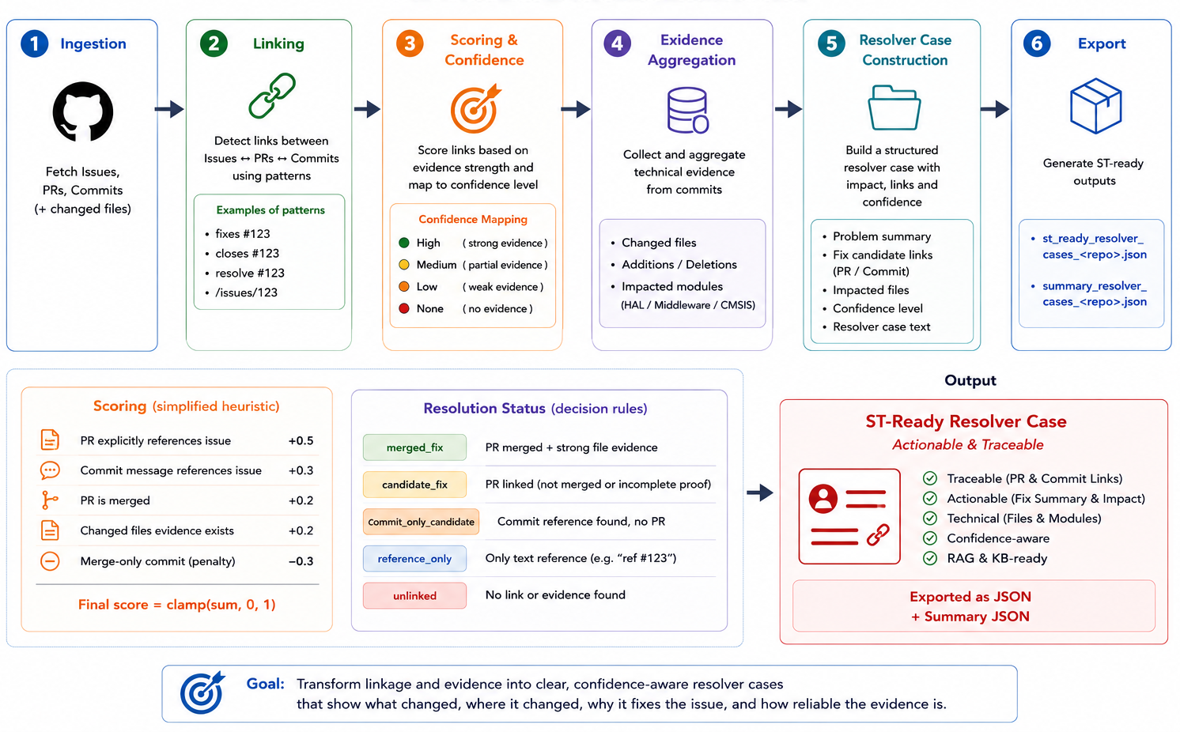
Resolver Cases — Tracing Bugs to Their Fix
Going beyond issue similarity: linking confirmed resolutions

Slide 47
Pipeline: Data Generation(Diagnostic cards)
Delivery — Why structure the final output?
Des exports ST-ready = actionable cases, ready to integrate
Diagnostic Cards: what we built and how
Real need: An ST engineer receives a customer question: “My HAL_SPI_Transmit_DMA blocks on 2 bytes, why?”, They need a structured, ready-to-use diagnostic card, not just a GitHub ticket or a link to a GitHub ticket.
Construction = Issue + Resolver
A Diagnostic Card contains
symptom_summary: Short symptom description.
likely_causes: Most probable technical causes.
confirmed_facts: Evidence facts(issue/PR/commit/confidence).
plausible_diagnosis: Reasoned technical hypotheses.
debug_checks: Recommended investigation steps.
possible_workarounds: Temporary mitigation options.
constraints_or_limits: Applicability scope and assumptions.
evidence_refs: Links to supporting technical evidence.
query_aliases: Alternative user phrasings for retrieval.
keywords and api_tags: Retrieval tags and API anchors.
Issue GitHub
Resolver Case
issue_title
layer, severity
component, board
st_ready_text
github_url
+
resolution_status
link_confidence
linked_pr_urls
linked_commits
files_evidence
→ build_diagnostic_card()
Diagnostic Card JSON
→ injected into the ST KB
→ optimized for retrieval RAG
Notes:
query_aliases = pour mieux retrouver,
possible_workarounds = pour agir tout de suite,
plausible_diagnosis = pour raisonner,
debug_checks = pour vérifier méthodiquement.

Slide 48
Diagnostic Cards — Why they matter
From "something went wrong" to "here is what to check and how to fix it"
UART callback is not reached on STM32H7, what are the likely causes and what should I check ?
Impact on persona quality
Highest-value artifacts in the entire pipeline
Each card provides: symptoms, likely causes, debug checks, workarounds, evidence refs
Benchmark showed clear QI jump on mixed questions , from generic abstention to actionable answers
Confidence-gated: if evidence is weak, caution is added automatically
Direct QI boost:
persona guides diagnosis like a senior engineer.
Before diagnostic cards — persona says:
"UART callback is not reached on STM32H7."
Describes the problem. No guidance. No debug steps
The engineer has to figure out the diagnosis alone.
After diagnostic cards — persona says:
"Symptom: UART callback not reached. Likely causes: NVIC
priority, DMA config. Debug: check IRQ enable, verify HAL init
sequence. Confidence: medium.“
The engineer gets a full troubleshooting guide instantly.
Resolver cases + diagnostic cards = the persona answers like a senior engineer, not a search engine.
48

Slide 49
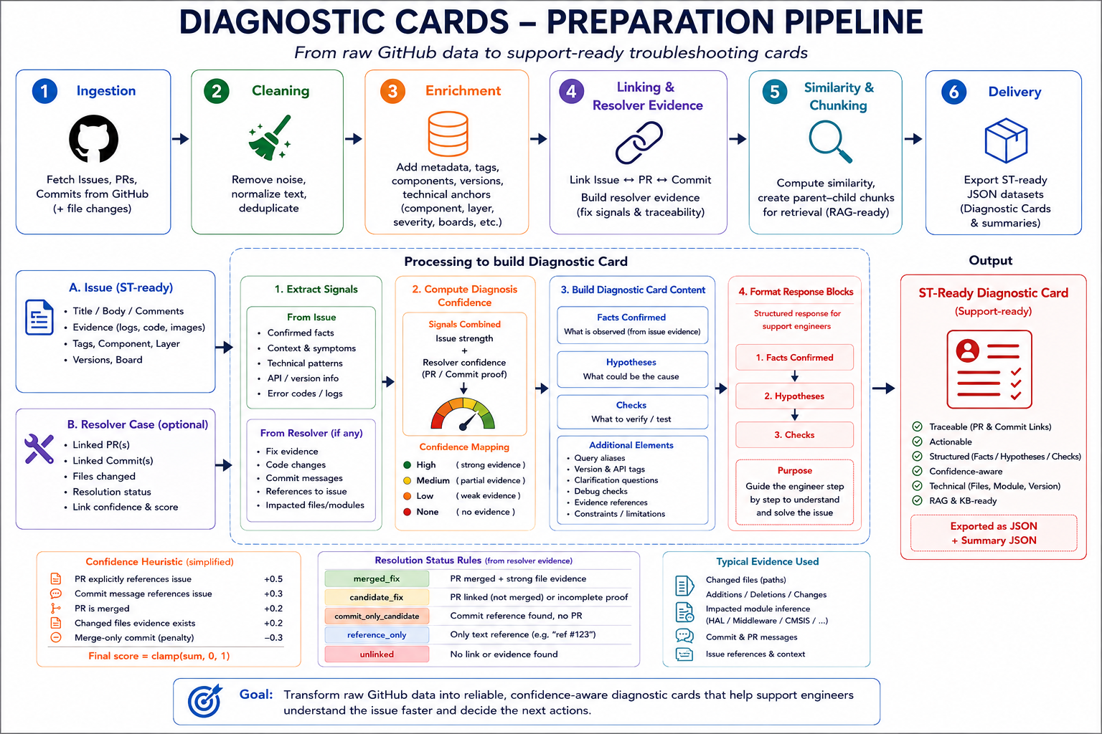
Diagnostic Cards — Structured Troubleshooting Knowledge

Slide 50
The Data Preprocessing Pipeline
8 steps to transform raw data into KB-ready knowledge
Each step is deliberate — nothing is done at random
1
2
3
4
5
6
7
8
Ingestion
Cleaning
Similarity
Data Generation
Chunking
Evaluation
(Benchmark)
Enrichment
(Feature
Engineering)
Delivery
Download raw data
from GitHub
Clean:
remove HTML,
Noisy text
Link related issues
describing the same bug
Split into chunks
for the evaluation
Deliver JSON
format ST-ready
Add board, component, layer, severity, issue_kind, is_valid
A post-processing stage that turns prepared data into actionable support artifacts
Test with 50
questions of reference
❓ Why chunk?
The AI cannot read 5,000 files at once. We split them into small chunks.
→ So we can use them to evaluate our preprocessing pipeline

Slide 51
Pipeline: chunking
Preparing data for offline evaluation — before uploading to ST ChatGPT
One chunk per issue
Each cleaned issue becomes a single chunk with all its metadata.
Fast and simple : good for short, focused issues.
clean_issue_to_chunk() → chunks_issues_<repo>.json
Preprocessed issues cleaned, enriched, similarity-linked
↓
Chunking split into JSON chunks
Why this step
This is NOT the final evaluation or the final pipeline output. We chunk the data, then test locally with a simple TF-IDF search to verify our preprocessing produces retrievable content. If it works here, the data is ready for the ST platform.
The offline evaluation is covered in the Evaluation section.

Slide 52


Pipeline: chunking
Chunking PARENT_CHILD — Splitting intelligently
Why not give the full document to the LLM at once?
Book analogy: If you look for information in a book, you do not send the entire book to someone.
You first find the right chapter (CHILD = 1,000 characters), then you read the full chapter to understand the context (PARENT = 3,000 characters).
PARENT CHUNK (~3,000 chars)
PARENT CHUNK (~3,000 chars)
CHILD CHUNK (~1,000 chars)
CHILD CHUNK (~1,000 chars)
Contains full document context
Contains full document context
Precise sub-segment of the parent
Precise sub-segment of the parent
Used by LLM to formulate the answer
Used by LLM to formulate the answer
subdivided into ▶
subdivided into ▶
Used for SEARCH in the KB
Used for SEARCH in the KB
Preserves global meaning of the section
Preserves global meaning of the section
Finds the right passage for the query
subdivide → one PARENT splits into several CHILD chunks
Finds the right passage for the query
Sent whole to AI for generation
Sent whole to AI for generation
Linked to parent to retrieve context
Linked to parent to retrieve context
Retrieval happens on children, but the answer can reconstruct context using the parent.

Slide 53
STM32Cube RAG for R&D
We knew the strategy. Not how to prepare for it.
KNOWN
ST ChatGPT uses parent-child chunking strategy internally.
UNKNOWN
We don’t know why some questions retrieve the wrong content
How to prepare our STM32CubeH7 data to be format-friendly to this strategy.
but
Solution: build a local off-domain benchmark to reverse-engineer the data requirements
Understand Parent–Child behavior :
Extracted Data Preprocessing Best Practices :
Using the dashboard developed, we identified the key factors that impact retrieval quality:
Based on dataset + retrieval failures, we derived concrete rules, instead of guessing improvements, we validated them using:
  Retrieval metrics
  Chunk quality metrics
  Per-question debugging
→ Result: preprocessing became a measurable engineering process
Context continuity is critical
Technical anchors improve matching
Parent reconstruction is necessary

Slide 54
The Data Preprocessing Pipeline
7 steps to transform raw data into KB-ready knowledge
Each step is deliberate — nothing is done at random
1
2
3
4
5
6
7
8
Ingestion
Cleaning
Similarity
Data Generation
Chunking
Evaluation
(Benchmark)
Enrichment
(Feature
Engineering)
Delivery
Download raw data
from GitHub
Clean:
remove HTML,
Noisy text
Link related issues
describing the same bug
Split into chunks
for the evaluation
Deliver JSON
format ST-ready
Add board, component, layer, severity, issue_kind, is_valid
A post-processing stage that turns prepared data into actionable support artifacts
Test with 50
questions of reference
❓ Evaluation Objective ?
Test whether our preprocessing decisions produce the right answers , before anything reaches ST ChatGPT.
50 real questions, measured offline and online, to catch hallucinations and missing context before deployment.

Slide 55
The Data Preprocessing Pipeline
8 steps to transform raw data into KB-ready knowledge
Each step is deliberate — nothing is done at random
1
2
3
4
5
6
7
8
Ingestion
Cleaning
Similarity
Data Generation
Chunking
Evaluation
(Benchmark)
Enrichment
(Feature
Engineering)
Delivery
Download raw data
from GitHub
Clean:
remove HTML,
Noisy text
Link related issues
describing the same bug
Split into chunks
for the evaluation
Deliver JSON
format ST-ready
Add board, component, layer, severity, issue_kind, is_valid
A post-processing stage that turns prepared data into actionable support artifacts
Test with 50
questions of reference
❓ Delivery objective
Delivery transforms raw technical data into knowledge directly usable in a support KB.
The goal:
Provide actionable answers for troubleshooting.
Maintain complete traceability to GitHub.
Provide a stable format for ingestion within ST.

Slide 56

Pipeline: Delivery
Delivery , Why structure the final output?
From processed data → ST-ready Knowledge Base payload
Goal: convert enriched STM32Cube data into a format directly ingestible by ST ChatGPT Knowledge Base.
4 ST-ready JSON payloads generated automatically:
Why Delivery matters (RAG constraints)
Issues JSON
Files JSON
Resolver Cases JSON
Diagnostic Cards JSON
Upload logs confirm Parent/Child chunking strategy.
→ Therefore, each document must be self-contained and chunk-friendly.
ST-ready text template (retrieval-optimized) : All key technical signals are injected into one structured field: st_ready_text
Structure: st_ready_text (issues) — fields exposed to the moteur RAG
Problem
Context
Constraints
Keywords
Root cause
Fix
Technical details
Key comments
Notes:
Issues JSON
Structured bug cards (Problem → Root cause → Fix)
Files JSON
Source code + documentation cards (HAL/LL/BSP, release notes, README, etc.)
Resolver Cases JSON
Issue ↔ PR ↔ Commit linking (fix evidence + confidence)
Diagnostic Cards JSON
Troubleshooting guidance (checks, causes, workarounds, constraints)

Slide 57
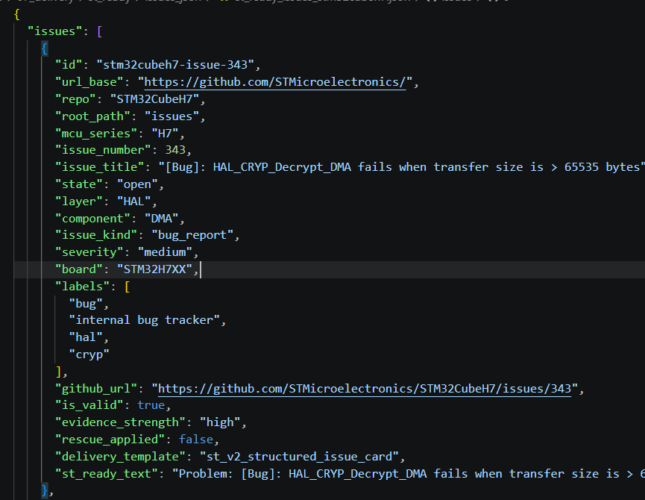
Pipeline: Delivery
Delivery , Why structure the final output?
From processed data → ST-ready Knowledge Base payload
Even if only a child chunk is retrieved, it still contains context + fix signal.

Slide 58
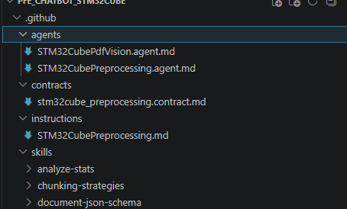
Pipeline: AI Agents — Two Specialized Assistants in the Project
Not just one AI: two agents used for engineering acceleration
Real need: avoid bad or noisy data before upload and keep the pipeline easy to improve.
Real need: capture technical information that exists only in PDF images.
benchmark outputs
Agent 1 — Preprocessing Agent
Agent 2 — PDF Vision Agent
STM32Cube Preprocessing Agent
STM32Cube PDF Vision Agent
Role
Assistant dedicated to pipeline analysis and documentation
Role
Analyzes figures and diagrams extracted from technical PDFs
Analyze
The data flow, JSON outputs, and benchmark outputs
Read
pdf_image_tasks_<repo>.jsonl
Document
Data schemas, test results
Analyze
Figures / diagrams from PDFs
Compare
Structuring strategies
Describe
Injectable technical text descriptions
Value
Documentation acceleration + pipeline readability
Faster iteration on data quality improvements
Value
Preserve information in PDF diagrams
Multimodal PDF workflow:
Text extraction →
Page image rendering →
Figure detection →
Crop figures →
JSONL tasks →
JSON descriptions →
Enriched re-injection

Slide 59
The full Pipeline
Building Our Persona in 10 Steps
Our Persona: Step-by-Step Approach
1
2
3
4
5
6
7
8
9
Ingestion
Similarity
Data Generation
Store and organize the chunks, their embeddings, and their metadata inside the knowledge base.
Cleaning
Enrichment
(Feature
Engineering)
Delivery
Chunking
Embeddings
Indexing
Download raw data
from GitHub
Clean:
remove HTML,
Noisy text
Add board, component, layer, severity, issue_kind, is_valid
Link related issues
describing the same bug
A post-processing stage that turns prepared data into actionable support artifacts
Deliver JSON
format ST-ready
Split into chunks
Numerical representation of a text.
10
Quality Index
Evaluation
Continuous improvement
Test with 50
questions of reference
The Data Preprocessing Pipeline
The Internal Steps of the ST ChatGPT Platform

Slide 60
Today’s Program
8 steps to understand the project
01
Project context
05
Tests , Results & evaluation
The daily problem it solves
benchmark , concrete numbers
02
ST ChatGPT : platform overview & access request
06
Challenges encountered
What our project is building
Concrete technical challenges
03
How ST ChatGPT answers : RAG workflow, data sources & demo
07
Next Steps & Perspectives
Persona, Knowledge Base, Data Sources
What remains and how to get there
04
The Data preprocessing pipeline
08
Q&A
Ingest → Clean → Enrich → Deliver
Open discussion

Slide 61

Evaluation Protocol & Benchmark Results
Concrete numbers
Incremental evaluation: each added source is evaluated separately to avoid introducing hallucinations or out-of-context responses.
Offline Evaluation :
Step 1
Stats Quality
test_stats_issues_v2
test_stats_files_v2
Distribution + metadata cover
Step 2
TF-IDF Retrieval
test_tfidf_search_issues_v2
test_tfidf_search_files_v2
Top-3 pertinence verified offline
Step 3
Schema Validation
validate_schemas.py
Contract doc verified
Step 4
30Q + 50Q Live
run_h7_50q_ab_test.ps1
DMA,UART,I2C,USB,ADC,FDCAN
Manuel Benchmark
Online Evaluation ( 50Q Live Run , ST Platform results ) :
Quality Index
↑

Slide 62
Offline evaluation
Can our preprocessed chunks retrieve the right answer with a simple search — before uploading to ST ChatGPT?
One chunk per issue
Each cleaned issue becomes a single chunk with all its metadata.
Fast and simple : good for short, focused issues.
clean_issue_to_chunk() → chunks_issues_<repo>.json
Preprocessed issues cleaned, enriched, similarity-linked
↓
Chunking split into JSON chunks
↓
TF-IDF search on JSON simple search, no RAG, no ST ChatGPT
Why this matters
If a basic TF-IDF search on our chunks already retrieves the right answer, it proves our preprocessing is solid.
If it fails, the problem is in our data , not in the ST platform.
This is our quality step before uploading anything.

Slide 63
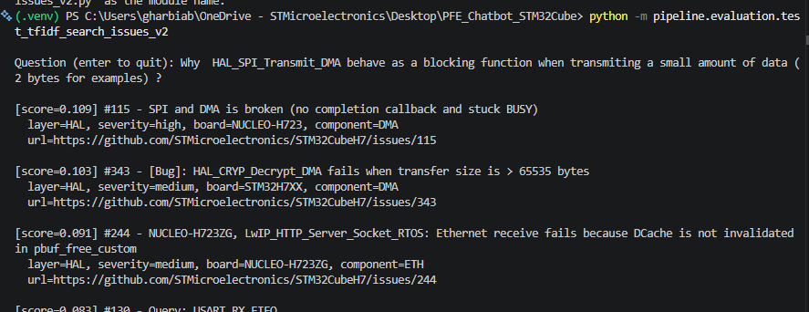
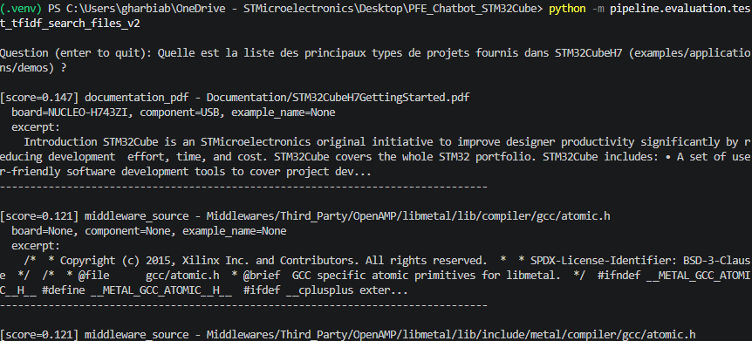
Offline Evaluation
Interactive TF-IDF Search
Why? How does it work?
Objective: Before uploading the data to the ST platform, we want to validate offline that the retrieval system returns relevant documents for real queries. Enter a natural-language question, and the system returns the 5 closest issues or files with a cosine similarity score.
Same TF-IDF pipeline, but in interactive query mode
Issue search
Files search
Output Example :
Output Example :

Slide 64
Today’s Program
8 steps to understand the project
01
Project context
05
Tests , Results & evaluation
The daily problem it solves
benchmark , concrete numbers
02
ST ChatGPT : platform overview & access request
06
Challenges encountered
What our project is building
Concrete technical challenges
03
How ST ChatGPT answers : RAG workflow, data sources & demo
07
Next Steps & Perspectives
Persona, Knowledge Base, Data Sources
What remains and how to get there
04
The Data preprocessing pipeline
08
Q&A
Ingest → Clean → Enrich → Deliver
Open discussion

Slide 65
Challenges encountered
Technical obstacles encountered during the project
Technical Challenges
Operational & Validation Challenges
Black-box RAG engine
Retrieval/chunking internals inaccessible. All improvements must be data-centric only.
→ Solution: Structured lexical anchors + stable card templates
4. Upload payload limits
STM32CubeH7: 4,707 docs / ~57.6 MB — exceeds single-batch limits.
→ Solution : Manual split workflow: 50 parts, deterministic upload order
2. Defining high data quality
No existing quality definition. What is "good enough" for RAG retrieval?
→ Solution : Schema validation >95% + TF-IDF smoke tests before every upload
5. Weak fix traceability
Most GitHub issues are not directly linked to: PRs and commits.
Resolver Cases could not always be generated, even for real bugs.
→ Solution : Technical pattern tags
3. Heterogeneous source formats
Issues, PRs, commits, files, PDFs: all have different structures.
→ Solution : Unified docs_v2 schema normalizing all sources
→
New bugs with no linked PR
Truly new bugs (e.g. HAL_CRYP >65535 bytes) return "I DON'T KNOW".
→ Next: Technical pattern tags for class-based retrieval (overflow, uint16_limit...)

Slide 66
Today’s Program
8 steps to understand the project
01
Project context
05
Tests , Results & evaluation
The daily problem it solves
benchmark , concrete numbers
02
ST ChatGPT : platform overview & access request
06
Challenges encountered
What our project is building
Concrete technical challenges
03
How ST ChatGPT answers : RAG workflow, data sources & demo
07
Next Steps & Perspectives
Persona, Knowledge Base, Data Sources
What remains and how to get there
04
The Data preprocessing pipeline
08
Q&A
Ingest → Clean → Enrich → Deliver
Open discussion

Slide 67

Next Steps & Perspectives
What remains in the next 2 months — and what comes after.
Done
Medium & long term : expanding sources
STM32CubeH7: The persona can now handle H7-related issues.
Option A : Add Jira tickets as data source
Rich internal support data , but internal and confidential.
Requires specific handling and access approval.
Short term : pipeline automation & validation
(estimated duration: 7–10 days)
Automate pipeline on all STM32Cube series
Same pipeline, new series — no manual rework per series
Option B : MCP server to Sidekick (ST Community)
No additional data extraction or preprocessing needed.
The MCP server calls Sidekick persona that already has its own KB.
Avoids confidentiality constraints entirely.
2. Start with 3-4 other series, run test suites
30Q + 50Q benchmark per series
Option C: Move toward continuous GitHub synchronization
Reduce manual pull / clone operations
Keep STM32Cube public data more up to date
Keep preprocessing inputs and KB content more up to date
Move forward with
↑
3. Extend to all remaining series
F4, H5, U5, WL, … → full coverage
! Important : 2 months remaining
All Medium & long-term perspectives depend on the mandatory work still required and how much time it takes. Priorities will be adjusted based on progress during the remaining period.

Slide 68
Today’s Program
8 steps to understand the project
01
Project context
05
Tests , Results & evaluation
The daily problem it solves
benchmark , concrete numbers
02
ST ChatGPT : platform overview & access request
06
Challenges encountered
What our project is building
Concrete technical challenges
03
How ST ChatGPT answers : RAG workflow, data sources & demo
07
Next Steps & Perspectives
Persona, Knowledge Base, Data Sources
What remains and how to get there
04
The Data preprocessing pipeline
08
Q&A
Ingest → Clean → Enrich → Deliver
Open discussion

Slide 69

https://stmicroelectronics.sharepoint.com/sites/AIAcademy
Q
A
&
Open Discussion

Slide 70

Thank you for your attention !

Slide 71
Supporting informations

Slide 72
Why RAG and not just standard ChatGPT ?
Standard ChatGPT
ST ChatGPT with RAG
Trained on generic internet data
Trained on real STM32 data (issues, docs, fixes)
No knowledge of your STM32 project
Knows your exact project context
VS
Invents plausible-sounding answers
Answers are built from retrieved passages
Cannot cite the source of its answer
Always cites the source (issue/PR/doc)
Dangerous for technical support
Reliable for technical support teams
The full story in 4 steps :
💡 Why it matters : without RAG, the AI invents answers (hallucinations).
With RAG, every answer is grounded in real STM32 documents.
→
→
→
1
You ask
2
RAG searches
3
RAG injects
4
AI answers
"Why does my STM32H7 DMA give wrong values after cache is enabled?"
Finds the 3 most relevant passages in STM32 documents
Passes those passages to the AI as context (augmented input)
Generates a precise answer — with source: Issue #1234, PR #456

Slide 73
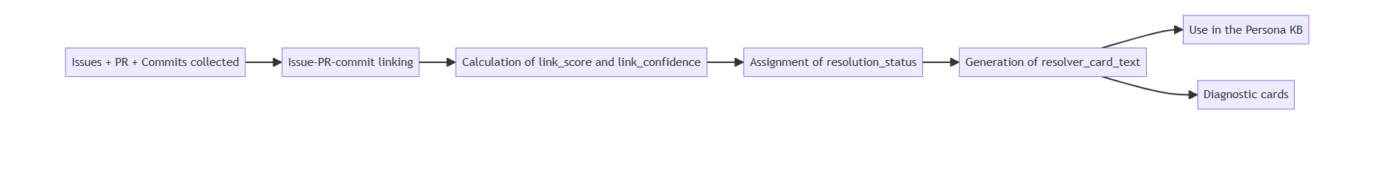
Resolver Cases — Tracing Bugs to Their Fix
Going beyond issue similarity: linking confirmed resolutions
Construction process:

Slide 74
Resolver Cases — Tracing Bugs to Their Fix
Going beyond issue similarity: linking confirmed resolutions
Construction process:

Slide 75
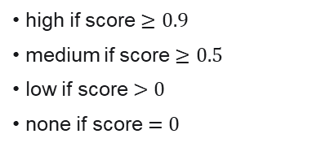
Resolver Cases — Tracing Bugs to Their Fix
Going beyond issue similarity: linking confirmed resolutions
Construction process:
Score calculation:
Confidence:
link_score=min(1,PR+MergeBonus+Commit)
high if score $≥0.9$
medium if score $≥0.5$
low if score $>0$
none if score $=0$
Avec: $PR∈\left\{0 , 0.5\right\}, MergeBonus∈\left\{0 , 0.1 , 0.3\right\} , Commit∈\left\{0 , 0.2\right\}$
Explicit PR found: +0.5
Merged PR: +0.3
If PR found but not merged: +0.1 (au lieu of +0.3)
Commit "meaningful trouvé" does: +0.2
Final score capped at 1.0

Slide 76
Resolver Cases — Tracing Bugs to Their Fix
Going beyond issue similarity: linking confirmed resolutions
Construction process:
Score calculation:
Resolution status:
Confidence:
link_score=min(1,PR+MergeBonus+Commit)
high if score $≥0.9$
medium if score $≥0.5$
low if score $>0$
none if score $=0$
merged_fix: PR mergée + commit meaningful
candidate_fix: PR trouvée + commit meaningful (merge non confirmé)
reference_only: PR trouvée mais pas of commit meaningful
unlinked: pas of chemin of fix crédible
Avec: $PR∈\left\{0 , 0.5\right\}, MergeBonus∈\left\{0 , 0.1 , 0.3\right\} , Commit∈\left\{0 , 0.2\right\}$
Explicit PR found: +0.5
Merged PR: +0.3
If PR found but not merged: +0.1 (au lieu of +0.3)
Commit "meaningful trouvé" does: +0.2
Final score capped at 1.0

Slide 77
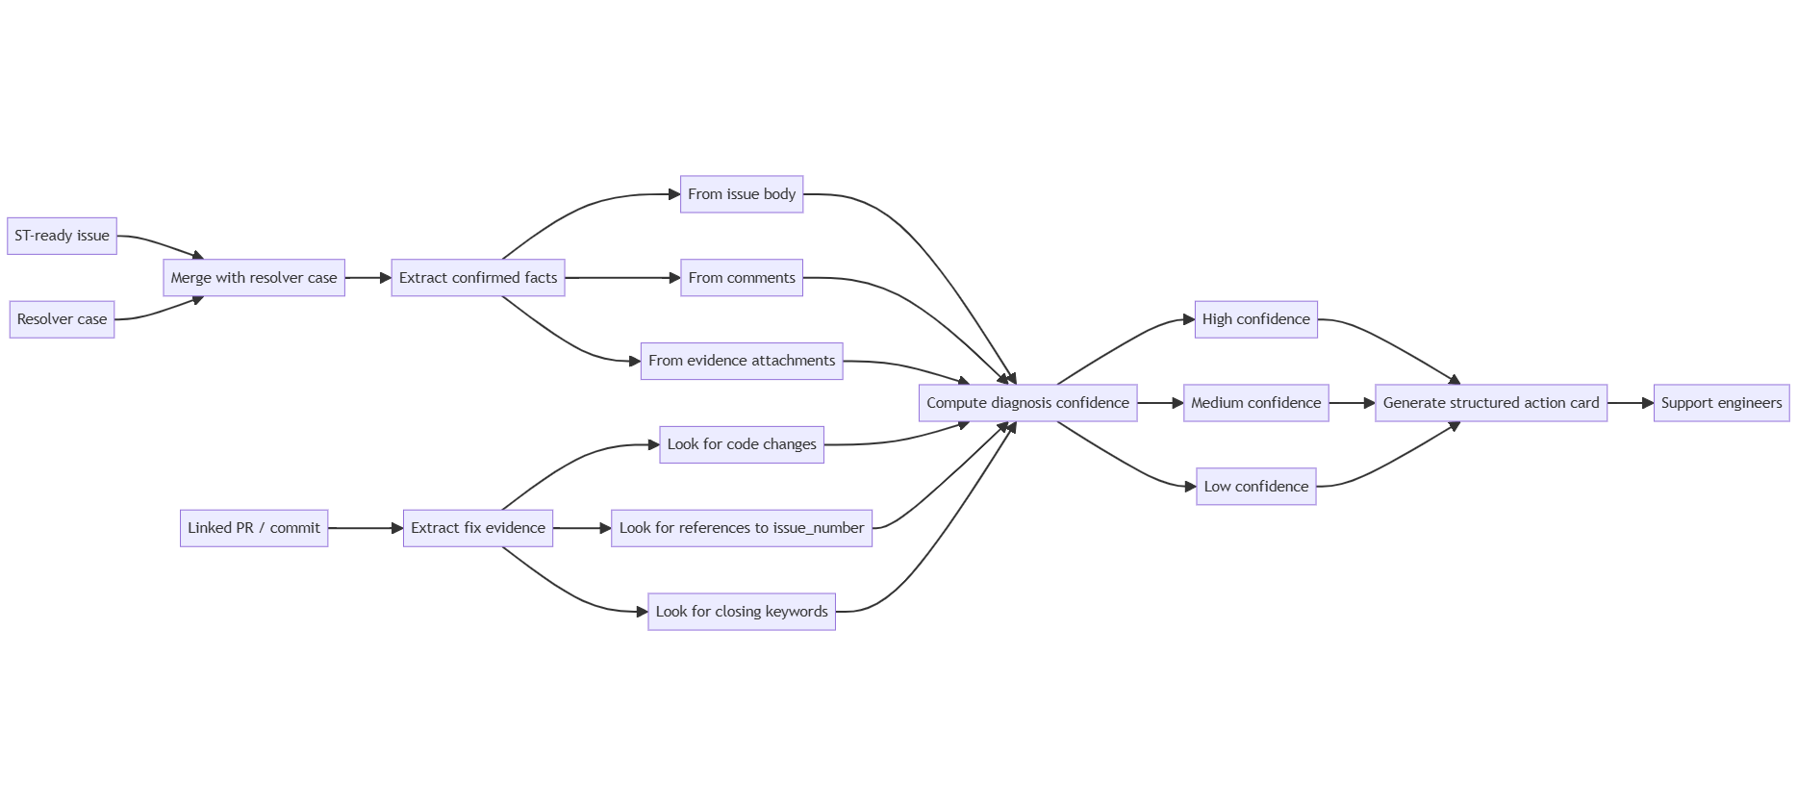
Diagnostic Cards — Structured Troubleshooting Knowledge

Slide 78
Putting it all together
Tokens → chunking → parent-child → RAG
1
You count the characters in your text
Issue #343 has 2 146 characters. 2146 ÷ 4 = ~536 tokens. That's the size of one document.
2
ST's RAG cuts it into child chunks of ~1 000 tokens
Issue #343 (536 tok) = 1 child. A long doc of 3 000 tok = 4 children. Each child is what gets embedded and indexed.
3
The parent (~3 000 tok) is stored alongside
When a child matches a user question, its parent is returned to the LLM — giving full context to answer correctly.
4
Preprocessing quality determines token quality
Missing mcu_series (295 docs) or component (138 docs) → the child embedding has no anchor → match fails → user gets wrong answer.

