Slide 1
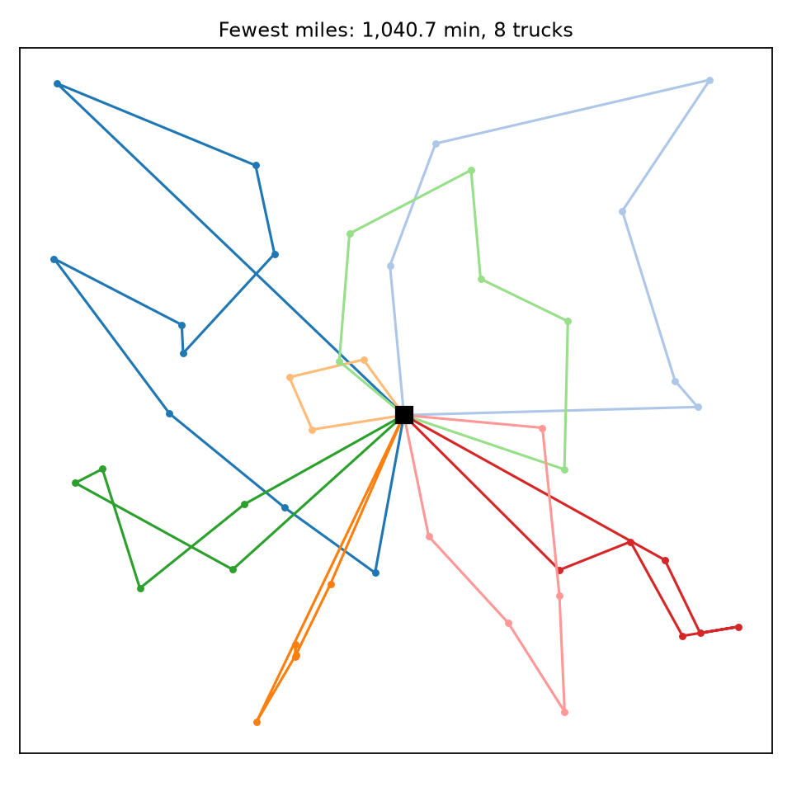
Planning Delivery Routes
Progress report on our decision tool
OM 522 Team Project · Option 3: vehicle routing with time windows
October 26, 2026
Our plan for 45 customers: 8 trucks, 1,040.7 travel minutes
Notes:
This is a progress report on our Option 3 tool, which plans daily delivery routes. The map shows the plan our method produces for the 45-customer development instance.

Slide 2


Where the project stands
Done
−38%
travel time vs. today's rule on 45 customers (1,683 → 1,041 min)
Rule to beat reproduces the worked example exactly (352.417 min)
Researched method beats the rule on all 4 instances and five 60-customer test cases
Independent checker, plus 36 automated tests (the 3 required ones included)
8 vs 11
trucks used; 8 is the fewest the demand allows (422 units, 60 per truck)
Stress test on 30 saved traffic scenarios
New: alternative plans for management and an interactive explorer
Before the final submission
0%
gap to optimal: an exact Gurobi model proves the 45-customer plan optimal
Rewrite the README's opening paragraph in our own words
Record the final video: each of us walks through a different agent-drafted component
Push the repo and submit the commit hash
Notes:
Three headline numbers, then status. Everything the guide requires for the tool itself is built and verified. What remains is team work: the README paragraph in our own words, the final video, and submission.

Slide 3




The decision: which truck serves whom, in what order
Each day a dispatcher assigns every customer to one truck and sets the stop order. Our tool makes that plan from four data files and reports its travel, waiting and service consequences.
How plans are scored
Primary: total travel time (excludes waiting and service)
Secondary: trucks used
Always reported: computation time
Capacity
A truck carries at most 60 units of demand.
Time windows
Instance | Customers | Use
hand_checkable | 6 | Trace the rule by hand
development_small | 15 | Debug
development_medium | 45 | Compare, stress test
development_large | 120 | Scale and runtime
edge_case | 10 | Infeasible (demand 65 > 60)
held-out (instructor) | 60 | Must beat the rule
Service must start inside each customer's window, about 90 minutes of a 600-minute day. Early trucks wait.
Shifts
Each truck leaves the depot at shift start and is back by shift end.
Every customer
Each customer is served exactly once. No skipping.
Notes:
The brief's constraints and measures. Windows are the hard part: about 90 minutes wide on a 600-minute day, so most rearrangements break some customer's window.

Slide 4
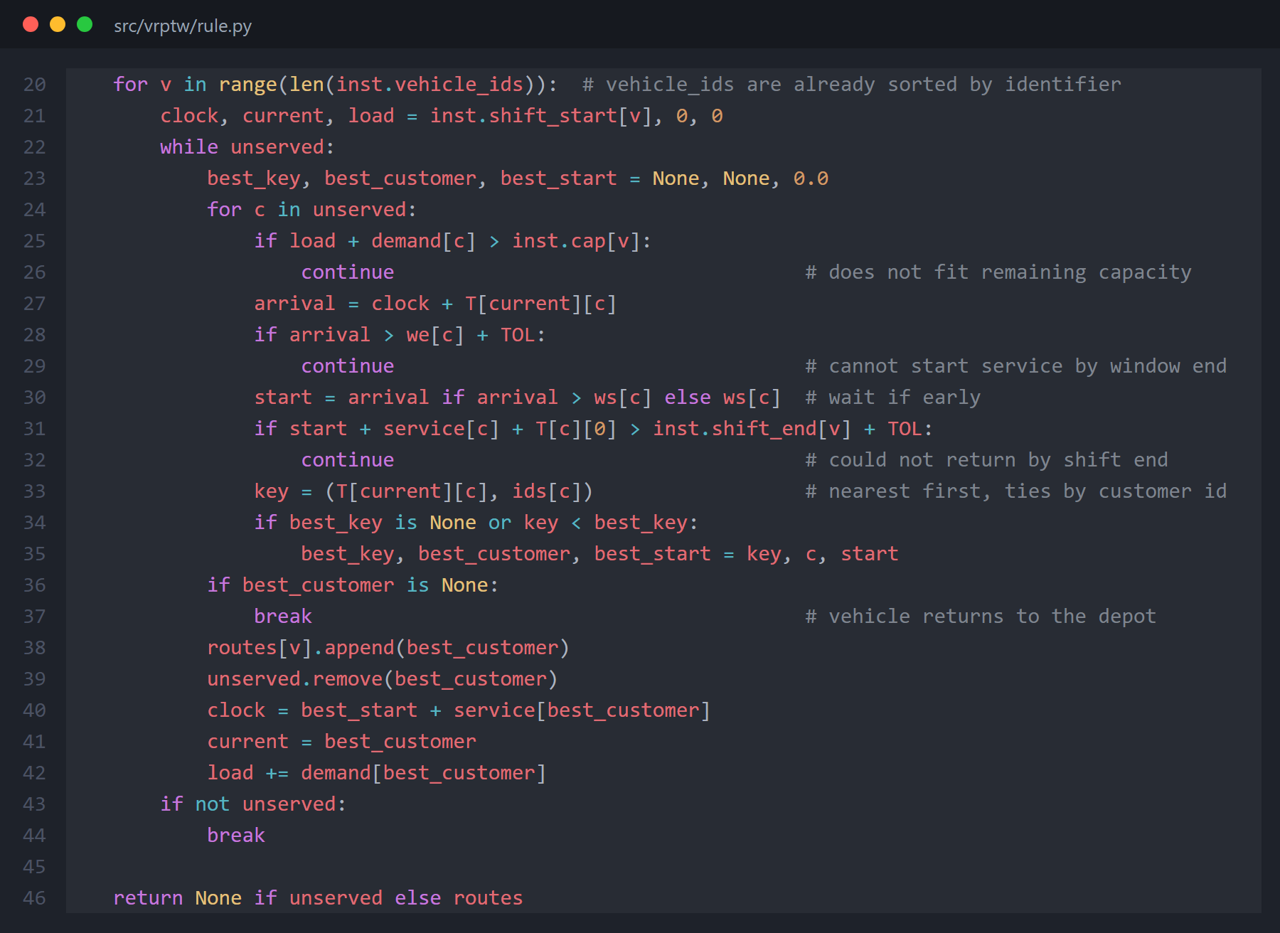
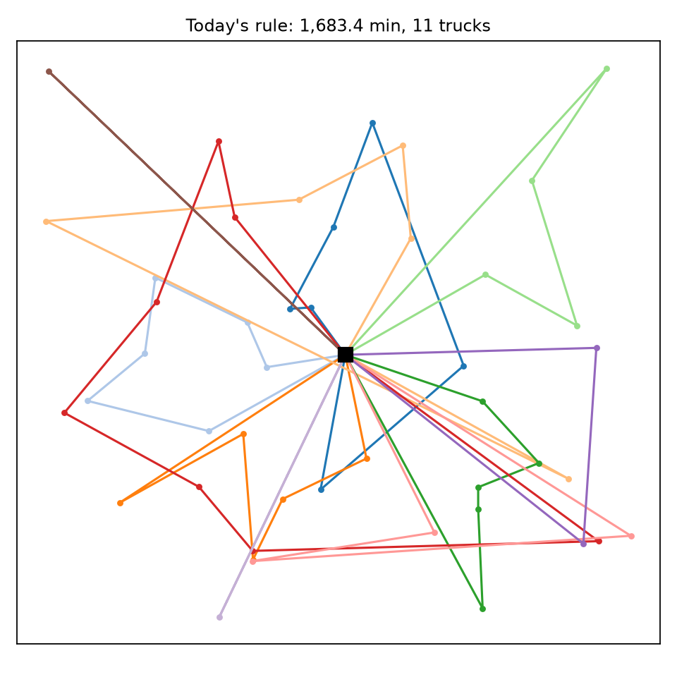
The rule to beat: nearest feasible stop, one truck at a time
1,683.4 min · 11 trucks
Greedy and myopic: early trucks take the easy stops, and the last trucks collect scattered leftovers. One truck works just 1.8 hours.
src/vrptw/rule.py: the brief's rule, line for line. It reproduces the worked example's 352.417 min.
Notes:
Method 1 is implemented exactly as the brief states, with ties broken by customer id. Its test is reproducing the worked example. The map shows why it loses: long spokes to leftover customers.

Slide 5
Our method: large neighborhood search
1
2
3
4
Build
Improve
Ruin and recreate
Accept
Regret-2 insertion builds all routes at once. The rule's plan is a second start. Keep the better.
Local search with 5 moves: 2-opt, or-opt, relocate, swap, 2-opt*. A move is kept only if it is shorter and feasible.
Remove 2 to 15 related customers, then reinsert the hardest-to-place first (regret insertion).
Simulated annealing sometimes accepts a worse plan early on to escape dead ends. Keep the best ever seen.
Steps 3 and 4 repeat 8,000 times with a fixed seed (522), so the same input always gives the same routes. A 480-second cap is only a safety net.
Why it fits this problem
Narrow windows make most single moves infeasible, so plain local search stalls. Removing a group of nearby, similar-time customers and rebuilding them together can reorganize several routes in one step.
Sources
Ropke & Pisinger (2006), Transportation Science 40(4)
Solomon (1987), Operations Research 35(2)
Savelsbergh (1992), ORSA J. on Computing 4(2)
Bräysy & Gendreau (2005), Transportation Science 39(1)
Notes:
The researched method, from Ropke and Pisinger. Construction, then local search, then repeated ruin and recreate with simulated-annealing acceptance. Fixed seed and iteration count, as the guide requires.

Slide 6
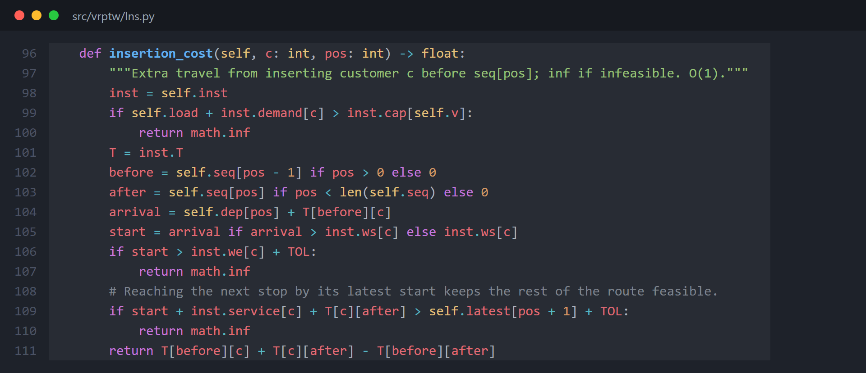
Fast feasibility: is there room for this customer?
Constant-time insertion test
Each route caches when it leaves every stop and the latest start each later stop can tolerate.
Whether a customer fits at a position is then three checks: capacity, its own window, and the next stop's latest start. No route replay (Savelsbergh 1992).
This is what makes 8,000 ruin-and-recreate iterations take seconds.
src/vrptw/lns.py, Route.insertion_cost
Notes:
The O(1) feasibility test. Cached departure and latest-start times let us test a proposed insertion in constant time instead of replaying the route.

Slide 7
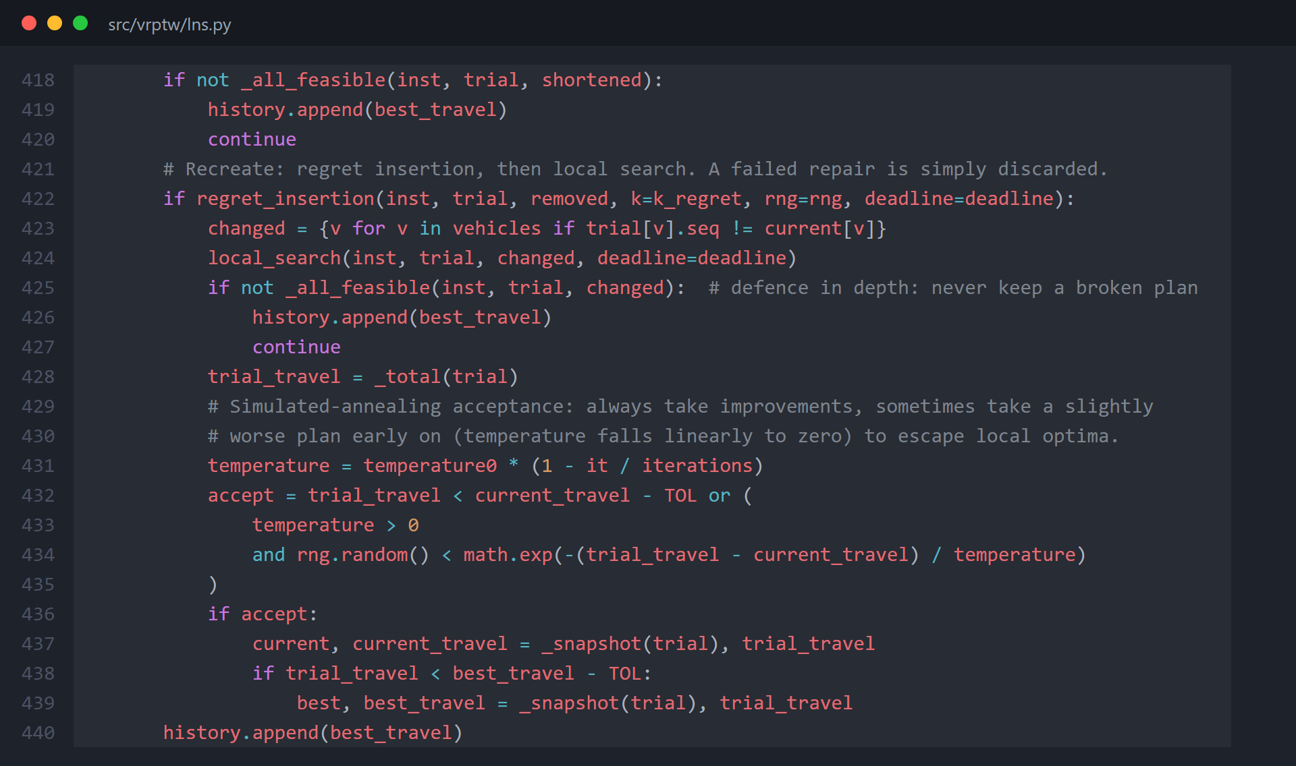
Safety: a broken plan is never kept
Check, then decide
After repair and local search, every changed route gets a full capacity, window and shift check (line 425).
Only then does simulated annealing decide: always accept a shorter plan, and sometimes a slightly longer one early on, with odds that fall to zero (lines 431-435).
The best feasible plan ever seen is what the tool returns.
src/vrptw/lns.py, inside _ruin_and_recreate
Notes:
The acceptance step. A full feasibility check runs before simulated annealing ever sees the plan, so the search can only ever keep feasible plans.

Slide 8
Same customers, same fleet: 38% less driving
−642.7 min
−3 trucks
Some LNS routes still cross. Each remaining crossing was tested: removing it would make a named customer miss its window.
Today's rule
Our method (LNS)
1,683.4 travel min · 11 trucks
1,040.7 travel min · 8 trucks
Notes:
Same 45 customers and fleet. The rule's map is full of long spokes. Our plan forms compact regional loops. Crossings that remain are forced by time windows; we tested every one.

Slide 9
The advantage grows with problem size
Instance | Saved | Trucks | LNS time
hand | 6.5% | 2 → 2 | 0.5 s
small | 26.0% | 5 → 4 | 1.0 s
medium | 38.2% | 11 → 8 | 8.9 s
large | 39.4% | 25 → 19 | 27.8 s
Held-out size check: on five 60-customer cases drawn from the large instance, our method saved 35.6% to 39.7% of travel, in about 16 seconds each (limit: 600 s).
Why it grows: with 6 customers there is little to rearrange. With more customers the rule's leftovers pile up for its last trucks.
Single instances from one generator; not a claim about every delivery network. Machine: Windows 11 laptop, Python 3.12, single thread.
Notes:
All four instances, both measures, and runtime, as the guide asks. The saving grows with size and the runtime stays far below the 10-minute limit. We avoid universal claims.

Slide 10
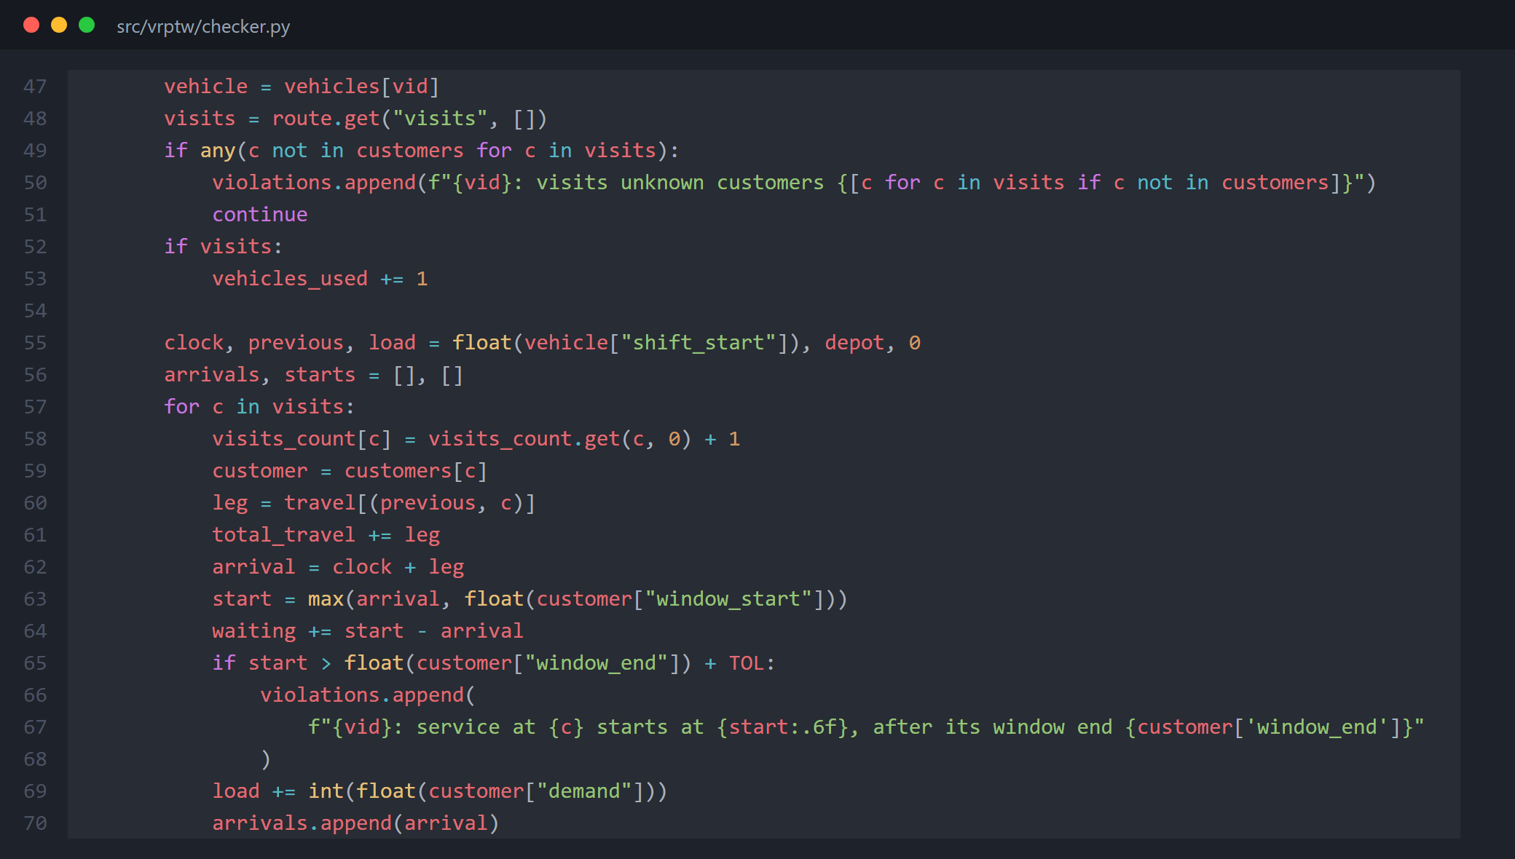



How we know the plans are right
Independent checker
Reads only the input files and decision.json. Every plan in this deck passed it.
36 automated tests
The 3 required tests, malformed inputs, determinism, shuffled rows, a mixed fleet, and regressions from an outside code review.
src/vrptw/checker.py: standard library only, imports no solver code. It replays each route from the input CSVs and recomputes every time and measure.
Exact benchmark (Gurobi)
Proves our plans optimal for 6, 15 and 45 customers. For 120, it found nothing better in 30 minutes.
Notes:
The checker is our main protection against agent-written code that claims results it didn't achieve. The Gurobi model is a labeled benchmark we formulated ourselves, never a graded method.

Slide 11
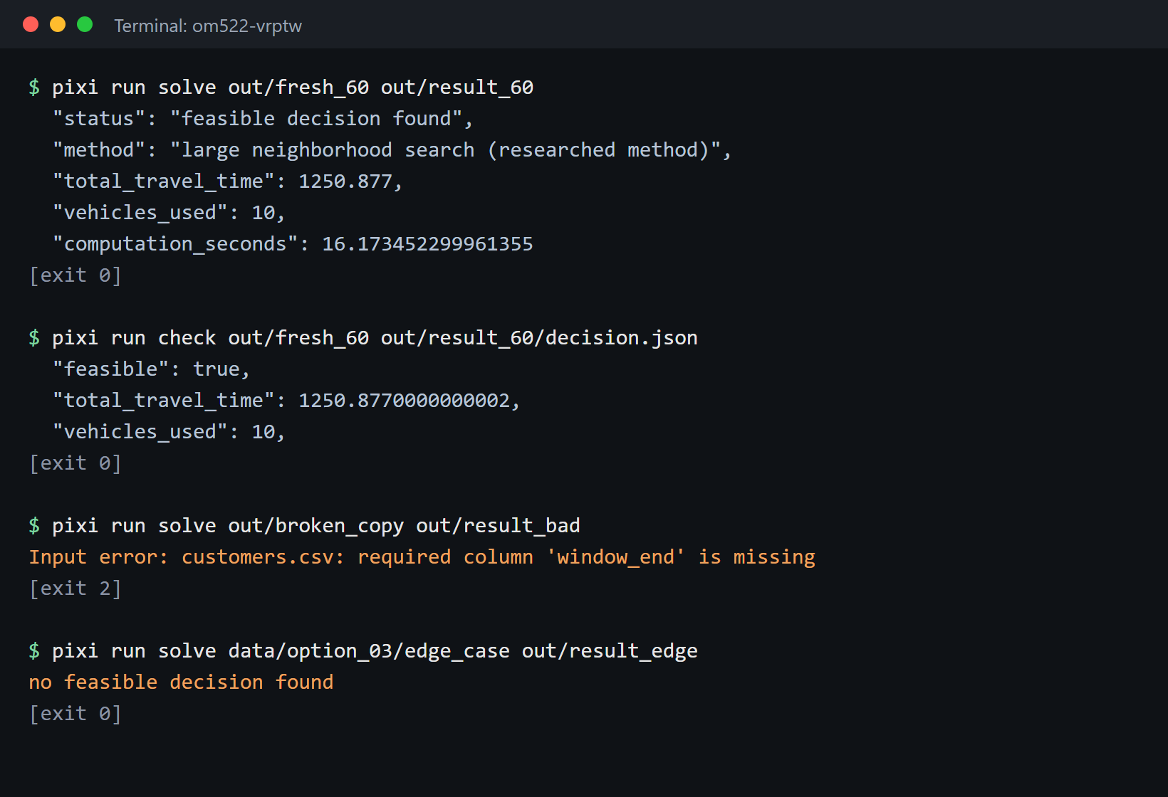

We rehearsed the instructor's grading run
Fresh 60-customer copy
beats the rule (1,250.9 vs 2,043.1 min) in 16 s and passes the checker
Malformed copy
names the file and column, writes no decision.json, exits 2
Infeasible edge case
prints “no feasible decision found” and exits 0
Rerun on a supplied case
same routes as the submitted results (fixed seed, iteration stop)
One command
pixi run compare regenerates every table, plot and scenario
Actual output, captured October 26 in the repo's out/ folder.
Notes:
This follows section 4.3 of the guide step by step. The 60-customer case stands in for the held-out instance.

Slide 12
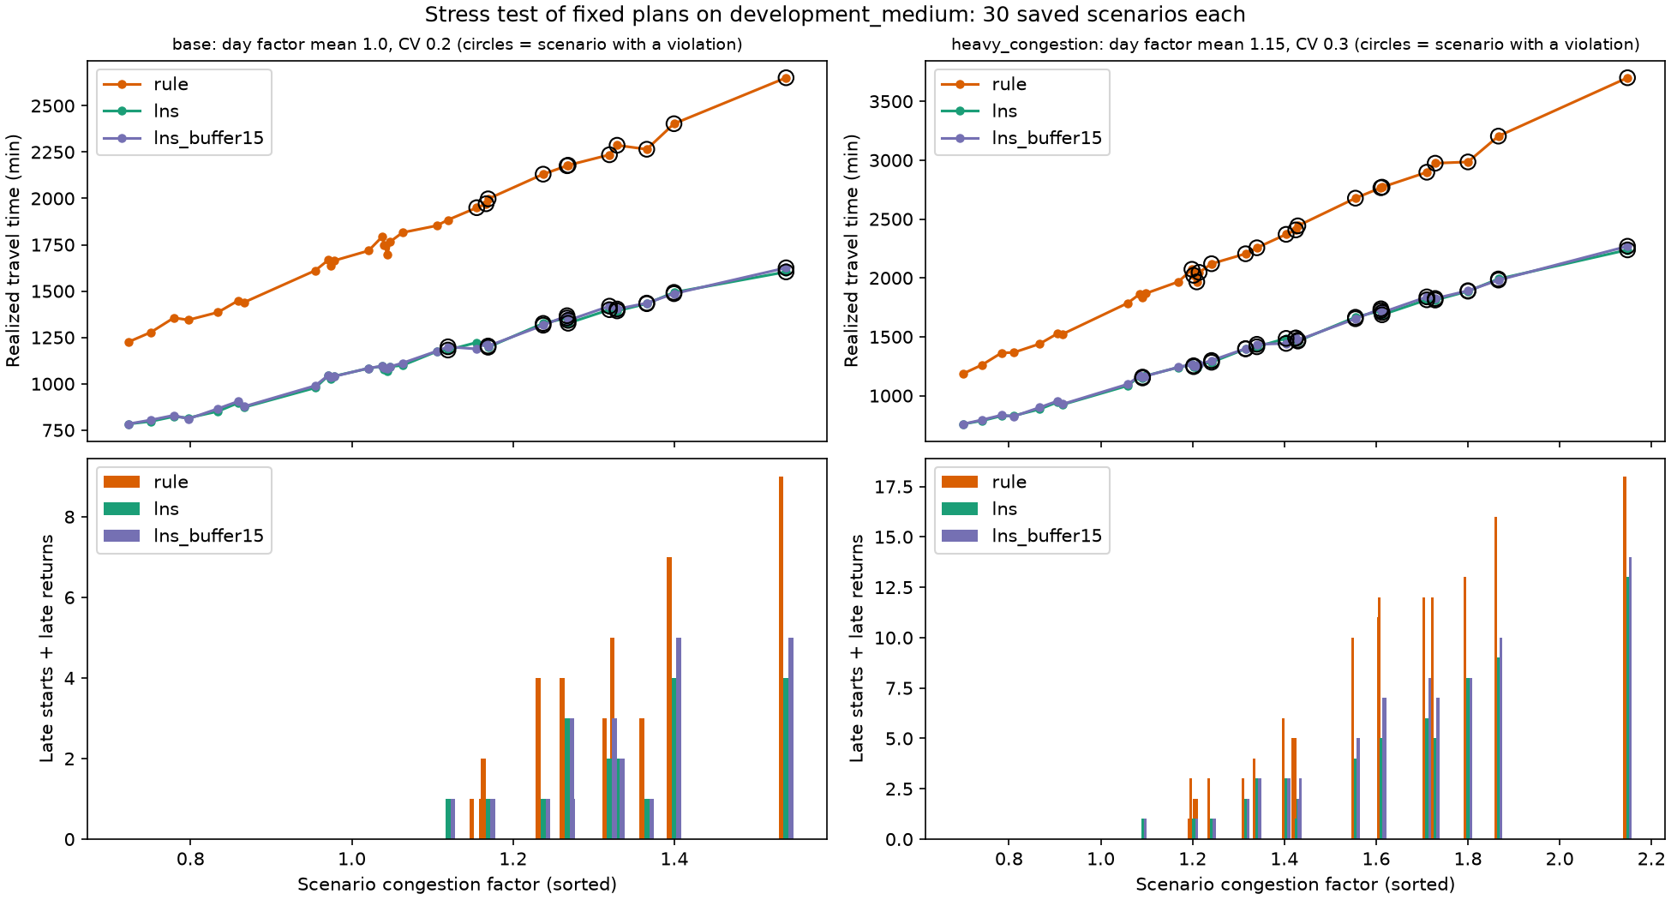
Stress test: our plan holds up better in traffic
1,126 vs 1,819
mean travel minutes (LNS vs rule)
19 vs 28
late service starts over 30 days
1 vs 14
late returns to the depot
10 vs 11
30 saved traffic days (seed 20261008), each plan driven unchanged. Circles mark days with at least one late stop.
days with any violation
Congestion: city-wide day factor (mean 1, CV 0.2) times road noise (CV 0.1). Trucks used is fixed by the plan: 8 vs 11 on every day.
Notes:
The guide's stress test. Same 30 scenarios for both plans, saved before either runs. LNS wins on mean and P90 travel. But it still has a violation on 10 of 30 days, which motivates the next section.

Slide 13




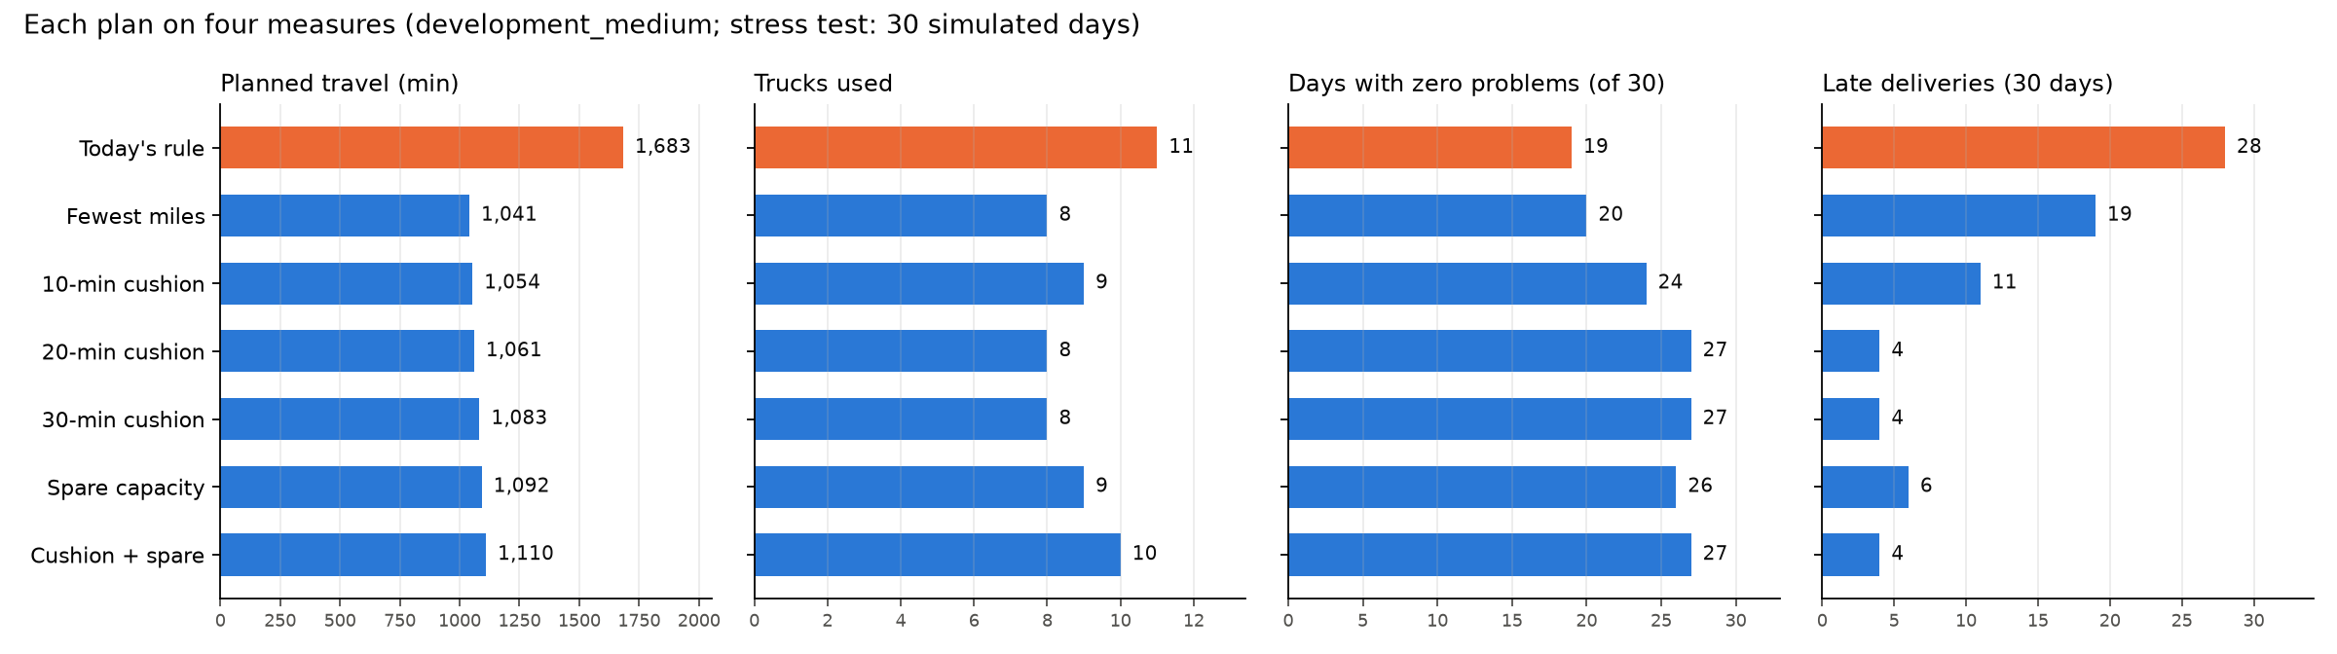
Miles aren't the only measure of success
Travel time
Trucks
Driver hours
Clean days
Cushion
Spare capacity
fuel, wear
fleet cost
wages, overtime
days with no late stop
minutes before a window closes
room for add-on orders
We planned five alternatives with the same method, each told to protect something extra, then scored every plan on every measure and on the same 30 traffic days.
Blue: plans from our method with different targets. Orange: today's rule.
Notes:
This answers 'what else should success mean?'. Blue measures are the graded ones; green are what an operations manager also cares about. A cushion plan is told every window closes N minutes early, so each stop keeps N minutes of protection.

Slide 14
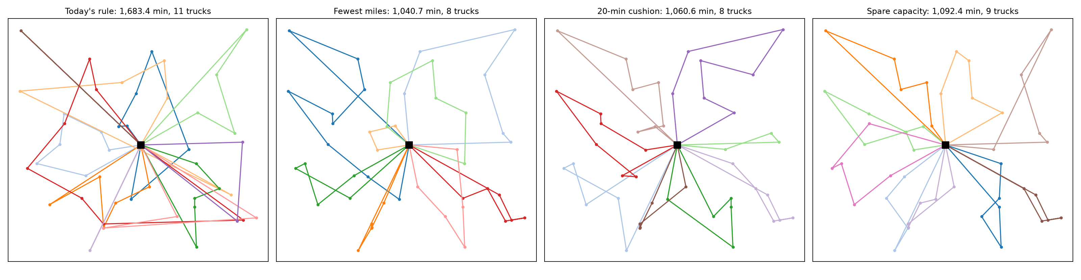
Four options for the boss
Option | Travel (min) | Trucks | Driver hours | Clean days (of 30) | Late events (30 days) | Choose it when
Today's rule | 1,683 | 11 | 73.9 | 19 | 42 | Never: it trails on every measure
Fewest miles | 1,041 | 8 | 63.8 | 20 | 20 | Late deliveries are cheap to fix
20-min cushion | 1,061 | 8 | 65.0 | 27 | 4 | A missed window costs over ~$100
Cushion + spare | 1,110 | 10 | 78.7 | 27 | 4 | Reliability matters most, or add-on orders are common
Late events: late starts plus late returns over the 30 simulated days. A 9-hour driver day is impossible for any plan: customer C039 opens at minute 500.
Notes:
The decision table. The 20-minute cushion costs 20 planned minutes and no extra truck, and cuts late events from 20 to 4. Fewest miles is cheapest only if late deliveries cost little. Spare capacity buys room for add-on orders at the price of extra trucks.

Slide 15
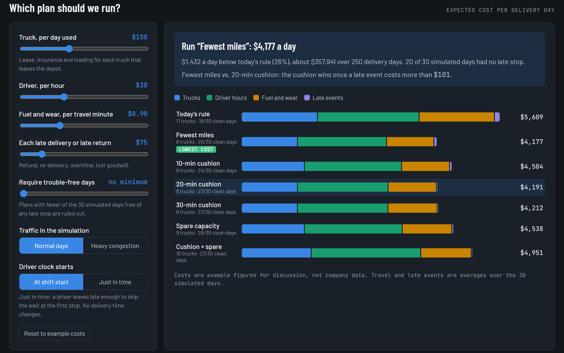
An interactive explorer lets the boss set the costs
Set four prices
truck per day, driver hour, travel minute, late event
Add a service floor
rule out plans below N clean days
Switch traffic and driver clock
normal or heavy congestion; drivers start at shift start or just in time
$101
is the break-even cost of a late event. Above it, the 20-min cushion beats fewest miles. At $75 they are within $15 a day.
Dispatch Plan Explorer, with example costs. Inspecting a plan also shows its map and every truck's day.
Open the explorer
Notes:
The boss decides what a late delivery really costs; the page does the arithmetic. The costs shown are example figures for discussion, not company data. The link is private until we share it.

Slide 16

Recommendation
Adopt our method
Plan with a 20-minute cushion if late deliveries are costly
About 640 fewer travel minutes a day (−38%) and 3 fewer trucks on a 45-customer day. In simulated traffic: 690 fewer minutes on average, 19 vs 28 late starts.
+20 planned minutes a day (+1.9%), the same 8 trucks, and late events fall from 20 to 4 over 30 days.
Tradeoff we accept
When this would change
5 to 35 seconds of computing per plan instead of an instant answer. Fuller trucks mean a breakdown affects more customers.
If traffic routinely runs more than about 25% above the travel table, any fixed morning plan fails often. The tool would then need to re-plan during the day.
Notes:
The guide asks for the method, its benefit, the tradeoff, and one condition that would change the recommendation. The cushion is an operating choice for the same method, not a third method.

Slide 17



Next steps before the final submission
Documentation
Final video (≤ 15 min)
Submit
Rewrite the README's opening paragraph in our own words
Confirm the 'every component reviewed' sentence
If a method changed after the prototype, say why in the README
Fresh instance, both methods, checker, comparison, stress test, recommendation
Each member walks a different agent-drafted component (AGENT_LOG.md rows 1–11)
Run pixi run test and pixi run compare on the final commit
Push to GitHub and submit the repo link, commit hash and video link
Optional: add a --cushion option to solve so a dispatcher can run the cushion plan directly. The default settings that the instructor runs would stay unchanged.
Notes:
What is left. Most of it is team work the guide reserves for us: our own words in the README and the video walk-throughs.

