Slide 1

Multimodal
Interaction
Fusion
António Teixeira

Slide 2
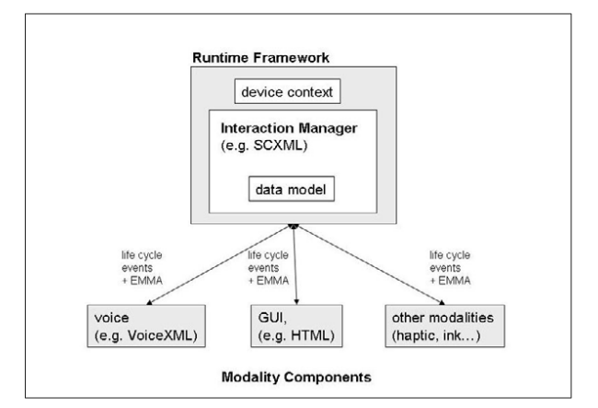
The Multimodal Architecture (again)
W3C Webinar: Developing Portable Mobile Applications with Compelling User Experience using the W3C MMI Architecture

Slide 3
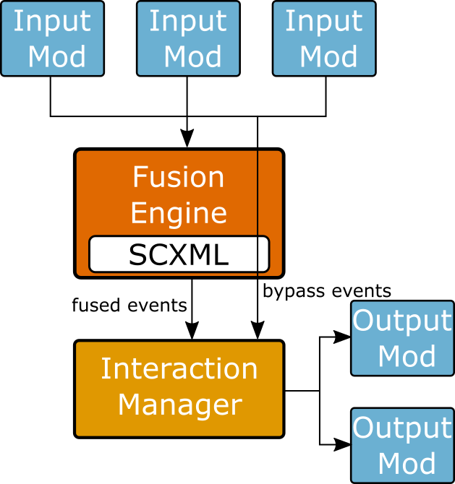
Fusion

Slide 4
DETI/IEETA FRAMEWORK FOR MULTIMODAL FUSION

Slide 5
What is available
Runtimes
IM
Modality examples
Speech
Second
Fusion
Help for Modality development
Lib
Example(s)

Slide 6
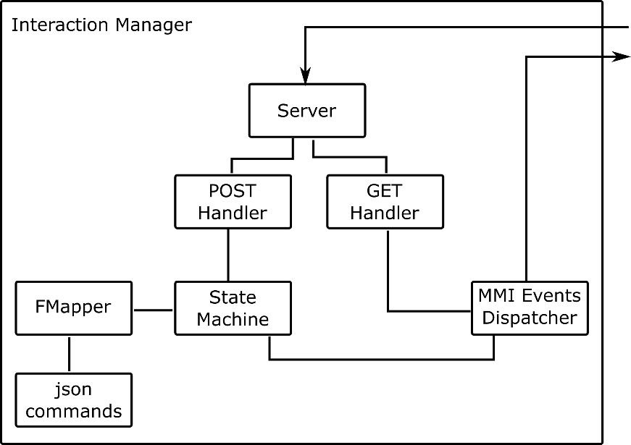
Interaction Manager
Developed in Java

Slide 7
IM
Technologies used:
Java
HTTP
SCXML
Apache implementation

Slide 8
Fusion Engine
Fusion process needs to be running
Communicates with IM
That must be running
Configured with SCXML
fusion.scxml
See chapter on SCXML

Slide 9
Fusion for developers
Enum with Events for each modality
Created by Modality developers
“Main” defines Fusion
Uses FusionGenerator class
Main methods:
Complementary(
Redundancy (…
Single
Build
Automatic generation of SCXML
Directly usable by Fusion engine

Slide 10
Fusion - How to
Use as basis Netbeans project in Elearning
Define input modalities (described by enums)
Adapt examples for Speech and Touch that are part of the project
Create Output enum
No timeout …
Create main ….
Adapting exemple given

Slide 11
Fusion - Example of Main
import scxmlgen.Fusion.FusionGenerator;
Main()
FusionGenerator F=new FusionGenerator();
F.Redundancy(Speech.HELP, Touch.OPENNEWSTITLE, Out1.OUT1);
try {
F.Build("c:\\temp\\ateixeira1.scxml");
} catch (IOException ex) {
Logger.getLogger(ATFusion1.class.getName()).log(Level.SEVERE, null, ex);
}
Run project
Suggest: use complete path …

Slide 12
DEMO(S)

Slide 13
DEMO - part 1
Run IM
Run FUSION
Uses fusion.scxml
(Compile and) Run Speech Modality
recognizes quadrado, triângulo vermelho etc
(Compile and) Run Second Modality
Very simple, for demo only
Can use Touch
AppGUI is the sample application

Slide 14
DEMO – part 2
Configuration of fusion

Slide 15
YOUR WORK …
Apply to your modality(ies)

Slide 16
Extra slides
on
W3C Architecture

Slide 17
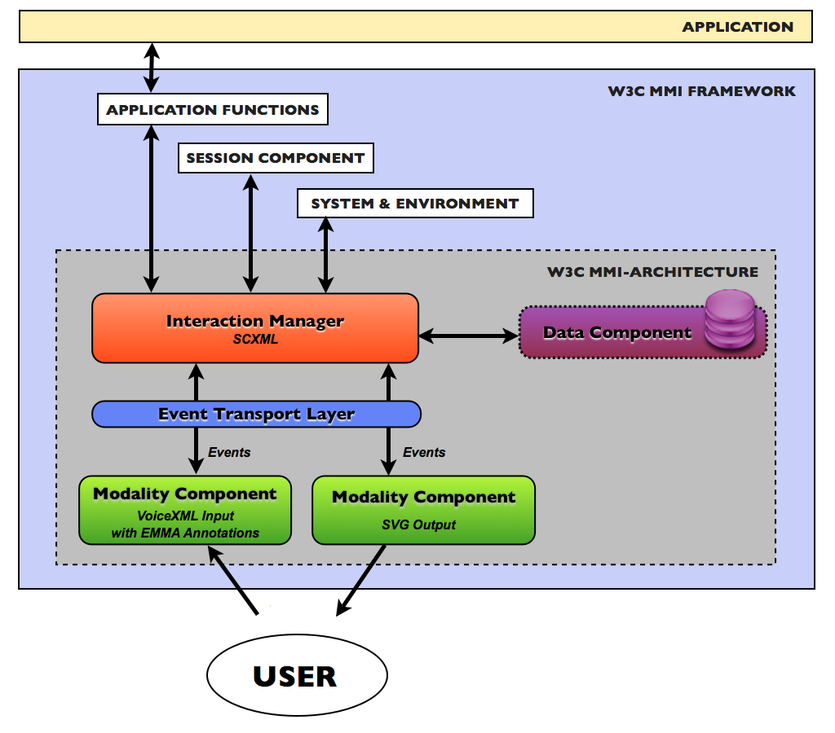
The interaction manager

Slide 18
Communication protocol between different modules
In the MMI architecture, the communication protocol is asynchronous, bi-directional and based on the exchange of event notifications that are raised by the system following a user action or some internal activity. This protocol defines the exchange mode and how to establish and end the communication between modules.
In the case of this specification, it is reflected in the Life-Cycle Events.
These are six standard control events that are proposed for controlling devices and material services (such as a video player or a sound reproduction device) and two notifications proposed for monitoring the current status of the multimodal system.

Slide 19
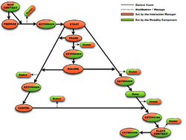
The Standard Life-Cycle Events
The specification recommends eight standard Life-Cycle Events specified as pairs of Request > Response exchanges:
NewContext
ClearContext
Prepare
Start
…

Slide 20
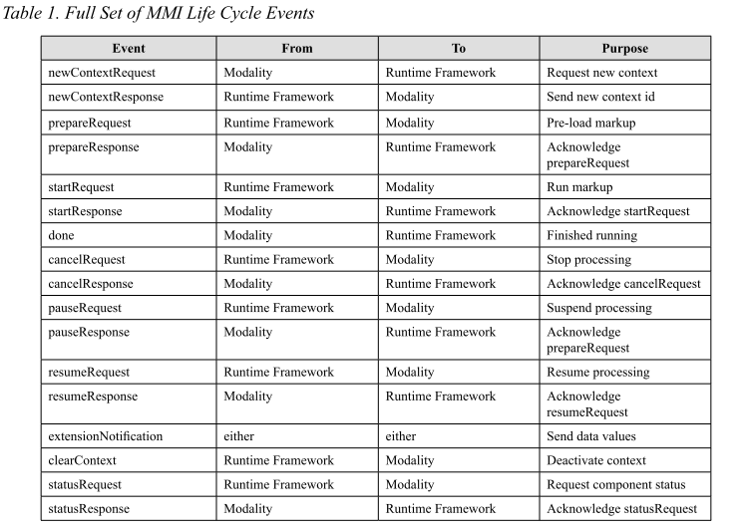
Set of MMI Life Cycle Events

Slide 21
EMMA - Extensible MultiModal Annotation markup language
The W3C EMMA provides a standardized XML representation language for encapsulating and annotating inputs to spoken and multimodal interactive systems.
As such, it targets primarily data transfer between entities of a given multimodal system
http://www.w3.org/TR/emma/

Slide 22
EMMA example
<emma:emma version="1.0"
xmlns:emma="http://www.w3.org/2003/04/emma"
xmlns:xsi="http://www.w3.org/2001/XMLSchema-instance"
xsi:schemaLocation="http://www.w3.org/2003/04/emma
http://www.w3.org/TR/2009/REC-emma-20090210/emma.xsd"
xmlns="http://www.example.com/example">
<emma:group id="grp">
<emma:interpretation id="int1" emma:medium="acoustic"
emma:mode="voice">
<action>move</action>
<object>this-battleship</object>
<destination>here</destination>
</emma:interpretation>
<emma:sequence id="seq1">
<emma:interpretation id="int2" emma:medium="tactile"
emma:mode="ink">
<x>0.253</x>
<y>0.124</y>
</emma:interpretation>
<emma:interpretation id="int3" emma:medium="tactile"
emma:mode="ink">
<x>0.866</x>
<y>0.724</y>
</emma:interpretation>
</emma:sequence>
</emma:group>
</emma:emma>

