Slide 1
WUMA TRAVEL UI Design Introduction
Shiyi Chen 1063701
Xuan Ma 1063950
Jinkua Liu 1098399
Haoyuan He 1098378

Slide 2

This is the logo of or app. We name our app WUMA TRAVEL and designed the app in a nostalgic style. The logo itself complies with the design style of the whole app.
五
馬
TRAVEL

Slide 3
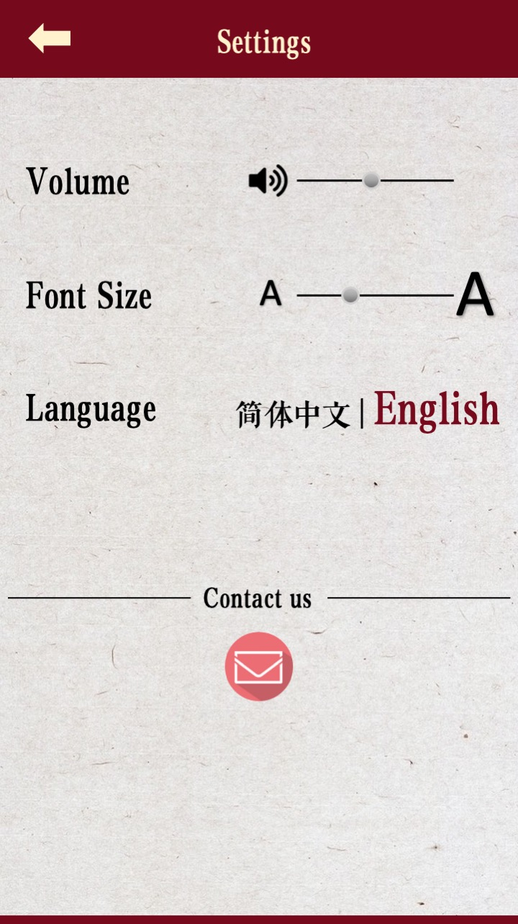
Users can enter the settings page from any page of the application. In the settings page, users can adjust the audio volume, switch languages, and change the font size. If they have any comments or suggestions on the application, they can contact the development team from here.

Slide 4
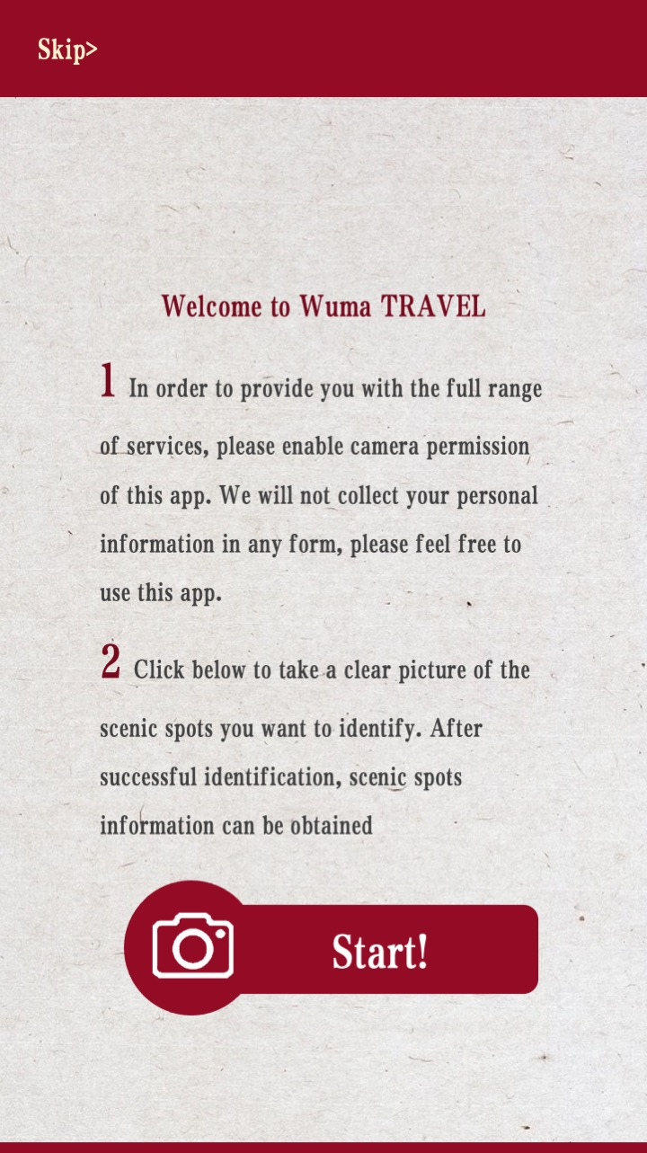
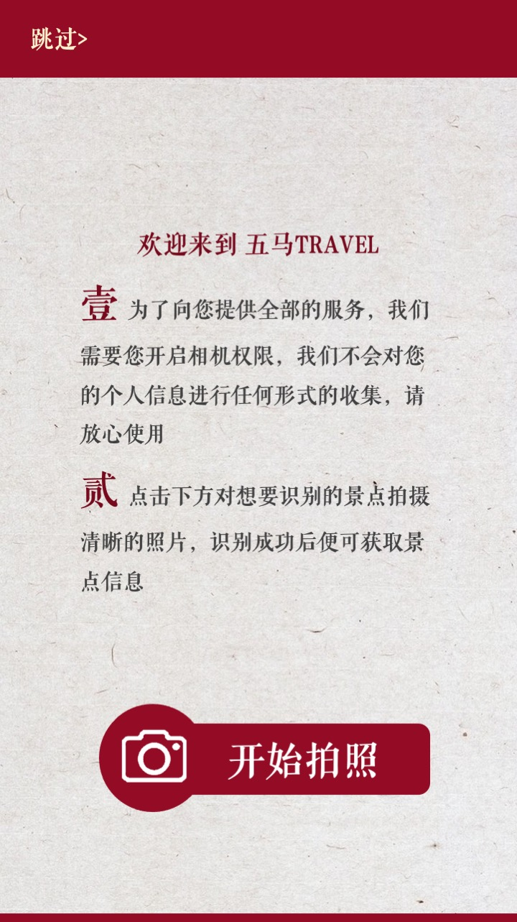
This is the introduction/welcoming page. It shows up when the user opens the app. This provides guidance and user agreement for all users.

Slide 5
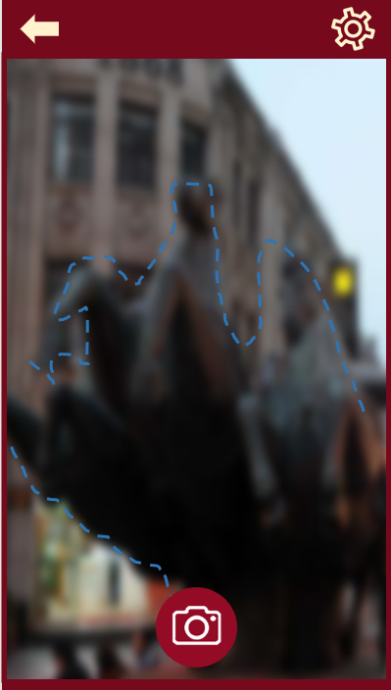
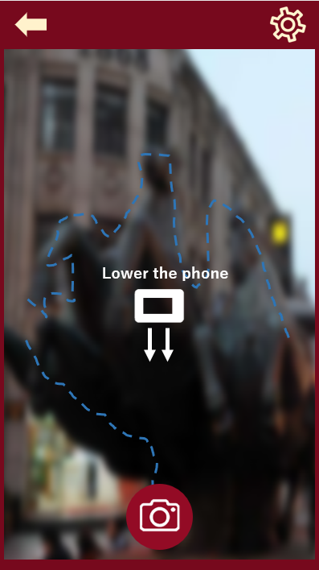
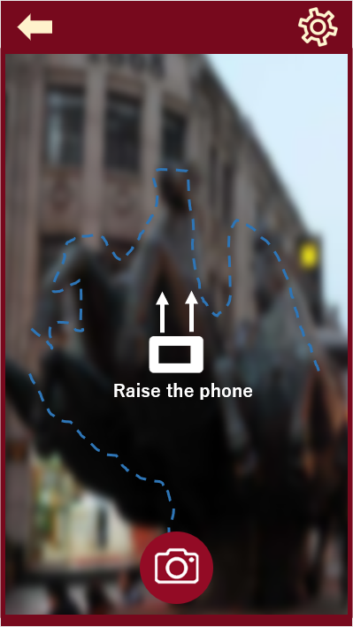
The identified auxiliary line is used for Feedback, which will prompt the user to move the phone higher, or lower.

Slide 6
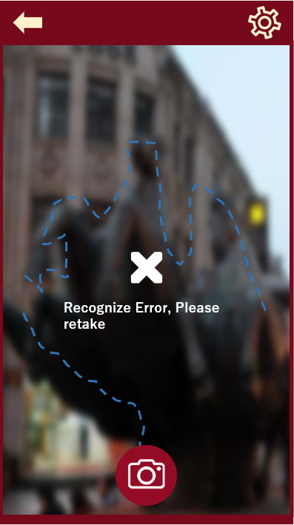

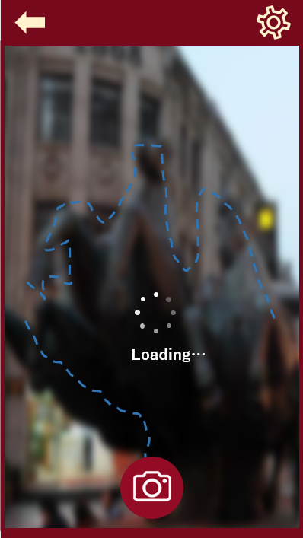
Our user will be prompted whether their recognition is successful.

Slide 7
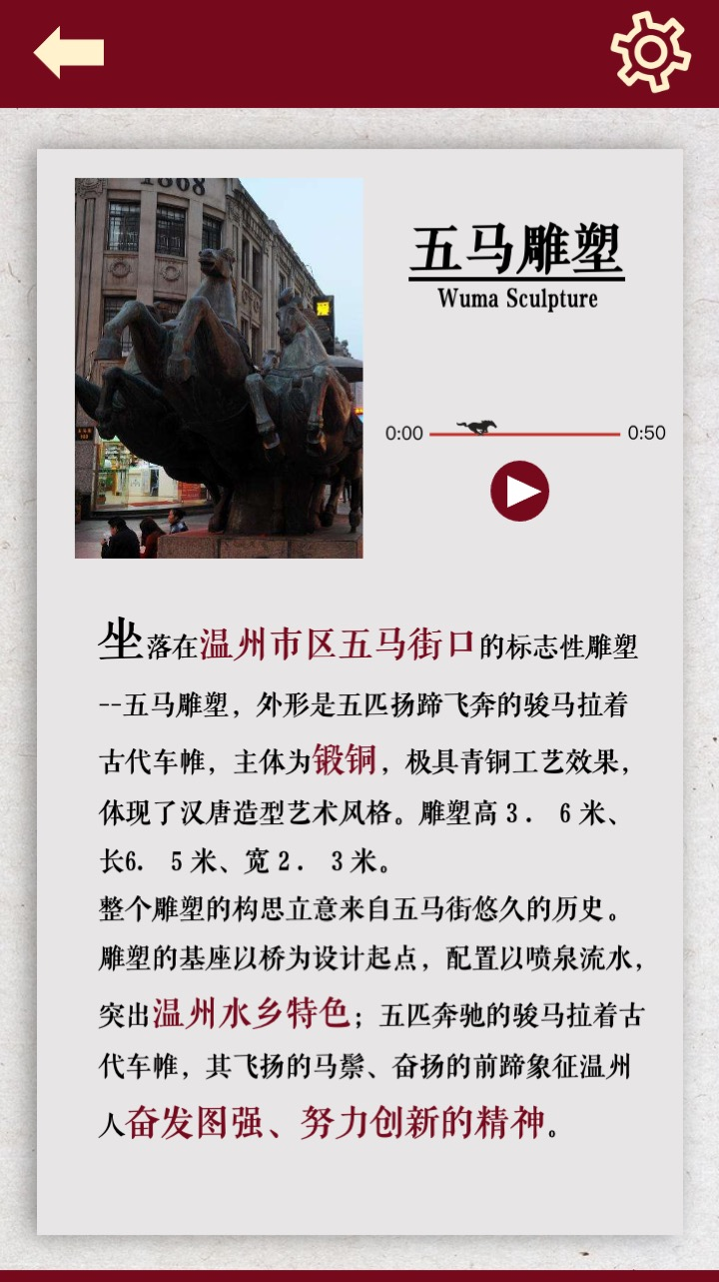

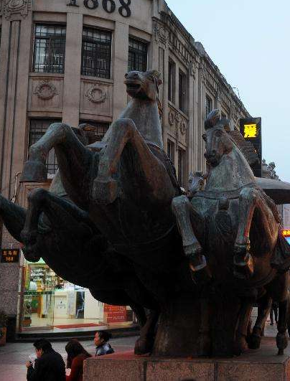

五马雕塑
Wuma Sculpture
After the recognition is successful, the information of the scenic spot is displayed on the main interface. The main information displayed is high-definition pictures of scenic spots, text introduction and voice introduction. The audio introduction includes Mandarin, English and Wenzhou dialect.
The idea of ​​the entire sculpture comes from the long history of Wuma Street. The pedestal of the sculpture takes the bridge as the design starting point, and is equipped with fountains and flowing water, highlighting the characteristics of Wenzhou's water town; five galloping horse-drawn horses wear ancient car curtains, and its flying horsehairs and vigorous forefoot symbolize the spirit of Wenzhou people's hard work and innovation .
Notes:
People scan when they meet those introduction---- Don’t Make me think, Chapter 4? Could scroll

