Slide 1
0-to-hero
01/07 Mentors <> 01/07 Sessions

Slide 2
Me
Kernel developer(Windows/Linux/Own)/Microarchitecture geek (Intel)/Security Researcher (Lenovo, Microsoft, Mysql, Python etc.)/
Software Engineer ∨ Architect/Hardware Engineer (FPGA, ASIC, Firmware researcher - BIOS, UEFI, coreboot)/Contributor/Virtualization lover (VTx)/Intel lover (SGX, VTx, TXT, MMX, VNNI)/Performance tuning ninja/System Architect.
http://linkedin.com/in/emin-ghuliev-461a22129/

Slide 3
Job / Education
Self-taught ninja
Work experience:
Mindcon
CERT Government
APA Holding
Lambercy
E-GOV
EnsignInfoSecurity (as soon as)

Slide 4
Software Architect/System Engineering
Algorithms (Bloom filter (space efficient), Tomasulo, Branch prediction, Speculative execution, Instruction pipelining)
Optimization (Cache types - WB, WT/Replacement algorithms - LRU,Random replacement, LIFO, FIFO - Compiler based optimization - Loop unrolling, Dead code elimination, Code coverage, Register allocation, Machine code optimization, Prefetching)
SWOT (strength, weakness, opportunities, threats) analysis.
Distributed and parallel computing - protocols (IPC, RPC, Shared memory), algorithms (consistent hashing, fork-join model, pipeline, concurrency, parallelism)
Parallelism, concurrency (reactor pattern) - Instruction-level, task-level, data level parallelism (Vector processor - SIMD, SIMT)
Virtualization (VTx/binary translation or emulation) - Memory, Device, CPU
Compiler/Interpreter principles - (Lexical, token, semantic), Interpreter based VM and bytecodes

Slide 5
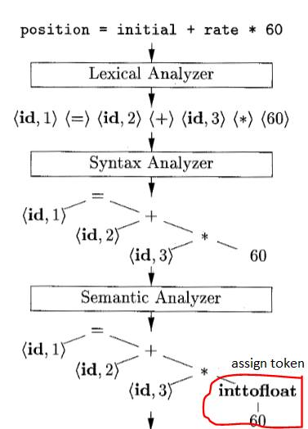
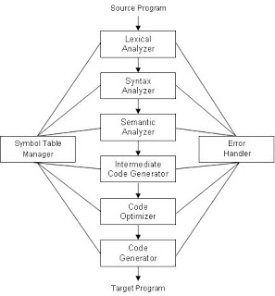
Compiler principles
Notes:
https://www.facebook.com/groups/azeri.developers/permalink/2337918729591636/?comment_id=2340253079358201&comment_tracking=%7B%22tn%22%3A%22R%22%7D
https://www.facebook.com/groups/azeri.developers/permalink/2337918729591636/?comment_id=2340253436024832&comment_tracking=%7B%22tn%22%3A%22R%22%7

Slide 6
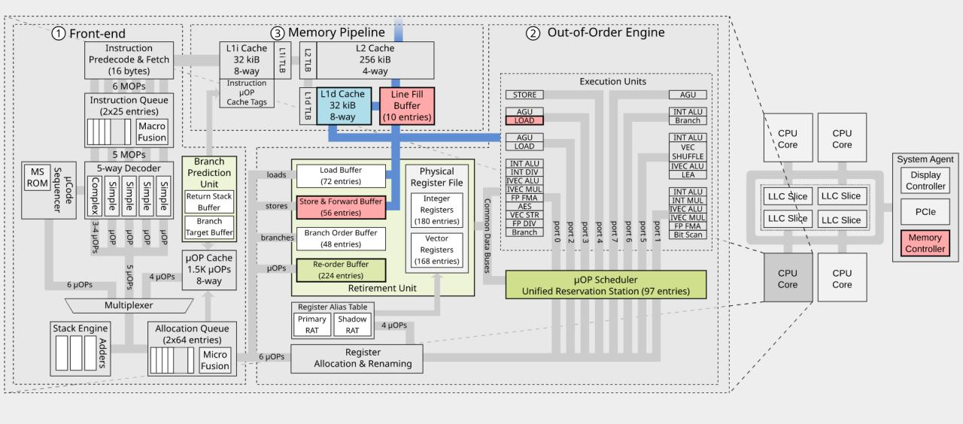
Modern CPU

Slide 7
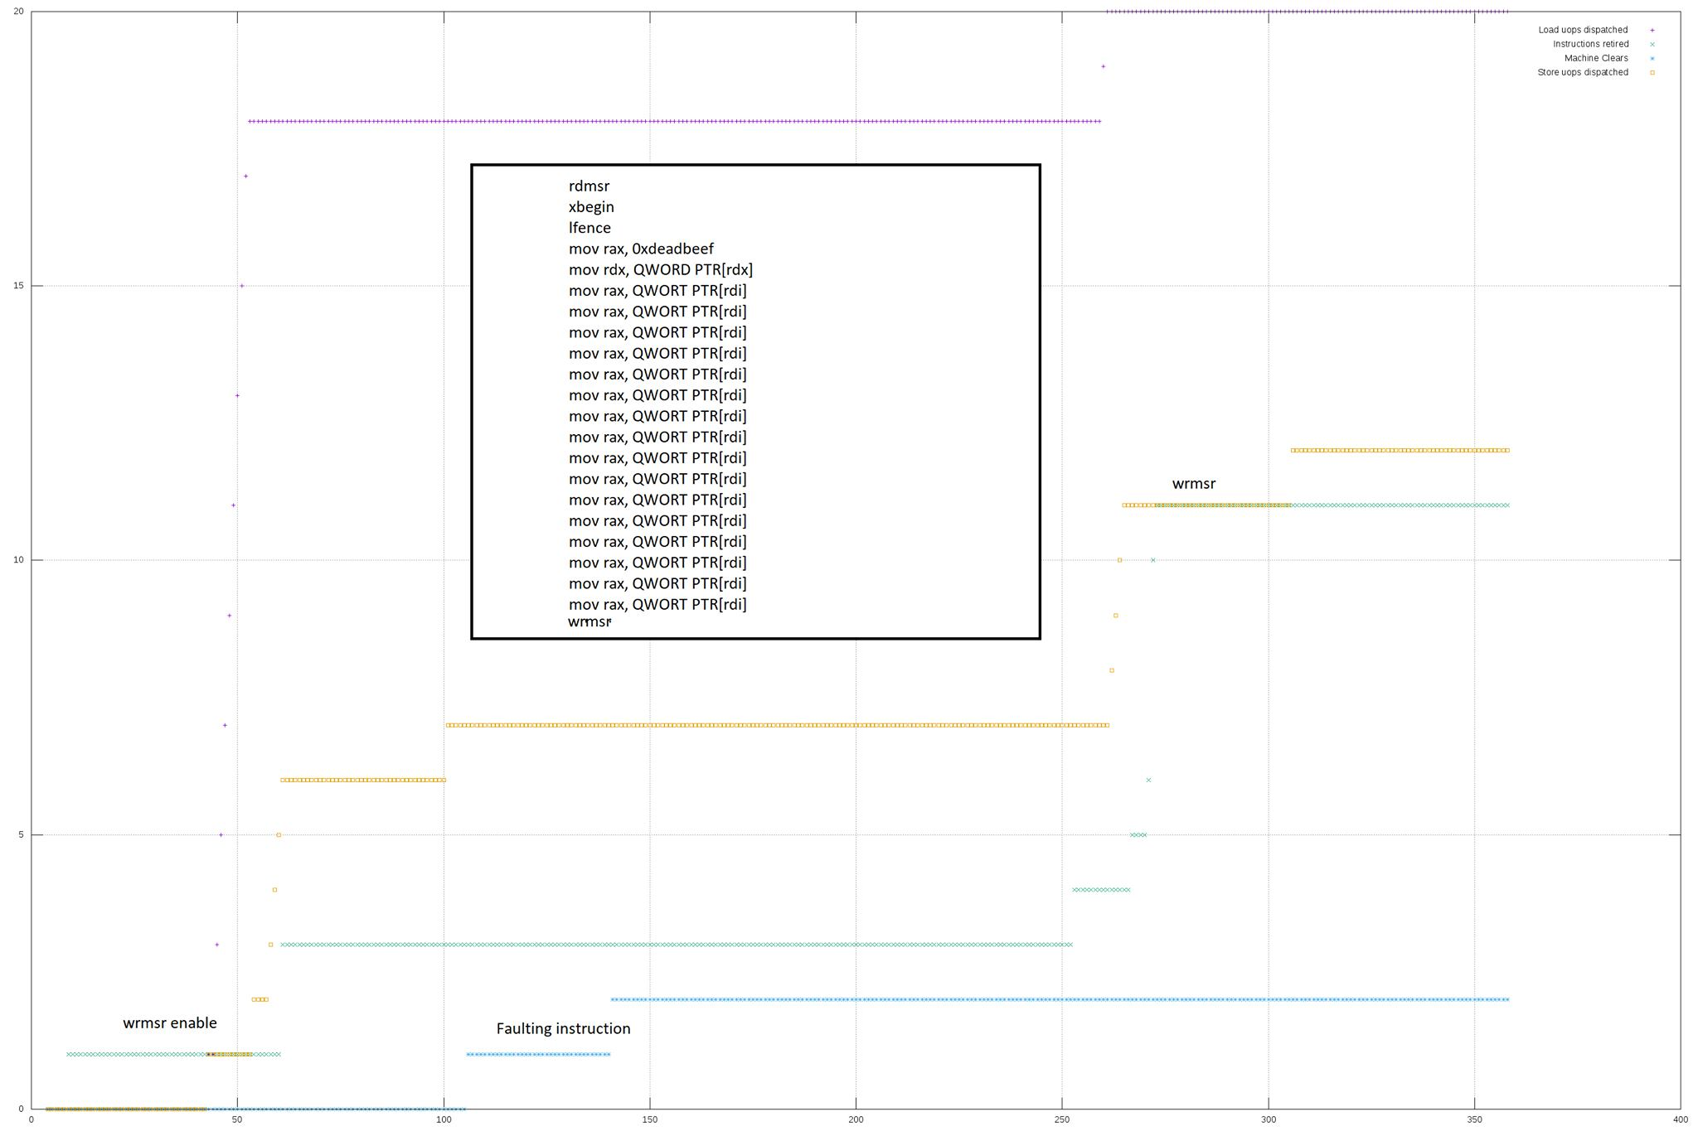
Instruction cycle

Slide 8
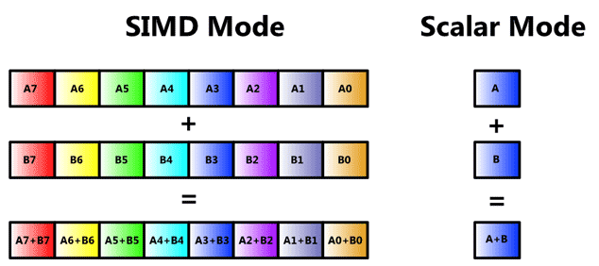
Machine Learning/Computer Vision

Slide 9
OS Kernel
BIOS/UEFI
Architectures - (Bootloader, BIOS data structures, Multiprocessing, Interrupts, Exceptions, ACPI, Hypervisor, Timer, Memory/IO mapped, PCI(e), Syscalls, Context switching)
Device drivers - (Network, USB, Storage - IDE/ATA, Keyboard)
File system
Process scheduler - Scheduler types:
Long term scheduler (which process are to be admitted to the ready queue - CPU or I/O bound)
Medium term scheduler (transfer to second storage from main memory)
Short term scheduler (schedule after interrupt)
Preemptive multitasking (Completely fair scheduler, Priority scheduling, Round-robin/time slicing)
Memory Management (TLB, Paging, Segmentation)
PXE (painful :-D )

Slide 10
Perf tuning/Troubleshooting
Code coverage - Cyclomatic complexity - Asymptotic notation - Big O
VM optimization
Memory management
Profiling - Metric
PMU/PT/LBR - Processor Feature
BCC
Linux perf
SystemTap
strace/dtrace/ltrace
Notes:
https://schweigi.github.io/assembler-simulator/

Slide 11
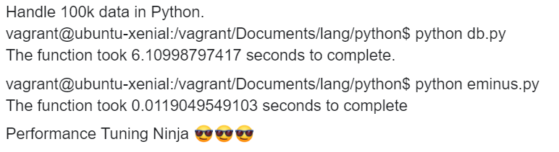
Perf Tuning ninja - SWOT analysis

Slide 12
Security Trends
SecOps
Reverse Engineering
Web App security

