Slide 1
0-to-hero
01/10 Mentors <> 01/10 Sessions

Slide 2
Me
Success is cover page of a failure book
Be failed, ignored, rejected but not stopped
Nobody is wrong, adjust your body
Do what u can, with what u have, where u are
https://www.linkedin.com/in/sakom/

Slide 3
Job / Education EU
France: Got 1 year work permit after MSc degree
Germany: Blue card, after 2y get permanent residence
Language: Is must for country you are moving
Requirements: IELTS / Toefl, References, Good grades transcript
Capital: 10k + Scholarship

Slide 4
Job / Education US
Visas: H1B, GreenCard, F1, J1
Capital: 50k $
Requirements: GRE / GMAT / Toefl
https://ectalent.global/
https://www.ciee.org/

Slide 5
Open Source
Experience
Knowledge
Visibility
Friends
Ideas

Slide 6
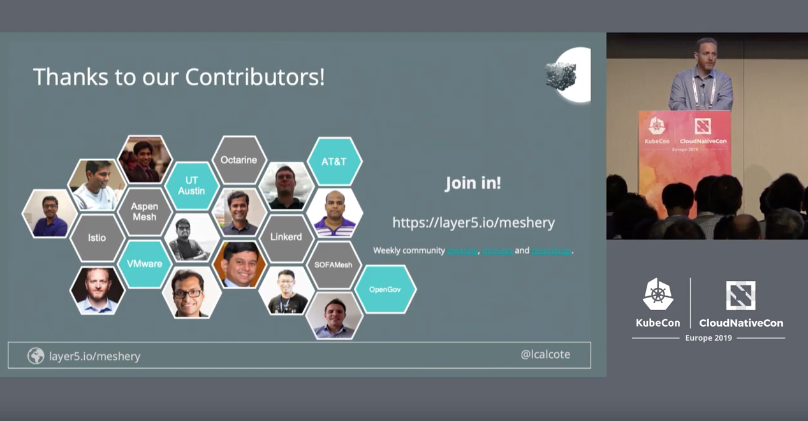
Google Summer of Code

Slide 7
Idea to action / Startup Bootstrap
All about Team
Talk, write, ask people
Put time consistently
Be part of other startup/team even free, to learn process
Enjoy failures, objections

Slide 8
Tech Stack
Algorithms and Data Structures
One of Cloud Provider: AWS, GoogleCloud or Azure
OS: Ubuntu, MAC OSX
Languages: Python, JS, NodeJS, C++, Go, Rust
Version Control System: Git
Agile Software Development process

