Slide 1

An on-chain growth platform based on gaming

Slide 2
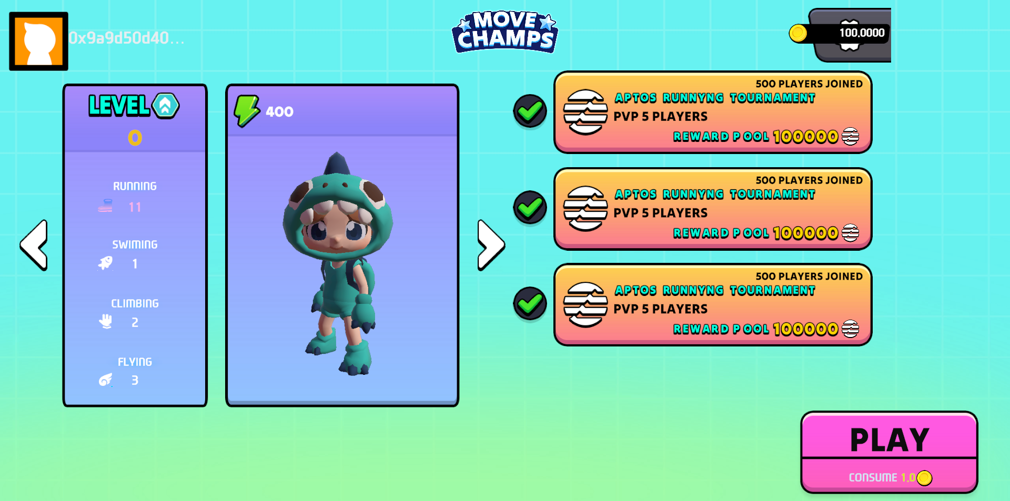


Problems
On-chain growth is difficult
RWA
BTC L2
Restaking
MEME
DEFI
Airdrop
AI
ETH
Solana
NFT
Gamefi
Expensive to acquire attention
Not enjoyable
How to ensure fairness

Slide 3
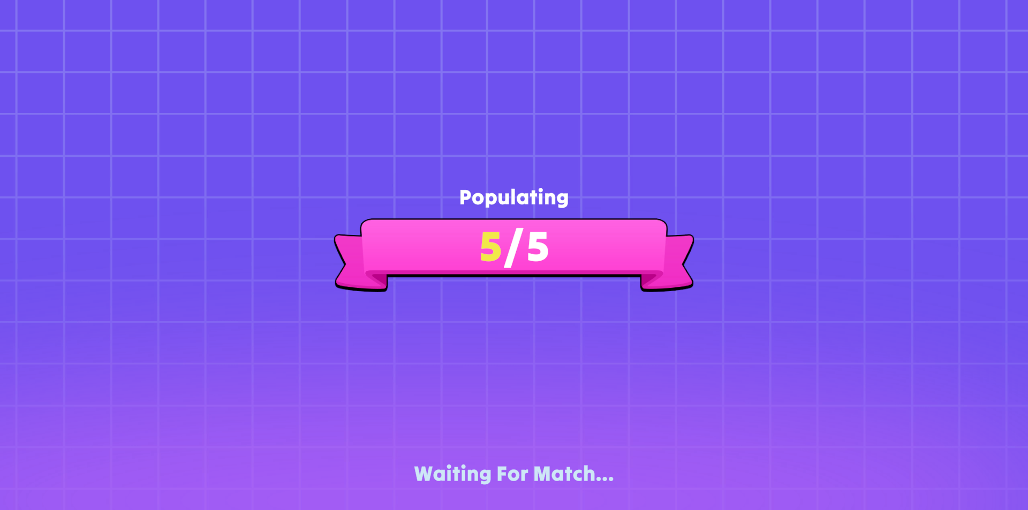
What is MoveChamps
MoveChamps
Fully on-chain
Gaming and socializing
Easy and cheap

Slide 4
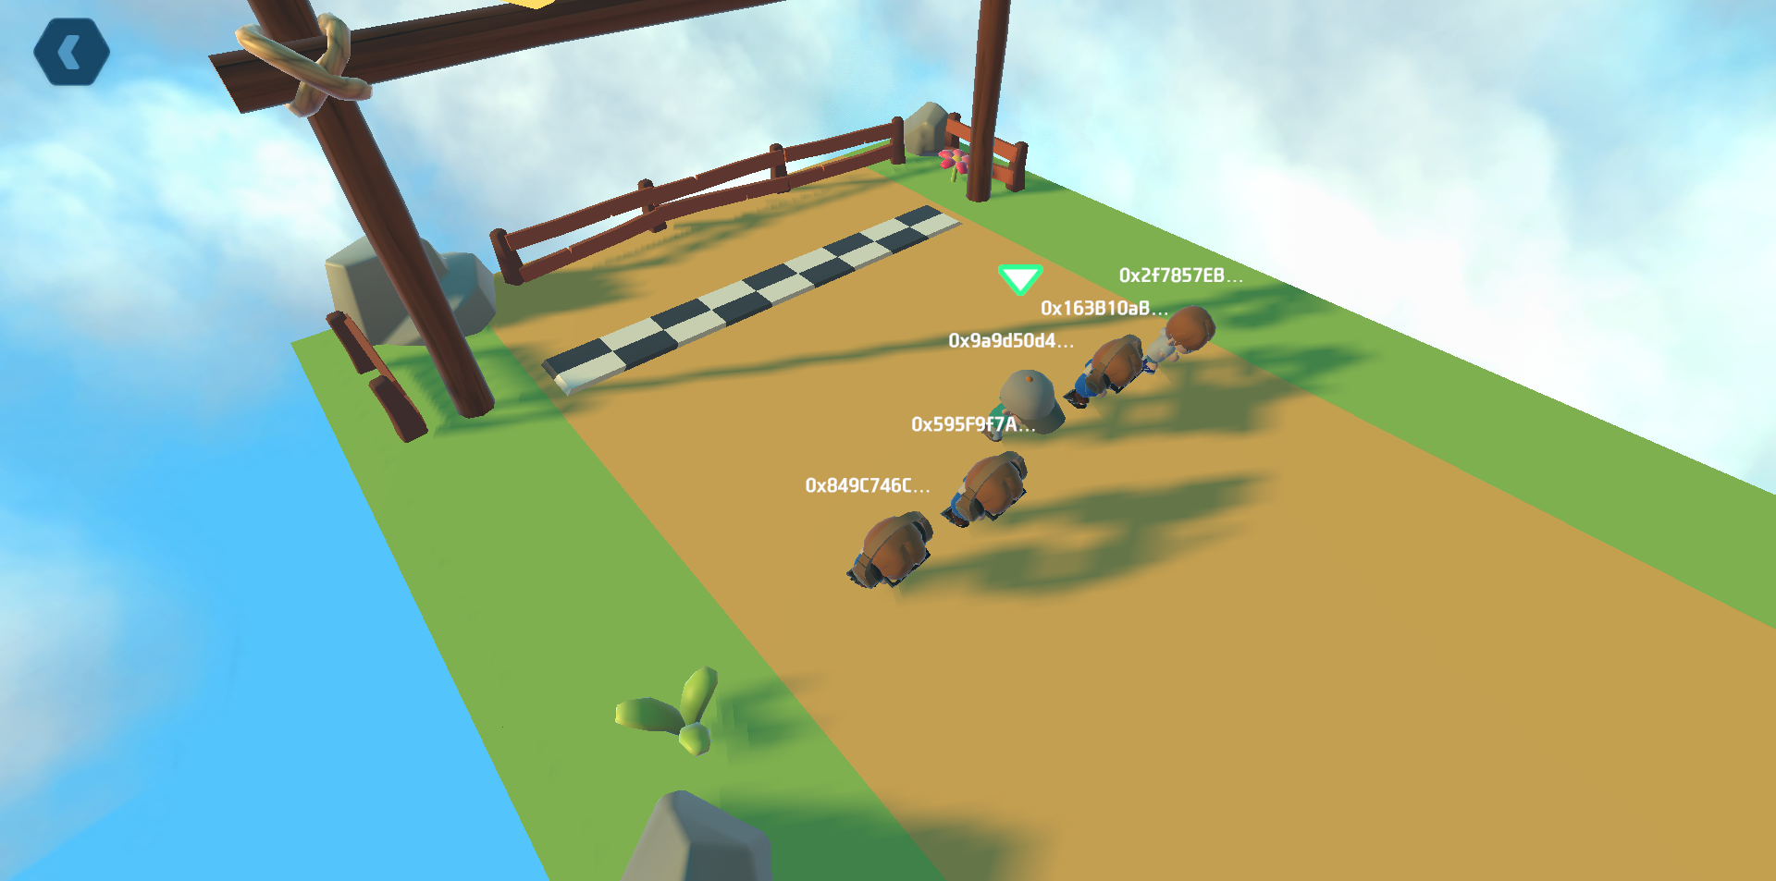
Team
Team
Mason 全栈
上海交通大学计算机图形学硕士，前Nvidia/网易游戏研发，主攻GPU图形渲染，参与研发了一款Web3游戏研发
LZ美术
北京电影学院动画学院，前网易概念设计/影视场景概念设计
Philp 游戏研发
新南威尔士大学人工智能专业硕士，Light & Wonder高级游戏工程师
ChaoS 产品
前广联达高级产品经理，Defi/Gamefi爱好者

Slide 5
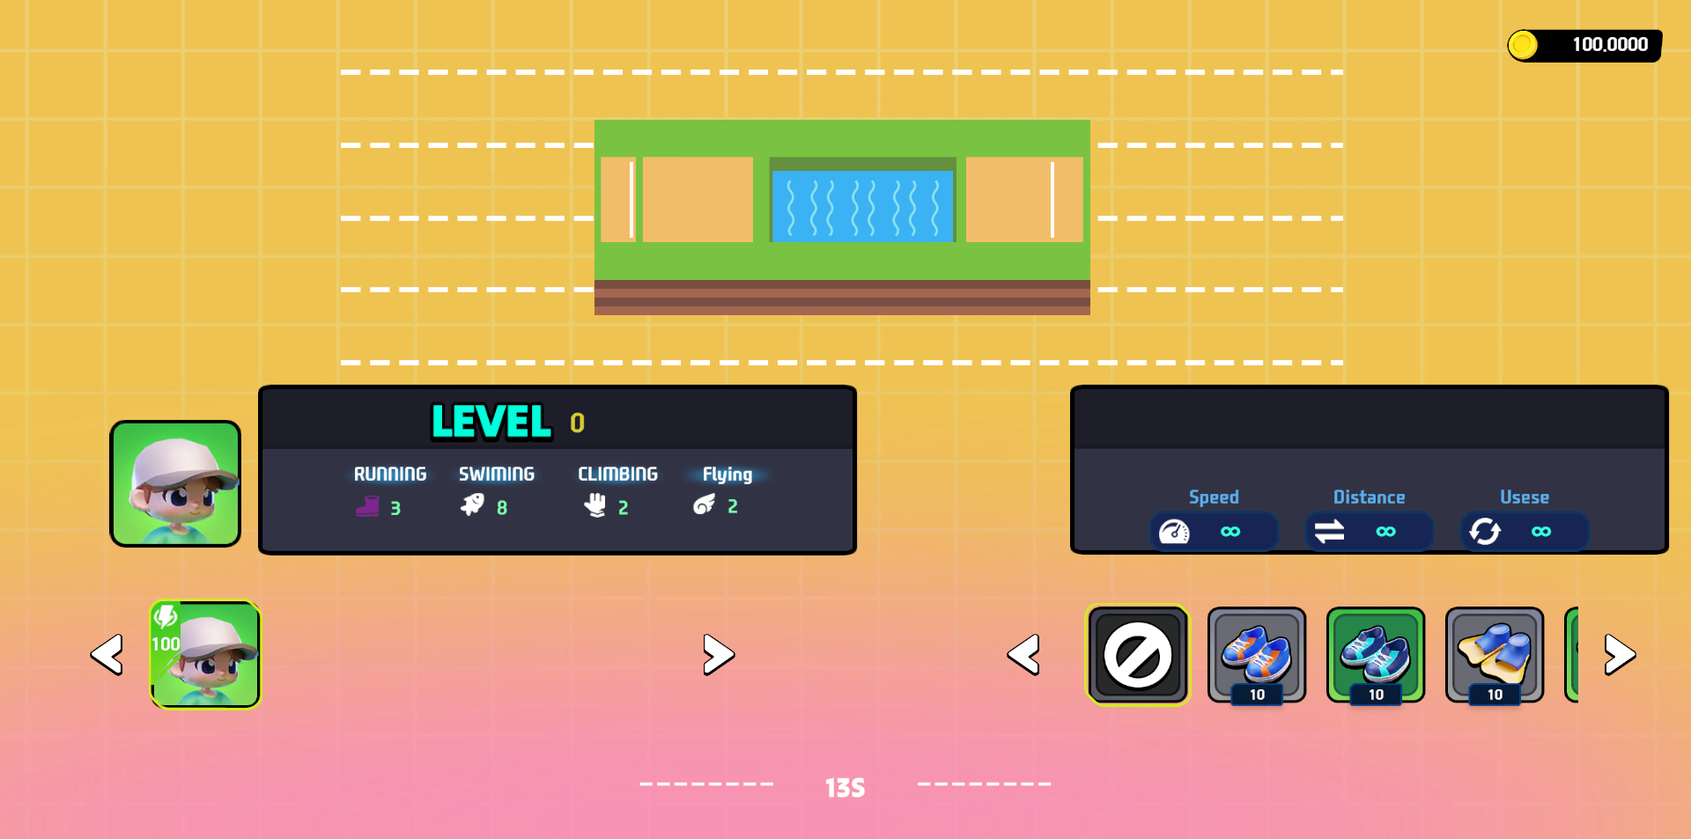
What’s next
What is Next
More Game
More rules

