Slide 1
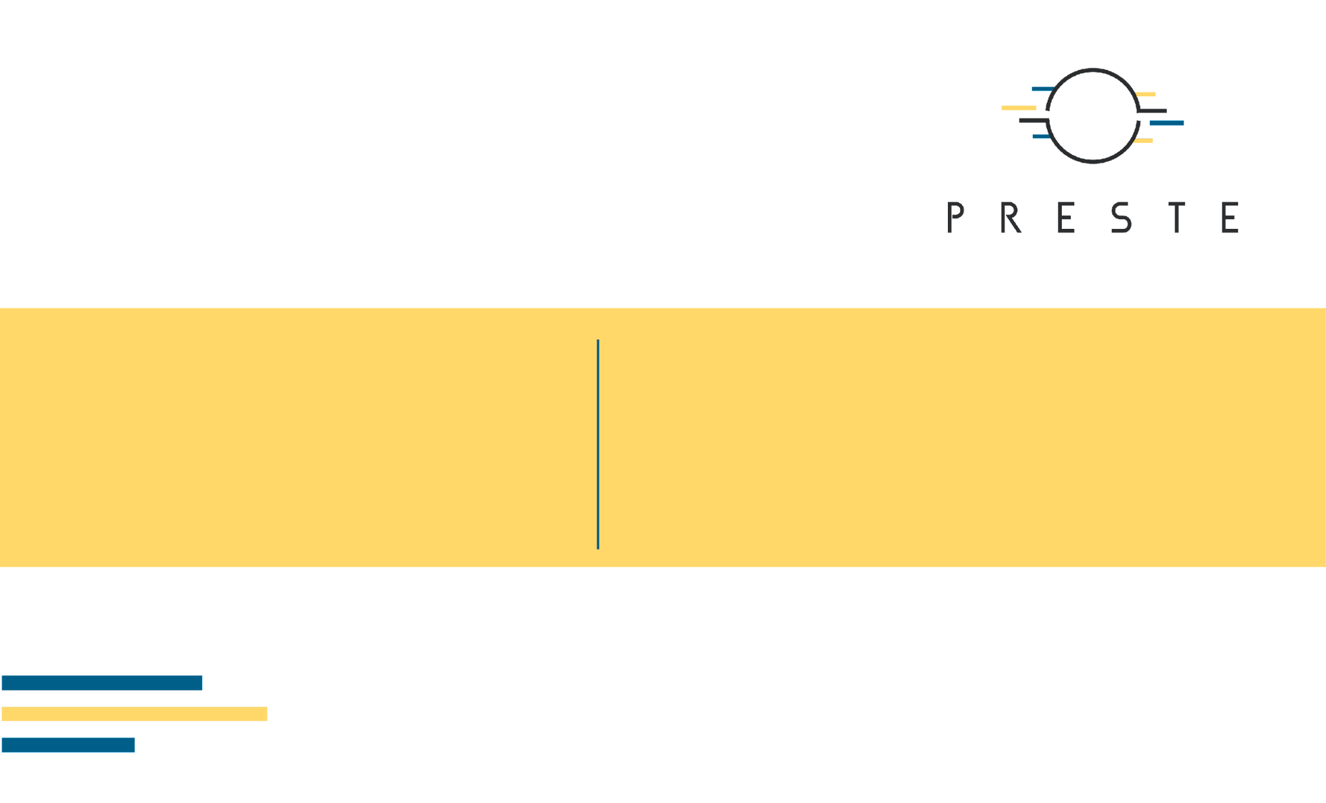
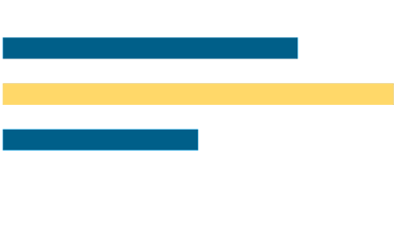
Machine Learning in Biosciences
What is ML; Where you see it in biology; types of data

Slide 2

Today’s agenda
1
Knowing each other and what will we do?
2
What is machine learning?
3
What does a model actually see?
4
Which biological modalities can we model?
5
What can ML do - and not do?
6
What does an ML workflow look like in biology?

Slide 3
Knowing each other and what will we do?
A course about using ML as a scientific instrument

Slide 4

Oleh Mezhenskyi
Не ви, а ти:)

Slide 5
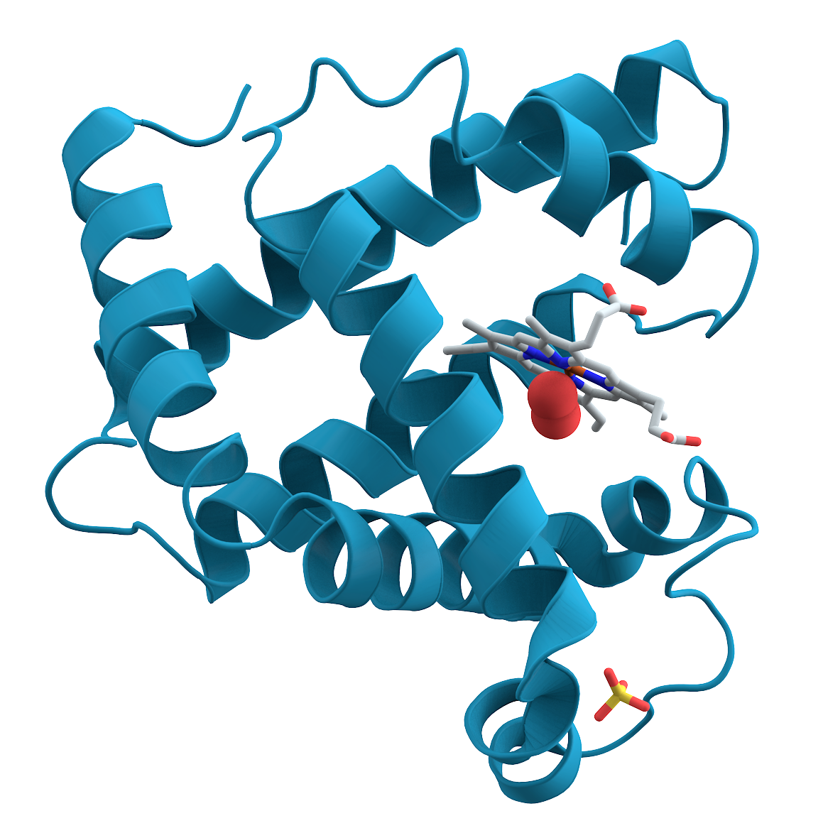
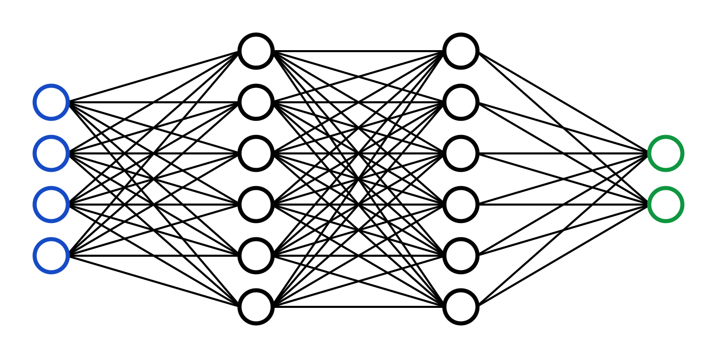
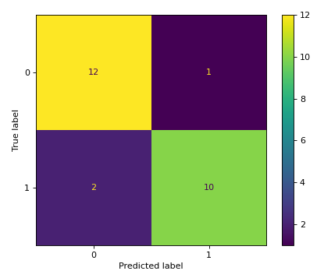
What this course is about
Biological question
Machine-learning method
Scientific interpretation
Start from a scientific or analytical problem: phenotype, function, activity, structure, image, sequence.
Choose a representation and model appropriate to the question and experimental design.
Evaluate performance, uncertainty, bias, leakage, and whether the result is biologically meaningful.

Slide 6
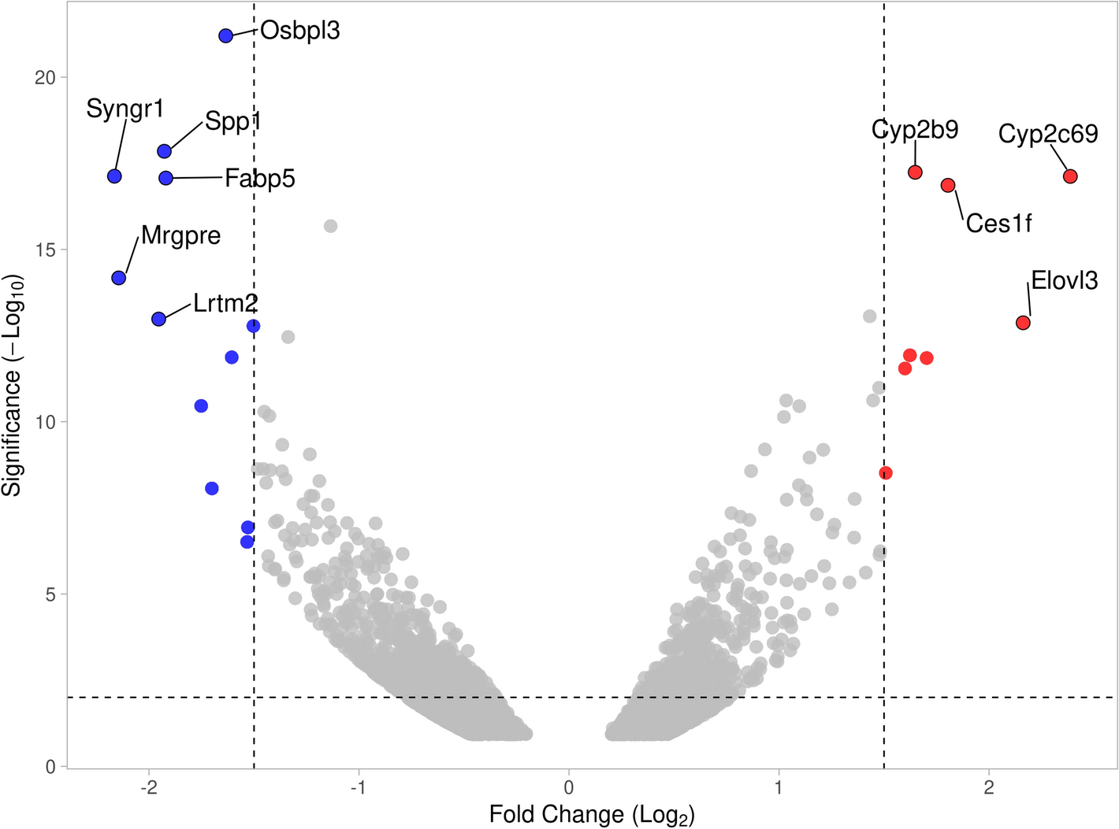
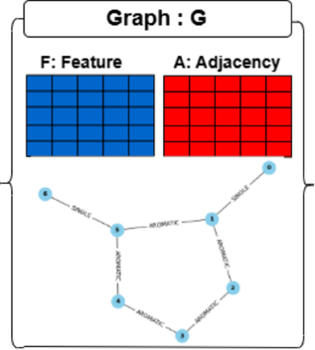
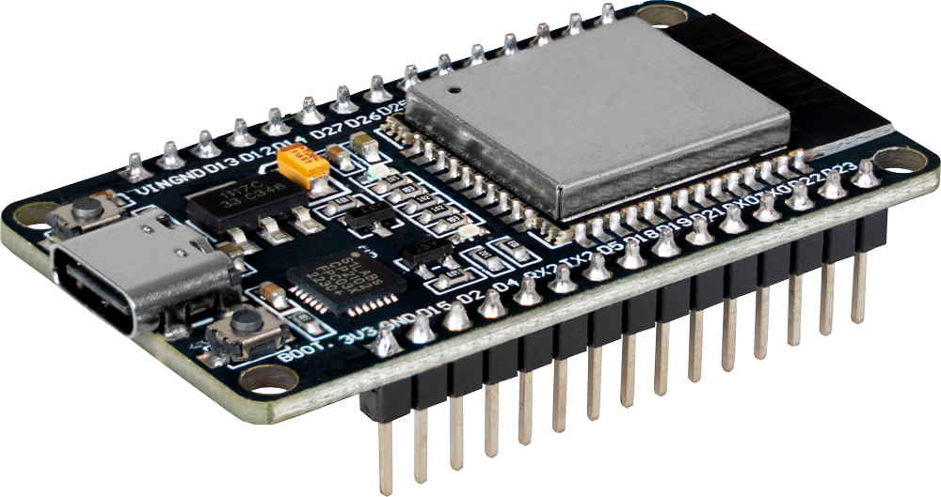
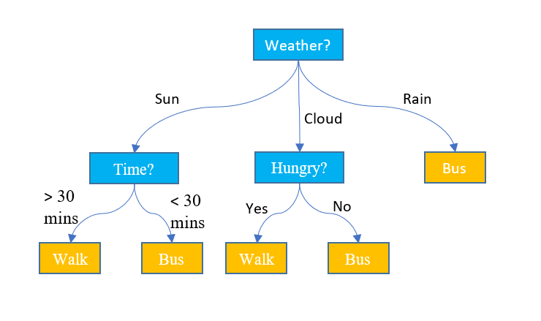
The course arc
We will move from classical ML to modern biological models and finally to deployment.
Classical ML
Biological modalities
Modern models
Efficient ML
Project
Linear models · trees · distance models · clustering
Omics · images · molecules · graphs
CNN · GNN · Transformers · foundation models
Model tracking · Data annotation · Compression · quantization · Edge AI
A complete reproducible biological ML workflow
?

Slide 7

How we will work
Lectures: concepts, biological examples, methodological choices.
Practicals: real or realistic bioscience datasets; notebook demos; discussion of the method implementation.
Repeated datasets where useful: compare representations and models without changing the biological problem.
Project: define a question, establish a baseline, validate correctly, interpret, document and present.
You do not need prior ML expertise - but you will need to reason about data and experimental design (and some Python knowledge).
You are here

Slide 8

2. What is machine learning?
Where does ML end and ordinary programming or statistics begin?

Slide 9
A definition
Machine learning is a set of methods that learn useful patterns or decision rules from data, rather than having every rule explicitly programmed.
Data
Learning
Generalization
Examples, measurements, sequences, images, molecules, graphs.
Optimize parameters so a model captures a useful relationship.
The learned relationship should work on unseen data.

Slide 10
Traditional programming vs machine learning
Traditional programming and computational methods
Machine learning
Rules + Data → Answers
Data + Answers → Learned model
Example: calculate GC content from a DNA sequence.
Example: learn whether expression profiles predict disease status.

Slide 11
Where ML appears in bioscience
Sequence
Omics
Images
variant effects · protein function · structure
cell types · disease signatures · response prediction
cells · tissues · colonies · segmentation
Molecules
Networks
Devices
activity · toxicity · ADMET · property prediction
interactions · pathways · molecular graphs
biosensors · portable diagnostics · edge inference

Slide 12
ML, statistics and data science overlap
Machine
Learning
Data
Science
Statistics
Inference
uncertainty
experimental design
Prediction
representation
optimization
data pipelines
visualization
communication
Machine Learning for Bioinformatics · Lecture 1

Slide 13

3. What does a model see?
Some sort of representation

Slide 14
The basic supervised-learning view: X → model → y
X
ŷ_{pred}
y_{true}
features / inputs
rows = observations
columns = measurements
MODEL
prediction
probability or value
known target
used during training
Learning = adjust the model so ŷ becomes useful for predicting y on unseen observations.

Slide 15
Most classical ML starts with a feature matrix
Observation | Feature_A | Feature_B | Feature_C | Target
S01 | 4.2 | 8.1 | 2.4 | control
S02 | 6.7 | 5.4 | 3.1 | disease
S03 | 5.1 | 7.6 | 2.8 | control
S04 | 7.2 | 4.9 | 3.6 | disease
Observation
One biological unit we want to generalize to: patient, sample, cell, molecule, image.
Feature
A numerical or encoded property of that unit available to the model.
Target
What we want to predict in supervised learning.

Slide 16
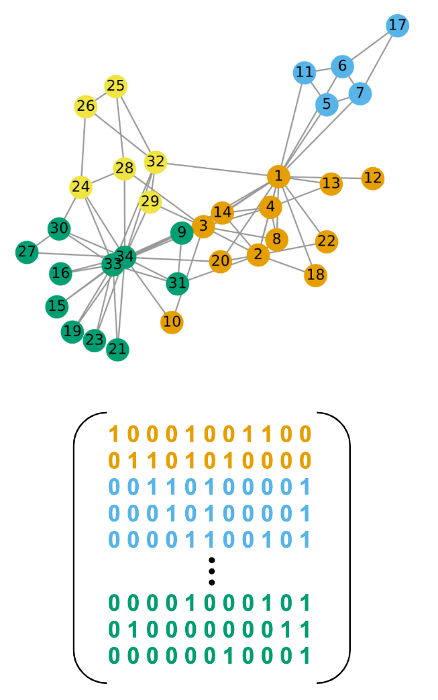
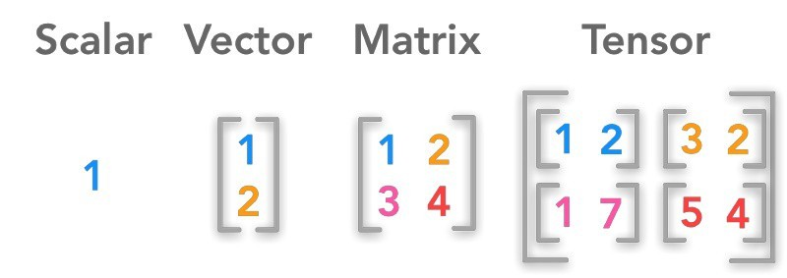
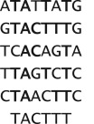
Models do not see actual samples — they see representations
Organism
age · biomarkers · lab values · metadata
vector
RNA sample
gene-expression values
high-dimensional vector
Microscopy
pixel intensities
tensor
Protein / DNA
tokens / embeddings
sequence
Molecule
descriptors · fingerprint · graph
vector / graph
Interaction network
nodes · edges · attributes
graph
Representation choice can matter as much as model choice.

Slide 17

4. What can ML do — and not do?
Predict and detect; explanation needs additional tools
and assumptions.

Slide 18
Four recurring ML tasks
Regression
Classification
Predict a continuous value
Example: IC50 · expression · viability
Assign a class / probability
Example: disease · phenotype · toxicity
Clustering
Dimensionality reduction
Discover groups without labels
Example: cell types · patient subtypes
Compress / visualize structure
Example: PCA · UMAP · embeddings

Slide 19
Learning settings: what supervision do we have?
Supervised
Unsupervised
Self-/semi-supervised
We know Y for training examples.
classification · regression
Main question: does the model generalize to new biological observations?
No target Y. We search for structure/anomalies.
clustering · dimensionality reduction · anomaly detection
Main question: is discovered structure stable and biologically interpretable?
Labels are scarce, but unlabeled data are abundant.
pretraining · embeddings · foundation models
Main question: does learned representation transfer to our task?

Slide 20
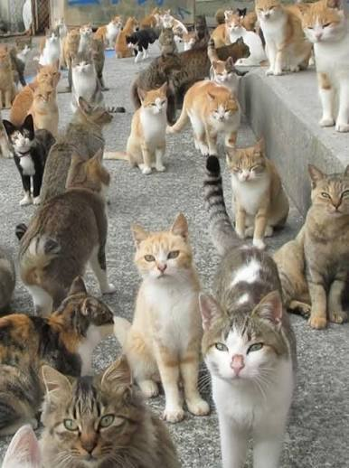
5. Biological data modalities
Different biological objects require different representations

Slide 21
A multimodal view of bioscience ML
Tabular / experimental
Omics
rows × measured variables
regression · trees · SVM
samples × genes/features
PCA · clustering · ML · foundation models
Images
Sequences
pixels / objects
CNN · detection · segmentation
DNA / RNA / proteins
k-mers · Transformers
Molecules
Networks
SMILES / descriptors / graphs
QSAR · GNN · molecular LMs
nodes + edges
graph algorithms · GNN

Slide 22
Tabular
Observation | Feature_A | Feature_B | Feature_C | Target
S01 | 4.2 | 8.1 | 2.4 | control
S02 | 6.7 | 5.4 | 3.1 | disease
S03 | 5.1 | 7.6 | 2.8 | control
S04 | 7.2 | 4.9 | 3.6 | disease
Tabular data
Examples: physiological measurements, assay outputs, patient characteristics.
Typical tasks: regression, classification, feature importance, risk prediction, clustering.
Key issue: experimental design and independence of observations.
Main principles: tidy data – one column per feature, one row per observation/sample
Classic models: linear models, trees, distance models
Modern example: TabPFN

Slide 23
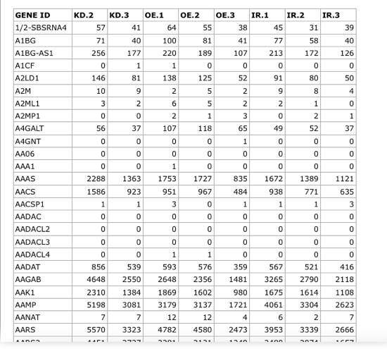
Omics data
Omics matrices
Examples: bulk RNA-seq, proteomics, metabolomics, single-cell measurements.
Typical tasks: subtype discovery, dimensionality reduction, phenotype prediction, representation learning.
Key issue: p ≫ n, batch effects, normalization.
Classic models: PCA · clustering · regularized models PCA
Modern examples: scVI · Geneformer · scGPT

Slide 24
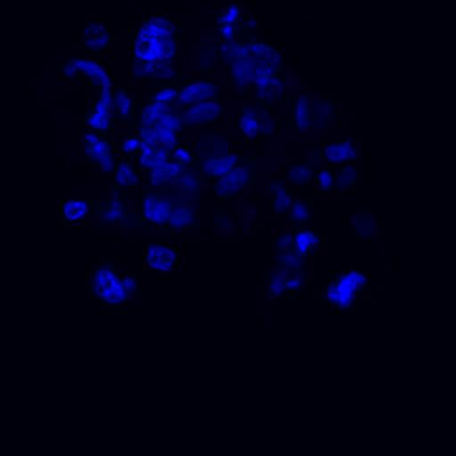
Images
Images
Examples: microscopy, tomography, organism/pathology photos
Typical tasks: classification · detection · segmentation
Key issue: computational cost · data annotation
Classic models: engineered features + SVM / Random Forest
Modern examples: U-Net · Cellpose · SAM · YOLO

Slide 25
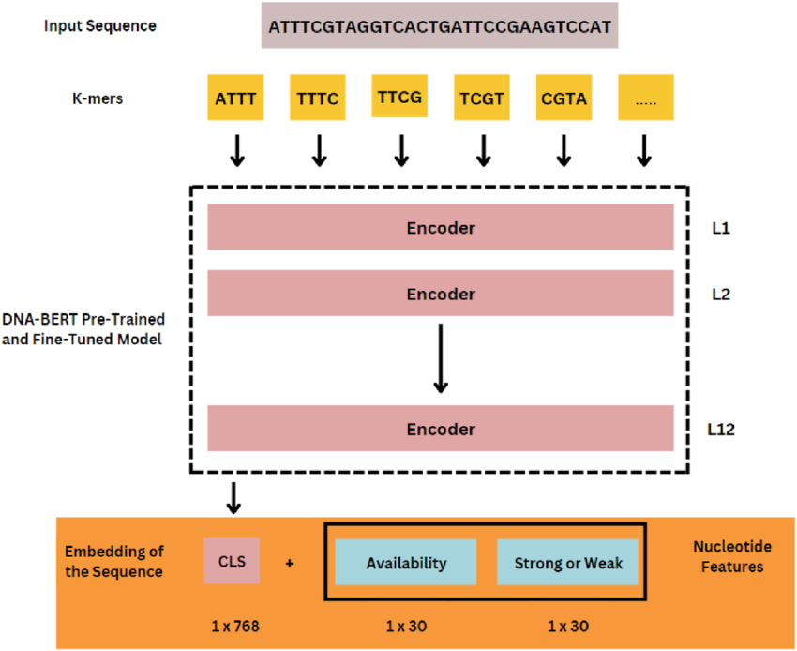
Sequences
Sequences
DNA: ACGT
Protein: MKLV
Representations: k-mers, tokens, embeddings.
Applications: function, variant effect, localization, structure-related tasks.
Modern examples: AlphaFold · DNABERT · ESM

Slide 26
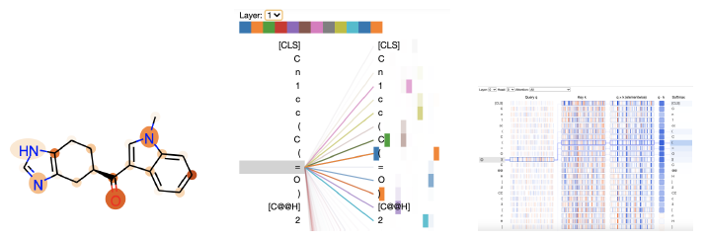
Molecules
Molecules
SMILES, descriptors, fingerprints, 2D/3D structure.
Applications: activity, toxicity, solubility, ADME, antimicrobial properties.
Same molecule → multiple valid representations.
Classic models: same as tabular
Modern examples: GNNs · ChemBERT-style molecular LMs

Slide 27
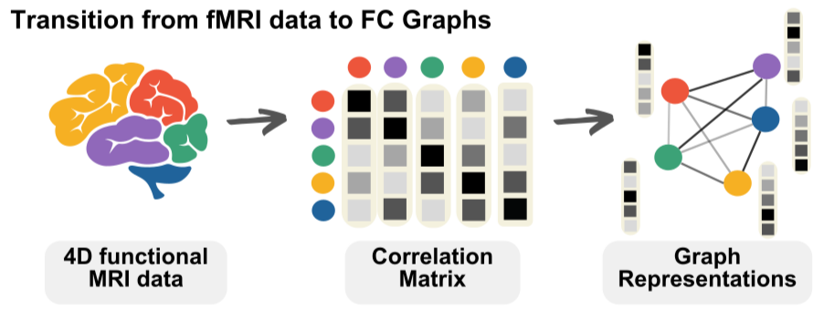
Graphs
Graphs
Atoms / proteins / cells = nodes
Bonds / interactions = edges
Applications: molecular property prediction, interaction networks, spatial biology.
Structure is part of the input.
Modern examples: GCN · GAT · GraphSAGE

Slide 28

6. The ML workflow in biology
Same-same but different

Slide 29
A generic machine-learning workflow
Data
Representation
Split
Train
Tune
Evaluate
Evaluate
Interpret
Deploy

Slide 30
Why biological ML is different
Small n, large p
Hierarchy
Batch effects
100 samples × 20,000 genes is normal.
images within wells within experiments within patients.
technical variation can dominate biology.
Dependence
Label uncertainty
Distribution shift
replicates are not independent observations.
phenotypes and assays have measurement error.
lab, instrument, cohort or protocol can change.

Slide 31
A biological train/test split can be wrong even when the code is correct
50 patients × 10 microscopy images each
Random image split
Patient-level split
400 images → train
100 images → test
Images from the same patient can appear in both sets.
Result: optimistic performance.
40 patients → train
10 patients → test
No patient appears in both sets.
Result: tests generalization to a new patient.
Rule of thumb: split at the level of the biological unit you want to generalize to.

Slide 32
Next: Practical 1 — from biological data to X and y
We will take a messy biological dataset and turn it into an ML-ready representation.
Inspect
Clean
Join
Explore
Define
Audit
What is one observation?
Missing values · types · duplicates
Measurements + sample metadata
Plots · distributions · suspicious patterns
X, y and the ML question
Leakage · batch · grouping

