Slide 1
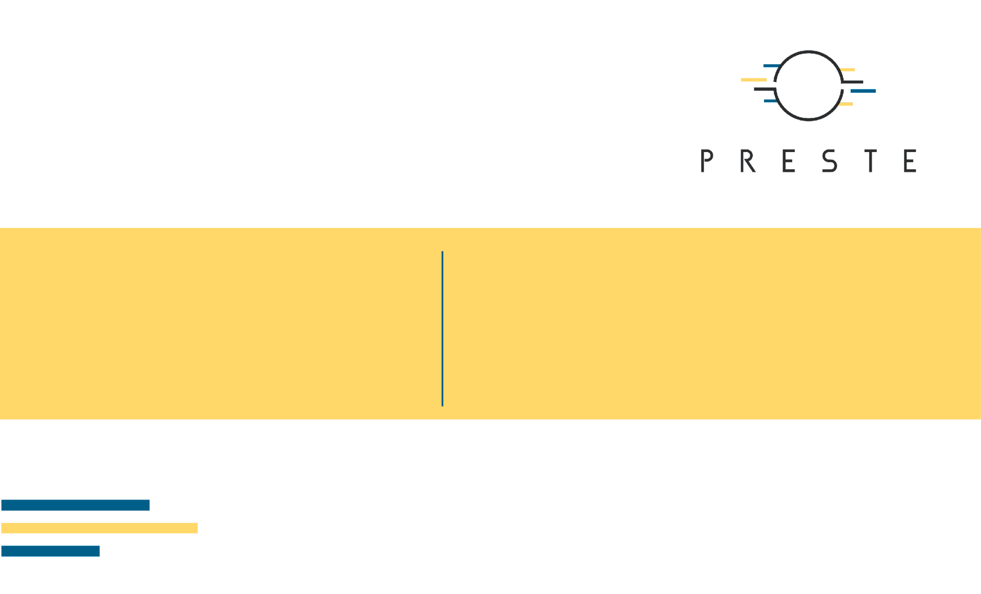
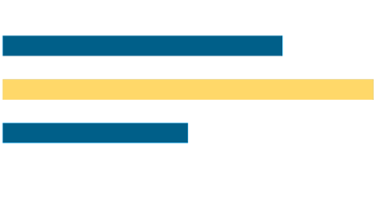
Quantitative Data Preprocessing
Scaling, normalization, missing values, outliers, and leakage-safe workflows

Slide 2

Today's agenda
1
Why preprocessing is part of the scientific question
2
Scale, units, and distributions
3
Core preprocessing operations
4
Biological examples: Diabetes, assays, and omics
5
Regression diagnostics and regularization
6
A leakage-safe workflow for Practical 2

Slide 3
Why preprocessing is a scientific step
The model learns from the representation we give it.

Slide 4

Oleh Mezhenskyi
Machine Learning for Bioinformatics · Lecture 2

Slide 5
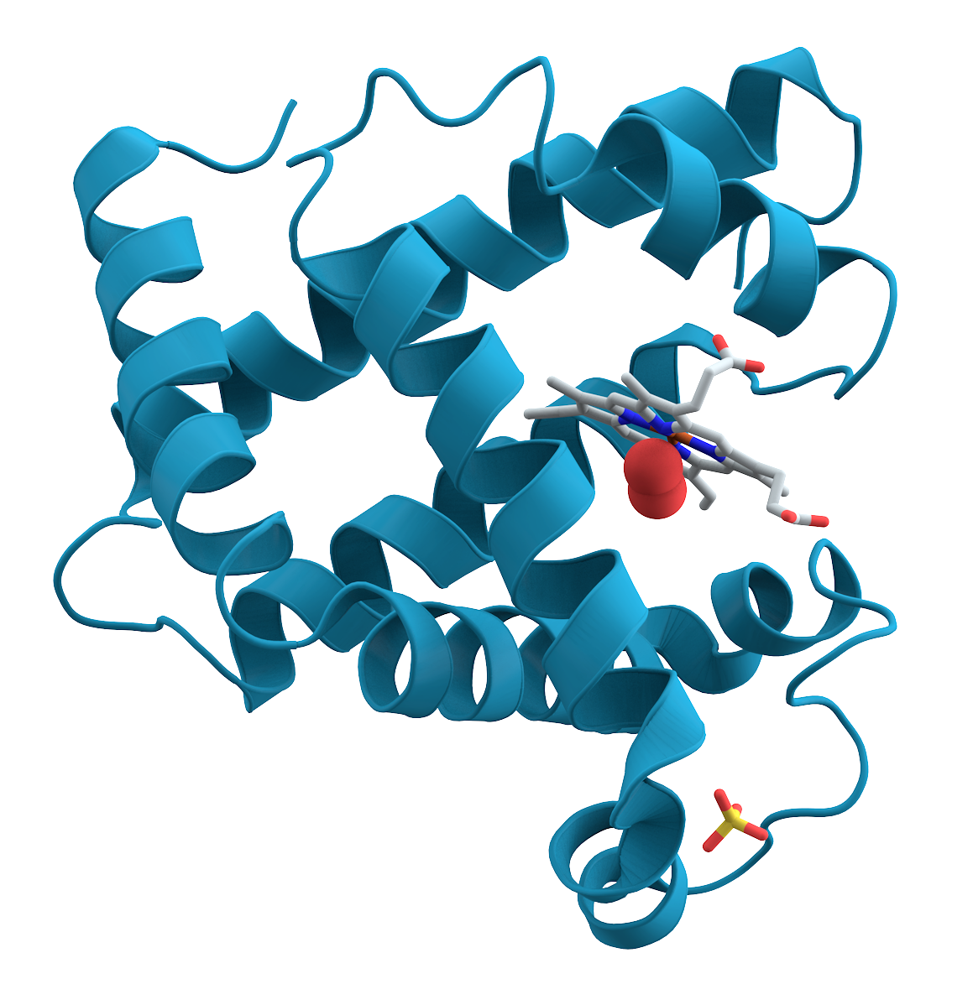
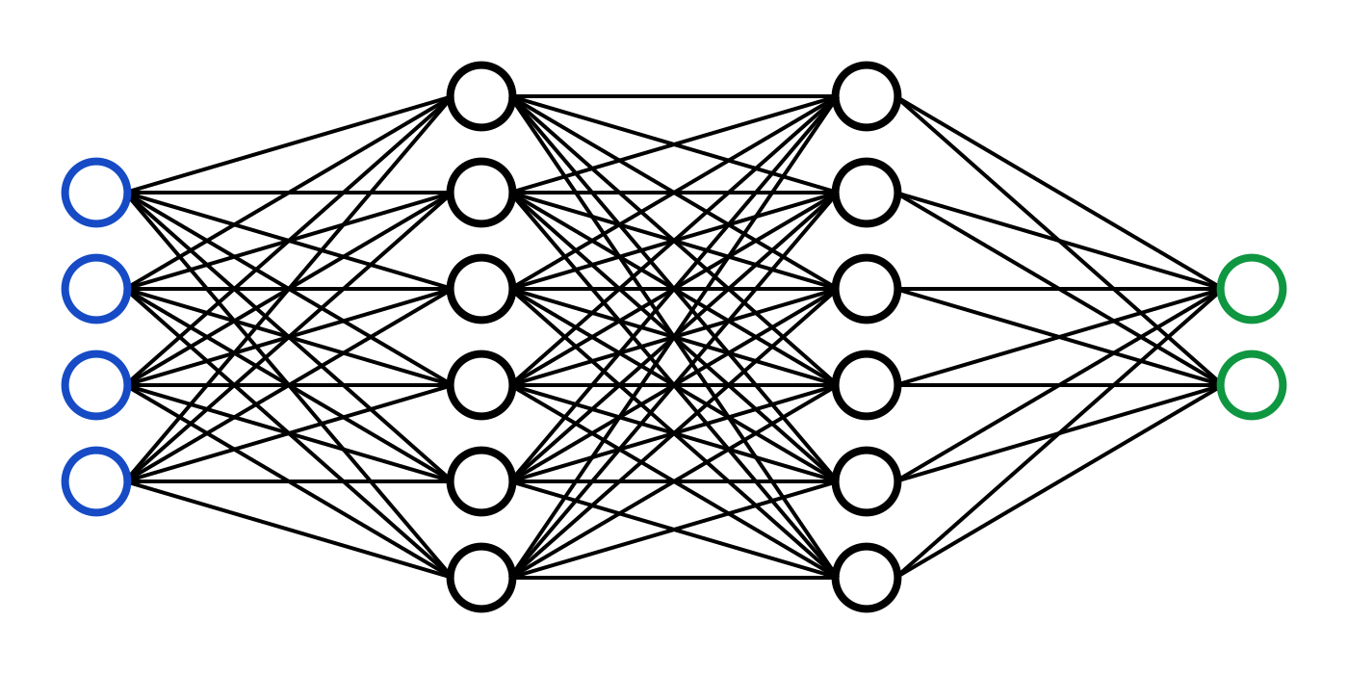
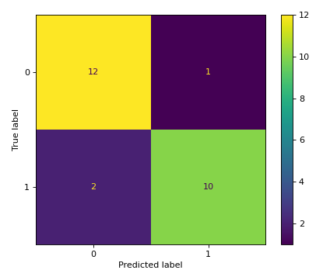
What this lecture is about
Measurement
Representation
Scientific interpretation
What was measured, in which units, and with what technical process?
How should measurements be arranged and transformed for a model?
Which patterns are biological, technical, or created by preprocessing?

Slide 6
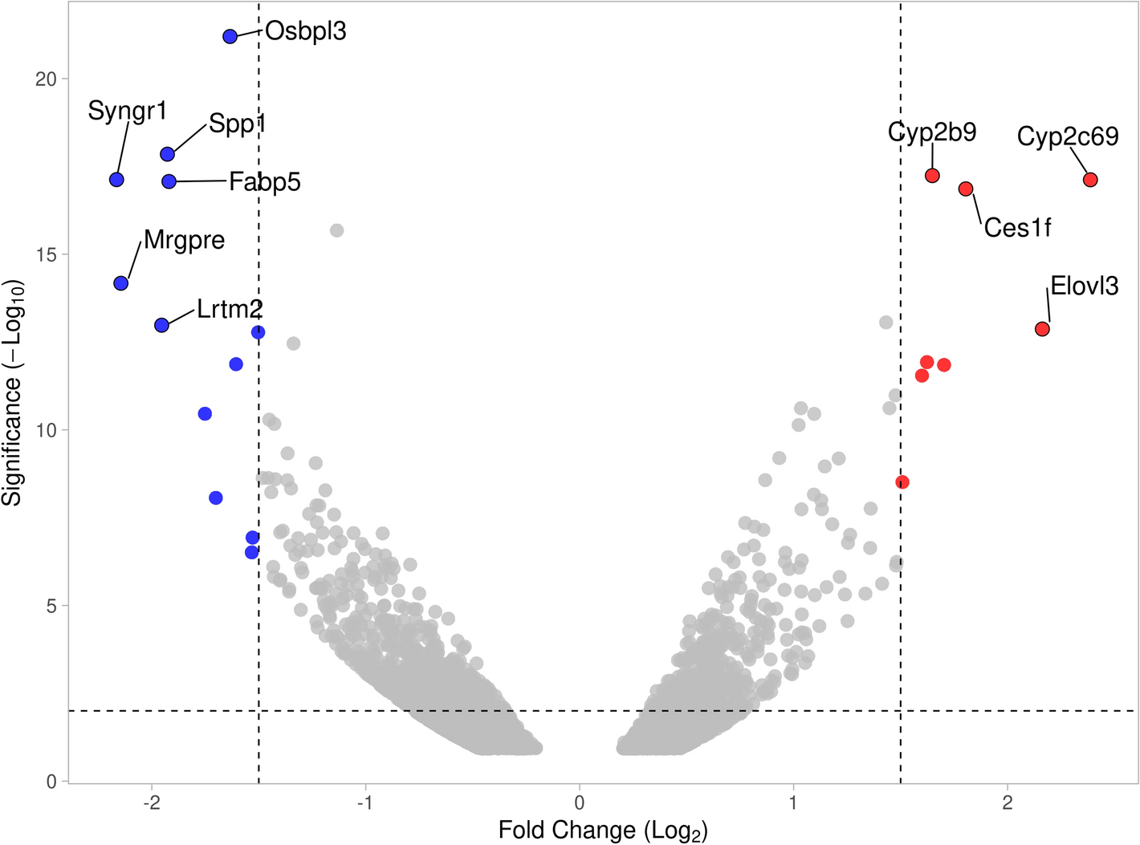
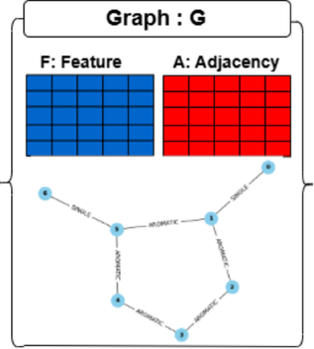
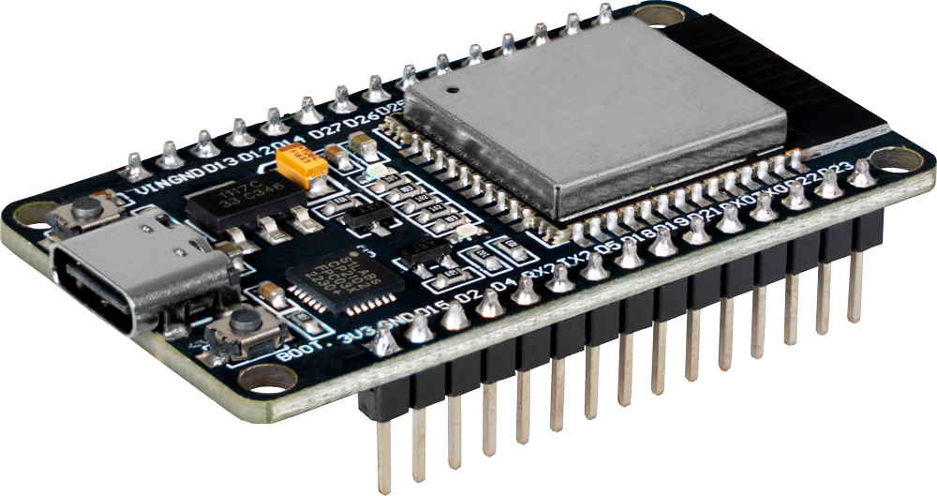
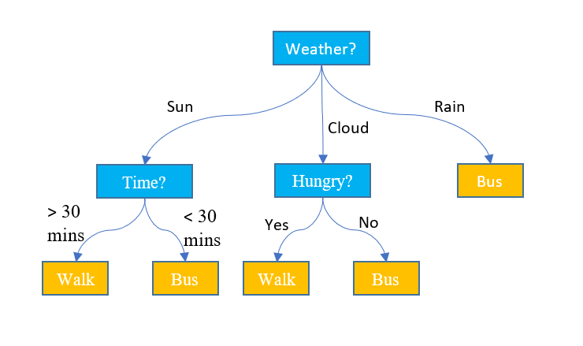
The course arc
Week 2 makes the data representation explicit before modelling.
Classical ML
Biological modalities
Modern models
Efficient ML
Project
Linear models · trees · distance models · clustering
Clinical data · assays · omics · images · molecules
CNN · GNN · Transformers · foundation models
Reproducible pipelines · tracking · deployment
A complete biological ML workflow

Slide 7

How we will work
Lectures introduce concepts, biological examples, and methodological choices.
Practicals use real or realistic datasets to make those choices executable.
This week: connect measurement scale and data quality to a safe quantitative ML pipeline.
You are here

Slide 8

1. What is a quantitative feature?
A number is not yet a meaningful model input.

Slide 9
A quantitative feature has a measurement story
A feature is a measured or derived property of an observation that is available to the model.
Value
Meaning
Geometry
The recorded number: concentration, age, expression, intensity, or score.
The biological object, unit, assay, and reference scale behind the number.
The distances, variances, and relationships the algorithm will use.

Slide 10
Measurement scale versus model scale
Raw measurements
Model representation
Units + instrument + protocol
Comparable numerical inputs
Example: age in years, BMI in kg/m², blood pressure in mmHg.
Example: centered/scaled features, transformed concentrations, encoded categories.

Slide 11
Where quantitative preprocessing appears in bioscience
Clinical / tabular
Omics
Assays / plates
age · BMI · blood pressure · laboratory measurements
expression · methylation · protein abundance · metabolites
well effects · controls · batch · detection limits
Images
Repeated measures
Multi-modal
intensity · area · shape · morphology features
time points · visits · technical replicates · subjects
joining measurements without losing provenance or alignment

Slide 12
Preprocessing is where measurement meaning becomes model geometry
scale
variance
outliers
Machine
Learning
Statistics
distance
optimization
generalization
Data
Science
pipelines
visualization
communication
Machine Learning for Bioinformatics · Lecture 2

Slide 13

2. Scale, units, and distributions
The same biological signal can look different after a change of scale.

Slide 14
A preprocessing transformation changes the representation
X_raw
X'
Why transform?
measured features
units and technical scale
TRANSFORM
model-ready features
comparable geometry
To make a modelling assumption reasonable, not to make the data look nicer.
Every transformation should have a documented purpose and a leakage-safe fit.

Slide 15
A feature matrix carries units and assumptions
Observation | Feature_A | Feature_B | Feature_C | Target
S01 | 4.2 | 8.1 | 2.4 | control
S02 | 6.7 | 5.4 | 3.1 | disease
S03 | 5.1 | 7.6 | 2.8 | control
S04 | 7.2 | 4.9 | 3.6 | disease
Observation
One patient, sample, mouse, or experimental unit per row.
Feature
One measured variable per column, with a known unit and meaning.
Target
The outcome defined by the biological question, kept separate from X.

Slide 16
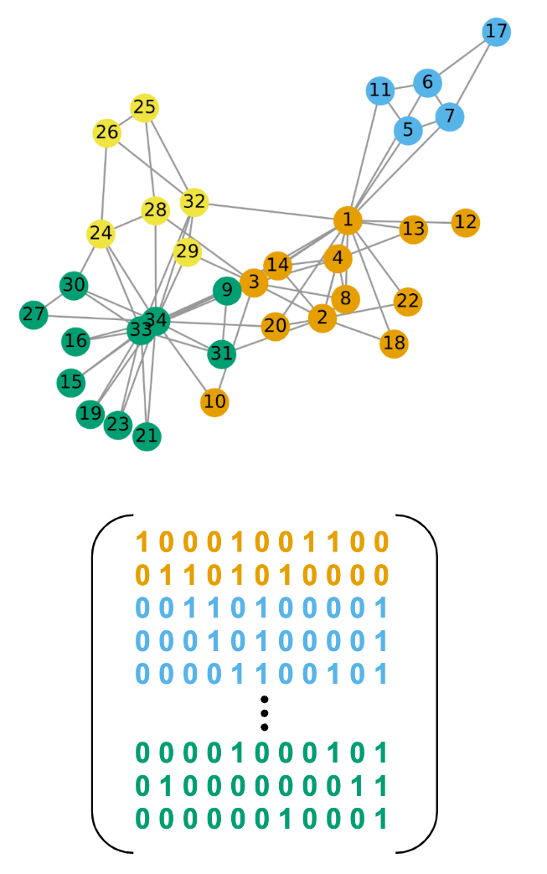
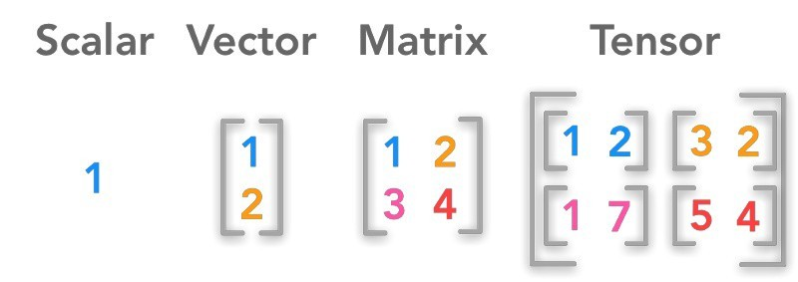
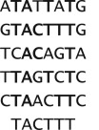
Models see geometry, not laboratory context
Small values
A feature with a narrow numerical range can appear unimportant to a distance-based model.
large scale
BMI / age
A feature with large units can dominate distances or optimization steps.
centered
expression
Centering changes the reference point; scaling changes the unit of variation.
scaled
protein
The right representation depends on the assay and the model.
units
measurement
Do not remove scientific meaning while making values numerically convenient.
context
biology
A transformed feature must remain traceable to its original measurement.
audit
record

Slide 17

3. What can preprocessing do — and not do?
It can control representation and reduce avoidable technical problems. It cannot repair a poor study design.

Slide 18
Four recurring preprocessing questions
Scaling
Normalization
Should features be centered or put on comparable variance?
Example: StandardScaler before a distance-based model.
Should measurements be made comparable within an assay?
Example: sample or library-size normalization.
Missing values
Outliers
What is missing, why is it missing, and should it be removed or imputed?
Is an extreme value biology, a technical failure, or a valid rare observation?

Slide 19
Preprocessing depends on the learning setting
Training data
Validation / test
Unsupervised exploration
Fit the scaler, imputer, selector, or transformation using training observations only.
Apply the already-fitted transformation. Never allow held-out values to determine it.
PCA and visualizations can use all data for description, but predictive evaluation still needs a clean split.

Slide 20
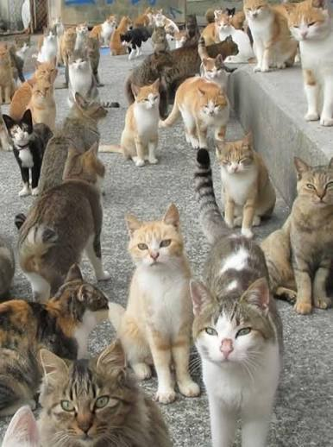
4. Biological examples
A preprocessing decision depends on how the measurement was generated.

Slide 21
A preprocessing choice depends on the assay
Clinical / tabular
Omics
Units, ranges, missingness, skew, and clinically impossible values.
Library size, normalization, batch, p ≫ n, and feature filtering.
Plate-based assays
Repeated measurements
Controls, well position, plate effects, detection limits, and drift.
Subject-level grouping and time order can matter more than a random row split.
Derived features
The pipeline must preserve biological provenance while changing numerical representation.
Document formulas, reference populations, and whether the derivation uses the target.

Slide 22
The Week 2 example: scikit-learn Diabetes
Observation | Feature_A | Feature_B | Feature_C | Target
S01 | 4.2 | 8.1 | 2.4 | control
S02 | 6.7 | 5.4 | 3.1 | disease
S03 | 5.1 | 7.6 | 2.8 | control
S04 | 7.2 | 4.9 | 3.6 | disease
Quantitative tabular data
442 observations · 10 baseline features · continuous disease-progression target
Features include age, sex, body-mass index, blood pressure, and six blood-serum measurements.

Slide 23
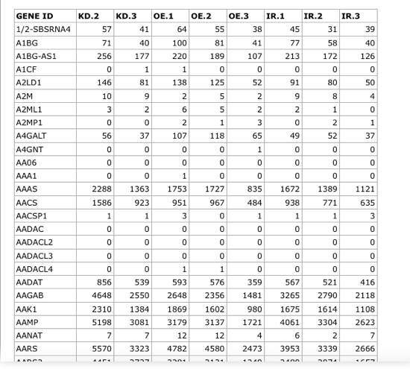
Omics data: scale is part of the problem
High-dimensional matrix
Many measured variables, often with p much larger than n.
Feature filtering, normalization, scaling, and regularization can all change the geometry used by the model.

Slide 24
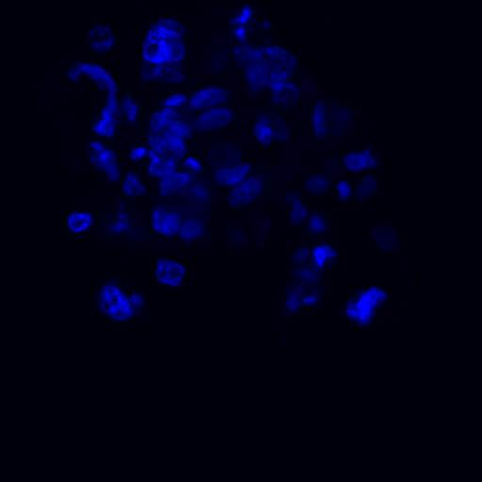
Assays and plates: technical structure can mimic biology
A plate, well, instrument, or processing batch can shift measurements.
Before correcting or removing the signal, ask whether it is a confounder, a design factor, or the target of interest.

Slide 25
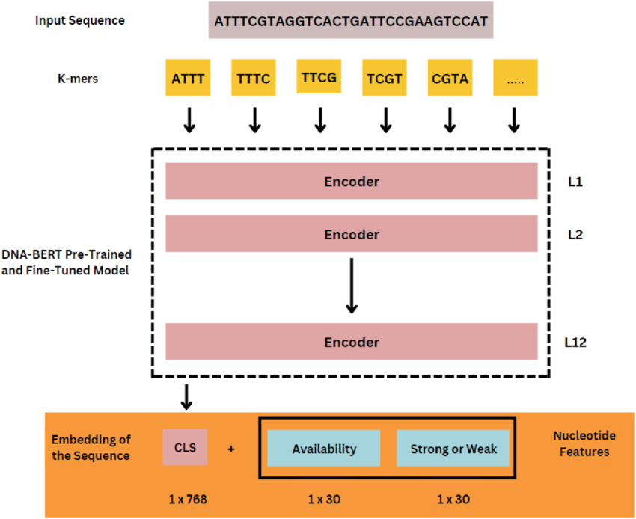
Repeated measurements are not automatically independent
Rows may represent visits, technical replicates, or pseudo-replicates from the same biological unit.
If the question is generalization to a new subject or sample, split by that subject or sample before fitting preprocessing steps.

Slide 26
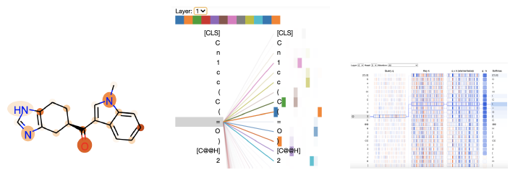
Normalization is not one thing
Feature scaling
Makes columns comparable for a model.
Sample normalization
Makes measurements comparable within an assay.
Batch correction
Attempts to separate technical and biological variation.
These operations answer different scientific questions. They should not be substituted for one another without justification.

Slide 27
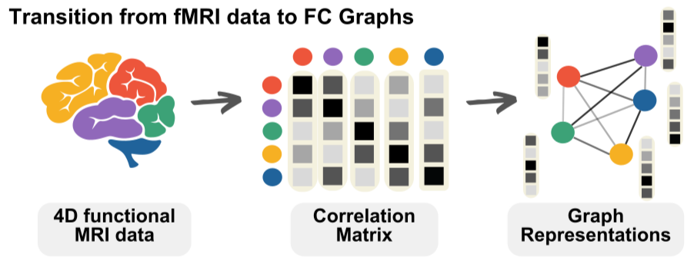
Regularization and feature selection address high-dimensionality
Feature selection + regularization
Feature selection restricts the model to a subset of variables. The selection rule must be fitted inside the training data.
Regularization penalizes model complexity so unstable or unnecessary coefficients are shrunk toward zero.

Slide 28

5. A leakage-safe quantitative workflow
The order of operations is part of the method.

Slide 29
A leakage-safe preprocessing workflow
Data
Inspect
Split
Fit preprocess
Train
Evaluate
Diagnose
Evaluate
Interpret

Slide 30
Why quantitative biological ML is different
Small n
Mixed scales
Missingness
The number of observations may be small relative to the number of measured variables.
Age, concentration, intensity, and counts can have very different numerical geometry.
Missing values may reflect technical limits or biological selection, not random noise.
Outliers
Confounding
Leakage
Rare biology and technical failure can look identical in a summary table.
Batch, site, plate, and cohort can be associated with the target.
A correct-looking transformation can still use information from the held-out data.

Slide 31
A preprocessing pipeline can be wrong even when the code runs
Leaky sequence
Safe sequence
1. Impute or scale the full dataset
2. Split into train and test
3. Fit the model
The held-out data influenced the representation.
1. Split at the biological unit
2. Fit preprocessing on training data
3. Transform train and test
4. Fit and evaluate the model
Put learned preprocessing and the estimator in one reproducible pipeline.

Slide 32
Next: Practical 2 — quantitative preprocessing with Diabetes
We will move from measurement descriptions to a leakage-safe regression workflow.
Inspect
Split
Preprocess
Model
Diagnose
Select
Shapes · types · units · distributions
Define the evaluation question before fitting transformations
Scaling · missing values · outliers
Baseline regression · regularization
Residuals · errors · influential observations
Feature selection inside the training workflow

