Slide 1
2-Stage-Operational-Amplifier

Slide 2
Objectives:
Complete designs of 2 Stage OP Amps with specifications :
Open loop gain = 10^6 = 120dB
Bandwidth = 50 MHz
Power Voltage Supply (Vdd) = 3.3 V
Max. Output Swing = Vdd/4 = 0.825 V
Slew Rate (V/μs) = 1
Power = 8 mW

Slide 3
Design Specifications:
Current Mirrors used for gate biasing of current source loads.
Golden Current Value ( reference current)
Differential Pair with Active Load
PMOS with NMOS load
Load Capacitance and an additional miller capacitance (Cc) for stability and dominant pole shift.

Slide 4
Design Description:
To achieve high gain systems we require two stage op amps as their amplifications get compounded.
The first stage is a differential pair with active load, followed by the second NMOS load.
The introduction of two stages causes two capacitances, at load of both stages making it a two pole system.
Two avoid instability and reduce oscillations due to poor phase margins an additional miller capacitance is used to transform the system into effectively an one pole system (by dominant pole shift)
A reference current is mirrored across the circuit so as to bias currents source loads.

Slide 5
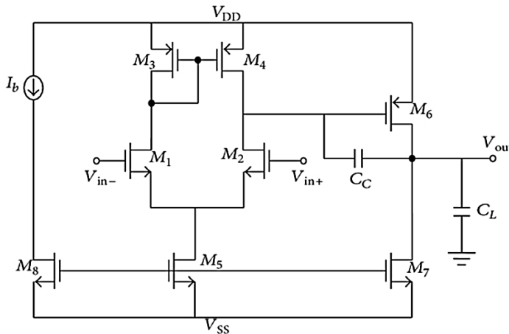
The Circuit:

Slide 6
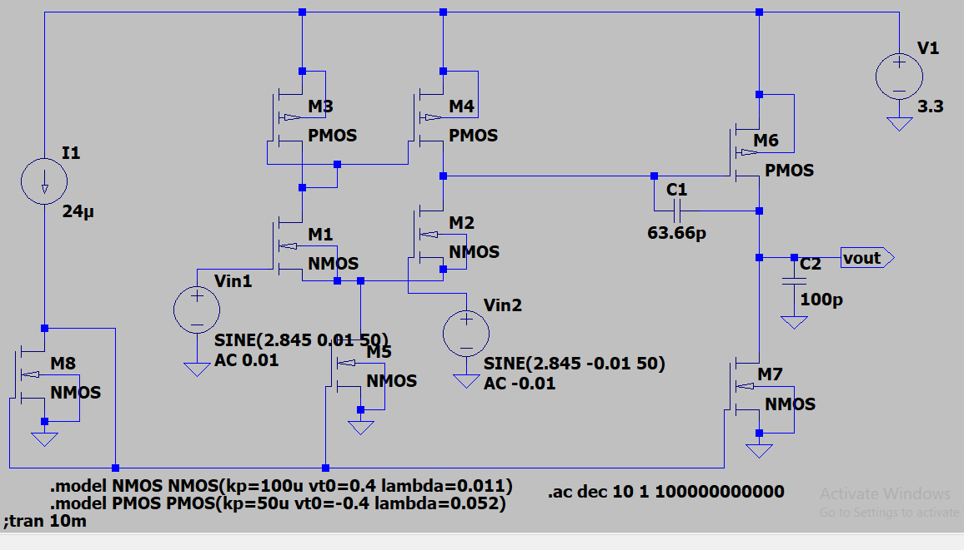
In LT spice:

Slide 7
Design Calculations:
Assumptions and Values used:
Single ended output is taken
M1 and M2 are identical
M3 and M4 are identical
Higher current flows in outer circuit to provide high swing, than in the inner circuit
µpCox = 50 µAV-2 and µnCox = 100 µAV-2
λp = 0.052 V-1 and λn = 0.011 V-1
Vthp = -0.4 V and Vthn = 0.4 V

Slide 8
.
Av1 = Vx/Vin and Av2 = Vout/Vx
Open Loop Gain = Av = Av1 x Av2
Power = 8mW
Vdd = 3.3V
Id = 8mW/3.3V = 2.424242 mA

Slide 9
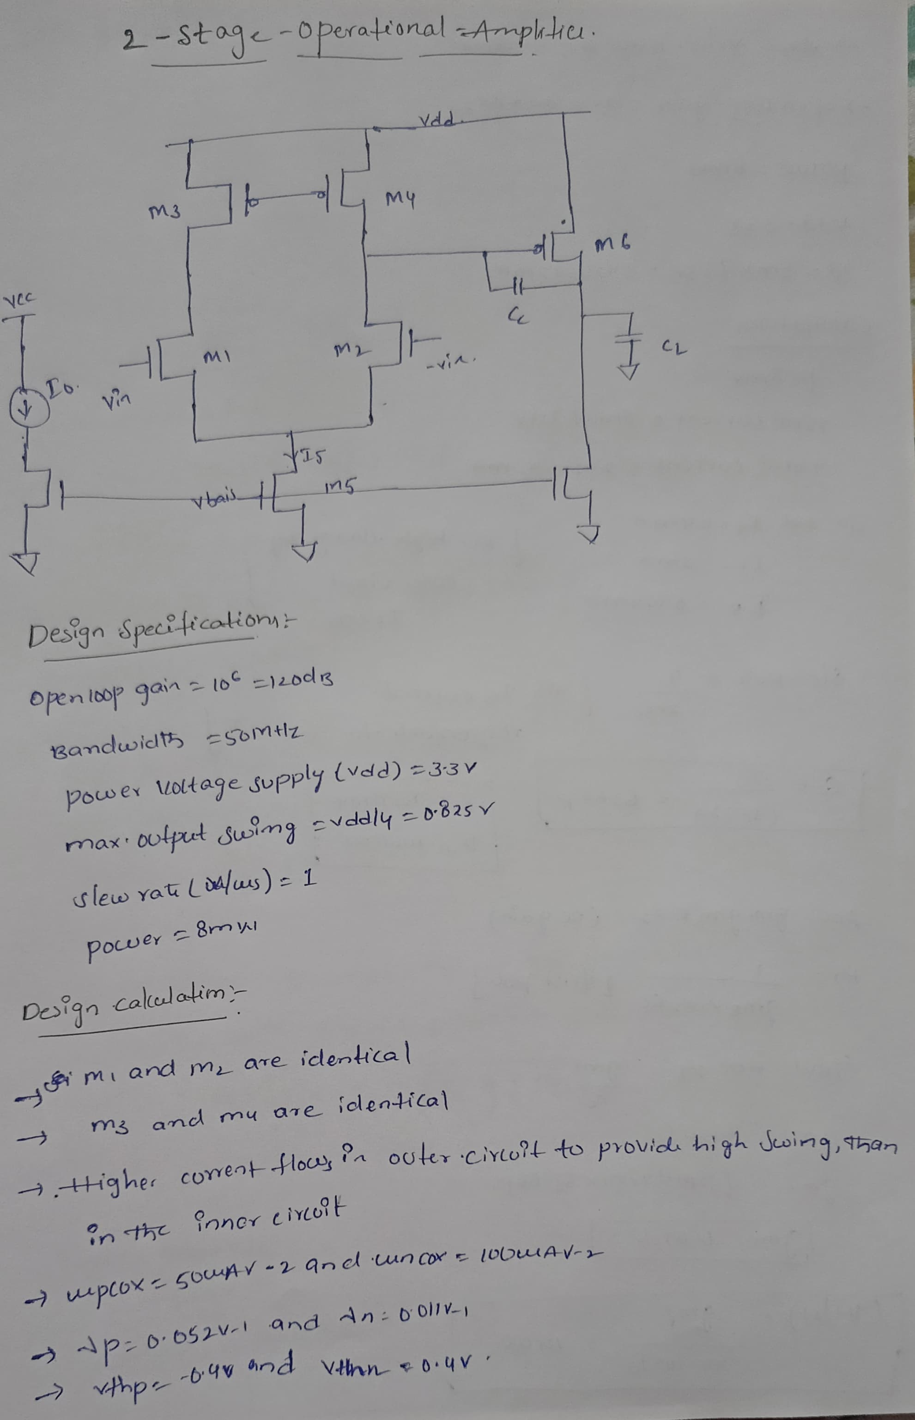
.

Slide 10
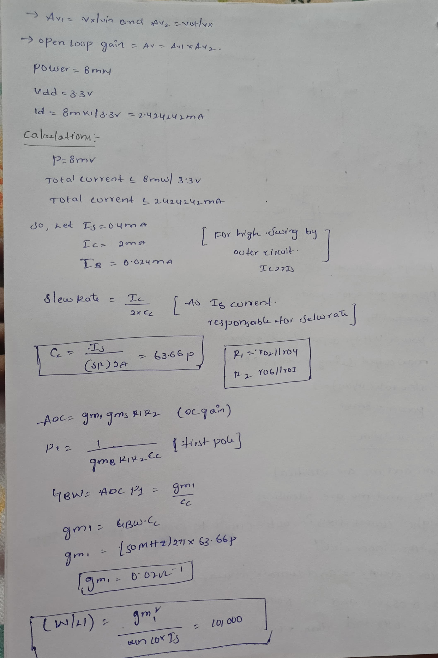
.

Slide 11
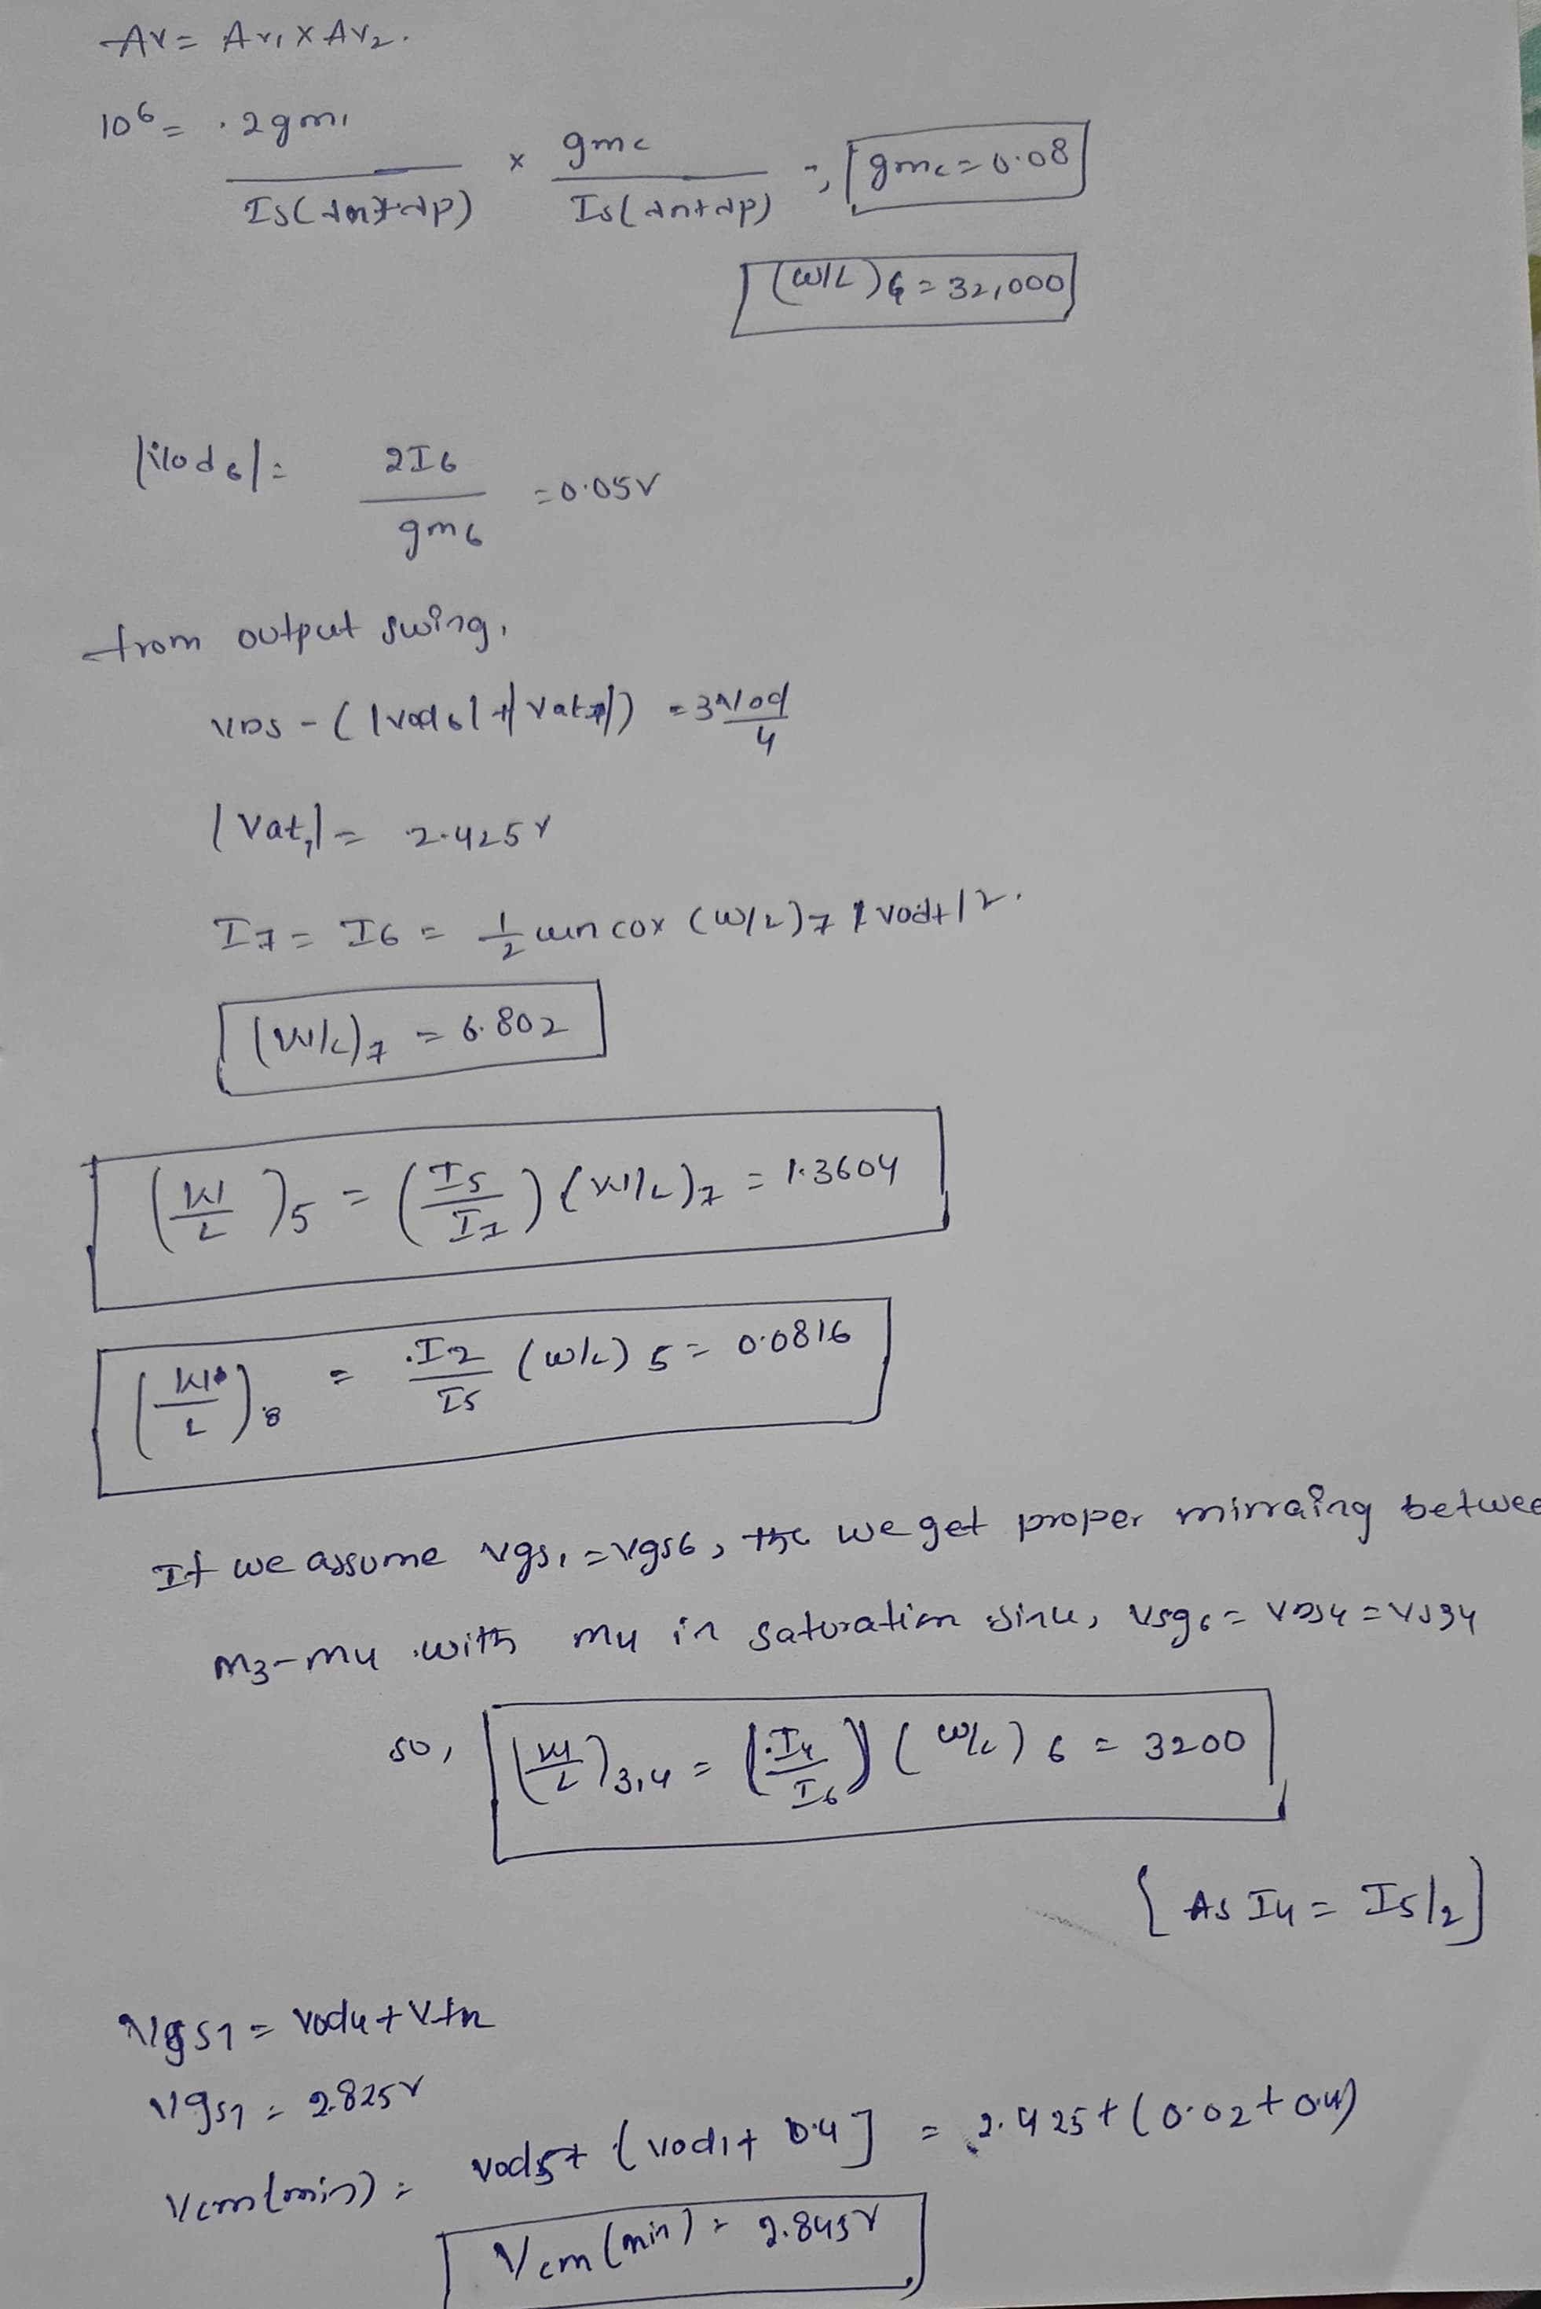
.

Slide 12
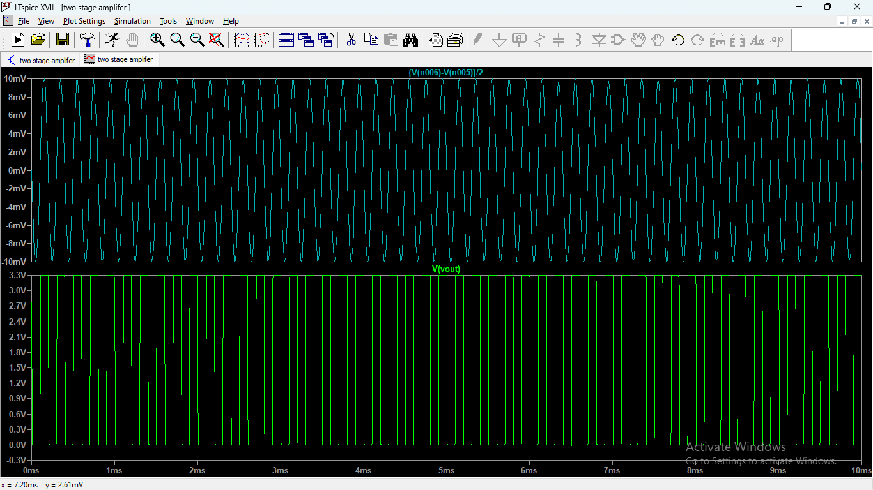
LTSpice Simulation Results:
.
INPUT
OUTPUT

Slide 13
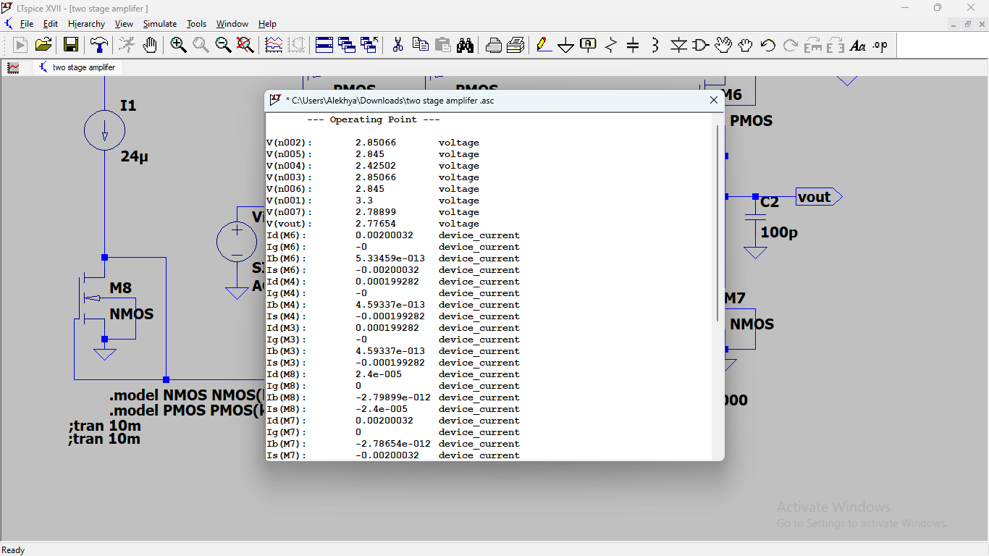
Operation Point Analysis:

Slide 14
Frequency Response:
The frequency response (Bode Plot curve) of the two stage op amp simulated is similar to a single pole one stage op amp in the required bandwidth (operation region)
The second pole occurs at 800MHz(P2=gm6/Cl , approx.) which in insignificant to our amplifier operation.
The only zero occurring at Z1=gm6/Cc because of Miller capacitor introduced(Cc) is at 1.25 GHz(approx.) which is also insignificant to our operation.
Hence the Bode plot is as shown and is equivalent to a one pole system till a few hundred MHz (until we have significant gain)

Slide 15
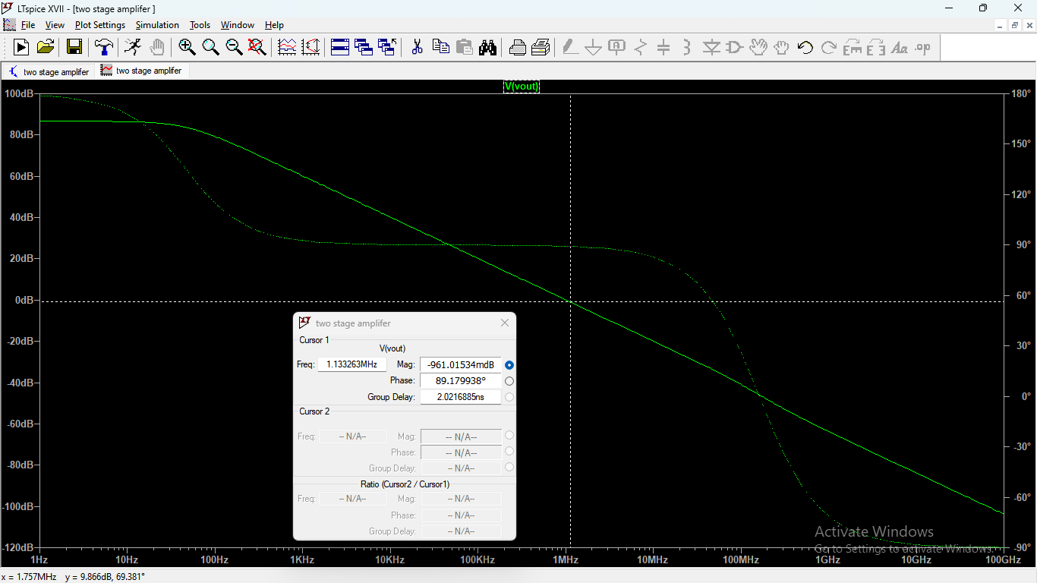
.

Slide 16
Conclusion:
A common “workhorse” opamp for medium performance applications.
A reasonably simple structure with reasonable performance
Design issues introduced : Two poles close to each other introduced. Very poor phase margin and instability until high load capacitance used.
Hence, the Concept of pole splitting introduced to decrease (shift left ) the dominant pole frequency which introduced because of stage one, causing stability

Slide 17
Summary:
A two stage OpAmp is designed with the given specifications.
First, a hand design was done followed by simulation in LTspice IV. The results are in agreement with the required value with a very small trade-off.
The trade-off may be due to neglecting body effect or any other transistor in built properties.

Slide 18

.

