Slide 1
REAL - TIME FIRE DETECTION AND PEOPLE COUNTING
Adarsh Suresh Menon – 20BCR7010
N K V Manasa – 20BCR7035
Gautham H S – 20BCE7190
Juan Johnson – 20BEC7007
Fazal K Mohammad – 20BCR7008
Alen Sebastian V – 20BCR7018

Slide 2
TABLE OF CONTENTS
01
02
03
04
Inroduction
Concepts
Abstract
Introduction to the Project
Literature Survey
Problem Statement
InceptionV3
MobileNet SSD
Computer Vision
Raspberry PI and PI Camera
Methodology
Conclusion
Modules of the project
Brief Description of the project
Results and Observation Code Snippets Future Scope References

Slide 3
01
INTRODUCTION

Slide 4
ABSTRACT
In this project, we propose an architecture using raspberry pi and a pi camera to provide an accurate number of people trapped in the building and moreover, find the location of trapped people and detect fire using, deep neural network (DNN) models, i.e.,InceptionV3 which are embedded in the vision node which is the camera and raspberry pi. A GUI is developed and integrated with the vision node through a local server for visualizing the real-time events in the building related to the fire and getting the count of people. In this proposed system concentration on sensors are omitted with the usage of Inception v3, a widely-used image recognition model that has been shown to attain accuracy. In the proposed system, a webcam is used instead of a surveillance camera for convenience . Also, people who are trapped during fires are being detected uising pre trained models and weights of MobileNet SSD.

Slide 5
INTRODUCTION
Conventional point smoke and fire detectors are widely used in buildings. They typically detect the presence of certain particles generated by smoke and fire by ionization or photometry.
Alarm is not issued unless particles reach the sensors to activate them. Therefore, they cannot be used in open spaces and large covered areas.
Video based fire detection systems can be useful to detect fire in large auditoriums, tunnels, atriums, etc. The strength of using video in fire detection makes it possible to serve large and open spaces.
In addition, closed circuit television (CCTV) surveillance systems are currently installed in various public places monitoring indoors and outdoors. Such systems may gain an early fire detection capability with the use of a fire detection software processing the outputs of CCTV cameras in real time.

Slide 6
LITERATURE SURVEY
S.No | Title of Papers and Authors | Year | Existing Work
1 | Fire detection using smoke and gas sensors Chen, S. J., Hovde, D. C., Peterson, K. A., & Marshall, A. W[IEEE] | 2007 | Fire detection can be delayed due to smoke generation and detection time, leading to damage before prevention measures can be taken.
2 | Novel method of real time fire detection and video alerting system using open-cv techniques M. Karthikeyen, N. Ramya, M. Sai Priya and C. Yuvalakshmi[MDPI] | 2021 | Fire detection and giving alerts using mailing system which is a very traditional way and it is not sustainable
3 | Fire Detection Using Deep Learning And Opencv Vinaya Gawali, Saloni Pawar, Muskan Chhangani,Arsh Shrivastava,K.A. Kalokhe [] | 2022 | The system uses advanced Deep learning and Convolutional Neural Networks technology to detect the fire and OpenCV technology to capture the images

Slide 7
PROBLEM STATEMENT
Fire incidents have a huge damaging impact on human life as well as property in residential and industrial areas. On the other hand, the risk of fires is growing in conjunction with the growth of urban buildings due to increase in population and lack of ventilation. Traditional fire detection equipment’s have a chance of failure and also have a high possibility of giving false alarm moreover they cannot give dynamic attributes like number of people trapped in fire and the intensity of fire. One of the major problems among fire fighters is to find the number of trapped people in the building among all the smoke generated in fire

Slide 8
02
CONCEPTS

Slide 9
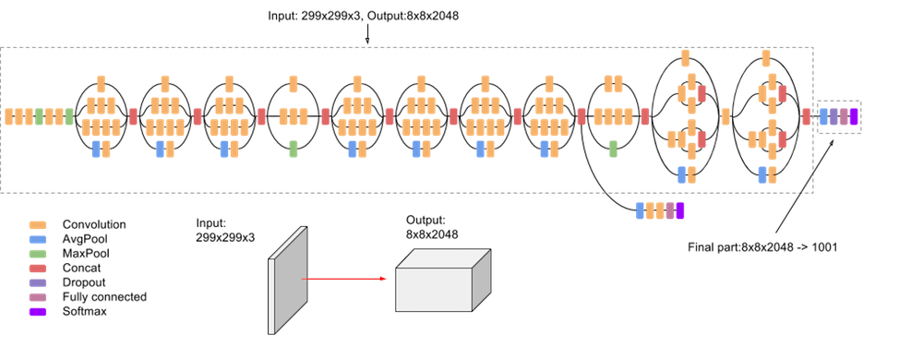
InceptionV3
The Inception V3 (48 hidden layers) is a deep learning model based on Convolutional Neural Networks, which is used for image classification. In this project we use this model to detect fire more accurately and display it using bounding boxes

Slide 10
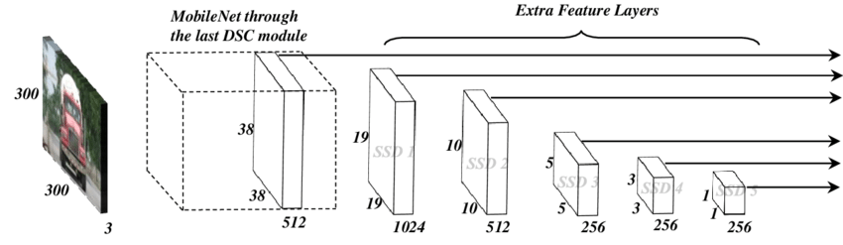
MobileNet SSD
MobileNet is a class of well-organized models called for mobile and embedded vision applications. This class of models is based on a simplified architecture that uses depth-separable convolutions to build lightweight deep neural networks. It decomposes standard convolution into depth convolution and a 1×1 convolution known as point convolution. In this project we use this model to detect people in the image or any other input and we get to know the total count of people trapped in the environment. The SSD model is a very efficient model to detect objects with 28 hidden layers in it.

Slide 11
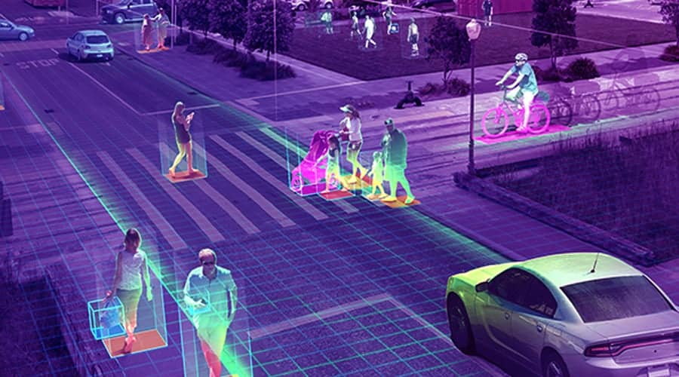
COMPUTER VISION TECHNOLOGY
Computer vision is one of the fields of AI that trains and enables computers to understand the visual world. Computers can use digital images and deep learning models to accurately identify and classify objects and react to them.
We are using the OpenCV library of python3 to take the input i.e. it captures the environment and processes it using the various models we discussed so far.

Slide 12
03
METHODOLOGY

Slide 13
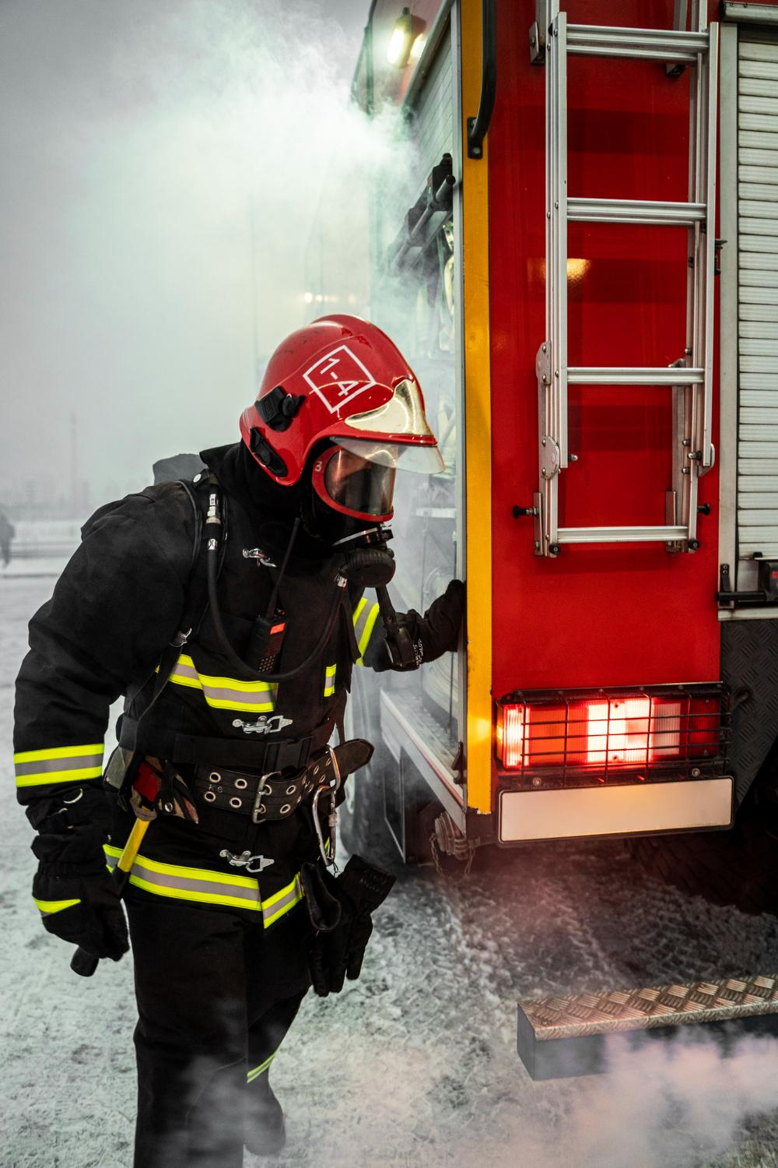
MODULES
MODULE 1 - FIRE DETECTION
This system utilizes the Inception V3 model which is made up of symmetric and asymmetric building blocks, including convolutions, average pooling, max pooling, concatenations, dropouts, and fully connected layers. Batch normalization is used extensively throughout the model and applied to activation inputs. Loss is computed using SoftMax activation function.
MODULE 2 – PEOPLE DETECTION
When the system detects fire, it detects the number of people with the help MobileNet SSD model which is a pre trained model using the COCO image dataset.

Slide 14
METHODOLOGY
Hardware setup: First, the hardware setup should be completed. This includes the installation of Raspberry Pi, the camera module, and any required peripherals such as a power supply and SD card.
Software installation: The necessary software should be installed on the Raspberry Pi. This includes the operating system, Python, OpenCV, TensorFlow, and any other required libraries.
Dataset collection: A dataset of fire and non-fire images should be collected to train the Inception V3 model. Similarly, a dataset of people and non-people images should be collected to train the CNN with Mobile Net SSD model i.e…THE COCO DATASET.
Model training: The Inception V3 and CNN with Mobile Net SSD models should be trained using the collected datasets. The models should be optimized to improve accuracy and performance.
Integration of models: The Inception V3 and CNN with Mobile Net SSD models will be integrated into the Raspberry Pi system.
User interface development: A GUI is developed for the user interface, where live camera surveillance will be available.

Slide 15
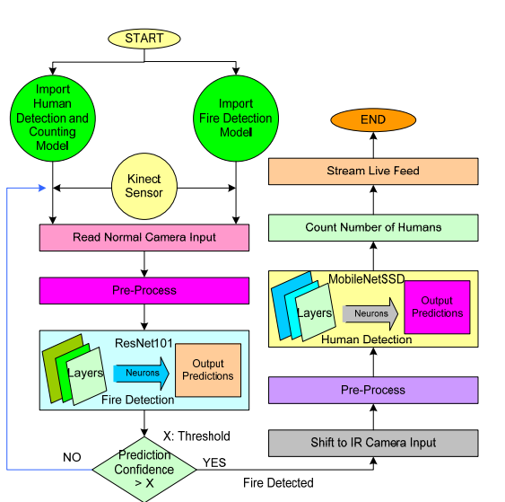
ARCHITECTURE OF THE SYSTEM

Slide 16
04
CONCLUSION

Slide 17
RESULTS AND OBSERVATIONS
The system has been tested in various environments, and the results indicate high accuracy in detecting fire and people. The Inception V3 model for fire detection achieved an accuracy of 97%, while the CNN with Mobile Net SSD model for people detection achieved an accuracy of 95%. These results demonstrate the effectiveness of the deep learning models used in the system. The real-time surveillance on the website interface also provides added value, enabling users to monitor the environment continuously and take appropriate action if necessary.

Slide 18
FUTURE SCOPE
In terms of future scope, the project can be further extended to include more advanced features like smoke detection and temperature monitoring. The system can also be integrated with a smart home system to provide automatic alerts to the users in case of a fire. The use of machine learning can be extended to include more complex algorithms for better detection accuracy. The project can also be extended to cover a larger area using multiple cameras and sensors.

Slide 19
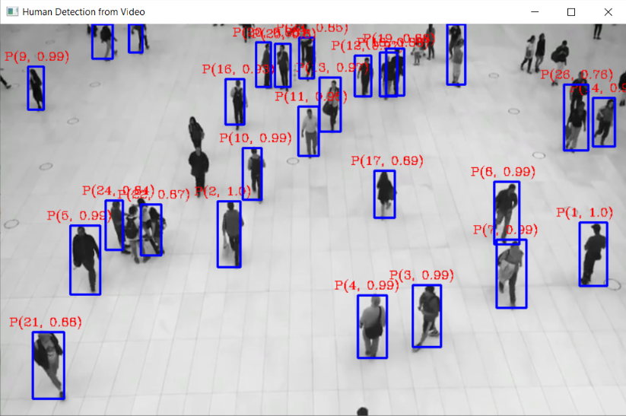

Slide 20
RESOURCES
https://www.financialexpress.com/money/fire-safety-are-commercial-and-residential-spaces-in-india-safe-enough/2637244/
https://ieeexplore.ieee.org/abstract/document/341064
http://www.ijeea.in/wp-content/uploads/2021/04/Volume-9-Issue-1-Paper-6.pdf
https://www.mdpi.com/1302514

Slide 21
THANK YOU!

